Slide 1
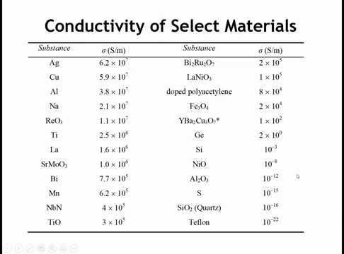
Notes:
So finally, we have to address the large different in conductivity between Teflon and doped polyacetylene

Slide 2

Organic Conductors
From Polymers to Nanotubes
Structure, Bonding & Electronic Properties
Chapter 10.5 - 10.6
Notes:
Today we're breaking a fundamental assumption about organic materials - that they're insulators, and we would be remiss if we didn’t’ cover the properties of carbon nanotubes, which can be either conductors or insulators depending on their chirality.

Slide 3
Learning Objectives
Explain how π-conjugation leads to delocalized molecular orbitals that form bands
Relate Peierls distortion and redox doping to the band gap and carrier formation in polymers
Define nanotube (n,m) indices and compute diameter and chiral angle
Predict metallic vs semiconducting behavior from the (n−m)/3 rule and Eg ∝ 1/d
Compare transport limits in polymers vs nanotubes and link back to structure
Notes:
These objectives build on your knowledge of molecular orbitals and band theory. Key emphasis: Conjugated π systems are THE foundation - without them, no organic conduction. We'll connect molecular-level structure to macroscopic properties. Common misconception: Students think 'organic = insulator' - we're about to shatter that assumption.

Slide 4
Why Organic Conductors?
Key Advantages
Breaking the Paradigm
Lightweight & flexible
Solution processable
Tunable properties
Applications: OLEDs, solar cells, sensors
Traditional view: organics = insulators
1970s revolution: conjugated systems conduct
Conductivity spans 15 orders of magnitude
2000 Nobel Prize in Chemistry
Notes:
Historical context: Until 1970s, organics were considered hopeless as conductors. Shirakawa's accidental synthesis changed everything. Conductivity range spans 15 orders of magnitude! 2000 Nobel Prize validates importance. Solution processability = printable circuits. Real-world: OLED displays, organic solar cells, biosensors, electronic skin.

Slide 5
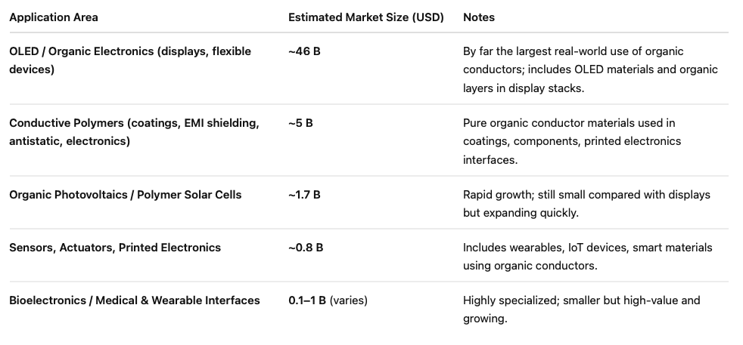

Slide 6
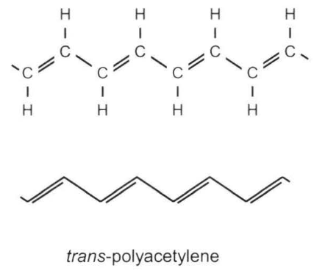
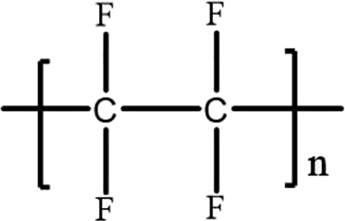
Teflon
Notes:
Common polymers are insulating due to sp³-hybridized carbon backbones with single bonds. Trans Polyacetylene is the simplest polymer with all sp²-hybridized backbone atoms, creating a conjugated π network. For trans-polyacetylene's electronic structure, like benzene and graphene, electrical and optical properties arise from π and π* orbitals. With two carbon atoms per repeat unit, the relevant basis sets are the π and π* MOs of the C₂H₂ repeat unit

Slide 7
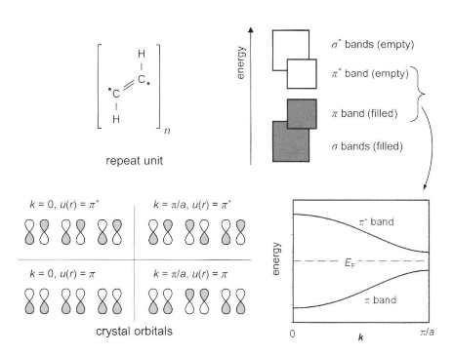
Notes:
The crystal orbitals corresponding to the π MOs are shown at k = 0 and π/a. at k = 0 the band formed from the π MO is completely bonding and will have the lowest possible energy, while the band formed from the π* MO is completely antibonding and will have the highest possible energy. At k = π/a, the interaction between carbon atoms in neighboring unit cells changes sign so that the band formed from the π MO runs uphill from k = 0 to π/a and the band formed from the π* MO runs downhill. The individual widths of the π and π* bands are estimated to be 5-6 eV [10].
If all carbon-carbon distances were identical, the bands would touch at k = π/a and trans-polyacetylene would be a metal. However, the distances alternate between 1.44 Å (single bond) and 1.36 Å (double bond). This alternation lifts the degeneracy and is responsible for the presence of a band gap of 1.7-1.8 eV. this is a classic case of a Peierls distortion.

Slide 8
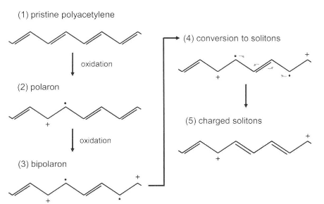
Notes:
Conjugated polymers are doped via oxidation/reduction rather than aliovalent substitution. When you expose polyacetylene to an oxidizing dopant like iodine, the dopant removes electrons from the polymer chain and creates localized positive charges. These charged defects distort the bond pattern and form mobile quasiparticles called polarons, and at higher doping levels bipolarons or solitons. Because these quasiparticles can move along the conjugated backbone, they act as charge carriers. Doping therefore injects mobile carriers into an otherwise insulating polymer, making polyacetylene conductive.

Slide 9
The Polymer
PEDOT:PSS = poly(3,4-ethylenedioxythiophene):polystyrene sulfonate
A complex of:
PEDOT
PSS
Conducting polymer backbone
Polyanion for water dispersibility
This unique combination enables commercial success
Notes:
Th Most commonly used conducting polymer by far is PEDOT. Poly(3,4-ethylenedioxythiophene) polystyrene sulfonate (PEDOT:PSS) is a composite material where PEDOT (the conductive polymer) provides electrical conductivity, and PSS (polystyrene sulfonate) acts as a counter-ion to balance the charge and improve the water solubility and processability of PEDOT. Polystyrene sulfonate is a sulfonated polystyrene. Part of the sulfonyl groups are deprotonated and carry a negative charge. The other component poly(3,4-ethylenedioxythiophene) (PEDOT) is a conjugated polymer and carries positive charges and is based on polythiophene. Together the charged macromolecules form a macromolecular salt.^{[2]}

Slide 10
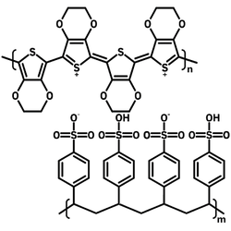
PEDOT
PSS
Notes:
Poly(3,4-ethylenedioxythiophene) polystyrene sulfonate (PEDOT:PSS) is a composite material where PEDOT (the conductive polymer) provides electrical conductivity, and PSS (polystyrene sulfonate) acts as a counter-ion to balance the charge and improve the water solubility and processability of PEDOT. Polystyrene sulfonate is a sulfonated polystyrene. Part of the sulfonyl groups are deprotonated and carry a negative charge. The other component poly(3,4-ethylenedioxythiophene) (PEDOT) is a conjugated polymer and carries positive charges and is based on polythiophene. Together the charged macromolecules form a macromolecular salt.^{[2]}

Slide 11
Key Advantage #1: Water Processable
The single biggest reason for commercial success
Processing Methods
Competitive Advantage
Solution casting at room temperature
Spin coating
Screen printing
Roll-to-roll compatible
Standard coating tools
Other conducting polymers require:
Harsh organic solvents
In-situ oxidative polymerization
Special handling conditions

Slide 12
Key Advantages #2 & #3: Stability & Film Quality
#2
Air Stable
#3
Superior Films
Unlike most conducting polymers that degrade in oxygen/moisture
Essential for electronics:
Optically clear
Uniform thickness
Low surface roughness
No cracking or defects
Storage without special precautions
Standard shipping & handling
Long shelf life

Slide 13

Key Advantages #4 & #5: Tunability & Industry Fit
Tunable Conductivity
Industry Compatible
Adjust PEDOT:PSS ratio or add dopants:
Direct integration into:
1 S/cm → 1000+ S/cm
OLED displays
Touch panels
Photovoltaics
Sensors
Antistatic coatings
Secondary dopants: DMSO, ethylene glycol, sorbitol
Conductivity Range Chart
No exotic equipment needed

Slide 14
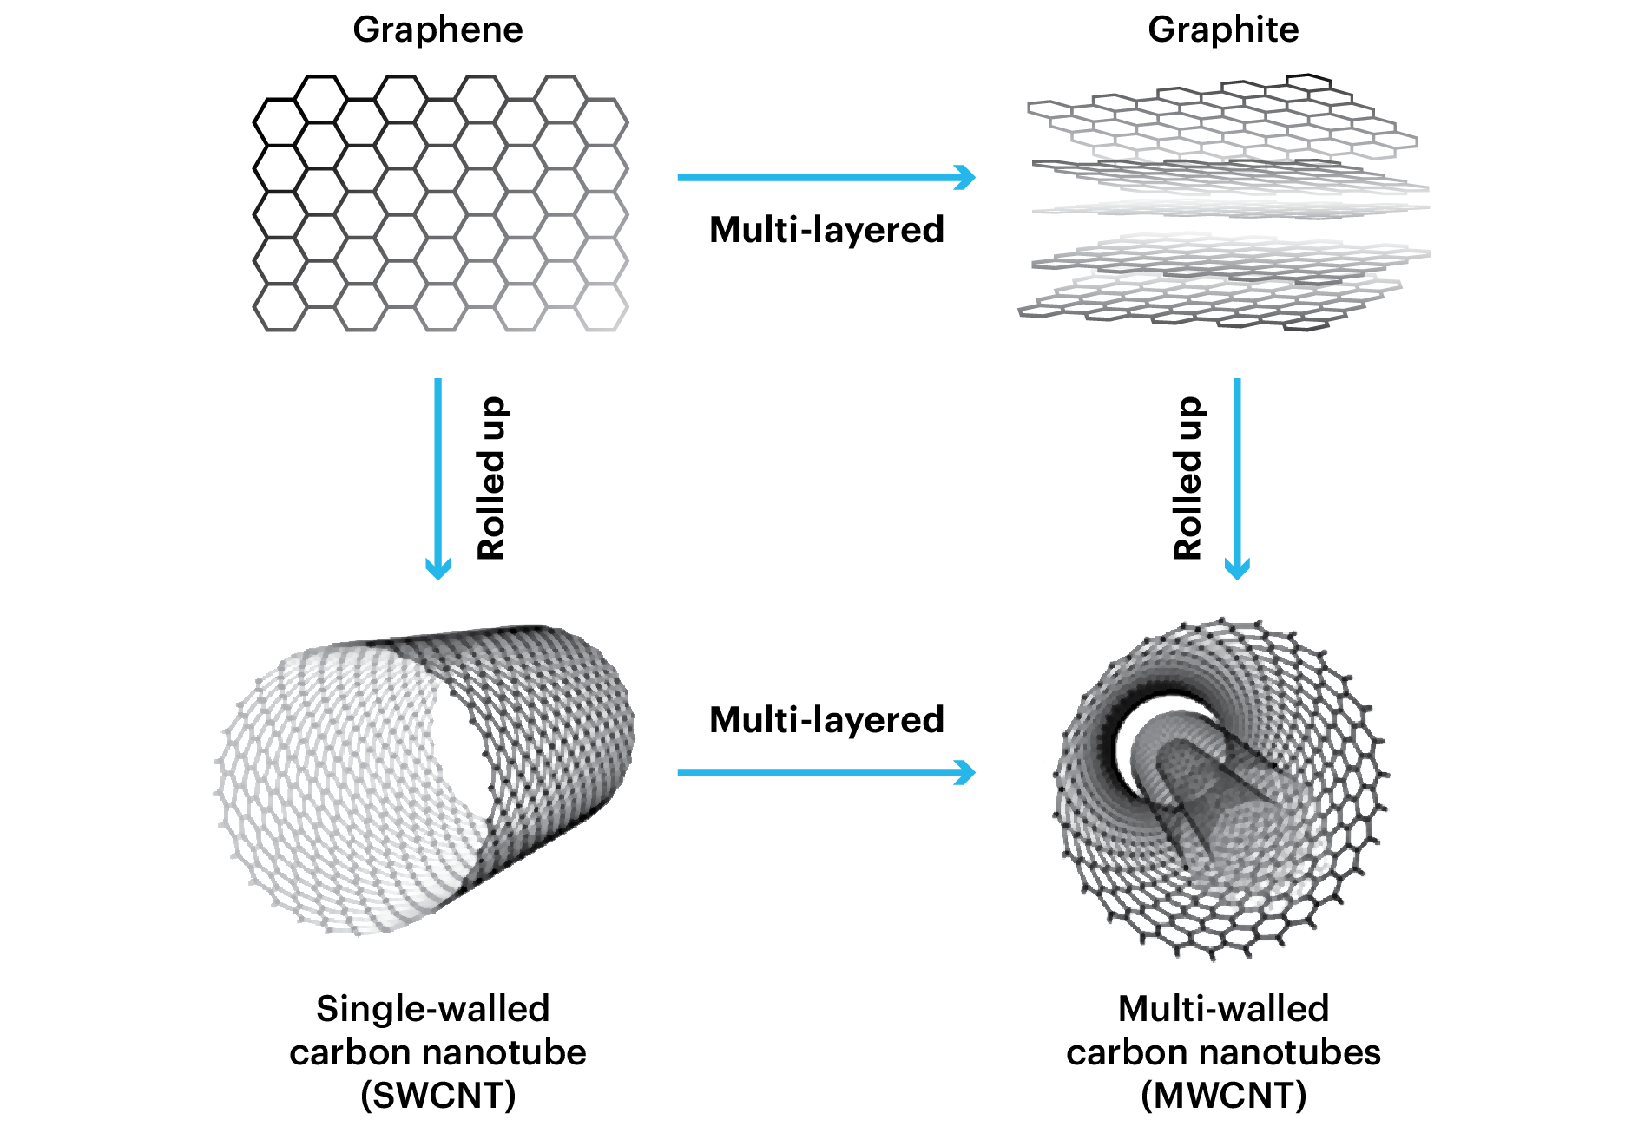
Notes:
Lastly for ch 10 let’s talk about CNTs. CNTs can be single-wlled, which is like wrapping up a single sheet of graphene, or multti walled, where you have multiple tubes layered within one another.

Slide 15
Hexagonal Lattice (Definition of Vectors)
y
Chiral vector
a₁
(4,-5)
a₂
x
T
O
C_{h}
θ
(6,3)
Notes:
The way you wrap up the shee of graphene determines the electronic properties. So let’s go through some terms that will help us determine the electrical properties of graphene. The circumferential vector can be expressed as a linear sum of the a and b lattice vectors of graphene in the general form C = 6a + 3b, where 6 and 3 are integers. The next step is to define the translational vector, T, that is perpendicular to C and links two equivalent sites. The rectangle formed by C and T defines the unit cell of the carbon nanotube. To complete the process, we imagine excising a strip, of width defined by C and infinite length, from the graphene sheet and rolling it up into a tube by connecting opposite sides of the strip. In this manner, the structure of the carbon nanotube is completely defined by the integers 6 and c, and is expressed using the notation (n,m), where n is the a1 integer and m is the a2 integer.

Slide 16
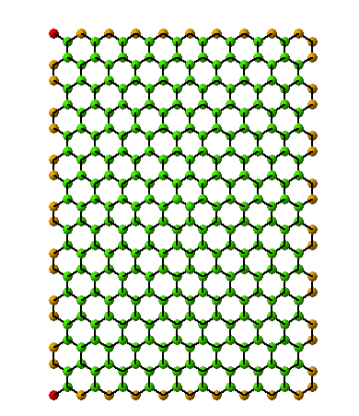
Wrapping (10,0) SWNT (zigzag)
(0,0)
C_{h} = (10,0)
y
a₁
a₂
x
Notes:
If you go “sideways” in that picture you are stepping only along a1. That direction traces a chain of carbon atoms in which the C–C bonds alternate left and right, creating a zigzag pattern of bond angles. If you isolate the atoms along that line you literally see a repeating zigzag shape. That is why the vector (n,0) is called zigzag.

Slide 17
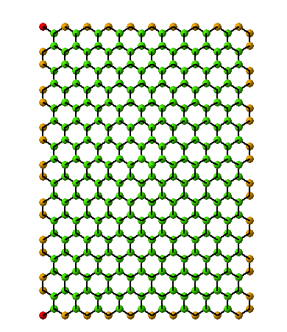
Wrapping (10,0) SWNT (Animation)
(0,0)
C_{h} = (10,0)
y
a₁
a₂
x

Slide 18
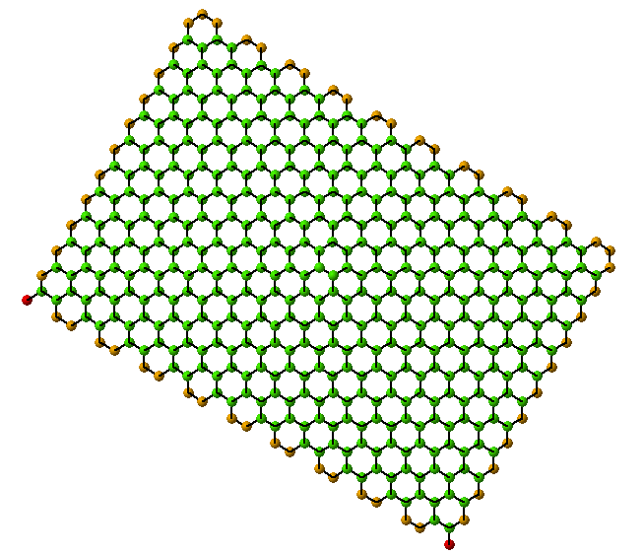
Wrapping (10,10) SWNT (armchair)
(0,0)
y
C_{h} = (10,10)
a₁
a₂
x
Notes:
The direction down and to the right is a1 + a2. When you follow that direction, the edge you encounter alternates in a pattern that looks like two adjacent carbons forming a flat pair, then a dip, then another flat pair. If you draw those atoms as points and bonds as lines, it resembles a row of connected armchairs. That is why lines in the (n=m) direction are called armchair.

Slide 19
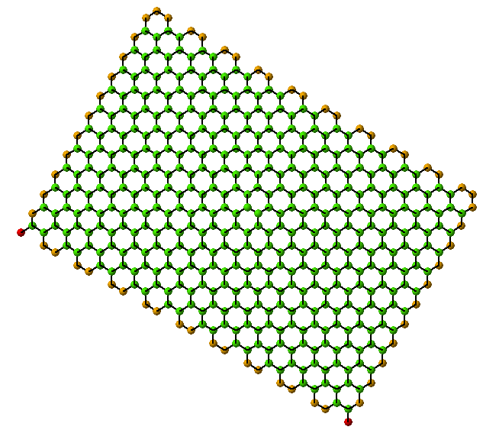
Wrapping (10,10) SWNT (Animation)
(0,0)
y
C_{h} = (10,10)
a₁
a₂
x

Slide 20
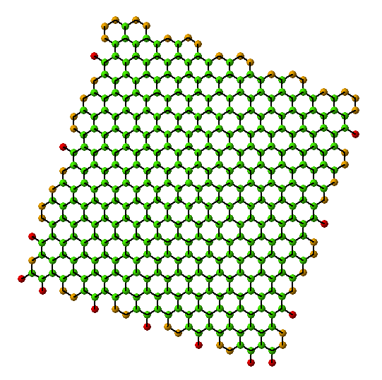
Wrapping (10,5) SWNT (chiral)
(0,0)
C_{h} = (10,5)
y
a₁
a₂
x
Notes:
Chiral is something other than zig-zag or armchair.

Slide 21

Wrapping (10,5) SWNT (Animation)
(0,0)
C_{h} = (10,5)
y
a₁
a₂
x

Slide 22
Hexagonal Lattice (n,m) nanotubes
Zigzag
(0,0)
(1,0)
(2,0)
(3,0)
(4,0)
(5,0)
(6,0)
(7,0)
(8,0)
(9,0)
(10,0)
(11,0)
(1,1)
(2,1)
(3,1)
(4,1)
(5,1)
(6,1)
(7,1)
(8,1)
(9,1)
(10,1)
(2,2)
(3,2)
(4,2)
(5,2)
(6,2)
(7,2)
(8,2)
(9,2)
(10,2)
(3,3)
(4,3)
(5,3)
(6,3)
(7,3)
(8,3)
(9,3)
(4,4)
(5,4)
(6,4)
(7,4)
(8,4)
(9,4)
y
(5,5)
(6,5)
(7,5)
(8,5)
a₁
(6,6)
(7,6)
(8,6)
a₂
(7,7)
Armchair
x
n - m = 3q (q: integer): metallic
n - m ≠ 3q (q: integer): semiconductor
Notes:
So it turn for a nanotube if n-m is a multiple of 3, the nanotube is metallic. Otherwise the nanotube is semiconducting. Where I’m showing the red dots are the metallic values of n and me, whereas the other dots are the semiconducting values.

Slide 23
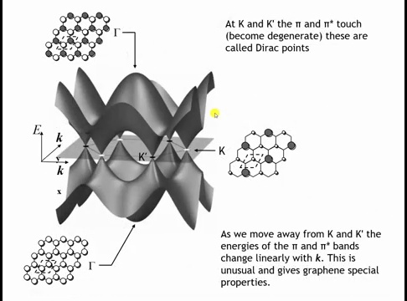
Notes:
So to answer that question recall that the band structure of graphene doesn’t’ touch except as certain values of K, called the dirac points. And its only at those values of K that graphene is metallic.

Slide 24
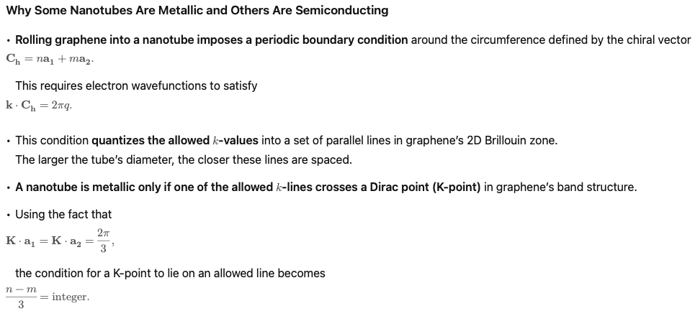
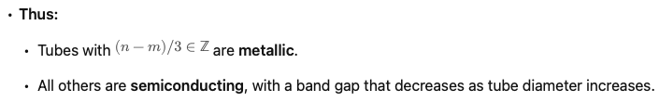

Slide 25
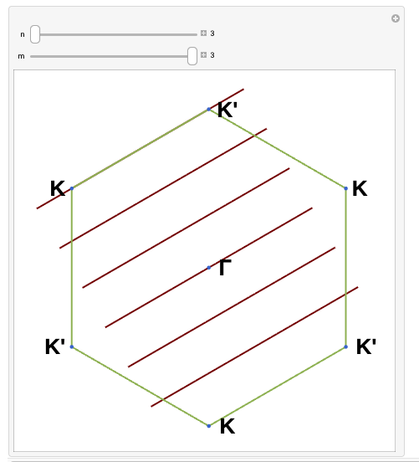
Metallic or Semiconducting?
https://demonstrations.wolfram.com/BrillouinZoneOfASingleWalledCarbonNanotube/
Notes:
Cutting through k point, n=m, metallic

Slide 26
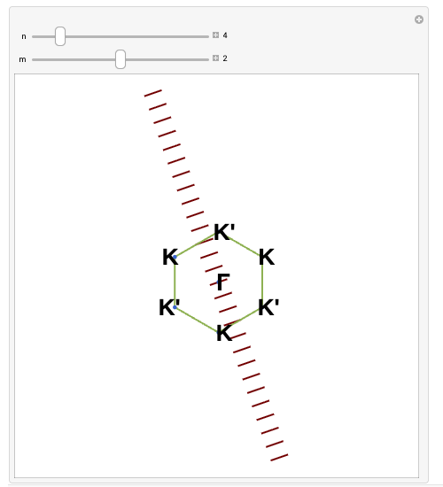
Metallic or Semiconducting?
https://demonstrations.wolfram.com/BrillouinZoneOfASingleWalledCarbonNanotube/
Notes:
N-m=4-2 is not equal to 3, line doesn’t intersect dirac point, semiconducting

Slide 27
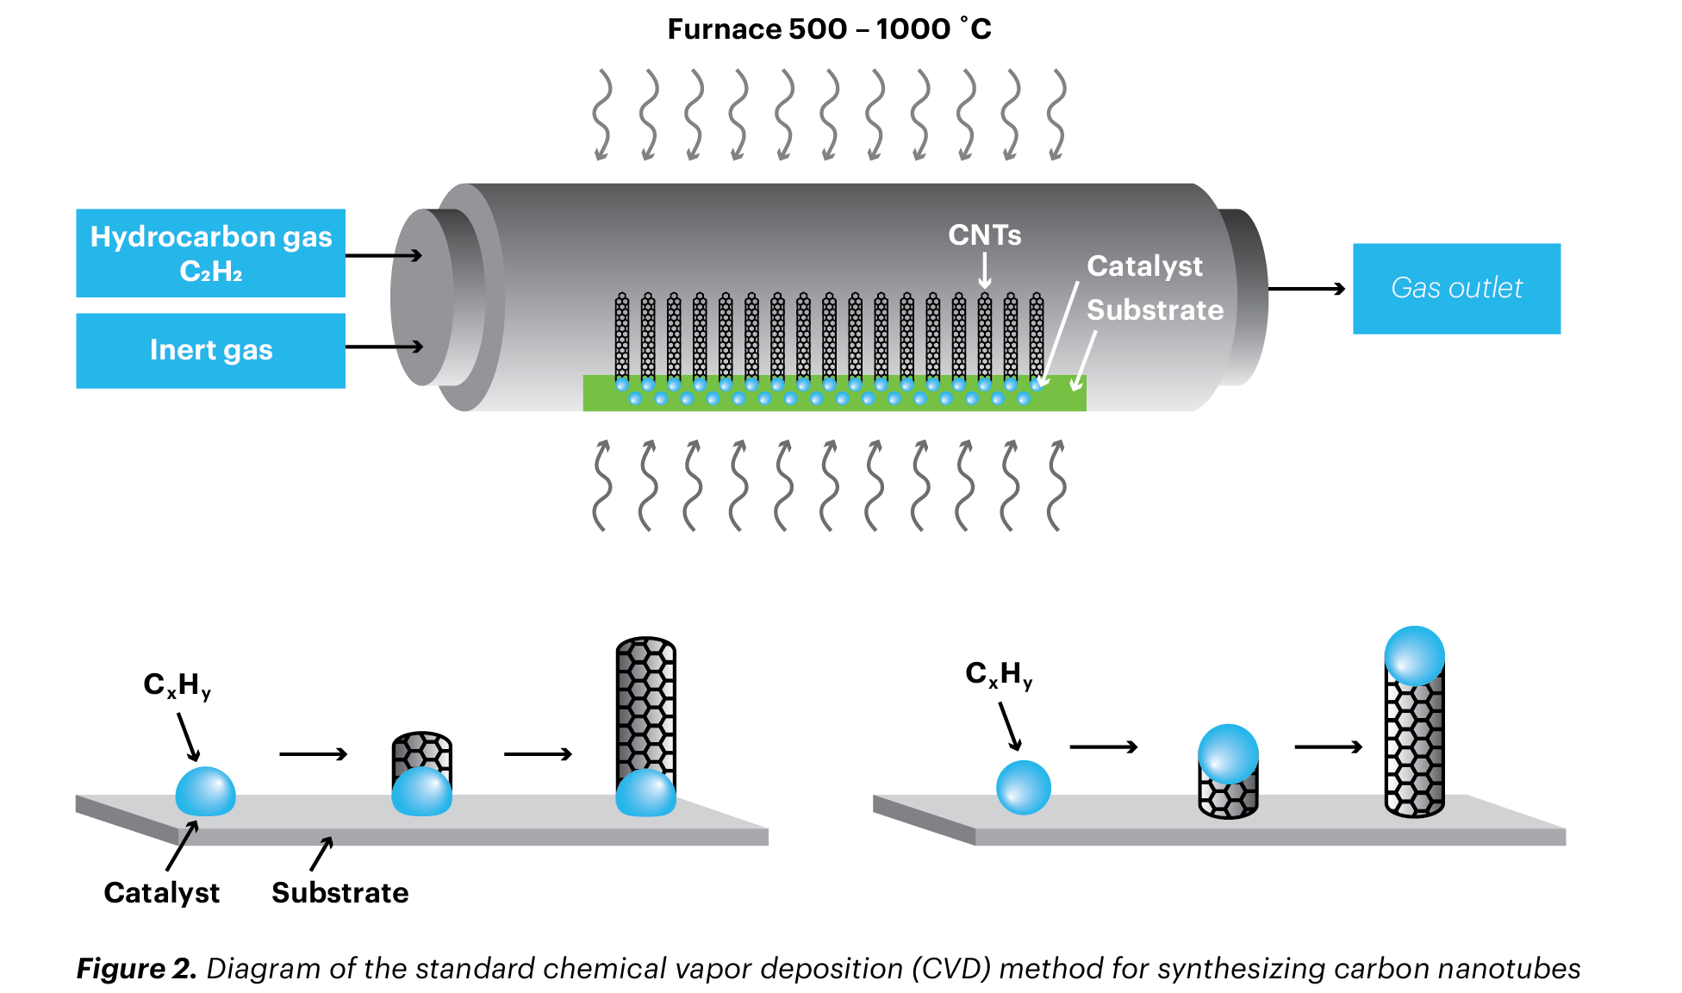
Notes:
Cnt synthesis involves flow of a carbon precursor over a nanoparticle catalyst (nickel, cobalt, iron or their combinations), the chirality is not controlled.

Slide 28
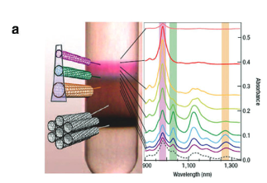
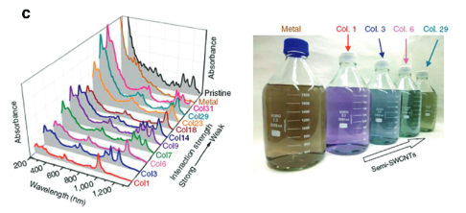
Ultracentrifuge Separation
M. S. Arnold, A. A. Green, J. F. Hulvat, S. I. Stupp, M. C. Hersam,Nat. Nanotechnol. 2006, 1, 60.
Chromatographic Separation
H. Liu, D. Nishide, T. Tanaka, H. Kataura, Nat. Commun. 2011, 2,309.
Notes:
Current synthesis processes

Slide 29


Slide 30
Homework:
Conducting polymers: 10.17
Carbon nanotubes: 10.18, 10.19, 10.20, 10.21, 10.22

Slide 31
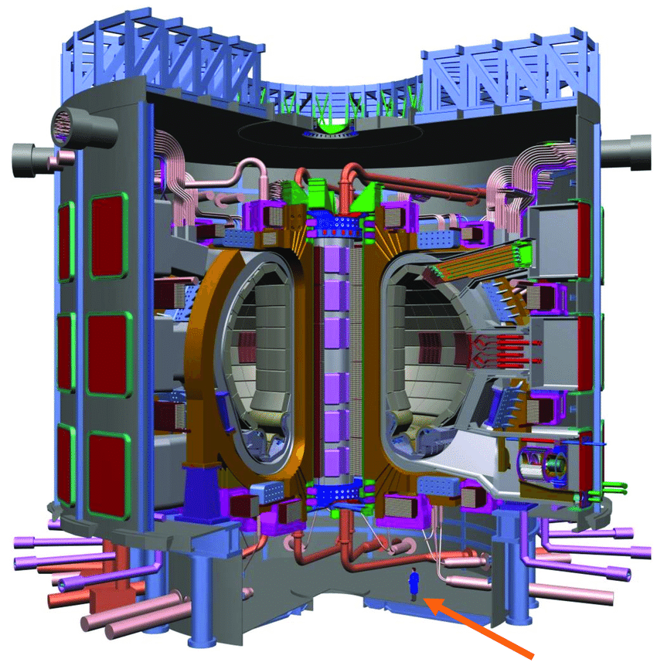
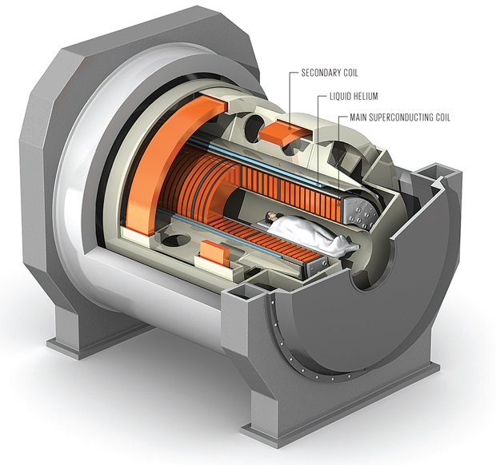
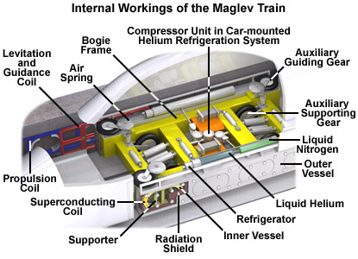
Chapter 12:
SUPERCONDUCTORS

Slide 32


Announced today: 11-20-25
https://x.com/tokamakenergy/status/1991423054115659795?s=42

Slide 33
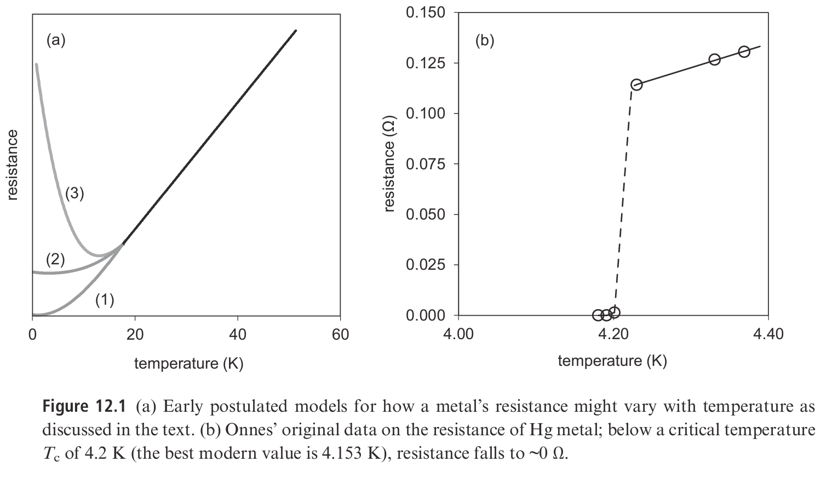
Notes:
The discovery of superconductivity exemplifies how basic research yields unexpected breakthroughs. In 1908, Heike Kamerlingh Onnes at the University of Leiden liquefied helium, which boils at 4.22 K, enabling physical measurements at unprecedented low temperatures. At that time, three possibilities existed for electrical resistance behavior at very low temperatures: resistance could drop to zero following the high-temperature trend, flatten to a finite value, or rise to infinity as conduction electrons "froze" to individual atoms. Initial measurements on gold and platinum suggested finite resistance, but mercury experiments revealed a dramatic resistance drop over just hundredths of a degree. Onnes reported that a sample with 172.7 Ω resistance at 0°C dropped to 0.084 Ω at 4.3 K, and below 3×10⁻⁶ Ω at 3 K—one ten-millionth of its 0°C value. Mercury had entered what he called "the superconductive state."

Slide 34
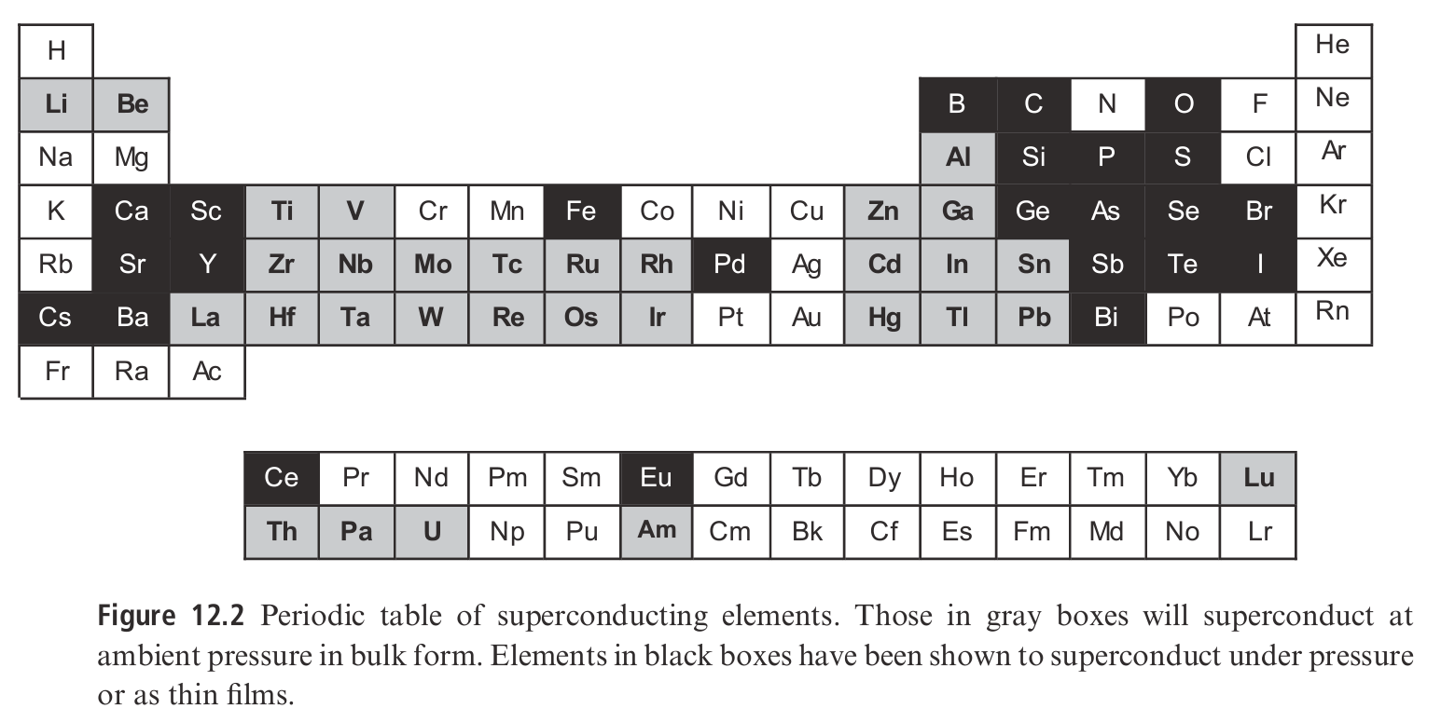
Highest Temp element is Nb @9.25 K and ambient pressure.
Notes:
Superconductivity below a critical temperature Tc is the ground state of approximately one-quarter of elements at ambient pressure and over half under higher pressure or as thin films. The lowest ambient-pressure Tc is rhodium at 0.000325 K; the highest is niobium at 9.25 K. Lithium superconducts at 0.004 K at ambient pressure but reaches 20 K at ~30 GPa pressure. Europium, the most recently discovered superconducting element (2009), has Tc of 1.8 K at 80 GPa. Two notable patterns emerge: naturally magnetic elements (ferromagnetic Fe, Co, Ni, Gd; antiferromagnetic Mn) do not superconduct at ambient pressure, and the best normal metallic conductors (Cu, Ag, Au with conductivities around 6×10^7 S/m at room temperature) do not superconduct.

Slide 35
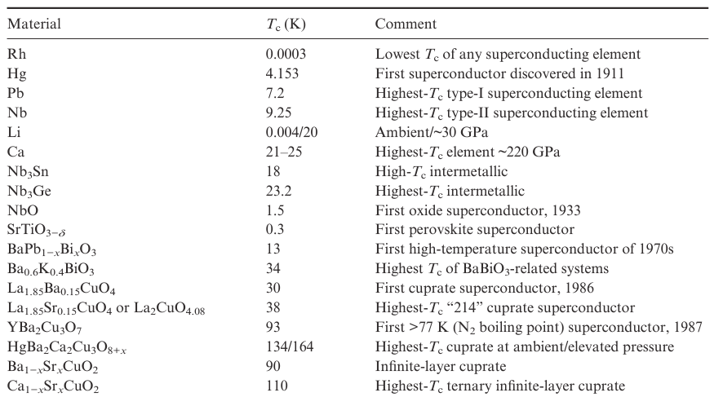
Notes:
Many compounds superconduct beyond elements, including some magnetically ordered materials. Until 1986, Nb₃Ge held the highest Tc record at 23.2 K. Copper-containing oxides then achieved superconductivity up to 138 K (~164 K under high pressure), maintaining the highest well-established Tc for years.

Slide 36

Applied Magnetic Field
• Created by current through a coil:
Applied
magnetic field H
N = total number of turns
L = length of each turn
current I
• Relation for the applied magnetic field, H:
current
applied magnetic field
units = (ampere-turns/m)
• Here a Magnetic Field is the result of a current
Notes:
Because there is a certain magnetic element to superconductors, I wanted to first have a brief introduction to magnetism in materials. We know from freshman physics that applying a current through a wire creased a magnetic field that inscreased with the applied current, the number of turns, and the length of the coil.

Slide 37
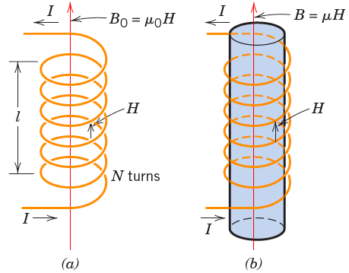






Response to a Magnetic Field
• Magnetic induction results in the material
Contribution to the field due to magnetization of the solid
Notes:
If you multiply the magnetic field strength H times the permittivity of vacuum, you have what’s call the magnetic induction, or flux density, B. Now if you stick a material in that coil there will be some response to that applied magnetic field that will change the value of B because now your permittivity is different. You can write an equation for B with a new variable M which includes all the magnetization that is due to the material. M is also equal to the relative permittivy minus 1 times H. So its just displacing the permittivity of vacuum with the permittivity of the material, but M includes the magnetization H.

Slide 38


Response to a Magnetic Field
• Magnetic susceptibility, χ (dimensionless)
B
χ
> 0
χ measures the
material response
relative to a vacuum.
vacuum
χ
= 0
χ
< 0
H
B = μ₀(H+M) = μ₀(1+χ_{m})H = μH
Notes:
You will also see a variable call the magnetic susceptibility chi, where Chi measures M relative to H. if chi is greater than 1, then the material increases the magnetic response relative to vacuum, if Chi is less than one it decreases the magnetic response relative to vacuum.

Slide 39
Origins of Magnetic Moments
• Electrons produce magnetic moments:
magnetic moments
electron
electron
nucleus
spin
• Net magnetic moment:
--sum of moments from all electrons.
• Three types of response...
Notes:
Where is the magnetization of the material coming from. Well you can thin of the electrons producing small magnetic moments as they move about the nucleus. Electrons themselves have a magnetic moment called their spin. These properties result in 3 typs of reponse to a magnetic field.

Slide 40
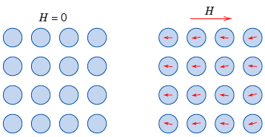
Diamagnetism
• Present in all materials
Electrons change their orbit to oppose applied field
Notes:
Materials for which a magnetic field penetrates less than in vacuum have
M < 0 \quad\text{and}\quad \mu_r < 1,
and are called diamagnetic. In these materials, the external field induces small orbital currents that generate a magnetic moment opposing the applied field. This induced moment is analogous to the way a current in a coil opposes a changing magnetic flux (Lenz’s law), but it arises from quantum-mechanical shifts of the electron orbits rather than from free currents.

Slide 41
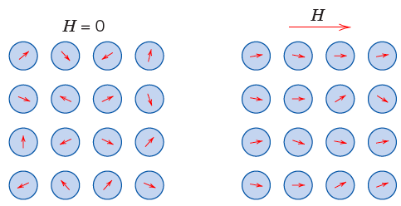
Paramagnetism
• Present in materials with unpaired electrons
Electron spins align with applied field
Notes:
Paramagnetic materials enhance the magnetic field within them because their unpaired electron spins partially align with the applied field, producing a positive magnetization. They still exhibit the small diamagnetic response present in all materials, but the spin alignment effect is larger, so the net magnetization is positive.

Slide 42
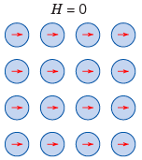
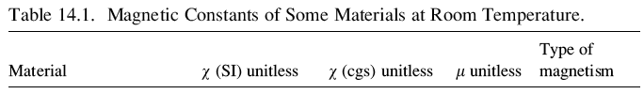

Ferromagnetism
• Spins couple and align with no applied field
Notes:
Certain materials are ferromagnetic because they contain unpaired electrons that give each atom a magnetic moment. In some solids, a quantum effect called the exchange interaction makes it energetically favorable for these spins to align parallel rather than antiparallel. This alignment lowers the total energy of the system, so regions of uniformly aligned spins (domains) form spontaneously. The effect is strongest in materials with partially filled d or f shells, such as Fe, Co, Ni, and rare earths. Their crystal structures also allow these aligned spins to reinforce each other over long distances. When all three conditions are satisfied—unpaired electrons, strong positive exchange, and a supportive lattice—the material becomes ferromagnetic.

Slide 43
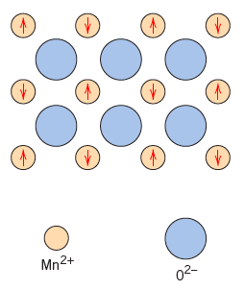
Antiferromagnetism
• Spins couple, align, and cancel
MnO
Notes:
Antiferromagnets are useful in technology because they can hold a very stable internal magnetic pattern without producing any external magnetic field. This makes them ideal for controlling nearby magnetic layers in devices. Most hard-drive read heads and many magnetic sensors use thin antiferromagnetic films to “pin” a neighboring magnetic layer in a fixed direction, which is necessary for the sensor to work properly.

Slide 44
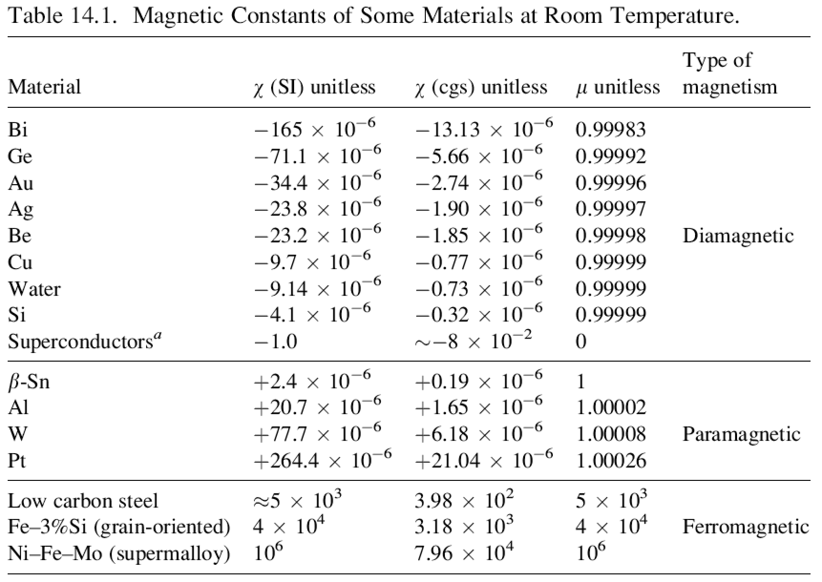
Notes:
Diamagnetic materials such as Bi, Ge, Au, and Cu have small negative susceptibilities because they develop only a tiny induced moment that opposes the applied field; superconductors are the extreme case with χ = –1, indicating complete expulsion of the field. Paramagnetic materials like β-Sn, Al, W, and Pt contain unpaired spins, but each spin responds individually to the field and is strongly randomized by thermal motion, so only a very small net alignment occurs and χ stays in the 10⁻⁵–10⁻⁴ range. Ferromagnetic materials such as low-carbon steel, Fe–3%Si, and Ni–Fe–Mo behave entirely differently: strong exchange interactions lock huge groups of spins into aligned domains that persist even at room temperature. An applied field simply rotates these already-aligned domains, so the magnetization grows by orders of magnitude and the susceptibility can reach 10³–10⁵.

Slide 45
Are Superconductors Special?
(1) Resistivity of Ag is 10⁻¹¹ ohm m at I K , for superconductors is 10⁻²⁵
Notes:
Now that we have some idea of magnetic properties, let’s turn to superconductors and just as the question – are they really different from normal conductors. Well (1) ….

Slide 46

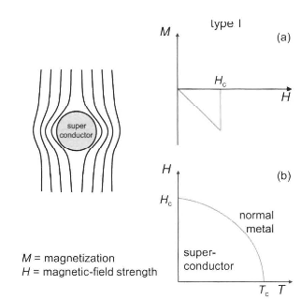
Are Superconductors Special?
(2) Different Magnetic Properties: Ag is a very weak diagmagnet, superconductors are perfect diamagnet up to a critical field H_{c}
Notes:
Superconductors exhibit the Meissner effect: when cooled below Tc in a magnetic field, they actively expel the field so that B inside is zero. This perfect diamagnetism comes from surface supercurrents that cancel the applied field and is observed only for certain sample geometries and only below a critical field.
The Meissner effect distinguishes a true superconductor from a hypothetical perfect metal with zero resistivity. If both materials are cooled to ρ = 0 while sitting in a static magnetic field, the superconductor generates currents that expel the field, whereas the perfect metal does not. Because a static field does not induce currents, the perfect metal simply retains the magnetic flux that was already inside.
In type-I superconductors (such as Pb), perfect diamagnetism (M = −H, χ = −1) persists only up to a critical field Hc. Hc is largest near 0 K and falls to zero at Tc; above Hc the material reverts to the normal, weakly diamagnetic state. Superconductivity is also destroyed if the current in a wire generates an internal magnetic field above Hc, which defines the critical current Ic

Slide 47
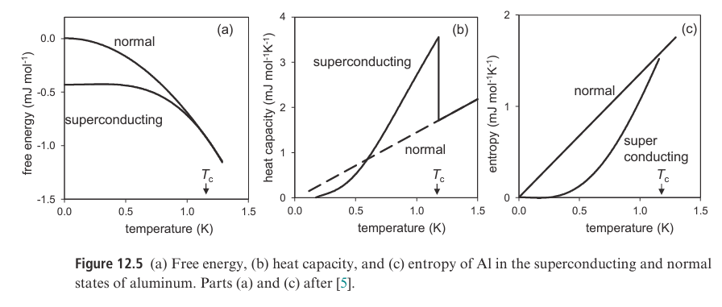

(3) Thermodynamic Analysis reviews Tc is associated with a 2nd order transition
Notes:
Temperature-dependent measurements of aluminum’s free energy, heat capacity, and entropy reveal the characteristic thermodynamic features of a second-order superconducting transition. The data were obtained by measuring aluminum in zero magnetic field (superconducting state) and then repeating the measurements in a field above Hc to enforce the normal state.
Panel (a) shows that the superconducting phase always has slightly lower free energy than the normal phase below Tc ≈ 1.2 K, confirming that superconductivity is the true equilibrium state. At Tc, the free energy curves join smoothly with no discontinuity, which is the defining signature of a second-order transition.
Panel (b) shows that, although the free energy is continuous, the heat capacity exhibits a finite jump at Tc. This reflects the relation C = T(dS/dT): entropy remains continuous across a second-order transition, but its slope with respect to temperature changes abruptly.
Panel (c) makes this explicit. The superconducting state has lower entropy (a more ordered electronic configuration) than the normal state, yet both entropy curves meet continuously at Tc.
Taken together—continuous free energy and entropy, but a discontinuous heat capacity—these measurements establish that the superconducting transition in Al is second order. Because the superconducting state is more ordered yet still lower in free energy, the system must gain an energetic advantage that outweighs the entropy loss. This insight led to the idea of an effective attractive interaction between electrons: by forming Cooper pairs, electrons lower the total free energy enough to stabilize the superconducting state.

Slide 48
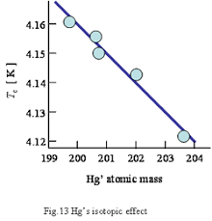
Notes:
In the 1950s, superconducting elements were discovered to exhibit an isotope effect where Tc ∝ M^(-α), with M being isotope mass. Mercury isotopes demonstrate this: Tc values range from 4.161 K to 4.126 K as mean atomic weight varies from 199.7 to 203.4, with α = 0.49(2). This dependence mirrors how vibrational frequencies depend on mass, indicating that lattice vibrations (phonons) create the electron-electron attractions A mercury atom is about 360,000 times more massive than an electron. That’s like a human moving 5,000 African elephants

Slide 49
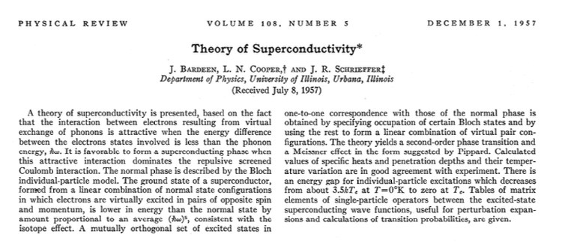
Notes:
Stimulated by this and other experimental data, Bareen, Cooper and Schrieffer published a theory of superconductivity at uiuc in 1957. This is a 30 page paper with quite a lot of math, so here we’re just going to try to get the key takeaways.

Slide 50
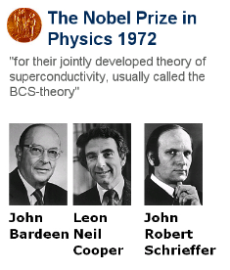

Slide 51
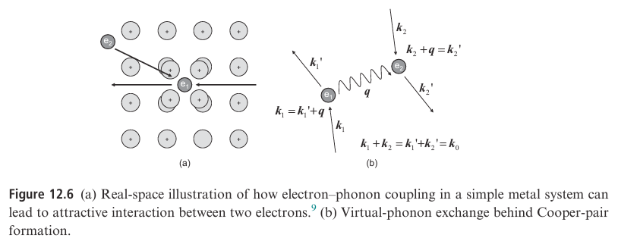
Notes:
The simplest model for electron-phonon (Frohlich) interaction involves an electron moving through a metal, its negative charge attracting positive metal ions around it, creating a temporary structural deformation and local region of excess positive charge. This moving region of positive charge, or polarization trail, attracts a second electron, forming a Cooper pair. Thus two electrons attract to form a pair not through direct interaction but via phonon-mediated pairing.

Slide 52
Electron Pairing Distance Estimate
Since electrons move much faster than the heavier metal ions, there is a time delay between the motion of the first electron (which distorts the lattice) and the subsequent attraction of the second electron. To estimate the distance d the first electron has traveled by the time the second is attracted, we use:
vₙ: velocity of an electron at the Fermi level
ω_D: Debye angular frequency, which sets how fast the lattice can respond
The estimated distance is
d = v_F (2π / ω_D)
For aluminum:
v_F ≈ 2×10⁶ m/s
ω_D ≈ 5×10¹³ s⁻¹
This gives:
d ≈ 2500 Å
This distance is large compared with atomic spacing, so Coulomb repulsion between the electrons is negligible, especially due to screening by the positively charged metal ions.

Slide 53



Conservation of momentum leads to the relationships:
Notes:
A more precise way to describe this interaction is in terms of the exchange of a virtual phonon between the electrons. In this process, we imagine electron 1 with an initial wave vector, k₁, emitting a phonon with wave vector q, after which its wave vector becomes k₁′. A second electron absorbs this phonon and is scattered from wave vector k₂ to k₂′. The phonon is said to be virtual because it is reabsorbed during the process, and no net vibrational energy is transferred to the lattice to produce electrical resistance.

Slide 54
Electron Pairing in k-Space
To form a Cooper pair through phonon exchange, each electron must scatter into a different quantum state. The Pauli exclusion principle limits which states are available: electrons deep below the Fermi energy EF cannot scatter because all nearby states are already occupied. Only electrons close enough to EF have empty states available.
A phonon of energy ħω can only change an electron’s energy by at most ħω. Therefore, an electron can scatter only if there is an unoccupied state within that energy range. When you combine this with Pauli exclusion, the result is that only electrons within an energy window of order ħω around EF can participate in pairing.
In k-space, this allowed energy window corresponds to a thin shell of states surrounding the Fermi surface, with thickness δk determined by ħω. Only electrons whose wave vectors fall within this narrow shell can experience the phonon-mediated attraction, as shown schematically in Figure 12.7.

Slide 55
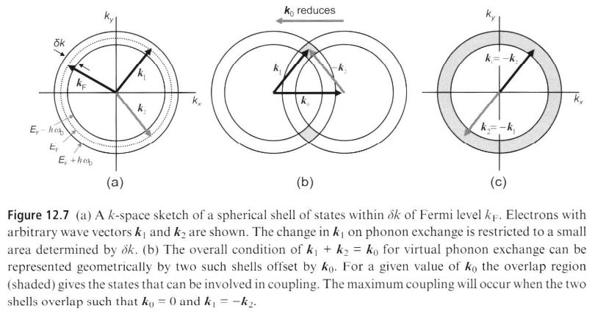
Notes:
The states involved can be represented graphically, as shown in Figure 12.7b, and their number is maximized, giving the largest number of electron–electron attractions, when k₀ = 0. that means that we have the condition on the electrons that k₁ = −k₂. If the two-electron wavefunction of the Cooper pair is to satisfy the overall condition that the electrons in the Cooper pair have opposite momenta and spin, the states are k and −k. This is called s-wave pairing and occurs in conventional or BCS superconductors. The pairs in a superconductor should not be thought of in the same way as electron pairs in a chemical bond, but as a dynamic state in which individual electrons are constantly exchanging phonons.

Slide 56
Why k₀ = 0 gives the most possible pairs
If k₀ = 0, then the rule becomes:
k₂ = −k₁
That means every state k in the shell automatically has a partner −k that is also in the shell.
This doubles your options: every point on the Fermi surface has a matching point directly opposite it. So the number of available pair states is maximized.
If k₀ is not zero (say, k₀ is some nonzero vector), then the partner of k₁ is k₂ = k₀ − k₁. Many of those points don’t lie in the allowed shell anymore, so the number of available pairs drops.

Slide 57
k₀ = k₁ + k₂, so k₀ = 0 means:
k₁ + k₂ = 0 → k₂ = −k₁
In other words, the two electrons in a Cooper pair must have equal and opposite momenta.
Because electrons are fermions, their spins must also be opposite for the overall two-electron wavefunction to be allowed. So a Cooper pair consists of states:
(k, ↑) and (−k, ↓)
This is called s-wave pairing, which is the type found in conventional (BCS) superconductors.
Finally, a Cooper pair is not like two electrons locked together in a fixed chemical bond. Instead, it is a dynamic quantum state in which many electrons near the Fermi surface continuously exchange phonons and momentarily form paired states with opposite momenta and opposite spins.

Slide 58
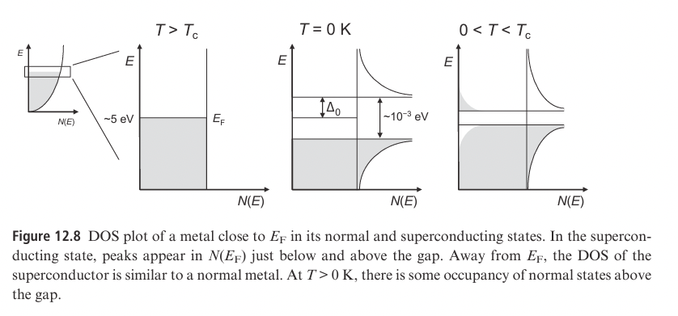
Notes:
In a superconductor, the ground state has lower energy than the normal free-electron state. Because of this, an energy gap (the superconducting gap) opens between the superconducting state and the normal state.
This gap forms because electrons near the Fermi energy exchange virtual phonons. That interaction slightly lowers their energy, which shows up as a peak in the electronic density of states. Only electrons within a small energy range of width ħω_D (about 10⁻³ eV) around the Fermi energy participate, which is a tiny fraction of all conduction electrons. This is why the total energy difference between the superconducting and normal states is small.
At T = 0 K, all states above the gap are empty. As temperature increases, some electrons gain enough energy to cross the gap, breaking some Cooper pairs. This reduces the size of the gap but does not destroy superconductivity. When the temperature reaches T_c, the gap collapses to zero and the material becomes a normal metal.

Slide 59
Notes:
Why This Leads to a Second-Order Phase Transition
Because the superconducting energy gap opens gradually as the temperature drops below T_c, the energy of the system changes smoothly with temperature. There is no sudden discontinuity in the total energy.
However, the rate at which the energy changes with temperature – the heat capacity – does show a sudden jump at T_c. This happens because the formation of the energy gap abruptly changes how many electronic states are available for thermal excitation. As soon as the gap appears, the system requires extra energy to excite electrons across it, which increases the heat capacity.
A smooth change in energy but a discontinuous change in heat capacity is the defining signature of a second-order phase transition.

Slide 60

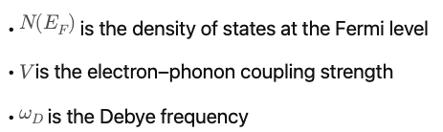



BCS Prediction for the Zero-Temperature Gap and Tc
Typical experimental measurements the zero temp energy gap are
BCS Theory further predicts that
Notes:
The energy gap is small because both the phonon energy scale (ħωD) and the electron–phonon coupling strength (V, together with N(EF)) are small. These factors appear as the prefactor and the exponential term in the BCS formula, so weak coupling and low phonon energy produce a very small superconducting gap. Based on that gap size, we see that BCS predicts a small Tc.

Slide 61

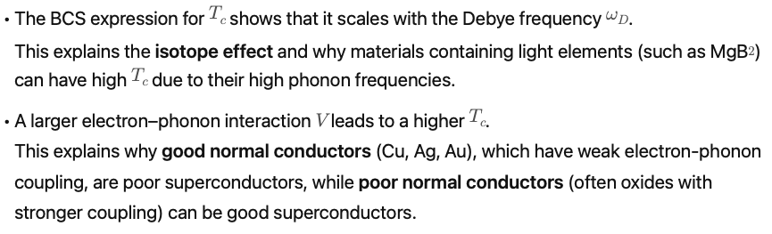
BCS prediction evaluated at Tc yields:

Slide 62
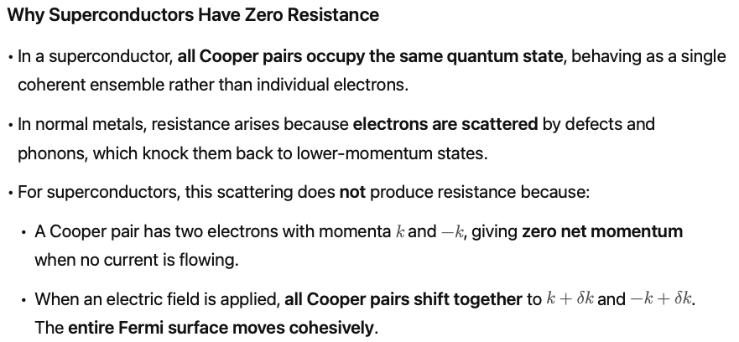
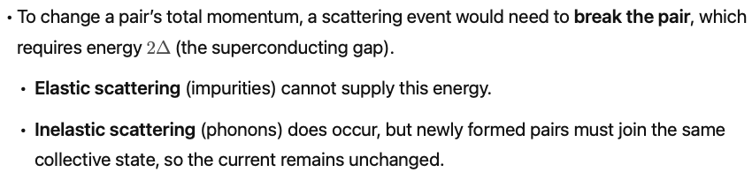

Slide 63
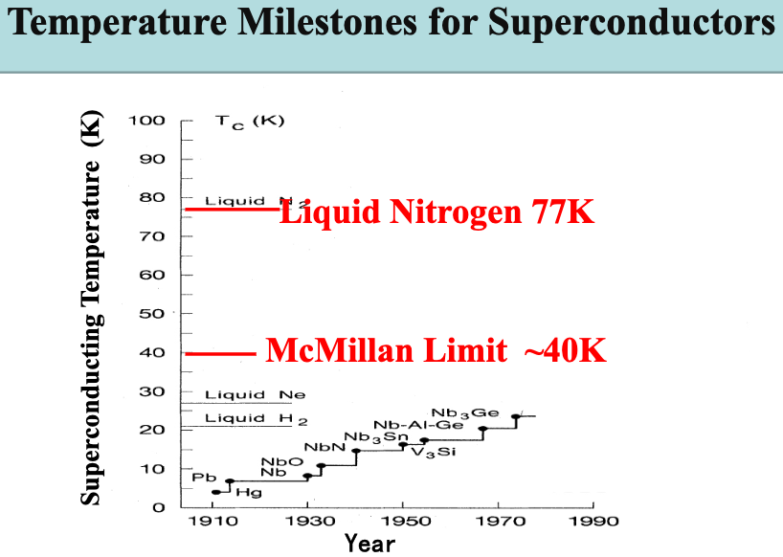
Notes:
BCS and Eliashberg theory predict an upper bound of about 40 K for phonon-mediated superconductivity.

Slide 64
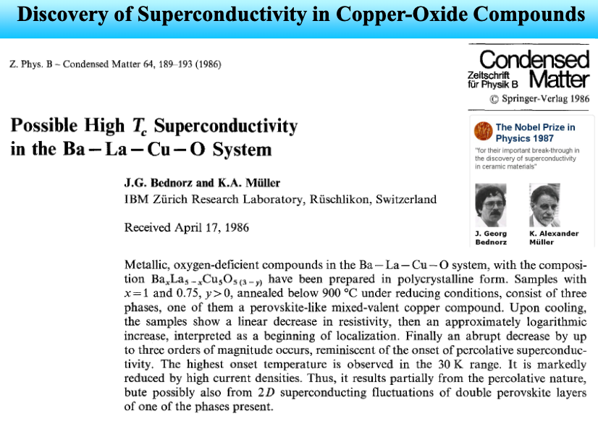

Slide 65
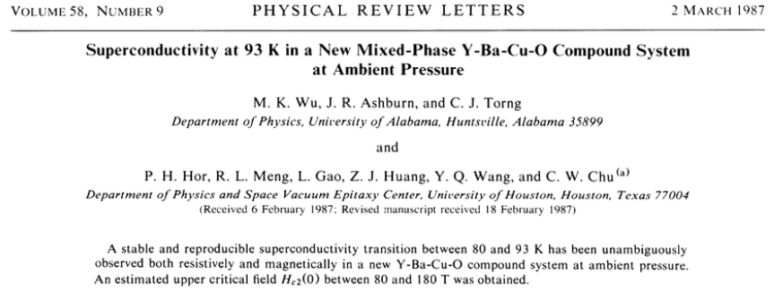

Slide 66
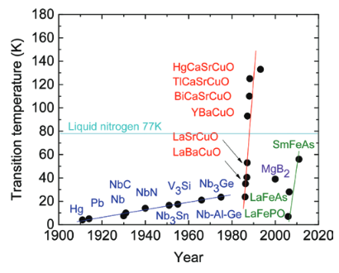

Slide 67

Notes:
The crystal structure of YBCO can be understood as a modification of the perovskite ABO₃ framework.
Starting from a prototype perovskite cell, tripling the unit along one axis produces a block containing three MO₆ octahedra (A₃M₃O₉).
To reach the YBa₂Cu₃O₇ composition, two oxygen atoms are removed according to Pauling’s parsimony rule, which favors the simplest oxygen-vacancy arrangement.
This selective removal splits the Cu sites into two distinct environments:
Cu–O chains, where missing oxygens reduce coordination.
CuO₂ planes, where Cu remains in square-planar coordination.
These two Cu substructures have different functions: the chains act as charge reservoirs that set the hole concentration, while the planes host the itinerant carriers that become superconducting.

Slide 68

Notes:
The structure and superconducting properties of YBa2Cu3O7-δ depend strongly on how much oxygen is present. When oxygen is removed from the fully oxygenated material, it comes out first from the Cu–O chain sites located halfway along the b-axis of the unit cell. If enough oxygen is removed so that δ reaches 1, the compound becomes YBa2Cu3O6, which has the chain sites completely empty.
Superconductivity disappears when the oxygen content drops below about YBa2Cu3O6.4. This loss of superconductivity is tied to a change in crystal structure. The superconducting material is orthorhombic, meaning the a and b lattice parameters are not equal. When enough oxygen is removed, the structure becomes tetragonal, where a and b become equal. This tetragonal structure occurs because the remaining oxygen atoms no longer form ordered chains.

Slide 69

Notes:
The CuO₂ planes contain a strongly antibonding band formed from overlap between Cu 3d_{x^2-y^2} orbitals and O 2p orbitals. In an ordinary band picture this half-filled band would make the material metallic. Instead, when an electron tries to hop onto a Cu site that already contains one electron, it must overcome a large on-site repulsion energy U. This repulsion prevents two electrons from occupying the same Cu site and forces the half-filled band to split into two separate sets of states: a lower Hubbard band containing singly occupied states, and an upper Hubbard band containing the higher-energy states that would require double occupancy. The split creates an energy gap even though the band is half-filled, so the undoped cuprate becomes a Mott–Hubbard insulator. Superconductivity only appears after doping introduces empty sites (holes) or extra electrons that allow charge to move without paying the energy cost U.

Slide 70

Notes:
Figure 12.22 summarizes how the electronic behavior of hole-doped cuprates evolves as carriers are added to the CuO₂ planes. At zero doping the materials are antiferromagnetic Mott insulators because the large on-site repulsion prevents electron motion. Introducing only a few percent of holes suppresses long-range antiferromagnetism and produces the pseudogap regime, where the electronic density of states develops a gap for some momenta and various short-range ordered states (such as charge- or spin-density waves) tend to form. Increasing the hole concentration to roughly 15–20 percent yields the highest superconducting transition temperatures, producing the characteristic superconducting dome. Beyond this optimal doping level, superconductivity weakens and eventually disappears, giving way to a metallic state. However, this metal is not conventional: in the region labeled “strange metal,” the resistivity is unusually large and grows linearly with temperature, reflecting the strong electron–electron interactions inherited from the Mott insulating parent. At still higher doping levels, those interactions diminish and the system gradually evolves into a more ordinary metal.

Slide 71


Slide 72

Notes:
CuO₂ planes are made of Cu²⁺ ions in a square of O²⁻ ions, so the Cu 3d levels are split with the d_{x^2-y^2} orbital highest in energy and pointing straight at the in-plane oxygens. This d_{x^2-y^2} orbital (hybridized with O 2p) forms the narrow band that controls the low-energy electrons in the cuprates. Because this orbital is compact and points directly at negatively charged oxygens, trying to put two electrons on the same Cu site costs a large Coulomb energy U. In the Hubbard model we keep just this one d_{x^2-y^2}-like orbital per Cu: electrons can hop between neighboring Cu sites with amplitude t, but double occupancy costs energy U. At one electron per Cu, U is big enough to localize electrons and give a Mott-like antiferromagnetic insulator. When we dope holes into this CuO₂ sheet, the same large U and the associated antiferromagnetic correlations generate strong, anisotropic (d-wave) pairing between electrons. In this way, superconductivity in cuprates can be viewed as emerging from electrons in this single d_{x^2-y^2} band that strongly repel each other (large U), rather than from an attractive interaction mediated by phonons.

Slide 73

Notes:
This diagram shows how the local Cu–O molecular orbitals in a CuO₂ plaquette turn into bands in the density of states. Most Cu 3d and O 2p combinations (regions I and II) lie well below the Fermi level and are essentially filled, so they do not participate in low-energy transport. The peak labeled III at the Fermi energy comes from the Cu d_{x^2-y^2}–O 2p σ antibonding orbital, which forms a narrow band that is only half-filled (one hole per Cu) in the undoped material. The Cu 3d partial DOS on the right highlights that this d_{x^2-y^2}-derived band dominates the low-energy states, while the other 3d orbitals contribute mainly at lower energies. This energy separation is what allows us to replace the full Cu–O chemistry by a single-band Hubbard model acting on the d_{x^2-y^2}–like band, with strong on-site repulsion U and hopping between Cu sites capturing the essential physics that ultimately leads to d-wave superconductivity upon doping.

Slide 74


Slide 75



Notes:
Modern large scale simulations of the 2D Hubbard model, which is just electrons hopping on a square lattice and strongly repelling each other on the same site, with no phonons included at all, now reproduce the key features of cuprates: an antiferromagnetic insulator at one electron per site, stripe like patterns of spin and charge plus a strange metal when you add carriers, and a superconducting state with d wave character whose strength versus doping looks like the Tc dome in real materials. The important point is that all of this, including strong d wave pairing, comes out of a model that has only electron electron interactions, which is strong evidence that the pairing glue in cuprates is primarily electronic and linked to spin fluctuations, with phonons at most tweaking the details rather than setting Tc.

Slide 76
Simple electronic models now reproduce superconductivity
The Hubbard model is the standard “minimal” model to capture strong electronic correlations on a lattice:
electrons live on a square lattice (like Cu sites)
they can hop to neighboring sites with amplitude t
if two electrons land on the same site, they pay a large energy penalty U (strong on-site repulsion)
At half-filling (one electron per site), and for large U, the Hubbard model naturally gives a Mott insulating antiferromagnet, just like undoped cuprates.
Modern large-scale numerical simulations then show that:
when you dope this model away from half-filling
you get a correlated metal with stripe-like charge/spin textures
This is important because the Hubbard model has no phonons built in. If it already stripes plus a dome-like Tc vs doping, then:
you can get cuprate-like superconductivity purely from electron–electron interactions
that strongly supports the idea that electronic correlations and spin fluctuations are sufficient to explain high-Tc in cuprates

Slide 77
Homework:
12.2-12.6
12.11 – 12.14

