Slide 1
Learning Objectives
Semiconductors
By the end of this lecture, you will be able to:
Explain the origin of low conductivity in intrinsic semiconductors and the role of band gaps in limiting charge carrier concentration
Describe donor and acceptor doping mechanisms and their effects on semiconductor conductivity through band structure modifications
Understand the temperature dependence of semiconductor conductivity including freeze-out, saturation, and intrinsic regimes
Explain P-N junction behavior including rectification, band bending, and the formation of depletion regions
Describe practical applications: photovoltaic cells, light-emitting diodes (LEDs), and metal-oxide-semiconductor field-effect transistors (MOSFETs)
Notes:
In this lecture, we turn our attention to semiconductors. And as we're about to learn, the conductivity of semiconductors differs from metals in a number of important ways.

Slide 2
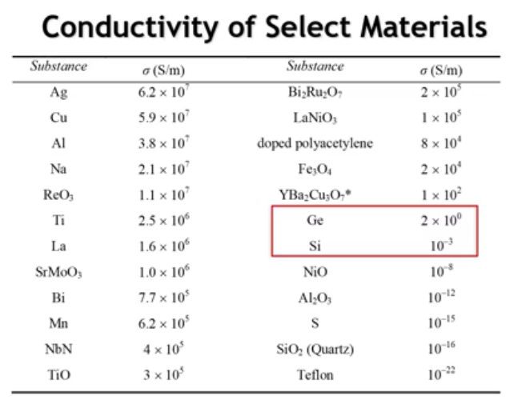
Notes:
Let's return to our conductivity table for select materials. Silicon and germanium, both elemental semiconductors, have rather modest conductivities—surprisingly low given their technological importance. However, these values represent intrinsic pure silicon and germanium. As we'll learn, semiconductor conductivity is extremely sensitive to impurities. But first, let's understand what makes the conductivity in these materials so low.

Slide 3
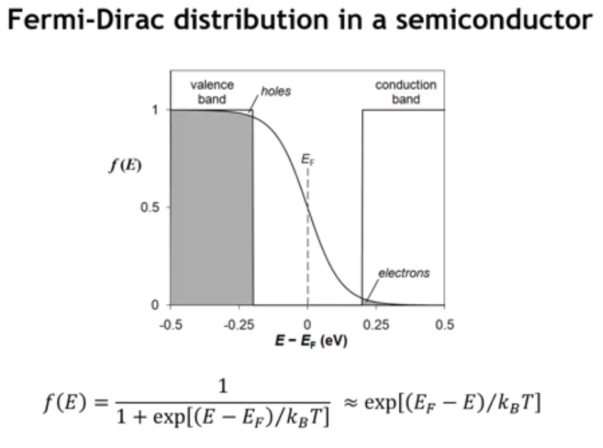
Notes:
The characteristic feature of a semiconductor is a band gap—an energy gap between filled and empty bands. Returning to the Fermi-Dirac distribution (shown at the bottom) and examining its effect on occupied crystal orbitals, we see that although thermal smearing occurs, there are no crystal orbitals near the Fermi level. This results in only a few missing electrons in the valence band (called holes) and just a few electrons in the conduction band. Semiconductors therefore have far fewer charge carriers than metals.
The expression for the Fermi-Dirac function can be simplified. At any given energy, we obtain this relationship:

Slide 4
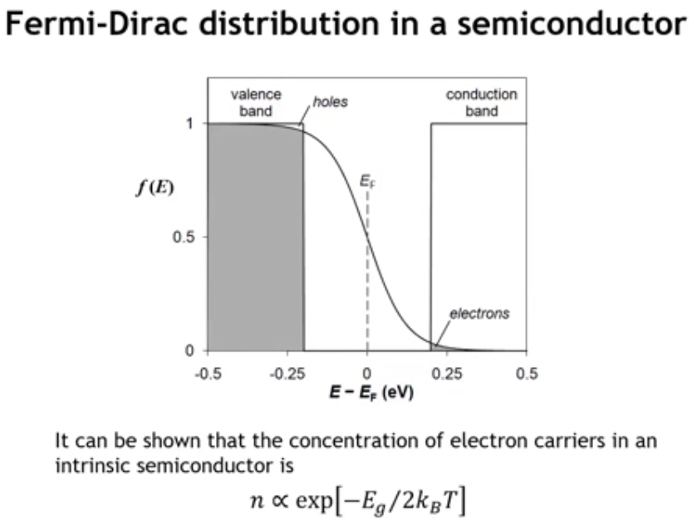
@300k, Si (Eg = 1.1 eV) has 1 electron per trillion atoms
Notes:
The concentration of electron charge carriers in an intrinsic semiconductor depends exponentially on the band gap, as shown in this relation. For silicon, with a band gap of 1.1 eV, approximately 10¹⁶ electrons per cubic meter are present in the conduction band to carry charge.
To put this in context: while 10¹⁶ may seem large, there are 10²⁸ atoms in that same cubic meter. This means only one electron carries charge for every 10¹² atoms—just one out of every trillion silicon atoms contributes a conduction electron. The conductivity of intrinsic semiconductors is therefore low because the charge carrier concentration is low.

Slide 5
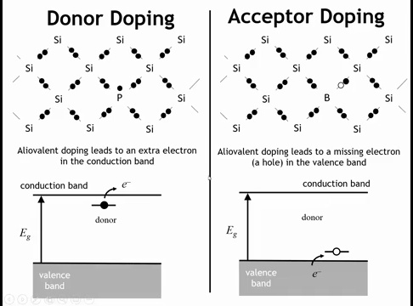
Notes:
To achieve meaningful charge carrier concentrations, we use a process called doping. This involves replacing host atoms with aliovalent dopants.

Slide 6
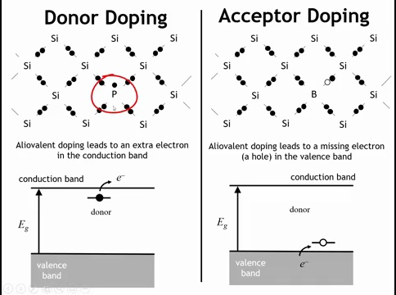
Notes:
Consider an aliovalent dopant like phosphorus, which has one more valence electron than silicon. In the localized bonding picture, this extra electron is not needed to satisfy local bonding requirements and can move through the crystal relatively easily.
In the band picture, phosphorus fills all valence band states and contributes one additional electron at an energy just below the conduction band. This electron can be easily thermally excited into the conduction band, where it moves freely through the crystal.

Slide 7
Notes:
The other doping method is acceptor doping, which uses aliovalent substitution with an element having one fewer valence electron than the host. Boron is a classic acceptor dopant in silicon.
In the localized bonding picture, electrons from neighboring atoms can fill the missing electron position (the hole) to complete the local bonding. In the band picture, this creates an empty state just above the valence band. When an electron moves into that state—becoming trapped on the boron atom—the valence band is no longer completely filled. This hole (missing electron) can now move through the crystal and carry charge.
Since a hole represents a missing electron, it has a positive charge. Under an applied electric field, holes move toward the negative electrode while electrons move toward the positive electrode—opposite directions for the two types of charge carriers.

Slide 8
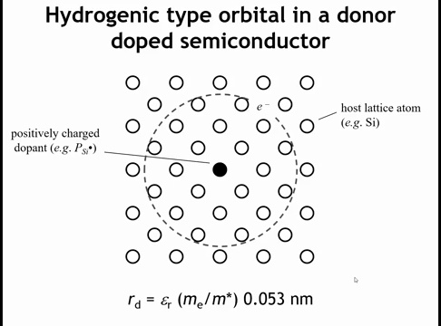
Notes:
Although the electron Although the electron from a donor dopant like phosphorus might seem free to move anywhere, remember that the phosphorus nucleus has one more positive charge than a silicon nucleus. The positively charged dopant attracts its donated electron, creating a bound state analogous to a hydrogen atom.
We can model this donor electron using a hydrogen-like treatment with two key modifications. First, the bound state radius is enlarged by the dielectric constant of the semiconductor, which screens the dopant's positive charge. Second, we must account for the electron's effective mass in the crystal. These corrections result in bound states with radii up to ~10 nm—quite large compared to atomic scales.
This describes the bound state of a donor electron. Acceptor dopants behave analogously, with the hole attracted to the negatively charged acceptor.

Slide 9
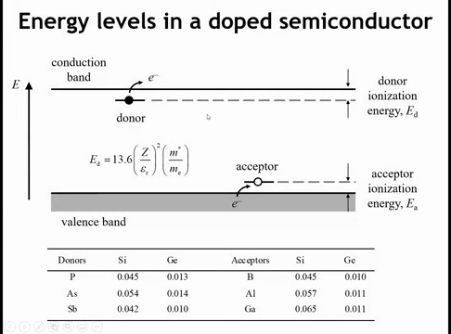
Notes:
This is why we draw these dopant levels within the band gap. Some excitation energy is required to ionize the dopant—either freeing the electron from phosphorus into the conduction band or filling the acceptor hole from the valence band. However, this ionization energy is quite small.
The table shows ionization energies for donor and acceptor dopants in silicon and germanium. These energies are only tens to hundreds of meV—the thermal energy needed to liberate the extra charge carriers from the dopants.

Slide 10
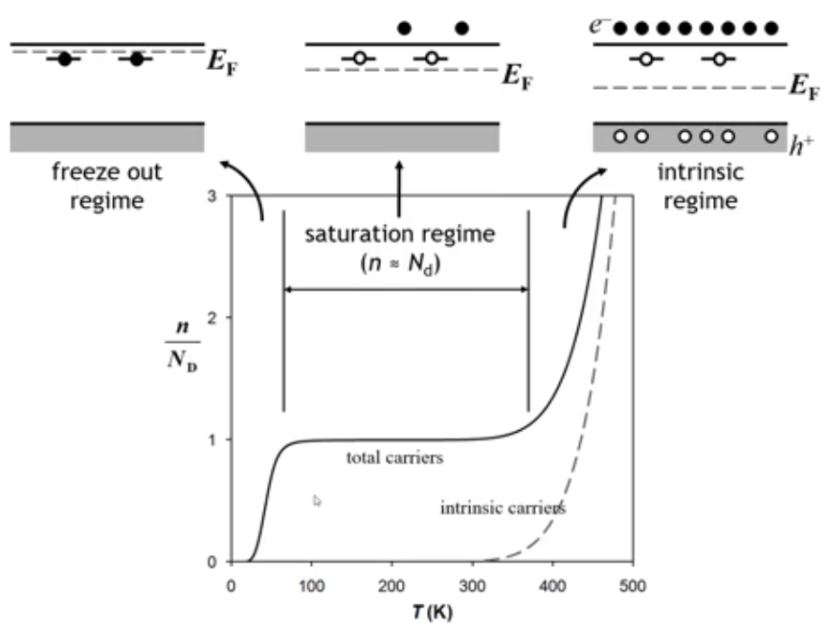
Notes:
This gives doped semiconductors an unusual temperature dependence. Looking at the dashed line, conductivity increases exponentially at high temperature. Unlike metals, whose conductivity decreases with temperature, a semiconductor’s conductivity rises because the carrier concentration grows exponentially with temperature. This effect outweighs the scattering from lattice vibrations that dominates in metals.
At very low temperatures, however, there isn’t enough thermal energy to free electrons from donor atoms such as phosphorus. This is the freeze-out regime, where conductivity is low. As temperature increases to modest levels (often below room temperature), all dopant electrons become thermally activated, leading to the saturation regime. Here, nearly all carriers from dopants are active, and excitation from the valence to conduction band is minimal, so conductivity shows little temperature dependence. This regime is advantageous for many devices.
At still higher temperatures, intrinsic carriers—those excited directly across the band gap—begin to dominate. This marks the intrinsic regime, where conductivity again increases rapidly with temperature

Slide 11
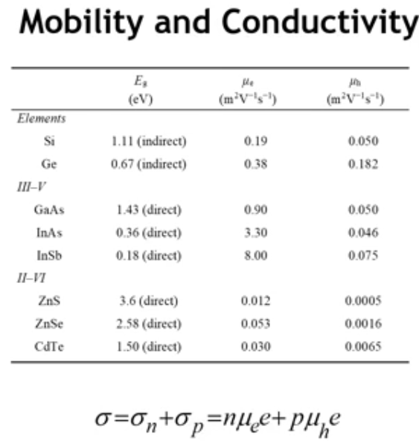
Notes:
To describe the conductivity of a semiconductor, we use the expression
σ = n q μₙ + p q μₚ
where conductivity is the product of carrier concentration, charge, and mobility. In semiconductors, both electrons and holes contribute, so their conductivities add together.
Most semiconductors are intentionally doped to be either n-type or p-type, meaning that in practice, only one type of carrier—electrons or holes—dominates.
Here are some representative mobility values for common semiconductors. Notice that the III–V semiconductors (like GaAs) have much higher mobilities than elemental (like Si, Ge) or II–VI semiconductors. The mobility of III–V semiconductors is higher because their crystal structures produce lower effective masses for charge carriers and weaker scattering from lattice vibrations and impurities, allowing electrons to move more freely through the material.
Also, as a general rule, electrons have higher mobility than holes.

Slide 12
See Gradescope Quiz 1
What is the primary reason for the low conductivity of an intrinsic (pure) semiconductor like silicon?
2. When an acceptor dopant like boron (which has one fewer valence electron than silicon) is added, what type of charge carrier is created?
3. How does the conductivity of a semiconductor generally change as temperature increases (in the intrinsic regime)?
4.In a doped semiconductor, what is the "saturation regime"?

Slide 13
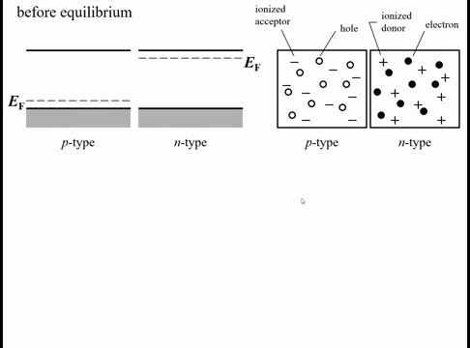
Notes:
Now let’s talk about a few simple but important semiconductor architectures. One of the most fundamental is the p–n junction, arguably one of the most important devices in all of science. In a p–n junction, one side of the crystal is doped p-type, meaning it has holes in the valence band, and the other side is doped n-type, with electrons in the conduction band. When these two regions are brought together, they form the p–n junction.

Slide 14
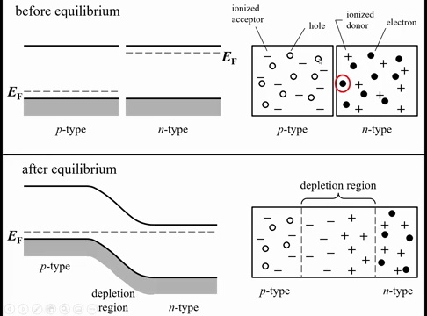
Notes:
When we bring the p-type and n-type materials together, the mobile electrons from the n-side find the mobile holes on the p-side, and the two recombine—the electron fills the hole and both disappear as mobile carriers. However, the ionized dopant atoms left behind, such as phosphorus or boron, are fixed in the lattice and cannot move. This leaves behind a depletion region, a zone with very few mobile charge carriers, similar to an intrinsic semiconductor. Within this region, ionized donors and acceptors remain, creating an electric field across the junction.
In an n-type semiconductor, the Fermi level lies near the conduction band, since electrons are the dominant carriers. In a p-type semiconductor, it lies near the valence band. When the two are joined to form a p–n junction, the Fermi level must align across both sides, which causes band bending in the conduction and valence bands across the depletion region.
If you imagine being an electron near the p-side conduction band, you would feel the electric field pulling you toward the n-side. In these band diagrams, it’s useful to remember that electrons move downhill, while holes move uphill.

Slide 15
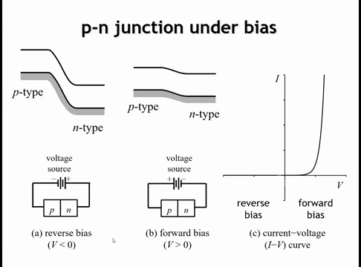
Notes:
What makes a p–n junction special is its property of rectification. This means that when a voltage is applied in one direction, current flows, but when the voltage is reversed, almost no current passes. When the positive lead of the voltage source is connected to the n-type side, electrons are pulled away from the junction and the junction is reverse biased, which increases the band bending and effectively stops current flow. When the polarity is reversed, the junction is forward biased, the band bending decreases, and current begins to flow. Because of this one-way behavior, a p–n junction can act as a rectifier, converting alternating current (AC) into direct current (DC) by allowing electrons to flow in only one direction.

Slide 16
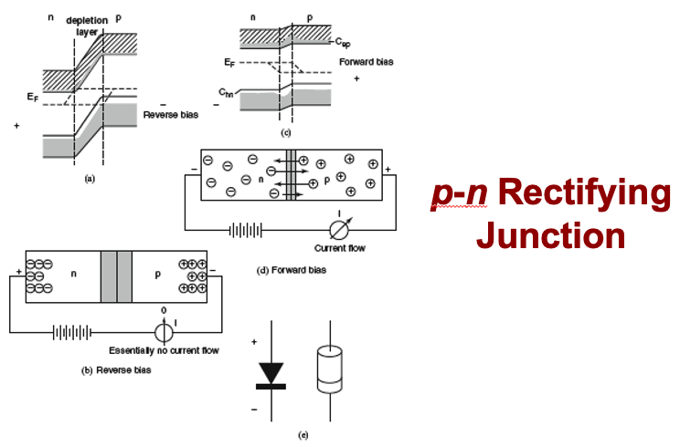
Notes:
Here’s another view of a pn junction whoing that when you apply a positive bias to the n-doped side, you pull charge carries away from the junction, so no current can flow. When you apply a negative voltage to the n-doped side, you drive charge carriers to the junction, where current can flow because the carriers annihate the positive charges.

Slide 17
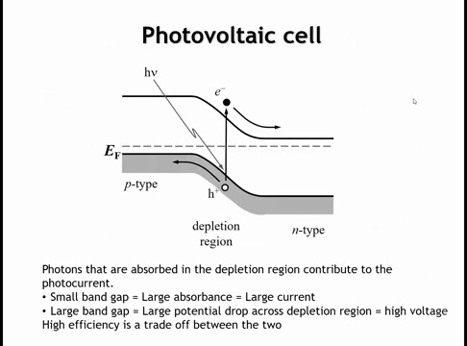
Notes:
Another important application of a p–n junction is in photovoltaic cells and light-emitting diodes (LEDs). In a photovoltaic cell, incoming photons excite electrons from the valence band to the conduction band. If this excitation occurs within the depletion region, the built-in electric field separates the electron and hole before they can recombine—the electron is swept toward the n-type side, and the hole toward the p-type side.
When designing a solar cell, there’s a trade-off in the choice of band gap. A larger band gap produces a higher voltage across the junction, since the maximum potential drop cannot exceed the band gap energy. However, a larger gap also means fewer photons have enough energy to be absorbed. The goal is to balance these effects: the band gap must be small enough to absorb sunlight efficiently but large enough to generate useful voltage. The optimal value is typically around 1.5 electron volts.

Slide 18
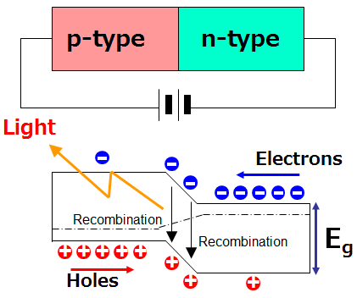
Notes:
The other device you can make from a p–n junction operates in the opposite way: by applying a voltage that pushes electrons and holes into the depletion region. If the material is a direct band gap semiconductor, these carriers can recombine radiatively, releasing light. This is the principle of a light-emitting diode (LED)—it works in the reverse sense of a photovoltaic cell, converting electrical energy into light instead of light into electrical energy.

Slide 19
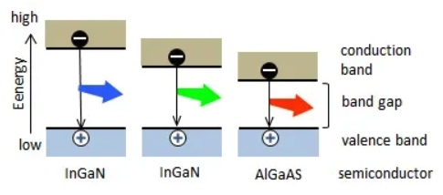
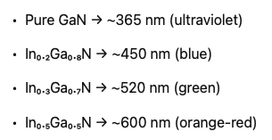
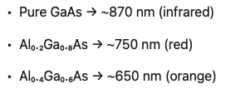
Notes:
Different colors of LEDs are related to the band gap of the semiconductor as well as the degree of alloying of different materials.

Slide 20
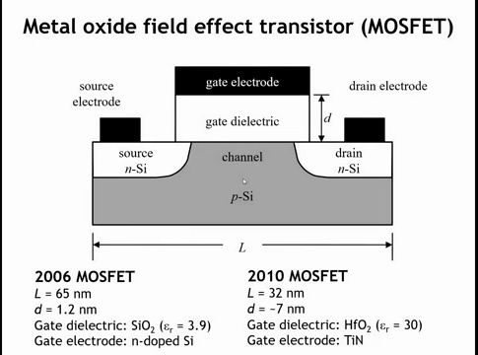
Notes:
Finally, let’s say a few words about the MOSFET, or metal–oxide–semiconductor field-effect transistor. This is the fundamental architecture used in microprocessors to switch between on and off states. A MOSFET has two main contacts: the source and the drain. When current can flow from the source to the drain, the transistor is on; when it cannot, it is off, giving the basic 0–1 logic used in digital circuits. The switching is controlled by applying an electric field to the gate electrode, which modulates the conductivity of the channel between the source and drain

Slide 21
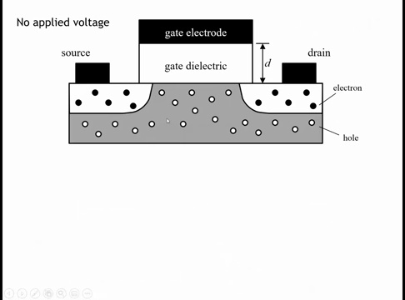
Notes:
Typically a MOSFET might be made from a P-type semiconductor that is doped n type near the source in the drain. But because you have to go across two P-injunctions, there's basically no flow of current in the absence of an applied field at the gate.

Slide 22
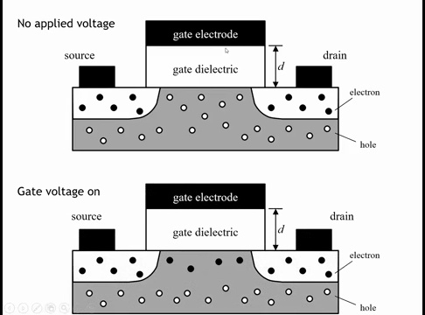
Notes:
But when you apply a large enough field at the gate electrode, it pushes the holes away from the gate dielectric and basically creates an N-type region here. Now you have a continuous N-type semiconductor all the way from the source to the drain. Current can flow from one to the other and the transistor is on.

Slide 23
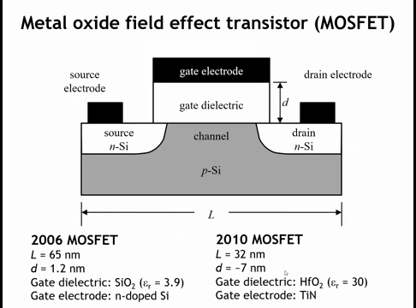
Notes:
About 10 or 15 years ago, there was a major change in transistor architecture and materials. For decades, the strategy to make faster, denser chips was simple: shrink the transistor. As the lateral dimension L of the channel got smaller, so did the area of the gate capacitor. Since capacitance decreases with area, engineers compensated by making the gate dielectric thinner.
By around 2006, when transistors reached a lateral size of about 65 nanometers, the gate dielectric had been reduced to just 12 angstroms (1.2 nanometers) thick. At that scale, quantum tunneling across the dielectric became a serious problem, making further thinning impossible.
For many decades, the gate dielectric was silicon dioxide (SiO₂), which was easy to form by oxidizing silicon but had a relatively low dielectric constant (~4). The solution was to switch to amorphous hafnium oxide (HfO₂), which has a much higher dielectric constant of about 30. This allowed the dielectric layer to be made physically thicker while still maintaining the same capacitance.

Slide 24
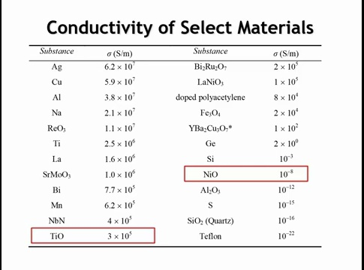

Slide 25
See Gradescope Quiz 2
In a p-n junction at equilibrium (no external voltage), what is the fundamental origin of the built-in electric field within the depletion region?
2. When a p-n junction is formed, the conduction and valence bands "bend" across the depletion region. What is the primary physical reason for this band bending?
3. Applying a reverse bias to a p-n junction (e.g., positive voltage to the n-type side) stops significant current flow. How does it accomplish this?
4. In an n-channel MOSFET built on a p-type substrate, how does applying a strong positive voltage to the gate electrode "turn on" the transistor?
5. Why was it necessary for the semiconductor industry to switch from silicon dioxide (SiO2) to a high-k dielectric like hafnium oxide (HfO2) for the gate?

Slide 26
Homework:
10.11-10.13

Slide 27

Learning Objectives
Conductivity of Transition Metal Compounds
After this lecture, you will be able to:
Explain how electron-electron repulsions determine conductivity in transition metal compounds
Apply the Hubbard model to predict metallic vs. insulating behavior by comparing bandwidth (W) and on-site repulsion (U)
Identify Mott-Hubbard insulators and explain their origin
Predict conductivity trends across rock salt structure oxides based on d-orbital contraction and metal-metal distance
Analyze conductivity patterns in perovskite structures and explain differences between 3+ and 4+ oxidation states
Notes:
In this lecture we're going to look at the conductivity of transition metal compounds, which are arguably among the most interesting of conductors. So we're going to go back once again to our table of the conductivities of select materials.

Slide 28
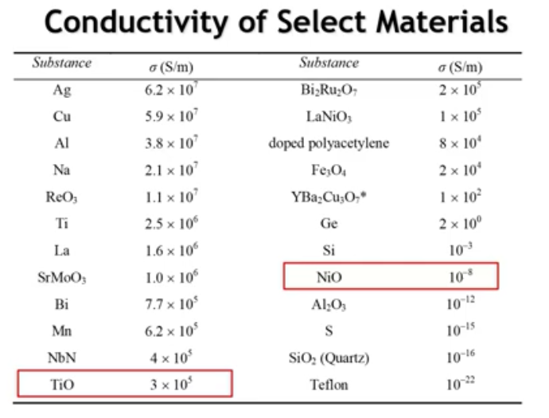
Notes:
Recall that nickel oxide and titanium oxide both have the rock salt structure and partially filled orbitals, yet their conductivities differ by 13 orders of magnitude. This dramatic divergence stems from electron-electron repulsions. Let's examine this more closely.

Slide 29
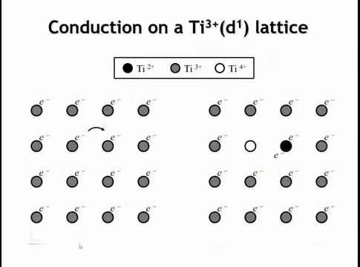
Notes:
Consider a square lattice of titanium 3+ ions, each with one d electron. For conductivity to occur, an electron must move from one titanium atom to another. When this happens, the receiving ion gains an electron and becomes titanium 2+, while the donating ion loses an electron and becomes titanium 4+.
The key point: electrons are no longer optimally separated. The titanium 2+ atom now has two electrons that repel each other, and this repulsion is crucial for understanding conductivity.

Slide 30
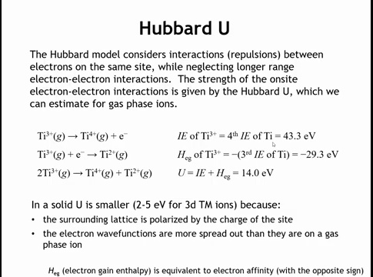
Notes:
How can we model these electron-electron repulsions? We'll use the Hubbard model, which considers only repulsions between electrons on the same site while neglecting longer-range electron-electron interactions.
For gas phase atoms, we can determine the on-site repulsion from ionization energies. Consider titanium: Ti³⁺ → Ti⁴⁺ + e⁻ requires the ionization energy of Ti³⁺, which is 43.3 eV. At the site where the electron arrives, Ti³⁺ → Ti²⁺ corresponds to the electron affinity (or electron gain enthalpy) of Ti³⁺, equal to the negative of titanium's third ionization energy: -29.3 eV.
Adding these together gives 2Ti³⁺ → Ti⁴⁺ + Ti²⁺ with an energy cost of 14 eV—the sum of the ionization energy and electron affinity. This is substantial; compare it to silicon's 1 eV band gap. This represents a significant energy penalty for bringing electrons closer together.
However, in a solid like titanium oxide, U is much smaller—typically 2-5 eV—for two reasons. First, the surrounding lattice can relax or polarize in response to charge movement. For example, oxygen ions can shift closer to Ti⁴⁺ and away from Ti²⁺, reducing the energy penalty. Second, electron wavefunctions are more spread out in extended solids than in isolated gas phase atoms, which also reduces electron-electron repulsions. Together, these effects lower U from 14 eV to just a few eV.

Slide 31
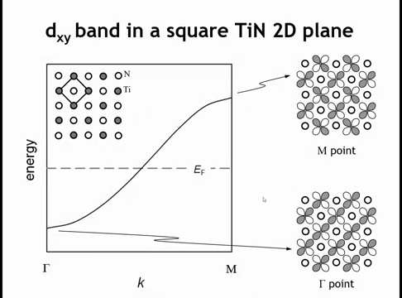
Notes:
Now let's consider the band width. Take a titanium nitride sheet with Ti³⁺ ions. We can examine the overlap of the titanium d_xy band at Γ (where it's bonding) and at M (where it's anti-bonding). This band has a certain width.
In the Hubbard model, we compare the band width to the size of the Hubbard U—that is, the electron-electron repulsions.

Slide 32
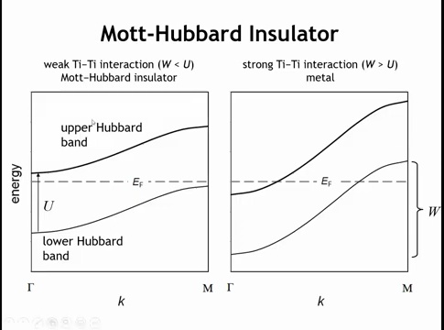
Notes:
Consider two extremes. If the titanium atoms are far apart or their interaction is weak, we get relatively narrow bands. When the band width is smaller than the Hubbard U, we effectively have a gap.
A note about the Hubbard model: it's really a single-band system. The upper and lower Hubbard bands can each hold only one electron. The key point is this: when the on-site electron-electron repulsion (Hubbard U) exceeds the band width, we get one filled band and one empty band—creating a gap. This yields an insulator called a Mott-Hubbard insulator, which is insulating due to electron-electron repulsions.
Conversely, if there's strong overlap of the titanium d orbitals and the band width W is larger than the Hubbard U, we have partially filled bands rather than one filled and one empty band. This leads to metallic behavior.
In summary, the conductivity of transition metal compounds depends on two factors: the band width and the electron-electron repulsions estimated by the Hubbard U.

Slide 33
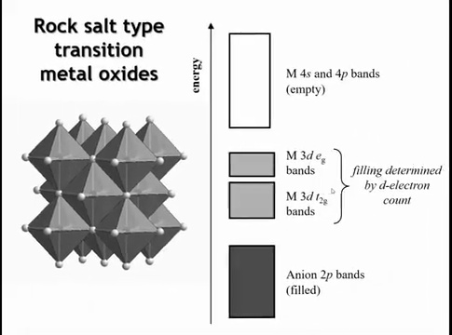
Notes:
Now let's examine real compounds to see this in action. Consider metal oxides with the rock salt structure. In this structure, each octahedron shares all its edges with neighboring octahedra.
The oxide bands sit at lower energy, while the metal d bands—where the interesting behavior occurs—sit above them. In the rock salt structure, the t₂g bands are wider than the eg bands because of overlap across the shared edges. The t₂g orbitals, like d_xy, point toward the octahedron edges and overlap with each other, as we saw a few slides back with the titanium nitride layer.
The band filling depends on the electron count.

Slide 34
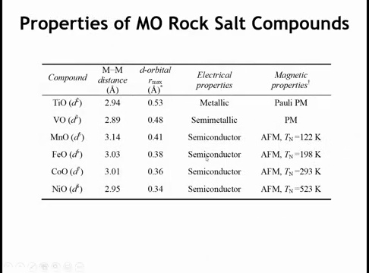
Notes:
Starting with titanium oxide (TiO), which has a d² configuration, we see metallic behavior. The column shows the titanium-titanium distance and the maximum in the radial distribution function—a proxy for d orbital size.
Moving to vanadium oxide, where V²⁺ has a d³ electron count, we observe semi-metallic behavior at the borderline between metal and semiconductor.
In MnO with d⁵, the manganese ions are now farther apart—Mn²⁺ is larger than Ti²⁺—yet the d orbitals are smaller. The behavior is clearly semiconducting, accompanied by antiferromagnetic ordering often associated with semiconductors.
This semiconducting behavior continues across the rest of the series. The d orbitals keep contracting, while the distance between transition metal ions changes little—decreasing slightly but not by the same percentage as the d orbital contraction.
This d orbital contraction reduces overlap between orbitals, decreasing the bandwidth. Simultaneously, because the d orbitals are smaller, placing two electrons in the same orbital incurs a larger energy penalty U.
In summary: bandwidth decreases while U increases across the series. This is why only TiO exhibits metallic behavior, while the later transition metal rock salt oxides do not.

Slide 35
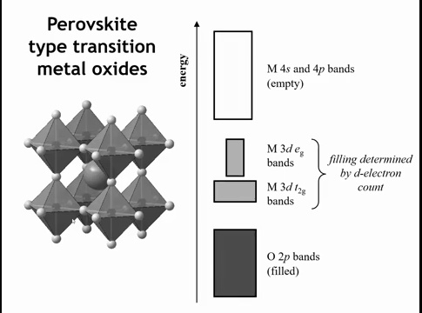
Notes:
Now let's examine the conductivity properties of perovskites with transition metal ions. Recall from Chapter 6 that we discussed the perovskite band structure in detail. The oxygen bands sit at lower energy, and again the d bands are where the interesting behavior occurs.
In perovskites, the t₂g bands are narrower than the eg bands. This is because we don't have metal bonding across shared edges—only shared corners. Consequently, there are no direct metal-metal interactions, and the bandwidth comes solely from the strength of the interaction with oxygen.
Remember that the eg bands are σ-antibonding bands, while the t₂g bands are π-antibonding bands. Therefore, the eg bands are wider.

Slide 36
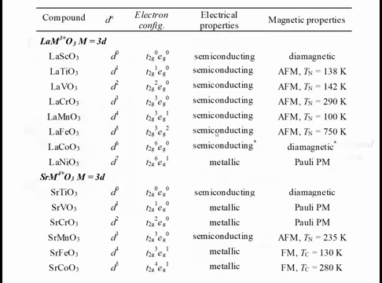
Notes:
Here are the properties of several first-row transition metal ions in perovskite structures. The table shows different transition metal ions with 3+ charge, progressing from no d electrons in scandium to progressively filled d orbitals.
Across this series, we observe semiconducting behavior everywhere, indicating that the Hubbard U exceeds the bandwidth. Only at lanthanum nickel oxide (LaNiO₃) do we see metallic behavior.
Why? First, the 3+ oxidation state is quite high for nickel, leading to substantial covalency with oxygen. Second, notice the partially filled eg band, which is wider than the t₂g band.
We might have expected metallic behavior for LaMnO₃, which has only one electron in the eg orbitals. However, LaMnO₃ undergoes a cooperative Jahn-Teller distortion. This d⁴ electron count triggers the Jahn-Teller distortion, which narrows the bands and localizes the electrons.
While Ni³⁺ could also undergo a Jahn-Teller distortion, the compound relieves this instability differently—by delocalizing the electrons in the eg orbitals instead.

Slide 37
Notes:
Interestingly, for perovskites with 4+ ions instead of 3+ ions, metallic behavior is the rule rather than the exception.
Why? The 4+ oxidation state leads to greater covalency with oxygen. These 4+ ions are smaller and more highly charged, resulting in larger covalency with oxygen and wider bands. This increased bandwidth is sufficient to maintain metallic conductivity for several of these compounds.
However, there are exceptions. Strontium titanate (SrTiO₃) is semiconducting because there are no electrons in the d orbitals. Strontium manganate (SrMnO₃) is semiconducting because at the d³ configuration we have half-filled t₂g orbitals.
Consider the Hubbard U for SrMnO₃. Moving an electron from one Mn⁴⁺ to another creates Mn³⁺ and Mn⁵⁺. For the Mn³⁺ site, where does the electron go? Mn³⁺ is typically a high-spin d⁴ ion, so the electron must go into the eg orbitals. This makes U especially large.
In general, ions with half-filled electron configurations have especially large U values. This is why SrMnO₃ is a semiconductor rather than a metal.

Slide 38
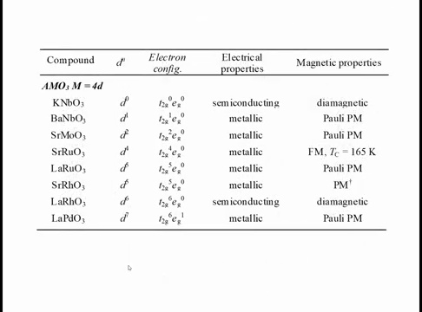
Notes:
If we go down to the 4D transition metals, the second time through the transition metal series, we see metallic behavior almost across the board, except for when we have no electrons in the D orbitals, like in K and VO3, or when we get to this length in a M03 where we have 6 electrons in the D orbitals. So the 6 electrons is enough to fill up the T2G orbitals, leave the EG orbitals empty, and in that compound we get a diamagnetic semi-conductor.

Slide 39
See Gradescope Quiz 3
Which of the following best explains the dramatic difference in conductivity between NiO and TiO, despite both having the rock salt structure and partially filled d-orbitals?
2. In the context of the Hubbard model, which condition is most likely to lead to a Mott-Hubbard insulator?
3. Considering transition metal oxides with the rock salt structure (e.g., TiO, VO, MnO), why does the conductivity trend from metallic (TiO) to semiconducting (MnO) as we move across the period?
4. Strontium manganate (SrMnO3) is a semiconductor, even though other 4+ perovskites exhibit metallic behavior. This is attributed to a particularly large Hubbard U. What characteristic of the Mn4+ (d3) electron configuration contributes to this exceptionally large U?

Slide 40
Homework:
10.14-10.16

Slide 41
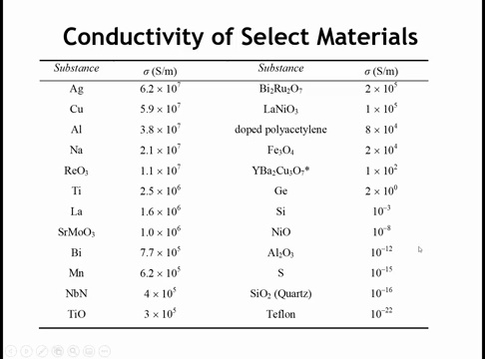
Notes:
So finally, we have to address the large different in conductivity between Teflon and doped polyacetylene

