Slide 1
Learning Objectives
Electrical Conductivity and the Drude Model
Distinguish between extrinsic (I, V, R) and intrinsic (J, E, σ, ρ) electrical properties
Apply the Drude model to describe electron behavior as an ideal gas in metals
Calculate key parameters: drift velocity, electron mobility, mean free path, and relaxation time
Derive the relationship between conductivity, carrier concentration, and mobility (σ = neμ)
Estimate conductivity parameters for simple metals using the Drude model
Recognize the limitations and failures of the Drude model in predicting temperature dependence and trends across different metals
Electrical Properties of Materials | Materials Science & Chemistry

Slide 2
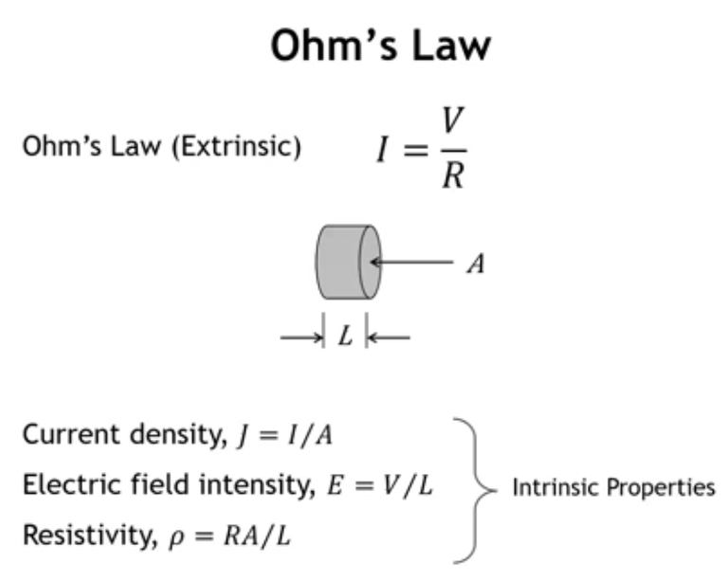
Notes:
Ohm's Law (V = IR) uses extrinsic quantities that depend on sample dimensions: resistance increases with length and decreases with cross-sectional area. For materials design, we need intrinsic properties:
Current → Current density (J = I/A)
Voltage drop → Electric field (E = V/L)
Resistance → Resistivity (ρ = RA/L)
These intrinsic properties are independent of sample geometry.

Slide 3
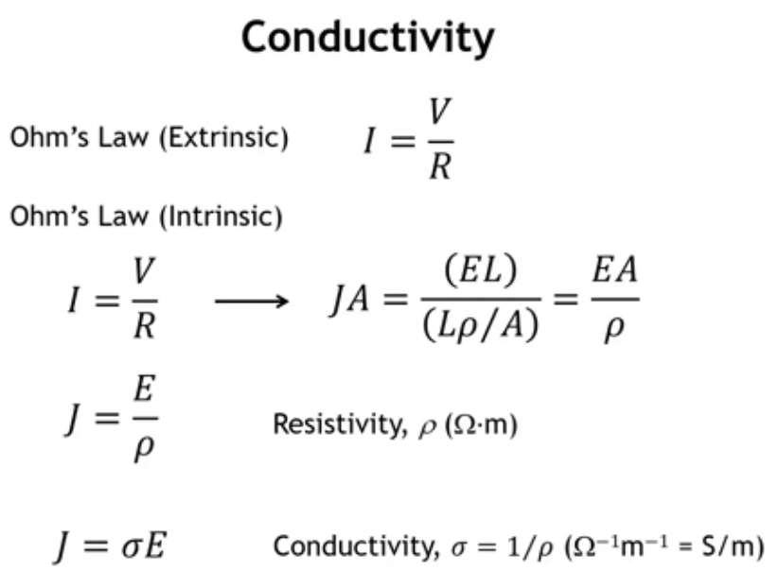
Notes:
Recasting Ohm's Law (I = V/R) into intrinsic form: substitute I → JA, V → EL, R → ρL/A, giving JA = EL/(ρL/A). Lengths and areas cancel, yielding:
J = E/ρ
Current density equals electric field divided by resistivity. Conductivity σ = 1/ρ, so alternatively J = σE.
Units: resistivity is Ω·m, conductivity is S/m (Siemens per meter, where S = 1/Ω).

Slide 4
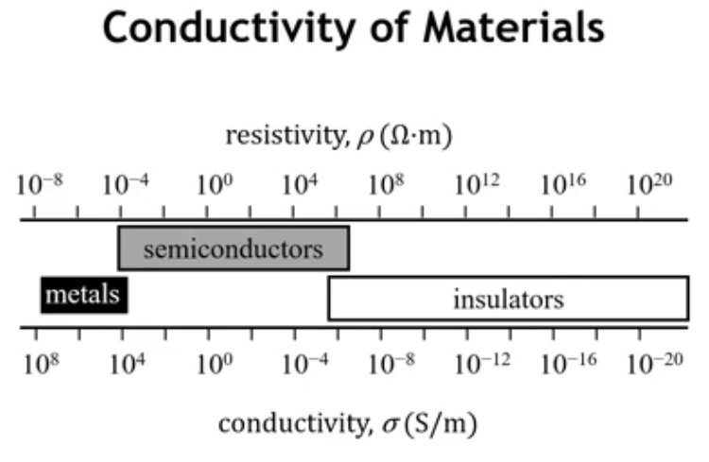
Notes:
Conductivity spans an immense 28 orders of magnitude—from the best metals to the most insulating insulators. Few properties exhibit such a wide range.
Metals: high conductivity, ~10^8 to 10^4 S/m Semiconductors: intermediate region Insulators: low conductivity, spanning a wide range

Slide 5
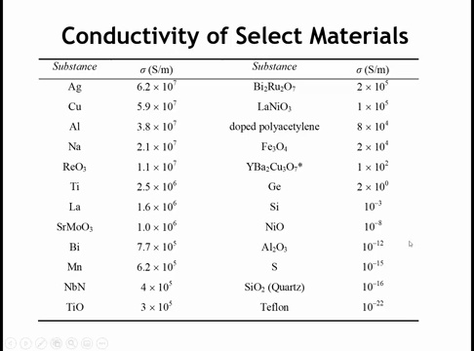
Notes:
In the upper left, we have elemental metals with the highest conductivity, often used as conductors. Silver and copper have conductivities around 6×10^7 S/m. Silver is actually the most conductive element at room temperature. Aluminum isn't far behind. We also see a mixture of other metals, including rhenium trioxide with quite high conductivity, other oxides, and a nitride like niobium nitride.
Looking at this table raises several questions:
What makes silver so much more conductive than metals like titanium or lanthanum? It's over an order of magnitude more conducting.
What makes some oxides like rhenium trioxide and strontium molybdates so highly conducting, whereas others like SiO2, aluminum oxide, and nickel oxide are highly insulating? You might say for SiO2 and aluminum oxide, all electrons are tied up in covalent bonds with no partially filled bands—and that's true, unlike in titanium oxide, niobium nitride, or rhenium trioxide. But what about nickel oxide? It has the rock salt structure, Ni2+ has a d8 configuration with partially filled d orbitals. Titanium oxide also has the rock salt structure with Ti2+ (d2), yet there's 13 orders of magnitude difference in their conductivity. What explains that?
We have semiconductors like silicon and germanium. Silicon's intrinsic conductivity isn't very high, yet there's a hugely important industry based on it. How do we understand semiconductor conductivity?
And we have organics like Teflon, which unsurprisingly is a terrible conductor. But what about doped polyacetylene? It has appreciable conductivity, not far behind some metals. How do we get polymers and organic molecules to conduct electricity?
These are questions we want to answer by the end of this chapter.

Slide 6
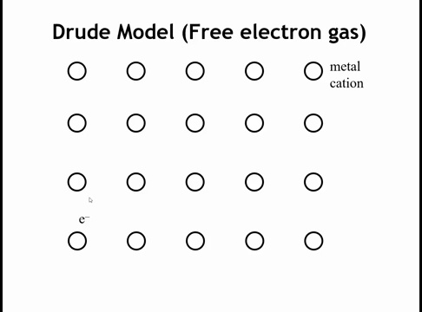
Notes:
The Drude model (Paul Drude, 1900) predates quantum mechanics. It treats metals as arrays of metal cations surrounded by a sea of valence electrons—for example, sodium as Na+ ions in a sea of electrons. While simple and not accurate, it provides a quantitative starting point by treating valence electrons as an ideal gas and applying kinetic molecular theory.

Slide 7
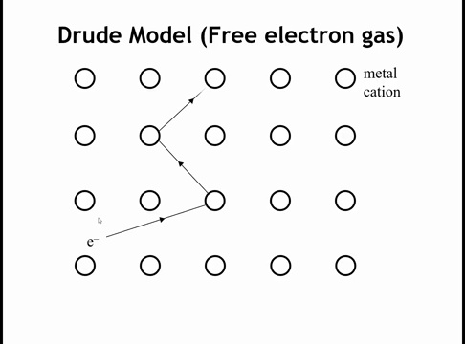
Notes:
So the electrons are moving very fast, but in some ways they're not really going anywhere because the electron moves fast and then it keeps colliding with the ions of the lattice. And every time it collides with one of the ions in the lattice, it redirects its path. And so over time, there's no net flow of current in one direction or the other in the absence of an external driving force.

Slide 8
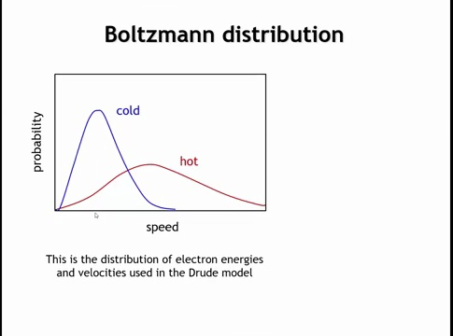
Notes:
Treating electrons as an ideal gas means using the Maxwell-Boltzmann distribution to describe electron speeds versus the number of electrons at each speed. For a cold gas, the distribution peaks at lower speeds, concentrated around the average. For a hot gas, it spreads out and shifts to higher speeds. (Similar effects occur for heavy versus light atoms, but here we're considering electrons.)

Slide 9
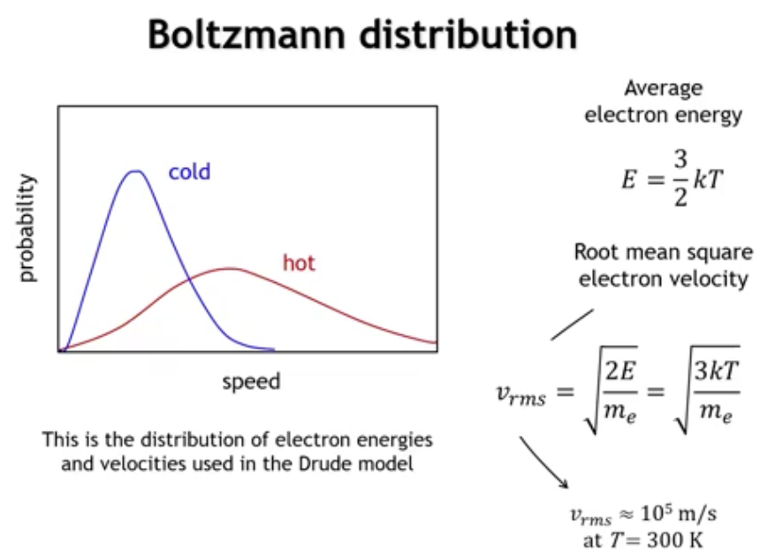
Notes:
In a Boltzmann distribution, average energy is E = (3/2)kT. From kinetic energy E = (1/2)mv², we can solve for velocity: v = √(2E/m). Substituting the Boltzmann energy expression gives v = √(3kT/m_e). At room temperature (300 K), this yields approximately 100,000 m/s for electrons—extremely fast because they're so light.

Slide 10
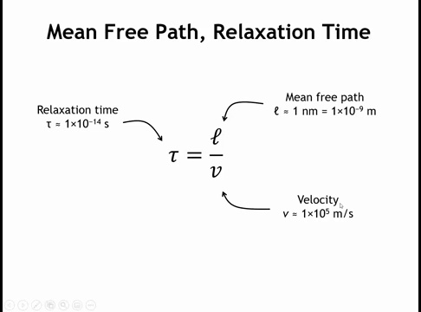
Notes:
Mean free path: distance an electron travels before colliding with a stationary ion. Relaxation time (τ): time between collisions = mean free path / velocity.
Using v ≈ 100,000 m/s from the previous slide and estimating mean free path ≈ 1 nm (about two unit cells in close-packed metals), we get relaxation time τ ≈ 1×10^-14 s—seemingly reasonable.

Slide 11
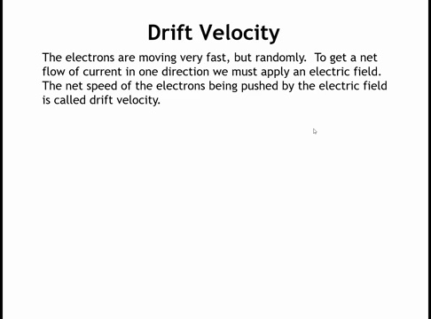

Slide 12
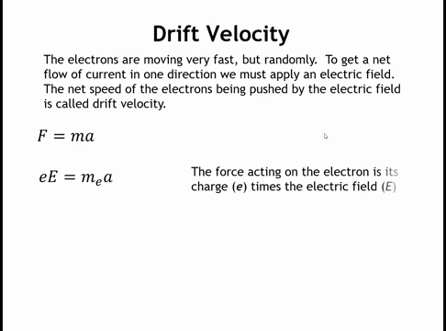

Slide 13
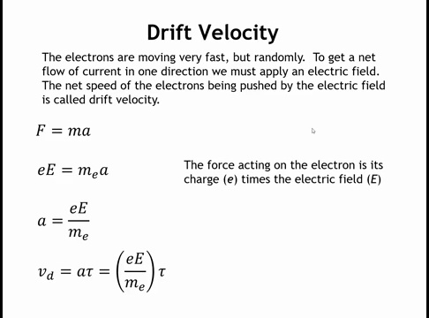

Slide 14
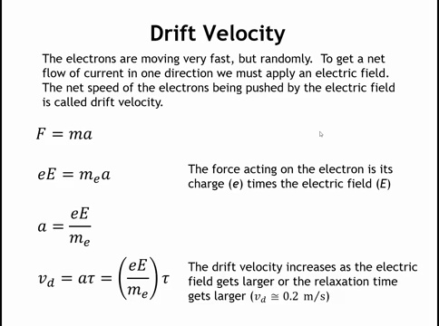
Notes:
Applying an electric field drives current flow. We need the drift velocity—the net speed in the field direction, not the thermal velocity.
From Newton's law, force on an electron: F = ma = -eE (charge × field). Rearranging: a = -eE/m_e.
Drift velocity: v_d = aτ = -eEτ/m_e (acceleration × relaxation time).
Example: With E = 100 V/m and τ ≈ 10^-14 s, v_d ≈ 0.2 m/s—much smaller than the thermal velocity (~100,000 m/s) because electrons keep colliding with ions. Increasing relaxation time (longer travel between collisions) increases drift velocity and current.

Slide 15
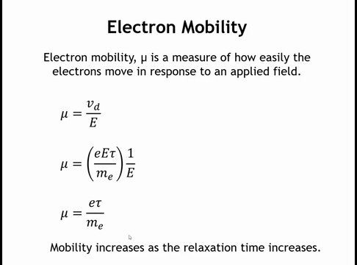
Notes:
Electron mobility (μ) measures how easily electrons move in response to an applied field: μ = v_d/E.
High mobility: large drift velocity from modest field. Low mobility: larger field needed for same response.
From the previous slide (v_d = -eEτ/m_e), substituting gives: μ = -eτ/m_e. The electric field cancels—mobility is an intrinsic material property, independent of applied field strength.
Longer relaxation time increases mobility. For high conductivity, electrons must avoid frequent scattering from ions.

Slide 16
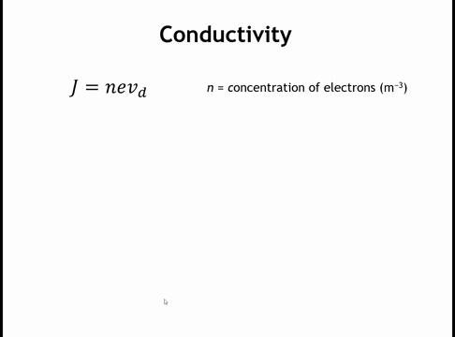
Notes:
In the Drude model, current density: J = nev_d, where n is the concentration of valence electrons, e is electron charge, and v_d is drift velocity.
Units check: (m^-3)(C)(m/s) = C/(s·m²) = current density.

Slide 17
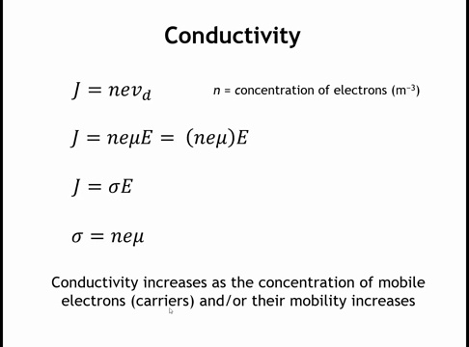
Notes:
Rewriting drift velocity as v_d = μE and substituting into J = nev_d gives: J = (neμ)E.
Comparing with intrinsic Ohm's law (J = σE), we find: σ = neμ.
Conductivity equals carrier concentration × charge × mobility. For higher conductivity, increase either the concentration of mobile electrons or their mobility.

Slide 18
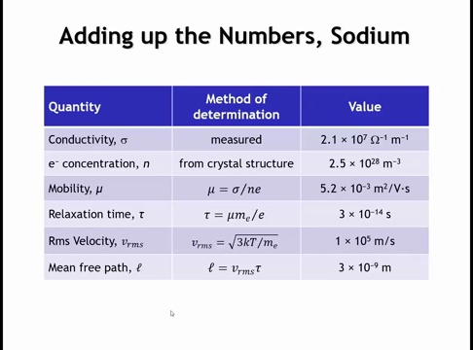
Notes:
For sodium (one valence electron per atom): measured conductivity is 2.1×10^7 S/m. Assuming each sodium contributes one electron, electron concentration n = 2.5×10^28 m^-3 (from crystal structure density).
From σ = neμ, we calculate mobility μ = 5×10^-3 m²/(V·s). From mobility, relaxation time τ = 3×10^-14 s (close to our earlier estimate). Using velocity from the Boltzmann distribution and τ, mean free path = 3 nm. This seems reasonable (our initial guess was 1 nm—electrons might travel 5-6 unit cells before collision).
However, the Drude model has limitations: it doesn't correctly predict that metals become more conductive at low temperatures (counterintuitive since electrons slow down), nor does it explain why alloys have reduced conductivity compared to pure metals.

Slide 19
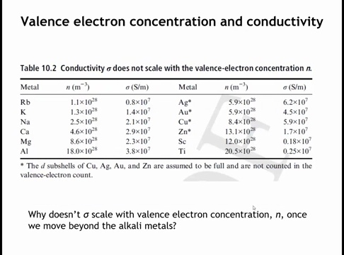

Slide 20
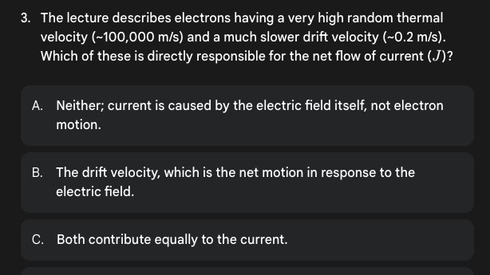

Slide 21
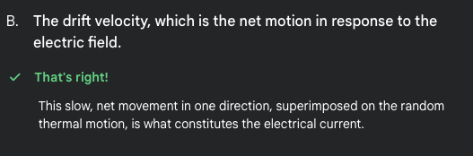

Slide 22
Homework:
10.1-10.4, 10.8, 10.9, 10.10

Slide 23
Learning Objectives
Quantum Mechanics and Metallic Conductivity
Explain the transition from the Drude model to the free electron model and identify the key quantum mechanical principles incorporated in the free electron model
Describe the parabolic E(k) relationship in the free electron model and relate it to the particle-in-a-box treatment
Connect effective mass (m*) to band curvature and predict how band structure affects carrier mobility and conductivity
Apply the Fermi-Dirac distribution to explain which electrons contribute to electrical conductivity and why only states near the Fermi level matter
Explain the temperature dependence of metallic conductivity, including the role of phonon scattering and residual resistivity
Predict relative conductivities across the periodic table by analyzing band structure, particularly distinguishing between d-band and s-band contributions to transport
Justify why coinage metals (Cu, Ag, Au) exhibit exceptionally high conductivities compared to transition metals based on their electronic band structures

Slide 24
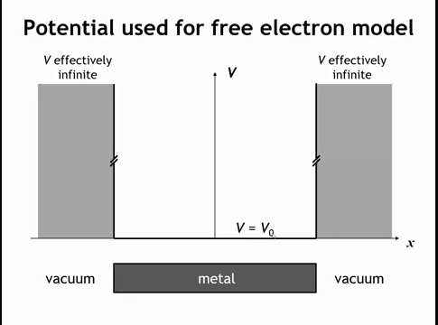
Notes:
So the idea behind the free electron model is almost analogous to the particle in a box treatment that you see when you take physical chemistry. We're going to say that our crystal has a certain potential, which we're going to call V0, when the electron is in the crystal. And the potential of the electron leaving the crystal, we're going to say is infinite. So the electrons are trapped inside the crystal.

Slide 25
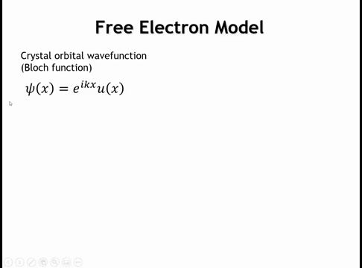
Notes:
What is the crystal orbital wave function? Recall from Chapter 6 that the Bloch function states the wave function of a crystal orbital equals e^(ikx) multiplied by a basis set function of x. We'll work in one dimension for simplicity.

Slide 26
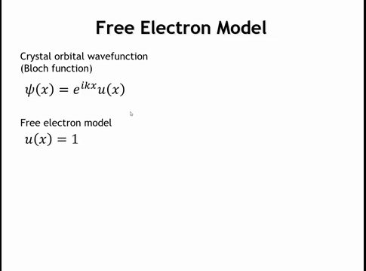
Notes:
In the free electron model, we set the basis set to unity. By assuming constant potential throughout the crystal, we effectively ignore the nuclei and their attractive forces—meaning we disregard atomic orbitals and bonding entirely. We simply confine electrons within the crystal boundaries. With this simplification, the wave function reduces to e^(ikx).

Slide 27
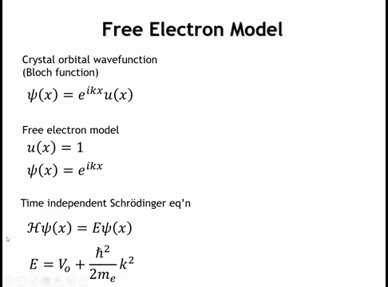
Notes:
Applying this wave function to the time-independent Schrödinger equation yields:
E = V₀ + (ℏ²/2mₑ)k²
where k is the crystal momentum—the quantum number discussed extensively in Chapter 6.

Slide 28
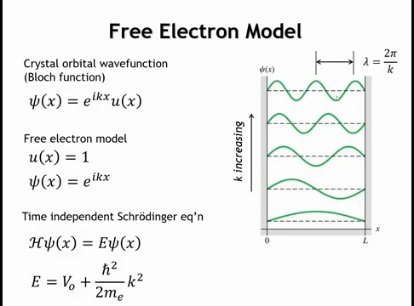
Notes:
Plotting the wave functions that solve the Schrödinger equation yields results analogous to the particle-in-a-box problem. At k = 0, the wave function equals 1—a straight line across the crystal. As k increases, the wave function oscillates more frequently. Recall that wavelength λ = 2π/k, so larger k means shorter wavelengths and more oscillations in the wave function. Now let's examine how the energies of these wave functions vary with k.

Slide 29
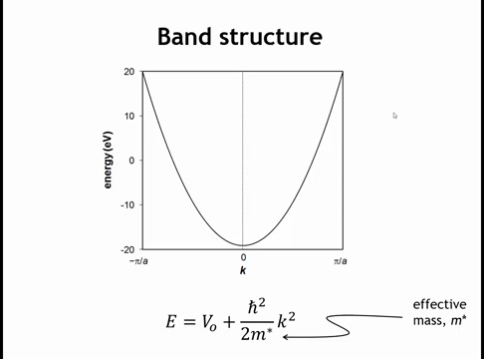
Notes:
Here's the free electron model band structure. The expression E = V₀ + (ℏ²/2m*)k² produces a parabola: larger k values mean more wave function oscillations across the crystal and higher energy.
Note that m* represents the effective mass—a tunable parameter rather than the fundamental electron mass. The effective mass determines band width: small m* yields steep, wide bands; large m* produces narrow, shallow bands.

Slide 30
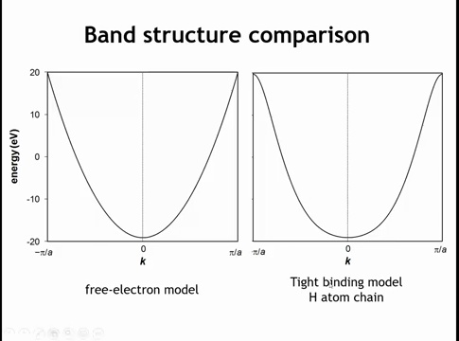
Notes:
Comparing the free electron model to the tight binding model from the hydrogen atom chain shows reasonable agreement given the model's simplicity. There are key differences, though. The tight binding model exhibits band flattening near the edges, while the free electron model is purely parabolic. We used adjustable parameters—V₀ and m*—to match the band minimum position and width.
While the hydrogen chain's band minimum was approximately parabolic, the free electron model treats it as exactly parabolic. This approach cannot capture features arising from p or d orbitals or multi-atom unit cells. However, it effectively models metals whose bands derive primarily from s-orbital overla

Slide 31
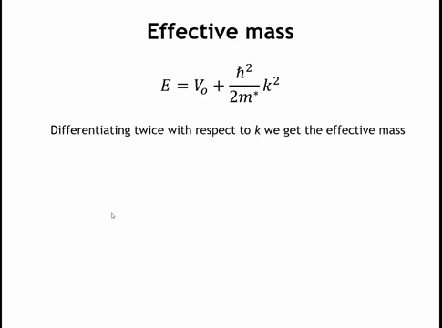
Notes:
Now let's dig a little bit deeper behind this m star, the effective mass. This is our expression for the energy of any crystal orbital in the band structure.

Slide 32
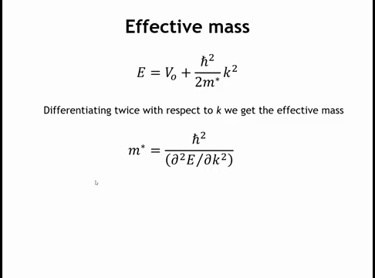
Notes:
If I were to take the second derivative of this function with respect to k, then the term on the right is just going to be reduced to h bar squared over m star. And then the term on the left is going to be the second derivative of the e versus k function with respect to k. What does this do for us?

Slide 33
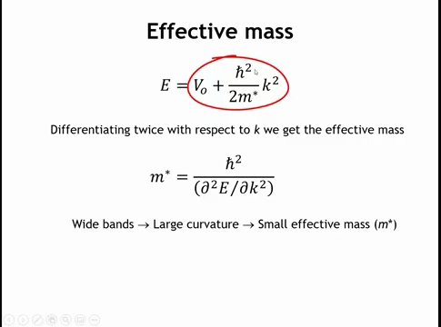

Slide 34
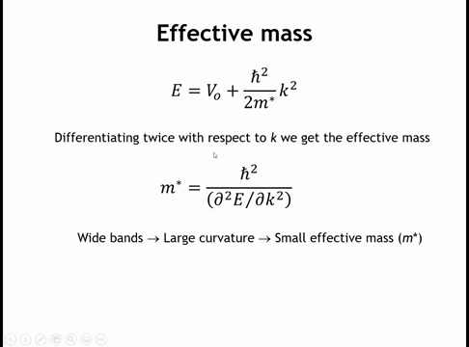
Notes:
This relationship connects effective mass to band curvature. Wide bands have large curvature, meaning the second derivative of E versus k is large, which gives a small effective mass. Conversely, flat bands have small curvature, so the second derivative is small. This small curvature in the denominator yields a large effective mass.

Slide 35
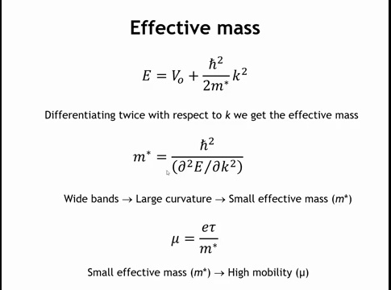
Notes:
We can also relate mobility to effective mass. The mobility expression is μ = eτ/m, where e is electron charge, τ is relaxation time, and m is mass. Substituting effective mass m* shows that small effective mass yields high mobility. Since mobility is a key factor determining conductivity, wide bands with large curvature produce small effective mass, leading to high mobility and therefore high conductivity—at least that's half of the conductivity equation.

Slide 36
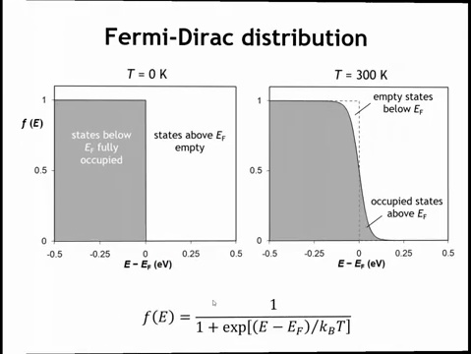
Notes:
The other half of the conductivity equation is the concentration of electrons that can move in response to an applied electric field. The Drude model assumed all valence electrons could respond, but that's not accurate. We need to consider how much energy it takes to excite an electron from a filled crystal orbital to an empty one. This is where the Fermi-Dirac distribution function comes in.
At zero Kelvin, all states below the Fermi level are fully occupied and all states above are empty. At finite temperatures, this sharp boundary smears out. The Fermi-Dirac function describes this smearing: some crystal orbitals above the Fermi level become occupied, while some below become empty. This means an electron very close to the Fermi level can be thermally excited into an empty state. However, an electron half an eV below the Fermi level is too far away to be thermally excited. As temperature increases, this smearing becomes more pronounced.

Slide 37
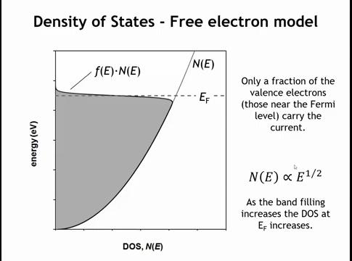
Notes:
Multiplying the Fermi–Dirac distribution by the density of states in the free-electron model produces this curve. Because the density of states increases with the square root of energy, two key points emerge.
First, not all valence electrons can respond to an applied electric field—only those near the Fermi level, within a few percent of the total. This might suggest that the concentration of mobile carriers is roughly similar in different metals. However, as more electrons are added, the Fermi level moves higher into the band, where the density of states is larger. Even though only a small fraction of electrons can respond, the absolute number of mobile carriers rises.
This explains the conductivity trend among the alkali metals: sodium conducts better than potassium, which conducts better than rubidium. As we move to smaller, more densely packed atoms, the same number of valence electrons occupy a smaller volume, so the electron density increases. A higher electron density pushes the Fermi level up to higher energies, where the density of states is larger. Although only electrons near the Fermi level can move, a higher density of states there means more mobile electrons in total, giving better conductivity.

Slide 38
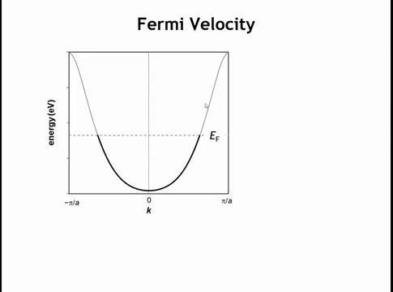
Notes:
Now what about the speed of the electron? That's another parameter that's going to be important in figuring out the conductivity. In the derivative model, it was a Maxwell-Boltzmann distribution of speeds. In the free electron model, it's actually dependent upon K.

Slide 39
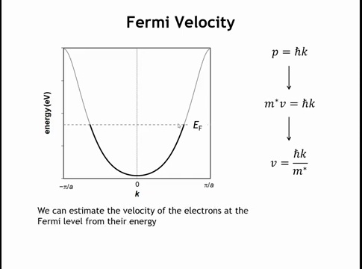
Notes:
We know the electron's momentum equals ℏ times k, its reciprocal space wave vector. Since momentum also equals mass times velocity, we can write mv = ℏk, where m is the effective mass. Solving for velocity gives v = ℏk/m*.
The key takeaway is that velocity depends on k. Electrons in states near k = 0 have almost no velocity—at k = 0, the velocity is exactly zero. As k increases toward the band edge where filling stops, the velocity becomes much higher. So what is the velocity of electrons at the Fermi level?

Slide 40
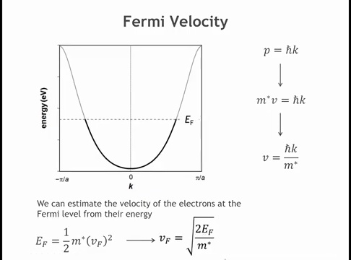
Notes:
Well, we can make an estimate of that. If we say that the energy is equal to 1 half m v squared, that's kinetic energy expression. And we take the energy to be the Fermi energy, then we call the velocity of those electrons the Fermi velocity. And we can solve for the Fermi velocity. And we get the square root of two times the Fermi energy divided by the effective mass.

Slide 41
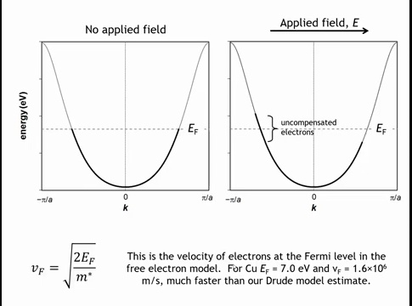
Notes:
In the free electron model, we can calculate the Fermi energy from atomic density and use it to estimate the velocity of electrons at the Fermi level. For copper, this velocity is 1.6 × 10^6 meters per second—more than an order of magnitude faster than the 1 × 10^5 meters per second we estimated in the Drude model. Crucially, these fast-moving electrons near the Fermi level are the ones that matter for conductivity.
Here's why. When we apply an electric field with a positive end and negative end, electrons with negative k values traveling leftward are attracted to the positive charge. Meanwhile, electrons with positive k values traveling rightward are repelled by the negative charge. This shifts the electron distribution, creating more electrons moving in one direction than the other. These uncompensated electrons—the ones without a corresponding electron traveling in the opposite direction to cancel them out—carry the electrical current. And these uncompensated electrons are located near the Fermi energy.
So while far fewer electrons can move when we apply an external voltage compared to the Drude model, those that do move are traveling much faster. These two effects largely compensate for each other, giving similar conductivity predictions from both models.

Slide 42
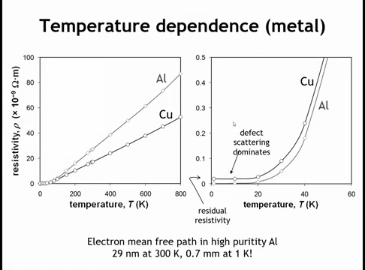
Notes:
However, there are important differences between the models. One is the temperature dependence of metals. Plotting the resistivity of aluminum and copper versus temperature shows that resistivity decreases as temperature drops. In other words, metals become more conductive at lower temperatures, and for simple metals this relationship is actually linear.
The Drude model predicts the opposite. It suggests electrons slow down at low temperature, which would decrease conductivity, not increase it. This contradicts experimental observations. What actually happens is not that electron speed changes significantly, or that the number of electrons responding to an external field differs much. Instead, at low temperatures the atoms vibrate much more slowly. These reduced thermal vibrations mean electrons scatter less frequently from ion cores, and this reduced scattering increases conductivity.
Back-of-the-envelope calculations show that in high-purity aluminum at room temperature, the mean free path is about 29 nanometers—ten times longer than the Drude model estimate. At very cold temperatures, electrons can travel almost a millimeter before colliding with an ion core, which is an incredible distance.
At very low temperatures, conductivity levels off and becomes nearly constant. This plateau is called the residual resistivity. And where that comes from is actually from impurities in the metal.

Slide 43
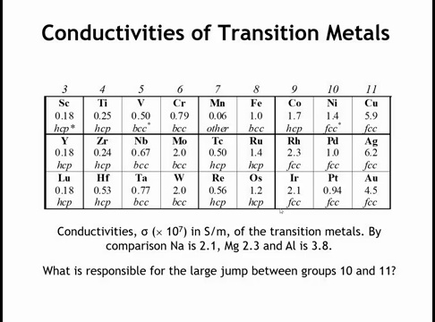
Notes:
Electrons are scattered by two mechanisms as they move through the lattice in response to an external field: vibrating atoms displaced from their proper positions, and defects or impurities in the crystal. At very cold temperatures, scattering from atomic vibrations becomes negligible, and defect scattering dominates. The temperature at which this transition occurs reflects crystal quality. This is the residual resistivity.
Now we can address the conductivities of transition metals. At room temperature, sodium's conductivity is about 2 × 10^7 Siemens per meter. Magnesium is similar, aluminum about 4 × 10^7. Most transition metals have much lower conductivities. The early transition metals fall well below this range, except perhaps molybdenum and tungsten, which approach magnesium and sodium. Groups eight and nine show respectable values. Group ten drops again. But group eleven—the coinage metals—suddenly jumps up by a factor of four to six.
What explains this? Why are copper and silver the kings of conductivity while manganese, titanium, and yttrium are poor conductors? Let's examine the band structure.

Slide 44
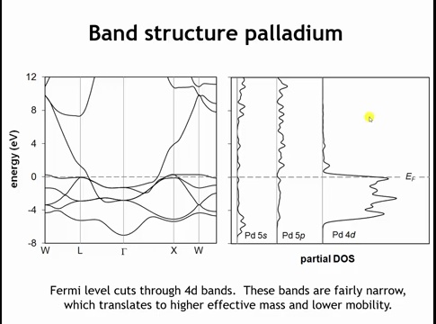
Notes:
We're now coming full circle. The Drude model was too simplistic. The free electron model is better—it incorporates quantum mechanics but ignores bonding entirely, so it can't distinguish one material from another. Now let's examine what the true band structure reveals.
Here's the band structure for palladium, which has a face-centered cubic structure. There's a wide band with significant S character—similar to our free electron band. Below that are five narrower, less dispersed bands. The partial density of states plots show these are the palladium 4d bands. At very high energy, almost irrelevantly high, are bands with P character. The key point is that the Fermi level cuts through several relatively flat bands with d orbital character.
What happens when we move to silver? That's one element to the right in the periodic table with one additional valence electron.

Slide 45
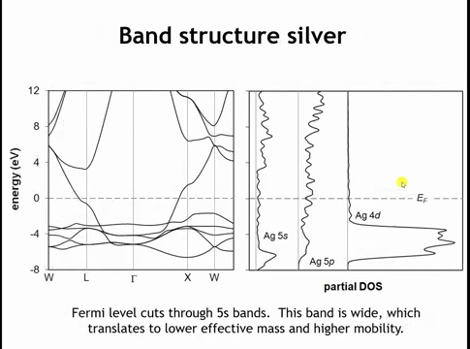
Notes:
Silver also has a cubic close-packed structure, the same as palladium, but with one additional electron per atom. This extra electron raises the Fermi level. Now the Fermi level no longer cuts through the d bands—they're completely filled. Instead, it cuts through the wide S-like band.
This S band is roughly 12 electron volts wide, compared to the d bands at about 2 electron volts wide. Remember, wide bands lead to small effective masses, which produce high mobilities. The key to this periodic variation is that once we move beyond the d bands and fill the S bands again, mobility increases dramatically. This increased mobility gives us much higher conductivity.

Slide 46
Homework:
10.5-10.7

Slide 47
Go to gradescope quiz.

