Slide 1
Learning Objectives
Band Structures of Transition Metal Oxides
Describe the crystal structure of ReO₃ and its relationship to perovskite structures
Construct band structure diagrams from molecular orbital diagrams for octahedral transition metal complexes
Identify and interpret oxygen 2p bands and metal d bands (π* and σ*) at special k-points
Extract key energetic parameters from band structures: octahedral ligand field splitting, charge transfer energy, and band gap
Predict periodic trends in band structure when moving across the periodic table (changing electronegativity and covalency)
Analyze the competing effects of spatial overlap versus energetic overlap when moving down the periodic table (3d vs 4d vs 5d)
Electronic Band Structures | Materials Science & Chemistry

Slide 2
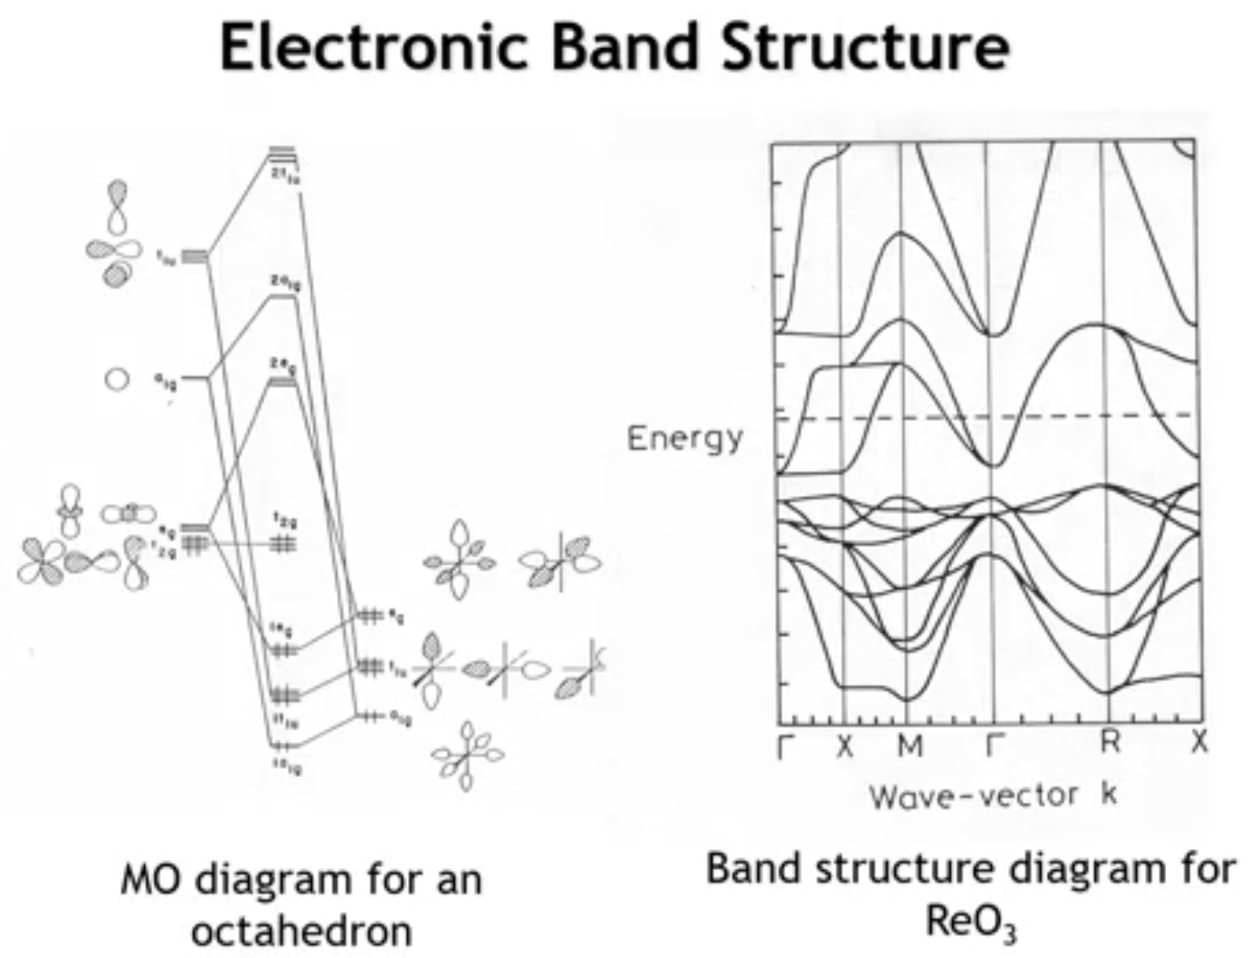
Notes:
Returning to the introductory slide from our electronic band structure study: our goal was to progress from a molecular orbital diagram—specifically for an octahedron—to the band structure of a three-dimensional solid. The example band structure diagram shown was for rhenium trioxide. We're now positioned to understand that diagram, marking significant progress.

Slide 3
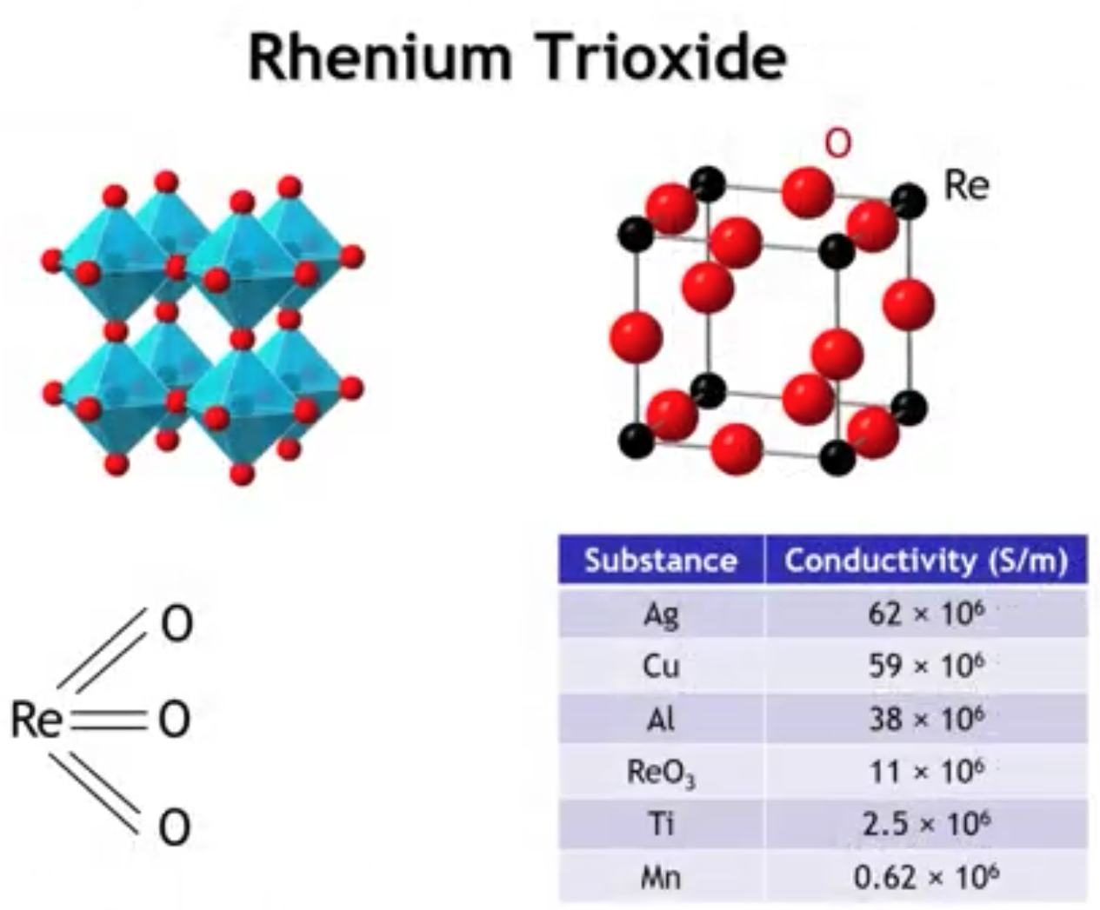
Notes:
Rhenium trioxide, discussed in Chapter 1, has a primitive cubic Bravais lattice: metals at unit cell corners, oxygens at edge centers. This builds an infinite network of corner-connected octahedra, with six-coordinate rhenium and two-coordinate oxygen.
Regarding electrical conductivity, rhenium trioxide is exceptional. While less conductive than silver or copper, it's substantially more conductive than early transition metals like titanium or manganese, and post-transition metals like bismuth. For an oxide—typically an ionic compound—this electrical conductivity is remarkable.

Slide 4
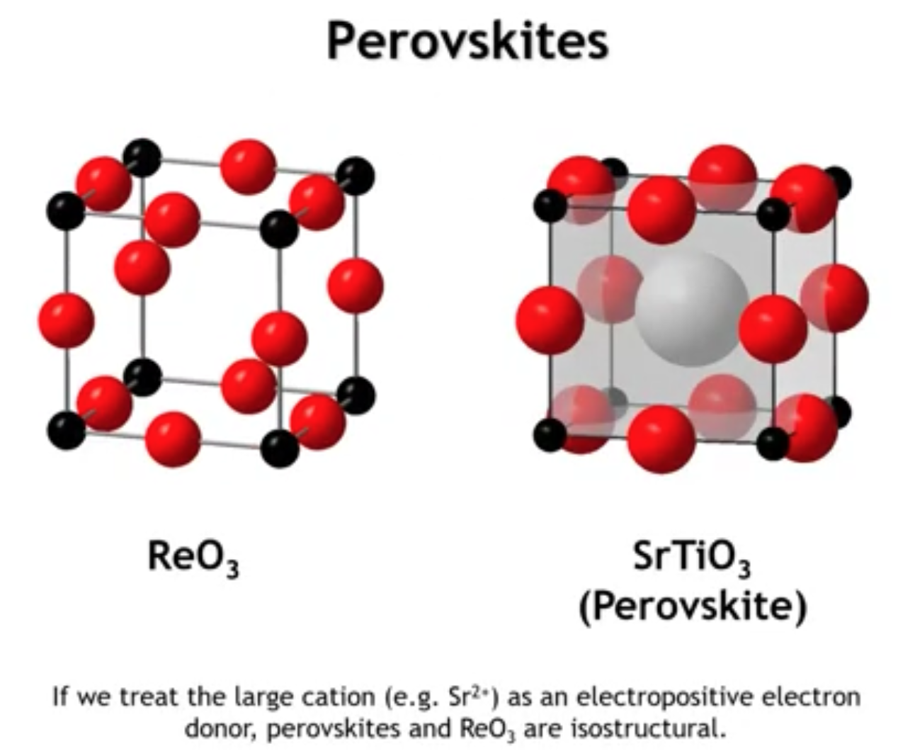
Notes:
The rhenium trioxide structure closely relates to the perovskite structure. The difference: perovskites like strontium titanate add a large electropositive cation (strontium) at the unit cell center within the cuboctahedral cage. This cation forms ionic bonds with the anions and, in the limit, simply donates its electrons to the metal-oxide framework. Under this approximation, perovskite band structures become analogous to rhenium trioxide band structures, so we'll treat them as essentially equivalent.

Slide 5
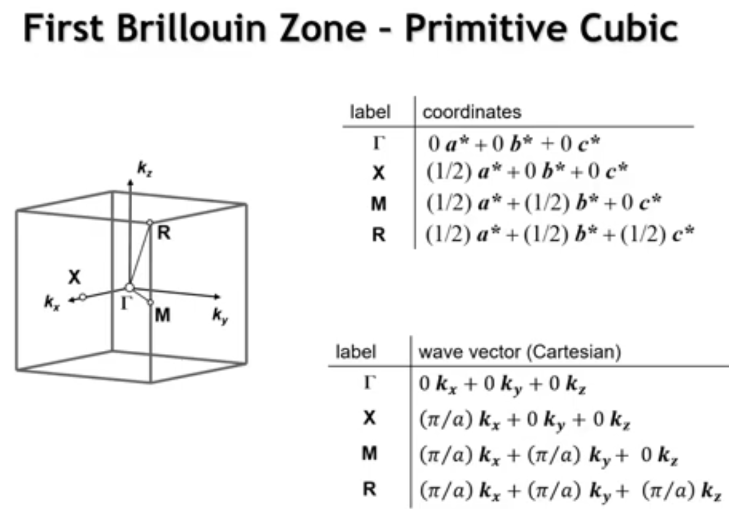
Notes:
A key advantage: the primitive cubic lattice yields a simple, easily understood primitive cubic first Brillouin zone. We covered this Brillouin zone in our first lecture on three-dimensional crystal structures when discussing alpha-polonium. If the special points are unclear, review that lecture.
Remember – the first Brillouin zone is defined as the points at ½ each of the lattice vectors, which is the point at which the scalar values of k = pi/a

Slide 6
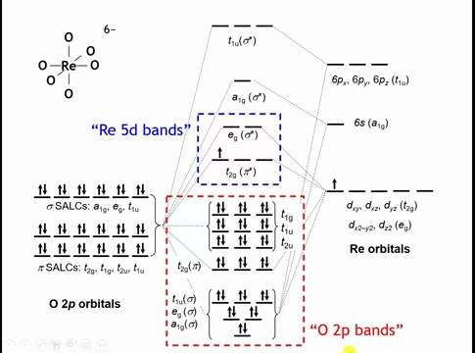
Notes:
Here's the molecular orbital diagram for a rhenium-centered octahedron (Chapter 6). Neglecting oxygen 2s orbitals (because of energy mismatch), we have 18 oxygen 2p SALCs (6×3) and five rhenium d-orbitals, plus higher-lying 6s and 6p orbitals.
From lowest to highest energy: rhenium-oxygen bonding MOs, then non-bonding oxygen 2p MOs (oxygen SALCs lacking rhenium partners), then antibonding rhenium 5d-oxygen 2p states split by the octahedral crystal field into triply degenerate t2g (π antibonding) and doubly degenerate eg (σ antibonding), and finally antibonding 6s and 6p states.
We'll focus on orbitals near the Fermi level (near HOMO/LUMO): the oxygen 2p and rhenium 5d bands. Note the molecular orbital diagram doesn't reliably predict band count because the Re:O ratio differs between an isolated octahedron and the extended solid where oxygens are shared between octahedra.

Slide 7
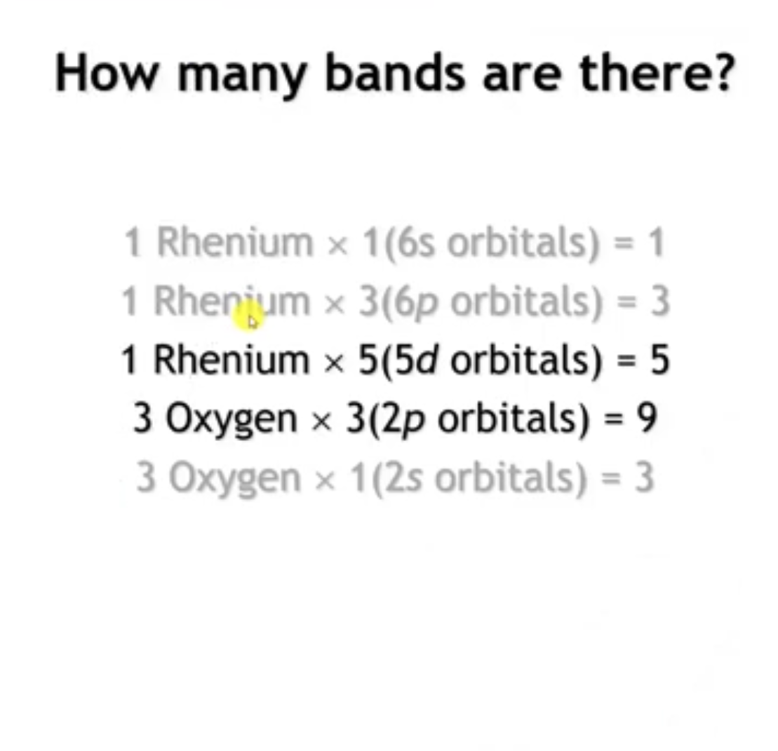
Notes:
The unit cell contains one rhenium and three oxygens, yielding: three oxygen 2s bands, nine oxygen 2p bands (3×3), five rhenium 5d bands, three rhenium 6p bands, and one rhenium 6s band. Neglecting the low-lying oxygen 2s and higher-lying rhenium 6s/6p bands, we focus on the oxygen 2p (nine bands) and rhenium 5d (five bands).

Slide 8
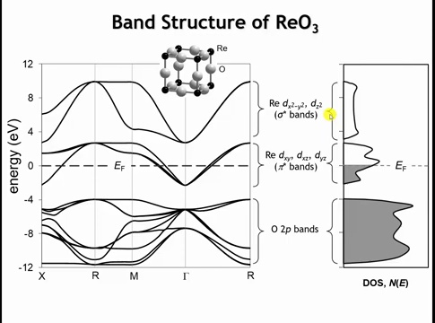
Notes:
The calculated band structure shows nine oxygen 2p bands at the bottom (three oxygens × three p orbitals each). High-energy regions correspond to oxygen 2p non-bonding states, while lower-energy regions reflect bonding with rhenium (bandwidth ~8 eV).
Three bands with rhenium 5d parentage are the t2g bands (from dxy, dxz, dyz)—called the π* bands. Since Re6+ is d1, these bands are one-sixth filled (, placing the Fermi level within them. At highest energy are more rhenium 5d bands from dx²-y² and dz² (the eg set, σ antibonding).
Each oxygen has 6 valence electrons (2s² 2p⁴). With three oxygens per unit cell, that's 18 electrons from oxygen. These 18 electrons completely fill the nine oxygen 2p-derived bands (each band holds 2 electrons with spin).
The Re6+ ion (d¹) contributes just 1 additional electron. Since the oxygen 2p bands are already full, this electron must occupy the lowest unoccupied states, which are the t2g (π*) bands.
Now let's examine crystal orbitals at various special points.

Slide 9
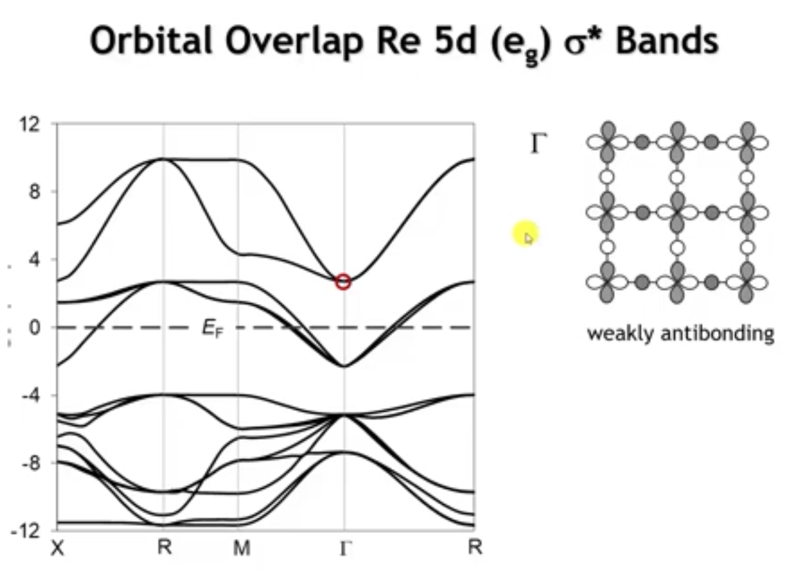
Notes:
Starting with the σ* bands (highest energy), at Γ the dx²-y² orbital overlaps with oxygen. As discussed for the copper-oxygen layer, the two oxygen p orbitals cannot mix with dx²-y² at Γ (net non-bonding). However, oxygen 2s does contribute (shown here), making this crystal orbital weakly antibonding.

Slide 10
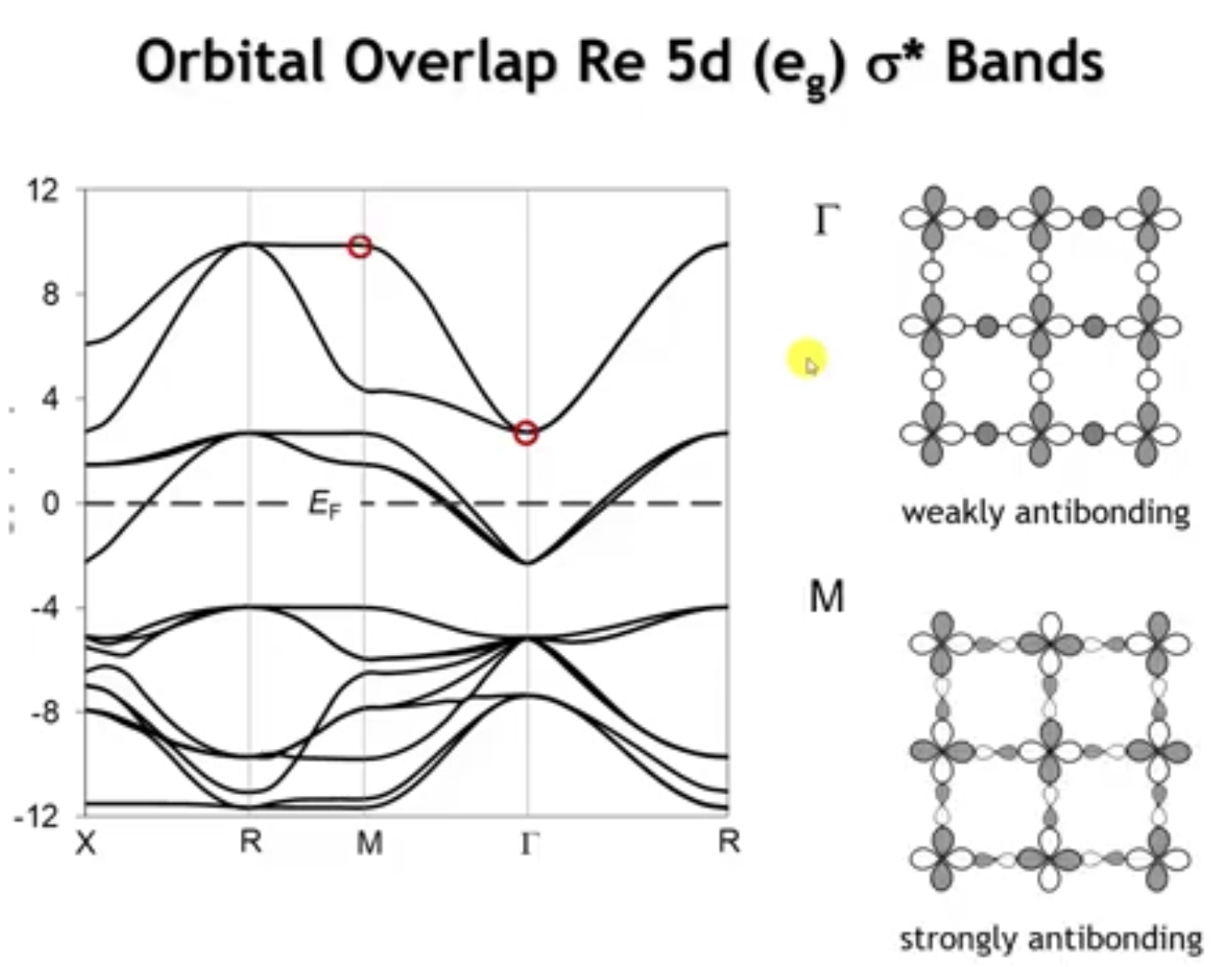
Notes:
Starting with the σ* bands (highest energy), at Γ the dx²-y² orbital overlaps with oxygen. As discussed for the copper-oxygen layer, oxygen p orbitals cannot mix with dx²-y² at Γ. However, oxygen 2s contributes, making this crystal orbital weakly antibonding—weak because oxygen 2s lies tens of eV below oxygen 2p and has poor energetic overlap with rhenium 5d.
Moving to the M point, energy increases substantially (wide bandwidth). The crystal orbital is now σ antibonding. This large energy increase occurs because at M, oxygen 2p orbitals (which have good energetic overlap with rhenium 5d) can now interact in a σ* fashion, unlike at Γ.

Slide 11
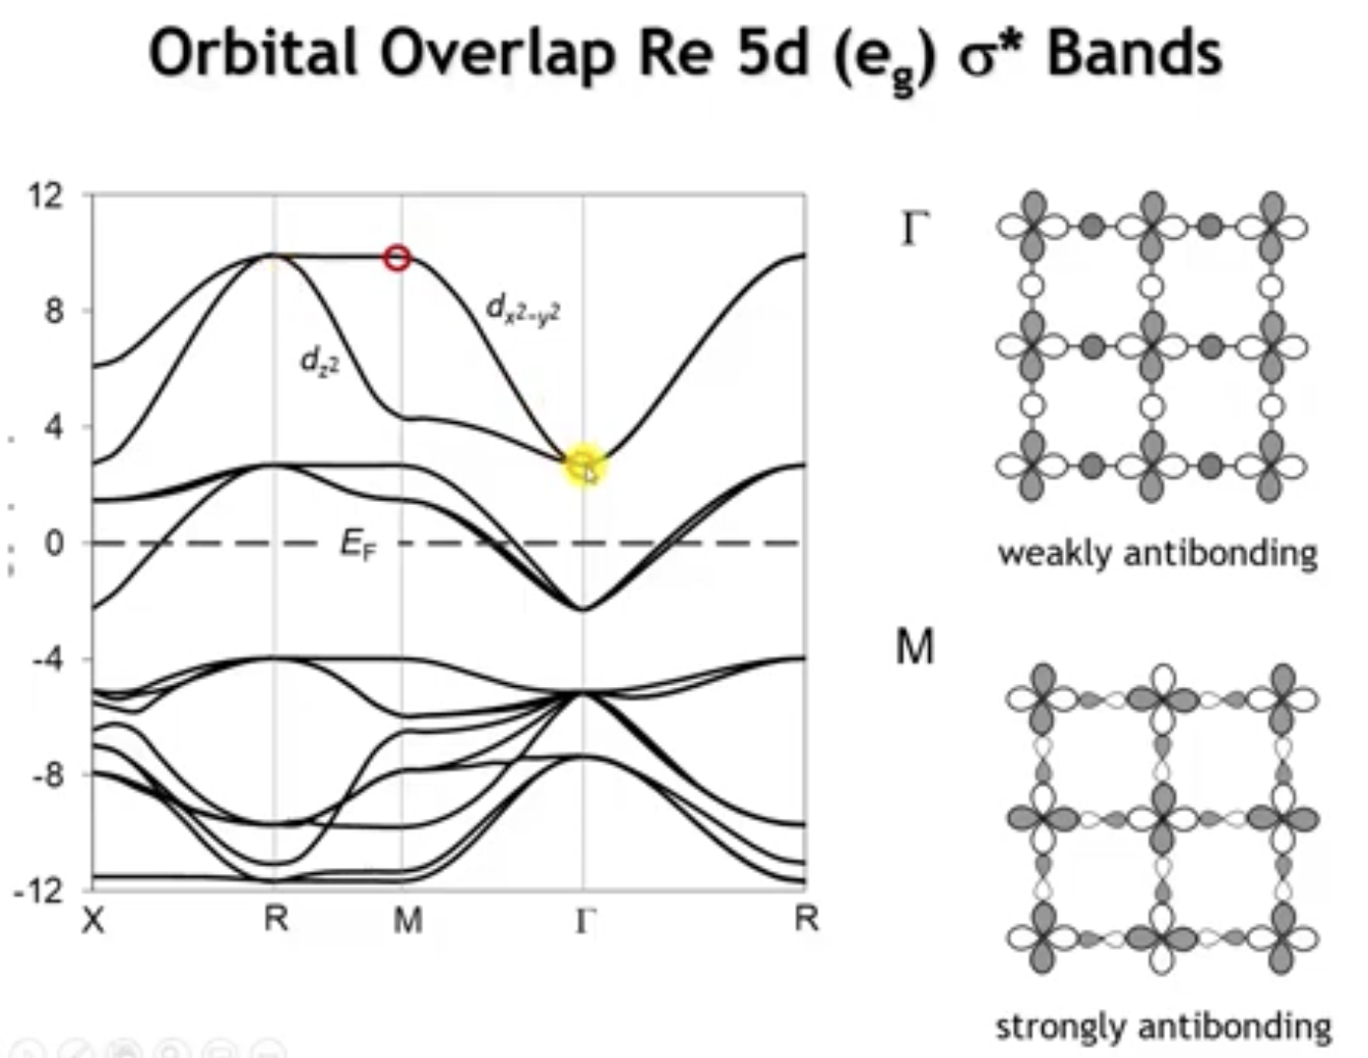
Notes:
This analysis identifies the discussed band as dx²-y², making the other σ* band dz² by default. They're degenerate at Γ and at R. Note: if these orbital overlap arguments seem fast, review the copper oxide layers lecture—the CuO2 layer overlaps are nearly identical to what occurs here in the xy plane.

Slide 12
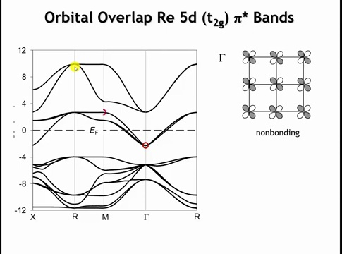
Notes:
Moving to the t2g (π*) bands: at Γ, the dxy orbital cannot overlap with oxygen 2p or 2s orbitals by symmetry, making this band entirely rhenium 5d non-bonding. The dxz and dyz bands are likewise completely non-bonding at Γ, explaining why all three bands are degenerate there.

Slide 13
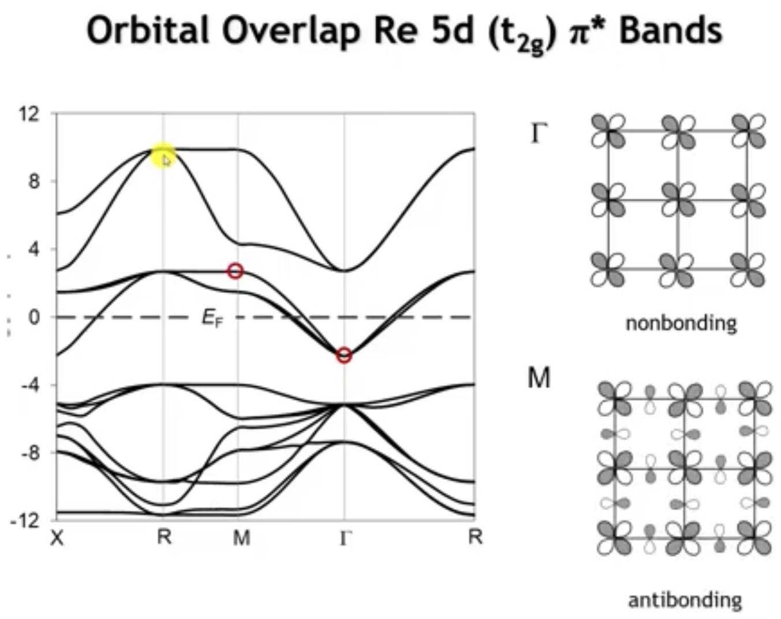
Notes:
Moving to M, antibonding π character develops, significantly increasing energy. At Γ (no phase change between unit cells) and R (phase changes with every unit cell translation in any direction), these three orbitals remain degenerate.

Slide 14
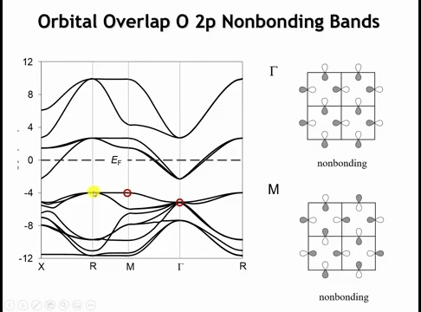
Notes:
Finally, examining the highest-energy oxygen 2p bands (mostly non-bonding): at Γ, the crystal orbital shows no bonding/antibonding between oxygens, and no rhenium s, p, or d orbitals have the correct symmetry to overlap—it's purely non-bonding.
At M, changing orbital phases along x or y doesn't alter this picture; these orbitals still lack the proper symmetry to mix with rhenium d, p, or s orbitals. A very weak π overlap with rhenium p orbitals is possible, explaining the slight energy changes from Γ to M to R.

Slide 15
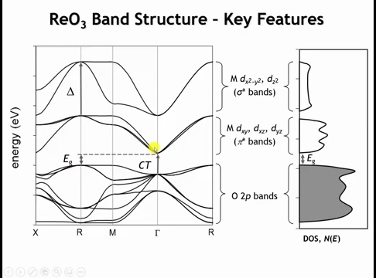
Notes:
This perovskite band structure reveals key bonding information through specific energy differences:
At R, where both t2g and eg orbitals are entirely antibonding with oxygen, their energy splitting equals the octahedral ligand field splitting (Δo) from the molecular orbital diagram.
At Γ, where both oxygen 2p and rhenium 5d states are non-bonding, their energy difference approximates the charge transfer energy from oxygen to rhenium. The σ* bands don't drop to this non-bonding level due to antibonding interaction with oxygen 2s, raising energy by several eV.
The energy difference between the highest oxygen 2p state (at R) and lowest rhenium 5d state (at Γ) becomes the band gap in d0 compounds like SrTiO3. This band gap is inherently indirect since the valence band maximum and conduction band minimum occur at different k-points.

Slide 16
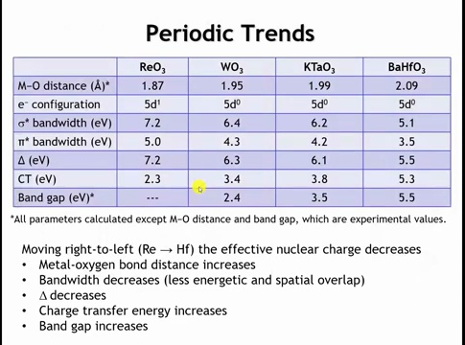
Notes:
Examining four cubic metal-oxygen frameworks moving right to left across the periodic table—Re, W, Ta, Hf with charges 6+, 6+, 5+, 4+ respectively (ReO3, WO3, KTaO3, BaHfO3)—reveals periodic trends. Band structures are qualitatively similar but differ quantitatively due to changing metal electronegativity and bond distances.
As effective nuclear charge decreases, metal-oxygen bond distances increase and covalency decreases (more ionic character). This causes two effects: (1) antibonding orbitals become less antibonding, narrowing σ* and π* bandwidths, and (2) longer bonds reduce spatial overlap. The octahedral ligand field splitting (Δo) also decreases.
Charge transfer energy increases with decreasing metal electronegativity (Re more electronegative than Hf). From Re to Hf, bonds become substantially more ionic (Hf more positively charged)—a significant change. This increased ionicity enlarges the band gap in d0 systems, since the band gap represents an oxygen-to-metal charge transfer.

Slide 17
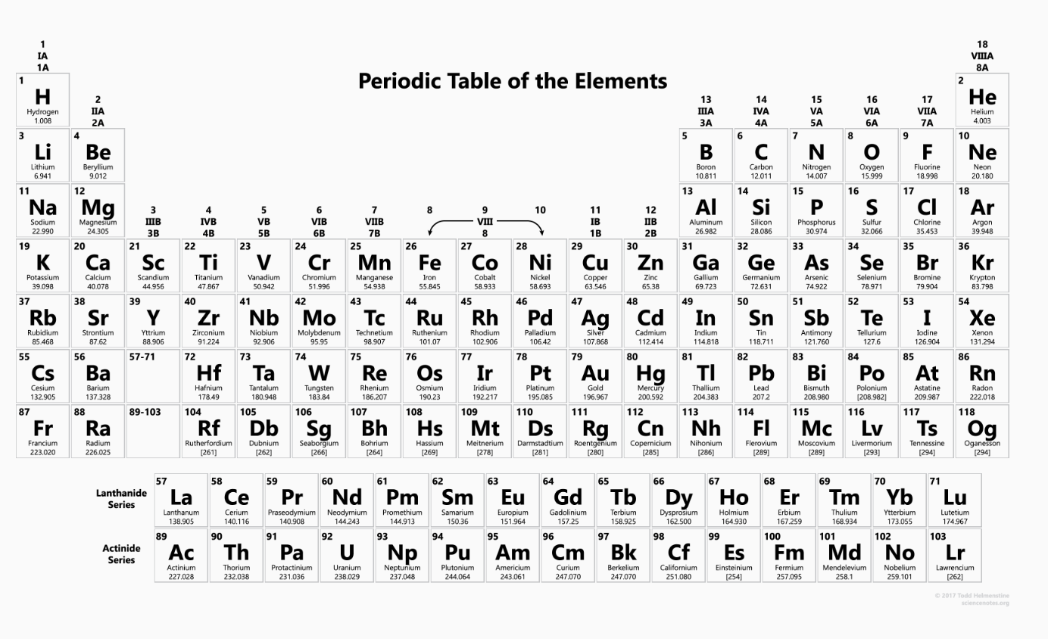

Slide 18
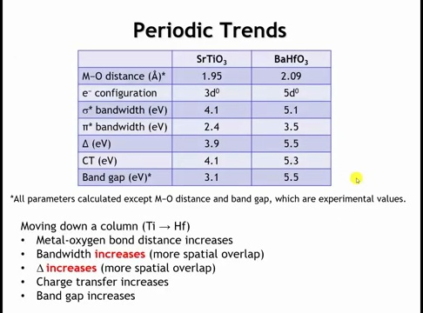
Notes:
Moving vertically in the periodic table: comparing SrTiO3 with BaHfO3 (Ti and Hf are both group 4).
Charge transfer energy increases from 4.1 eV (SrTiO3) to 5.3 eV (BaHfO3), indicating titanium is more electronegative than hafnium—better energetic overlap between Ti and O.
However, BaHfO3 shows larger bandwidths despite poorer energetic overlap. This occurs because 5d orbitals (Hf) extend farther from the nucleus than 3d orbitals (Ti), providing greater spatial overlap between metal and oxygen.
Competing trends: energetic overlap favors Ti, spatial overlap favors Hf. These competing factors—bandwidth and charge transfer energy—will be crucial for determining whether perovskites exhibit localized or delocalized electrons when discussing electrical properties.

Slide 19
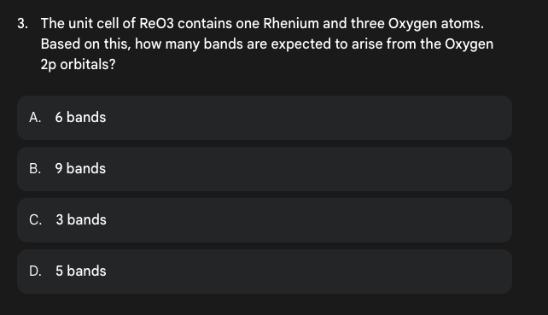

Slide 20
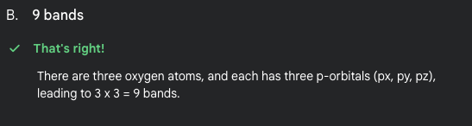

Slide 21
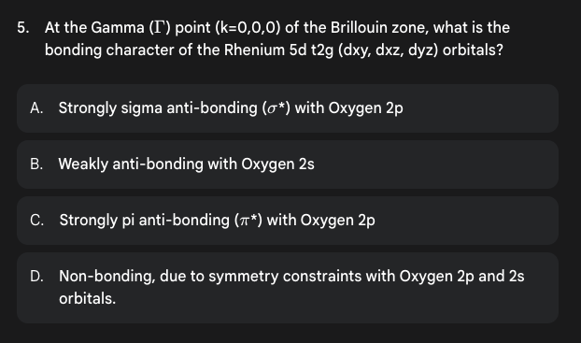

Slide 22
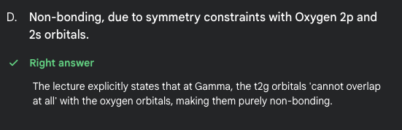

Slide 23
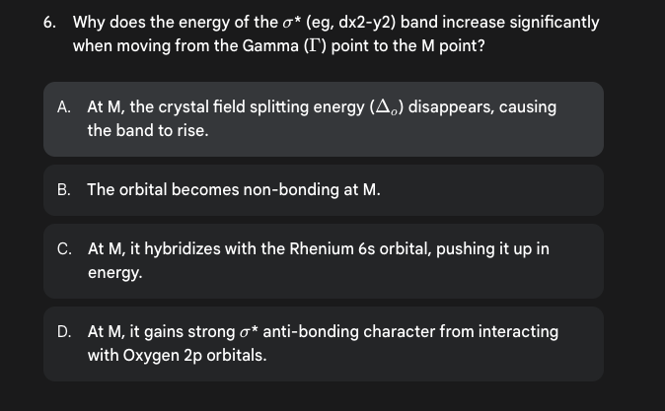

Slide 24
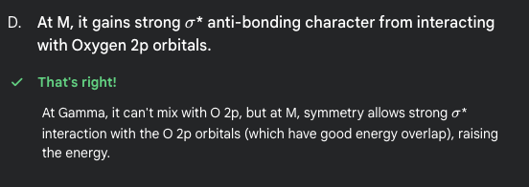

Slide 25
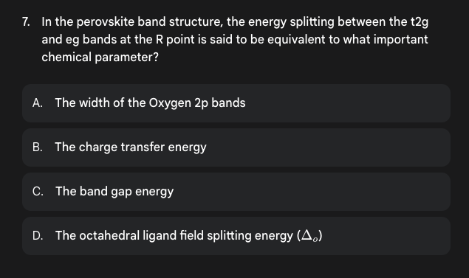

Slide 26
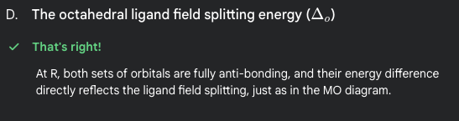

Slide 27
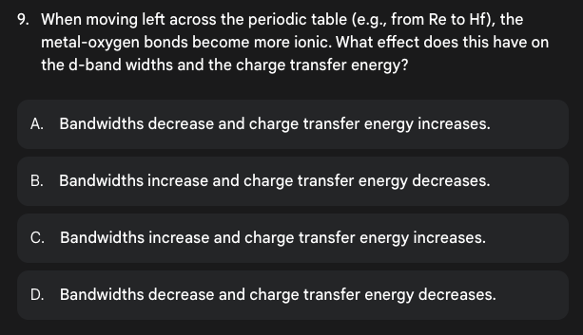

Slide 28
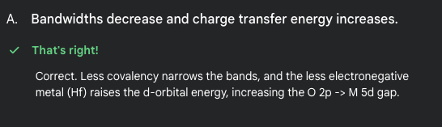

Slide 29
Learning Objectives
Electrical Conductivity and the Drude Model
Distinguish between extrinsic (I, V, R) and intrinsic (J, E, σ, ρ) electrical properties
Apply the Drude model to describe electron behavior as an ideal gas in metals
Calculate key parameters: drift velocity, electron mobility, mean free path, and relaxation time
Derive the relationship between conductivity, carrier concentration, and mobility (σ = neμ)
Estimate conductivity parameters for simple metals using the Drude model
Recognize the limitations and failures of the Drude model in predicting temperature dependence and trends across different metals
Electrical Properties of Materials | Materials Science & Chemistry

Slide 30
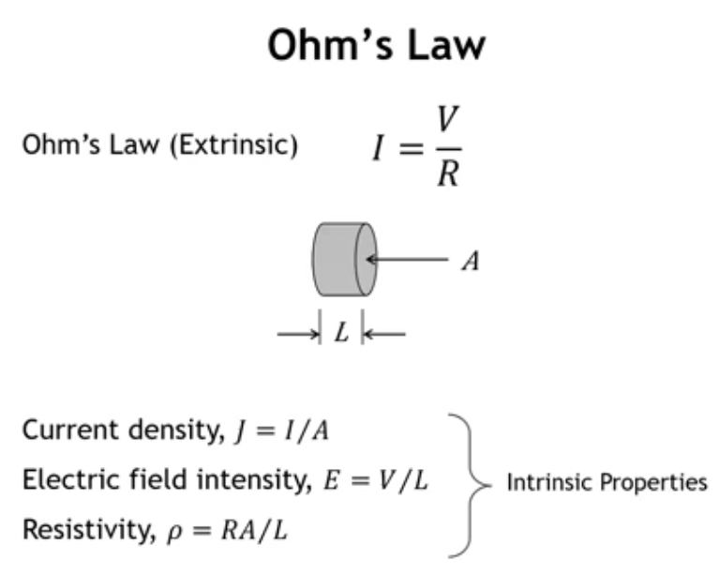
Notes:
Ohm's Law (V = IR) uses extrinsic quantities that depend on sample dimensions: resistance increases with length and decreases with cross-sectional area. For materials design, we need intrinsic properties:
Current → Current density (J = I/A)
Voltage drop → Electric field (E = V/L)
Resistance → Resistivity (ρ = RA/L)
These intrinsic properties are independent of sample geometry.

Slide 31
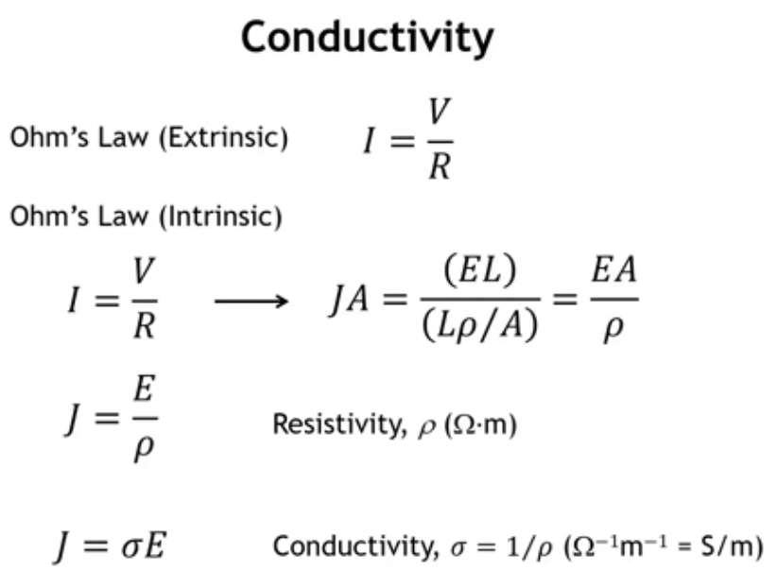
Notes:
Recasting Ohm's Law (I = V/R) into intrinsic form: substitute I → JA, V → EL, R → ρL/A, giving JA = EL/(ρL/A). Lengths and areas cancel, yielding:
J = E/ρ
Current density equals electric field divided by resistivity. Conductivity σ = 1/ρ, so alternatively J = σE.
Units: resistivity is Ω·m, conductivity is S/m (Siemens per meter, where S = 1/Ω).

Slide 32
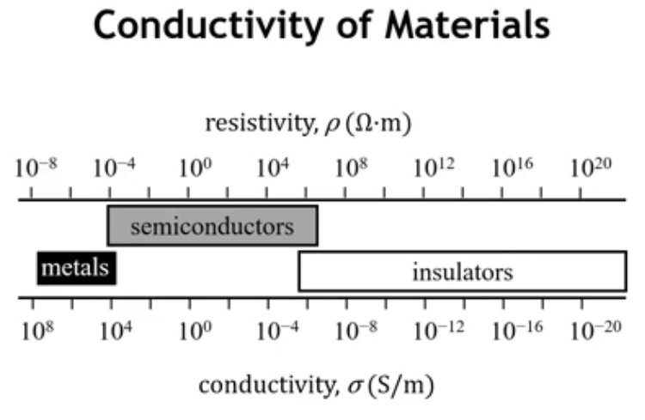
Notes:
Conductivity spans an immense 28 orders of magnitude—from the best metals to the most insulating insulators. Few properties exhibit such a wide range.
Metals: high conductivity, ~10^8 to 10^4 S/m Semiconductors: intermediate region Insulators: low conductivity, spanning a wide range

Slide 33
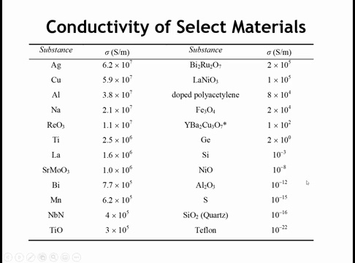
Notes:
In the upper left, we have elemental metals with the highest conductivity, often used as conductors. Silver and copper have conductivities around 6×10^7 S/m. Silver is actually the most conductive element at room temperature. Aluminum isn't far behind. We also see a mixture of other metals, including rhenium trioxide with quite high conductivity, other oxides, and a nitride like niobium nitride.
Looking at this table raises several questions:
What makes silver so much more conductive than metals like titanium or lanthanum? It's over an order of magnitude more conducting.
What makes some oxides like rhenium trioxide and strontium molybdates so highly conducting, whereas others like SiO2, aluminum oxide, and nickel oxide are highly insulating? You might say for SiO2 and aluminum oxide, all electrons are tied up in covalent bonds with no partially filled bands—and that's true, unlike in titanium oxide, niobium nitride, or rhenium trioxide. But what about nickel oxide? It has the rock salt structure, Ni2+ has a d8 configuration with partially filled d orbitals. Titanium oxide also has the rock salt structure with Ti2+ (d2), yet there's 13 orders of magnitude difference in their conductivity. What explains that?
We have semiconductors like silicon and germanium. Silicon's intrinsic conductivity isn't very high, yet there's a hugely important industry based on it. How do we understand semiconductor conductivity?
And we have organics like Teflon, which unsurprisingly is a terrible conductor. But what about doped polyacetylene? It has appreciable conductivity, not far behind some metals. How do we get polymers and organic molecules to conduct electricity?
These are questions we want to answer by the end of this chapter.

