Slide 1

Learning Objectives
Electronic Band Structure of Graphene
By the end of this lecture, you will be able to:
Construct reciprocal lattice vectors for non-orthogonal hexagonal systems and identify the hexagonal first Brillouin zone
Locate special k-points (Gamma, M, K, K') in hexagonal Brillouin zones and convert between reciprocal lattice and Cartesian coordinates
Distinguish sigma and pi band contributions in graphene and apply orbital orthogonality at high-symmetry points
Predict bonding character of pi orbitals at Gamma, M, and K points using phase relationship analysis
Explain semi-metallic behavior, Dirac points, and linear dispersion as unique features of graphene's electronic structure
Notes:
Welcome to our lecture on graphene - arguably the most famous 2D material. This lecture introduces hexagonal lattices, where unit cell axes are no longer orthogonal.
HEXAGONAL RECIPROCAL LATTICE: For hexagonal systems, real space vectors A and B have equal length with 120 degree angle. A-star must be perpendicular to B, pointing vertically in our convention, while B-star is perpendicular to A. The reciprocal lattice vectors make a 60 degree angle. The first Brillouin zone is a hexagon - the Wigner-Seitz cell defined as points closer to the origin than any other lattice point. This differs from crystallographic unit cells.
SPECIAL K-POINTS: Gamma at the center where k equals zero. M at the hexagon edge center, half A-star with no B component. K at hexagon corners at one-third A-star plus one-third B-star. K-prime at two-thirds A-star minus one-third B-star. These high-symmetry points are where we analyze the band structure.
GRAPHENE STRUCTURE: Honeycomb lattice of fused benzene rings. Two carbons per unit cell means eight total bands from 2s, 2px, 2py, 2pz orbitals. At gamma, 2s is orthogonal to 2p orbitals - a recurring theme where valence s forms bonding orbitals and valence p forms orthogonal antibonding orbitals.
PI BANDS: Like benzene, graphene's key features come from pi overlap of 2pz orbitals perpendicular to the sheet. These remain orthogonal to sigma orbitals throughout the Brillouin zone, simplifying our analysis to just pi interactions.
CRYSTAL ORBITALS: At gamma, pi bonding MO has bonding interactions everywhere - lowest energy. Pi antibonding MO has antibonding everywhere - highest energy. At M with k equals half A-star, phases alternate in A direction but not B. Each carbon has two bonding and one antibonding interaction, giving weakly bonding and weakly antibonding character. At K with one-third lattice vectors in both directions, phases change every three unit cells. The three neighbors of each carbon have zero pz coefficient - completely nonbonding for both pi and pi-star. The bands touch precisely at K.
SEMI-METALLIC BEHAVIOR: With four valence electrons per carbon, eight total per unit cell fills exactly four bands - three sigma bands plus the pi band, leaving pi-star empty. At K and K-prime points, bands just touch with zero gap - these are Dirac points. This makes graphene a perfect semi-metal: Fermi level neither cuts through a band like metals nor has a gap like semiconductors. Near Dirac points, energy varies linearly with k-vector - unique behavior with important implications we'll explore in chapter 10. Any doping converts graphene to a metallic conductor.

Slide 2
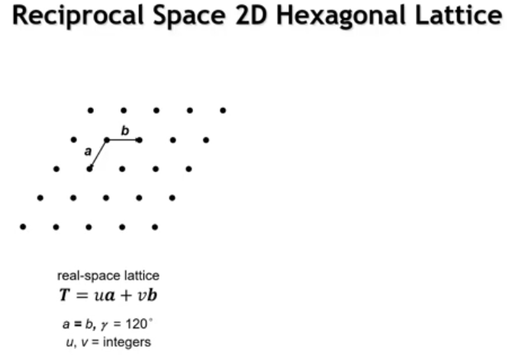
Notes:
For graphene's band structure, the unit cell axes are non-orthogonal (hexagonal lattice), requiring us to define the reciprocal space lattice for a hexagonal system. In real space, lattice vectors A and B have equal length with a 120° angle between them.

Slide 3
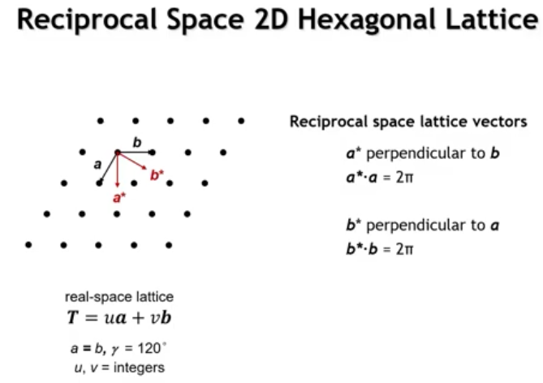
Notes:
Reciprocal space lattice vectors follow these criteria: A* is perpendicular to B (oriented vertically downward), and B* is perpendicular to A (oriented at an angle). The resulting reciprocal space lattice vectors form a 60° angle with each other.

Slide 4
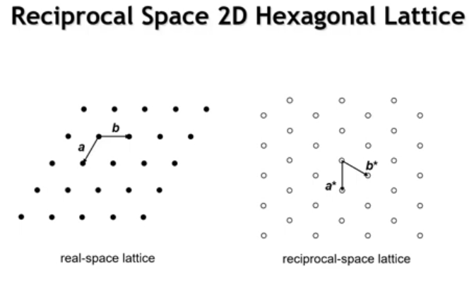
Notes:
And if we were to draw the entire lattice of reciprocal space points, it would look like this. And it still has that hexagonal symmetry to it, but the lattice vectors are now pointing in somewhat different directions.

Slide 5
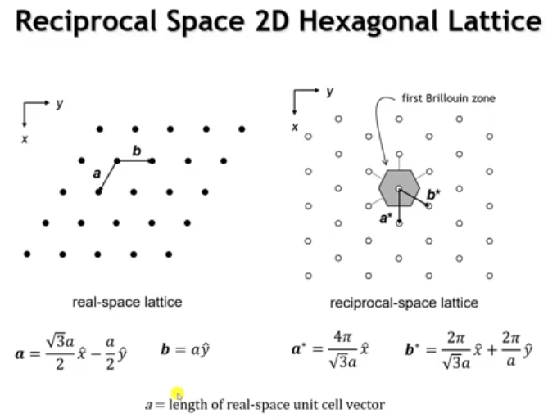
Notes:
The first Brillouin zone (BZ) is the locus of points closest to the origin. To construct it: draw lines from the origin to all nearest lattice points, then bisect each line. This yields a hexagon for a 2D hexagonal lattice.
For real space lattice vectors in Cartesian coordinates: B points along Y with magnitude A (the lattice vector length). Vector A has the same length but isn't along X due to non-orthogonal vectors, forming a 30-60 right triangle: A has components (√3/2)A in X and -A/2 in Y.
Now, when we take the dot product of A times A star, that's got to be 2 pi, and B times B star has to be 2 pi. And so that gives us these lattice vectors. So these are the Cartesian coordinates of them. I'll leave it for you to confirm that if you take A dot A star, you get 2 pi, and if you take B dot B star, you get 2 pi.

Slide 6
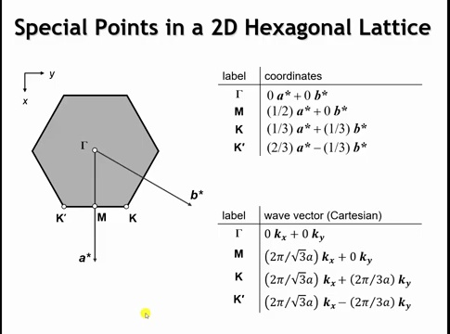
Notes:
The reciprocal lattice condition requires A·A* = 2π and B·B* = 2π, which gives us the reciprocal lattice vectors in Cartesian coordinates. You can confirm that A·A* = 2π and B·B* = 2π.
Now for the special symmetry points in the first Brillouin zone of a 2D hexagonal lattice: At the center is the Γ point, where the k vectors are zero. Point M exists at the center of a hexagonal edge at (1/2)A* with no B component. The two special corner points are K at (1/3)A* + (1/3)B* and K' at (2/3)A* - (1/3)B*. These are key points for analyzing graphene's band structure—we'll examine their energies and crystal orbitals. Cartesian coordinates are written below but we won't focus on them.

Slide 7
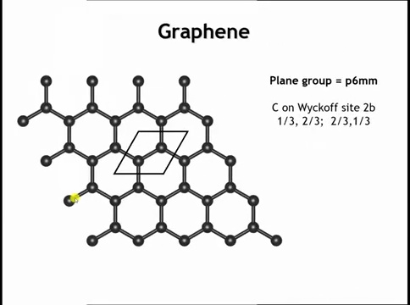
Notes:
So everything I've set up to this point is generic for any crystal that has a two-dimensional hexagonal lattice. But what do we say specifically about graphene? So here's the structure of graphene. We see that graphene is this two-dimensional honeycomb, or you might think about it as chicken wire, of these fused benzene rings. The unit cell here contains two carbon atoms, and they're on the Y-coffsite 2B of the plane group P6MM.

Slide 8
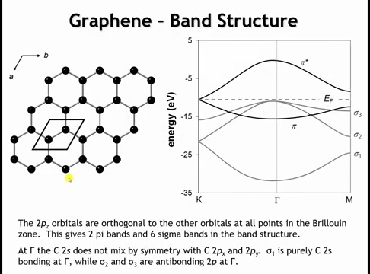
Notes:
The user wants me to make this explanation more concise while keeping all concepts. Let me identify the key concepts:
Carbon atomic orbitals: 2S, 2PX, 2PY, 2PZ
Two carbon atoms per unit cell = 8 total bands
Showing 5 lowest energy bands
Three lowest bands at M or K are sigma bands
At gamma point: 2S orthogonal to 2P orbitals
Lowest crystal orbital: only 2S character, bonding
Two degenerate bands at this point: 2PX and 2PY
General feature: at gamma, bonding S orbital + orthogonal antibonding P orbitals
Sigma bands not the focus here
Like benzene, pi overlap is key
Pi and pi* bands from 2PZ overlap (perpendicular to graphene plane)
2PZ orthogonal to other three orbitals everywhere in first BZ
Simplifies analysis - only need to consider pi overlap
Higher energy: antibonding sigma bands (not shown, not important)
Focus now on pi and pi* bands and their crystal orbitals at key points
Let me condense while keeping all these points.
Carbon's relevant atomic orbitals are 2S, 2PX, 2PY, and 2PZ. With two carbons per unit cell, the band structure has eight bands total; five lowest energy bands are shown here. The three lowest bands at M or K are sigma bands. At the Γ point, 2S is orthogonal to 2P orbitals, so the lowest crystal orbital is purely 2S bonding character, with two degenerate bands (2PX and 2PY) above it. This is a recurring pattern: at Γ, valence S orbitals form bonding crystal orbitals, while valence P orbitals form orthogonal antibonding crystal orbitals.
However, these sigma bands aren't our focus. Like benzene, graphene's key electronic features arise from π overlap. The π and π* bands come from 2PZ orbital overlap (perpendicular to the graphene plane). The 2PZ orbital is orthogonal to the other three everywhere in the first Brillouin zone, simplifying analysis—we only need to consider π overlap between 2PZ orbitals. Antibonding sigma bands exist at higher energy (not shown) but aren't important for properties. Let's now examine the π and π* bands' crystal orbitals at key Brillouin zone points.

Slide 9
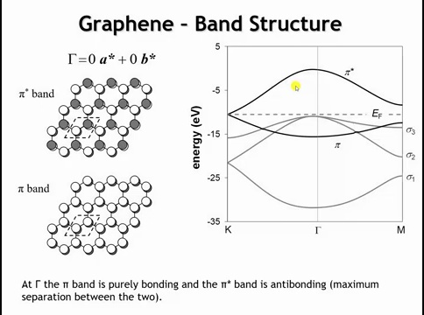
Notes:
At Γ, there are two bands from the two PZ orbitals in the unit cell (one per carbon). The basis set is the π bonding MO (lower band) and π* antibonding MO (upper band). Looking down at the P orbital lobe emerging from the plane, we see each carbon forms bonding interactions with its three nearest neighbors—making this a bonding orbital at low energy. This is the lowest energy crystal orbital. Conversely, the π* antibonding orbital shows each carbon forming antibonding interactions with its three nearest neighbors, making it the most antibonding crystal orbital in the entire first Brillouin zone, at considerably higher energy. Now let's go to M.

Slide 10
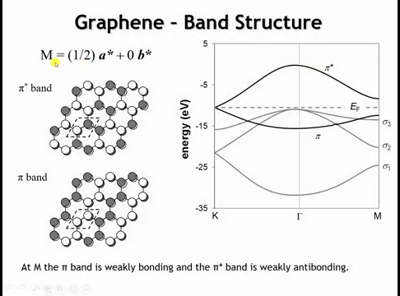
Notes:
At M, the reciprocal space lattice vector is (1/2)A* + 0B*, meaning orbital phase changes when moving in the A direction but stays constant in the B direction. For the bonding MO, moving one unit cell in the A direction changes the phase, while moving in the B direction preserves it. Each carbon forms two π bonding and one π antibonding interaction, yielding a weakly bonding crystal orbital. For the antibonding band, the same phase change pattern applies: moving horizontally changes phase between unit cells, while moving along the other lattice vector maintains constant phase. This gives each carbon two antibonding and one bonding interaction—a weakly π antibonding crystal orbital. At M, there's still considerable energy separation between the two bands. What about at K?

Slide 11
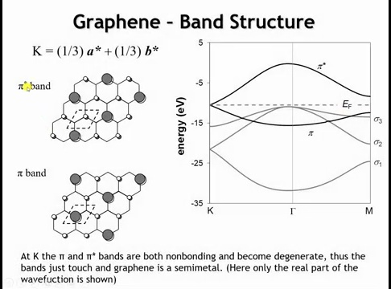
Notes:
At K, the k vector is (1/3)A* + (1/3)B*, meaning orbital phase changes once every three unit cells in both directions. Moving three unit cells in any direction returns to the same phase. This orbital is harder to visualize; here only the real part of the wave function is shown (there's also an imaginary part at K). Examining the orbital reveals that starting from any carbon, the coefficient of the pz orbital on its three neighbors is zero—making this a non-bonding orbital. This non-bonding nature applies to both π and π* bands, so they touch precisely at K. For electron filling: carbon has four valence electrons, giving eight valence electrons per unit cell (two carbons). This fills four bands: the three sigma bands and the π band, leaving π* empty.

Slide 12
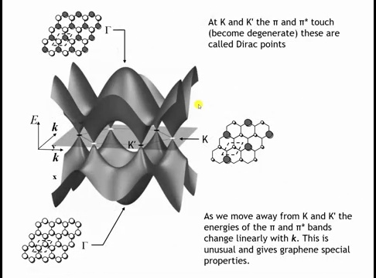
Notes:
Here's a 3D plot visualizing graphene's π and π* band structure. The plane shows the first Brillouin zone, with Γ (where KX = KY = 0) at the center. At Γ, there's large energy separation between the low-energy π band and high-energy π* band. At K, the bands touch—they're degenerate. The same occurs at K'. Around the hexagonal first Brillouin zone periphery, there are six points where upper and lower bands just touch, called Dirac points.
This touching makes graphene a perfect semi-metal. In metals, bands cut through the Fermi level; in semiconductors, there's a gap between filled and empty bands; in a perfect semi-metal, bands just touch—so the Fermi level doesn't cut through a band, yet there's no gap. This means doping converts graphene to a metallic conductor: p-type doping (removing electrons) lowers the Fermi level to cut through bands below this plane; n-type doping (adding electrons) raises the Fermi level into the conduction band. Any deviation from perfect electron count makes graphene metallic.
Graphene's unique feature: moving away from Dirac points, π* band energy increases linearly with wave vector k, while π band energy decreases linearly with k. We'll explore these implications in Chapter 10.

Slide 13
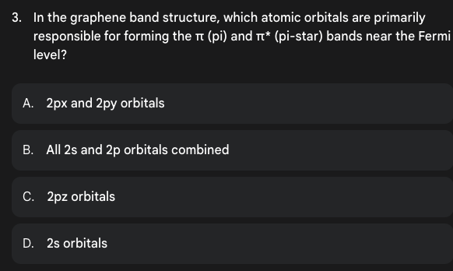

Slide 14
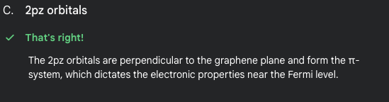

Slide 15
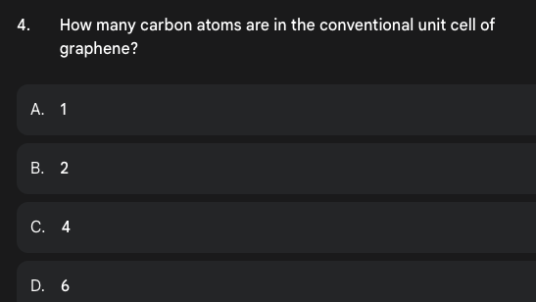

Slide 16
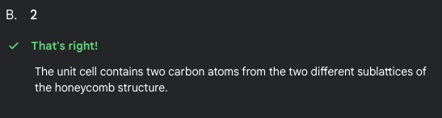

Slide 17
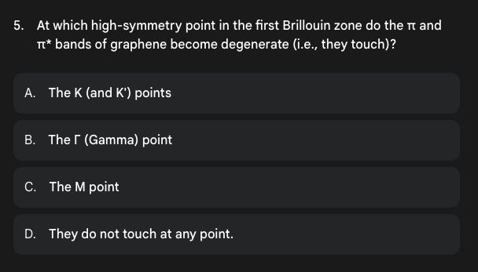

Slide 18
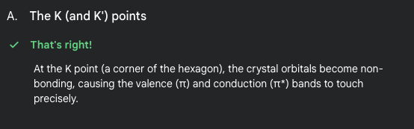

Slide 19
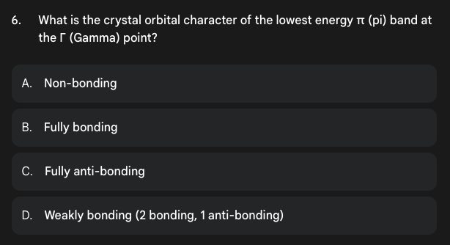

Slide 20
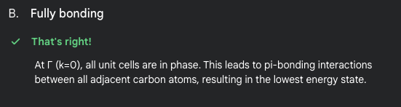

Slide 21
Learning Objectives
3D Band Structures: Primitive Cubic Systems
By the end of this lecture, you will be able to:
Construct 3D reciprocal lattice vectors using cross products and identify special k-points (Gamma, X, M, R) in primitive cubic Brillouin zones
Predict band dispersion for s and p orbitals by analyzing nearest-neighbor bonding patterns at high-symmetry points
Explain how p-orbital directionality causes band splitting and determines which bands remain degenerate at specific k-points
Apply sigma and pi overlap analysis to rationalize subtle energy variations between k-points
Predict Peierls distortions in half-filled p-band systems and calculate Fermi level positions from valence electron count
Notes:
Welcome to 3D band structures. We start with the simplest case: primitive cubic alpha-polonium. Reciprocal lattice vectors use cross products: A-star equals B cross C times 2 pi over unit cell volume. For orthogonal lattices, reciprocal vectors are also orthogonal, same directions as real space. Primitive cubic reciprocal lattice is also primitive cubic.
Special k-points: Gamma at origin, X at half A-star, M at half A-star plus half B-star, R at half of all three vectors. Alpha-polonium has one atom per unit cell with 6s and 6p orbitals, giving four bands. Lower band from 6s, upper three from 6p. DFT calculations set zero energy at Fermi level by convention.
6s BAND ANALYSIS: At Gamma, same phases everywhere give six bonding nearest neighbors, lowest energy. At X, phases alternate in x only, two antibonding plus four bonding. At M, phases alternate in x and y, four antibonding plus two bonding. At R, phases alternate in all directions, six antibonding, highest energy.
P ORBITAL DIRECTIONALITY: At Gamma, all three p orbitals degenerate with sigma antibonding character. 6px: drops at X when sigma becomes bonding, rises slightly M to R due to pi changing from bonding to nonbonding to antibonding. 6pz: remains high at X and M due to sigma antibonding, drops at R with sigma bonding. Directionality breaks degeneracy except at Gamma and R. At Gamma, s orbitals generally bonding, p orbitals antibonding with large separation.
FERMI LEVEL: Polonium has six valence electrons, fills 6s completely plus two-thirds of p bands. Bismuth with five valence electrons has half-filled p bands, triggering Peierls distortion to rhombohedral structure with three short bonds and three long bonds, lowering occupied states. Spin-orbit coupling in heavy elements removes p-orbital degeneracy at Gamma and R.

Slide 22
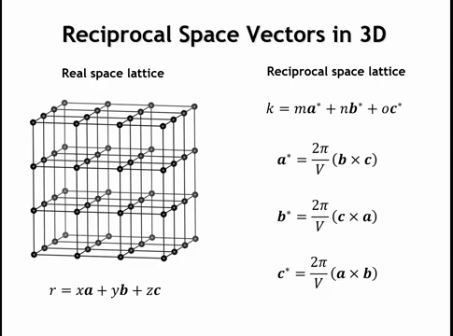
Notes:
To define the first Brillouin zone in three dimensions, we need three reciprocal space lattice vectors. In 3D, we have three real space lattice vectors (A, B, C) with fractional coordinates (X, Y, Z). Correspondingly, there are three reciprocal space lattice vectors (A*, B*, C*) defined as: A* = (B × C) × 2π/V_cell, with similar relationships for B* and C*, where V_cell is the unit cell volume.
If real space lattice vectors are orthogonal, then reciprocal space lattice vectors are also orthogonal and point in the same directions as their real space counterparts. This follows because the cross product of two vectors yields a vector perpendicular to both, with length equal to the parallelogram area they define. We won't derive these reciprocal space lattice vectors in detail, but it's useful to understand their origin

Slide 23
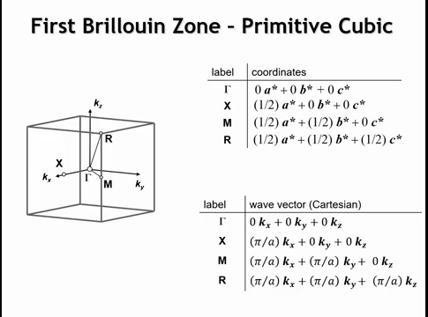
Notes:
For a primitive cubic lattice, the reciprocal space lattice is also primitive cubic. Special points in the first Brillouin zone (a cube) relate to the 2D square lattice treatment: Γ is at (0,0,0) at the cube's center—Γ is always at the first Brillouin zone center. X is at (1/2)A*, M is at (1/2)A* + (1/2)B*—the same special points from the 2D square lattice. There's one additional point: R at (1/2)(A* + B* + C*)—half of all three reciprocal space lattice vectors. Let's see how these reciprocal space lattice vectors impact orbital phases in a real material.

Slide 24
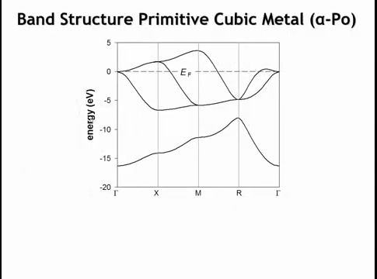
Notes:
The simplest 3D material is arguably a primitive (simple) cubic metal. Alpha-polonium is the only element with this structure. Shown here is the calculated band structure for alpha-polonium using DFT calculations, which we'll use for the rest of this chapter. By convention, zero energy is set at the Fermi level—different from the extended Hückel calculations used previously.
There's one polonium atom per unit cell. Polonium is a p-block metal with valence shell s and three p orbitals (6s and 6p), explaining why we see four bands. Without knowing orbital overlap details, you can recognize that the lower energy band comes from the 6s orbital, while the upper three bands arise from the 6p orbitals.

Slide 25
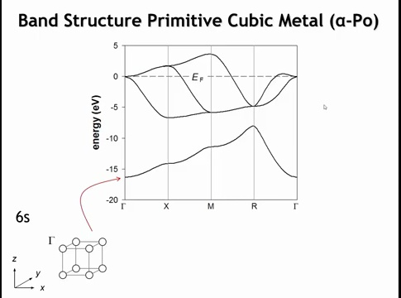
Notes:
Let's look at the orbital overlap first with the 6s orbital. So at the gamma point, all of the atoms must have the same phase as we go from one unit cell to the next. Our base set here is just a single atomic orbital, the 6s orbital on Pollonium. And that gives rise to six nearest neighbor bonding interactions. And that is the lowest point in the 6s band.

Slide 26
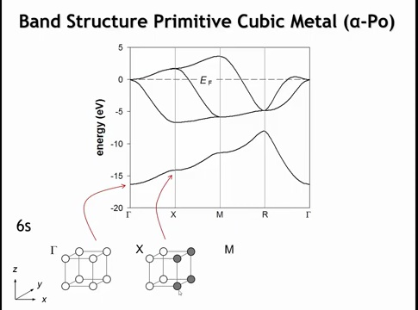
Notes:
If we go to x, the phases of the orbitals are going to change as we move along the x-axis, but not in the y or z direction. And so now of the 6 nearest neighbors of Pollonium, two, those in the x direction, are going to be anti-bonding, and the other four are still going to be bonding. So the energy still is not bonding, but it's higher in energy than gamma.

Slide 27
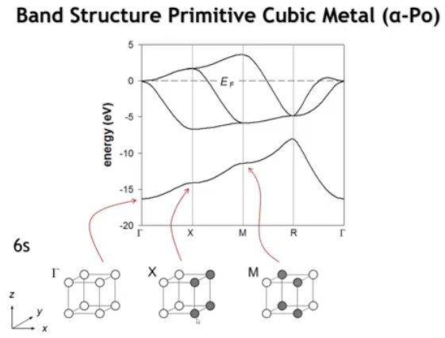
Notes:
When we go to m, it means that the phases of the orbitals are going to change every time we translate a unit cell vector in either the x or the y direction. And so we get a crystal orbital that looks like this one. You can see now that the four nearest neighbors in the x, y plane are all anti-bonding, but the two nearest neighbors in the z direction are still bonding. So this is more anti-bonding than bonding, and higher energy still.

Slide 28
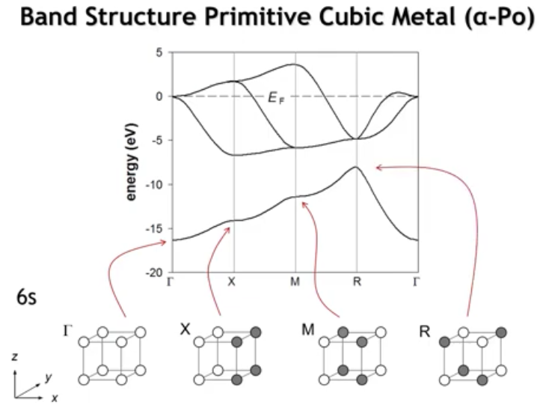
Notes:
And finally, when we go to r, we change the phase of the orbitals every time we translate by a unit cell vector in any of the three directions. And so that gives us this crystal orbital, where now all six nearest neighbor interactions have become anti-bonding. And that's the highest energy crystal orbital in the success band. This structure could have been pretty easily extrapolated from what we learned in one and two dimensions, just looking at these hydrogen atom sheets.

Slide 29
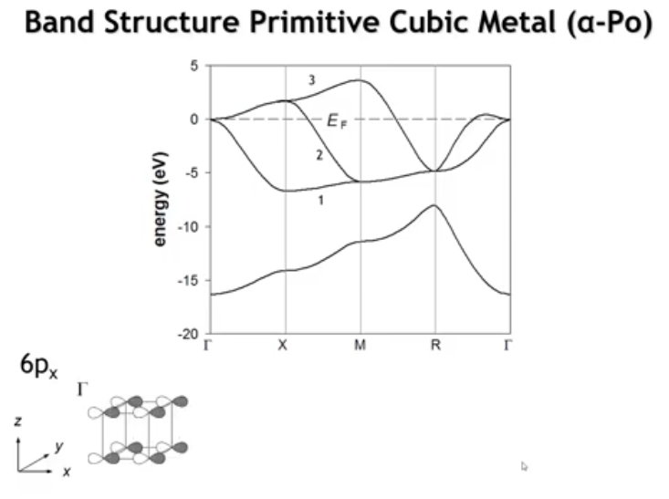
Notes:
So let's consider the six p orbitals. Start with the six p x. Let's look at the overlap at gamma. Just like we did with our fluorine atom chain, that the sigma interaction between p orbitals is going to be anti-bonding. This is going to be at a relatively high energy. And if you look at the gamma point, you would see that all three p orbitals are degenerate. They all have the same energy, which is this anti-bonding sigma interaction.

Slide 30
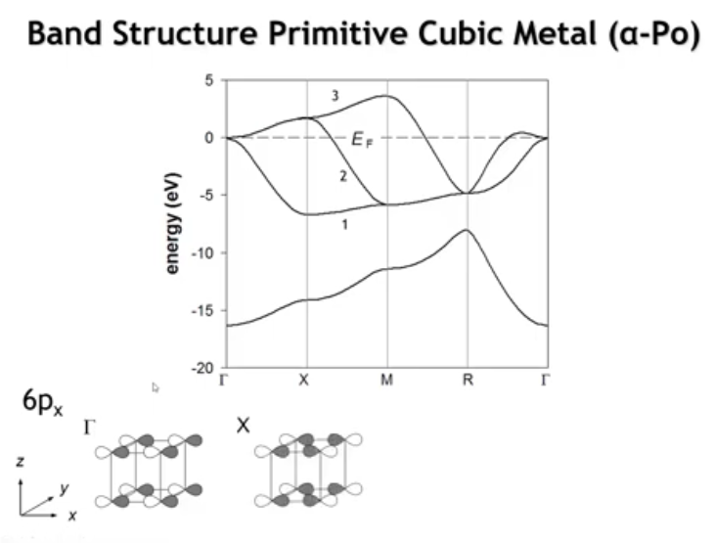
Notes:
When we go to x, now when we translate in the x direction, we change the phase of our orbitals. So you can see that the orbitals have become sigma bonding. And so the energy should drop.

Slide 31
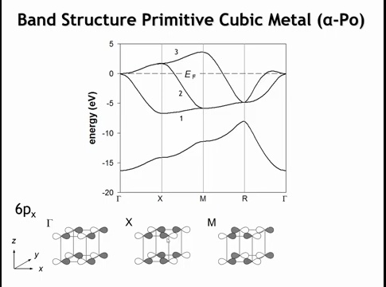
Notes:
If we go to m, now we change the phase of the orbitals in the x and the y direction. So if you look at these orbitals on the back phase of our unit cell, you'll notice they have a different phase than at the x point. But the sigma interactions are still bonding here. X-bonding, y antinbonding so higher energy.

Slide 32
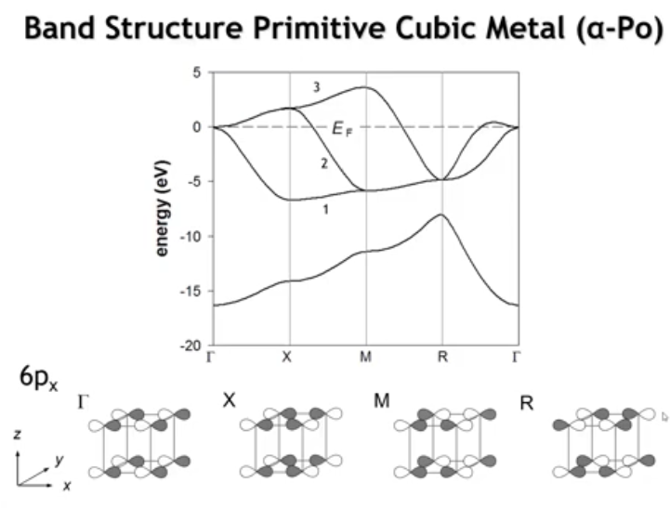
Notes:
Bonding x, antibonding y, antibonding z ; Of the three p bands, which is the 6px band—band 1, 2, or 3? Going from Γ to X changes from σ antibonding to σ bonding, causing a substantial energy drop. Only band 1 drops from Γ to X, so this is the 6px band. It makes sense that 6px is high at Γ and relatively low at other k points.
Why is it lowest at X, then rises at M, then rises further at R? This requires considering weaker π interactions between 6p orbitals. At both Γ and X, π interactions with the four neighbors are bonding. At M, π interaction along z is bonding but along y is antibonding, yielding a net non-bonding state. At R, π interactions in both directions perpendicular to the 6px orbital are antibonding. This accounts for the subtle rise of the 6px band from X to M to

Slide 33
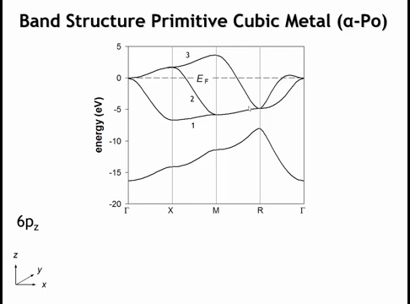

Slide 34
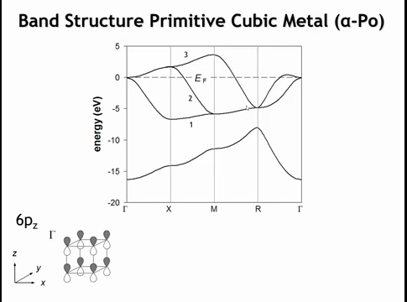
Notes:
Now the other p bands are not all on top of the six p x band. And we can see why if we look at the orbital overlap in the six p z band. So here would be the overlap at gamma. We can see this sigma anti-bonding character and pi bonding character.

Slide 35
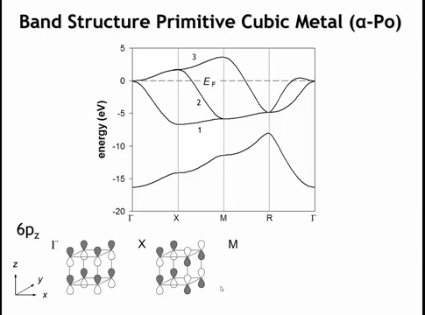
Notes:
Here's the overlap when we go to x. So when we go to x, now just as before, we're going to change the phases of the orbitals that are displaced by one unit cell in the x direction. So all of these orbitals on this right hand phase of the unit cell are different in phase. But notice that because it's a six p z orbital, we still have a sigma anti-bonding interactions everywhere. So the six p z orbital does not go down in energy when we go from gamma to x.

Slide 36
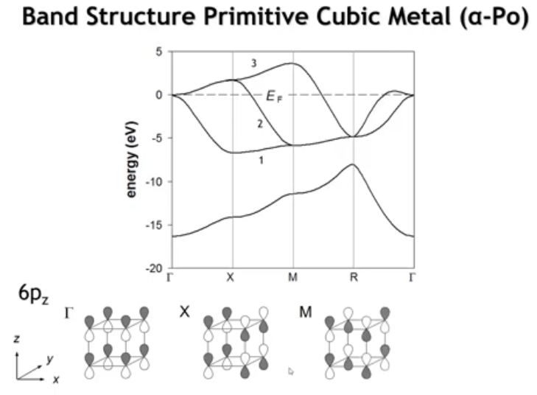
Notes:
If we go to m, we now change phases in both the x and y directions.

Slide 37
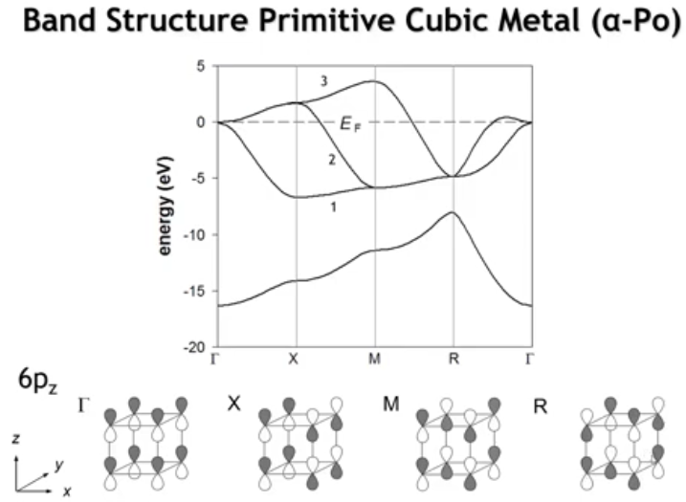
Notes:
And when we finally go to the r point, we have a change in phase every time we translate by one unit cell in any direction. And we're back to this sigma bonding, pi anti-bonding interactions. So at r and at gamma, all three orbitals are degenerate. But at the other points, they're not. And that's simply because of the directionality of the p orbitals. So which of these three bands is the p z orbital?

Slide 38
Notes:
Hopefully you can see that it's band number three, right? Because at gamma x and m, it's going to be sigma star. So that's going to be a relatively high energy. And only band three does that. It goes up from gamma to x to m because the pi interactions are going from bonding to non-bonding to anti-bonding. And then it drops sharply when we go to the r point.

Slide 39
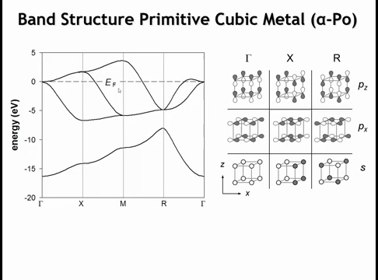
Notes:
Putting this together for polonium's band structure: we didn't examine py orbital overlap, but by deduction, this band is the py band. Note a recurring pattern: at Γ, s orbitals typically have bonding overlap while p orbitals have antibonding overlap, with large energy separation between them.
For Fermi level placement: polonium is group 16 with six valence electrons. The 6s orbitals are filled, leaving four electrons for the 6p orbitals, making the p bands two-thirds filled—this determines the Fermi energy position.
Moving one element left (to lower atomic number) gives bismuth with three valence p electrons, making the p orbitals half-filled. Recall that a half-filled band is susceptible to distortion. In one dimension, this is called a Peierls distortion, and bismuth metal indeed exhibits something analogous to a Peierls distortion.

Slide 40
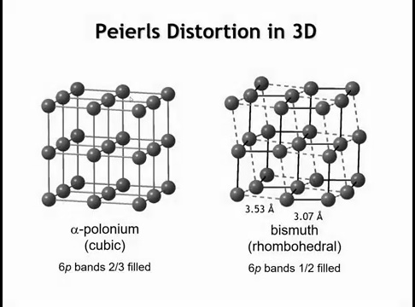
Notes:
Bismuth has a rhombohedral structure that's close to primitive cubic. A distortion has occurred where each bismuth atom has three short contacts (3.07 Å, shown as solid lines) and three longer contacts (3.53 Å, shown as dashed lines) with neighboring bismuth atoms. While not far from simple cubic, this distortion arises from half-filling and lowers the energy of occupied 6p bands at the expense of unoccupied 6p bands.

Slide 41
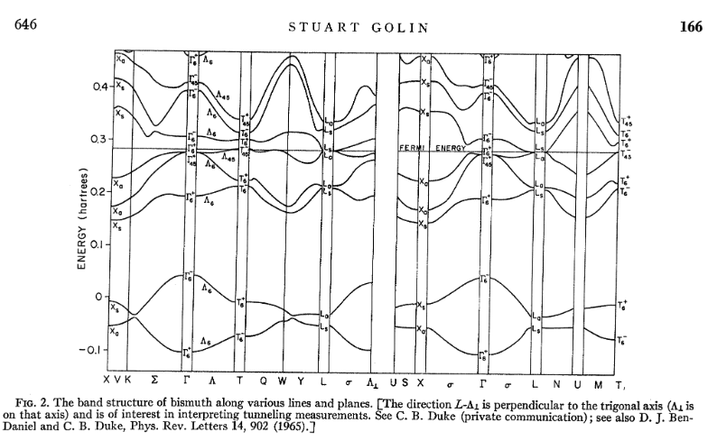
Notes:
This symmetry breaking splits degenerate bands and opens a gap at the Fermi level, converting what would be a metal (like polonium) into a semimetal or semiconductor. In polonium's band structure, the p bands smoothly cross the Fermi level with no gap. In bismuth's distorted structure, you see band splitting with a gap opening where the bands would have crossed—the occupied states drop in energy while unoccupied states rise, stabilizing the distorted structure.

Slide 42
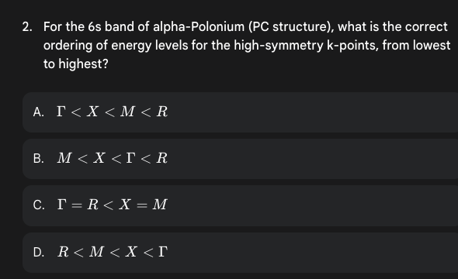

Slide 43
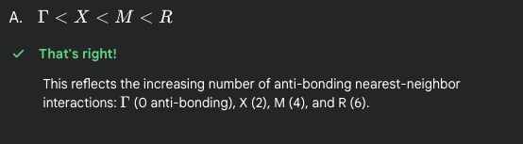

Slide 44
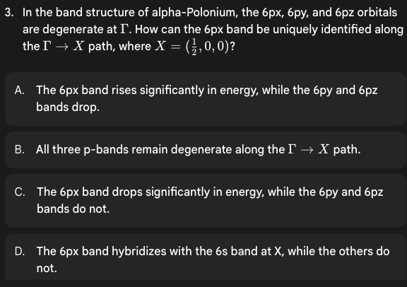

Slide 45
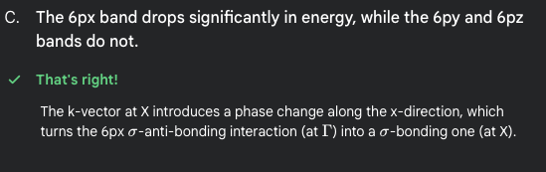

Slide 46
Homework
6.12

Slide 47
Learning Objectives
Band Structures of Face-Centered Cubic Crystals
Understand the first Brillouin zone structure for face-centered cubic lattices
Analyze the electronic band structure of FCC metals using aluminum as a representative example
Examine band structures of diamond structure materials (carbon, silicon, germanium)
Distinguish between valence bands, conduction bands, and band gaps in semiconductors
Explain the progression from insulator to semiconductor to metal down Group 14 elements
Understand how orbital overlap influences bonding/anti-bonding states and metallic vs semiconducting behavior
Electronic Band Structures | Materials Science & Chemistry

Slide 48
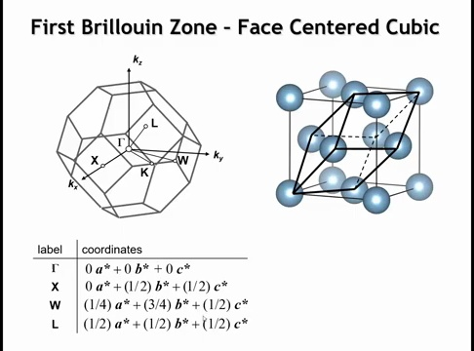
Notes:
The first Brillouin zone for a face-centered cubic (FCC) Bravais lattice looks much more complicated than simple cubic. This complexity arises because the Brillouin zone corresponds to the primitive unit cell of FCC. The cubic-centered unit cell has four atoms per unit cell, while the dark lines show the rhombus primitive unit cell with equal-length edges and 60° angles between them. Using this rhombus primitive unit cell explains why the reciprocal space first Brillouin zone appears so complex.
This shape is a truncated octahedron. Special points in the first Brillouin zone include: Γ is always at (0,0,0) at the center. The L point is the FCC equivalent of the R point in primitive cubic—its coordinates are (1/2) of each of the three reciprocal space lattice vectors, so phase changes occur from one unit cell to the next in any real space lattice direction.

Slide 49
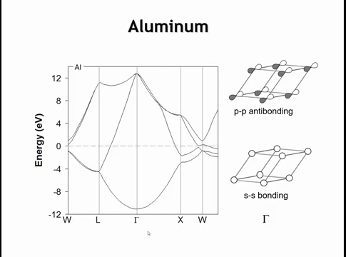
Notes:
For aluminum with cubic close-packed (FCC) metallic structure, the primitive cell contains one aluminum atom, giving four bands: a 3s band and three 3p bands.
At Γ, there's large separation between the s and p bands. The 3s crystal orbital at Γ has all interactions in phase and bonding—each aluminum has 12 nearest neighbors with all bonding interactions, making this the lowest energy crystal orbital in the entire structure.
The p orbitals at Γ are drawn parallel to the rhombohedral unit cell's long axis. Because p orbitals have nodal planes and change phase from one side to the other, at Γ there are antibonding interactions between p orbitals. All three p orbitals are degenerate at Γ with antibonding character—this is the highest energy crystal orbital in the first Brillouin zone.
At other special points and along lines between them, sp mixing occurs, producing crystal orbitals between these two extremes.
Key takeaways: four bands (one atom per unit cell), very wide bands spanning ~24-25 eV. Aluminum has three valence electrons, filling bands only 37.5% (3/8). The Fermi level cuts through these wide bands—a recipe for delocalized electronic conductivity.

Slide 50
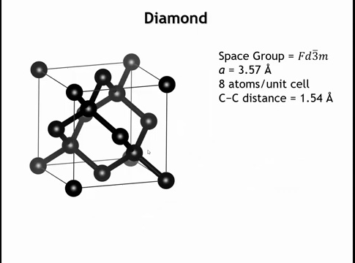
Notes:
Now for diamond, the sp³ polymorph of carbon. We've examined graphene (the 2D equivalent of graphite), and graphite's band structure is quite similar to graphene's with subtle differences. What about the sp³ form?
Diamond has a face-centered cubic lattice with carbon atoms at corners and on each face (like aluminum), but also has carbon atoms inside the unit cell—four carbons at the centers of alternating octants. This gives eight carbon atoms per unit cell (the centered unit cell). The primitive unit cell is four times smaller and contains two carbon atoms per primitive unit cell

Slide 51
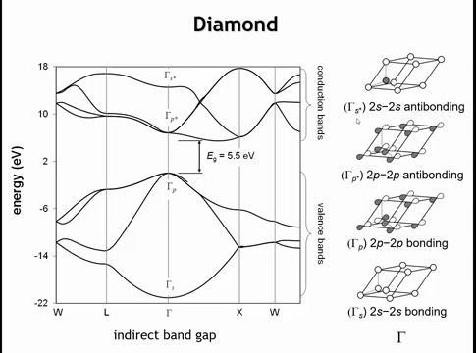
Notes:
With two atoms per primitive unit cell, we have doubled the number of bands—eight total. The lower four bands come from bonding MOs between the two carbons in the unit cell. Like aluminum, at Γ the s and p orbitals don't mix. These lower bands resemble aluminum's: a completely bonding crystal orbital at Γ with carbon 2s character, and higher-energy crystal orbitals from carbon 2p states that are largely antibonding.
What does "antibonding in the bonding MO band" mean? The two-atom motif within the unit cell has bonding interactions, but this same two-atom basis has antibonding interactions with neighboring unit cells' basis sets. So at Γ_p, it's a mixture—one bonding interaction but antibonding interactions with carbons in neighboring unit cells.
The upper four bands come from antibonding combinations of the two-atom basis: one antibonding s band and three antibonding p bands.
For band filling: each carbon has four valence electrons, with two carbons per unit cell giving eight valence electrons—enough to fill the bottom four bands. There's a 5.5 eV gap to the next four empty bands. In semiconductor nomenclature, these filled (mostly bonding) states are the valence band, and the empty (mostly antibonding) states are the conduction band. This 5.5 eV gap makes diamond an insulator. The valence band maximum is at Γ while the conduction band minimum is between Γ and X, making diamond an indirect band gap semiconductor.

Slide 52
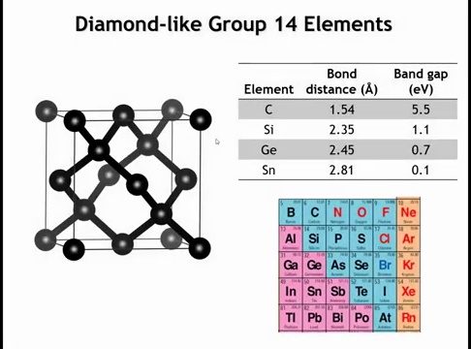
Notes:
Moving down group 14: elements immediately below carbon—silicon and germanium—also crystallize with the diamond structure. Bonds lengthen moving down the periodic table (as expected), and the band gap decreases substantially. Silicon and germanium have ~1 eV band gaps, ideal for electronic devices—silicon is one of the most important elements for modern computer technology.
Tin is polymorphic. Gray tin has the diamond structure with longer bonds and only 0.1 eV band gap, making it practically a semimetal. White tin has a tetragonal structure with properties closer to a metal than a semiconductor. Lead is metallic with a close-packed structure, not a semiconductor.
This transformation from insulator (top of group 14) to semiconductors (Si, Ge, Sn) to metal (Pb) isn't unique to group 14—it occurs across much of the p-block. How can we understand this from a bonding perspective?

Slide 53
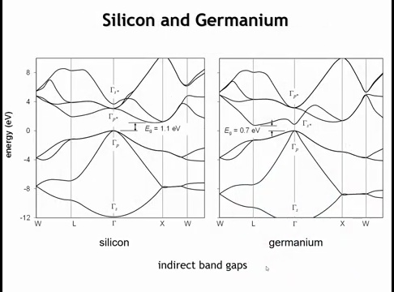
Notes:
Silicon and germanium band structures are qualitatively similar to diamond—both are indirect band gap semiconductors with valence band maximum at Γ and conduction band minimum elsewhere. The key observation is the S* band energy at Γ (the crystal orbital from the antibonding combination of 2s orbitals in the basis at Γ).
In carbon, S* is much higher than the antibonding p bands. In silicon, S* is still higher but not by much. In germanium, S* drops below the antibonding p bands, quite close to the valence band top. In tin, the gap almost disappears.
What's happening: as bond distance increases and orbital overlap decreases, bonding states become slightly less bonding while antibonding states become substantially less antibonding. This shrinks the gap between antibonding and bonding bands.
In lead, the S* band drops below bonding p states (if calculated with diamond structure). Now antibonding states fill before bonding states complete filling, totally destabilizing the tetrahedral coordination of the diamond structure—no more semiconducting behavior.
Bottom line: decreasing orbital overlap drives the insulator→semiconductor→metal crossover. As overlap decreases, the low-coordination covalent bonding arrangement becomes less stable.

Slide 54
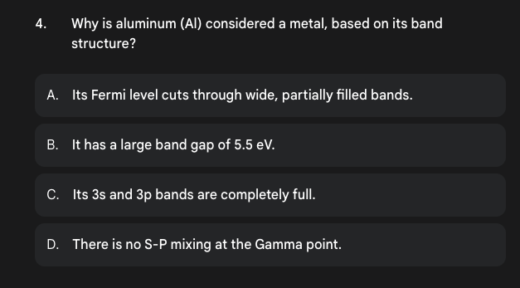

Slide 55
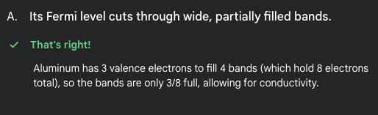

Slide 56


Slide 57


