Slide 1
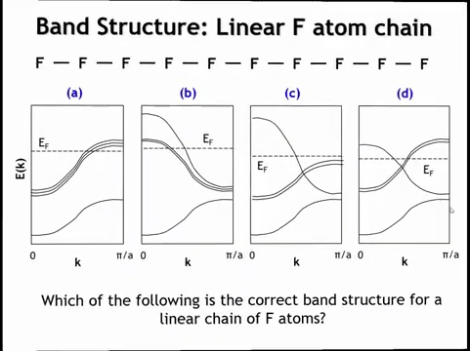
Notes:
Okay, let's finish this lecture by going to another example, a linear chain of fluorine atoms. And I want you to figure out what the band structure looks like. I've given you four possibilities here, A through D. One of these is the correct answer. So why don't you analyze this and decide which one of these is correct, and after you've done so we'll go over the answer.

Slide 2
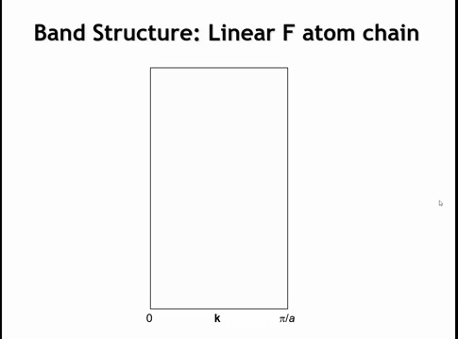

Slide 3
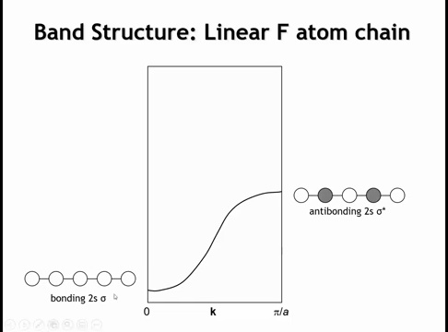
Notes:
The F atom chain band structure follows the same approach as the H chain, but now we consider both s and p orbitals. The 2s orbital is bonding at k = 0 and anti-bonding at k = π/a—this band runs uphill in energy.

Slide 4
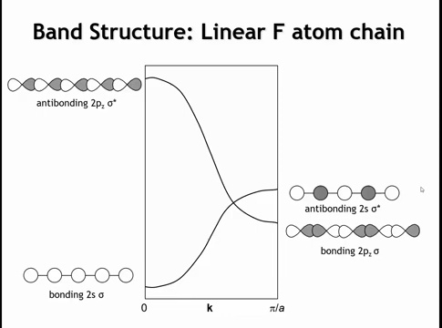
Notes:
For the p orbital along the internuclear axis (pz): at k = 0, uniform phases create anti-bonding interactions (high energy), but at k = π/a, phase alternation produces bonding interactions. This band runs downhill, with k = π/a below the anti-bonding 2s—though note the large intrinsic 2s-2p energy separation on fluorine.

Slide 5
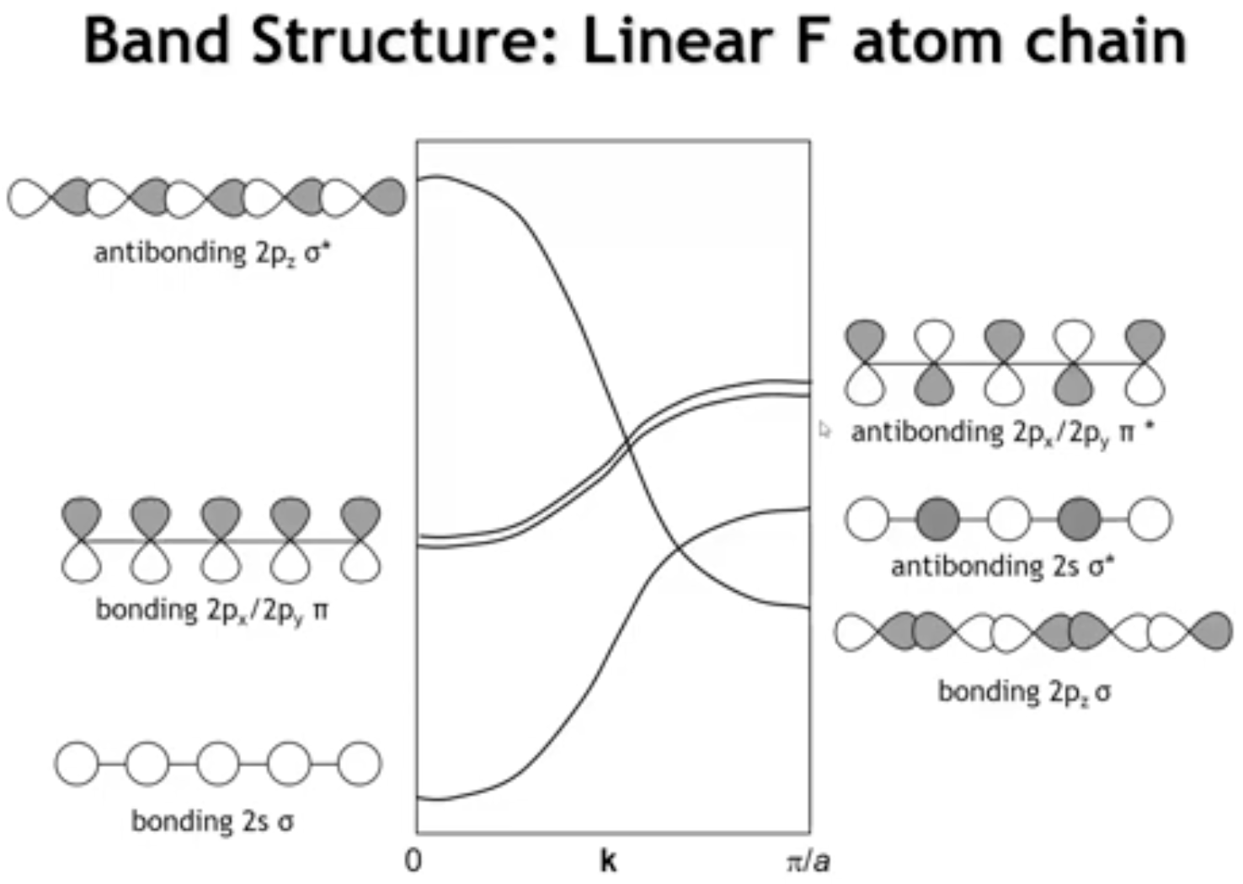
Notes:
The 2px and 2py orbitals, perpendicular to the chain, give bonding π interactions at k = 0 and anti-bonding π at k = π/a—running uphill like the 2s band. However, this band is narrower because π overlap is weaker than σ overlap.

Slide 6
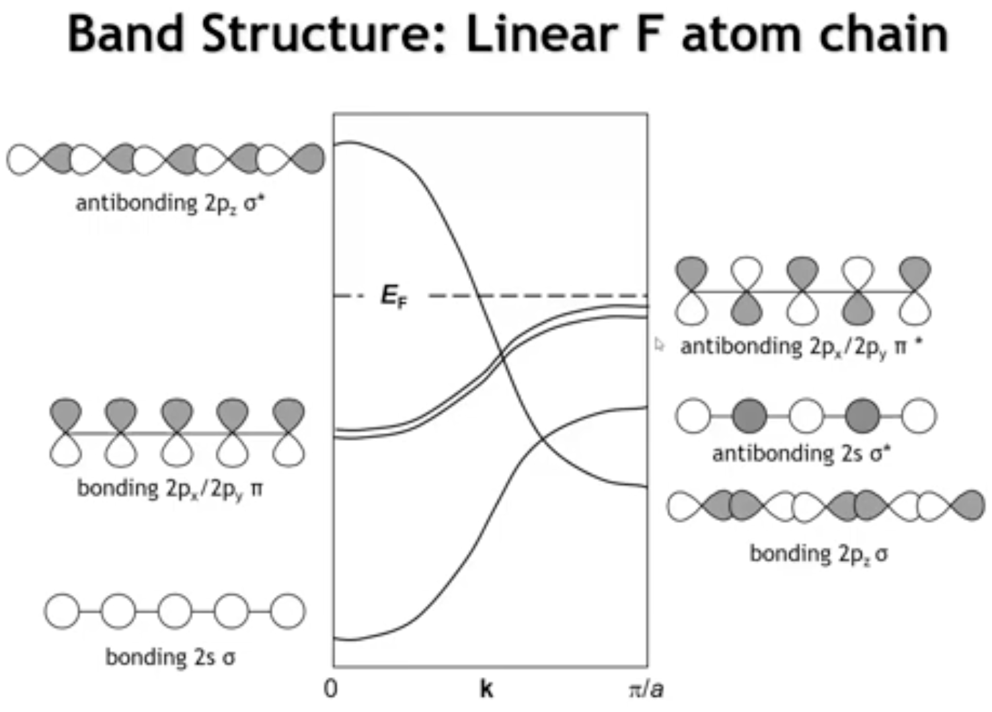
Notes:
To place the Fermi level: fluorine has 7 valence electrons, filling 3.5 bands (each band holds 2 electrons). The Fermi level cuts through the middle of the 2pz band, with three bands fully occupied below it. This hypothetical F atom chain would be a metal.

Slide 7
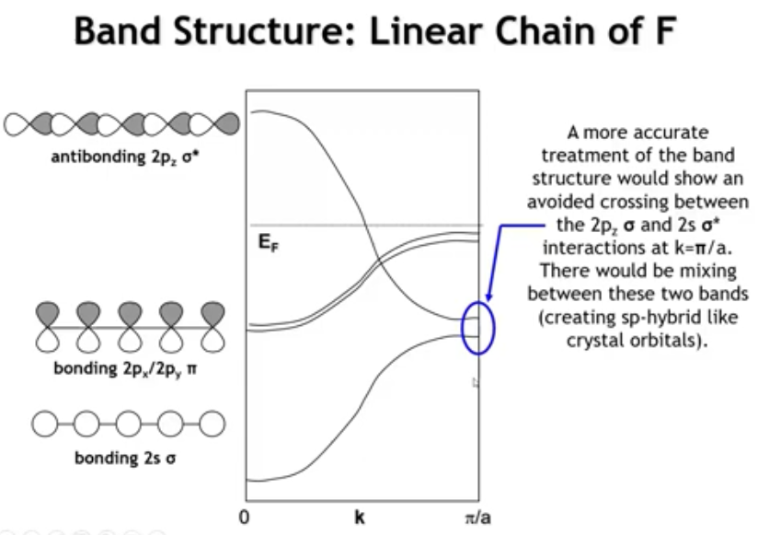
Notes:
One subtlety: more rigorous calculations show σ 2s and σ 2pz orbitals mix as their bands approach each other at k = π/a. The bands avoid crossing—the 2s gains p character (lowering energy) while the 2pz gains s character (raising energy), creating sp-hybrid character. This is analogous to s-p mixing in the O2 molecular orbital diagram.

Slide 8
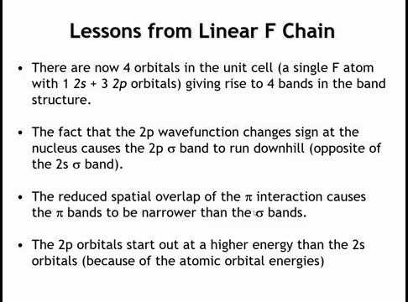
Notes:
Summary: Four orbitals in the unit cell (2s and three 2p) produce four bands. Sketching at k = 0 and k = π/a reveals the 2pz band runs downhill while the other three run uphill. The π bands (2px, 2py) are narrower than σ bands due to weaker overlap. Finally, the atomic 2s-2p energy separation significantly influences the overall band structure.

Slide 9

Key Concepts
1D Band Structures Summary
Band Formation
Material Properties
Bloch functions: ψ = e·u(x) determines phase relationships across unit cells
Zone boundaries: k = 0 (uniform phase) vs k = π/a (alternating phase via e = -1)
Orbital-band rule: Number of orbitals in unit cell = number of bands
Peierls distortion: Dimerization opens band gap by stabilizing filled states
Classification: Fermi level cuts band (metal) vs between bands (semiconductor/insulator)
Direct gap: VBM and CBM at same k → efficient optical transitions (LEDs)
Indirect gap: Different k-points → requires phonon for momentum (Si solar cells)
Bandwidth: σ orbitals wider than π orbitals due to stronger overlap

Slide 10
Homework
6.6-6.8, 6.12

Slide 11

Learning Objectives
Electronic Band Structures in 2D Systems
By the end of this lecture, you will be able to:
Construct reciprocal lattice vectors from real space lattice vectors using perpendicularity and length requirements
Identify the first Brillouin zone as the Wigner-Seitz cell of reciprocal space
Locate and interpret special k-points (Γ, X, M) in 2D square lattices
Predict crystal orbital phase relationships at different k-points in two dimensions
Read and construct band structure diagrams for 2D materials using cuts through reciprocal space
Notes:
we can only go so far with one dimensional materials. Most of the materials that we are interested in exist in higher dimensions. Mostly in three dimensions, but increasingly there are a lot of interesting materials that are essentially two-dimensional in nature. In this lecture we're going to look at band structures in two dimensions. We'll see that the basic idea is the same, but when we go to two dimensions, the representation gets a little trickier.

Slide 12
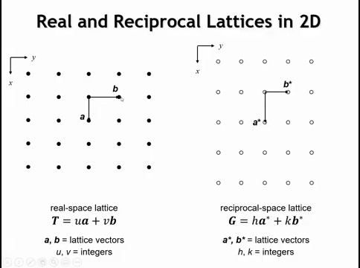
Notes:
Before discussing electronic structure, we need reciprocal space lattices—a concept used in both band theory and crystallography, though not intuitive for most chemists. A real space lattice (left) is generated by integer combinations of vectors A and B. For every real space lattice, there's a corresponding reciprocal lattice (right). While this rectangular example looks similar, the reciprocal vectors A* and B* differ in length and sometimes direction. Like real space, reciprocal lattice points are generated by integer multiples of their lattice vectors.

Slide 13
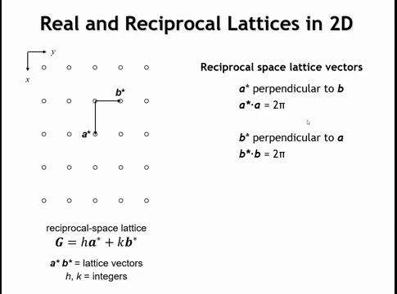
Notes:
Let's consider a little bit more carefully how the reciprocal space lattice vectors are related to the real space lattice vectors. So the reciprocal space lattice vectors have to meet a couple of criteria. In two dimensions, the A star lattice vector must be perpendicular to the real space B lattice vector. And the B star lattice vector must be perpendicular to the real space A lattice vector. So for this rectangular lattice where the real space lattice vectors are at a right angle, that means that A star is parallel to A, and B star is parallel to B. There's also a requirement on the length. The dot product of A star times A is equal to 2 pi, and the dot product of B star times B is equal to 2 pi.

Slide 14
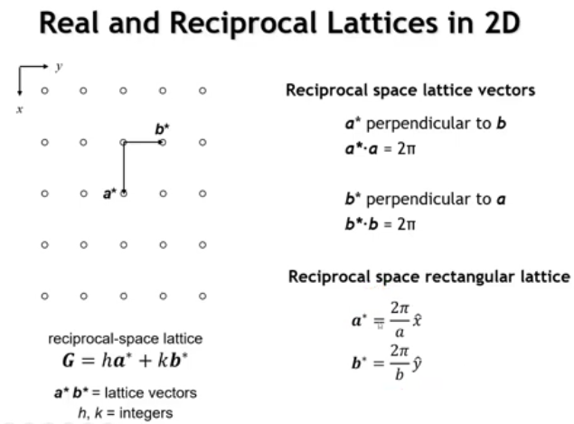
Notes:
Now when we put these both together, we can come up with these expressions for the reciprocal space lattice vectors. The length of the A star lattice vector is just 2 pi divided by the length of the real space A lattice vector, and we have an analogous equation for the B star lattice vector. So what this means is the longer the lattice vector becomes, in real space, the shorter the reciprocal space lattice vector becomes.

Slide 15
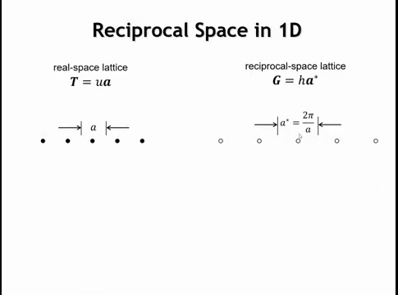
Notes:
How does reciprocal space relate to band structure? Let's return to one dimension. We previously skipped reciprocal lattices in 1D because they're trivial—with only one direction, real and reciprocal space differ only in unit cell length. The reciprocal vector length equals 2π divided by the real space vector length, giving the inverse relationship we saw earlier.

Slide 16
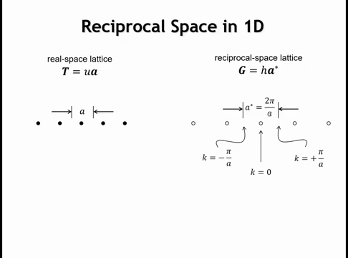
Notes:
But remember that our k vector also had a 1 over distance component to it. And to highlight that, remember when we talked about the first B1 zone, we said that to know everything we have to know about the electronic structure. We need to examine the k values between minus pi over A to plus pi over A. And you can see from this drawing that interval is exactly the same as the reciprocal space unit cell. So the first B1 zone is the unit cell of the reciprocal space lattice. And so that's partly why it's so important.

Slide 17
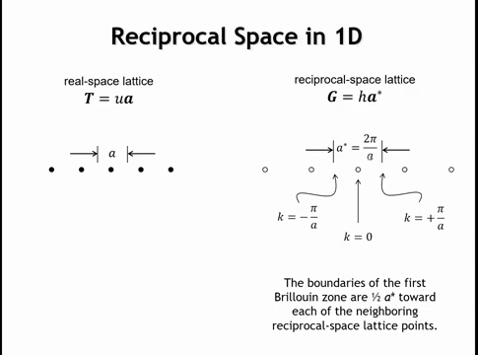
Notes:
And we see here that to find the B1 zone, we just have to start at a lattice point and take one half of the reciprocal space lattice vector in either direction. And that would define our first B1 zone.

Slide 18
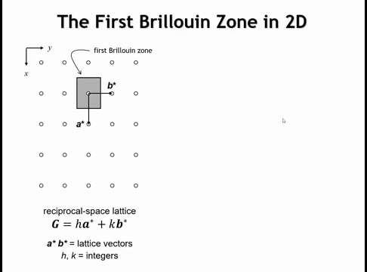
Notes:
So let's take that idea now and bring it into two dimensions. Here's our two-dimensional rectangular reciprocal space lattice. Now if we were to define an area here a rectangle that bisects both of the unit cell vectors halfway to the next reciprocal space lattice point, that would be our first B1 zone.

Slide 19
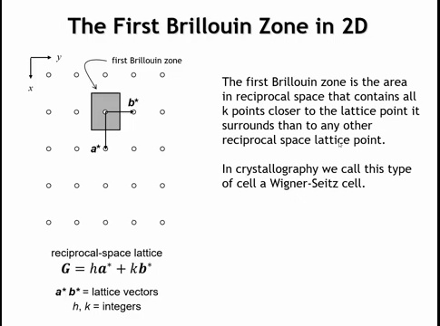
Notes:
The first Brillouin zone is the region of k-points closer to the origin than to any other lattice point. This type of unit cell, formed by bisecting lattice vectors, is called a Wigner-Seitz cell. Unlike crystallographic unit cells, the first BZ doesn't need to be a parallelogram (2D) or parallelepiped (3D) for non-orthogonal lattices like hexagonal or oblique systems.
To represent 2D band structure, we need energy at every point in the first BZ—requiring a three-dimensional plot with kx, ky, and energy axes. We typically take cuts through this 3D structure.

Slide 20
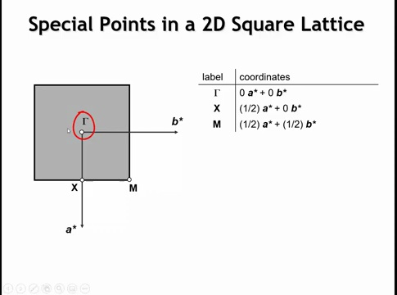
Notes:
Special high-symmetry points are convenient for representation because band extrema (maxima and minima) typically occur there. For a 2D square lattice, there are three special points: Γ (gamma) at the BZ center, X at the zone boundary in the A* direction, and M at the zone corner. A point at the B* boundary would be equivalent to X due to the square lattice's fourfold symmetry. These points are defined by coordinates in reciprocal lattice vectors.

Slide 21
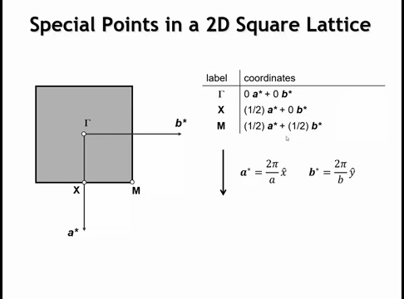

Slide 22
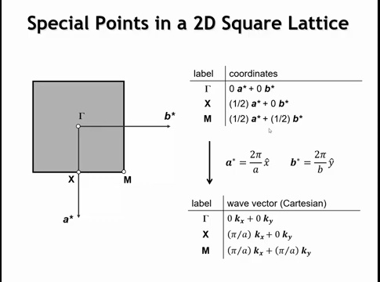
Notes:
Now we want to write these as k-vectors. k is now a vector, not a scalar—often called the reciprocal space lattice vector. Remembering A* = 2π/A and B* = 2π/B, and for a square lattice where A = B, both equal 2π/A.
We can rewrite Γ, X, and M in k-vector terms: At Γ, kx = 0 and ky = 0. X is (1/2)A*, so that's π/A times the kx unit vector plus 0 times ky. For M, we get π/A times both kx and ky components.
We already know how to treat these values. When k = 0, orbital phase doesn't change between unit cells. When k = π/A, we reverse orbital phase between neighboring unit cells.

Slide 23
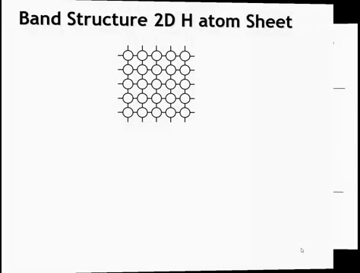
Notes:
So let's illustrate these k vectors with a simple example. Let's look at the band structure of a two-dimensional hydrogen atom sheet, where the hydrogen atoms form a square lattice. So here's the positions of our atoms.

Slide 24
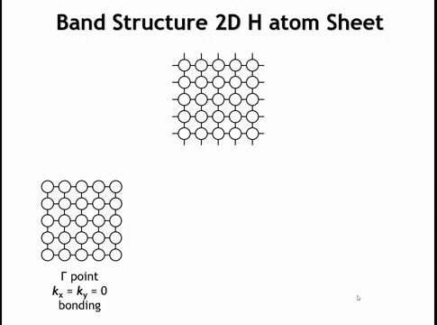
Notes:
If we wanted to look at the orbital overlap at the gamma point, all of the hydrogen 1s orbitals are going to have the same phase at gamma, because k x is 0, and k y is 0. That means when we move to a neighboring unit cell, that the phases of the orbitals stay the same, right? Our e to the ik x term is just 1, a constant.

Slide 25
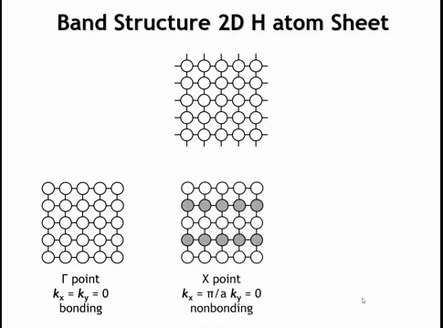
Notes:
At point X, kx becomes π/A, so every time we move from one unit cell to the next in the x-direction, we change the orbital phase. Here's a positive phase, then negative, then positive again, and so on. But in the y-direction, ky = 0, so when we move between unit cells in y, there's no phase change. This crystal orbital is essentially non-bonding—each atom has anti-bonding interactions with its two x-direction neighbors and bonding interactions with its two y-direction neighbors.

Slide 26
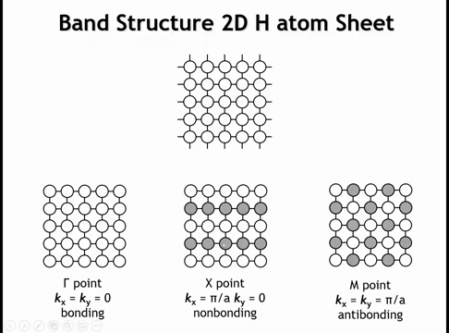
Notes:
Finally, at point M, orbital phases alternate in both x and y directions. Each hydrogen now has four anti-bonding interactions with its neighbors—this is the most anti-bonding crystal orbital. The energy ordering goes: gamma to X to M.

Slide 27
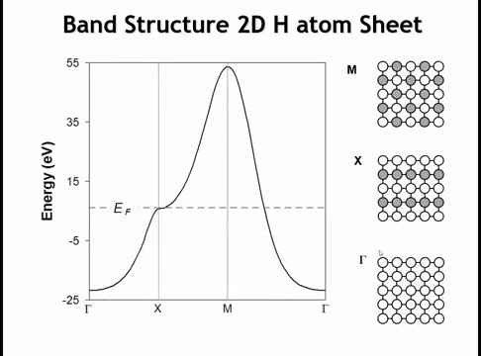
Notes:
How do we represent the band structure? This diagram shows one approach for our 2D square hydrogen sheet. The y-axis is energy, as in 1D. The x-axis shows special k-points—not a continuous coordinate, but labeled positions.
At Γ where kx = ky = 0, we have the all-bonding orbital at minimum energy. At X where kx = π/a and ky = 0, we're anti-bonding in one direction and bonding in the other—approximately non-bonding at intermediate energy. At M, anti-bonding in both directions gives maximum energy.
The path goes Γ to X to M. Often we continue from M back to Γ—the choice is somewhat arbitrary, but points between represent a line through the first Brillouin zone. Like the H atom chain, this is a half-filled band, so the Fermi level cuts through around X, making this a metal.

Slide 28
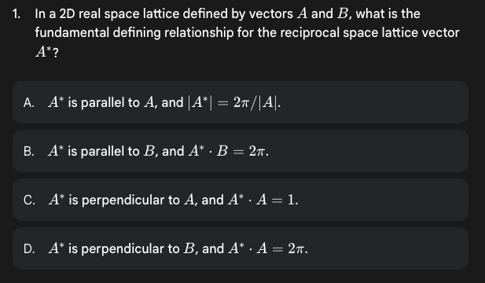

Slide 29
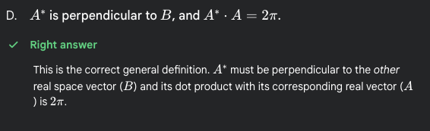

Slide 30
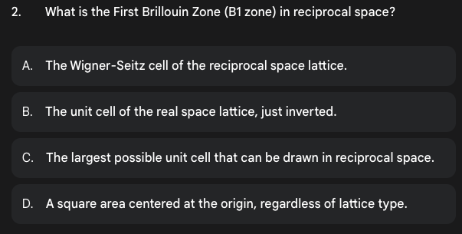

Slide 31
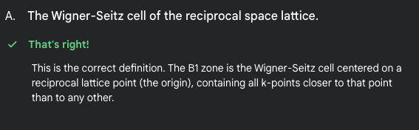

Slide 32
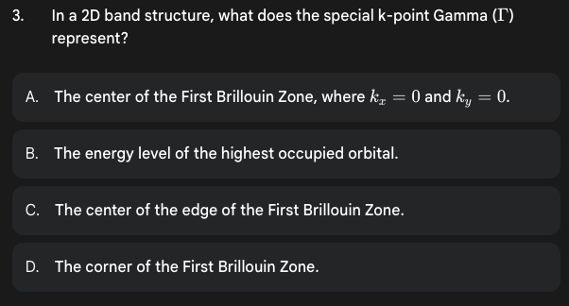

Slide 33
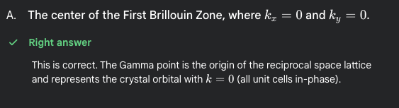

Slide 34
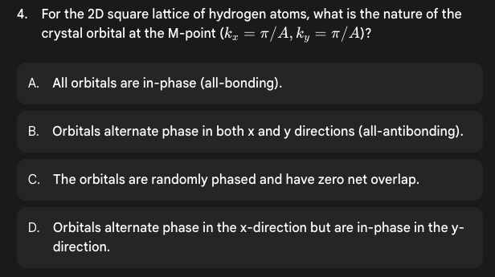

Slide 35
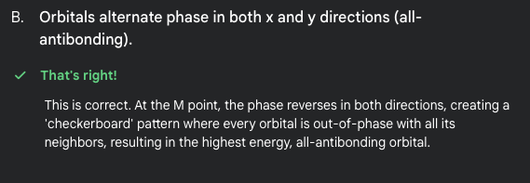

Slide 36
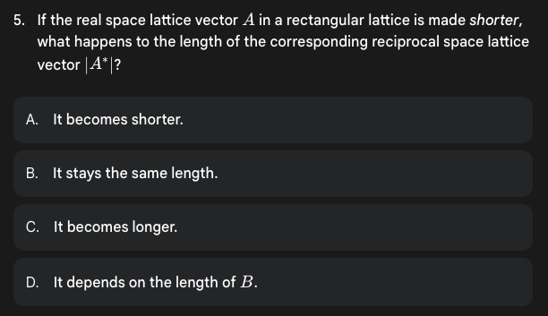

Slide 37
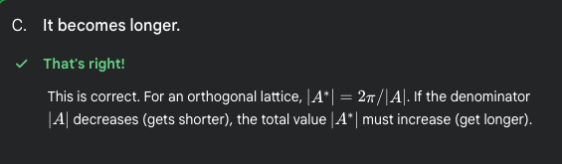

Slide 38
Homework
6.13, 6.14

Slide 39
Learning Objectives
Band Structure of the CuO₂²⁻ Layer
By the end of this lecture, you will be able to:
Construct band structures for multi-atom unit cells from molecular orbital diagrams
Interpret density of states (DOS) and partial DOS diagrams to identify orbital contributions
Predict orbital overlap patterns and symmetry-allowed interactions at different k-points
Relate band width to orbital overlap strength and electron delocalization
Extract key properties from band structure diagrams: metallic vs semiconducting behavior, localized vs delocalized electrons
Notes:
In this lecture, we're going to continue our exploration of electronic band structures. We're going to remain in two dimensions, but we're going to look at something a little more realistic and a little more interesting than a sheet of hydrogen atoms.

Slide 40
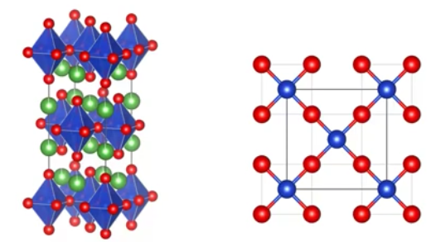
Notes:
Today's topic is the CuO₂²⁻ layer. I chose this example for two reasons: it's our first structure with two atom types, and it's more than a textbook case—this copper oxide layer is the key building block in cuprate superconductors.
The example shown is lanthanum copper oxide, La₂CuO₄, which has a layered perovskite structure. When you replace some lanthanum with divalent cations like strontium or barium, it oxidizes copper from +2 to +3, triggering superconductivity. This discovery in the late 1980s sparked tremendous excitement.
Structurally, the drawing shows octahedral coordination around copper. However, Cu²⁺ exhibits a pronounced Jahn-Teller distortion, making the axial bonds very long. By ignoring these long bonds, we can treat the copper as square planar."

Slide 41
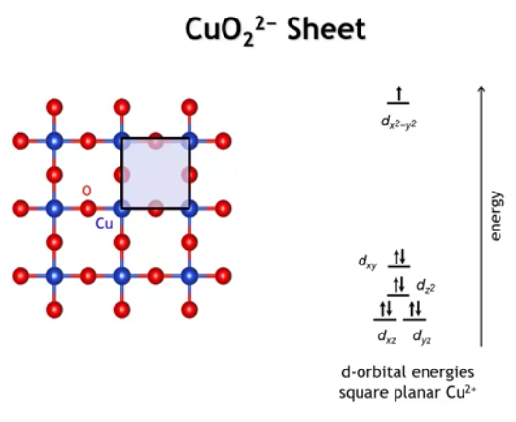
Notes:
For the rest of this lecture, we'll focus on a 2D sheet with Cu²⁺ surrounded by four oxygens in square planar geometry. The unit cell is a square with copper at the corners and oxygen at each edge midpoint.
The MO diagram on the right shows Cu²⁺ in a square planar ligand field. The key feature: the dx²-y² orbital lies much higher in energy than the other four d orbitals because it points directly at the oxygens, making it sigma antibonding.

Slide 42
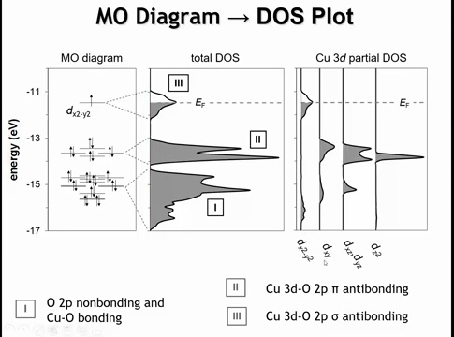
Notes:
Let's start with the band structure results, then work backwards to rationalize them. On the left is the calculated MO diagram for square planar Cu²⁺ using extended Hückel theory. We see four d orbitals (dxz, dyz, dxy, dz²) clustered around -14 eV, then dx²-y² several eV higher as the sigma antibonding MO. Lower in energy are predominantly O 2p orbitals with some Cu mixing to form bonding MOs.
Broadening these molecular orbitals gives the density of states plot in the middle, divided into three regions. Region I contains O 2p nonbonding and Cu-O bonding bands—most bonding at the bottom, least bonding at the top. Region II comes from the four d orbitals not pointing at ligands: dxy, dxz, and dyz form pi antibonding bands, while dz² is weakly antibonding. Region III is the sigma star band from dx²-y², which is half-filled since this orbital holds one electron.

Slide 43
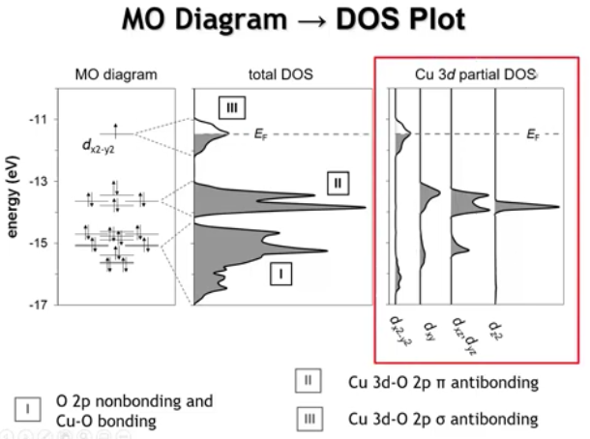
Notes:
The partial density of states (PDOS) on the right shows where specific orbitals contribute to the electronic structure. For dx²-y², we see contributions at the bottom (bonding with oxygen) and top (antibonding). The large splitting reflects its strongest interaction with oxygen.
The dxy orbital, which lies in the xy plane, shows the next highest splitting through π and π* interactions with oxygen—bonding character in the oxygen bands below, antibonding in region II. The dxz and dyz behave similarly, also forming π bonding and antibonding interactions.
The dz² orbital appears in a very narrow energy range because it has weak interactions with oxygen, making it essentially nonbonding.

Slide 44
Notes:
One final point about the DOS: the relative areas reflect orbital counting. Regions II and III both come from Cu d orbitals, but region II has four orbitals while region III has only one—so region III's area is one-fourth that of region II.
Region I is dominated by O 2p orbitals. With two oxygens per copper and three p orbitals each, there are six bands total. Region I's area should be about 50% larger than region II, which contains only four bands.
The density of states is as far as the MO diagram takes us. To determine band widths and create the actual band structure—the spaghetti diagram—we need to analyze orbital overlap.

Slide 45
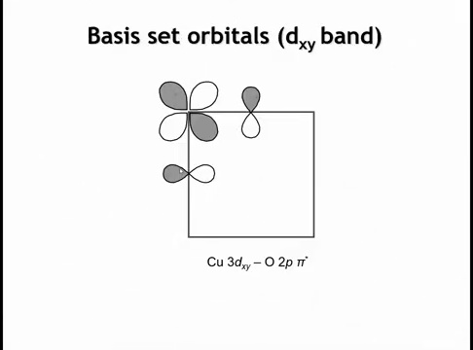
Notes:
Let's analyze two bands, starting with the dxy band. This higher-energy band represents the antibonding interaction between Cu dxy and O 2p orbitals. Here I've drawn this interaction for our basis set—one copper and two oxygens, the unit cell contents.
The next step is applying the e^(ikx) term at different k-points to map out how orbital phases change from one unit cell to the next.

Slide 46
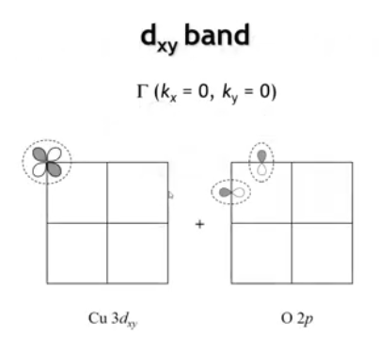
Notes:
So let's start at the gamma point where KX and KY are both zero. Here I've separated the copper orbitals and the oxygen orbitals on two different diagrams just for clarity.

Slide 47
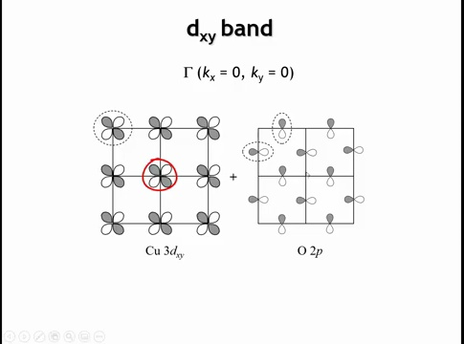
Notes:
So because we're at gamma, it means that if we move to a neighboring unit cell, the phase of the orbital doesn't change. And so we can see here that all of the copper DXY orbitals, they all have exactly the same phase. Now the same must be true for the oxygen. So if we apply that rule, we would get these oxygen two p orbitals. Notice that for the vertical ones, the shaded lobe is pointing up in all cases. And for the horizontal ones, the shaded lobe is pointing to the left in all cases. The next thing is to say, all right, how are these going to interact with each other? And the answer is the interaction is going to be zero. To explain why that is, let's take one of these copper DXY orbitals. Let's take this one here right in the middle. Let's plop it in over here on the oxygen and look at the net interaction between copper and oxygen.

Slide 48
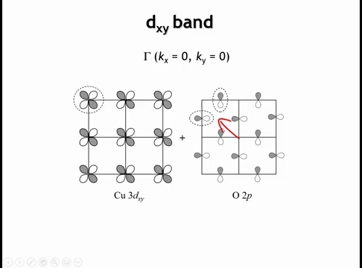
Notes:
So the lobe that goes off this way, that would have a bonding interaction with the oxygen two p orbitals.

Slide 49
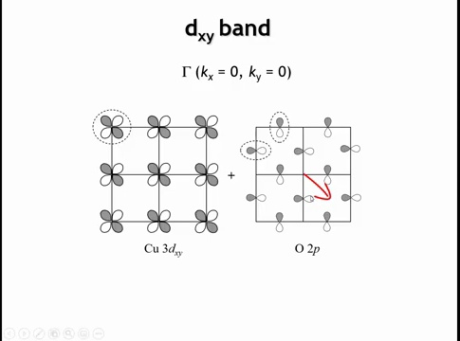
Notes:
ut the lobe that goes in the opposite direction, it's also shaded dark, it's going to have an anti-bonding interaction with the oxygen two p orbitals.

Slide 50
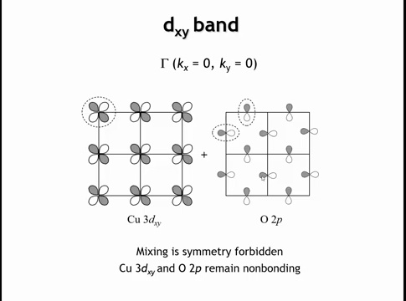
Notes:
If we were to look at the other two lobes, the one that comes uppr right and lower left, they're going to encounter oxygen two p orbitals of opposite phase. And so that's also going to be equal bonding and anti-bonding overlap. And so the net interaction is equal parts bonding and anti-bonding. And when we see that, what it means is that these two sets of orbitals have different symmetries. And they're not permitted to mix by symmetry. So they're going to remain non-bonding at the gamma point. And this copper DXY band that we're interested in, we can just call it non-bonding copper DXY at the gamma point.

Slide 51
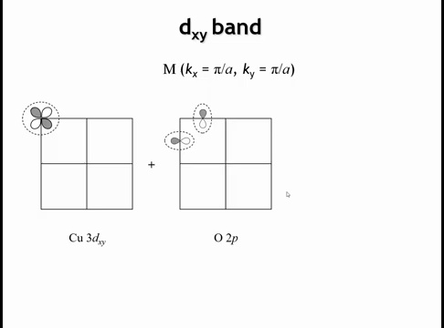
Notes:
Well, how does this picture change if we go to the M point where the KX and the KY are both equal to pi over A? So that point means that when we translate by one unit cell vector in either the X or the Y direction, the orbital phase has to change.

Slide 52
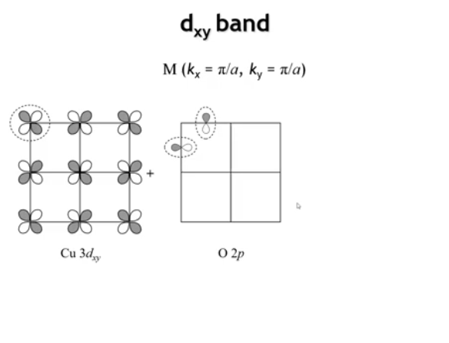
Notes:
every time I move one unit cell in either the X or the Y direction, the phases of the copper orbitals change.

Slide 53
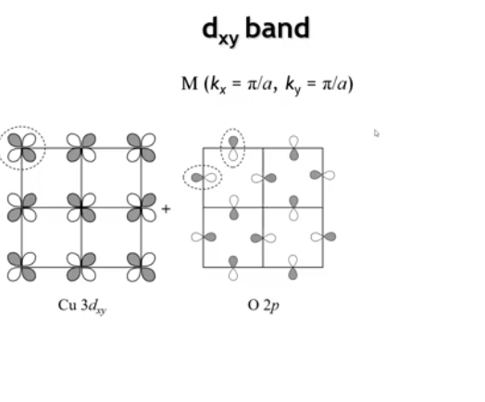
Notes:
We're going to do exactly the same thing for the oxygens. So here, notice I've translated by one unit cell in the X, I change the phase. Translate by one unit cell in the X and I change the phase.

Slide 54
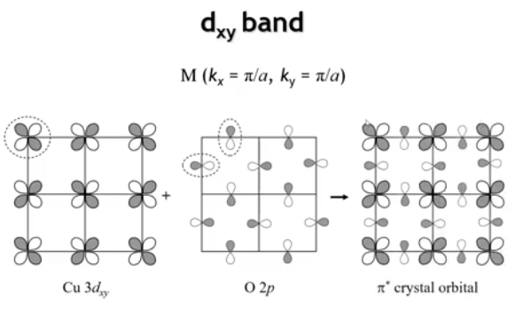
Notes:
Now let's overlay these two orbital sets—they're all part of the same crystal. When we do, we see antibonding π interactions everywhere. This crystal orbital represents the most antibonding π interaction possible between Cu dxy and O 2p orbitals.

Slide 55
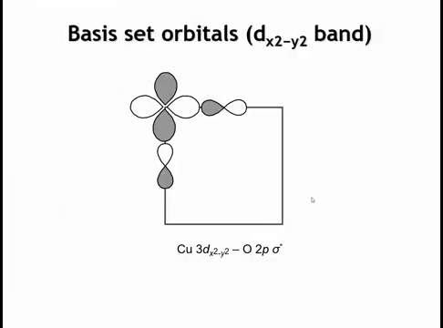
Notes:
What about the DXY squared minus Y squared band, right? That's the band that's at the highest energy. It also happens to be the band where the Fermi level cuts through and that makes it the most important for the properties. Here, I've drawn the anti-bonding sigma interaction between the DXY squared minus Y squared orbital on copper and the oxygen 2P sigma orbitals.

Slide 56
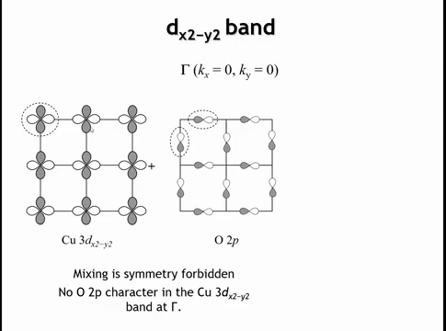
Notes:
We can apply the same analysis for the dx²-y² band at gamma. All copper orbitals have identical phases, as do the oxygen 2p sigma orbitals—horizontal ones with shaded lobes pointing left, vertical ones pointing down.
Just as with dxy at gamma, symmetry prevents mixing. Everywhere a bonding overlap exists, there's an equal and opposite antibonding overlap. These orbitals don't mix at gamma.

Slide 57

Notes:
However, Cu dx²-y² isn't completely nonbonding at gamma. The lower-lying O 2s orbitals, previously neglected, have the correct symmetry to mix in an antibonding way with dx²-y². This interaction is weak due to poor energetic matching between O 2s and Cu 3d, but it's not zero.

Slide 58


Slide 59


Slide 60


Slide 61

Notes:
here I show a picture which has the interactions of these two D orbitals at gamma at X and at M. And you can see that both of them have, there's minimum energy at gamma. They become anti-bonding in one direction when we go to the X point. And then they become anti-bonding in both directions when we go to the M point. So the energy is going to increase as we go from gamma to X to M.

Slide 62

Notes:
The DX²-Y² band starts lowest at Γ, rises to X, rises further to M, then descends back to Γ. The copper DXY band follows similar behavior. The copper DZ² band is nearly flat, indicating minimal ligand interaction. The DXZ and DYZ bands transition from non-bonding at Γ to anti-bonding at X and M (though less anti-bonding than DX²-Y²). Corresponding bonding orbitals mirror these anti-bonding orbitals at lower energy. The count matches expectations: six oxygen 2p bands, four lower-energy d bands, and one half-filled band (copper DX²-Y²) at higher energy than the other d bands.

Slide 63

Notes:
What's plotted: Energy (Y-axis) vs K vector (X-axis). The K vector indicates how orbital phases change between unit cells and relates to electron crystal momentum.
Number of bands: One band per atomic orbital in the unit cell.
Band energy position: The band's center of gravity derives from the orbital energy in the building unit's molecular orbital diagram.
Band slope: Determined by orbital overlap—predicts whether bands rise or fall from Γ to M.
Property predictions: Fermi level cutting through a band indicates metallic conductivity; gaps between filled and empty bands indicate semiconducting or insulating behavior.
Band width interpretation: Wide bands reflect strong orbital overlap between unit cells, yielding delocalized electrons (if partially filled). Narrow/flat bands (like DZ²) indicate minimal overlap between neighboring unit cells, corresponding to localized electrons.

Slide 64
Homework:
6.9
6.10
6.11
6.13
6.14
6.15
6.16

