Slide 1
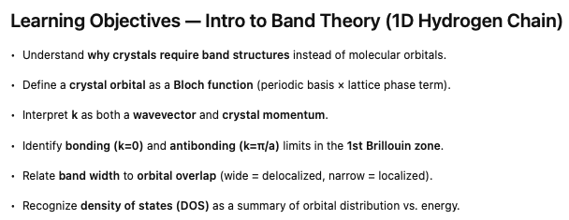
Notes:
Over the past several lectures, we've been talking about the electronic structures, first of atoms and then of molecules. Now, as we move on to chapter 6, we're going to look at the electronic structure of an infinite crystal.

Slide 2
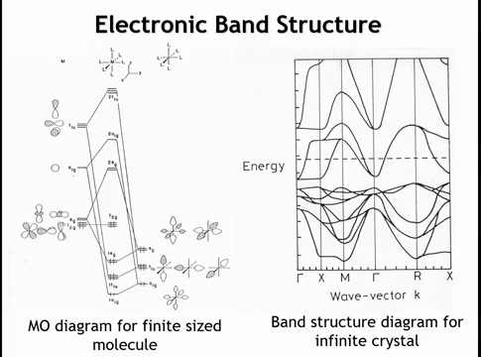
Notes:
This slide shows where we’re headed. On the left is the molecular orbital diagram for an octahedral transition-metal complex, formed by combining metal orbitals with ligand SALCs. But in a crystal, atoms repeat infinitely—so treating it as a giant molecule isn’t practical. Instead, we describe its electronic structure with a band structure. The diagram on the right shows the band structure of ReO₃, built from transition-metal–centered octahedra. The goal of this chapter is to understand how such “spaghetti diagrams” arise from atomic orbitals and bonding in extended solids.

Slide 3
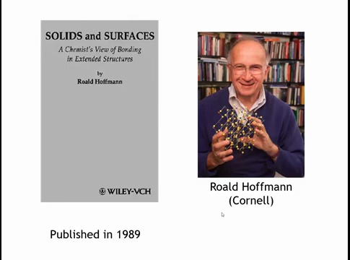
Notes:
We’ll be following Chapter 6 of Solid State Materials Chemistry. Much of the conceptual foundation, though, comes from Roald Hoffmann at Cornell, who pioneered how chemists describe electronic structures of solids. His short 1989 book—Solids and Surfaces—is an excellent, deeper companion resource.

Slide 4
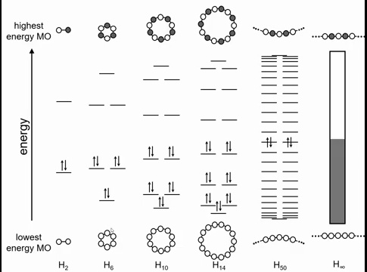
Notes:
To move toward understanding electronic structure in solids, we’ll start small and scale up. We begin with molecules made only of hydrogen—each atom contributing one 1s orbital—and build larger systems until we reach an infinite, one-dimensional chain with translational symmetry. The smallest unit is H₂, with bonding and antibonding molecular orbitals. Expanding to rings of 6, 10, 14, or 50 H atoms shows key trends: the number of orbitals equals the number of atoms, half are filled, and the energy spacing between orbitals decreases as the system grows. In the infinite limit, the levels form a continuum—half filled—with more closely spaced orbitals at the top and bottom of the energy range than in the middle.

Slide 5
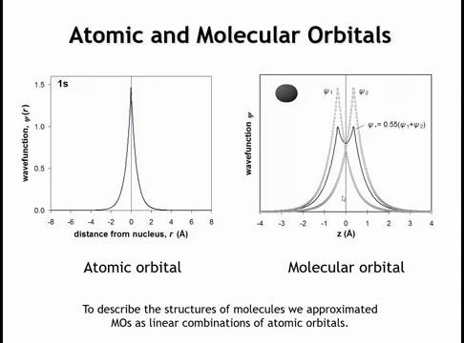
Notes:
You noticed on the last slide that I drew pictures with orbitals shaded lighter dark until I got to the one that was, you know, infinity. And then I just shaded things in. How do we construct or think about the orbitals that exist in an infinite solid? It's worth remembering that when we constructed the electronic structure of a molecule, we used molecular orbitals. And those molecular orbitals, we took to be linear combinations of atomic orbitals.

Slide 6
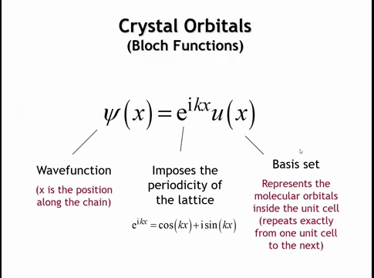
Notes:
For a crystal, we construct crystal orbitals as linear combinations of atomic orbitals using the Bloch function:
\psi(x) = u(x)e^{ikx}.
Here, x is position along the 1D chain. The basis function u(x) repeats periodically—identical in every unit cell—and represents the local atomic or molecular orbitals (for hydrogen, the 1s orbital). The phase factor e^{ikx}, a complex exponential, imposes the lattice periodicity and defines how orbitals in different unit cells combine. By Euler’s relation, e^{ikx} = \cos(kx) + i\sin(kx), describing the periodic oscillation of the wavefunction across the crystal.

Slide 7
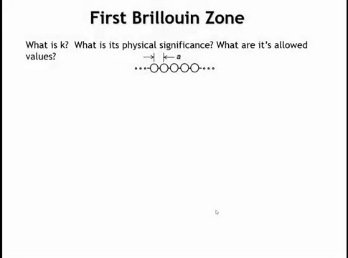
Notes:
Everything so far should feel familiar. The u(x) term is just the hydrogen 1s wave function. The e^{ikx} term involves x, the position in the chain—but what about k? What does it represent physically, and what values can it take? To answer that, let’s start by determining the possible range of k values. Consider our one-dimensional chain—not infinite for now, but a ring of hydrogen atoms.

Slide 8
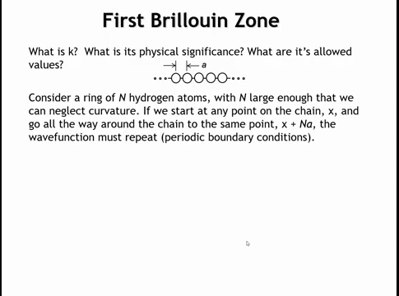
Notes:
We can take the ring large enough that its curvature is negligible—say, 10,000 hydrogen atoms. Starting half an angstrom from the atom we call the origin, traveling once around the ring means moving through 10,000 lattice spacings, each of length A, the distance between atoms. After going 10{,}000A, we return to the same point, so the wavefunction must have the same value there.

Slide 9
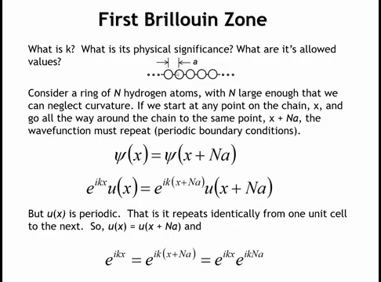
Notes:
The wavefunction must satisfy
\psi(x) = \psi(x + N A),
where N is the number of atoms and A is the lattice spacing. In the limit of an infinite chain, this becomes a periodic boundary condition: the wavefunction’s value at one end equals its value at the other.
We write \psi(x) = e^{ikx}u(x). At x + N A:
\psi(x + N A) = e^{ik(x + N A)}u(x + N A)
Since u(x) is identical in each unit cell and periodic with A,
u(x + N A) = u(x).
This cancels out, leaving
e^{ikx} = e^{ik(x + N A)} = e^{ikx} e^{ik N A}.

Slide 10
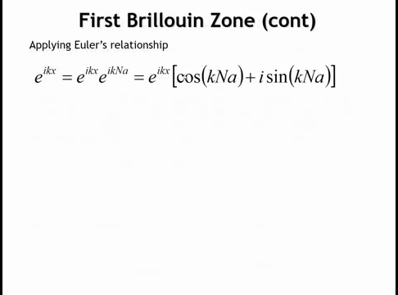
Notes:
Let's use Euler's relationship now just for the second term. Let's write e to the ikna as cosine of kna plus i sine of kna. Now, if you look at this for a minute, it's not too hard to work out that this term in brackets has to be one for this equality to hold. Because only if it's one is e to the ikx going to be equal to e to the ikx. If it takes any other value, the equality would be violated. So let's think about what would make this term in brackets equal to one.

Slide 11
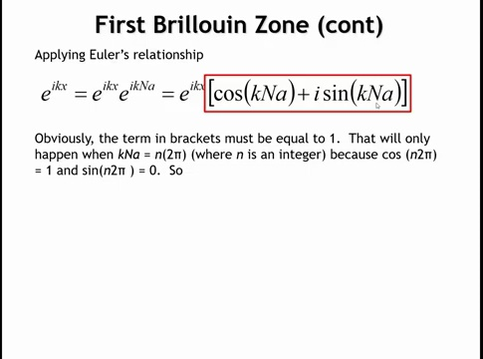
Notes:
If we think in radians, the term in brackets must equal an integer multiple of 2 pi for the wavefunction to repeat. Cosine of 2 pi, 4 pi, and so on is 1, and sine of those values is 0, so the function returns to the same value. This means that k, multiplied by the number of atoms in the chain (N) and the spacing between them (A), must equal an integer times 2 pi.

Slide 12
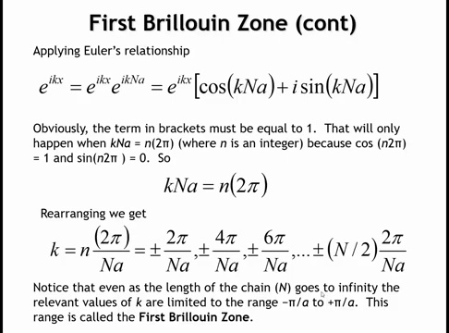
Notes:
Rearranging gives k equal to an integer n times 2 pi divided by the number of atoms N and the lattice spacing a. For a ring of 10,000 hydrogen atoms, there are 10,000 molecular orbitals. Allowing n to take both positive and negative values—plus or minus 1, 2, 3, and so on up to 5,000—produces one orbital for each atom. As the ring grows larger, the allowed k values move closer together, but the endpoints stay fixed at plus and minus pi over a. In the limit of an infinite chain, this range from minus pi over a to plus pi over a defines the first Brillouin zone, which plays the same role for electronic structure as the unit cell does for the crystal lattice. Knowing the states within this zone gives the complete electronic structure.

Slide 13
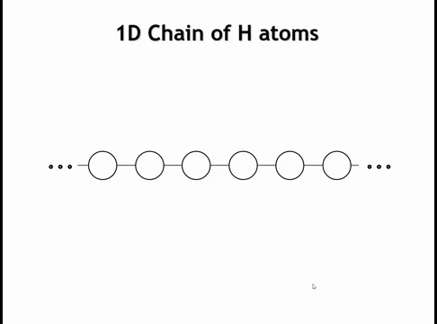
Notes:
Okay, so this might all seem slightly abstract to you. So let's illustrate it with an example. Let's go to our one-dimensional chain of hydrogen atoms. We're going to let this be infinite now.

Slide 14
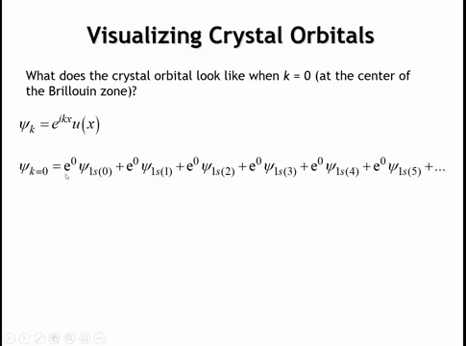
Notes:
And let's write the mathematical functions for our different crystal orbitals.
At k equals zero, we’re at the center of the first Brillouin zone. The crystal orbital is given by the same general formula, but with k equal to zero, the exponential term becomes one. So each term in the sum—whether it’s the 1s orbital at the origin, one unit cell away, two unit cells away, and so on—adds with the same phase.

Slide 15
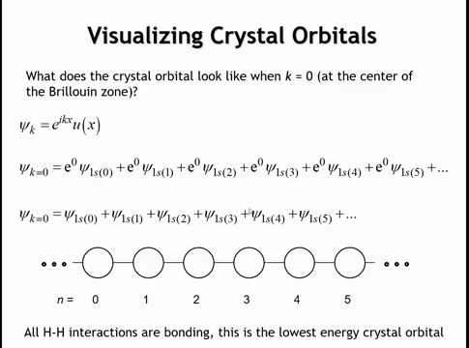
Notes:
Since e to the zero equals one everywhere, each orbital has the same coefficient of one. The total wavefunction is therefore just the sum of all the hydrogen 1s orbitals along the chain. If we draw the first few orbitals, all overlap constructively, forming a fully bonding molecular orbital—the most bonding possible combination. This makes it the lowest-energy crystal orbital in the first Brillouin zone.

Slide 16
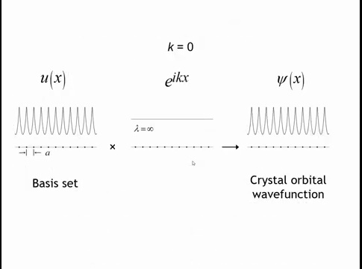
Notes:
Mathematically, we can plot this as a sum of 1s orbitals centered on each hydrogen atom. The dots mark the nuclei, and the curve shows their combined wavefunctions. Since the exponential term equals one when k is zero, it’s constant, so the crystal orbital simply matches the summed 1s atomic orbitals—this is its mathematical form.

Slide 17
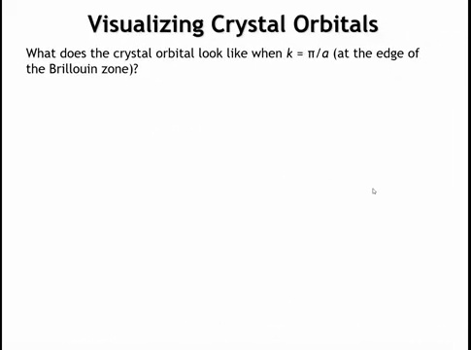
Notes:
Now let’s move to the other extreme in the first Brillouin zone—the largest possible k value, k equals pi over a. Here, a is the one-dimensional lattice constant, the spacing between hydrogen atoms.

Slide 18
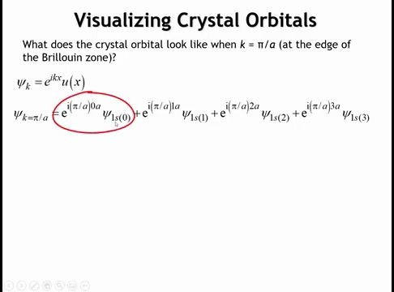
Notes:
We start with the same formula, but now k equals pi over a instead of zero. Substituting this value throughout, each orbital’s coefficient depends on its position x. For the atom at the origin, x equals zero, so its exponential term equals one.

Slide 19
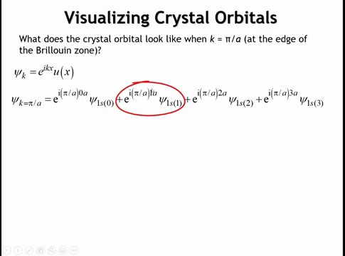
Notes:
For the orbital one unit cell from the origin, x equals one times the lattice spacing a. For the hydrogen two unit cells away, x equals two a, and so on for each successive atom along the chain.

Slide 20
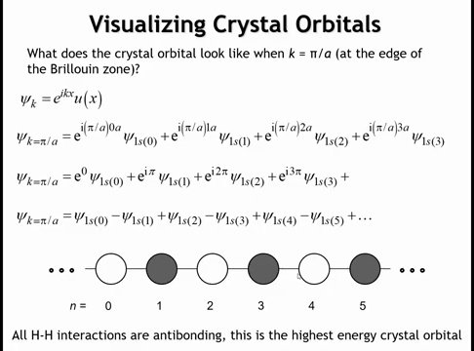
Notes:
Using Euler’s relation, the first term equals e to the zero, or one. The next term, e to the i pi, gives cosine of pi equals negative one and sine of pi equals zero. The following term, e to the i 2 pi, returns positive one, then e to the i 3 pi gives negative one again. The coefficients therefore alternate between +1 and –1 across the chain. Graphically, each hydrogen 1s orbital alternates in phase—positive, negative, positive, negative—so neighboring orbitals interfere destructively. This produces a fully antibonding crystal orbital, the highest-energy and most antibonding state possible.

Slide 21
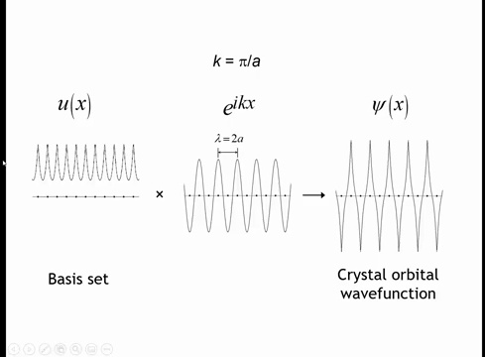

Slide 22
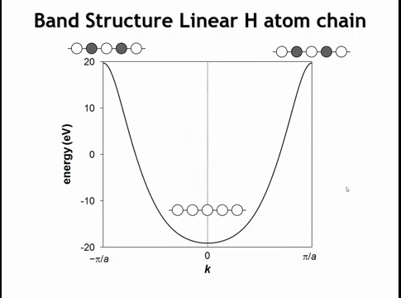
Notes:
Putting this all together gives what’s called the band structure—the “spaghetti diagram.” In this simple case there’s only one band, but we can still see key features. At k equals zero, at the center of the first Brillouin zone, all orbital interactions are bonding, giving the lowest-energy crystal orbital. At k equals pi over a, all interactions are antibonding, giving the highest-energy orbital in the zone. If we move in the negative k direction, the cosine and sine terms produce a mirror image. From what we’ve derived, we only know the energies at a few points, so the actual curve between them could be straight or slightly curved. The shape shown here, calculated with extended Hückel theory, is roughly parabolic. Let’s consider what the crystal orbital looks like at intermediate points—such as k equals pi over 2a, halfway between the center and the zone boundary.

Slide 23
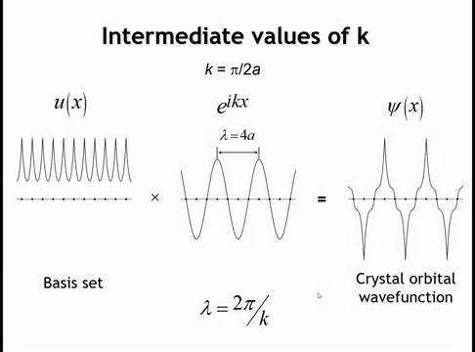
Notes:
At k equals pi over 2a, the function still varies sinusoidally, but because of the factor of 2 in the denominator, its wavelength doubles. The wavefunction now repeats every four unit cells instead of two. In general, the wavelength equals 2 pi divided by k. Substituting k equals pi over 2a gives a wavelength of four times the lattice spacing a. When this oscillating term multiplies the 1s basis set, the resulting crystal orbital alternates in phase every two atoms: positive, node, negative, node, and so on. The nodal planes are now two atoms apart, making this orbital less antibonding—and therefore lower in energy—than the one at k equals pi over a, but higher in energy than the fully bonding orbital at k equals zero.

Slide 24
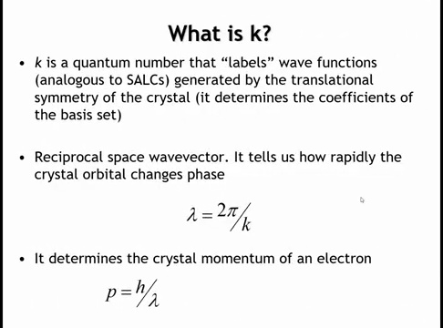
Notes:
So what exactly is this variable k? We can think of it in several ways.
Each crystal orbital has its own k value. In a finite ring of 10,000 atoms, there are 10,000 distinct k values—one for each molecular orbital. In an infinite crystal, k can take infinitely many values, each describing a different crystal orbital with a unique phase pattern among the hydrogen 1s wavefunctions. In this sense, k serves as a label that defines the phase relationships, or coefficients, of the atomic orbitals in the crystal.
It also tells us how quickly these coefficients alternate in sign, which relates to how rapidly the orbital oscillates within the lattice. From this oscillation, we can define a wavelength for the crystal orbital, and by de Broglie’s relation, the momentum of the electron is Planck’s constant divided by that wavelength.

Slide 25
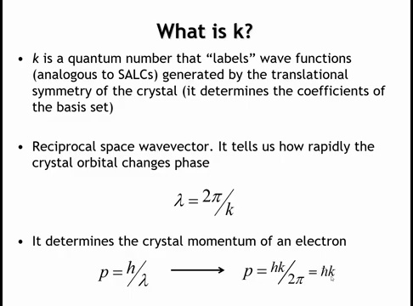
Notes:
If we use this value of lambda from up here and plug it into Broglie's relationship, then we get this relationship. The momentum of the electron is equal to h bar times the value of k. And so we see that k also tells us something about the momentum of the electron. And in that sense, it's called a crystal momentum. And we'll see for things like optical transitions that has important consequences.

Slide 26
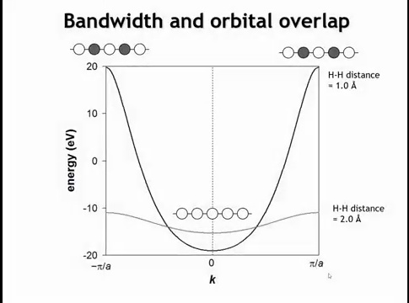
Notes:
To relate the band structure to the real-space crystal, consider this one-dimensional elemental solid. The plotted band structure assumes hydrogen atoms spaced one angstrom apart. In this case, the highest-energy crystal orbital is about +20 electron volts, and the lowest is about –20 electron volts. If we increase the atomic spacing to two angstroms, the overall symmetry of the band—its parabolic shape—remains the same, but the bonding interactions at k equals zero weaken due to reduced orbital overlap. As a result, the lowest-energy, fully bonding orbital rises in energy compared to when the atoms were closer together.

Slide 27
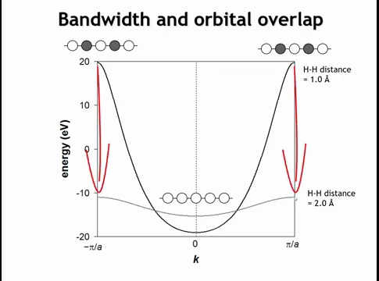
Notes:
At the edges of the Brillouin zone, the antibonding interactions also weaken significantly, lowering the energy there as well. The energy difference between the top and bottom of a band is called the bandwidth. When orbitals from neighboring unit cells overlap strongly, the bandwidth is large—the band is wide or highly dispersed—and the electrons are more delocalized. When the overlap is small, the bandwidth narrows, and the electrons become more localized.

Slide 28
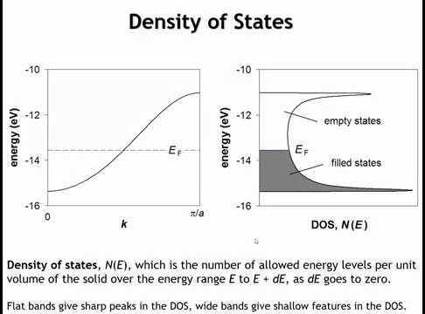
Notes:
The final concept is the density of states plot, a simplified way to represent the full band structure or “spaghetti diagram.” The density of states (DOS) shows how many crystal orbitals exist within an infinitesimal energy range between E and E plus delta E.
In the hydrogen atom chain, the band flattens near the top and bottom, meaning many states fall within a small energy range there. As a result, the DOS shows peaks at both ends of the band. In the middle, the band is steeper, so a small energy window includes fewer orbitals, producing a minimum in the DOS.
This matches what we saw earlier for a 50-atom hydrogen ring, where orbitals were closely spaced at the bottom and top but farther apart in the middle. The DOS plot for the infinite chain captures that same pattern. Although it omits detailed features of the full band structure, it gives essential information about the electronic structure of a crystal.

Slide 29
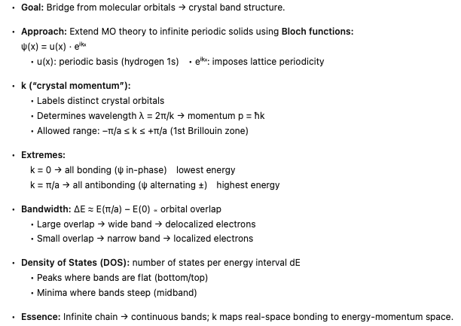

Slide 33
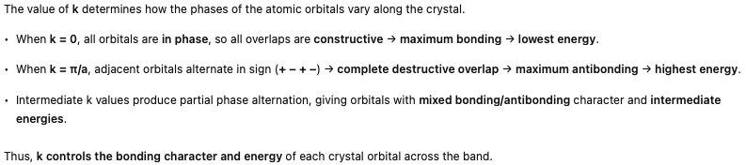

Slide 34
Homework
6.1-6.5

Slide 35

Learning Objectives
Electronic Band Structures in 1D Systems
By the end of this lecture, you will be able to:
Construct band structures for one-dimensional molecular chains and understand how dimerization creates band gaps
Predict the number of bands from the number of atomic orbitals in the unit cell
Distinguish between direct and indirect band gaps and explain their impact on optical properties
Classify materials as metals, semiconductors, or insulators based on band structure and Fermi level position
Analyze how different atomic orbitals (s, p-sigma, p-pi) contribute to band formation and dispersion
Notes:
Welcome to today's lecture on electronic band structures in one-dimensional systems. This builds directly on our previous discussion of the hydrogen atom chain, where we saw how a simple linear arrangement creates a half-filled metallic band.
Today we'll explore more complex systems, starting with H2 molecular chains to understand how dimerization opens a band gap - transforming a metallic system into a semiconductor. This is our first example of a Peierls distortion, where structural rearrangement lowers the overall energy.
A key principle we'll establish is the direct correspondence between atomic orbitals in the unit cell and the number of bands in the structure. One orbital gives one band, four orbitals give four bands - this becomes a powerful predictive tool.
We'll also distinguish between direct and indirect band gaps, which has critical implications for optoelectronic applications. Direct gap materials can absorb and emit light efficiently - think LEDs and solar cells - while indirect gap materials like silicon require phonon assistance, making them less efficient emitters.
Finally, we'll examine a fluorine atom chain to see how s and p orbitals contribute differently. The sigma-bonding p orbitals create wider bands than pi orbitals due to better overlap, and we'll see how orbital mixing (similar to sp hybridization) occurs when bands approach each other in energy.
By the end of today's lecture, you'll be able to sketch band structures, predict material properties, and understand the fundamental connection between atomic structure and electronic behavior in extended solids.

Slide 36
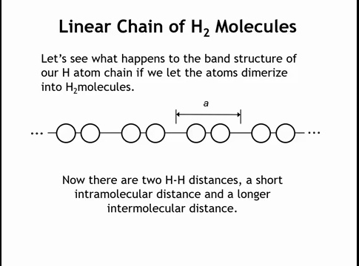
Notes:
"In the last lecture, we saw that a hydrogen atom chain produces one half-filled band, giving metallic conductivity—which does occur at high pressures like in Jupiter's interior. However, under standard conditions, hydrogen atoms dimerize into H2 molecules. In an H2 chain, we now have two distinct H-H distances: short (intra-molecular) and long (inter-molecular). This dimerization doubles the unit cell length, which now contains two atoms—the complete H2 molecule. What are the consequences of this structural rearrangement?"

Slide 37
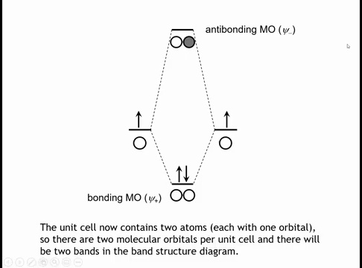
Notes:
The most important consideration is now we have two atoms in the unit cell. Each of those atoms has one orbital, and so there's going to be two bands in our band structure. There's going to be a direct correspondence between the number of atomic orbitals in the unit cell and the number of bands in our band structure. The best way to think about it is just to think about the molecular orbitals of the H2 molecule. We have a bonding molecular orbital, and we have an anti-bonding molecular orbital. And both of those molecular orbitals are going to give us a band.

Slide 38
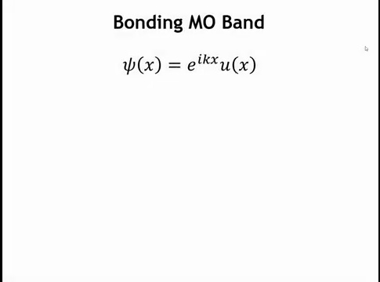
Notes:
Let's start with the bonding molecular orbital. The Bloch function for this band is ψ = e^(ikx) · u(x), where u(x) is our basis set—the molecular orbitals within the unit cell. For this band, u(x) equals the bonding molecular orbital, ψ+.

Slide 39
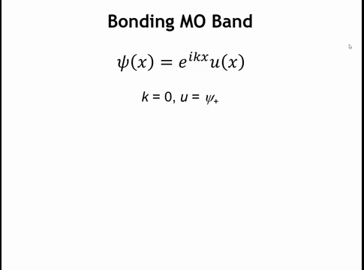
Notes:
So let's take a look at this crystal orbital at a couple of different k points. Let's start at k equals zero.

Slide 40
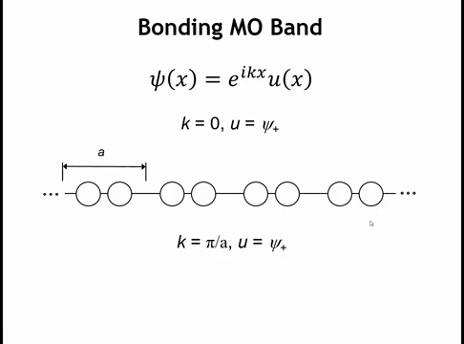
Notes:
At k = 0, the e^(ikx) term equals one, so the coefficient for each unit cell is one—meaning orbital phases remain constant across all unit cells. Since the 1s orbitals maintain the same phase everywhere, interactions are bonding both within each molecule (by definition of our bonding MO basis) and between molecules.

Slide 41
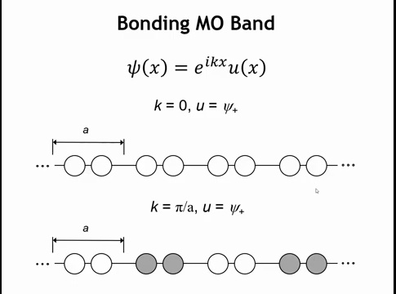
Notes:
At the Brillouin zone edge (k = π/a), the e^(ikx) term alternates between +1 and -1, causing orbital phases to flip between neighboring unit cells. The intra-molecular interaction remains bonding, but inter-molecular interactions become anti-bonding. Crystal orbitals for this band span between these two extremes (k = 0 and k = π/a), and knowing these endpoint energies is sufficient to sketch the band.

Slide 42
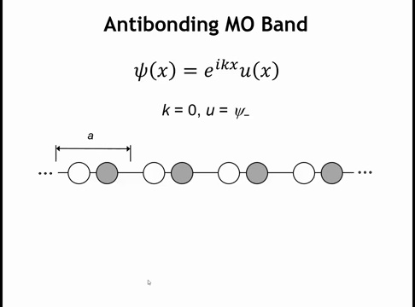
Notes:
For the anti-bonding band, the basis set is now the anti-bonding MO. At k = 0, uniform phases across unit cells create anti-bonding interactions both within and between molecules—doubly anti-bonding—making this the highest energy crystal orbital in the entire band structure.

Slide 43
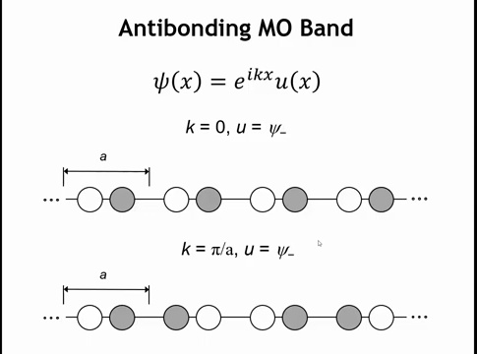
Notes:
At k = π/a with the anti-bonding basis, phase alternation between unit cells makes intra-molecular interactions remain anti-bonding while inter-molecular interactions become bonding. This crystal orbital is lower in energy than at k = 0.

Slide 44
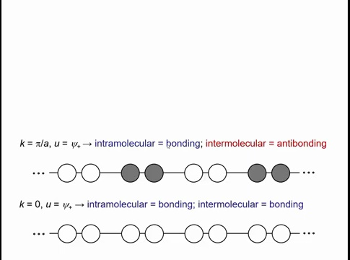
Notes:
Let's arrange these four crystal orbitals by energy. The bonding MO at k = 0 is bonding everywhere—within and between molecules—making it the lowest possible energy. At k = π/a, the bonding MO basis retains intra-molecular bonding but gains inter-molecular anti-bonding, raising the energy.

Slide 45
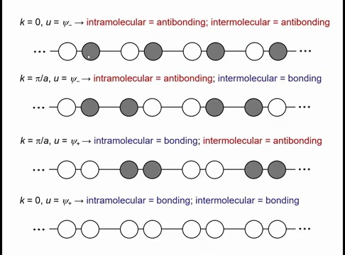
Notes:
The anti-bonding MO at k = π/a is anti-bonding within molecules but bonding between them. This is higher in energy than the bonding MO at k = π/a because the shorter intra-molecular H-H distance creates stronger interactions. Finally, the anti-bonding MO at k = 0 is doubly anti-bonding—both within and between molecules—making it the highest energy state. With these four crystal orbitals ordered, we can now sketch the band structure.

Slide 46
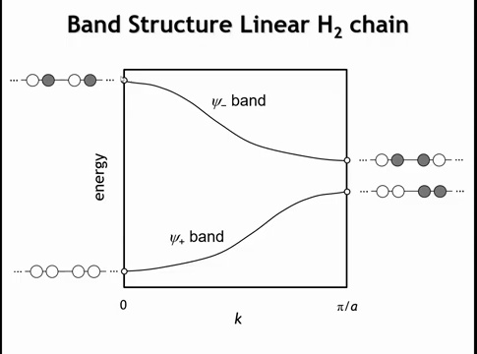
Notes:
We plot the bonding MO at k = 0 (lowest energy) and k = π/a (higher), with k on the x-axis. The anti-bonding MO at k = π/a sits slightly above the bonding MO at that same k-point, while the anti-bonding MO at k = 0 is highest. Connecting these points gives two bands: one from the bonding MO, one from the anti-bonding MO.

Slide 47
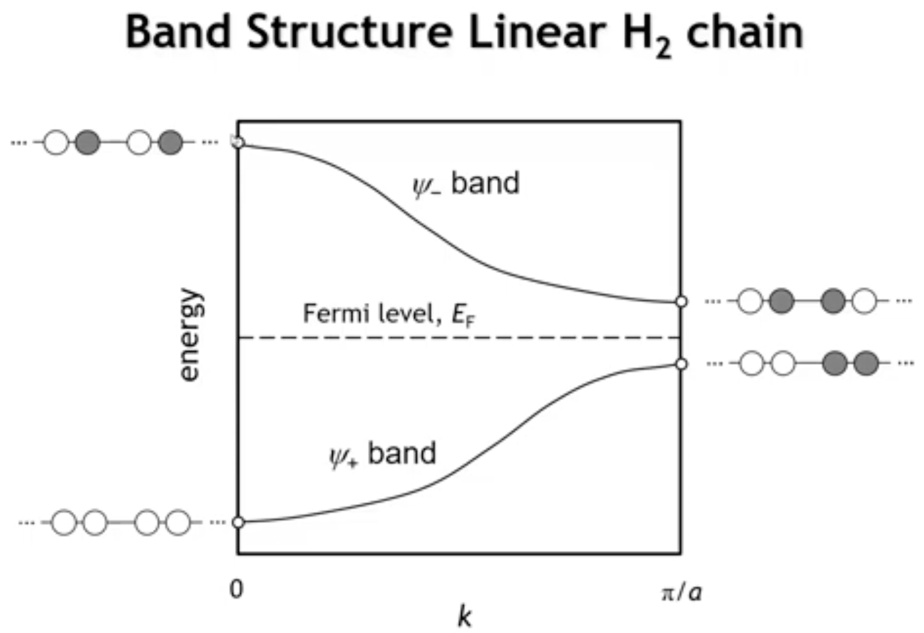
Notes:
Band diagrams must show which states are occupied. The Fermi energy separates filled states (below) from empty states (above) at T = 0. Here, the bonding band is filled and the anti-bonding band is empty.
This diagram explains why dimerization occurs: without it, the two bands would be degenerate at k = π/a. Dimerization stabilizes the bonding band and destabilizes the anti-bonding band. Since only the filled band gains stabilization, the distortion is energetically favorable. This is called a Peierls distortion—the solid-state analog of a Jahn-Teller distortion.

Slide 48
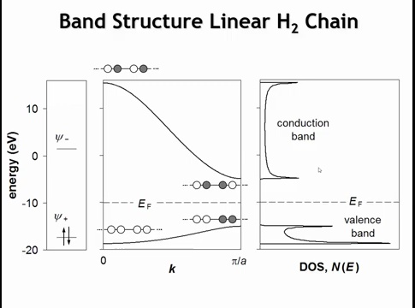
Notes:
Using extended Hückel theory for a more rigorous calculation shows the anti-bonding band is wider than the bonding band—anti-bonding orbitals destabilize more than bonding orbitals stabilize (though extended Hückel may exaggerate this asymmetry). The basic features remain: the lower band rises from k = 0 to π/a, the upper band falls, and the Fermi level lies in the gap. In semiconductor terminology, filled bands are called valence bands, empty bands are conduction bands, and their separation is the band gap.

Slide 49
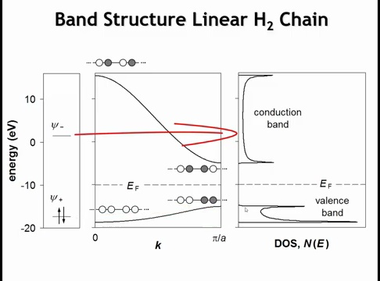
Notes:
We also see in this drawing that if we had drawn the mo diagram for an h2 molecule, we can really kind of think about at least this density of states plot as being obtained by broadening each orbital out into a band

Slide 50
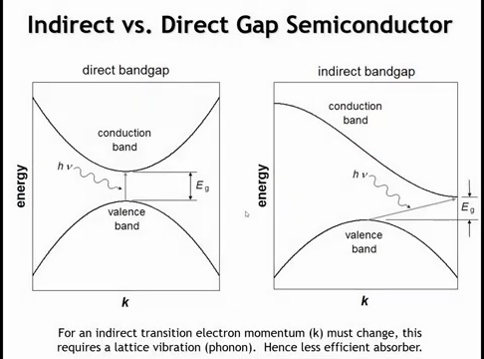
Notes:
When the Fermi level cuts through a band (like in the H-atom chain), infinitesimal thermal energy excites electrons between states—these are metals. When the Fermi level falls between bands, a larger gap (HOMO-LUMO separation) exists—these are semiconductors (or insulators for large gaps).
Semiconductors divide into two types:
Direct band gap: Valence band maximum and conduction band minimum occur at the same k-point. A photon alone can excite electrons vertically—efficient optical absorption and emission.
Indirect band gap: Band extrema occur at different k-points. Since k-vector represents momentum and photons carry negligible momentum, the electron needs both a photon (for energy) and a phonon/lattice vibration (for momentum change). This three-body process is inefficient, giving much lower absorption coefficients—similar to forbidden molecular transitions. For optical applications like LEDs, direct band gap semiconductors are strongly preferred.

