Slide 1
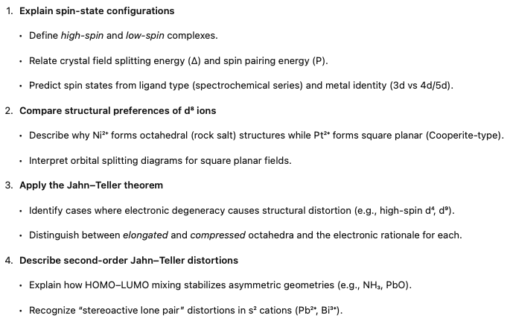
Spin States & Jahn–Teller Distortions
Notes:
In this lecture, we're going to talk about a couple of bonding issues that don't really fit cleanly anywhere else. We're going to talk about spin-state configurations of transition metal ions and yonteler distortions.

Slide 2
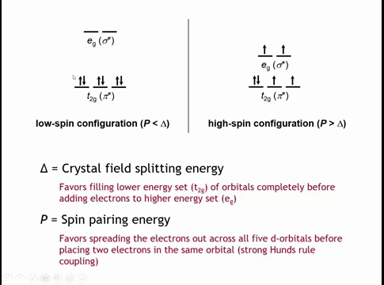
Notes:
When transition metal ions form complexes, the frontier orbitals governing their properties are usually the metal’s d orbitals. In an octahedral field, these split into lower-energy triply degenerate t₂g orbitals (dxy, dyz, dxz) and higher-energy doubly degenerate e_g orbitals (dx²–y², dz²).
Electrons fill t₂g orbitals first, each singly with parallel spins according to Hund’s rule. For the fourth electron onward, two options exist: pair electrons within t₂g or occupy the higher e_g orbitals. Pairing electrons costs spin-pairing energy (P), while promoting them costs crystal field splitting energy (Δ).
If P < Δ, electrons pair in t₂g before entering e_g → low-spin configuration.
If P > Δ, electrons occupy all five d orbitals singly before pairing → high-spin configuration.

Slide 3
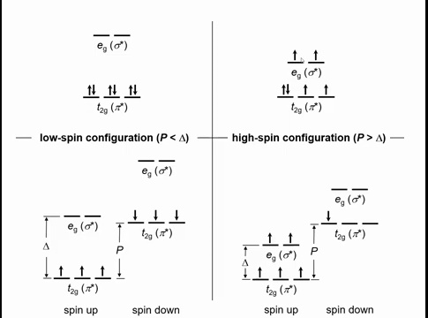
Notes:
Textbooks often compare the crystal field splitting (Δ) and spin-pairing energy (P) using diagrams with two sets of five d-orbital lines: one for spin-up electrons and one for spin-down.
When P < Δ, electrons pair in the lower-energy t₂g orbitals before occupying e_g — the low-spin case.
When P > Δ, electrons fill all spin-up t₂g and e_g orbitals before any spin-down pairing — the high-spin case.

Slide 4
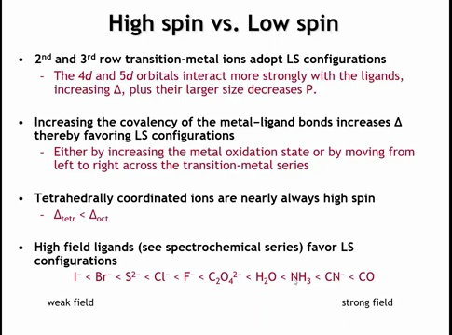
Notes:
Whether a complex adopts a high- or low-spin configuration depends on the relative magnitudes of crystal field splitting (Δ) and spin-pairing energy (P).
For 4d and 5d transition-metal ions, the d orbitals are larger and overlap more with ligands, producing a larger Δ and smaller P — these ions are always low spin. Increasing metal–ligand covalency (shorter bond distance, higher metal electronegativity) also increases Δ, favoring low-spin states.
Δ is smaller in tetrahedral fields, about half that of octahedral ones, so tetrahedral complexes are almost always high spin.
Ligand identity also matters: in the spectrochemical series, weak-field ligands like halides give small Δ (high spin), while strong-field ligands such as CO or CN⁻, which have empty π* orbitals stabilizing t₂g levels, give large Δ (low spin).

Slide 5
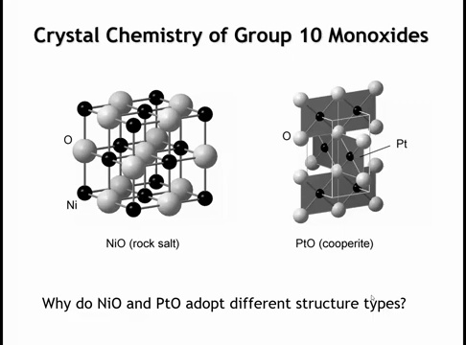
Notes:
Nickel oxide (NiO) and platinum oxide (PtO) share the same stoichiometry and both metals belong to group 10, yet they adopt different structures: NiO forms the octahedral rock-salt structure, while PtO forms the square-planar Cooperite structure. The cause is electronic, not size-related—platinum is larger than nickel, so size would predict higher, not lower, coordination.

Slide 6
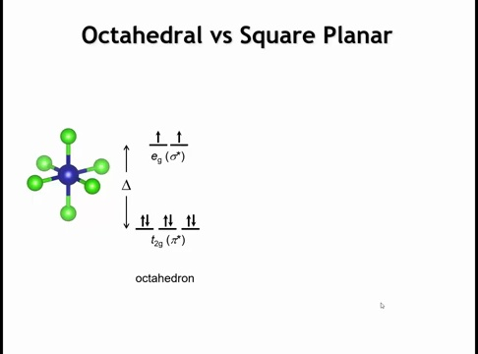
Notes:
To understand this, examine how the 3d orbitals fill. In an octahedral field—such as for Ni²⁺ in nickel oxide—the ion has eight 3d electrons. These occupy the lower-energy t₂g orbitals first, then the higher-energy e_g orbitals, as shown. Now, consider how this filling changes in a square-planar field.

Slide 7
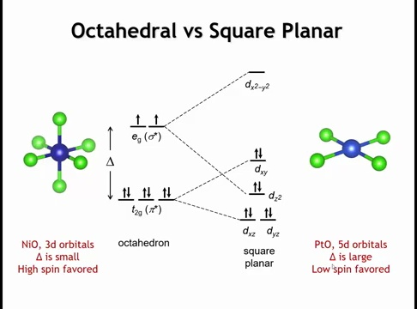
Notes:
Removing ligands along the z-axis reduces interactions in that direction, so the x–y ligands move closer to maintain bonding. This changes orbital splitting: orbitals with z components (d_xz, d_yz) drop in energy, becoming less antibonding; d_xy rises since its lobes lie in the ligand plane. The e_g set splits further—d_z² lowers significantly, even below d_xy, while d_x²–y², pointing directly at ligands, rises sharply. The result is one high-energy antibonding d_x²–y² orbital and four lower-energy orbitals. A d⁸ configuration stabilizes the square-planar field by filling the low orbitals and leaving d_x²–y² empty, though all electrons are now paired, increasing repulsion. In Ni²⁺ (3d⁸), the small splitting favors octahedral geometry to avoid pairing energy, but in Pt²⁺ (5d⁸), strong metal–ligand interactions produce large splitting, stabilizing the square-planar distortion that lowers d_z² and depopulates d_x²–y². Square-planar coordination thus commonly appears for d⁸ and sometimes d⁹ ions with strong ligand fields.

Slide 8
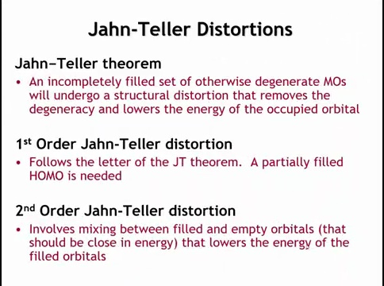
Notes:
The Jahn–Teller theorem states that any molecule or crystal with a degenerate, partially filled highest occupied molecular orbital (HOMO) will undergo a symmetry-lowering distortion to remove that degeneracy and stabilize the system. The distortion allows electrons to occupy the newly lowered orbital, reducing total energy. This is called a first-order Jahn–Teller distortion and requires a partially filled HOMO.
A related effect, the second-order Jahn–Teller distortion, occurs when a filled HOMO and a nearby empty LUMO mix during a distortion, lowering the energy of the filled orbital through orbital hybridization.

Slide 9
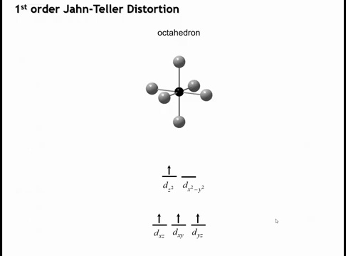
Notes:
A first-order Jahn–Teller distortion commonly occurs in octahedral complexes with high-spin d⁴ (e.g., Mn³⁺) or d⁹ (e.g., Cu²⁺) configurations.
In these cases, the e_g orbitals are unevenly occupied—such as having one electron shared between dz² and dx²–y²—creating a degenerate partially filled HOMO.
This degeneracy drives the system to distort and lower its symmetry to stabilize one orbital and reduce total energy.

Slide 10
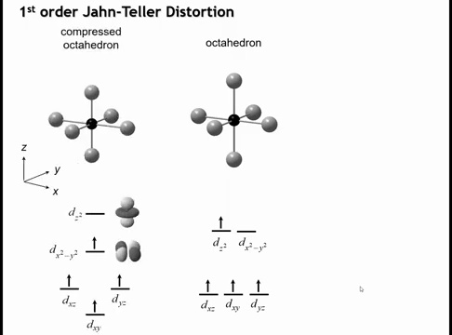
Notes:
Distorting the octahedron removes the orbital degeneracy, as predicted by the Jahn–Teller theorem, though the theorem doesn’t specify how distortion occurs. Two main distortions are possible. In a compressed octahedron, bonds along the z-axis shorten and those in the xy-plane lengthen. This raises the energy of the dz² orbital and lowers the dx²–y² orbital. Both are σ-antibonding, but compression reduces the antibonding character of dx²–y², stabilizing it and lowering the overall energy.

Slide 11
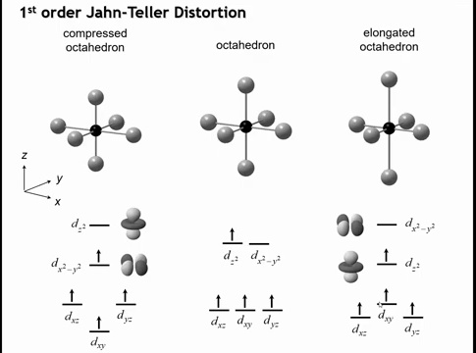
Notes:
We could also elongate the octahedron by stretching the bonds along the z-axis and compressing those in the xy-plane, producing the opposite distortion of the compressed case. Both distortions lower the energy by a similar amount, so from the orbital diagram alone, it’s unclear which will occur. However, in practice, complexes with high-spin d⁴ or d⁹ ions almost always adopt the elongated octahedral geometry, while the compressed form is rare. The question is what stabilizes this elongated structure.

Slide 12
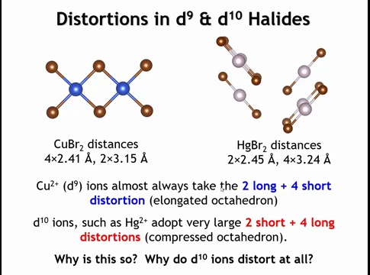
Notes:
In some d¹⁰ systems like Hg²⁺, we often see linear coordination rather than tetrahedral or octahedral. This can be viewed as an extreme form of a Jahn–Teller distortion—a compressed version.
If two bonds are shortened and four are lengthened enough, the structure appears linear.
For example, in CuBr₂ (d⁹) there are four short bonds (2.4 Å) and two long ones, giving an elongated octahedron. In HgBr₂ (d¹⁰), the opposite occurs—two short bonds and four long, forming a compressed octahedron.
This raises the question: why does a fully filled d¹⁰ ion still distort, and what drives this distortion?

Slide 13
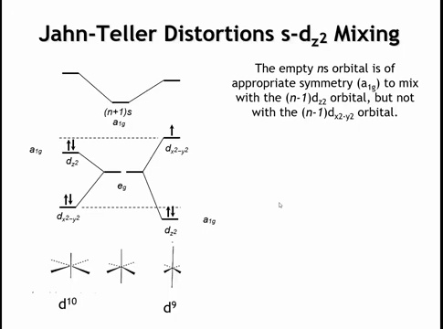
Notes:
To explain this, we need to include the nearby empty s orbital—4s for Cu²⁺ or 6s for Hg²⁺. In an undistorted octahedron, the metal’s e₉ orbitals (dz², dx²–y²) are degenerate and have E_g symmetry, while the s orbital has A₁g symmetry. Because their symmetries differ, no mixing or hybridization occurs.
When the octahedron distorts (either elongates or compresses), the symmetry is lowered from O_h to D₄h (Hermann–Mauguin 4/mmm). This lowering allows previously forbidden mixing between orbitals of compatible symmetry, changing their relative energies.

Slide 14
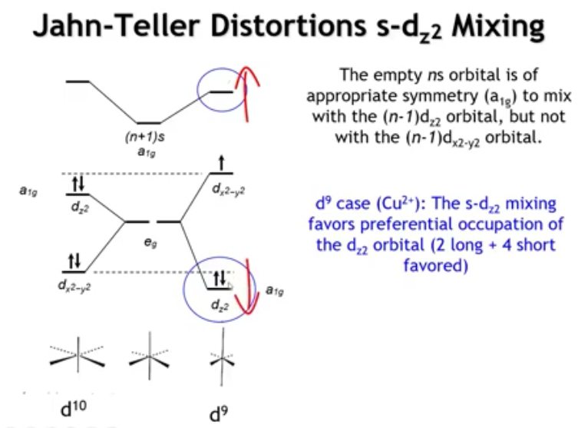
Notes:
When the octahedron’s symmetry lowers, the dz² orbital gains A₁g symmetry, matching the s orbital. Orbitals with the same symmetry can now mix (hybridize)—just like σ(s) and σ(p) mixing in O₂. This interaction raises the s orbital and lowers the dz² orbital in energy.
In a d⁹ configuration, elongation of the octahedron lowers the dz² orbital enough that it becomes doubly occupied, while dx²–y² remains singly occupied, giving a greater stabilization than compression would. Thus, s–dz² hybridization under elongation explains the preferred distortion in d⁹ systems.

Slide 15
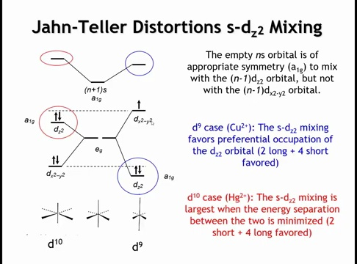
Notes:
In the d¹⁰ case (e.g., Hg²⁺), both dz² and dx²–y² orbitals are doubly occupied. It becomes favorable to raise the dz² orbital’s energy closer to that of the s orbital, increasing s–dz² hybridization. Greater hybridization strengthens orbital mixing and stabilizes the dz² orbital overall.
If the opposite distortion occurred, the energy gap between dz² and s would widen, reducing hybridization and providing less stabilization. Thus, compression increases s–dz² overlap and lowers total energy.

Slide 16
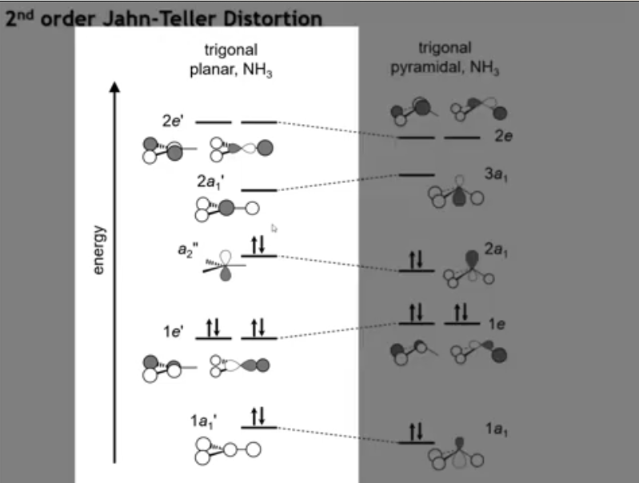
Notes:
A second-order Jahn–Teller distortion is exemplified by ammonia (NH₃).
In a hypothetical trigonal planar NH₃, the molecular orbitals are:
1A₁′ – bonding between N(2s) and H(1s).
2A₁′ – antibonding counterpart.
1E′ – bonding between N(2pₓ, 2p_y) and H(1s).
2E′ – antibonding counterpart.
A₂″ – nonbonding N(2p_z) orbital, which cannot mix with H orbitals and serves as the HOMO.
This configuration sets up conditions for a distortion that mixes the filled nonbonding orbital with nearby empty orbitals.

Slide 17
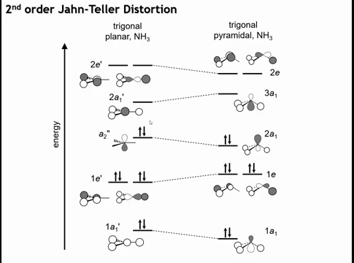
Notes:
Ammonia is not trigonal planar but trigonal pyramidal due to a second-order Jahn–Teller distortion.
When the geometry changes from planar to pyramidal, the p_z and s orbitals both gain A₁ symmetry, allowing mixing between the HOMO (nonbonding p_z) and LUMO (antibonding 2s).
This hybridization creates a filled orbital that is mostly nonbonding but slightly bonding, and an empty orbital that is strongly antibonding.
The filled orbital gains stability because its electron density shifts toward the pyramid apex, forming a weakly bonding region.
Although the antibonding orbital rises in energy, it’s unoccupied, so there’s no penalty.
This distortion occurs when the HOMO–LUMO gap is small and symmetry lowering enables mixing, thereby stabilizing the filled orbital.

Slide 18
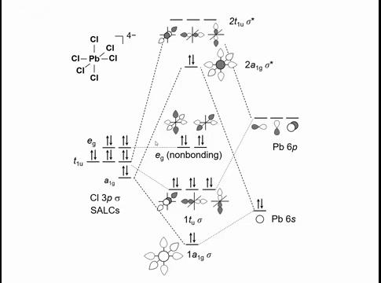
Notes:
A common second-order Jahn–Teller distortion in solid-state chemistry appears in main-group ions such as Pb²⁺, important in ferroelectrics.
In an octahedral environment, the HOMO is the antibonding Pb 6s–Cl combination, and the LUMO is the antibonding Pb 6p–Cl combination.
A distortion that allows mixing of the s and p orbitals (normally symmetry-forbidden) produces stabilization through orbital hybridization—this is the second-order Jahn–Teller effect.

Slide 19
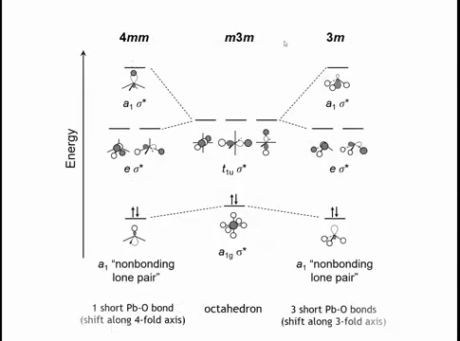
Notes:
Lowering the octahedral symmetry allows mixing between Pb 6s and 6p orbitals.
If Pb²⁺ shifts along the fourfold axis—forming one short and one long Pb–Cl bond—the symmetry drops to D₄h (4mm). This distortion stabilizes the antibonding Pb 6s–Cl interaction and destabilizes the mainly p_z–Cl interaction.
The result is an occupied orbital that is almost nonbonding and localized toward one side of the octahedron.
This is the stereoactive lone-pair distortion, analogous to how VSEPR theory explains the pyramidal shape of NH₃ through a filled sp³ hybrid orbital. The molecular orbital picture provides a deeper, quantitative version of that concept.

Slide 20
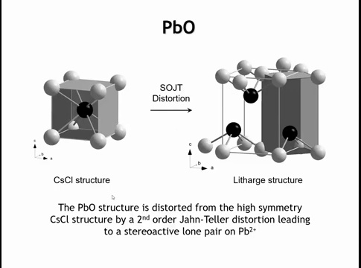
Notes:
Lead compounds commonly show stereoactive lone-pair distortions, a form of second-order Jahn–Teller distortion.
In PbO, which resembles the CsCl structure, the Pb²⁺ ion shifts off-center toward one face of the cube, forming four short Pb–O bonds and two long ones. This creates a cavity that accommodates the lone pair, arising from mixing between the filled antibonding Pb 6s orbital (HOMO) and the empty Pb 6p orbital.
Similar distortions occur in d⁰ transition-metal oxides with high-valence cations such as Mo⁶⁺, Nb⁵⁺, Ta⁵⁺, and Ti⁴⁺, where the cation displaces from the center of its coordination polyhedron due to the same second-order Jahn–Teller mechanism.

Slide 21
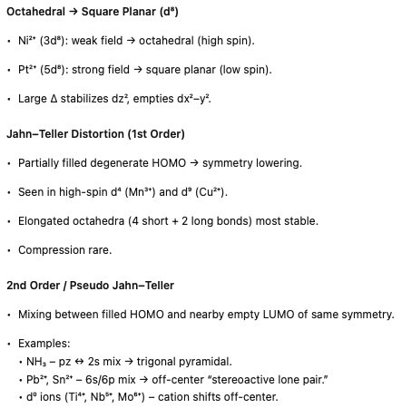
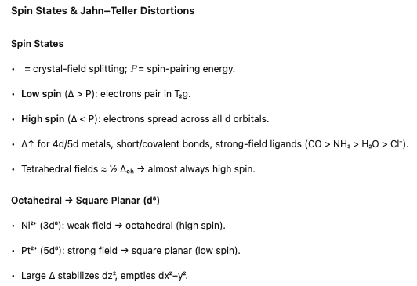
Notes:
Okay, let’s summarize what we’ve seen.
The first idea is about spin states — it’s a balance between the crystal-field splitting, Δ, and the spin-pairing energy, P.
If Δ is large, it pays to pair up electrons in the lower t₂g orbitals — that’s the low-spin case.
If Δ is small, it’s cheaper to spread them out into all five d orbitals — that’s the high-spin case.
Δ gets larger for 4d and 5d metals, for short and more covalent bonds, and for strong-field ligands like CO and CN⁻.
In tetrahedral fields, the splitting is only about half as big, so those are almost always high spin.
Now for d⁸ metals, the difference between nickel and platinum is a good example.
Nickel has a small Δ and stays octahedral.
Platinum has a large Δ and distorts to square planar, pushing the dx²–y² orbital way up and stabilizing the rest.
Then we have the Jahn–Teller effect.
Whenever a degenerate orbital is partially filled — like in high-spin d⁴ or d⁹ ions — the system lowers its energy by distorting, usually by elongating the octahedron.
That removes the degeneracy and stabilizes one orbital.
Finally, in the second-order Jahn–Teller case, we get mixing between a filled and an empty orbital of the same symmetry.
That’s why ammonia isn’t flat — the nitrogen s and p orbitals mix.
And it’s why Pb²⁺ and Sn²⁺ cations shift off-center — their 6s and 6p orbitals mix to make a stereoactive lone pair.
You see the same thing in d⁰ oxides like Ti⁴⁺ or Nb⁵⁺.
All of these effects — spin states, square-planar geometry, Jahn–Teller distortions — come from the same principle: the system always finds a way to lower its energy by changing how the d orbitals are occupied or mixed.

Slide 26
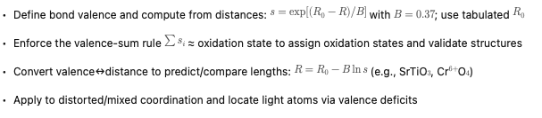
Learning Objectives
Notes:
We are going to conclude our coverage of chapter 5 by talking about something that is collectively called the Bonne Valence Method. It could easily be the most useful thing we're going to learn in all of chapter 5.

Slide 27
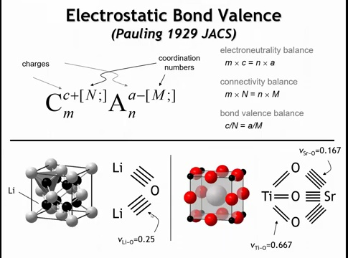
Notes:
The Bond Valence Method builds on Linus Pauling’s early work on ionic bonding. In his 1929 papers, Pauling identified several key balances in ionic compounds.
-First is the electroneutrality balance—the total positive charge of the cations must equal the total negative charge of the anions.
-Second is the connectivity balance—every bond from a cation must terminate at an anion. Knowing the stoichiometry and coordination number of one species fixes that of the other.
-Finally, the bond-valence balance, the focus here, states that the strength of each cation–anion bond must be consistent in both directions. The bond valence s equals the cation charge divided by its coordination number, and this value must also equal the anion charge divided by its coordination number.

Slide 28
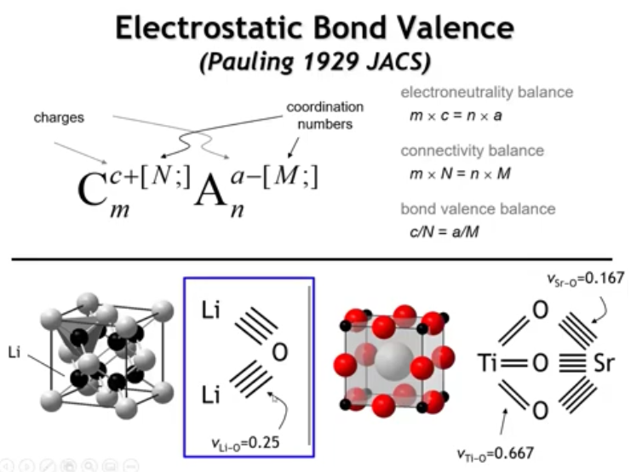
Notes:
-Example: In Li₂O, which adopts the antifluorite structure, oxide ions form a cubic close-packed array and lithium occupies tetrahedral holes. Lithium (+1) has four bonds, giving s = +1/4 per Li–O bond. Oxygen (–2) is coordinated by eight Li atoms, giving s = –2/8 = –1/4. The equal magnitudes confirm the bond-valence balance. So when we draw our bond graph here, what we can say is that each of these lines represents a bond with a valence of 1 quarter.

Slide 29
Notes:
In strontium titanate (SrTiO₃), which adopts the cubic perovskite structure, each titanium atom (Ti⁴⁺) is surrounded by six oxygens. Each Ti–O bond therefore has a valence of 4/6 = 2/3. Strontium (Sr²⁺) is coordinated by twelve oxygens, giving each Sr–O bond a valence of 2/12 = 1/6.
To satisfy the bond-valence balance at oxygen, each O²⁻ must receive two strong bonds from Ti (2 × 2/3 = 4/3) and four weaker bonds from Sr (4 × 1/6 = 2/3). The total, 4/3 + 2/3 = 2, matches oxygen’s oxidation state.
What we're going to do in this lecture is show you how we can become quantitative in our use of these valences.

Slide 30
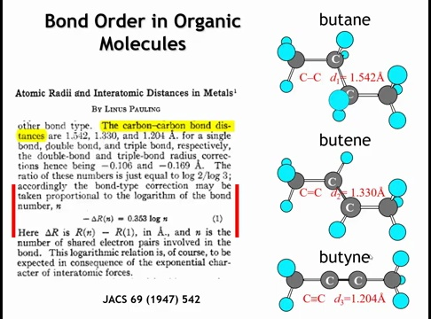
Notes:
In his 1947 paper, Linus Pauling examined the relationship between bond order and bond length in organic molecules such as butane. A C–C single bond typically measures 1.54 Å, a double bond about 1.33 Å, and a triple bond roughly 1.20 Å.
Pauling observed a quantitative trend: as bond order increases, bond length decreases in a predictable logarithmic way. He expressed the change in bond length, ΔRₙ (the difference between the length of a bond of order n and that of a single bond), as:
-ΔRₙ = 0.353 \log(\text{bond order})
This establishes a mathematical link between bond order and bond length, showing that stronger (higher-order) bonds are systematically shorter.

Slide 31
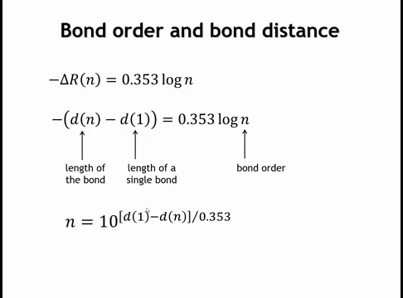
Notes:
Pauling’s equation can be rewritten in terms of bond length (D) for clarity. Here, D_n is the length of a bond of unknown order n, and D_1 is the length of a single bond. Using these variables, the relationship becomes:
D_n - D_1 = -0.353 \log(n)
This form means that if the bond order is known, the bond length can be predicted, and vice versa. Rearranging gives:
n = 10^{(D_1 - D_n)/0.353}
Thus, bond order and bond length are quantitatively linked—knowing one allows direct calculation of the other.

Slide 32
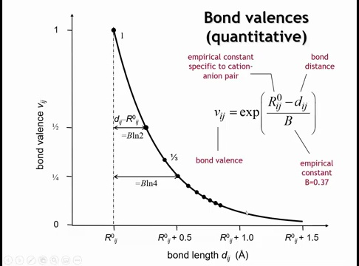
Notes:
To connect this to inorganic compounds like strontium titanate or lithium oxide, we first recognize that bond valence—analogous to bond order—can take non-integer values.
Following Pauling’s idea, we adopt a similar functional form but use an exponential relationship instead of a logarithmic one. The bond valence s_{ij} between atoms i and j is expressed as:
s_{ij} = \exp\!\left(\frac{R_0 - R_{ij}}{b}\right)
Here, R_{ij} is the observed bond length, R_0 is the length of a unit-valence (single) bond, and b is an empirical constant, typically 0.37 Å.
This relationship shows that bond valence decreases exponentially as bond length increases—mirroring the trend Pauling observed in covalent systems but generalized for ionic and mixed compounds. Ok, how are we going to use this?

Slide 33
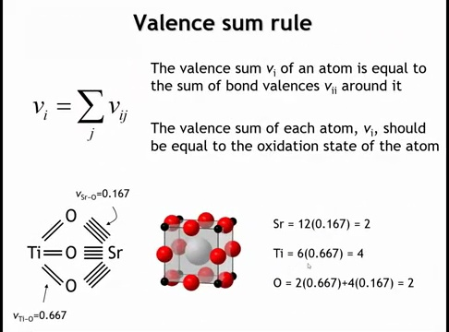
Notes:
In strontium titanate, the key principle of the bond valence method is that the sum of all bond valences to an atom must equal its oxidation state.
Previously, we estimated these bond valences using idealized Pauling values. Now, using the empirical relationship between bond valence and bond length, we can calculate bond valences directly from measured bond distances.
This allows comparison between experimental and idealized values, testing how well real bond lengths conform to the expected valence-sum rule in the structure.

Slide 34
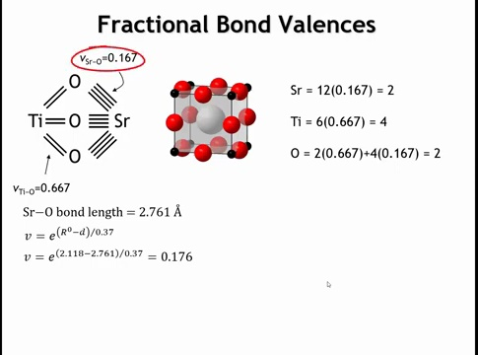
Notes:
For strontium in SrTiO₃, the measured Sr–O bond length is 2.761 Å.
Using the bond valence expression
s_{ij} = \exp\!\left(\frac{R_0 - R_{ij}}{b}\right),
we need the empirical R₀ parameter specific to Sr–O bonds, analogous to looking up an ionic radius. From tabulated data, R₀ = 2.118 Å and b = 0.37 Å.
Substituting:
s_{ij} = \exp\!\left(\frac{2.118 - 2.761}{0.37}\right) = 0.176.
This calculated bond valence (0.176) is slightly higher but close to the idealized value of 1/6 (≈0.167), confirming consistency between measured and theoretical bond strengths.

Slide 35
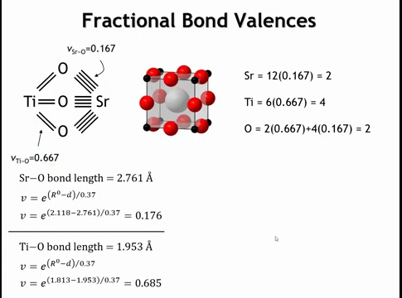

Slide 36
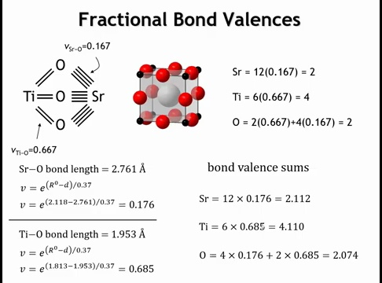
Notes:
Using the valence-sum rule, we add up the total bond valences around each atom.
For strontium, 12 Sr–O bonds each contribute 0.176, giving 2.11, close to the expected +2.
For titanium, 6 Ti–O bonds yield 4.11, near the ideal +4.
For oxygen, 4 Sr–O bonds and 2 Ti–O bonds sum to 2.07, matching its –2 oxidation state.
These small deviations confirm that the measured bond lengths and derived bond valences are consistent with the ideal oxidation states, validating the structure as chemically reasonable. And if you didn’t know if you’re structural measurements were correct on a compound, this would be one way to check.

Slide 37
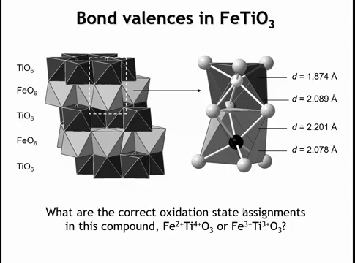
Notes:
Another case where we might use bond valences is when the oxidation states are uncertain.
Here we have the crystal structure of ilmenite (FeTiO₃), a cation-ordered variant of the corundum structure. The structure consists of face-sharing octahedra, where both titanium and iron atoms are displaced away from the shared face.
These distortions make it difficult to predict oxidation states using ionic radii or ideal geometry. However, such distortions are not a problem for the bond valence method—we can use the measured bond distances to calculate the valence sums of each cation directly.

Slide 38
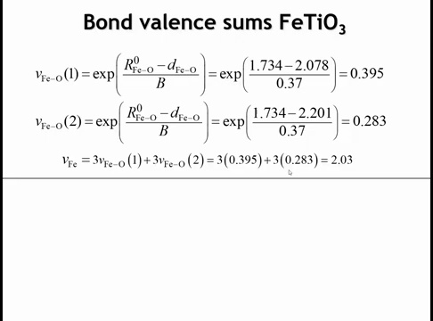
Notes:
So for iron, we have three iron oxygen bonds, which are 2.078 angstroms in length. They have a valence of 0.395 valence units. We have three Feobons that are 2.201 angstroms in length. They have a valence of 0.283 valence units. And so when we add these up, three of each bond, we come up with a bond valence sum of 2.03. So this is suggesting that in this compound we have iron 2 plus. So by inference, the titanium should be 4 plus.

Slide 39
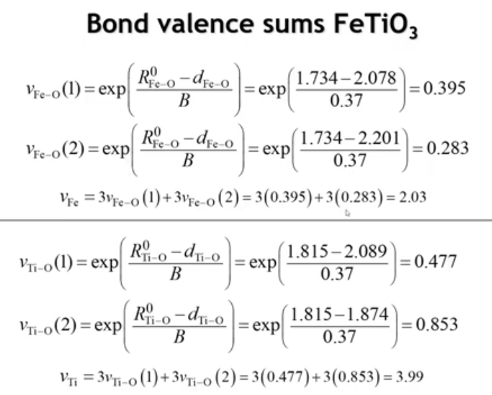
Notes:
Let's look at its bond valence sum to see if that works out. We have three titanium oxygen bonds that are quite long, 2.089 angstroms. Those have a valence of 0.477. And then we have three bonds that are much shorter, 1.874 angstroms. And so those have a valence of 0.853 valence units. And like iron, the titanium is 6-coordinate, 3 of each kind of bond. So when we add up all of those 6 bonds, we get a valence sum of 3.99. Very close to 4, as expected.

Slide 40
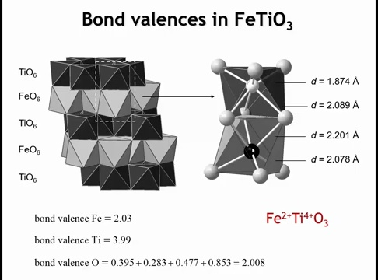
Notes:
So to summarize this compound, our bond valence sum at iron is 2. Our bond valence sum at titanium is 3.99. And if we add up the four bonds to oxygen, we see that's also very close to 2. So we can confidently say that this is iron 2 plus titanium 4 plus.

Slide 41
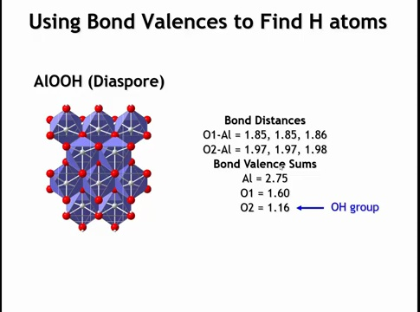
Notes:
Bond valences can also help locate hydrogen atoms, which are difficult to detect by X-ray diffraction due to their low scattering power.
For example, in the mineral diaspore (AlO(OH)), examining the bond valence sums shows one oxygen with a valence of 1.6 and another with 1.16. Both are slightly less than 2 because of covalent and hydrogen bonding, but the key point is that the O2 site has the smaller valence.

Slide 42
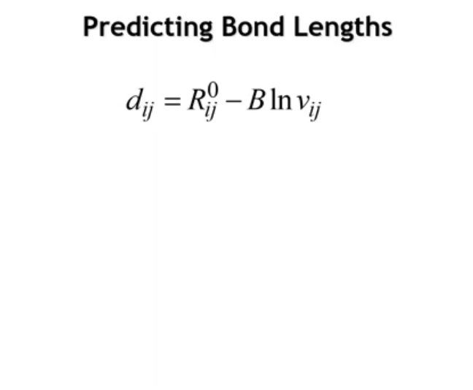
Notes:
We can also use bond valences predictively in the following sense. If we were to go back to our earlier equation that related the valence of a bond to its distance, and we did some algebraic manipulation of that equation to solve for the distance we would get this equation. Armed with this equation, if we have a valence that we want to see, we can predict what the distance should be.

Slide 43
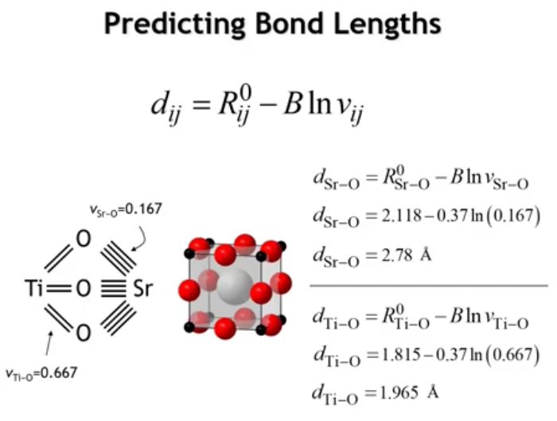
Notes:
Let’s return to strontium titanate (SrTiO₃) and its cubic perovskite structure. From the idealized bond valences in our bond graph, we can now calculate the corresponding bond distances using
R = R_0 - b \ln(s)
For Sr–O, with R_0 = 2.118 Å, b = 0.37 Å, and s = 0.167, we get R = 2.78 Å.
For Ti–O, substituting the appropriate R_0 value and s = 0.667, we find R = 1.965 Å.
These predicted bond lengths define the idealized SrTiO₃ structure. Because the cube edge is the only variable in the geometry, the Sr–O bond must be √2 times longer than the Ti–O bond—a relationship that holds almost exactly. Thus, SrTiO₃ is nearly a perfect cubic perovskite.

Slide 44
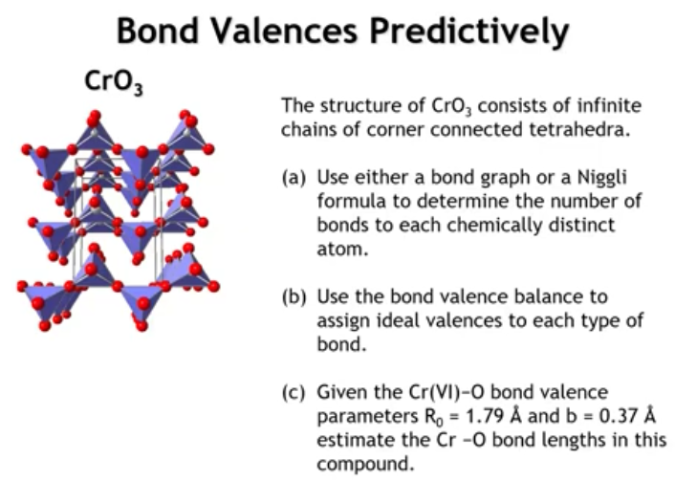
Notes:
Let’s work through a problem that puts everything together. Here is the structure of chromium(VI) oxide, which consists of infinite chains of corner-sharing tetrahedra. - I want you to pause the lecture and answer three questions: - (1) How many chemically distinct oxygens are present in this structure? - (2) Draw the bond graph and assign bond valences to each bond. - (3) Using the given bond valence parameters for the Cr⁶⁺–O bonds, estimate the bond lengths. - Pause the video, work through the calculations, and then resume to check your answers.

Slide 45
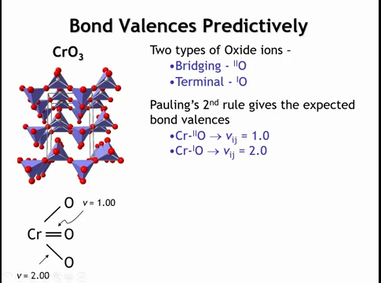
Notes:
Let’s start with the bond graph. We have one chromium and three oxygens, and chromium must make four bonds. The only way to achieve this is with two terminal oxygens, each bonded to one chromium, and one bridging oxygen shared between two tetrahedra. So we have two one-coordinate (terminal) oxygens and one two-coordinate (bridging) oxygen.
To find the bond valences, it’s easiest to sum around the oxygens.
For the terminal oxygens, each forms one bond and must reach a total valence of 2, so each Cr–O bond = 2.
For the bridging oxygen, it has two bonds and must also reach a total valence of 2, so each Cr–O bond = 1.
Checking chromium: it has two bonds of valence 2 and two of valence 1, which sum to 6, matching chromium’s +6 oxidation state.

Slide 46
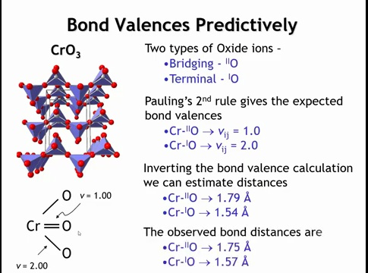
Notes:
If we use the bond valences that we're given on the last slide we can predict that the valence of the bond to the terminal oxygen will be two when the length is 1.54 angstroms and the valence of the bond between the chromium and the bridging oxygen will be one when its length is 1.79 angstroms. So how do these values compare with the experimental structure of chromium six oxide? In the experimental structure we see bond lengths of 1.57 and 1.75. Not an exact match but not very far off either.

Slide 47
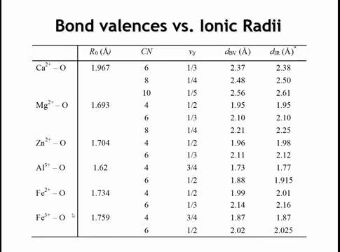
Notes:
Bond valence parameters can be used to predict bond lengths, just as ionic radii can—making the two approaches partly redundant.
For example, using Shannon–Prewitt radii for Mg–O bonds:
4-coordinate: 1.95 Å
6-coordinate: 2.10 Å
8-coordinate: 2.25 Å
These values depend on coordination number, requiring separate radii for each case.
Using bond valences, we need only one parameter set. For Mg²⁺:
4 bonds → each s = 2/4 = 0.5 → R = 1.95 Å
6 bonds → s = 2/6 = 0.33 → R = 2.10 Å
8 bonds → s = 2/8 = 0.25 → R = 2.21 Å
The results match or closely approximate the ionic-radius predictions.
Unlike ionic radii, the bond valence method handles distorted environments naturally.
For instance, in Cr⁶⁺ compounds, ionic radii would predict equal Cr–O distances, but bond valences easily capture the variation among different bond lengths.
Thus, bond valences provide a more flexible and generally superior way to analyze and predict bond lengths.

Slide 48
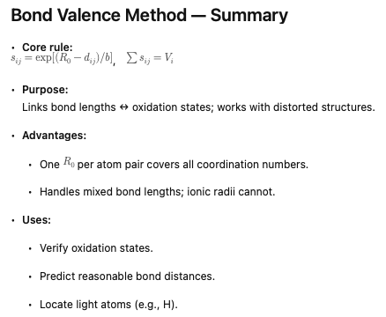

Slide 49
Homework
5.16 – 5.20

