Slide 1
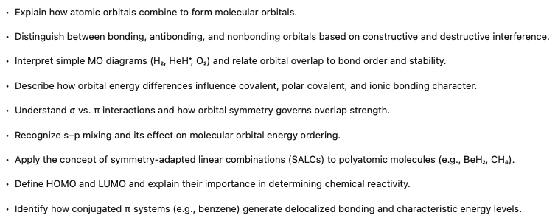
Molecular Orbital Theory
Notes:
In the last lecture, we looked at the properties of atomic orbitals. But of course, if we're ultimately interested in materials, what we really want to know is how do those orbitals behave when we bring atoms together to form molecules, to form extended solids. And to do that, we have to go one step further and talk a little bit about molecular orbital theory.

Slide 2
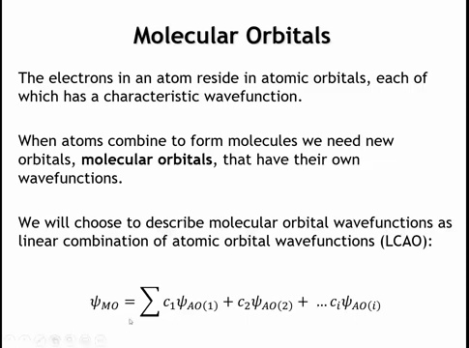
Notes:
A molecular orbital behaves like an atomic orbital—it has a wave function that describes the behavior of an electron and follows the Pauli exclusion principle, holding up to two electrons. The key difference is that a molecular orbital can extend over the entire molecule rather than being confined to one atom. Molecular orbitals can be constructed in different ways; here, we build them as linear combinations of atomic orbitals. In this approach, the molecular orbital wave function (ψ_MO) is expressed as a sum of atomic orbital wave functions, each multiplied by a coefficient.

Slide 3
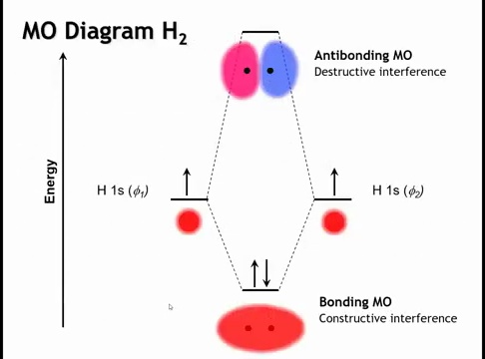
Notes:
The simplest and best-known molecular orbital diagram is for H₂. The hydrogen molecule has two molecular orbitals: a lower-energy bonding orbital and a higher-energy antibonding orbital. The bonding molecular orbital forms through constructive interference of the 1s wave functions from the two hydrogen atoms, increasing electron density between the nuclei. This concentrated electron density enhances attraction to the positively charged nuclei, stabilizing the system. As a result, the bonding molecular orbital lies lower in energy than the atomic orbitals of isolated hydrogen atoms.

Slide 4
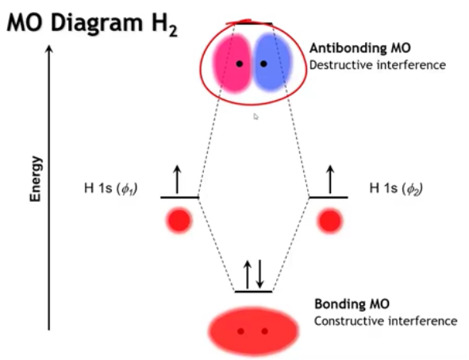
Notes:
We also get an antibonding molecular orbital, formed by destructive interference between the two hydrogen 1s wave functions. The color coding represents the sign of the wave function—red for positive, blue for negative. The node between the atoms forces a region of zero electron density, pushing electrons away from the internuclear region. This reduces stabilization and raises the energy. As a result, the antibonding molecular orbital lies higher in energy than the atomic orbitals of the separate hydrogen atoms.

Slide 5
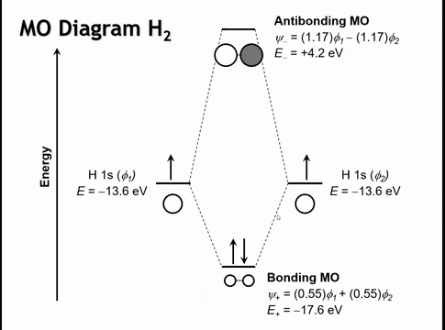
Notes:
We can redraw this using the symbolic style we’ll use going forward. When both atomic orbitals have the same sign, their overlap produces constructive interference and a bonding molecular orbital. When they have opposite signs, destructive interference occurs, creating an antibonding orbital. Using extended Hückel theory, we find that the coefficients in the bonding MO are smaller than those in the antibonding MO. This happens because, during normalization, the antibonding orbital’s positive and negative regions partially cancel each other out when the total wave function is integrated over space. To achieve the same overall normalization (so that the total probability remains one), the remaining portions of the wave function must be scaled up, resulting in larger coefficients. The bonding orbital is stabilized by about 4 eV, while the antibonding orbital is destabilized by about 17 eV. In general, the energy stabilization of a bonding orbital is always less than the destabilization of its antibonding counterpart, which is why filling both orbitals provides no net stabilization and makes bond formation unfavorable.

Slide 6
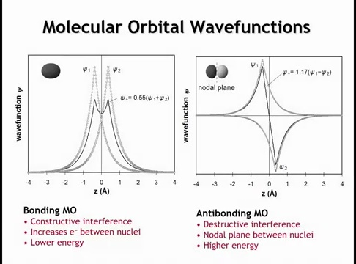
Notes:
If we plot the molecular orbital wave function along the internuclear axis, we see clear interference patterns. In the bonding molecular orbital, the wave functions overlap constructively, increasing electron density between the nuclei. In the antibonding orbital, the wave functions have opposite signs and cancel at z = 0, producing a nodal plane at that point. This pushes electron density away from the nuclei, making the antibonding orbital higher in energy.

Slide 7
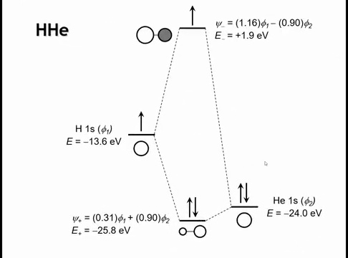
Notes:
Now let’s look at a more complex case with two different atoms. Replacing one hydrogen with helium introduces a higher nuclear charge, so the helium 1s orbital lies lower in energy than hydrogen’s. This energy difference creates partial ionicity—what we call a polar covalent bond.
In the bonding molecular orbital, the coefficient for helium is larger than for hydrogen, meaning the bonding orbital resembles helium’s 1s orbital more strongly. The opposite occurs in the antibonding orbital, which is weighted more toward hydrogen. As the energy gap between atomic orbitals increases, the bonding orbital increasingly resembles the more electronegative atom, while the antibonding orbital resembles the more electropositive one. In the limit of a very large energy difference, the bond becomes purely ionic.

Slide 8
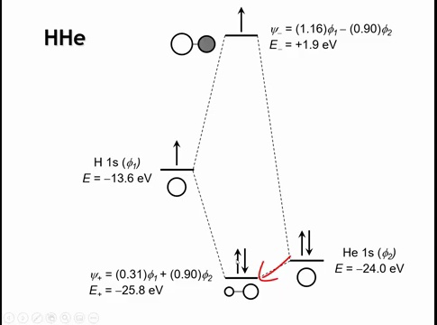
Notes:
Another key point is that the stabilization of the bonding molecular orbital decreases when the atomic orbitals differ in energy. In H₂, the bonding MO is stabilized by about 4 eV, but in the H–He system it’s only about 1.8 eV. This shows that as the energy mismatch between atomic orbitals increases, their overlap and degree of mixing diminish, reducing the bonding interaction.

Slide 9
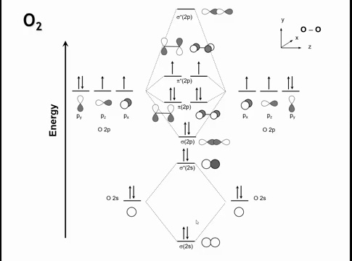
Notes:
Let’s examine O₂, starting with a simplified view and then moving toward the full MO diagram. The two 2s orbitals overlap to form bonding and antibonding MOs, similar to H₂. The 2p orbitals, being higher in energy, also combine—but their interactions split into a 1–2–2–1 pattern rather than three equal pairs.
Along the internuclear (z) axis, the p_z orbitals overlap head-on, forming σ (sigma) bonding and antibonding MOs. The p_x and p_y orbitals overlap side-on, forming π (pi) bonding and antibonding MOs with less overlap. Greater spatial overlap leads to a larger energy gap between bonding and antibonding orbitals, so σ bonds are stronger than π bonds.
To obtain the true O₂ MO diagram, we must also account for σ–σ mixing between the 2s and 2p orbitals, which slightly alters their energies and ordering.

Slide 10
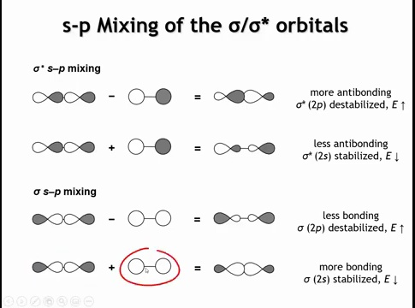
Notes:
When we introduce s–p mixing, the 2s and 2p σ bonding orbitals interact. Adding their wave functions constructively increases electron density between the nuclei, stabilizing the resulting MO. Subtracting them (changing the sign of one orbital) reduces density between the nuclei and increases it on the molecular periphery, raising the energy. As a result, mixing stabilizes the orbital with more 2s character and destabilizes the one with more 2p character. The same pattern occurs for the corresponding σ antibonding orbitals.

Slide 11
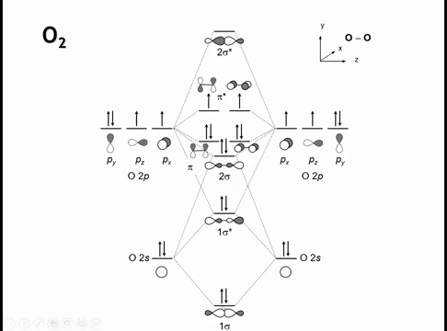
Notes:
Returning to the MO diagram, the σ2s orbital gains some p character, which stabilizes it, while the σ2p orbital gains some s character, which destabilizes it. The same occurs for the antibonding orbitals: σ2s becomes slightly stabilized, and σ2p becomes more destabilized. The net effect is a smaller energy gap between the σ2p and π2p orbitals. In lighter diatomic molecules such as N₂ or C₂, this mixing is strong enough that the σ2p orbital rises above the π2p orbitals in energy.

Slide 12
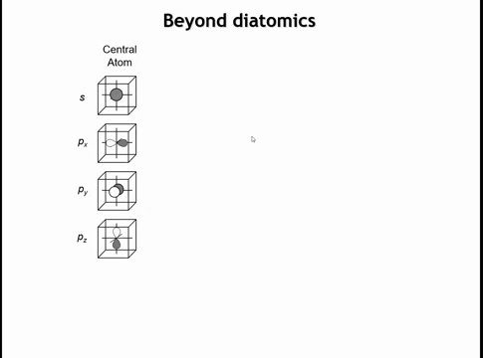
Notes:
To move beyond diatomic molecules, we decompose the system into a central atom and its surrounding atoms, called ligands. The ligand orbitals are then grouped by symmetry into symmetry-adapted linear combinations (SALCs), which represent how the ligand orbitals combine and interact with the central atom’s orbitals to form molecular orbitals consistent with the molecule’s overall symmetry.

Slide 13
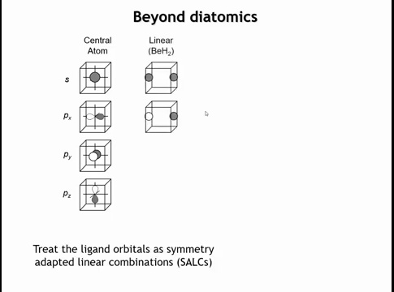
Notes:
The symmetric SALC can overlap with the Be 2s orbital, while the antisymmetric SALC aligns with the Be 2pₓ orbital. The remaining 2p orbitals (2p_y and 2p_z) do not interact because their orientations produce no net bonding or antibonding overlap. These relationships can be derived formally from group theory, but here they are evident from visual inspection of orbital symmetry.

Slide 14
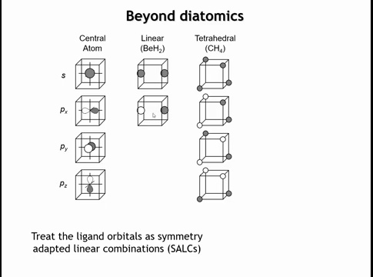
Notes:
In a tetrahedral molecule like methane (CH₄), the four hydrogen atoms form four ligand SALCs. These combinations are arranged so that each matches the symmetry of one of carbon’s valence orbitals. The totally symmetric SALC overlaps with the carbon 2s orbital, while the remaining three SALCs align with the three 2p orbitals, forming equivalent σ bonds in the tetrahedral geometry.

Slide 15
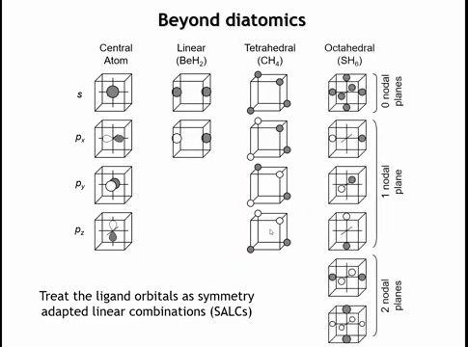
Notes:
In an octahedral molecule like hypothetical S–H₆, six ligands each contribute one orbital, forming six ligand SALCs. Determining their shapes requires group theory, but once identified, the first SALC matches the symmetry of the sulfur s orbital, and the next three align with the sulfur p orbitals to form bonding interactions. The remaining two SALCs have no matching symmetry with sulfur’s valence orbitals and therefore remain nonbonding.

Slide 16
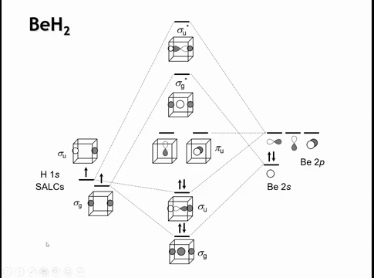
Notes:
In BeH₂, the ligand SALCs are shown on the left and the Be 2s and 2p orbitals on the right. Beryllium contributes two valence electrons in its 2s orbital, and the two hydrogens contribute one each. The symmetric (σ_g) SALC overlaps with Be’s 2s orbital to form bonding and antibonding MOs. The antisymmetric (σ_u) SALC overlaps with the Be 2p orbital oriented along the molecular axis, also forming bonding and antibonding MOs.
Because the 2p orbitals are higher in energy than the 2s, their resulting bonding and antibonding MOs are also higher in energy. The remaining two Be 2p orbitals, oriented perpendicular to the axis, have no matching ligand SALCs and thus remain nonbonding—effectively behaving like atomic orbitals.

Slide 17
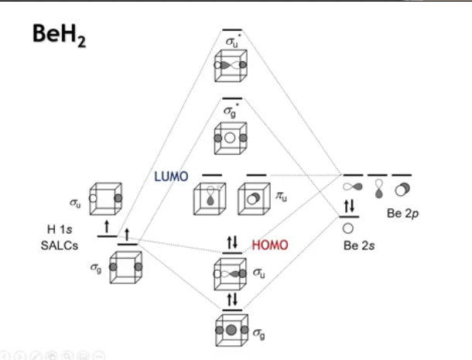
Notes:
In an MO diagram, certain orbitals dominate a molecule’s behavior—these are the frontier orbitals. The highest occupied molecular orbital is the HOMO, and the lowest unoccupied is the LUMO. In BeH₂, the HOMO corresponds to the bonding interaction between the Be 2p orbital and the hydrogen SALC, while the LUMO consists of the degenerate nonbonding Be 2p orbitals.

Slide 18
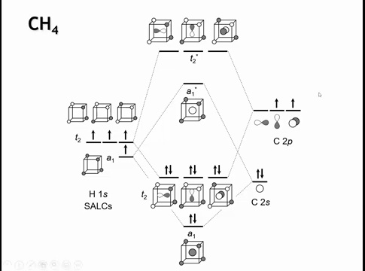
Notes:
In methane (CH₄), carbon has four valence orbitals and the four hydrogens form four ligand SALCs. Each carbon orbital can pair with one SALC, producing a bonding and an antibonding molecular orbital. The A₁ orbital represents the bonding interaction between carbon’s 2s and hydrogen orbitals, while the T₂ orbitals arise from bonding between carbon’s 2p and hydrogen orbitals, with corresponding antibonding counterparts.
In organic chemistry, this bonding is often described as sp³ hybridization of carbon. However, molecular orbital theory shows no actual sp³ hybrid orbitals exist—there is no s–p mixing. Instead, we have distinct σ bonding and antibonding MOs derived separately from the 2s and 2p orbitals. The “sp³ hybridization” terminology simply indicates that the carbon 2s and three 2p orbitals all participate in forming four equivalent σ bonds to hydrogen.

Slide 19
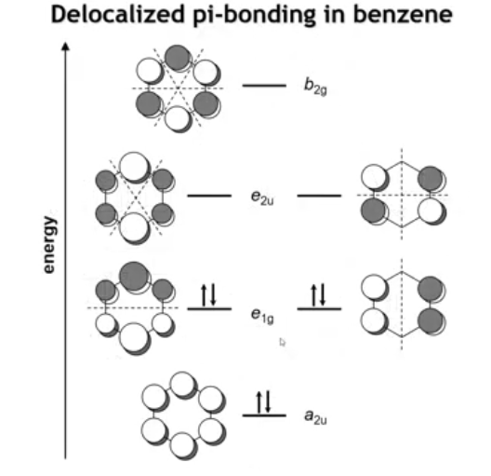
Notes:
In conjugated π systems, such as benzene, six p_z orbitals—one on each carbon—combine to form six π and π* molecular orbitals. Looking down on the ring, each p orbital has one lobe above and one below the plane. The key principle is conservation of orbital count: six atomic orbitals produce six molecular orbitals.
The lowest-energy π MO has all bonding interactions and no perpendicular nodal planes. The highest-energy π* MO is antibonding between every carbon pair, with three perpendicular nodal planes. Between these extremes are four intermediate orbitals: two degenerate E₁g orbitals with one perpendicular nodal plane each, and two degenerate E₂u orbitals with two perpendicular nodal planes. These delocalized π orbitals define benzene’s stability and electronic properties.

Slide 20
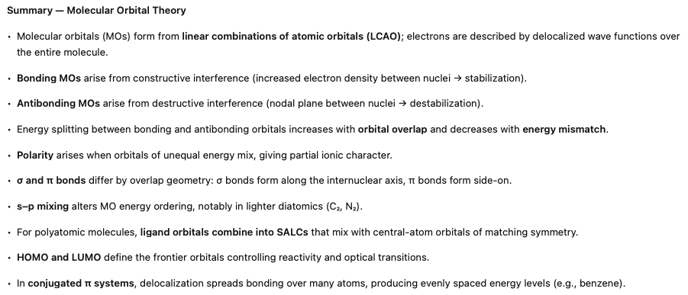
Notes:
-Molecular orbitals form when we combine atomic orbitals—literally a linear combination of atomic orbitals, or LCAO. The electrons are no longer tied to a single atom; they’re described by wave functions that extend over the entire molecule.
-Constructive overlap between orbitals gives a bonding MO—electron density between the nuclei, stabilization. Destructive overlap gives an antibonding MO—a nodal plane between nuclei and higher energy. The larger the overlap, and the smaller the energy mismatch, the bigger the splitting between them.
-When orbitals of unequal energy mix, we get polarity in the bond—one side of the molecule takes on more character from the lower-energy orbital.
-σ and π bonds just describe the geometry of that overlap—σ along the internuclear axis, π side-on. In light diatomic molecules, s–p mixing can shift the order of the orbitals, as in C₂ and N₂.
-For polyatomic systems, we can’t just pair orbitals one by one, so we form ligand group orbitals or SALCs that match the symmetry of the central atom’s orbitals.
-The HOMO and LUMO define the molecule’s frontier—the orbitals that control its reactivity and optical transitions.
-And finally, in conjugated π systems like benzene, the π orbitals spread out over the entire framework, giving delocalized bonding and evenly spaced energy levels—exactly what makes those systems so stable.”

Slide 21
Homework: 5.7 – 5.13, 5.15

Slide 22
How does σ–π splitting differ for p orbitals in O₂, and what determines the energy separation between bonding and antibonding orbitals?

Slide 23
How does σ–π splitting differ for p orbitals in O₂, and what determines the energy separation between bonding and antibonding orbitals?
For O₂, p_z orbitals overlap head-on to form σ and σ* orbitals, while p_x and p_y overlap side-on to form π and π* orbitals. The σ orbitals experience greater overlap, producing a larger bonding–antibonding energy gap. The more spatial overlap between atomic orbitals, the greater the energy splitting between bonding and antibonding MOs. s–p mixing (σ₂s–σ₂p interaction) further modifies these energy levels.

Slide 24
What is a symmetry-adapted linear combination (SALC), and how does it simplify the construction of molecular orbitals in polyatomic molecules?

Slide 25
What is a symmetry-adapted linear combination (SALC), and how does it simplify the construction of molecular orbitals in polyatomic molecules?
A SALC is a combination of ligand orbitals grouped according to symmetry, allowing them to interact only with central atom orbitals of matching symmetry. For example, in BeH₂, one SALC interacts with the Be 2s orbital and another with the Be 2p_z orbital, forming bonding and antibonding pairs while other p orbitals remain nonbonding. This approach generalizes MO theory beyond diatomic molecules to complex geometries like tetrahedral (CH₄) and octahedral (SH₆) systems.

Slide 26
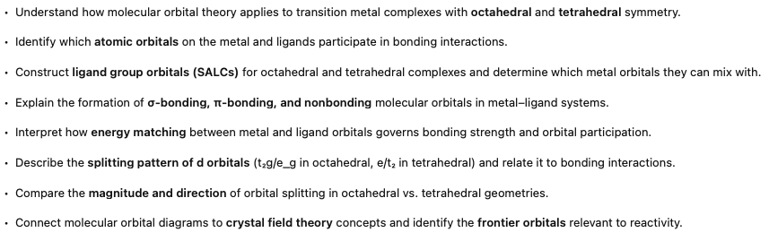
MO Theory Part II
Notes:
In this lecture, we continue our brief overview of molecular orbital theory with a look at transition metal complexes that have octahedral and tetrahedral symmetry.

Slide 27
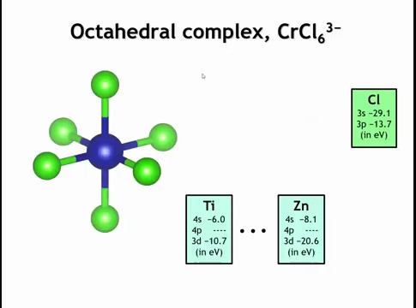
Notes:
Let’s take chromium hexachloride (CrCl₆³⁻) as our model system. The first step is to determine which atomic orbitals combine to form molecular orbitals. As in the hydrogen–helium example, orbitals interact most strongly when their energies are similar. The chlorine 3s orbital lies around –29 eV, while the 3p orbitals are at about –13 to –14 eV. Interpolating chromium’s orbital energies between titanium and zinc gives 3d orbitals near –12 to –13 eV—close in energy to chlorine’s 3p orbitals—while the 4s and 4p orbitals are higher. This energy alignment allows us to simplify the system by focusing on interactions between chlorine 3p and chromium 3d orbitals.

Slide 28
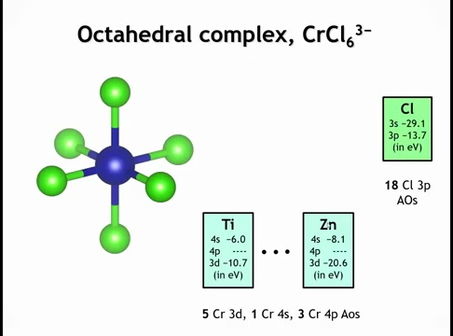
Notes:
We’ll treat the chlorine 3s orbitals as core orbitals and ignore them. That leaves the 3p orbitals—three per chlorine and six chlorines total—giving 18 chlorine 3p orbitals to include in the molecular orbital diagram. For chromium, we include all nine valence orbitals: five 3d, one 4s, and three 4p.

Slide 29
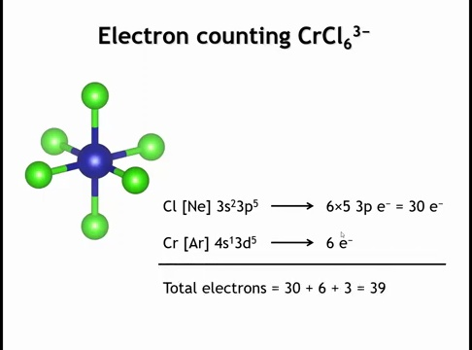
Notes:
For electron counting: each chlorine has the configuration 3s²3p⁵, but since the 3s orbitals are treated as core, we only count the five 3p electrons per chlorine. Six chlorines contribute 6 × 5 = 30 electrons. Chromium adds six valence electrons, and the complex has a 3– charge, giving a total of 30 + 6 + 3 = 39 valence electrons.

Slide 30
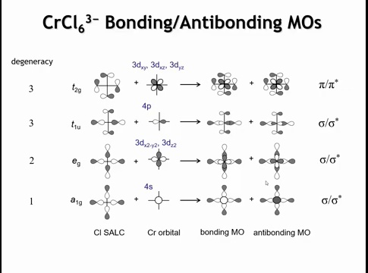
Notes:
Next, we take the nine valence orbitals on chromium and find ligand SALCs with matching symmetry. The chromium 4s orbital mixes with a ligand SALC where all chlorine 3p orbitals point toward the metal with the same phase, forming bonding and antibonding MOs. Only atoms in the xy plane are shown for clarity, but all six chlorines contribute equally. The dx²–y² orbital also mixes with a matching ligand SALC to form σ bonding and antibonding orbitals, as does dz². The dxy, dxz, and dyz orbitals interact with appropriately phased ligand SALCs to form π bonding and antibonding orbitals, which contain a nodal plane through the bond axis. Counting degeneracies—t (triply), e (doubly), and a/b (singly)—we’ve used nine chromium orbitals and nine ligand SALCs. Since chlorine provides 18 SALCs total, half remain unused.

Slide 31
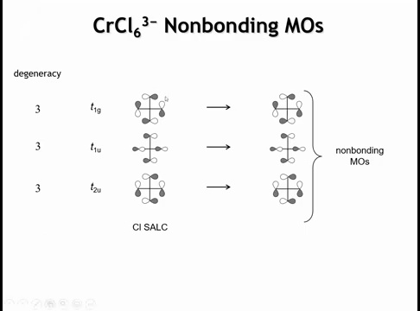
Notes:
The remaining SALCs are shown here. Two of them, t₁g and t₂u, have chlorine p orbitals oriented perpendicular to the bonds, so they cannot overlap with any chromium orbitals and remain nonbonding. The t₁u SALC, however, can weakly interact with chromium 3p orbitals since both share the same symmetry, though it’s mostly nonbonding. Unlike the σ and π bonding combinations discussed earlier, this interaction would involve both σ bonding and π antibonding character, which largely cancel each other out.

Slide 32
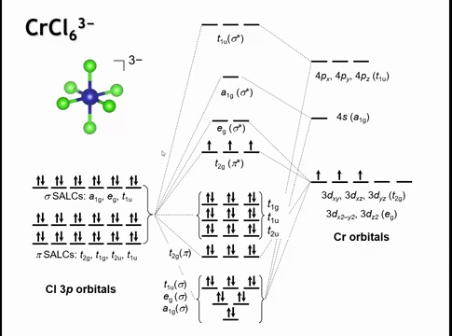
Notes:
In the MO diagram, we combine the 18 chlorine 3p-derived ligand SALCs with the 9 chromium valence orbitals. This produces 9 bonding MOs and 9 corresponding antibonding MOs, plus 9 nonbonding MOs. Although the full diagram looks complex, we focus mainly on the frontier orbitals. For transition metals, these are the d-derived orbitals: the t₂g set (dxy, dxz, dyz) forming π antibonding combinations with chlorine, and the e_g set (dz², dx²–y²) forming σ antibonding orbitals directed at the ligands. This familiar t₂g–e_g splitting from crystal field theory dominates the chemistry of the complex. This diagram is one we’re going to return to again.

Slide 33
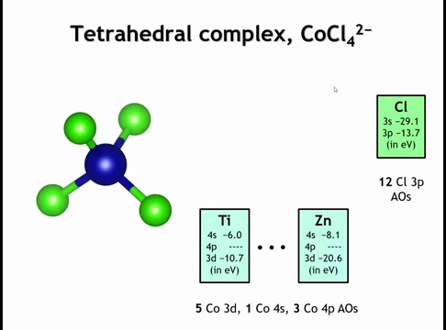
Notes:
If we switch to a tetrahedral geometry, keeping a transition metal at the center, consider the complex ion [CoCl₄]²⁻. Again, we focus on the chlorine 3p orbitals. With four chlorines, there are 4 × 3 = 12 chlorine 3p orbitals to include, along with the same nine valence orbitals (five 3d, one 4s, three 4p) on the central cobalt.

Slide 34
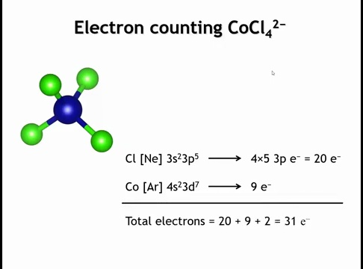
Notes:
For electron counting: each chlorine contributes five 3p electrons, giving 4 × 5 = 20 electrons. A neutral cobalt atom adds nine valence electrons, and the 2– charge contributes two more, for a total of 31 valence electrons.

Slide 35
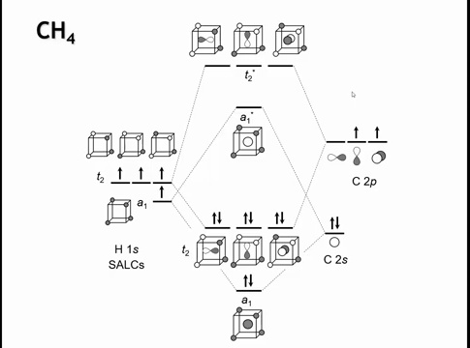
Notes:
The interactions of cobalt’s s and p orbitals with the ligands are the same as in methane, differing only in energy. The 4s orbital forms one bonding and one antibonding MO with the ligand SALC, while the three 4p orbitals form a triply degenerate set of bonding and antibonding MOs with the ligands.

Slide 36
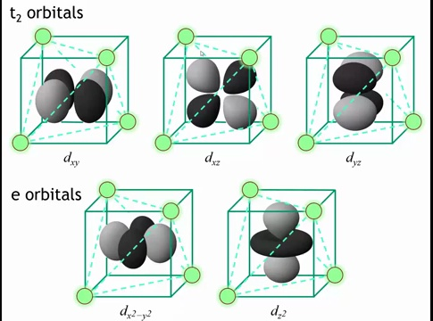
Notes:
What’s new here is the interaction of the cobalt d orbitals with the ligands. Visualizing the tetrahedron inside a cube helps. The ligands sit at the cube’s alternating corners. The dx²–y² and dz² orbitals point toward the edges of the tetrahedron—maximizing their distance from the ligands—so they interact least and lie lowest in energy. The remaining d orbitals (dxy, dxz, dyz), labeled t₂, don’t point directly at or between ligands, so they experience greater repulsion and stronger mixing with the chloride ligands.

Slide 37
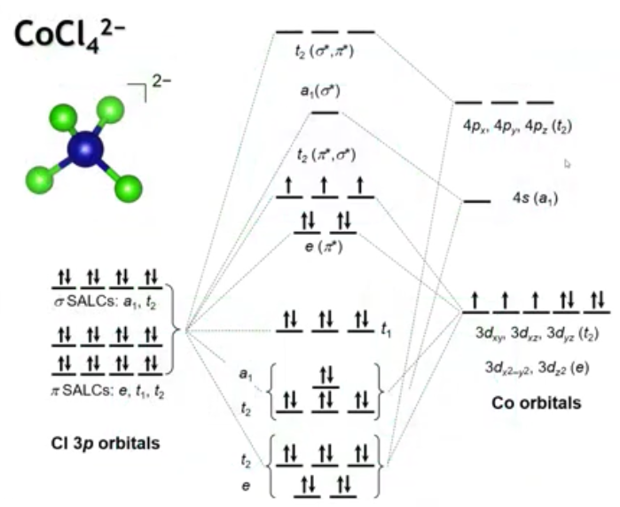
Notes:
The resulting MO diagram contains nine bonding MOs, nine antibonding MOs, and only three nonbonding ligand MOs due to the reduced number of ligands. The key region of interest is the antibonding set formed between ligand and metal d orbitals. Compared to the octahedral case, the splitting is reversed: the dx²–y² and dz² orbitals are now lower in energy, still doubly degenerate, while the other three d orbitals lie higher. The overall splitting is also smaller—about half as large—because tetrahedral geometry lacks purely σ antibonding orbitals, reducing the energy gap between the two sets.

Slide 38
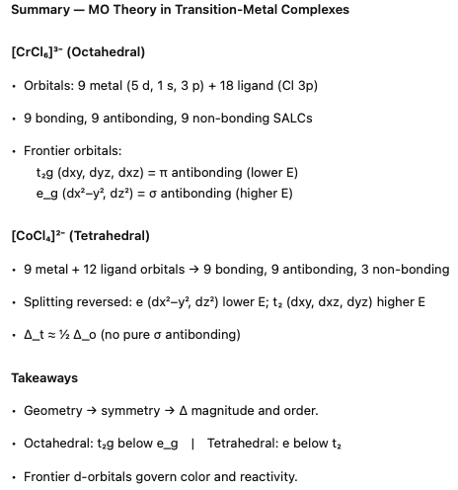
Notes:
-Let’s summarize what we’ve done with molecular orbital theory applied to transition-metal complexes.
-We started with the octahedral [CrCl₆]³⁻ complex. Chromium brings nine valence orbitals — the five 3d, one 4s, and three 4p. Each of the six chlorides contributes three 3p orbitals, so eighteen ligand orbitals in total. When we combine them, we get nine bonding, nine antibonding, and nine non-bonding symmetry-adapted combinations. The orbitals that matter most are the antibonding combinations with metal d character — the t₂g set, which are π-antibonding and lower in energy, and the e_g set, which are σ-antibonding and higher in energy. That’s the same splitting we recognize from crystal-field theory: t₂g below e_g in an octahedral field.
-Now if we change the geometry to tetrahedral, like [CoCl₄]²⁻, we have only four ligands — twelve ligand 3p orbitals instead of eighteen. The mixing pattern changes. The e orbitals on the metal (dₓ²₋ᵧ² and d_z²) now interact least with the ligands, so they’re lower in energy, while the t₂ set (d_xy, d_xz, d_yz) interact more strongly and are higher in energy. The ordering is therefore reversed relative to the octahedral case, and the splitting Δ_t is roughly half the magnitude of Δ₀ because the overlap with ligands is smaller and there are fewer σ interactions.
-The main takeaway is that the geometry and the symmetry control both the order and the size of the splitting, and that the frontier orbitals — these antibonding d-orbitals — govern the optical properties, magnetism, and reactivity of the complex.

Slide 40
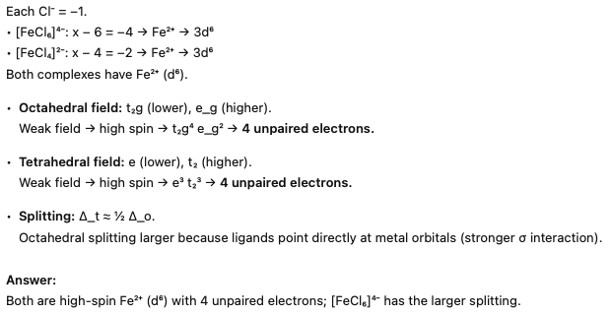

Slide 41
homework

Slide 42
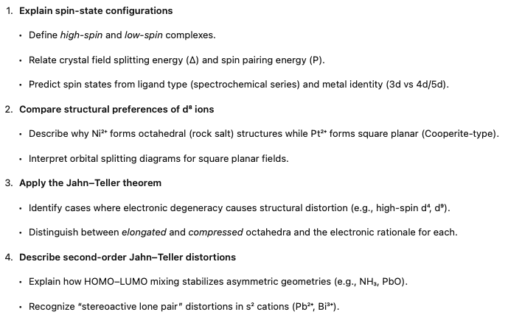
Spin States & Jahn–Teller Distortions
Notes:
In this lecture, we're going to talk about a couple of bonding issues that don't really fit cleanly anywhere else. We're going to talk about spin-state configurations of transition metal ions and yonteler distortions.

Slide 43
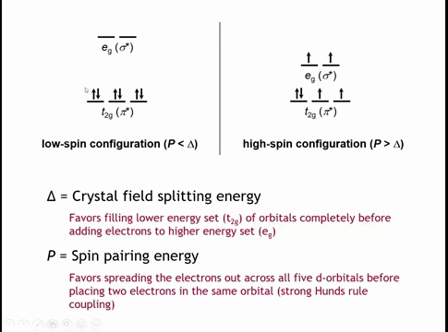
Notes:
When transition metal ions form complexes, the frontier orbitals governing their properties are usually the metal’s d orbitals. In an octahedral field, these split into lower-energy triply degenerate t₂g orbitals (dxy, dyz, dxz) and higher-energy doubly degenerate e_g orbitals (dx²–y², dz²).
Electrons fill t₂g orbitals first, each singly with parallel spins according to Hund’s rule. For the fourth electron onward, two options exist: pair electrons within t₂g or occupy the higher e_g orbitals. Pairing electrons costs spin-pairing energy (P), while promoting them costs crystal field splitting energy (Δ).
If P < Δ, electrons pair in t₂g before entering e_g → low-spin configuration.
If P > Δ, electrons occupy all five d orbitals singly before pairing → high-spin configuration.

Slide 44
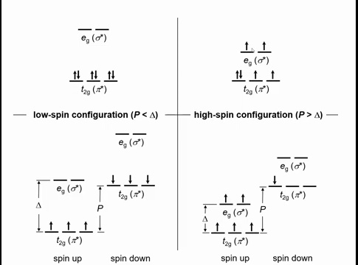
Notes:
Textbooks often compare the crystal field splitting (Δ) and spin-pairing energy (P) using diagrams with two sets of five d-orbital lines: one for spin-up electrons and one for spin-down.
When P < Δ, electrons pair in the lower-energy t₂g orbitals before occupying e_g — the low-spin case.
When P > Δ, electrons fill all spin-up t₂g and e_g orbitals before any spin-down pairing — the high-spin case.

Slide 45
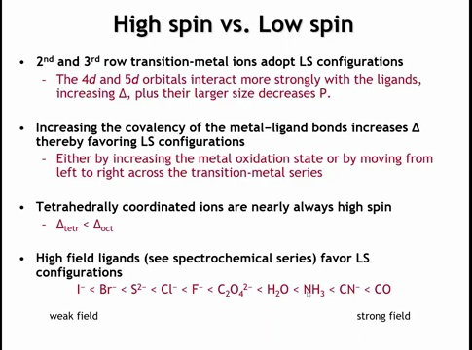
Notes:
Whether a complex adopts a high- or low-spin configuration depends on the relative magnitudes of crystal field splitting (Δ) and spin-pairing energy (P).
For 4d and 5d transition-metal ions, the d orbitals are larger and overlap more with ligands, producing a larger Δ and smaller P — these ions are always low spin. Increasing metal–ligand covalency (shorter bond distance, higher metal electronegativity) also increases Δ, favoring low-spin states.
Δ is smaller in tetrahedral fields, about half that of octahedral ones, so tetrahedral complexes are almost always high spin.
Ligand identity also matters: in the spectrochemical series, weak-field ligands like halides give small Δ (high spin), while strong-field ligands such as CO or CN⁻, which have empty π* orbitals stabilizing t₂g levels, give large Δ (low spin).

Slide 46
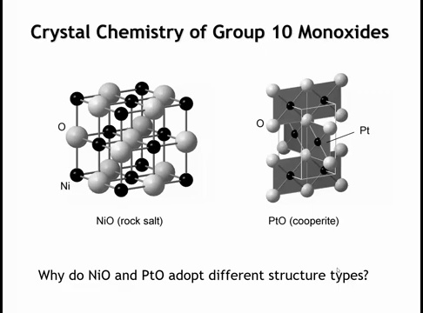
Notes:
Nickel oxide (NiO) and platinum oxide (PtO) share the same stoichiometry and both metals belong to group 10, yet they adopt different structures: NiO forms the octahedral rock-salt structure, while PtO forms the square-planar Cooperite structure. The cause is electronic, not size-related—platinum is larger than nickel, so size would predict higher, not lower, coordination.

Slide 47
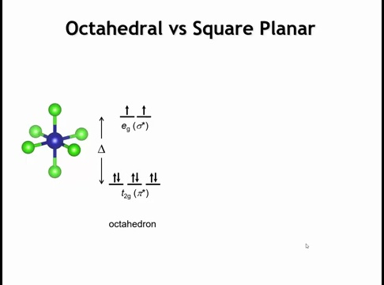
Notes:
To understand this, examine how the 3d orbitals fill. In an octahedral field—such as for Ni²⁺ in nickel oxide—the ion has eight 3d electrons. These occupy the lower-energy t₂g orbitals first, then the higher-energy e_g orbitals, as shown. Now, consider how this filling changes in a square-planar field.

Slide 48
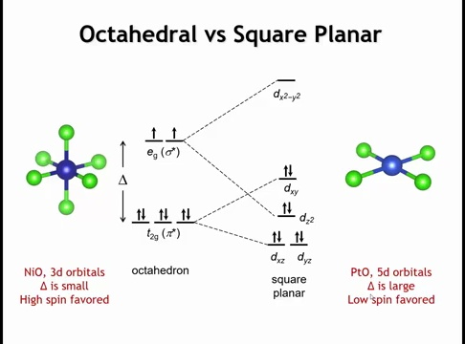
Notes:
Removing ligands along the z-axis reduces interactions in that direction, so the x–y ligands move closer to maintain bonding. This changes orbital splitting: orbitals with z components (d_xz, d_yz) drop in energy, becoming less antibonding; d_xy rises since its lobes lie in the ligand plane. The e_g set splits further—d_z² lowers significantly, even below d_xy, while d_x²–y², pointing directly at ligands, rises sharply. The result is one high-energy antibonding d_x²–y² orbital and four lower-energy orbitals. A d⁸ configuration stabilizes the square-planar field by filling the low orbitals and leaving d_x²–y² empty, though all electrons are now paired, increasing repulsion. In Ni²⁺ (3d⁸), the small splitting favors octahedral geometry to avoid pairing energy, but in Pt²⁺ (5d⁸), strong metal–ligand interactions produce large splitting, stabilizing the square-planar distortion that lowers d_z² and depopulates d_x²–y². Square-planar coordination thus commonly appears for d⁸ and sometimes d⁹ ions with strong ligand fields.

Slide 49
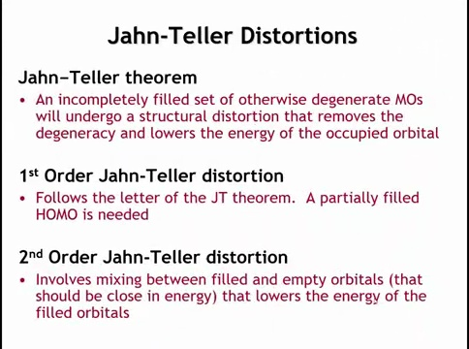
Notes:
The Jahn–Teller theorem states that any molecule or crystal with a degenerate, partially filled highest occupied molecular orbital (HOMO) will undergo a symmetry-lowering distortion to remove that degeneracy and stabilize the system. The distortion allows electrons to occupy the newly lowered orbital, reducing total energy. This is called a first-order Jahn–Teller distortion and requires a partially filled HOMO.
A related effect, the second-order Jahn–Teller distortion, occurs when a filled HOMO and a nearby empty LUMO mix during a distortion, lowering the energy of the filled orbital through orbital hybridization.

Slide 50
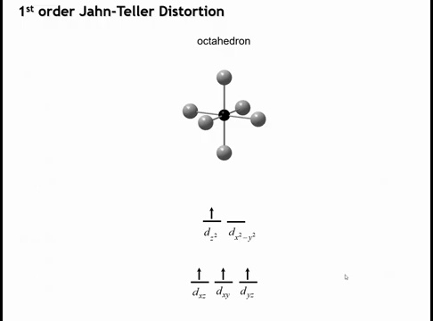
Notes:
A first-order Jahn–Teller distortion commonly occurs in octahedral complexes with high-spin d⁴ (e.g., Mn³⁺) or d⁹ (e.g., Cu²⁺) configurations.
In these cases, the e_g orbitals are unevenly occupied—such as having one electron shared between dz² and dx²–y²—creating a degenerate partially filled HOMO.
This degeneracy drives the system to distort and lower its symmetry to stabilize one orbital and reduce total energy.

Slide 51
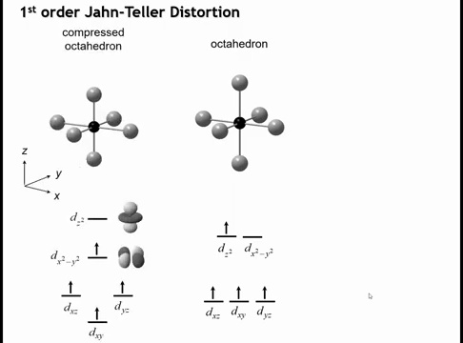
Notes:
Distorting the octahedron removes the orbital degeneracy, as predicted by the Jahn–Teller theorem, though the theorem doesn’t specify how distortion occurs. Two main distortions are possible. In a compressed octahedron, bonds along the z-axis shorten and those in the xy-plane lengthen. This raises the energy of the dz² orbital and lowers the dx²–y² orbital. Both are σ-antibonding, but compression reduces the antibonding character of dx²–y², stabilizing it and lowering the overall energy.

Slide 52
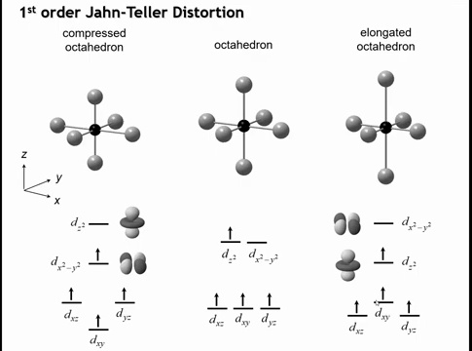
Notes:
We could also elongate the octahedron by stretching the bonds along the z-axis and compressing those in the xy-plane, producing the opposite distortion of the compressed case. Both distortions lower the energy by a similar amount, so from the orbital diagram alone, it’s unclear which will occur. However, in practice, complexes with high-spin d⁴ or d⁹ ions almost always adopt the elongated octahedral geometry, while the compressed form is rare. The question is what stabilizes this elongated structure.

Slide 53
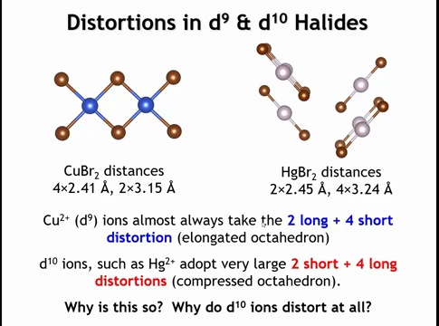
Notes:
In some d¹⁰ systems like Hg²⁺, we often see linear coordination rather than tetrahedral or octahedral. This can be viewed as an extreme form of a Jahn–Teller distortion—a compressed version.
If two bonds are shortened and four are lengthened enough, the structure appears linear.
For example, in CuBr₂ (d⁹) there are four short bonds (2.4 Å) and two long ones, giving an elongated octahedron. In HgBr₂ (d¹⁰), the opposite occurs—two short bonds and four long, forming a compressed octahedron.
This raises the question: why does a fully filled d¹⁰ ion still distort, and what drives this distortion?

Slide 54
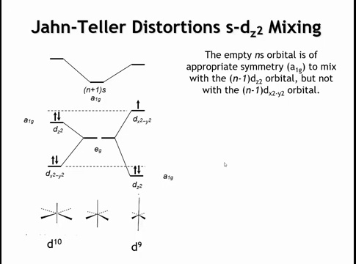
Notes:
To explain this, we need to include the nearby empty s orbital—4s for Cu²⁺ or 6s for Hg²⁺. In an undistorted octahedron, the metal’s e₉ orbitals (dz², dx²–y²) are degenerate and have E_g symmetry, while the s orbital has A₁g symmetry. Because their symmetries differ, no mixing or hybridization occurs.
When the octahedron distorts (either elongates or compresses), the symmetry is lowered from O_h to D₄h (Hermann–Mauguin 4/mmm). This lowering allows previously forbidden mixing between orbitals of compatible symmetry, changing their relative energies.

Slide 55
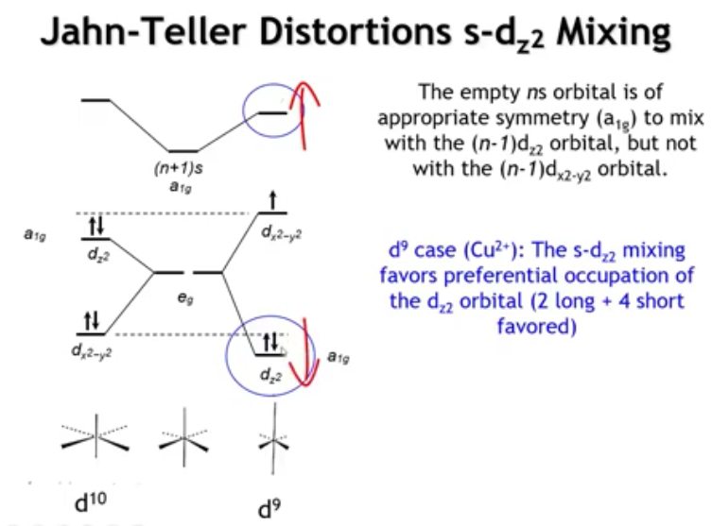
Notes:
When the octahedron’s symmetry lowers, the dz² orbital gains A₁g symmetry, matching the s orbital. Orbitals with the same symmetry can now mix (hybridize)—just like σ(s) and σ(p) mixing in O₂. This interaction raises the s orbital and lowers the dz² orbital in energy.
In a d⁹ configuration, elongation of the octahedron lowers the dz² orbital enough that it becomes doubly occupied, while dx²–y² remains singly occupied, giving a greater stabilization than compression would. Thus, s–dz² hybridization under elongation explains the preferred distortion in d⁹ systems.

Slide 56
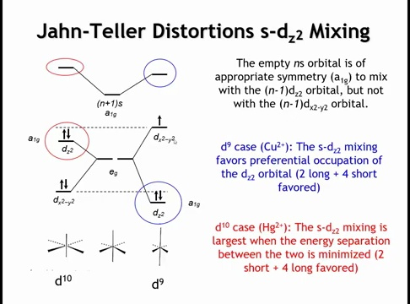
Notes:
In the d¹⁰ case (e.g., Hg²⁺), both dz² and dx²–y² orbitals are doubly occupied. It becomes favorable to raise the dz² orbital’s energy closer to that of the s orbital, increasing s–dz² hybridization. Greater hybridization strengthens orbital mixing and stabilizes the dz² orbital overall.
If the opposite distortion occurred, the energy gap between dz² and s would widen, reducing hybridization and providing less stabilization. Thus, compression increases s–dz² overlap and lowers total energy.

Slide 57
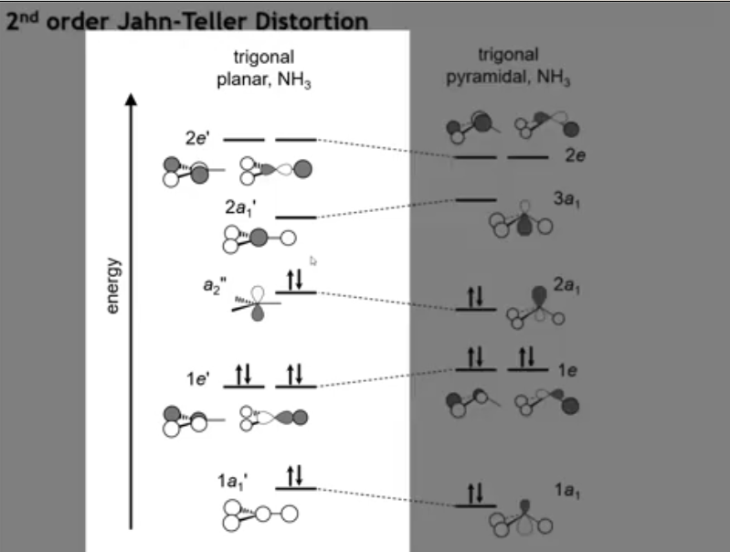
Notes:
A second-order Jahn–Teller distortion is exemplified by ammonia (NH₃).
In a hypothetical trigonal planar NH₃, the molecular orbitals are:
1A₁′ – bonding between N(2s) and H(1s).
2A₁′ – antibonding counterpart.
1E′ – bonding between N(2pₓ, 2p_y) and H(1s).
2E′ – antibonding counterpart.
A₂″ – nonbonding N(2p_z) orbital, which cannot mix with H orbitals and serves as the HOMO.
This configuration sets up conditions for a distortion that mixes the filled nonbonding orbital with nearby empty orbitals.

Slide 58

Notes:
Ammonia is not trigonal planar but trigonal pyramidal due to a second-order Jahn–Teller distortion.
When the geometry changes from planar to pyramidal, the p_z and s orbitals both gain A₁ symmetry, allowing mixing between the HOMO (nonbonding p_z) and LUMO (antibonding 2s).
This hybridization creates a filled orbital that is mostly nonbonding but slightly bonding, and an empty orbital that is strongly antibonding.
The filled orbital gains stability because its electron density shifts toward the pyramid apex, forming a weakly bonding region.
Although the antibonding orbital rises in energy, it’s unoccupied, so there’s no penalty.
This distortion occurs when the HOMO–LUMO gap is small and symmetry lowering enables mixing, thereby stabilizing the filled orbital.

Slide 59

Notes:
A common second-order Jahn–Teller distortion in solid-state chemistry appears in main-group ions such as Pb²⁺, important in ferroelectrics.
In an octahedral environment, the HOMO is the antibonding Pb 6s–Cl combination, and the LUMO is the antibonding Pb 6p–Cl combination.
A distortion that allows mixing of the s and p orbitals (normally symmetry-forbidden) produces stabilization through orbital hybridization—this is the second-order Jahn–Teller effect.

Slide 60

Notes:
Lowering the octahedral symmetry allows mixing between Pb 6s and 6p orbitals.
If Pb²⁺ shifts along the fourfold axis—forming one short and one long Pb–Cl bond—the symmetry drops to D₄h (4mm). This distortion stabilizes the antibonding Pb 6s–Cl interaction and destabilizes the mainly p_z–Cl interaction.
The result is an occupied orbital that is almost nonbonding and localized toward one side of the octahedron.
This is the stereoactive lone-pair distortion, analogous to how VSEPR theory explains the pyramidal shape of NH₃ through a filled sp³ hybrid orbital. The molecular orbital picture provides a deeper, quantitative version of that concept.

Slide 61

Notes:
Lead compounds commonly show stereoactive lone-pair distortions, a form of second-order Jahn–Teller distortion.
In PbO, which resembles the CsCl structure, the Pb²⁺ ion shifts off-center toward one face of the cube, forming four short Pb–O bonds and two long ones. This creates a cavity that accommodates the lone pair, arising from mixing between the filled antibonding Pb 6s orbital (HOMO) and the empty Pb 6p orbital.
Similar distortions occur in d⁰ transition-metal oxides with high-valence cations such as Mo⁶⁺, Nb⁵⁺, Ta⁵⁺, and Ti⁴⁺, where the cation displaces from the center of its coordination polyhedron due to the same second-order Jahn–Teller mechanism.

Slide 62


Notes:
Okay, let’s summarize what we’ve seen.
The first idea is about spin states — it’s a balance between the crystal-field splitting, Δ, and the spin-pairing energy, P.
If Δ is large, it pays to pair up electrons in the lower t₂g orbitals — that’s the low-spin case.
If Δ is small, it’s cheaper to spread them out into all five d orbitals — that’s the high-spin case.
Δ gets larger for 4d and 5d metals, for short and more covalent bonds, and for strong-field ligands like CO and CN⁻.
In tetrahedral fields, the splitting is only about half as big, so those are almost always high spin.
Now for d⁸ metals, the difference between nickel and platinum is a good example.
Nickel has a small Δ and stays octahedral.
Platinum has a large Δ and distorts to square planar, pushing the dx²–y² orbital way up and stabilizing the rest.
Then we have the Jahn–Teller effect.
Whenever a degenerate orbital is partially filled — like in high-spin d⁴ or d⁹ ions — the system lowers its energy by distorting, usually by elongating the octahedron.
That removes the degeneracy and stabilizes one orbital.
Finally, in the second-order Jahn–Teller case, we get mixing between a filled and an empty orbital of the same symmetry.
That’s why ammonia isn’t flat — the nitrogen s and p orbitals mix.
And it’s why Pb²⁺ and Sn²⁺ cations shift off-center — their 6s and 6p orbitals mix to make a stereoactive lone pair.
You see the same thing in d⁰ oxides like Ti⁴⁺ or Nb⁵⁺.
All of these effects — spin states, square-planar geometry, Jahn–Teller distortions — come from the same principle: the system always finds a way to lower its energy by changing how the d orbitals are occupied or mixed.

