Slide 1
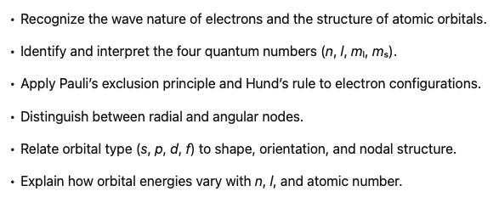
Atomic Orbitals
Notes:
We can only get so far in our understanding of the properties of solids by thinking about ionic bonding. So to really understand many of the properties we're going to encounter later on, we need to understand covalent bonding. To build up to that understanding of covalent bonding, we're going to have a couple of lectures that will be probably review for some of you, especially if you're a chemistry major. In this lecture, we're going to talk about the basic properties of atomic orbitals.

Slide 2
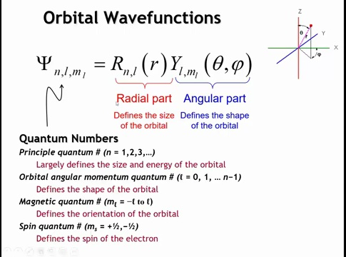
Notes:
Quantum mechanics revolutionized physics by treating the electron as a wave. In spherical polar coordinates, the wave function separates into a radial part, describing variation with distance from the nucleus, and an angular part, defined by the angles θ (from the z-axis) and φ (in the xy-plane).
Each electron is defined by four quantum numbers:
Principal quantum number (n): integer ≥ 1; determines orbital size and energy. For hydrogen, n alone fixes energy.
Orbital angular momentum quantum number (l): defines orbital shape (s, p, d, …). Values range from 0 to n − 1. In multi-electron atoms, both n and l affect energy.
Magnetic quantum number (mₗ): orientation of the orbital; ranges from −l to +l.
Spin quantum number (mₛ): +½ or −½; intrinsic electron spin, key to magnetic behavior.

Slide 3
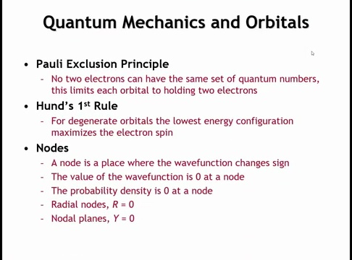
Notes:
The Pauli exclusion principle states that no two electrons share the same set of quantum numbers, so each orbital can hold only two electrons with opposite spins (+½ and −½).
Hund’s first rule applies to degenerate orbitals—those with equal energy, such as the five d orbitals—and says that the lowest-energy configuration maximizes total spin. Electrons fill different orbitals with parallel spins before pairing, reducing repulsion by keeping electrons spatially separated.
A node is a region where the wave function equals zero because its sign changes. The probability density of finding an electron is also zero at nodes. There are two types: radial nodes, where the radial part of the wave function goes to zero, and nodal planes, where the angular part does.

Slide 4
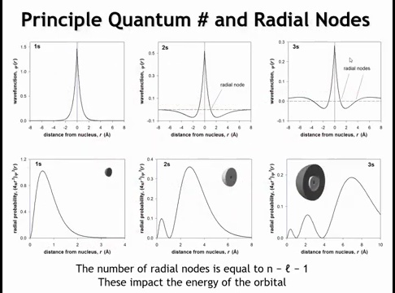
Notes:
S orbitals are spherical, so their angular wave function is constant, and all structure comes from the radial wave function. The 1s, 2s, and 3s orbitals all peak at the nucleus and decay outward.
1s: Always positive, no nodes.
2s: One node (~1 Å) where the wave function changes sign—like a ripple crossing zero.
3s: Two nodes; alternates positive–negative–positive.
The number of radial nodes = n − l − 1. For s orbitals (l = 0), that’s 0, 1, and 2 for 1s, 2s, and 3s respectively.
The radial probability function multiplies the squared wave function by 4πr² to give the probability of finding the electron at distance r.
1s peaks at ~0.54 Å.
2s has one inner and one outer peak separated by a node.
3s has two nodes and an outer maximum around 7 Å.
As n increases, orbitals grow larger and electron density shifts farther from the nucleus.
ψ(r) peaks at r = 0 because it represents the wave amplitude, which is largest at the nucleus.
The radial probability density 4πr²|ψ|² peaks around 0.5 Å because the r² term (the surface area of a spherical shell) increases with distance, while |ψ|² decreases.

Slide 5
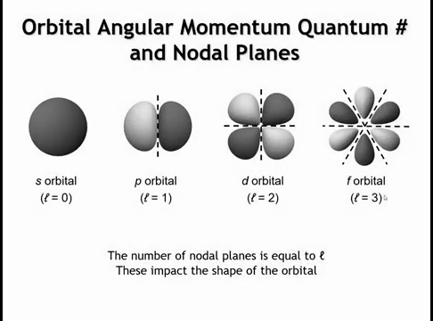
Notes:
For p orbitals (l = 1), there is one nodal plane, producing two lobes.
For d orbitals (l = 2), there are two nodal planes, giving four lobes.
For f orbitals (l = 3), there are three nodal planes, yielding six lobes.
The shading indicates the sign of the wave function (positive or negative).
In general, the number of nodal planes equals the orbital angular momentum quantum number l.

Slide 6
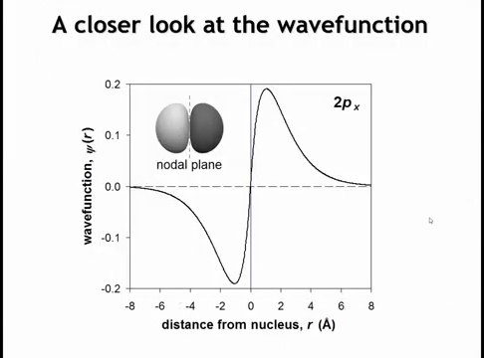
Notes:
Along the x-axis, the 2pₓ wave function rises to a peak near the nucleus, drops sharply to zero at the nodal plane (the yz-plane), and becomes negative on the opposite side. Far from the nucleus, it decays toward zero. This sign change at the node defines the orbital’s two-lobed structure and opposite phases, which are essential for understanding bonding and orbital overlap.

Slide 7
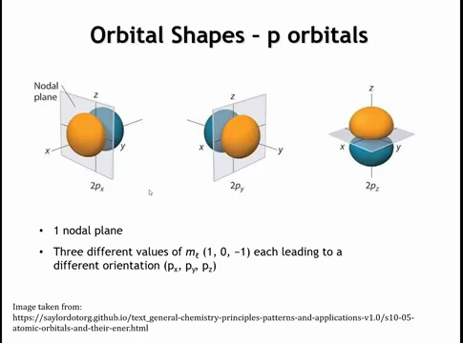
Notes:
For each principal quantum number, there are three p orbitals corresponding to magnetic quantum numbers m_l = -1, 0, +1.
They share the same shape but differ in orientation:
2pₓ: nodal plane perpendicular to the x-axis
2pᵧ: nodal plane perpendicular to the y-axis
2p_z: nodal plane perpendicular to the z-axis

Slide 8
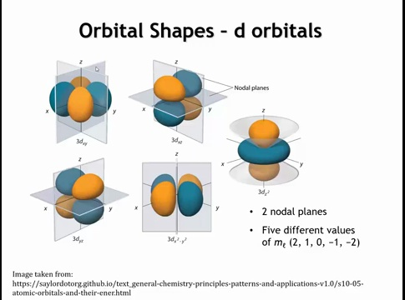
Notes:
For d orbitals (l = 2), the magnetic quantum number m_l ranges from −2 to +2, giving five orbitals. Each has two nodal planes. The dₓᵧ orbital has nodal planes in the yz and xz planes; the other four share the same four-lobe form with different orientations. The d_z² orbital is distinct—it has nodal cones instead of planes—but is energetically equivalent to the others.

Slide 9
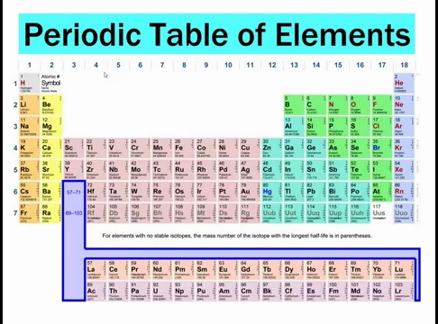
Notes:
Orbital energies in multi-electron atoms determine the structure of the periodic table. The first two columns correspond to filling the s orbitals, the ten-element-wide section in the middle to d orbitals, the six-element-wide block on the right to p orbitals, and the two 14-element rows below—the lanthanides and actinides—to f orbitals. The structure of the table reflects the relative energies of these orbitals.
Now, consider this question: if we compare the energy of an electron in the 4s orbital with one in the 3d orbital, which is lower? Is that the same everywhere in the periodic table, or does it change as we move across it?
Let’s also ask why the orbital angular momentum quantum number (l) affects energy. In a one-electron atom, l has no effect—the energy depends only on the principal quantum number n. But in multi-electron atoms, the situation changes: electron–electron interactions cause orbitals with different l values to have different energies.

Slide 10
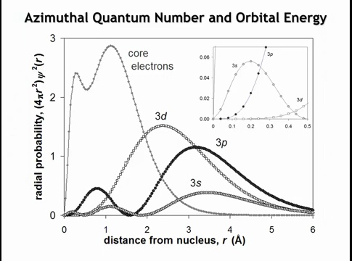
Notes:
To understand why orbital energies differ, examine the radial probability functions for the 3s, 3p, and 3d orbitals in a hydrogen-like atom. The maximum probability occurs farthest from the nucleus for 3s, closer for 3p, and closest for 3d. As l increases (s → p → d), the orbital shrinks—its maximum moves inward. You might expect that being closer to the nucleus means stronger attraction and lower energy. However, near the nucleus, differences appear due to radial nodes.
The 3s orbital has two nodes and a strong inner peak around 0.2 Å, giving it substantial electron density near the nucleus. The 3p orbital, with one node, has a smaller inner peak around 0.7–0.8 Å, giving moderate penetration. The 3d orbital has no radial nodes and very little electron density close to the nucleus. Because it lacks this penetrating density, it experiences less nuclear attraction and therefore has higher energy than 3s and 3p, even though its overall extent is smaller.

Slide 11
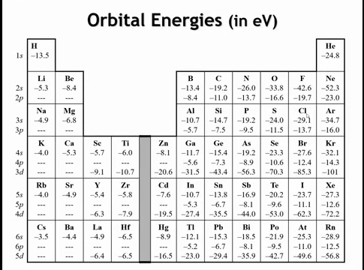
Notes:
Most of what we’ve covered so far should be review. Now, let’s look at the energies of specific orbitals, based on Dirac–Fock calculations for isolated atoms. As we move up and to the right in the periodic table (toward neon), orbital energies become more negative due to the increasing effective nuclear charge.
Next, consider the relative energies of the 4s and 3d orbitals. At potassium and calcium, only 4s is occupied, so it must be lower in energy than 3d. But by scandium and titanium, the 3d orbitals have dropped below the 4s in energy. By the end of the transition series (zinc, gallium), the 3d orbitals are much deeper and more stable than 4s.
This trend explains the chemistry of zinc—it forms Zn²⁺ by losing its 4s electrons only; the 3d orbitals act as core levels. By gallium, the gap between 3d and 4s is about 20 eV, and by krypton, it widens to ~70 eV. Thus, the 3d orbitals become deep core states, a key factor in elemental trends and bonding behavior.

Slide 12
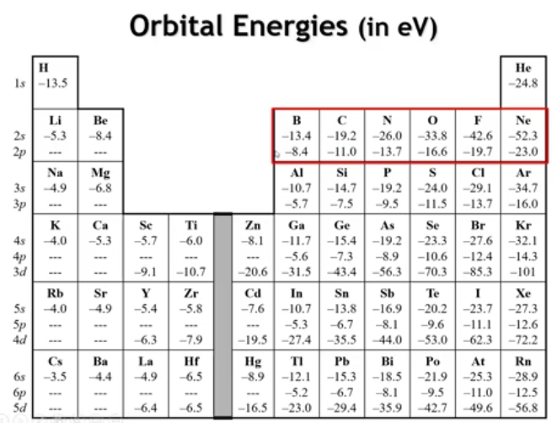
Notes:
The s–p orbital energy gap also follows clear trends. In the second period, the 2s orbital of boron lies about 5 eV below the 2p, but this gap widens across the row—to roughly 23 eV in fluorine—as effective nuclear charge increases. For fluorine, the 2s becomes a core orbital, largely uninvolved in bonding, while in boron and carbon, both 2s and 2p participate.
In the heavier p-block elements, the valence s orbitals are again lower than the p orbitals, by about 6 eV in gallium, 8 eV in germanium, 5–7 eV in indium and tin, but the gap grows further to ~9 eV in lead and similar in bismuth. These extra-stabilized s orbitals are 2–3 eV lower than expected from lighter-element trends due to relativistic effects—in heavy atoms, inner electrons move near the speed of light, increasing mass and contracting s orbitals, which lack nodes at the nucleus.
This relativistic s stabilization profoundly affects bonding. Along Group 4A, oxidation states shift from +4 (Si, Ge, Sn) to +2 dominance in Pb, since the stabilized 6s electrons are less available for bonding—the origin of the inert-pair effect observed in Tl, Pb, Hg, and Bi.

Slide 13
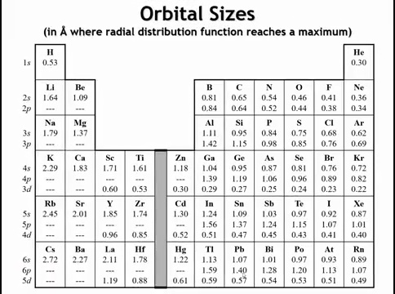
Notes:
Orbital size is hard to define because it extends infinitely, but the maximum of the radial distribution function gives a practical measure. When a subshell is filled for the first time, its electrons are drawn unusually close to the nucleus—they feel a stronger-than-expected attraction that makes the orbital smaller than predicted. This contraction reflects the reduced shielding and greater effective nuclear charge experienced by those new electrons.

Slide 14
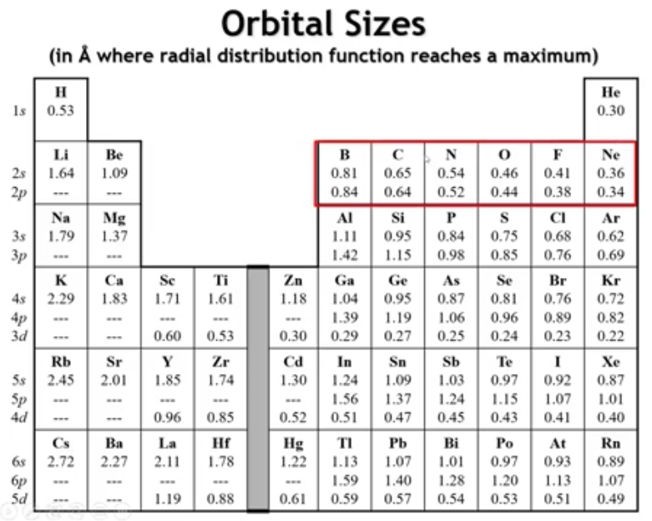
Notes:
So what do I mean? If we were to look at the sizes of the 2s and the 2p orbitals, as we go across the second period, you can see that by and large, they're almost the same.

Slide 15
Notes:
As we move to the third, fourth, and fifth periods, the s orbitals become smaller than the p orbitals. The exception occurs in the second period, where the 2p orbitals are anomalously small. This happens because there are no p orbitals in the core to shield them—only s orbitals exist closer to the nucleus. Without inner p orbitals to provide screening, the 2p electrons feel an unusually strong nuclear attraction, which pulls them closer and contracts the orbital. The result is that the 2s and 2p orbitals are nearly the same size. This similarity allows strong overlap in π bonding, which dominates carbon chemistry but is far weaker for silicon, whose larger 3p orbitals overlap poorly. The ubiquity of π bonds in carbon—and their near absence in silicon—is ultimately rooted in this size anomaly, and it underpins the distinct chemistry that makes life’s carbon-based molecules possible.

Slide 16
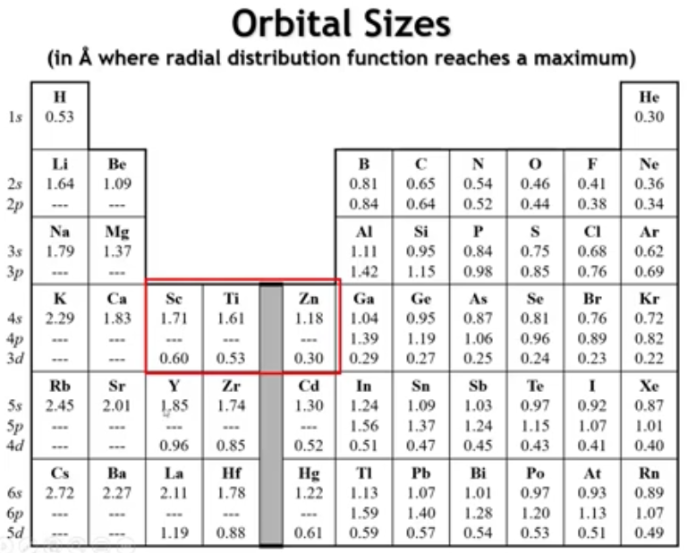
Notes:
The 3d orbitals are unusually small compared to the s orbitals. Although d orbitals are always smaller than s orbitals of the same principal quantum number, the difference is greatest for the 3d set. This gives 3d transition metals their characteristic properties. Because 3d orbitals lie between valence and core levels, they can easily lose different numbers of electrons, leading to multiple oxidation states. Their partially filled d shells also allow unpaired electrons, producing magnetic behavior. Similar effects occur for 4d and 5d elements, but they are most pronounced for the 3d series.
In the lanthanides and actinides, the 4f orbitals are even smaller—so compact that they behave as core orbitals. As a result, the +3 oxidation state dominates across the lanthanide series, a uniformity rarely seen elsewhere in the periodic table. The small, shielded 4f orbitals also give rise to sharp electronic transitions within the f shell, which are responsible for the vivid luminescence of lanthanide compounds used in phosphors and other optical materials.

Slide 17
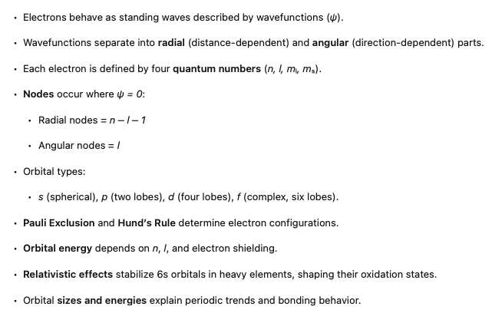
Summary

Slide 18
1. How does the number of radial and angular nodes in an orbital relate to the quantum numbers, and why is this relationship significant for understanding bonding in solids?

Slide 19
1. How does the number of radial and angular nodes in an orbital relate to the quantum numbers, and why is this relationship significant for understanding bonding in solids?
The number of radial nodes equals n – l – 1, and the number of angular (nodal planes) equals l. For example, a 3s orbital (n = 3, l = 0) has two radial nodes, while a 3d orbital (n = 3, l = 2) has two angular nodes. This relationship is significant because the presence and type of nodes determine orbital shapes and electron density distribution, which in turn control orbital overlap and bonding directionality in solids

Slide 20
2. Why are 3d orbitals higher in energy than 4s orbitals in potassium but lower in energy by the time we reach zinc, and how does this trend affect the chemistry of transition metals?

Slide 21
2. Why are 3d orbitals higher in energy than 4s orbitals in potassium but lower in energy by the time we reach zinc, and how does this trend affect the chemistry of transition metals?
In early transition metals (e.g., K, Ca), 4s orbitals lie lower in energy because they penetrate closer to the nucleus. As we add more d electrons, electron–electron repulsion and poor shielding by d orbitals lower the 3d energies until they become core-like by zinc. Consequently, transition metals preferentially lose 4s rather than 3d electrons during oxidation, explaining the stable +2 oxidation state of zinc and the variability of oxidation states across the transition series

Slide 22
3. What causes the “inert pair effect” observed in heavy p-block elements, and how does this arise from relativistic effects?

Slide 23
3. What causes the “inert pair effect” observed in heavy p-block elements, and how does this arise from relativistic effects?
In heavy atoms like thallium and lead, the 6s orbitals are relativistically stabilized because inner electrons move at speeds approaching light, increasing their effective mass and contraction. This lowers the energy of s orbitals relative to p orbitals by 2–3 eV more than expected, reducing the tendency of the s electrons to participate in bonding. The result is stabilization of lower oxidation states such as Pb²⁺ over Pb⁴⁺

Slide 24
4. Why do second-period elements (C, N, O) form strong π bonds, whereas heavier congeners (Si, P, S) rarely do, and what orbital property explains this difference?

Slide 25
4. Why do second-period elements (C, N, O) form strong π bonds, whereas heavier congeners (Si, P, S) rarely do, and what orbital property explains this difference?
The 2p orbitals of second-period elements are anomalously small and similar in size to 2s orbitals, enabling effective side-by-side overlap for π bonding. In contrast, 3p orbitals in heavier elements are much larger and diffuse, leading to poor overlap and weak π bonding. This size similarity between 2s and 2p orbitals underlies the rich π-bond chemistry of carbon and its importance in organic and solid-state structures

Slide 26
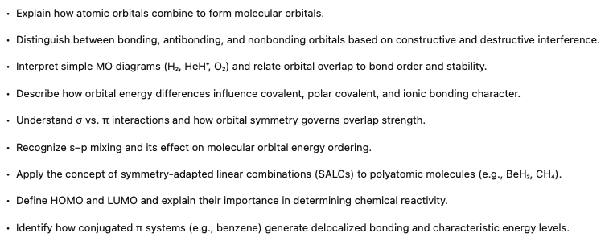
Molecular Orbital Theory
Notes:
In the last lecture, we looked at the properties of atomic orbitals. But of course, if we're ultimately interested in materials, what we really want to know is how do those orbitals behave when we bring atoms together to form molecules, to form extended solids. And to do that, we have to go one step further and talk a little bit about molecular orbital theory.

Slide 27
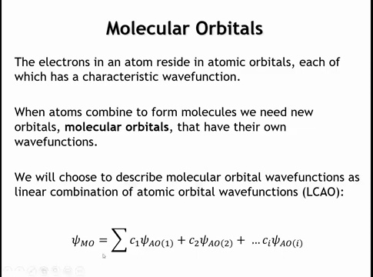
Notes:
A molecular orbital behaves like an atomic orbital—it has a wave function that describes the behavior of an electron and follows the Pauli exclusion principle, holding up to two electrons. The key difference is that a molecular orbital can extend over the entire molecule rather than being confined to one atom. Molecular orbitals can be constructed in different ways; here, we build them as linear combinations of atomic orbitals. In this approach, the molecular orbital wave function (ψ_MO) is expressed as a sum of atomic orbital wave functions, each multiplied by a coefficient.

Slide 28
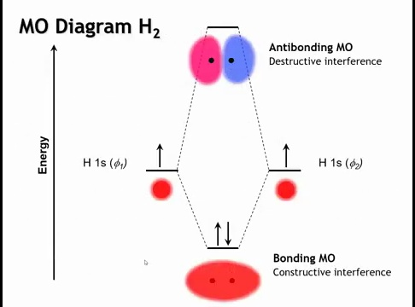
Notes:
The simplest and best-known molecular orbital diagram is for H₂. The hydrogen molecule has two molecular orbitals: a lower-energy bonding orbital and a higher-energy antibonding orbital. The bonding molecular orbital forms through constructive interference of the 1s wave functions from the two hydrogen atoms, increasing electron density between the nuclei. This concentrated electron density enhances attraction to the positively charged nuclei, stabilizing the system. As a result, the bonding molecular orbital lies lower in energy than the atomic orbitals of isolated hydrogen atoms.

Slide 29
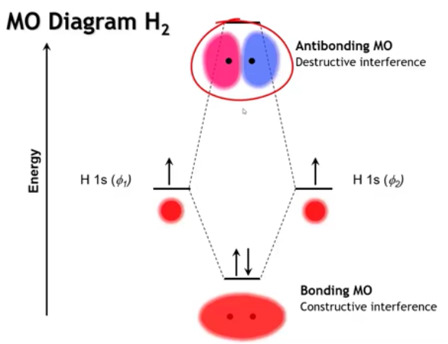
Notes:
We also get an antibonding molecular orbital, formed by destructive interference between the two hydrogen 1s wave functions. The color coding represents the sign of the wave function—red for positive, blue for negative. The node between the atoms forces a region of zero electron density, pushing electrons away from the internuclear region. This reduces stabilization and raises the energy. As a result, the antibonding molecular orbital lies higher in energy than the atomic orbitals of the separate hydrogen atoms.

Slide 30
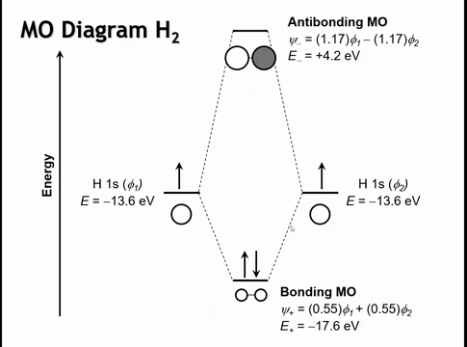
Notes:
We can redraw this using the symbolic style we’ll use going forward. When both atomic orbitals have the same sign, their overlap produces constructive interference and a bonding molecular orbital. When they have opposite signs, destructive interference occurs, creating an antibonding orbital. Using extended Hückel theory, we find that the coefficients in the bonding MO are smaller than those in the antibonding MO. This happens because, during normalization, the antibonding orbital’s positive and negative regions partially cancel each other out when the total wave function is integrated over space. To achieve the same overall normalization (so that the total probability remains one), the remaining portions of the wave function must be scaled up, resulting in larger coefficients. The bonding orbital is stabilized by about 4 eV, while the antibonding orbital is destabilized by about 17 eV. In general, the energy stabilization of a bonding orbital is always less than the destabilization of its antibonding counterpart, which is why filling both orbitals provides no net stabilization and makes bond formation unfavorable.

Slide 31
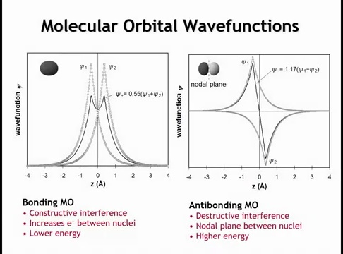
Notes:
If we plot the molecular orbital wave function along the internuclear axis, we see clear interference patterns. In the bonding molecular orbital, the wave functions overlap constructively, increasing electron density between the nuclei. In the antibonding orbital, the wave functions have opposite signs and cancel at z = 0, producing a nodal plane at that point. This pushes electron density away from the nuclei, making the antibonding orbital higher in energy.

Slide 32
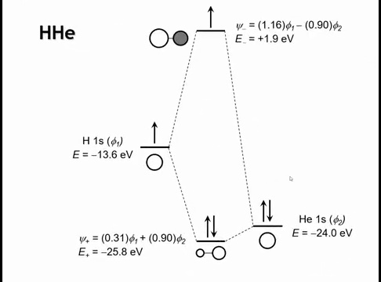
Notes:
Now let’s look at a more complex case with two different atoms. Replacing one hydrogen with helium introduces a higher nuclear charge, so the helium 1s orbital lies lower in energy than hydrogen’s. This energy difference creates partial ionicity—what we call a polar covalent bond.
In the bonding molecular orbital, the coefficient for helium is larger than for hydrogen, meaning the bonding orbital resembles helium’s 1s orbital more strongly. The opposite occurs in the antibonding orbital, which is weighted more toward hydrogen. As the energy gap between atomic orbitals increases, the bonding orbital increasingly resembles the more electronegative atom, while the antibonding orbital resembles the more electropositive one. In the limit of a very large energy difference, the bond becomes purely ionic.

Slide 33
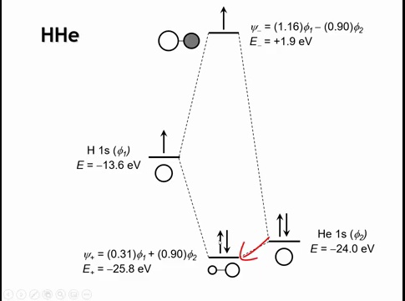
Notes:
Another key point is that the stabilization of the bonding molecular orbital decreases when the atomic orbitals differ in energy. In H₂, the bonding MO is stabilized by about 4 eV, but in the H–He system it’s only about 1.8 eV. This shows that as the energy mismatch between atomic orbitals increases, their overlap and degree of mixing diminish, reducing the bonding interaction.

Slide 34
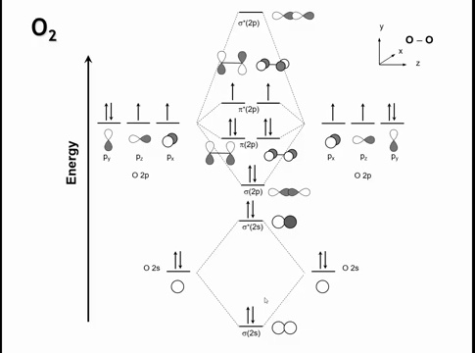
Notes:
Let’s examine O₂, starting with a simplified view and then moving toward the full MO diagram. The two 2s orbitals overlap to form bonding and antibonding MOs, similar to H₂. The 2p orbitals, being higher in energy, also combine—but their interactions split into a 1–2–2–1 pattern rather than three equal pairs.
Along the internuclear (z) axis, the p_z orbitals overlap head-on, forming σ (sigma) bonding and antibonding MOs. The p_x and p_y orbitals overlap side-on, forming π (pi) bonding and antibonding MOs with less overlap. Greater spatial overlap leads to a larger energy gap between bonding and antibonding orbitals, so σ bonds are stronger than π bonds.
To obtain the true O₂ MO diagram, we must also account for σ–σ mixing between the 2s and 2p orbitals, which slightly alters their energies and ordering.

Slide 35
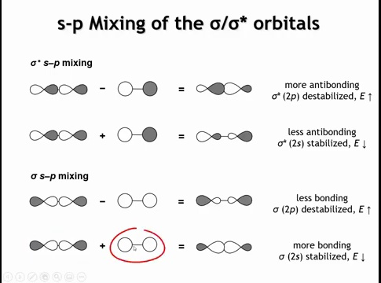
Notes:
When we introduce s–p mixing, the 2s and 2p σ bonding orbitals interact. Adding their wave functions constructively increases electron density between the nuclei, stabilizing the resulting MO. Subtracting them (changing the sign of one orbital) reduces density between the nuclei and increases it on the molecular periphery, raising the energy. As a result, mixing stabilizes the orbital with more 2s character and destabilizes the one with more 2p character. The same pattern occurs for the corresponding σ antibonding orbitals.

Slide 36
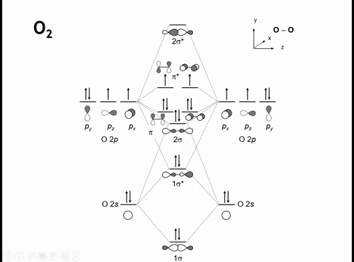
Notes:
Returning to the MO diagram, the σ2s orbital gains some p character, which stabilizes it, while the σ2p orbital gains some s character, which destabilizes it. The same occurs for the antibonding orbitals: σ2s becomes slightly stabilized, and σ2p becomes more destabilized. The net effect is a smaller energy gap between the σ2p and π2p orbitals. In lighter diatomic molecules such as N₂ or C₂, this mixing is strong enough that the σ2p orbital rises above the π2p orbitals in energy.

Slide 37
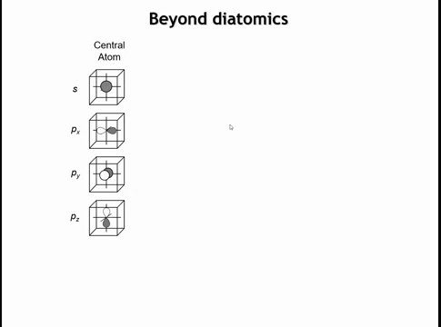
Notes:
To move beyond diatomic molecules, we decompose the system into a central atom and its surrounding atoms, called ligands. The ligand orbitals are then grouped by symmetry into symmetry-adapted linear combinations (SALCs), which represent how the ligand orbitals combine and interact with the central atom’s orbitals to form molecular orbitals consistent with the molecule’s overall symmetry.

Slide 38
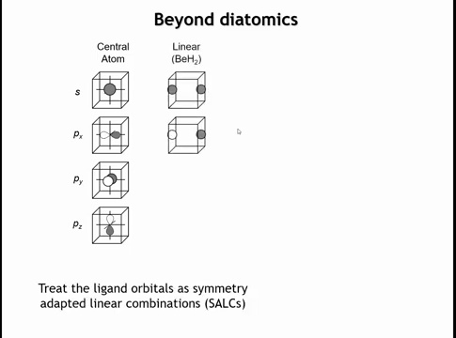
Notes:
The symmetric SALC can overlap with the Be 2s orbital, while the antisymmetric SALC aligns with the Be 2pₓ orbital. The remaining 2p orbitals (2p_y and 2p_z) do not interact because their orientations produce no net bonding or antibonding overlap. These relationships can be derived formally from group theory, but here they are evident from visual inspection of orbital symmetry.

Slide 39
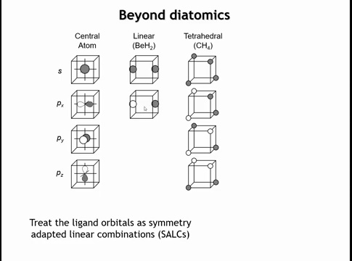
Notes:
In a tetrahedral molecule like methane (CH₄), the four hydrogen atoms form four ligand SALCs. These combinations are arranged so that each matches the symmetry of one of carbon’s valence orbitals. The totally symmetric SALC overlaps with the carbon 2s orbital, while the remaining three SALCs align with the three 2p orbitals, forming equivalent σ bonds in the tetrahedral geometry.

Slide 40
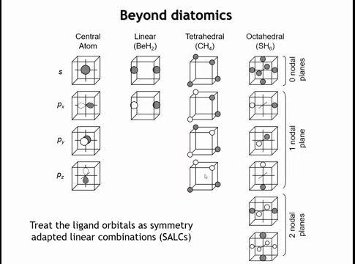
Notes:
In an octahedral molecule like hypothetical S–H₆, six ligands each contribute one orbital, forming six ligand SALCs. Determining their shapes requires group theory, but once identified, the first SALC matches the symmetry of the sulfur s orbital, and the next three align with the sulfur p orbitals to form bonding interactions. The remaining two SALCs have no matching symmetry with sulfur’s valence orbitals and therefore remain nonbonding.

Slide 41
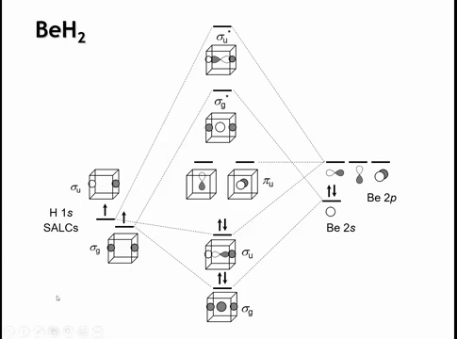
Notes:
In BeH₂, the ligand SALCs are shown on the left and the Be 2s and 2p orbitals on the right. Beryllium contributes two valence electrons in its 2s orbital, and the two hydrogens contribute one each. The symmetric (σ_g) SALC overlaps with Be’s 2s orbital to form bonding and antibonding MOs. The antisymmetric (σ_u) SALC overlaps with the Be 2p orbital oriented along the molecular axis, also forming bonding and antibonding MOs.
Because the 2p orbitals are higher in energy than the 2s, their resulting bonding and antibonding MOs are also higher in energy. The remaining two Be 2p orbitals, oriented perpendicular to the axis, have no matching ligand SALCs and thus remain nonbonding—effectively behaving like atomic orbitals.

Slide 42
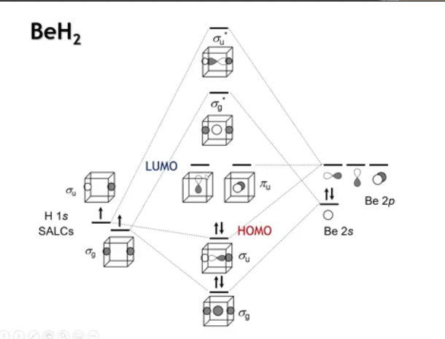
Notes:
In an MO diagram, certain orbitals dominate a molecule’s behavior—these are the frontier orbitals. The highest occupied molecular orbital is the HOMO, and the lowest unoccupied is the LUMO. In BeH₂, the HOMO corresponds to the bonding interaction between the Be 2p orbital and the hydrogen SALC, while the LUMO consists of the degenerate nonbonding Be 2p orbitals.

Slide 43
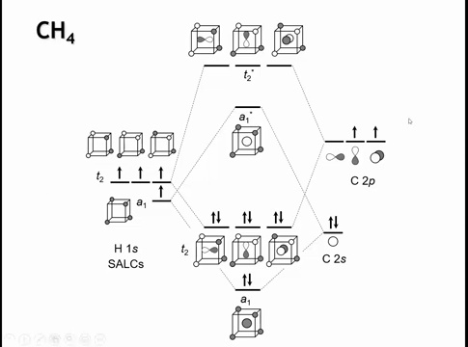
Notes:
In methane (CH₄), carbon has four valence orbitals and the four hydrogens form four ligand SALCs. Each carbon orbital can pair with one SALC, producing a bonding and an antibonding molecular orbital. The A₁ orbital represents the bonding interaction between carbon’s 2s and hydrogen orbitals, while the T₂ orbitals arise from bonding between carbon’s 2p and hydrogen orbitals, with corresponding antibonding counterparts.
In organic chemistry, this bonding is often described as sp³ hybridization of carbon. However, molecular orbital theory shows no actual sp³ hybrid orbitals exist—there is no s–p mixing. Instead, we have distinct σ bonding and antibonding MOs derived separately from the 2s and 2p orbitals. The “sp³ hybridization” terminology simply indicates that the carbon 2s and three 2p orbitals all participate in forming four equivalent σ bonds to hydrogen.

Slide 44
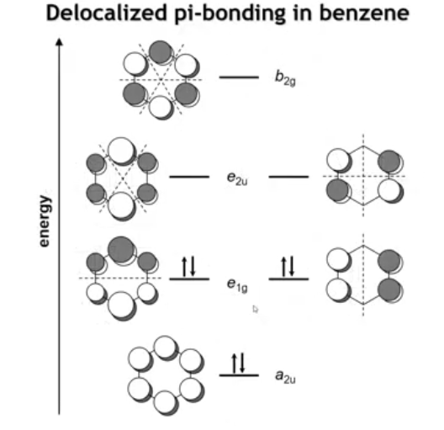
Notes:
In conjugated π systems, such as benzene, six p_z orbitals—one on each carbon—combine to form six π and π* molecular orbitals. Looking down on the ring, each p orbital has one lobe above and one below the plane. The key principle is conservation of orbital count: six atomic orbitals produce six molecular orbitals.
The lowest-energy π MO has all bonding interactions and no perpendicular nodal planes. The highest-energy π* MO is antibonding between every carbon pair, with three perpendicular nodal planes. Between these extremes are four intermediate orbitals: two degenerate E₁g orbitals with one perpendicular nodal plane each, and two degenerate E₂u orbitals with two perpendicular nodal planes. These delocalized π orbitals define benzene’s stability and electronic properties.

Slide 45
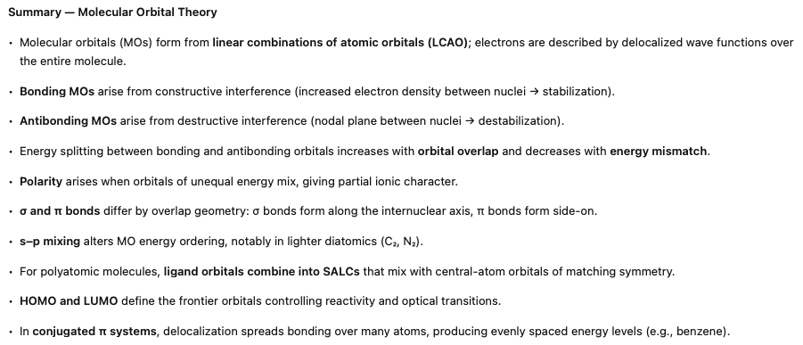

Slide 46
Homework: 5.7 – 5.13, 5.15

