Slide 1
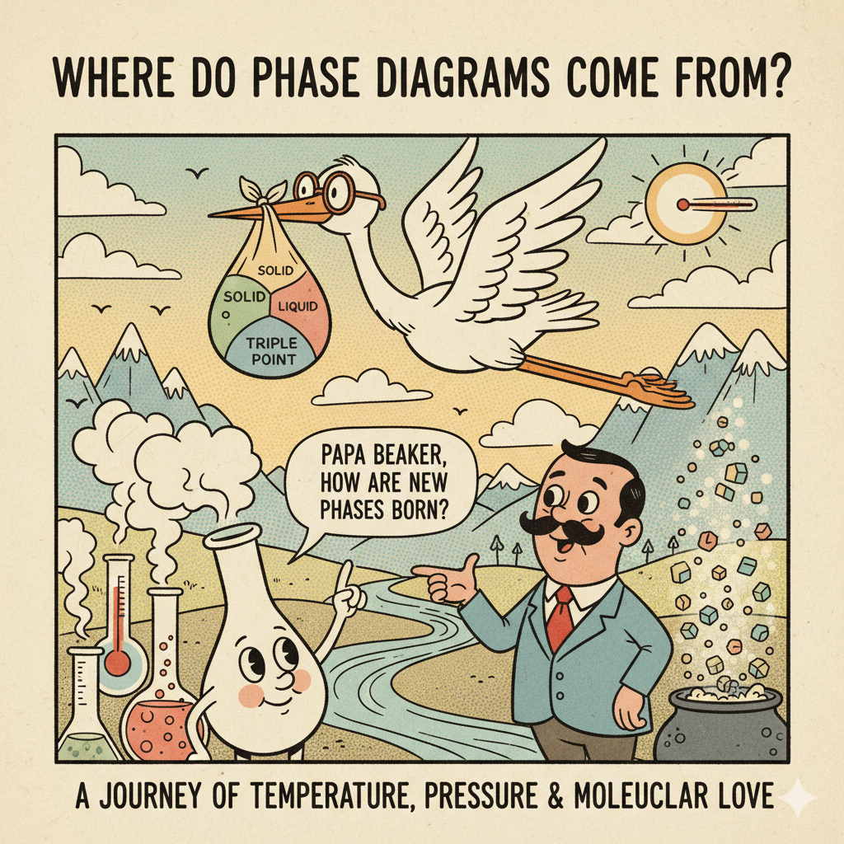

Slide 2
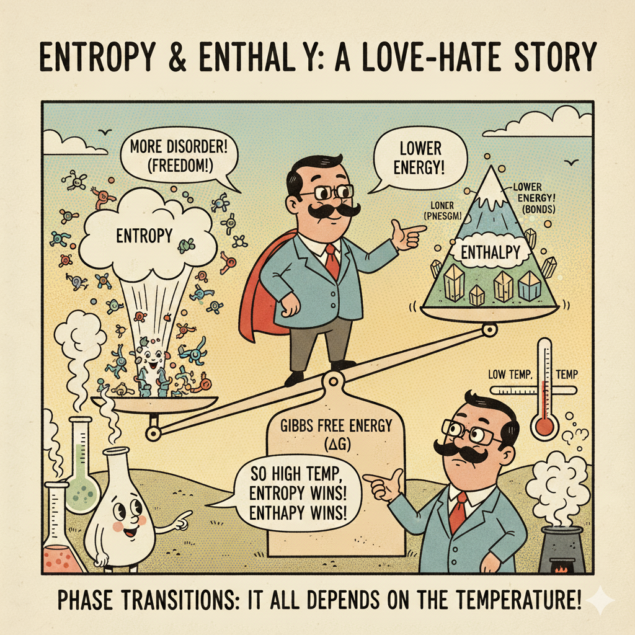

Slide 3
Where do Phase Diagrams Come From?
F=U-TS
Matter seeks to minimize the Helmoltz free energy at constant temp and Volume
Notes:
Today we connect what you see on phase diagrams to the thermodynamics that generates them. At fixed T and V, equilibrium
minimizes the Helmholtz free energy F=U−TS. For condensed phases at fixed T and p, using Gibbs free energy G leads to the same constructions; think of every boundary as a place where competing minima in free■energy are equal in value and slope.

Slide 4
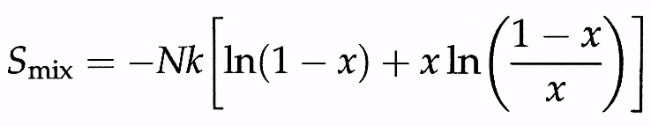
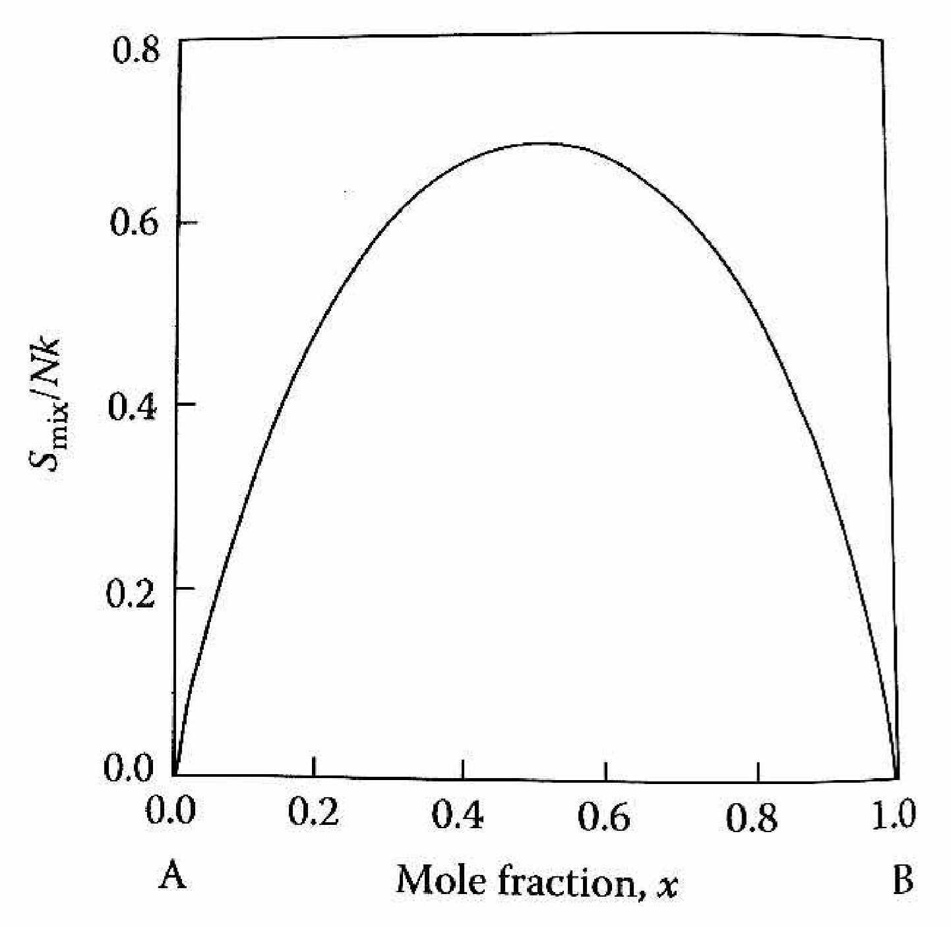
Entropy term is positive because there are more ways of rearranging 2 atoms in space then 1. Maximum at x=0.5.
Notes:
Mixing A and B increases the number of arrangements W=N!/(N_A!N_B!) (N is number of atoms), which by Stirling gives S_mix = −Nk_B[(1−x)ln(1−x)+x ln x]. This contribution is always positive and peaks at x=0.5 with S_mix/Nk_B=ln 2≈0.693. Left and right ends, x→0 or 1, return S_mix→0. Alone, entropy would make every composition mix; enthalpy decides otherwise. N = Na+Nb = total # of atoms

Slide 5
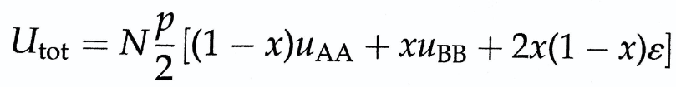
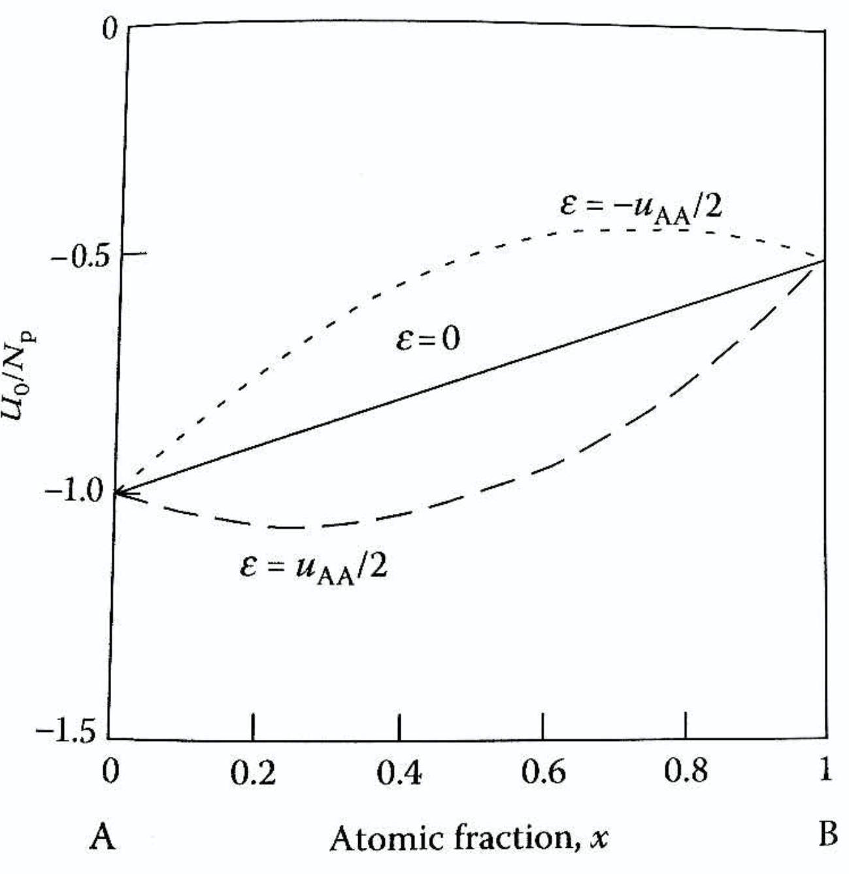
ε≡u_AB−1⁄2(u_AA+u_BB).
Internal energy term is from bonding, which can be energetically favorable or unfavorable.
P is number of nearest neighbors.
Notes:
We count nearest■neighbor pairs with energies u_AA, u_BB, and u_AB. In a mean■field model with p neighbors per atom, ∆U(x)=N p x(1−x) ε where ε≡u_AB−1⁄2(u_AA+u_BB). ε<0 (strong A–B bonding) makes mixing exothermic; ε>0 (weak A–B bonding) makes mixing endothermic. This simple curvature term competes directly with the concave■up entropy term to shape F(x,T).

Slide 6
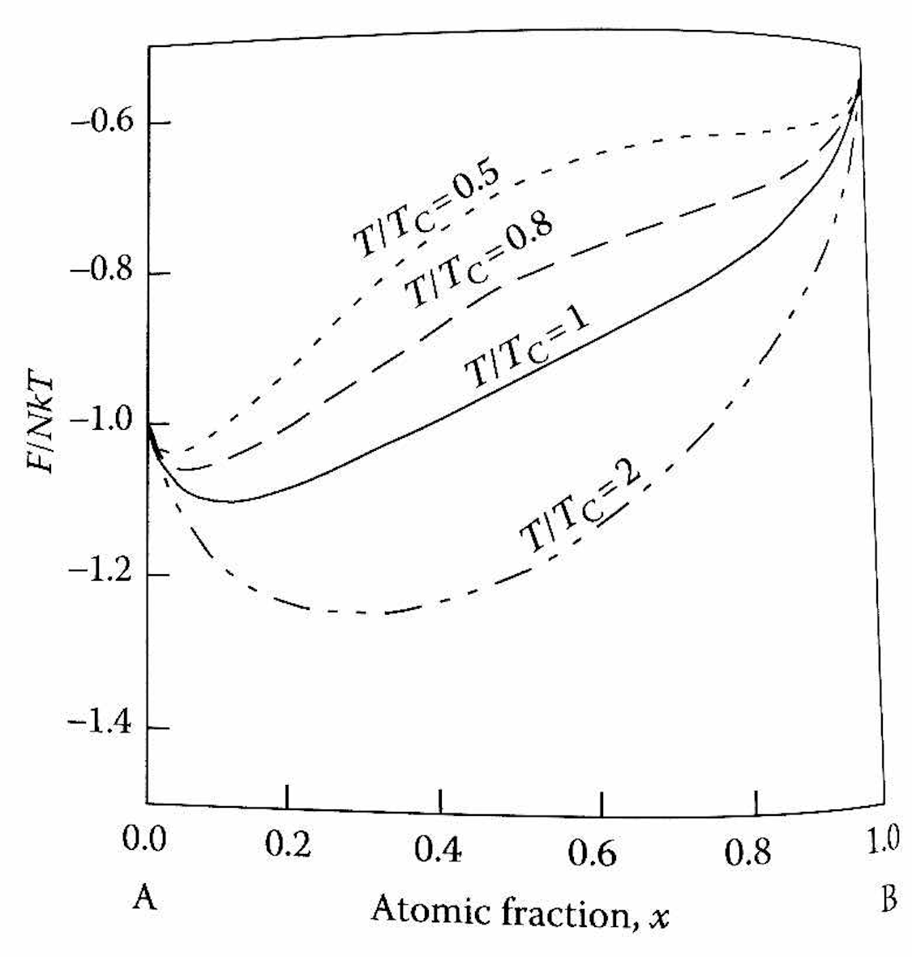
F(x,T)=∆U(x)−T S_mix(x)
At High T, Entropy Term dominates and mixing is favorable.
At low T, local minima appear, leading to phase segregation.
T_{c} = pε/2k
p = #nearest neighbors
ε= energy penalty per unlike bond
k= Boltzmann constant
Notes:
At high temperature entropy dominates and the free-energy curve is smooth with one minimum so the mixture is completely miscible, but at lower temperature if unlike bonds cost energy (ε > 0) the curve develops two dips near the pure ends with a barrier in the middle so the alloy separates into two phases, and the special point where the single dip just splits into two is called the consolute temperature given by T_c = (p × ε) / (2 × k_B),
for example with p = 12 and ε = 0.010 eV (10 meV) the consolute temperature is about 696 K while
with ε = 0.015 eV (15 meV) it is about 1040 K,
which means that the larger the energy penalty the higher the consolute temperature because more thermal disorder is needed to keep the system mixed

Slide 7
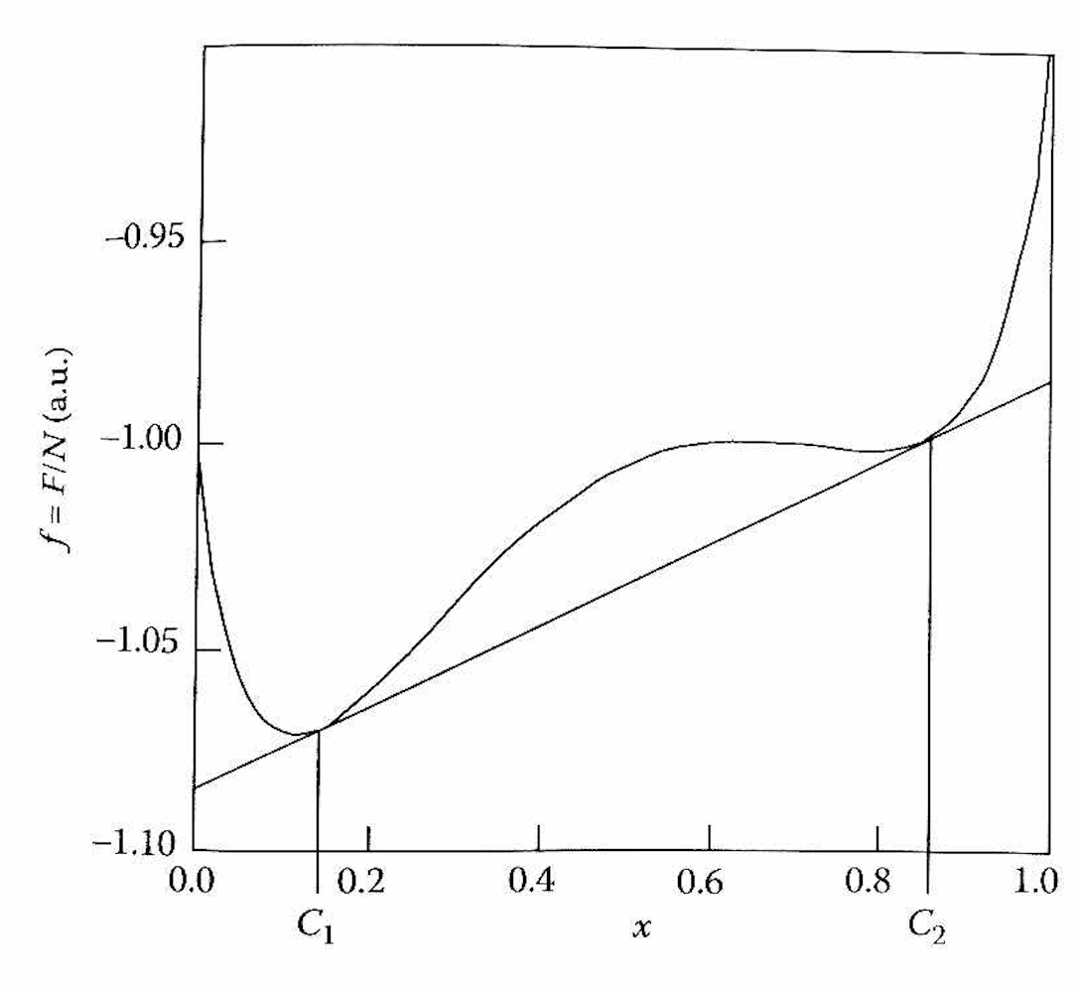
Method of Tangents
Method of Tangents can be used to find the compositions of each phase that are in equilibrium, in this case 13.2 % for alpha and 85.9 % for beta.
Notes:
Method of tangents lets us find the compositions of the two phases that can coexist at a given temperature by drawing a straight line that just touches the free-energy curve at two points, and these tangent points give the equilibrium compositions directly, so in this case the line touches at x = 0.132 (13.2%) for the alpha phase and at x = 0.859 (85.9%) for the beta phase, meaning if the overall composition lies anywhere between these values the system will split into a mixture of alpha and beta with those compositions.

Slide 8
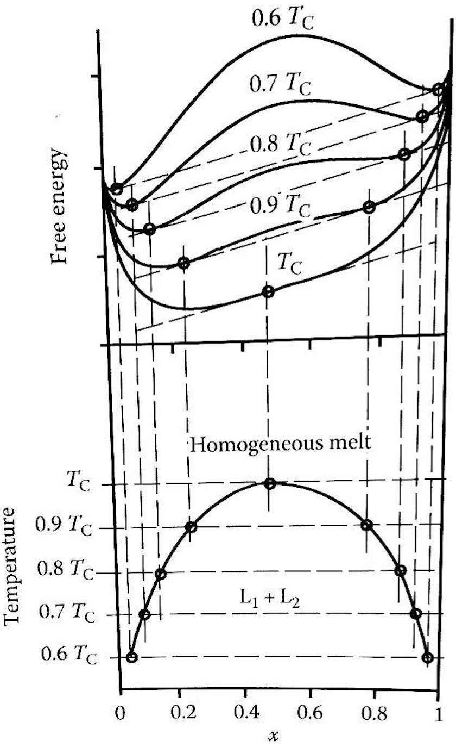
Applying the method of Tangents to free energy curves at different temperatures can be used to create a phase diagram.
Notes:
By applying the method of tangents to the free-energy curves at different temperatures we can trace out the pairs of compositions that coexist, and when we project those tangent points down onto the temperature–composition plane we generate the phase diagram, so at high temperature the curve has only one minimum and the system is fully mixed, while at lower temperatures two minima appear and the tangent gives two coexisting compositions, and by repeating this at many temperatures we build the binodal curve that outlines the miscibility gap with the consolute temperature at its peak.

Slide 9
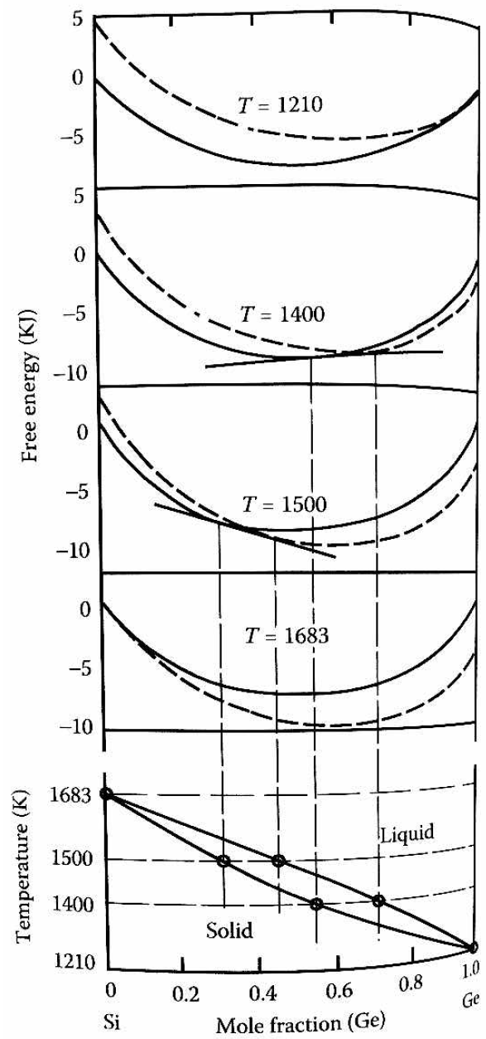
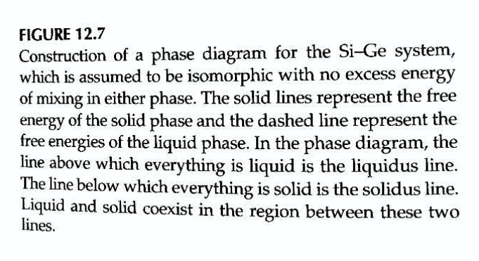

Example of real ideal system (no heat of mixing)
Notes:
In the Si–Ge system there is no heat of mixing, so the solid free energy is F_s(x,T) = RT[x ln(x) + (1–x) ln(1–x)] and the liquid free energy is F_l(x,T) = RT[x ln(x) + (1–x) ln(1–x)] + ΔS[x(T_B – T) + (1–x)(T_A – T)], where ΔS is the entropy of fusion per mole and T_A and T_B are the melting points of pure Si and pure Ge, so the entropy of mixing is the same in both phases but the liquid curve is shifted by how far the temperature is below each melting point, which means at low temperature the solid has lower free energy and is stable, at high temperature the liquid has lower free energy and is stable, and in between the curves cross so a common tangent defines the liquidus and solidus, giving the smooth phase diagram with complete miscibility that we see for Si–Ge.

Slide 10
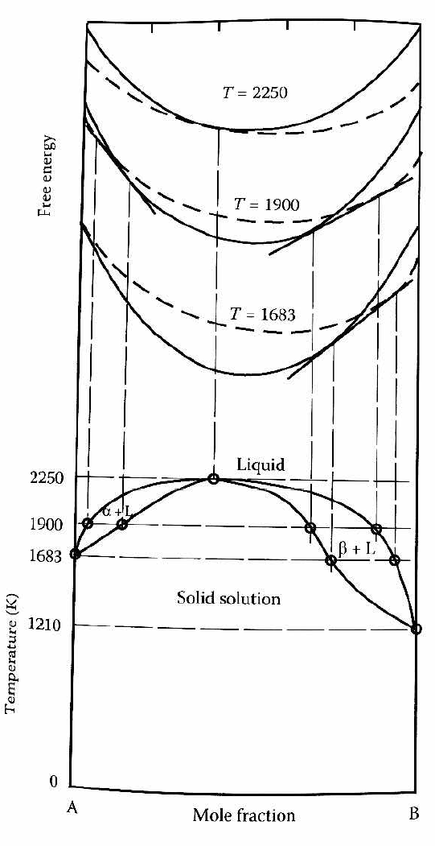
Example of system with heat of mixing of -30 kJ/mol
Positive heat of mixing means the melting point of the alloy is not higher than the melting point of the pure phases.
Notes:
When the solid has a large negative heat of mixing (–30 kJ/mol in this example), the strong A–B interactions raise the solidus above the melting points of the pure components. This produces a congruent melting point at which the alloy solidifies directly from the liquid at the highest temperature, unlike systems with positive heats of mixing, where the melting point is always depressed.

Slide 11
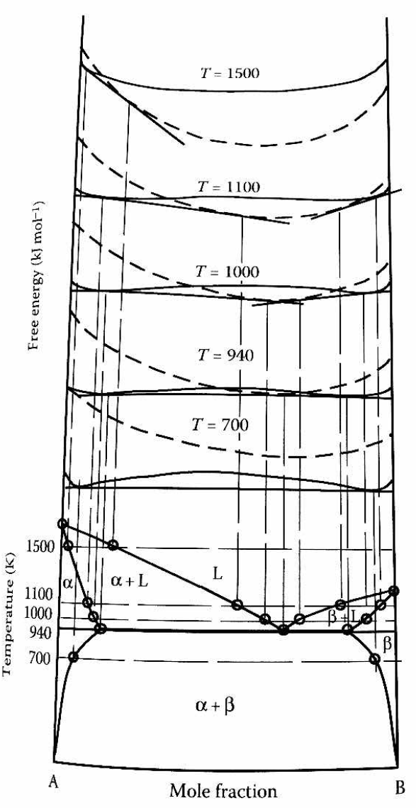
Example of system with Positive heat of mixing.
The point where the liquid line minima meets the tangents of the two solid phase minima leads to a lower melting point eutectic.
Notes:
From high T (1500 K, single-phase liquid L), through 1100–1000 K where the liquid free energy rises and mutual tangents to the solid minima define α+L and β+L fields with tie-lines giving equilibrium compositions (lever rule), down to the eutectic at ~940 K where the liquid minimum just touches the common tangent between α and β (an invariant three-phase point, L ⇌ α+β, depressed below the pure melting points by positive solid heat of mixing), and finally at lower T (e.g. 700 K) the liquid lies above the α–β tangent leaving only two solids (α+β), with phase compositions from tangent points and fractions from the lever rule—illustrating how positive enthalpy of mixing produces the V-shaped liquidus, eutectic reaction, and α+β solid region [oai_citation:0‡Nauman_ch12_phase_equilibria.pdf](file-service://file-Q1ewSHDHZyMzxiqeDyNy2m).

Slide 12
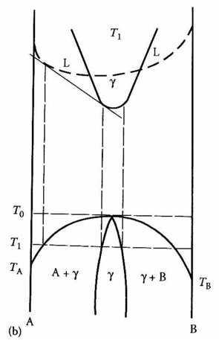
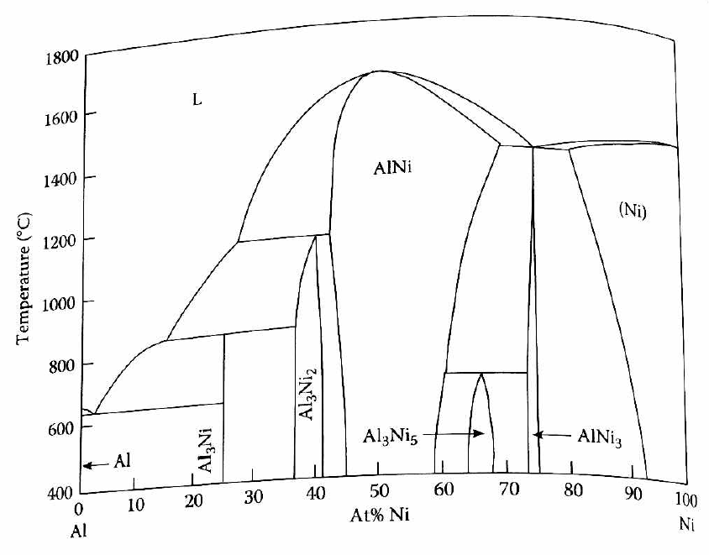
Example of solid solution intermediate phase
Notes:
Left: The γ phase forms because the free-energy curve has a rounded “nose,” so a **common tangent line** touches it at two points—giving a finite composition range (A+γ and γ+B) instead of a single point; Right: In Al–Ni this solid-solution intermediate phase is AlNi, stable from ≈45–58 at% Ni and melting above both Al and Ni.

Slide 13
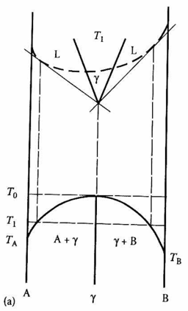
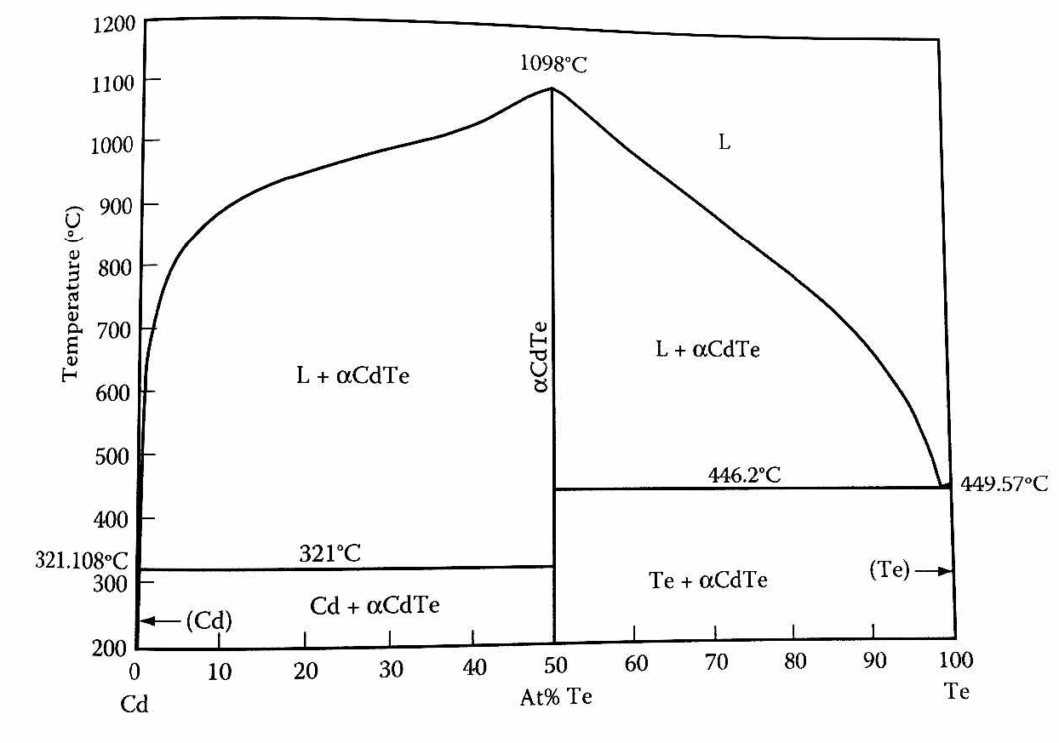
Example of Line compound.
Notes:
What is a “line compound,” and why is it a vertical line?
Some compounds only form at one exact composition. In Cd–Te that’s CdTe (50 at% Te), so any off-stoichiometric alloy splits into Cd + CdTe (left) or Te + CdTe (right). The reason it’s a vertical line is the tangent construction in free-energy space: the solid-CdTe free-energy curve has a sharp, wedge-like minimum at stoichiometry, so the common tangent from the liquid touches it at a single composition; when mapped to the T–x diagram this single tangent point projects to a vertical CdTe line (no composition range). If the solid’s free-energy minimum were rounded, the common tangents would touch at two compositions, projecting a finite γ + L two-phase band—i.e., a solid-solution instead of a line compound. The right panel shows real Cd–Te data: congruent melting of CdTe at ≈ 1098 °C, far above Cd ≈ 321 °C and Te ≈ 450 °C, with the vertical α-CdTe field evidencing the line compound; the left sketch is the generic A–γ–B topology for such cases.

Slide 14
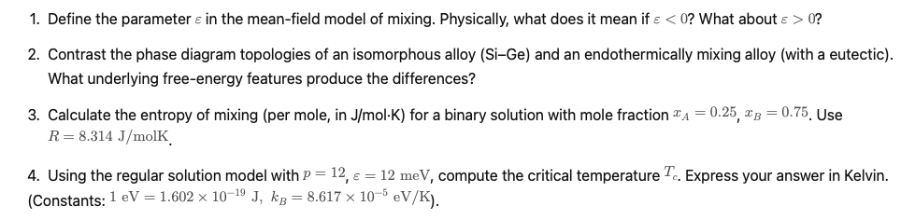
Homework Questions

Slide 15

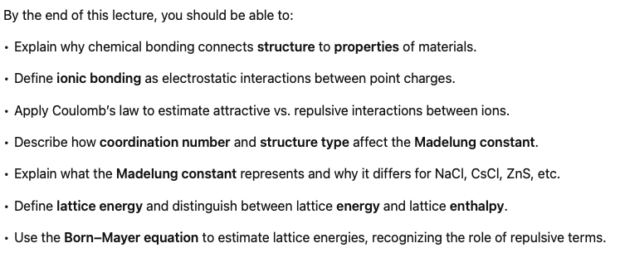
Notes:
Now we're moving on to chapter 5. Chapter 5 is all about chemical bonding. Chemical bonding is really the link between on the one hand structure, which we've already talked about, and on the other hand, the properties of materials. To understand the properties of many materials, we're going to have to think about what's called the electronic band structure. And when I first started teaching this class many years ago, I kind of jumped right into this electronic band structure. But what I realized after teaching this one or two times is that really students needed a little refresher on chemical bonding. And that's particularly true for those of you who might not be chemistry majors. Our first foray into the world of bonding is going to deal with ionic bonding. After this, we're going to talk about atomic orbitals and then covalent bonding.

Slide 16
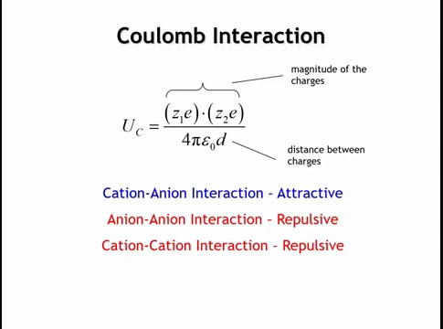
Notes:
Ionic bonding can be described in a simple, though not fully realistic, way by treating a crystal as a collection of point charges. In potassium fluoride, for example, potassium ions are taken as +1 charges and fluoride ions as –1 charges, and we calculate the electrostatic, or Coulomb, interactions between them. The interaction energy comes from multiplying the charges, dividing by four pi times the permittivity of free space, and then dividing by the distance between them. When we say +1 charge, we mean +1 times the elementary charge of an electron, which is 1.602 × 10⁻¹⁹ coulombs.
This equation shows several things. Opposite charges give negative energy, which means attraction. Like charges give positive energy, which means repulsion; two cations, for instance, will push apart until the energy tends toward zero. The magnitude of the interaction grows with larger charges or shorter distances. Finally, because the Coulomb energy decreases only as one over distance, these interactions remain significant even over relatively long ranges.

Slide 17
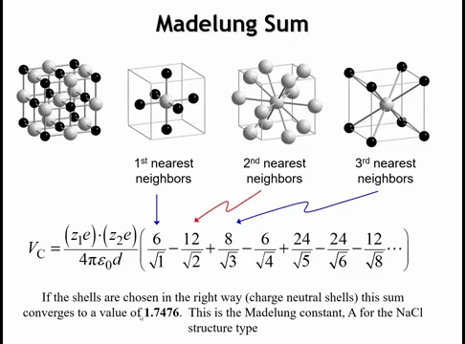
Notes:
Once we have the energy expression for two interacting charges, the next step is to sum all such interactions in the crystal. Consider sodium chloride, which has the rock salt structure. Starting from a central chloride ion, we look at successive shells of neighbors. The nearest neighbors are six sodium ions arranged octahedrally at a distance equal to the interatomic spacing, giving six attractive interactions. The second nearest neighbors are twelve chloride ions located along the edges of the unit cell. Their distance is longer—specifically, the edge times the square root of two—and because they are like charges, these interactions are repulsive. The third nearest neighbors are eight sodium ions at the corners of the cube, at a distance equal to the edge times the square root of three, giving attractive contributions. Continuing this process shell by shell yields a series that alternates in sign and decreases in magnitude with distance. When summed to infinity, this series converges to 1.7476 for the sodium chloride structure, a value known as the Madelung constant.

Slide 18
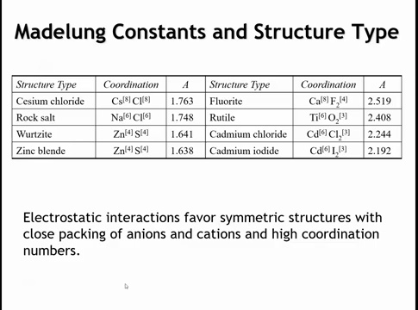
Notes:
Different crystal structures give different Madelung constants because each has distinct neighbor shells. A table of values for common structures shows clear trends. For compounds with a 1:1 ratio of cations to anions, the Madelung constant decreases as the coordination number drops: from eight-coordinate in cesium chloride, to six-coordinate in sodium chloride, to four-coordinate in zinc blende and wurtzite. This reflects a general rule: higher symmetry and higher coordination maximize ionic bonding.
For 1:2 compounds, the Madelung constant is larger overall because more ions contribute per formula unit, but the same coordination trend appears. Going from eight-coordinate calcium fluoride to six-coordinate rutile TiO₂ to layered cadmium chloride and cadmium iodide, the constant decreases. The difference between rutile and the layered CdCl₂/CdI₂ types is especially instructive: although all have six-coordinate cations and three-coordinate anions, rutile spreads its octahedra in three dimensions, minimizing cation–cation repulsion, while the layered CdCl₂/CdI₂ structures concentrate cations in certain planes, increasing repulsion and lowering the Madelung constant.

Slide 19
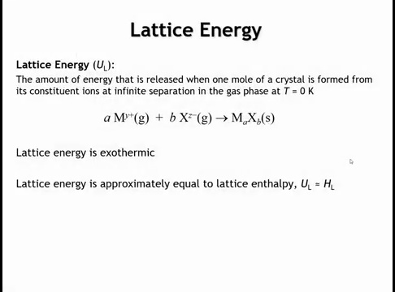
Notes:
Lattice energy can be defined in different ways depending on the textbook. Here we define it as the energy released when cations and anions, initially separated in the gas phase, come together to form a solid. Because this process is exothermic, the lattice energy is negative. In practice, experimental methods usually give the lattice enthalpy rather than the internal energy, but in solids the difference between the two is only a few kilojoules per mole at room temperature. Within the accuracy of our calculations, lattice energy and lattice enthalpy can therefore be treated as essentially equivalent.

Slide 20
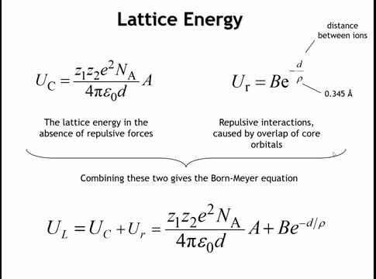
Notes:
To calculate the lattice energy, we start with the expression for the electrostatic energy of point charges arranged in a crystal. This energy is negative and grows more favorable as ions get closer. However, the equation alone would predict collapse of the ions, which does not occur in reality. The reason is short-range quantum mechanical repulsion from overlapping core electrons. We approximate this repulsion with an exponential function, where B is an empirical constant and rho is another constant set to 0.345 Å. The repulsive energy is positive, while the Coulombic energy is negative, so combining them gives the full lattice energy expression. The difficulty is that B cannot be derived directly and must be determined empirically, while all other parameters—Madelung constant, rho, and interionic distances—are known.

Slide 21
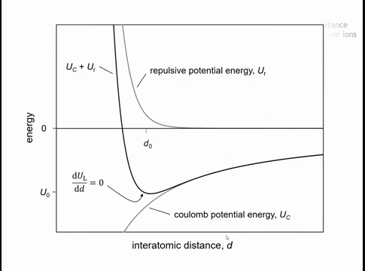
Notes:
If we plot the Coulomb energy versus distance, it becomes more and more negative as the ions get closer. The repulsive energy, caused by overlapping core electrons, is negligible at long range but rises sharply at short range because of its exponential dependence. When the two curves are added, the result is a total energy curve with a minimum. This minimum occurs at a specific equilibrium separation, called d₀.

Slide 22
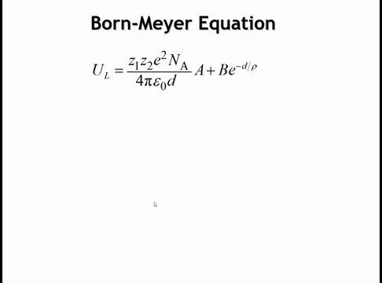
Notes:
If we go back to the lattice energy expression, we can take its derivative with respect to the interatomic distance d and set it equal to zero. Setting the derivative to zero identifies the minimum of the function, which corresponds to the equilibrium separation between ions.

Slide 23
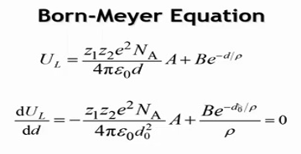
Notes:
Taking the derivative of the lattice energy expression helps locate the equilibrium bond distance. The Coulomb term varies as 1 over d, so its derivative is –1 over d², giving a negative contribution. The repulsive term, an exponential, remains an exponential upon differentiation but gains a factor of 1 over rho. Setting the total derivative equal to zero and evaluating at d₀, the equilibrium distance, gives the condition for the minimum of the lattice energy.

Slide 24
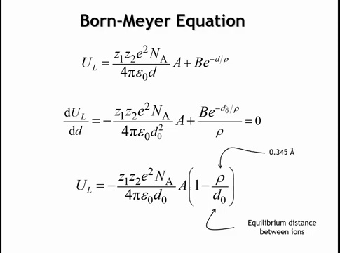
Notes:
By solving for the constant B and substituting it back, we obtain the Born–Mayer equation, which allows calculation of lattice energy. To use it, we need a few inputs: the ionic charges, Avogadro’s number, the elementary charge, and the permittivity of free space—all physical constants. We also need the Madelung constant, which depends on structure type, and the equilibrium distance d₀ between cations and anions. This distance can be estimated by adding the ionic radii of the two ions. With these values, the Born–Mayer equation provides the lattice energy of an ionic compound.

Slide 25
F(x,T)=∆U(x)−T S_mix(x)
At High T, Entropy Term dominates and mixing is favorable.
At low T, local minima appear, leading to phase segregation.
T_{c} = pε/2k
p = #nearest neighbors
ε= energy penalty per unlike bond
k= Boltzmann constant
Notes:
And its that U, which is the sum of the bond energies in the lattice, which we used earlier in our Helmholtz free energy equation to determine the boundaries of phase diagrams.

Slide 26


Slide 27
Homework: 5.1 – 5.5

Slide 28
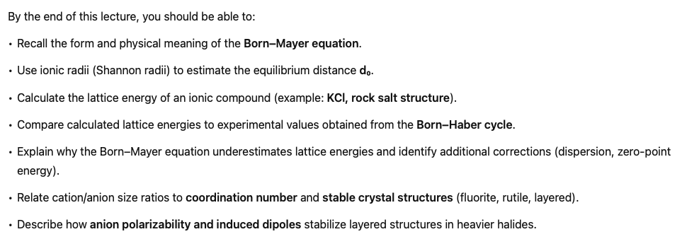
Part 2

Slide 29
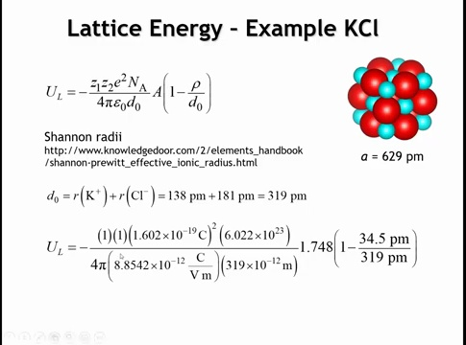
Notes:
In the In the last lecture, we derived the Born–Mayer equation for calculating the lattice energy of ionic compounds. The equation has two main parts: the electrostatic potential energy of a lattice of point charges, and a repulsive correction, –ρ/d₀, that accounts for short-range ion repulsion.
As an example, consider KCl, which crystallizes in the rock salt structure. To apply the equation, we need the ionic charges, Avogadro’s number, the elementary charge (1.602 × 10⁻¹⁹ C), the permittivity of free space, the Madelung constant (1.748 for rock salt), and the equilibrium ion separation d₀. The hardest value to obtain is d₀, which is estimated from Shannon (Shannon–Prewitt) ionic radii. For six-coordinate K⁺ (138 pm) and Cl⁻ (181 pm), the sum gives d₀ = 319 pm.
With these values, we assign charges of 1e (absolute values used in the equation, with the negative sign accounting for attraction), multiply by Avogadro’s number, divide by 4πϵ₀, and substitute d₀. Finally, we add the repulsion correction using ρ = 34.5 pm. This procedure yields the lattice energy of KCl as calculated by the Born–Mayer equatio

Slide 30

Notes:
So when you put all of that into the calculator, you're going to get minus 679 kilojoules. You can see that if we didn't have the repulsive term, it would be minus 761 kilojoules. So the inclusion of the repulsive term reduces the lattice energy by a ballpark of about 10%. Now we might ask ourselves how close is that to the true lattice energy?

Slide 31
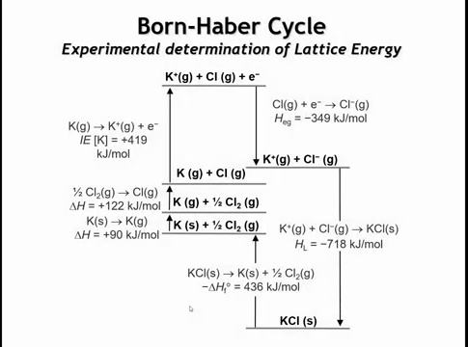
Notes:
The Born–Haber cycle is a method of determining the experimental lattice energy of an ionic compound. For KCl, we can either measure the direct enthalpy of formation from potassium metal and ½Cl₂(g), which releases 436 kJ·mol⁻¹, or reconstruct it step by step. First, vaporize K (ΔH = +90 kJ·mol⁻¹), then dissociate Cl₂ into atoms (ΔH = +122 kJ·mol⁻¹). Next, ionize K to K⁺ (ΔH = +419 kJ·mol⁻¹), and allow the electron to attach to Cl, corresponding to the electron gain enthalpy (ΔH = –349 kJ·mol⁻¹, the only exothermic step up to this point). With K⁺ and Cl⁻ in the gas phase, we then let them combine to form KCl; by definition, this enthalpy change is the lattice energy, 718 kJ·mol⁻¹ released. This lattice enthalpy, nearly equal to lattice energy, provides the driving force for the reaction: although forming ions from neutral atoms is endothermic, the large exothermic lattice energy stabilizes the compound. Comparing to theory, the Born–Mayer equation gave about –680 kJ·mol⁻¹, while experiment gives –718 kJ·mol⁻¹, showing the equation slightly underestimates the lattice energy.

Slide 32
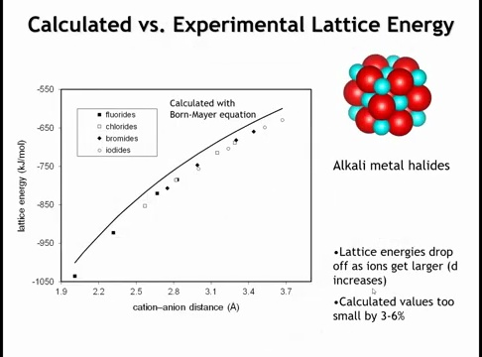
Notes:
The Born–Mayer equation underestimates lattice energies by only about 3–6%, which is reasonably accurate given its simple assumption of ions as point charges. For alkali metal halides with the rock salt structure, the calculated lattice energy depends only on the interatomic distance. Plotting this relationship gives a smooth curve of predicted lattice energies, while experimental values obtained from Born–Haber cycles appear as discrete points

Slide 33
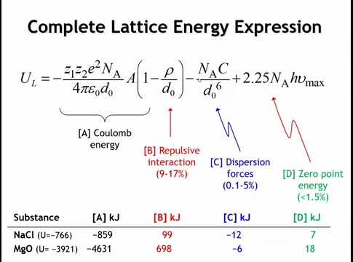
Notes:
In these simple lattice energy calculations, we mainly include two terms: the Coulomb energy (the dominant, negative term from ion–ion attraction) and the short-range repulsion (about 9–17% of the Coulomb energy, depending on the compound). For greater accuracy, we could also add a dispersion term with a 1/r^6 dependence, representing van der Waals forces, which stabilizes the lattice by roughly 1–5%. Finally, there is the zero-point energy, a quantum mechanical contribution of opposite sign that slightly destabilizes the lattice. Because the dispersion and zero-point terms are small and nearly cancel, they are often neglected.

Slide 34
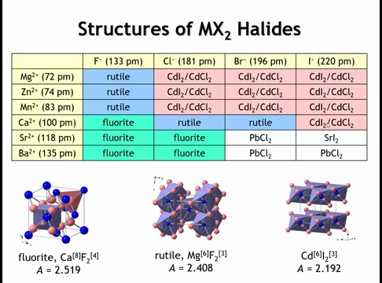
Notes:
To predict the most stable structures in MX₂ compounds, we compare possible cation–anion arrangements. The fluorite structure gives the cation 8 anion neighbors and the anion 4 cation neighbors; the rutile structure lowers this to 6 and 3, respectively. Layered structures such as CdI₂ and CdCl₂ fill only half the octahedral holes, producing alternating filled and empty layers that differ only in stacking sequence. Among these, the fluorite structure has the largest Madelung constant due to high coordination and symmetry, so it would naively be expected to dominate. Indeed, for large cations with relatively electronegative anions, fluorite is experimentally observed. However, as cations get smaller, the rutile structure becomes favored, and with larger, less electronegative halides, layered CdI₂/CdCl₂ structures emerge as most stable. More complex variants like PbCl₂ or SrI₂ have less symmetry and cation coordination numbers of 7. The overall trend is that stability depends not just on Madelung constant but also on relative ion sizes and electronegativity, which shift the balance between fluorite, rutile, and layered structures.
What explains these trends? You just pause the video for a second and have a little discussion if you're in a group or maybe if you're watching this by yourself, just jot down some ideas of what's going on here. What causes these structures to emerge as the most stable in different parts of this table?
Let's take a look first at the size argument. So let's concentrate on the fluoride compositions in this table and we see that for small cations, we have the rootile structure for large cations, we have the fluoride structure.

Slide 35
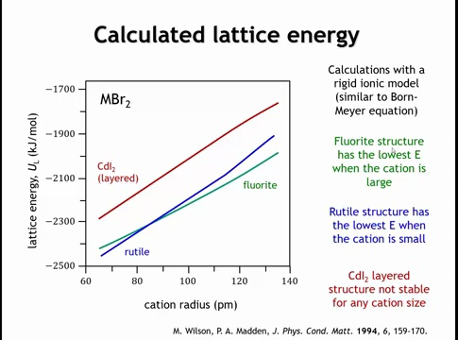
Notes:
Wilson and Madden extended Born–Mayer–type calculations by treating ion–ion repulsion more realistically and including dispersion forces, allowing predictions of lattice energies as cation radius varies. Their results show that for small cations the rutile structure has the lowest (most negative) lattice energy, but as cations grow larger a crossover occurs where the fluorite structure becomes most stable. Layered CdI₂-type structures remain consistently higher in energy because, although the cation-to-anion ratio is the same, the cations are concentrated in layers rather than maximally separated, leading to shorter cation–cation distances and stronger repulsion. Thus even these relatively simple models capture the rutile-to-fluorite crossover and explain why layered structures are less stable.

Slide 36
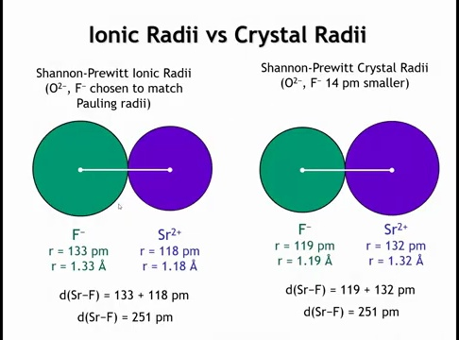
Notes:
Before continuing, we need to discuss ionic radii. In Shannon and Prewitt’s original work and Shannon’s 1976 revision, two sets of values were tabulated: ionic radii and crystal radii. What can be measured directly with high accuracy is the distance between the centers of a cation and its coordinating anions, e.g., Sr–F. To partition this distance into individual radii, Shannon and Prewitt fixed the oxide and fluoride radii to match Pauling’s earlier, widely accepted values. However, more detailed crystallographic studies of electron density suggested Pauling had overestimated anion sizes; the improved estimate reduced all anion radii by 14 pm and increased cation radii by the same amount. Thus, the sum of cation + anion radii is unchanged, but the split differs: ionic radii follow Pauling’s convention, while crystal radii shift 14 pm from anion to cation. Although crystal radii arguably better reflect electron-density boundaries, most of the community continues to use ionic radii, and I now generally follow that convention.

Slide 37
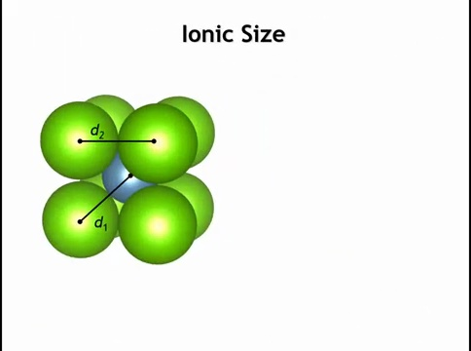
Notes:
But in what follows, we're going to talk about these ions as though they really were hard spheres. And we want to look at where the anions start to overlap. And in that kind of consideration, it's best to use the crystal radii. So we're going to use the crystal radii for the rest of this lecture. Now if we were to take a cation and put it into a cube of anions, as I show here, as you have in the fluoride structure, there's a couple of distances we can get from simple trigonometry.

Slide 38
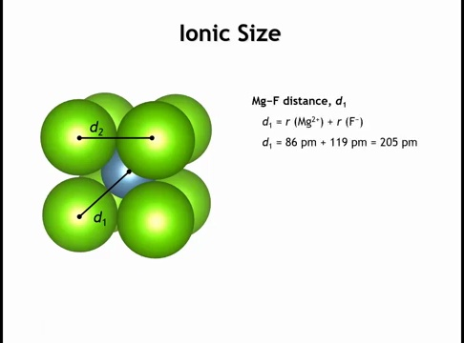
Notes:
So the distance from the center of the cation to the center of the anion here, D1, if we make the cation magnesium in the anion fluoride, that distance is just 205 picometers. And we can get it simply by adding the radii of the two species. Now because it's a cube, once we've specified this distance, we've also fixed the distance from the center of the fluoride ion to the center of the neighboring fluoride ion.

Slide 39
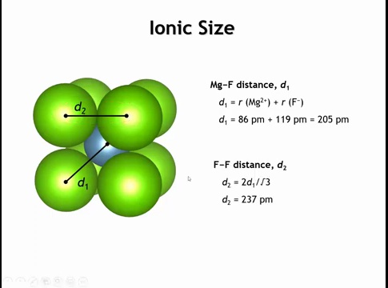
Notes:
If we take two times this D1, that is the cation anion distance, two times that would be the body diagonal of this cube. And then if we divide by the square root of three, we get the edge length of the cube. And that's the fluorine-floring distance. So when you do that, you come up with an estimate of 237 picometers from the center of this fluoride ion to the center of this one.

Slide 40
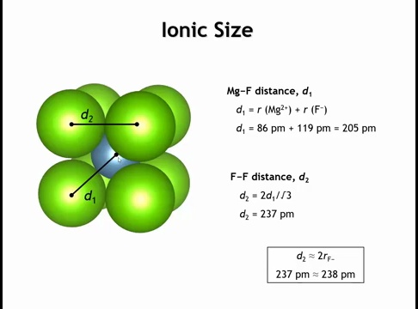
Notes:
And how does that compare to the actual radius of a fluoride ion? Well, the radius of a fluoride ion, 119 picometers, we multiply that by two, and we get 238 picometers. So what we see is that the size of the magnesium cation is such that to get the optimal cation anion distance, so they touch, we practically have to bring the fluoride ions together so they touch. And that second thing is not favorable because as the fluorides get close to each other, we get these repulsions between the core electrons. So it starts to become unfavorable to put eight anions around the cation when the cation gets too small.

Slide 41
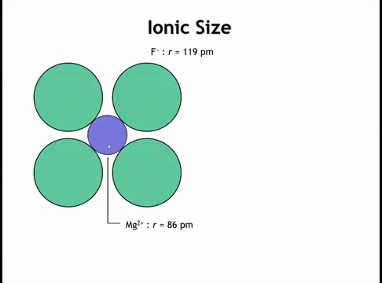
Notes:
If we were to reduce the coordination number to six, like it is in Rutile, here I'm just looking at, let's say, the equatorial plane of an octahedron. If we wanted the full octahedron, we'd have one anion above and below. I'm not drawing those just so we can see the geometry. Now what is the anion anion distance?

Slide 42
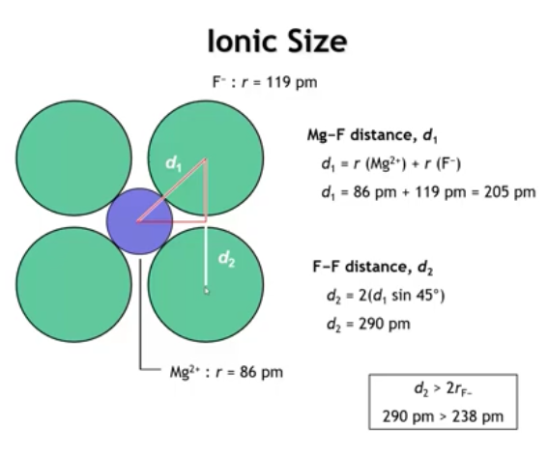
Notes:
Using a bit of trigonometry, the F–F distance can be estimated from a 45° triangle: the side length is d₁ times sin 45°, and doubling it gives an F–F separation of 290 pm. Since this is much larger than 238 pm, the anions are not in contact and core–core repulsions between fluoride ions are avoided. This explains why smaller cations or larger anions favor lower coordination numbers: reducing cation size or increasing anion size would otherwise force anions closer together, leading to unfavorable repulsions.

Slide 43
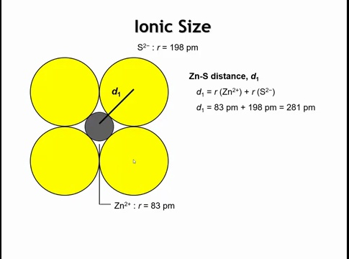
Notes:
Now eventually, even six coordinate becomes too small and we can do the same calculation for zinc sulfide. What we get is the zinc sulfur distance being 281 picometers.

Slide 44
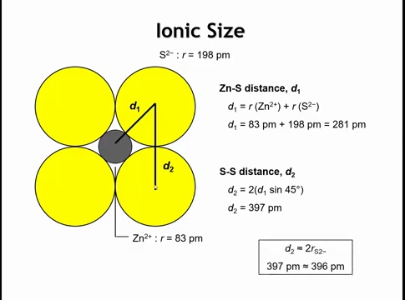
Notes:
And then the sulfur sulfur distance being 397 picometers and that 397 is very close to the sum of two sulfide ion radii. So now the sulfur ions are practically touching. We're getting unfavorable electron-electron repulsions between the sulfur. And if you know anything about the crystal chemistry of zinc sulfide, you know that the structures it adopts, wurtzite and zinc blend both have four coordinates zinc rather than six coordinates zinc.

Slide 45
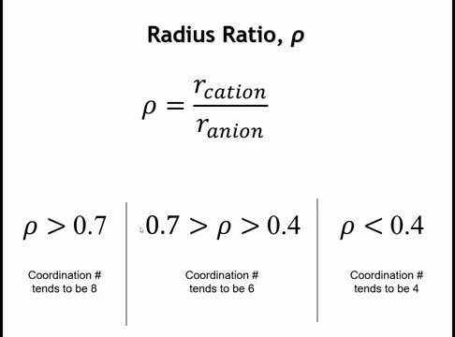
Notes:
Early in the twentieth century, Linus Pauling proposed the radius ratio rule: the stability of a coordination number depends on the ratio of cation radius to anion radius. If this ratio is greater than 0.7, eight anions can fit around a cation, giving a coordination number of eight. When the ratio falls below 0.7, eightfold coordination is no longer possible, and the number drops to six. If the ratio decreases further, below 0.4, even sixfold coordination cannot be sustained, and the coordination number falls to four.

Slide 46

Notes:
All right, let's go back to our table here once again. Remember the green ones have coordination number eight, the blue and the red are coordination number six. And then these white entries over here, that would be coordination number seven. So what kind of radius ratio do we get for these compounds?

Slide 47
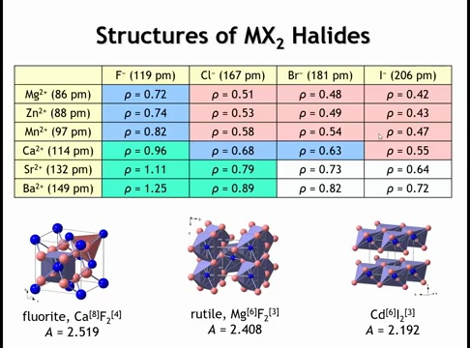
Notes:
Using updated crystal radii gives more accurate radius ratio values than Pauling had, but the cutoff values should not be treated as absolute. The 0.7 threshold is not a strict boundary because ions are not hard spheres. Instead, the trend is that as the cation-to-anion radius ratio decreases, the coordination number also decreases. For example, in fluorides the crossover from eightfold to sixfold coordination occurs below about 0.96, while in chlorides, which are softer, the crossover lies between 0.79 and 0.68. Thus radius ratios are useful guidelines, but not exact rules. They also do not explain every case—for instance, compounds such as zinc chloride, zinc bromide, and manganese iodide adopt layered CdI₂-type structures rather than rutile, despite both being six-coordinate, and despite rutile having a higher Madelung constant. Why is that goign

Slide 48

Notes:
If we go back to these calculations of Wilson and Madden, remember that, you know, this also predicted that we should never see the cadmium iodide structure. But we do. And in fact, layered compounds are a really topical area of research in modern day and age. So what's responsible for stabilizing these layered structures?

Slide 49
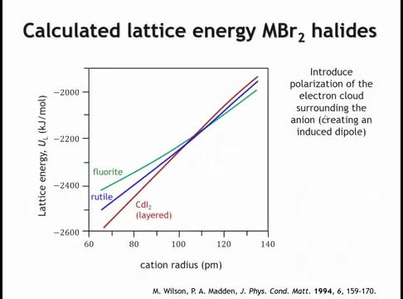
Notes:
In the same study, an additional term was introduced to make the modeling more realistic by allowing the anion’s electron cloud to deform, essentially accounting for polarization. For example, a large iodide ion has its negative charge spread over a wide electron cloud. When a small cation such as magnesium approaches, the cloud shifts toward it, creating an induced dipole. As a result, the electron distribution is no longer symmetric, and polarization effects must be included in the lattice energy.

Slide 50
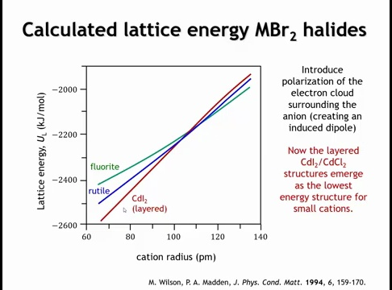
Notes:
When polarization effects are added to the calculation, the CdI₂-type layered structure emerges as the most stable for small cation sizes, at least for the bromides in the middle of the series. Including the induced dipole lowers the lattice energy of the layered structure significantly, while the fluorite structure remains essentially unchanged and the rutile structure decreases only slightly. The effect is stronger for the layered CdI₂ and CdCl₂ structures because their geometry concentrates cations in planes, leading to stronger polarization interactions and a larger stabilization compared with the other structures.

Slide 51
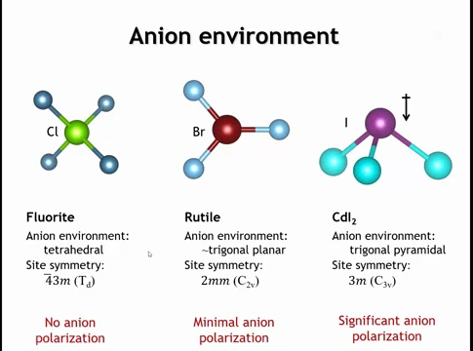
Notes:
To understand why, we look at the anion environment and how polarization effects depend on cation arrangement. In the fluorite structure, each anion is surrounded by a perfect tetrahedron of cations. The pulls on the electron cloud cancel out, so no dipole is induced. In rutile, the environment is close to trigonal planar; if it were perfectly symmetric the same cancellation would occur, but because the angles deviate slightly from 120°, only a very small polarization results. In contrast, the CdI₂-type structure has a trigonal pyramidal environment, with all cations on one side of the anion. This asymmetry pulls the electron cloud in the same direction, creating a significant induced dipole. As a result, layered structures gain substantial stabilization from anion polarization, while highly symmetric structures like fluorite show almost none.

Slide 52
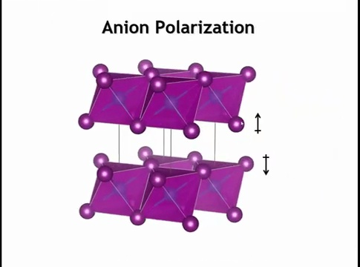


Notes:
Now the other thing that's beneficial about this induced dipole is by pulling the negative charge of the anion down toward the layers that contain the cations. We also reduce the repulsive interaction between anions across this empty layer. And that's also important in stabilizing the structure.

Slide 53

Notes:
These polarization effects become stronger as the anion gets larger and more easily distorted. Fluoride is not very polarizable, chloride is somewhat more so, and bromide and iodide are highly polarizable. Larger, more polarizable anions favor asymmetric cation arrangements that can pull the electron density unevenly. This explains why the heavier halides often stabilize in layered CdI₂-type structures.

Slide 54

Summary

Slide 55

Homework

