Slide 1
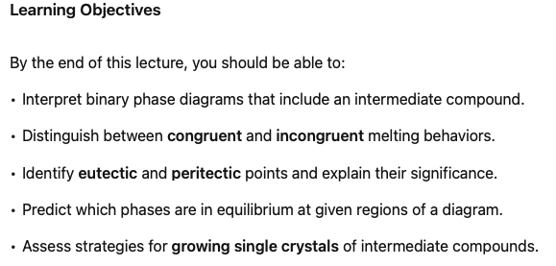
Binary Phase Diagrams Part 2
Notes:
Continuing our look at binary phase diagrams, we're now going to introduce an element of complexity in that we are going to allow there to be formation of a compound intermediate between A and B.

Slide 2
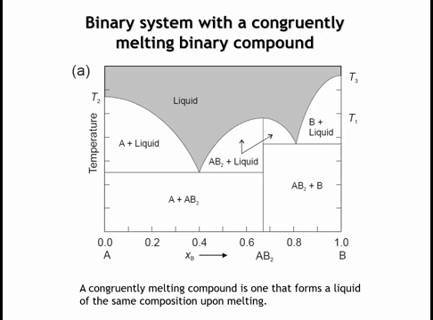
Notes:
This phase diagram shows one intermediate compound forming between the two end members. Functionally, it behaves like two eutectic phase diagrams placed side by side. In the previous lecture, the eutectic extended from A to B; here, the first eutectic is between A and AB₂, and the second is between AB₂ and B. The white regions represent two-phase fields, with the labels indicating which phases coexist.
The compound AB₂ is a line phase, meaning its stoichiometry is fixed at a 1:2 ratio of A to B. Following the vertical line for AB₂ upward, it remains at this composition until the liquidus is reached. Because AB₂ melts directly to a liquid of the same composition, it is classified as a congruently melting compound.

Slide 3
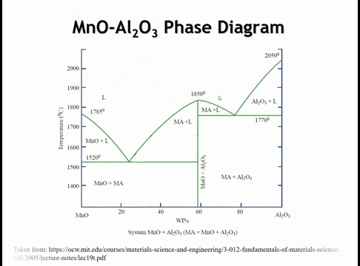
Notes:
Here’s an example of such a phase diagram: the MnO–Al₂O₃ system. Only one intermediate compound forms—MnAl₂O₄—corresponding to a 1:1 molar ratio of Al₂O₃ to MnO. Interestingly, on the diagram the compound does not appear exactly at 50% composition, but we can set that detail aside.

Slide 4
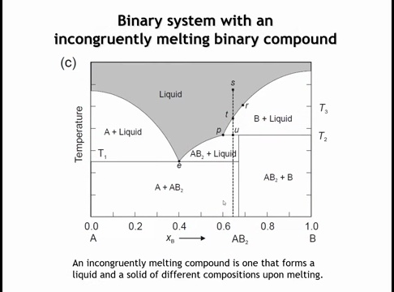
Notes:
In phase diagrams with compound formation, some intermediate compounds melt incongruently. In this case, when melting begins, the liquid composition differs from the solid composition. On the diagram, this appears because the vertical line at the compound’s composition does not reach the liquidus.
For example, if AB₂ melts incongruently, following its vertical line up shows that at temperature T₂ the solid begins to melt. Above T₂, the system consists of phase B plus a liquid richer in A than AB₂. As temperature increases, more liquid forms until the liquidus is crossed, at which point the sample becomes a homogeneous liquid of overall AB₂ composition.

Slide 5
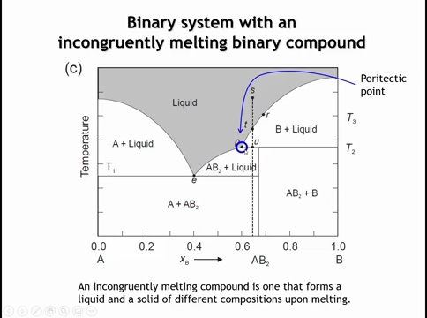
Notes:
In phase diagrams with incongruently melting compounds, we encounter a peritectic point (P). Like a eutectic, it is a three-phase equilibrium of two solids and a liquid. Here, the solids are AB₂ and B, coexisting with a liquid of composition richer in A than either solid.
-The peritectic produces a kink in the liquidus (not a minimum). This complicates crystal growth: for a congruently melting compound, we can simply cool the liquid of the correct composition slowly to grow single crystals. For an incongruently melting compound such as AB₂, cooling at its exact composition instead yields crystals of B.
-As cooling proceeds along the vertical line through AB₂, crystals of B first form. Crossing point U, the equilibrium solid suddenly switches from B to AB₂. Unless cooled extremely slowly, there is insufficient time for B to fully transform into AB₂, so the final microstructure may not reach equilibrium.
-To grow AB₂ single crystals, we instead begin with a liquid composition between the eutectic (E) and the peritectic (P). On cooling, AB₂ is then the first solid to crystallize. The typical approach is to cool very slowly through the region where AB₂ and liquid coexist, then quench rapidly below the solidus to preserve AB₂ crystals.

Slide 6
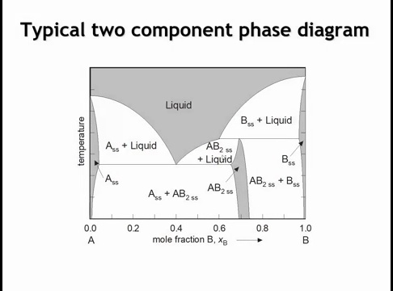
Notes:
Now, if we're going to talk about realistic phase diagrams, we oftentimes have elements not just of compound formation, but the compounds and the end members can oftentimes form solid solutions as is shown on this diagram. So not every intermediate composition is going to be a line phase that's just present as a vertical line on the phase diagram. Oftentimes there would be some solid solution that forms around those intermediate compositions.

Slide 7
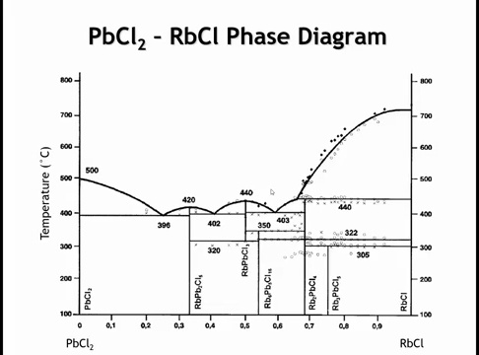
Notes:
Okay, let's finish this section on binary phase diagrams by looking at a real phase diagram. And I'm going to ask you different questions about interpreting this phase diagram. And if you've got a good grasp on things, I think these questions should be pretty easy.

Slide 8
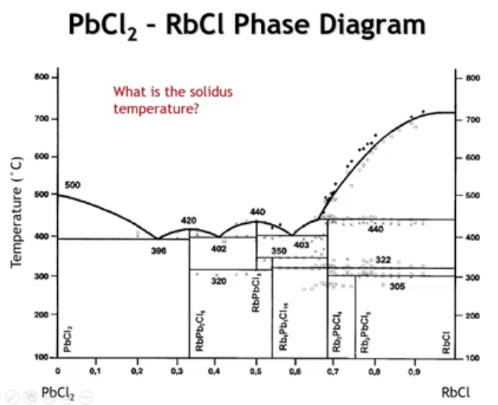
Notes:
So my first question for you is in this phase diagram between lead chloride and rubidium chloride, what is the solidest temperature? Remember that the solidest temperature is the temperature below which there are no liquid phases present. So in this phase diagram, conveniently they put some of the temperatures on here. We can see that these lines right here represent the points below which a liquid phase is not present. And the lowest of them is 396 degrees C. So the solidest temperature of this phase diagram is 396 C.

Slide 9
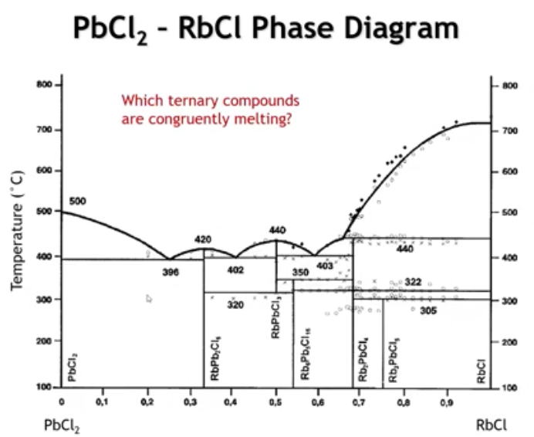
Notes:
On this phase diagram, we see five ternary phases. To identify which are congruently melting, recall that a congruently melting compound is represented by a vertical line that extends fully to the liquidus. Only two meet this criterion: RbPb₂Cl₅ and RbPbCl₃. The remaining three ternary phases are all incongruently melting.

Slide 10
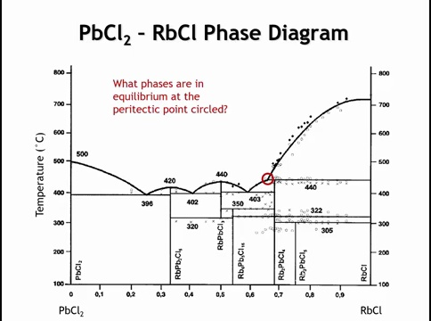
Notes:
At the circled peritectic point, three phases are in equilibrium. First, the region above the liquidus is liquid, so liquid must be one of the phases—this is always true at a peritectic (or eutectic). Second, the region of liquid + RbCl shows that rubidium chloride is present. Third, the region of liquid + Rb₂PbCl₄ shows that this compound is also in equilibrium.
Thus, at the peritectic point, the three coexisting phases are: liquid, RbCl, and Rb₂PbCl₄.

Slide 11
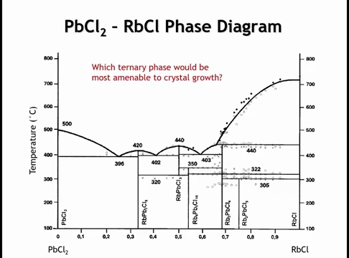
Notes:
As a rule, it’s easiest to grow crystals of congruently melting compounds. In this phase diagram, those are RbPb₂Cl₅ and RbPbCl₃. However, RbPbCl₃ is only stable down to about 320 °C; below that, it decomposes into other phases. That makes straightforward growth impractical.
The only phase well suited to routine crystal growth is RbPb₂Cl₅. Still, growing RbPbCl₃ is not impossible: one would need to cool slowly at the 50–50 composition, then quench rapidly from high temperature to preserve the phase.

Slide 12
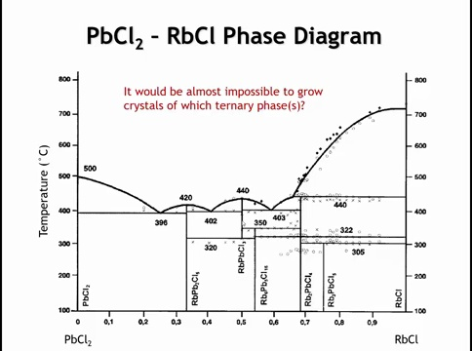
Notes:
The converse question is there are some phases on this phase diagram for which I cannot imagine any good way to grow. Which phases are going to be the most difficult, practically impossible to grow crystals of. Alright, so we've already talked about rubidium PB two C L five and rubidium PB C L three. We haven't talked about the other three turnary phases. I think one of them it would be possible to grow crystals, and the other two would be very, very difficult. And the reason why I say that is it would be very difficult to grow crystals of any phase that does not have an equilibrium with the liquid.

Slide 13
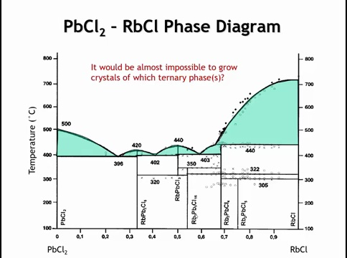
Notes:
Looking at the regions where solids coexist with liquid (highlighted in green), we notice that two phases—Rb₆Pb₅Cl₁₆ and Rb₃PbCl₅—never enter a liquid + solid field. Since they lack equilibrium with the liquid, crystal growth cannot proceed from melt; instead, it would require a solid–solid phase transformation, which is generally ineffective for growing quality crystals.

Slide 14
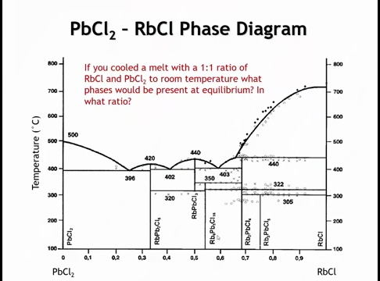
Notes:
If we tried to make RbPbCl₃ by slow cooling from the melt, it would not survive to room temperature. RbPbCl₃ is only stable between ~320 °C and 440 °C; below 320 °C it disappears from the phase diagram. Cooling through this range puts the system into a two-phase region. The lever rule shows the equilibrium phases are mainly Rb₆Pb₅Cl₁₆ with some RbPb₂Cl₅.
Thus, a slow-cooled 1:1 mixture of RbCl and PbCl₂ ends up as this two-phase mixture, not pure RbPbCl₃. XRD at room temperature would confirm decomposition. Variable-temperature diffraction could reveal its stability window, and quenching might preserve it—but in practice, even rapid cooling from ~350 °C allows enough diffusion for RbPbCl₃ to decompose into the two ternary phases.

Slide 15
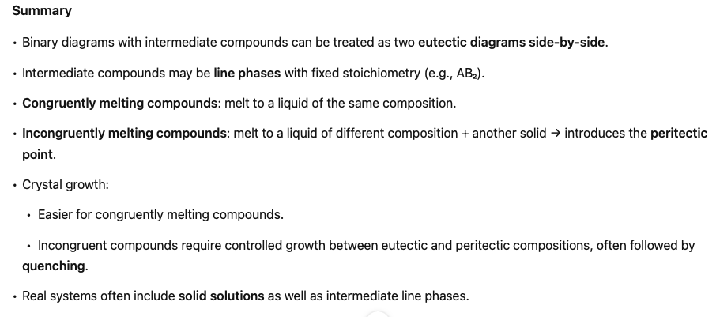

Slide 16

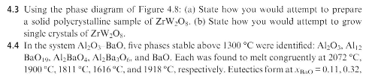

Homework

Slide 17
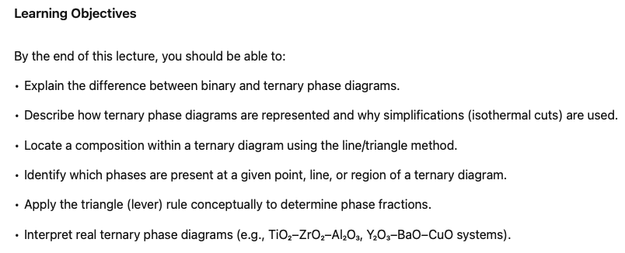
Ternary Phase Diagrams
Notes:
We spent the last two lectures talking about how to use and interpret binary phase diagrams. You know, unfortunately, not everything can be boiled down to a binary or a pseudo binary phase diagram. Sometimes we have to go to a three component, ternary phase diagram. The concepts of a ternary phase diagram are more or less just the same as they are for a binary phase diagram. However, representation starts to get more complicated.

Slide 18
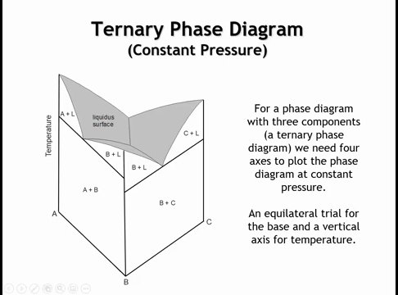
An equilateral triangle for the base and a vertical axis for temperature
Notes:
A complete ternary phase diagram requires three axes for composition, one for temperature, and one for pressure—a five-dimensional plot that is impractical to visualize. If we fix the pressure, we can reduce it to a three-dimensional diagram: an equilateral triangular base representing the three compositions, with temperature as the vertical axis. Each vertical face of this prism corresponds to a binary phase diagram (e.g., eutectic diagrams on the front, left, and back faces). While such diagrams can capture complex behavior, including intermediate phase formation, they quickly become difficult to interpret. For this reason, most applications—including in this class—use isothermal sections (constant temperature slices) of ternary phase diagrams.

Slide 19
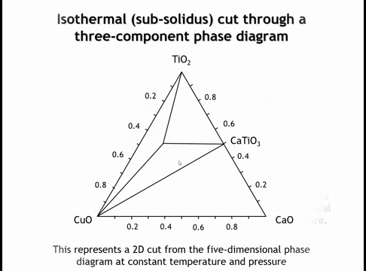
Notes:
We will take a constant temperature to obtain a 2D slice of the phase diagram, focusing on isothermal cuts below the solidus so no liquid phases appear. An example is the ternary phase diagram of TiO₂–CaO–Cu₂O, represented as an equilateral triangle. The goal of today’s lecture is to learn how to read and interpret such diagrams.

Slide 20
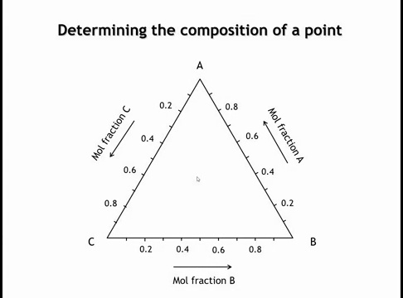
Notes:
To begin, we need to know how to locate a given composition of A, B, and C on the ternary diagram. In a binary diagram, this is straightforward: drop a vertical line to the x-axis to read the A:B ratio. In a ternary diagram, we instead work within a triangle, so the method is different. Several approaches exist, and these are detailed in the textbook. I'm just going to describe one of those, which I think is the simplest way.

Slide 21
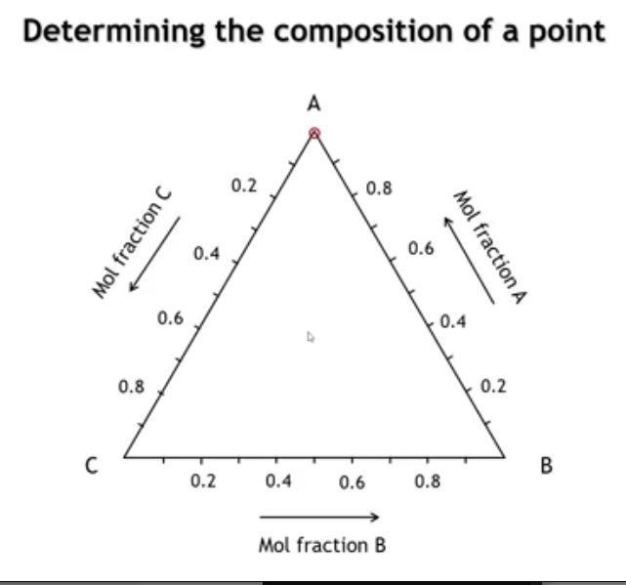
Notes:
So let's start at the upper vertex, the upper corner of this phase diagram where we have only A present. At that point, the sample would be 100% A, and no B or C.

Slide 22
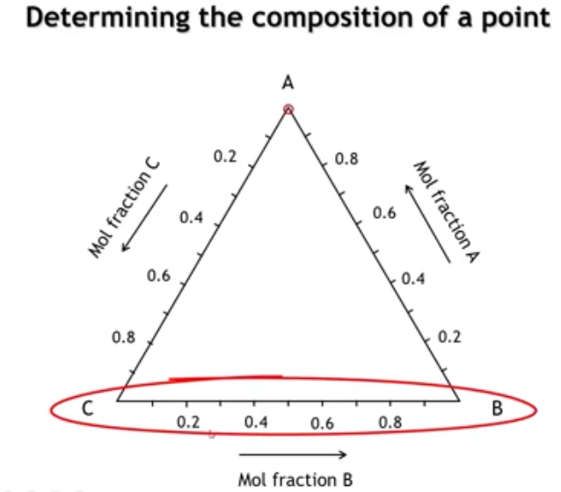
Notes:
Let's look at the edge opposite that vertex, which is down here at the bottom, and let's draw a series of horizontal lines parallel to the opposite edge.

Slide 23
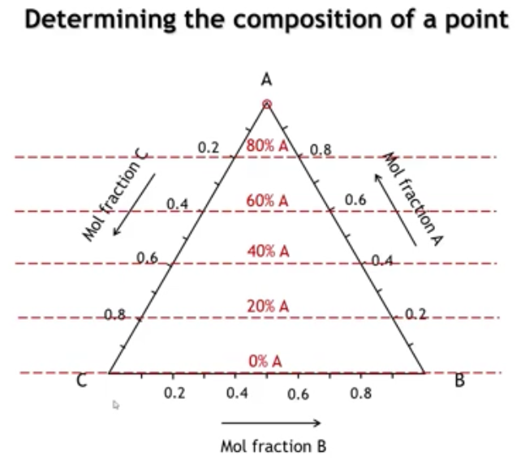
Notes:
Each dashed red line shows a constant amount of A. Along the base from C to B, A = 0, giving the binary C–B diagram. The line above marks 20% A, then 40%, 60%, and 80%. The scale on the right confirms these values (e.g., 0.6 = 60%, 0.8 = 80%). The left scale instead measures C in the A–C binary, so 20% C corresponds to 80% A.

Slide 24
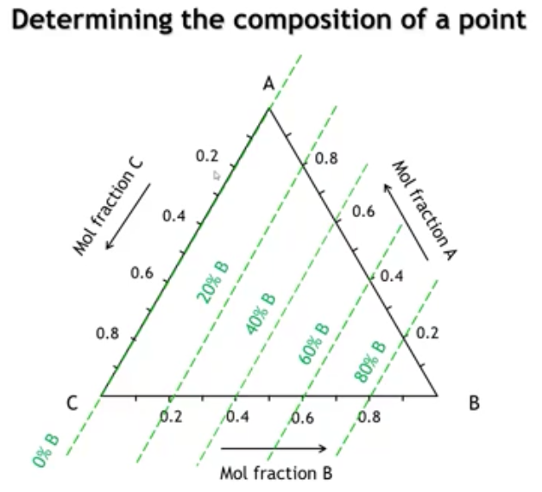
Notes:
Now we could do the same thing for the other two components. If we were to look at the amount of B, we want to draw lines that are parallel to the AC side of the triangle. Here you can see the lines of constant B.

Slide 25
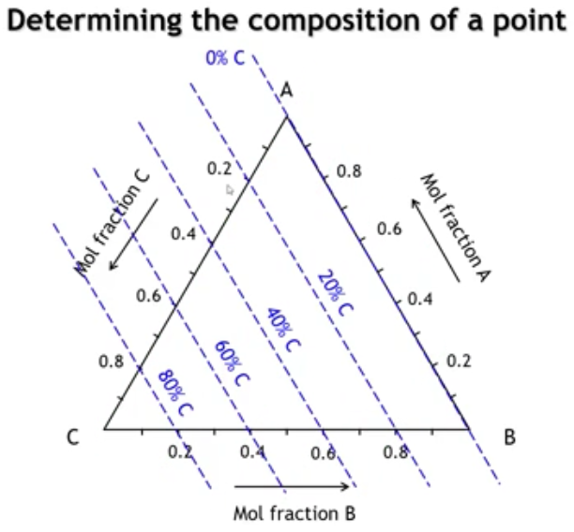
Notes:
It's analogous for C. In that case, the lines of constant C are parallel to the side of the triangle that represents the mixture of A and B.

Slide 26
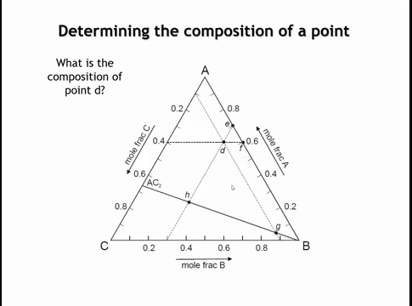
Notes:
Asking what is the composition of point d

Slide 27
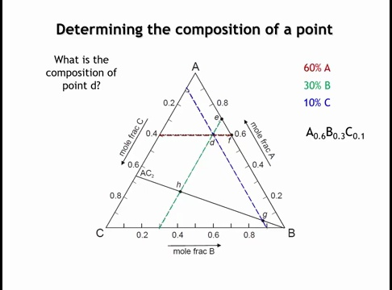
Notes:
To find the composition, draw lines parallel to each edge of the triangle. A is read from a line parallel to BC—here about 60%. B is read from a line parallel to AC—about 30%. C is read from a line parallel to AB—about 10%. Adding them gives 100%, so this sample is 60% A, 30% B, 10% C.

Slide 28
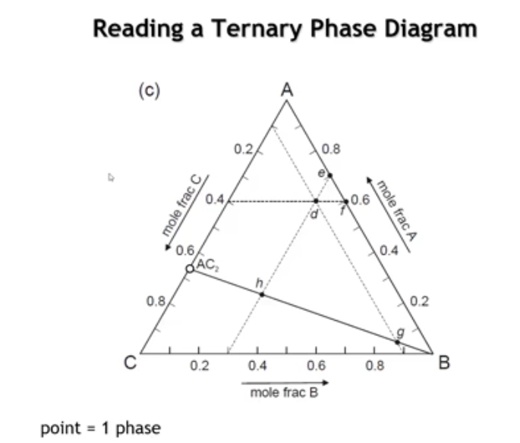
Notes:
Once we locate a composition on the diagram, the next step is to determine what phases are in equilibrium at that point. In a ternary phase diagram, three cases are possible. First, the point may fall directly on a phase. For example, at the special point AC₂—just like at pure A, B, or C—the only phase present is that compound.

Slide 29
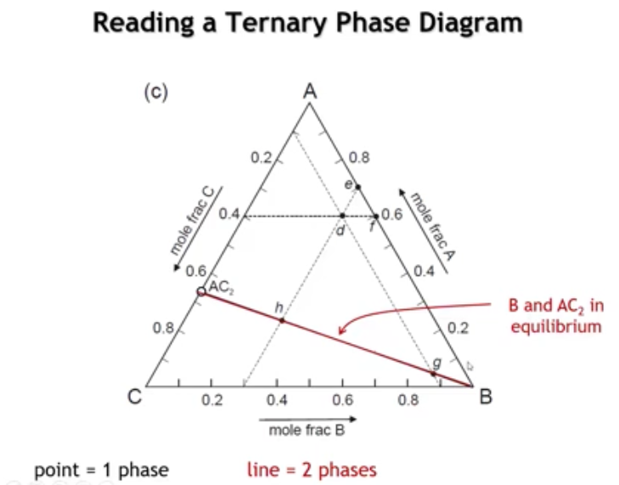
Notes:
If the composition lies on a line, the system is a two-phase mixture. For example, on the line between AC₂ and B, the phases are AC₂ and B. Along the bottom edge, the mixture is B + C; on the right edge, A + B. On the left edge, the mixture depends on position: above the junction it is A + AC₂, and below it is AC₂ + C.

Slide 30
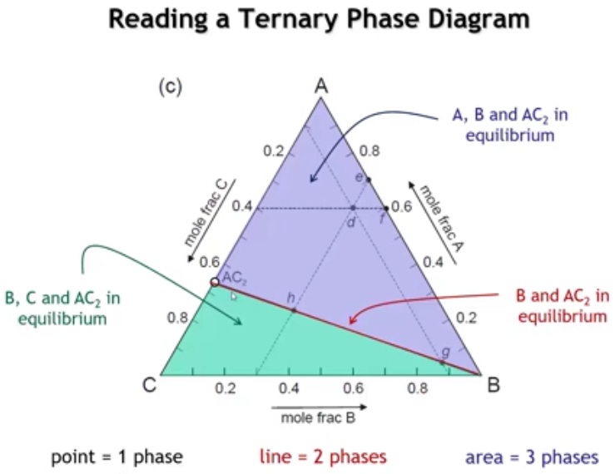
Notes:
The rest of the phase diagram is divided into triangular regions. Each region represents equilibrium between the three phases at its vertices. In this example, the green triangle (B, C, AC₂) corresponds to mixtures of those phases, while the blue triangle (A, B, AC₂) corresponds to mixtures of those three.

Slide 31
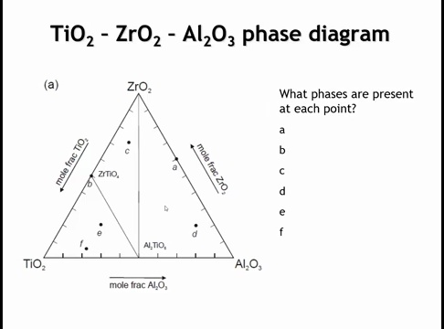
Notes:
Now consider a simple real ternary diagram: TiO₂–ZrO₂–Al₂O₃. It contains two binary compounds—ZrTiO₄ and Al₂TiO₅—and no ternary compounds involving all three components. Points A–F are marked; for each point, identify the phase(s) present. Answer the question. Right down the phases present at each point.

Slide 32
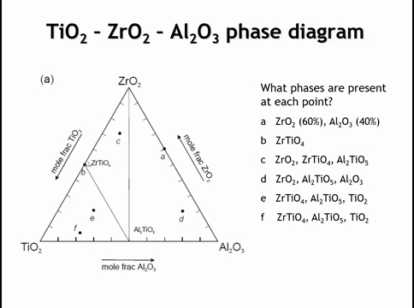
Notes:
Point A: On the ZrO₂–Al₂O₃ binary; no intermediates → two-phase mixture, ~60% ZrO₂ / 40% Al₂O₃.
Point B: Midway on TiO₂–ZrO₂; forms the binary compound ZrTiO₄.
Point C: Inside triangle {ZrO₂, ZrTiO₄, Al₂TiO₅} → three-phase equilibrium of those vertices.
Point D: Inside triangle {ZrO₂, Al₂O₃, Al₂TiO₅} → three-phase equilibrium of those vertices.
Points E, F: Both inside triangle {TiO₂, Al₂TiO₅, ZrTiO₄} → same three phases at equilibrium (TiO₂, Al₂TiO₅, ZrTiO₄); only phase proportions differ between E and F.

Slide 33
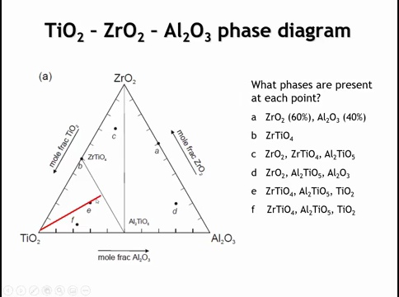
Notes:
To find the phase ratios at point E, we use the triangle rule, analogous to the lever rule. Draw a line from each vertex through E to the opposite side. For each component, the fraction equals the length of the opposite segment divided by the total line length. Repeating this for all three vertices gives the phase proportions.

Slide 34
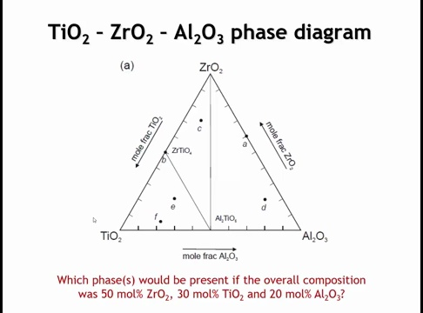
Notes:
Suppose we have 50 mol% ZrO₂, 30 mol% TiO₂, and 20 mol% Al₂O₃. We mix, grind, and heat to the isothermal condition (say 1000 °C), then measure the equilibrium phases. Where does this 50/30/20 point plot on the ternary, and which phases are present there?

Slide 35
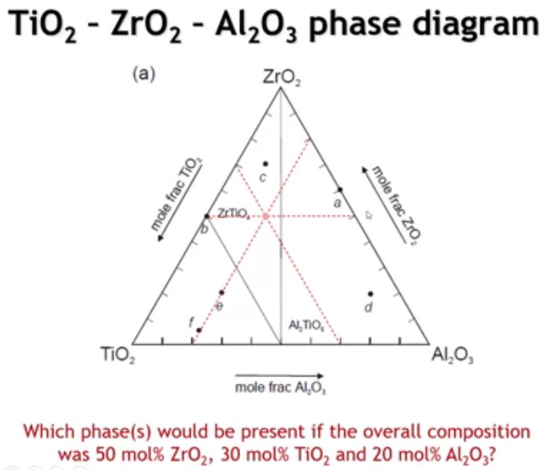
Notes:
For 50% ZrO₂, plot along the horizontal line marking 30% TiO₂. This line is 30% of the way toward TiO₂ from both the base and the apex. Their intersection marks the composition. To confirm, check the line for 20% Al₂O₃—it intersects the same point, verifying the 50/30/20 composition on the diagram.

Slide 36
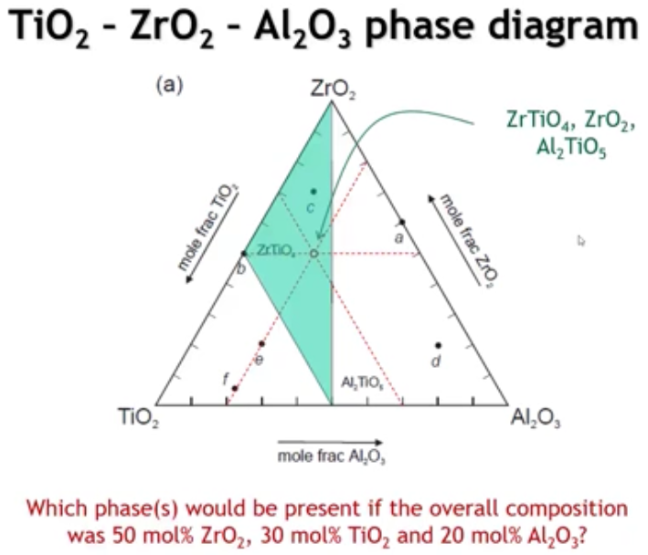

Slide 37
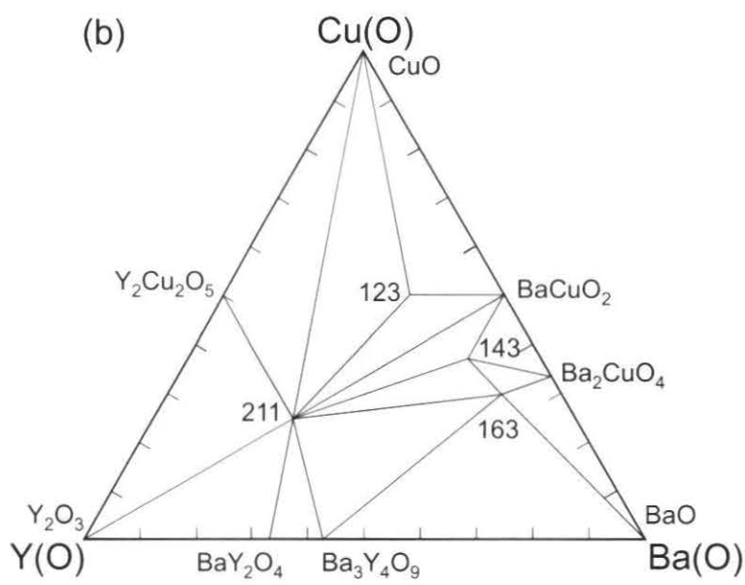
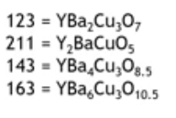
Notes:
Now let’s examine a more complex ternary diagram: Y₂O₃–BaO–CuO. This diagram is historically significant because high-temperature superconductors were discovered from systems like this. It contains two binary compounds between Y₂O₃ and BaO, two between BaO and CuO, and one between Y₂O₃ and CuO. In addition, there are four ternary compounds containing all three components, shown here by abbreviations. As always, the diagram breaks into triangular regions, and if a region doesn’t form a triangle, the diagram has been drawn incorrectly. Here, every region is triangular.

Slide 38

Notes:
Question: For Y₂Ba₂Cu₄O₉, is the equilibrated sample single-phase, two-phase, or three-phase, and which phases?
Key step: locate the composition on the Y₂O₃–BaO–CuO ternary. Convert the formula to oxide components: 1 Y₂O₃ + 2 BaO + 4 CuO (O totals check: 3+2+4 = 9). Normalize to mole fractions: Y₂O₃ = 1/7 ≈ 14.3%, BaO = 2/7 ≈ 28.6%, CuO = 4/7 ≈ 57.1%. Plot (14.3, 28.6, 57.1) and read the triangular region to identify the equilibrium phase set.

Slide 39
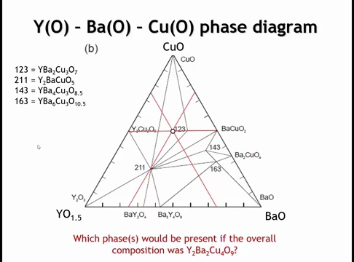
Notes:
So the 50% copper oxide line is going to be this horizontal line shown in red. So 25% yttrium oxide is going to be along this line which runs parallel to the barium oxide, copper oxide, face. And the 25% barium oxide line is going to run along this red line. And so those all three intersect at the point that I've drawn there with the white circle.

Slide 40
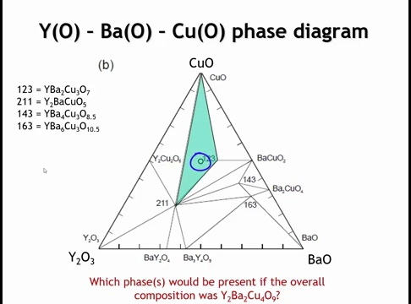
Notes:
And I should be able to see that that point is in this triangle that I've shaded here with green.

Slide 41
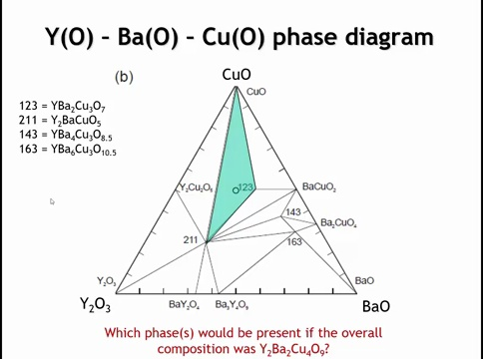
Notes:
And I should be able to see that that point is in this triangle that I've shaded here with green.

Slide 42
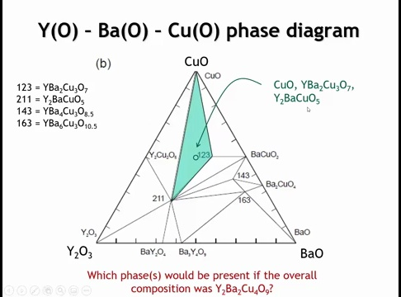
Notes:
The relevant three-phase region has vertices at CuO (apex), YBa₂Cu₃O₇ (“123”), and Y₂BaCuO₅ (“211”). If you start with Y₂Ba₂Cu₄O₉, grind, heat, and quench, then XRD reveals a mixture of these three phases, it means the target composition does not correspond to a stable single phase in this diagram—it lies inside that three-phase triangle and decomposes into CuO + 123 + 211 at the stated conditions.

Slide 43
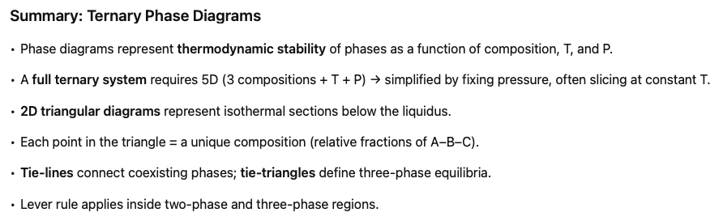

Slide 44
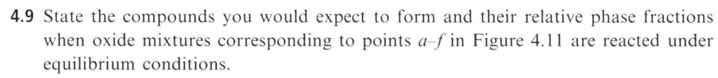
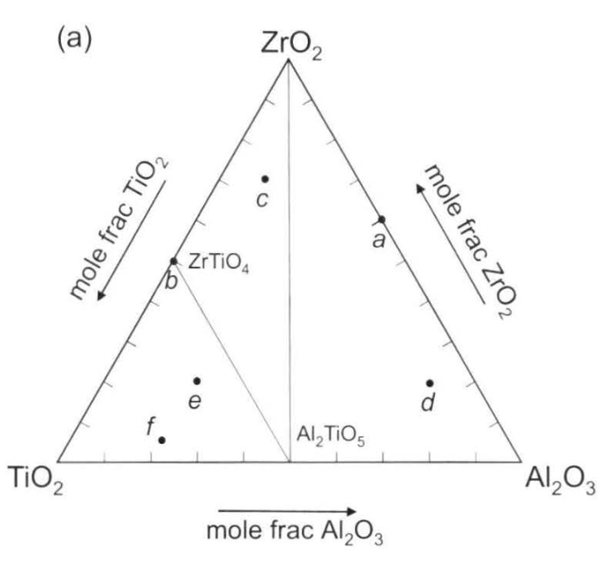
Homework

Slide 45
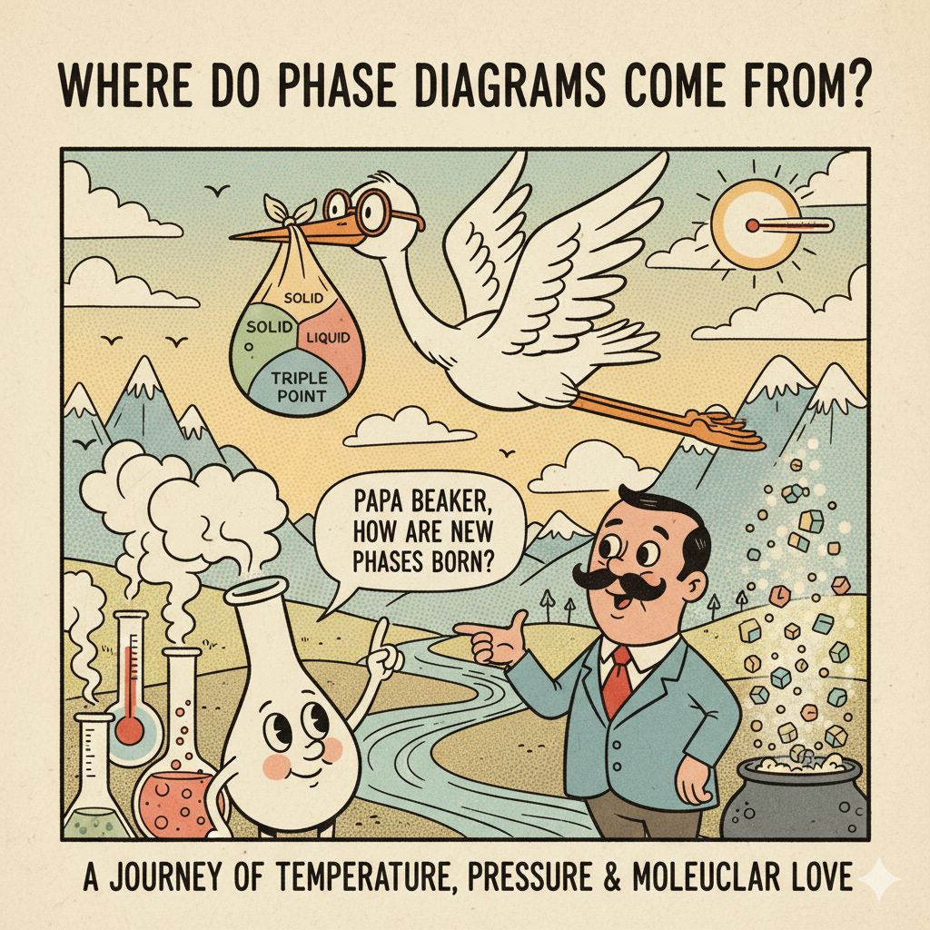

Slide 46
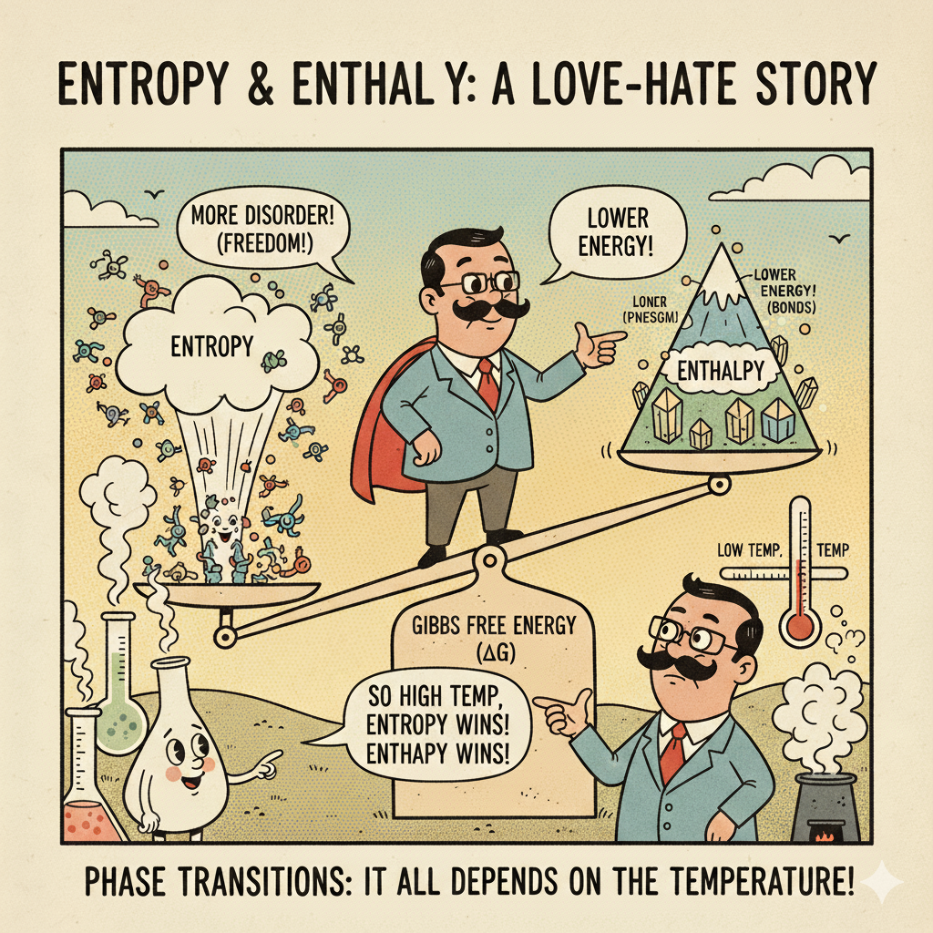

Slide 47
Where do Phase Diagrams Come From?
F=U-TS
Matter seeks to minimize the Helmoltz free energy at constant temp and Volume
Notes:
Today we connect what you see on phase diagrams to the thermodynamics that generates them. At fixed T and V, equilibrium
minimizes the Helmholtz free energy F=U−TS. For condensed phases at fixed T and p, using Gibbs free energy G leads to the same constructions; think of every boundary as a place where competing minima in free■energy are equal in value and slope.

Slide 48
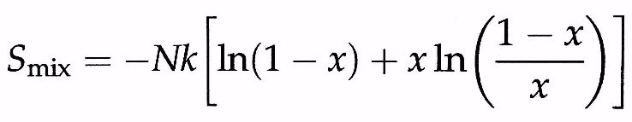
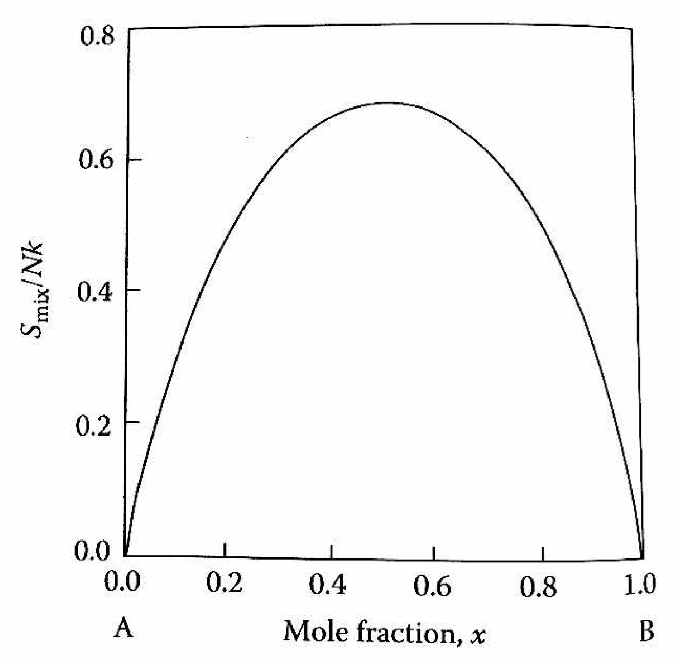
Entropy term is positive because there are more ways of rearranging 2 atoms in space then 1. Maximum at x=0.5.
Notes:
Mixing A and B increases the number of arrangements W=N!/(N_A!N_B!) (N is number of atoms), which by Stirling gives S_mix = −Nk_B[(1−x)ln(1−x)+x ln x]. This contribution is always positive and peaks at x=0.5 with S_mix/Nk_B=ln 2≈0.693. Left and right ends, x→0 or 1, return S_mix→0. Alone, entropy would make every composition mix; enthalpy decides otherwise. N = Na+Nb = total # of atoms

Slide 49
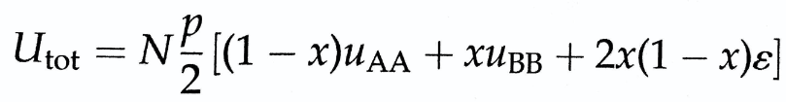

ε≡u_AB−1⁄2(u_AA+u_BB).
Internal energy term is from bonding, which can be energetically favorable or unfavorable.
P is number of nearest neighbors.
Notes:
We count nearest■neighbor pairs with energies u_AA, u_BB, and u_AB. In a mean■field model with p neighbors per atom, ∆U(x)=N p x(1−x) ε where ε≡u_AB−1⁄2(u_AA+u_BB). ε<0 (strong A–B bonding) makes mixing exothermic; ε>0 (weak A–B bonding) makes mixing endothermic. This simple curvature term competes directly with the concave■up entropy term to shape F(x,T).

Slide 50

F(x,T)=∆U(x)−T S_mix(x)
At High T, Entropy Term dominates and mixing is favorable.
At low T, local minima appear, leading to phase segregation.
T_{c} = pε/2k
p = #nearest neighbors
ε= energy penalty per unlike bond
k= Boltzmann constant
Notes:
At high temperature entropy dominates and the free-energy curve is smooth with one minimum so the mixture is completely miscible, but at lower temperature if unlike bonds cost energy (ε > 0) the curve develops two dips near the pure ends with a barrier in the middle so the alloy separates into two phases, and the special point where the single dip just splits into two is called the consolute temperature given by T_c = (p × ε) / (2 × k_B),
for example with p = 12 and ε = 0.010 eV (10 meV) the consolute temperature is about 696 K while
with ε = 0.015 eV (15 meV) it is about 1040 K,
which means that the larger the energy penalty the higher the consolute temperature because more thermal disorder is needed to keep the system mixed

Slide 51

Method of Tangents
Method of Tangents can be used to find the compositions of each phase that are in equilibrium, in this case 13.2 % for alpha and 85.9 % for beta.
Notes:
Method of tangents lets us find the compositions of the two phases that can coexist at a given temperature by drawing a straight line that just touches the free-energy curve at two points, and these tangent points give the equilibrium compositions directly, so in this case the line touches at x = 0.132 (13.2%) for the alpha phase and at x = 0.859 (85.9%) for the beta phase, meaning if the overall composition lies anywhere between these values the system will split into a mixture of alpha and beta with those compositions.

Slide 52

Applying the method of Tangents to free energy curves at different temperatures can be used to create a phase diagram.
Notes:
By applying the method of tangents to the free-energy curves at different temperatures we can trace out the pairs of compositions that coexist, and when we project those tangent points down onto the temperature–composition plane we generate the phase diagram, so at high temperature the curve has only one minimum and the system is fully mixed, while at lower temperatures two minima appear and the tangent gives two coexisting compositions, and by repeating this at many temperatures we build the binodal curve that outlines the miscibility gap with the consolute temperature at its peak.

Slide 53



Example of real ideal system (no heat of mixing)
Notes:
In the Si–Ge system there is no heat of mixing, so the solid free energy is F_s(x,T) = RT[x ln(x) + (1–x) ln(1–x)] and the liquid free energy is F_l(x,T) = RT[x ln(x) + (1–x) ln(1–x)] + ΔS[x(T_B – T) + (1–x)(T_A – T)], where ΔS is the entropy of fusion per mole and T_A and T_B are the melting points of pure Si and pure Ge, so the entropy of mixing is the same in both phases but the liquid curve is shifted by how far the temperature is below each melting point, which means at low temperature the solid has lower free energy and is stable, at high temperature the liquid has lower free energy and is stable, and in between the curves cross so a common tangent defines the liquidus and solidus, giving the smooth phase diagram with complete miscibility that we see for Si–Ge.

Slide 54

Example of system with heat of mixing of -30 kJ/mol
Positive heat of mixing means the melting point of the alloy is not higher than the melting point of the pure phases.
Notes:
When the solid has a large negative heat of mixing (–30 kJ/mol in this example), the strong A–B interactions raise the solidus above the melting points of the pure components. This produces a congruent melting point at which the alloy solidifies directly from the liquid at the highest temperature, unlike systems with positive heats of mixing, where the melting point is always depressed.

Slide 55

Example of system with Positive heat of mixing.
The point where the liquid line minima meets the tangents of the two solid phase minima leads to a lower melting point eutectic.
Notes:
From high T (1500 K, single-phase liquid L), through 1100–1000 K where the liquid free energy rises and mutual tangents to the solid minima define α+L and β+L fields with tie-lines giving equilibrium compositions (lever rule), down to the eutectic at ~940 K where the liquid minimum just touches the common tangent between α and β (an invariant three-phase point, L ⇌ α+β, depressed below the pure melting points by positive solid heat of mixing), and finally at lower T (e.g. 700 K) the liquid lies above the α–β tangent leaving only two solids (α+β), with phase compositions from tangent points and fractions from the lever rule—illustrating how positive enthalpy of mixing produces the V-shaped liquidus, eutectic reaction, and α+β solid region [oai_citation:0‡Nauman_ch12_phase_equilibria.pdf](file-service://file-Q1ewSHDHZyMzxiqeDyNy2m).

Slide 56


Example of solid solution intermediate phase
Notes:
Left: The γ phase forms because the free-energy curve has a rounded “nose,” so a **common tangent line** touches it at two points—giving a finite composition range (A+γ and γ+B) instead of a single point; Right: In Al–Ni this solid-solution intermediate phase is AlNi, stable from ≈45–58 at% Ni and melting above both Al and Ni.

Slide 57


Example of Line compound.
Notes:
What is a “line compound,” and why is it a vertical line?
Some compounds only form at one exact composition. In Cd–Te that’s CdTe (50 at% Te), so any off-stoichiometric alloy splits into Cd + CdTe (left) or Te + CdTe (right). The reason it’s a vertical line is the tangent construction in free-energy space: the solid-CdTe free-energy curve has a sharp, wedge-like minimum at stoichiometry, so the common tangent from the liquid touches it at a single composition; when mapped to the T–x diagram this single tangent point projects to a vertical CdTe line (no composition range). If the solid’s free-energy minimum were rounded, the common tangents would touch at two compositions, projecting a finite γ + L two-phase band—i.e., a solid-solution instead of a line compound. The right panel shows real Cd–Te data: congruent melting of CdTe at ≈ 1098 °C, far above Cd ≈ 321 °C and Te ≈ 450 °C, with the vertical α-CdTe field evidencing the line compound; the left sketch is the generic A–γ–B topology for such cases.

Slide 58

Homework Questions

