Slide 1
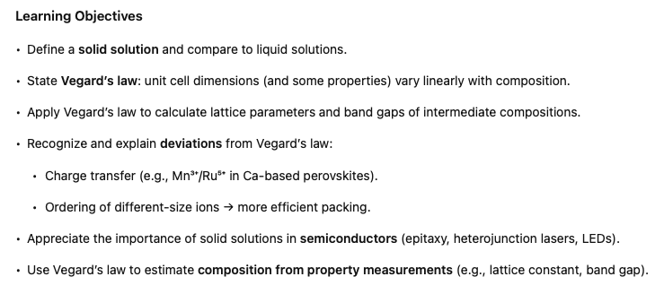
Solid Solutions and Vegard’s Law
Notes:
Let's finish our brief foray into the world of point defects by talking about a concept that is quite simple yet also very powerful for certain applications. So we are going to talk about solid solutions, I'll say in a minute what I mean by a solid solution and something called Desgards law.

Slide 2
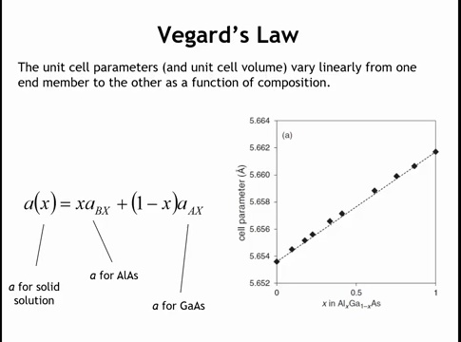
Notes:
A solid solution is the solid-state analog of a liquid solution: just as water and ethanol mix homogeneously in any ratio, solids can form homogeneous crystals across a full composition range. For example, AlAs–GaAs forms a continuous solid solution. According to Vegard’s law, the unit cell size varies linearly between the two end members. Both are cubic (zinc blende) structures: AlAs has a slightly smaller lattice constant (~5.653 Å), GaAs a larger one. Thus, by adjusting composition, we can obtain any lattice parameter between these limits. Conversely, by measuring the lattice parameter, we can determine the composition. Mathematically, the lattice constant is the weighted sum of each end member’s constant:
where x is the AlAs fraction and 1-x the GaAs fraction.

Slide 3
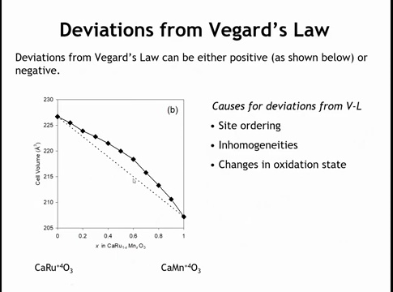
Notes:
Not all solid solutions obey Vegard’s law, and the author’s thesis advisor noted that Vegard himself doubted its validity—ironically, the linear case now bears his name. An example of deviation comes from solid solutions between CaRuO₃ (Ru⁴⁺) and CaMnO₃ (Mn⁴⁺). In the middle compositions, the lattice parameter curve shows a positive deviation (bowing upward). Spectroscopy reveals charge transfer: Mn³⁺ and Ru⁵⁺ appear, whose average ionic size is larger than Mn⁴⁺ and Ru⁴⁺, explaining the expansion.
Deviations can also be negative: when random distributions of differently sized ions reorder into a more efficient packing, the lattice contracts below the linear Vegard prediction.

Slide 4
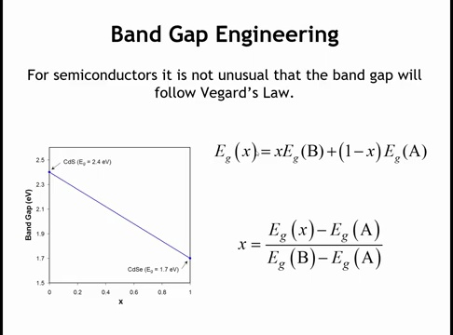
Notes:
Not only lattice constants but also other properties can vary linearly with composition, in which case they are said to obey Vegard’s law. The best-known example is the band gap of semiconductors: while not universally true, many show nearly linear band gap evolution with composition. The mathematics mirrors that of lattice parameters: the band gap of an intermediate composition is the weighted sum of the end members’ band gaps. For systems like CdS–CdSe, this relation can be used both to predict the band gap of a given composition and, conversely, to determine composition from a measured band gap.

Slide 5
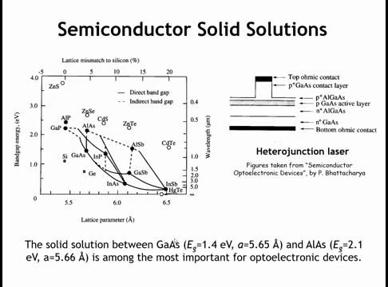
Notes:
n semiconductor devices, solid solutions are critical because many involve epitaxial thin films—a crystal layer grown on a substrate with bonds matched at the interface. Here, the lattice constants of adjacent layers must be closely matched to minimize strain, while the band gaps must vary to achieve desired functions (e.g., in heterojunction lasers).
The GaAs–AlAs solid solution is especially useful: their lattice parameters are nearly identical, enabling epitaxial growth across the full range, while the band gap can be tuned from ~2.0 eV (AlAs) to ~1.4 eV (GaAs). Such tunability underpins many LEDs and lasers, where compositions with direct band gaps are essential.
Although semiconductors highlight the importance of Vegard’s law, the principle applies broadly to other solid solutions as well.

Slide 6
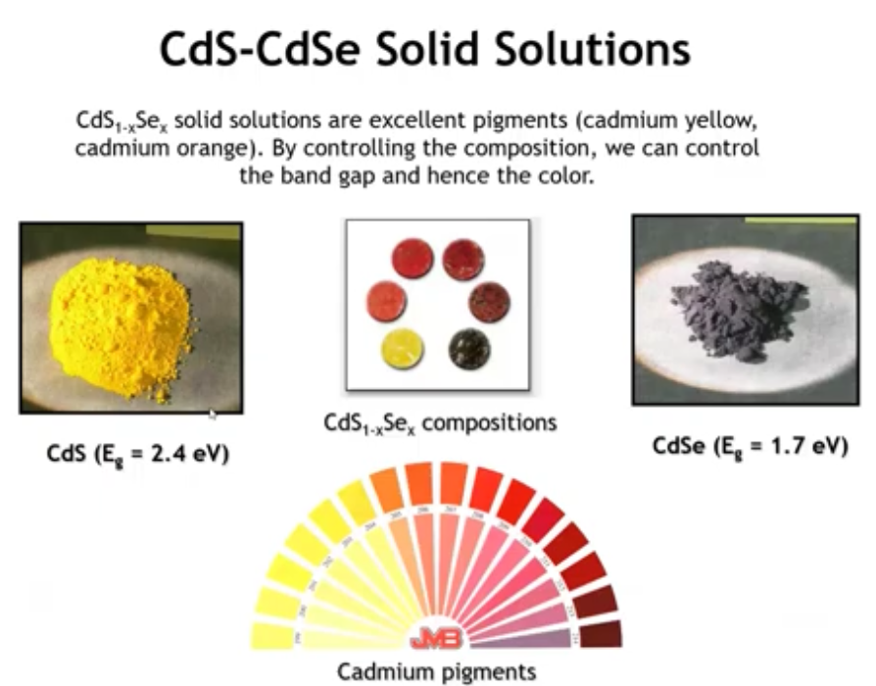
Notes:
As a final example, CdS–CdSe solid solutions have long been used as pigments. Their color varies continuously with composition—from yellow (CdS, slightly brighter than cheddar cheese) to orange, red, and nearly black (CdSe-rich). Although cadmium pigments have declined due to toxicity concerns, they illustrate Vegard’s law in practice: by tuning composition, one can design a pigment of any desired color, such as orange at an intermediate band gap.

Slide 7
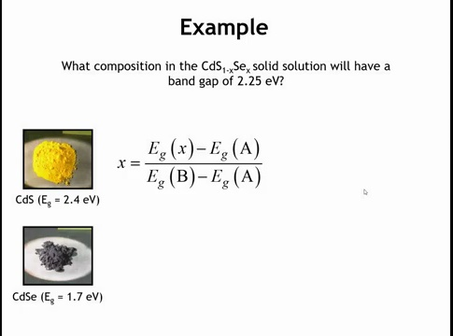
Notes:
So I would say the ideal band gap for making orange is something pretty close to 2.25. So composition do we need if we wanted to make the band gap exactly 2.25?
Okay, to get the value of x here all we really have to do are to plug in the band gaps for the end members. Let's call a cadmium sulfide with the band gap of 2.4 and b cadmium cellanide with the band gap of 1.7 and the band gap of the intermediate composition we want that to be 2.25.

Slide 8
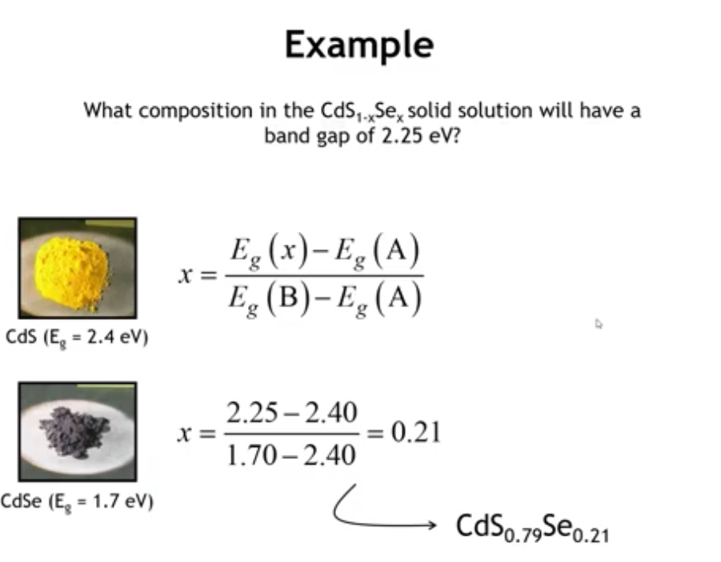
Notes:
So when you plug that all into the formula you get 0.21. So the way we've set this up is that this is going to be the selenium content in our solid solution. So crystal that had composition cadmium, sulfur 0.79, selenium 0.21 should have a band gap very close to 2.25 provided vagards laws followed.

Slide 9
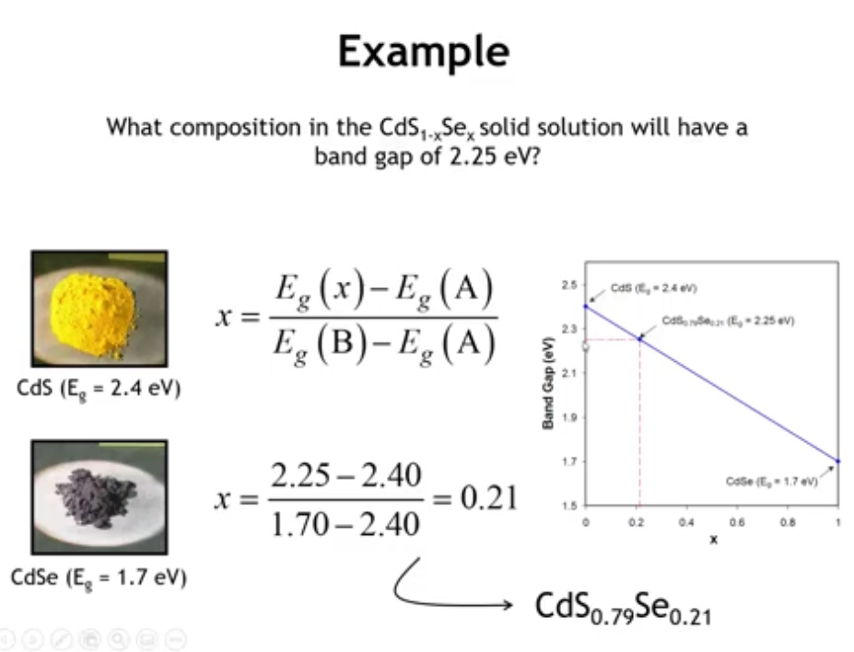
Notes:
A graph assuming perfect Vegard’s law shows that x = 0.21 corresponds to a band gap of 2.25 eV. It’s easy to confuse whether 0.21 refers to Se or S, but a reality check helps: since 2.25 eV is much closer to CdS (2.4 eV) than CdSe (1.7 eV), the composition must be S-rich. This confirms the solution as CdS₀.79Se₀.21.

Slide 10
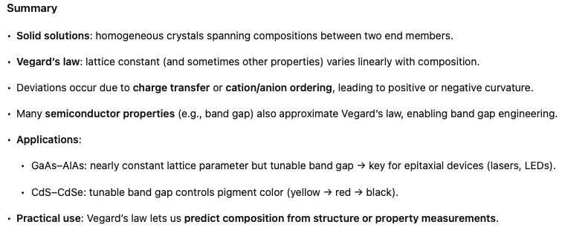

Slide 11
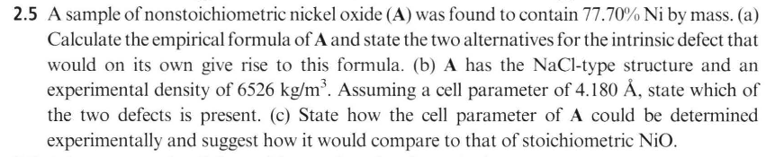
Homework

Slide 12
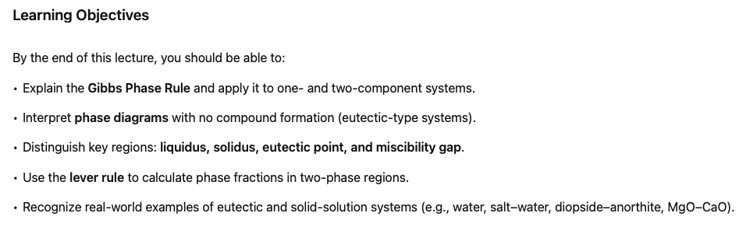
Phase Diagrams
Notes:
Next, we turn to phase diagrams, essential tools for planning the synthesis of solid-state materials. Knowing a phase diagram allows us to choose suitable synthesis temperatures and, when needed, to grow single crystals. In this lecture, we focus on the simplest phase diagrams—those without compound formation. In the following lecture, we will extend this to systems with intermediate compositions between end members.

Slide 13
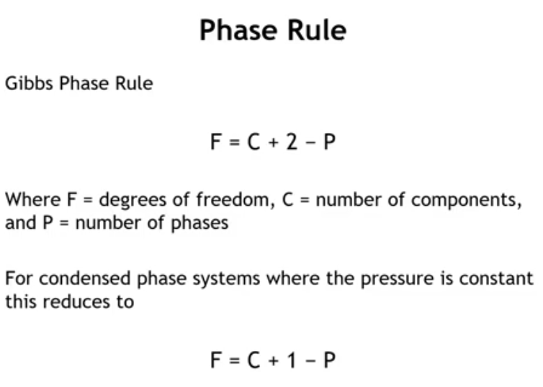
Notes:
So let's start with the Gibbs phase rule, which is stated here. And the Gibbs phase rule tells us that the degrees of freedom, that is the number of variables that we can change and keep the same mixture, is equal to C, the number of components, plus 2, minus P, the number of phases. Now, in this class, we are almost always dealing with condensed phase systems, and we can simplify this if we talk about just one atmosphere of pressure. In that case, the degrees of freedom equals the number of components, plus 1, minus the number of phases present at equilibrium.

Slide 14
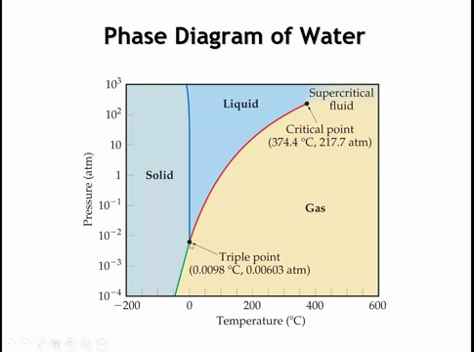
Notes:
Let’s look at a familiar phase diagram: water. This is a one-component system, so applying the Gibbs phase rule gives C + 2 – P = 3 – P. The degrees of freedom cannot be negative, so no point on the diagram can have more than three phases in equilibrium. At the triple point, three phases meet, P = 3, and the degrees of freedom are zero—any change in pressure or temperature disturbs equilibrium. In a single-phase region, such as solid ice, P = 1, so the degrees of freedom are two; pressure and temperature can vary independently while remaining solid. Along a phase boundary, such as the melting line between solid and liquid water, P = 2 and the degrees of freedom are one. Changing pressure forces temperature to change in a defined way to maintain equilibrium. This framework prepares us to extend to condensed systems with more than one component.

Slide 15
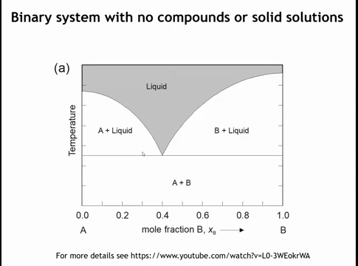
Notes:
Now let’s consider one of the simplest binary phase diagrams. We have two components, A and B, which may be elements (e.g., Cu–Pd) or compounds (e.g., CaO–MgO). Composition varies along the x-axis, from pure A on the left to pure B on the right, while temperature is on the y-axis. We assume constant atmospheric pressure; varying pressure would require a three-dimensional diagram. The key question is: how many phases exist in each region of the diagram?

Slide 16
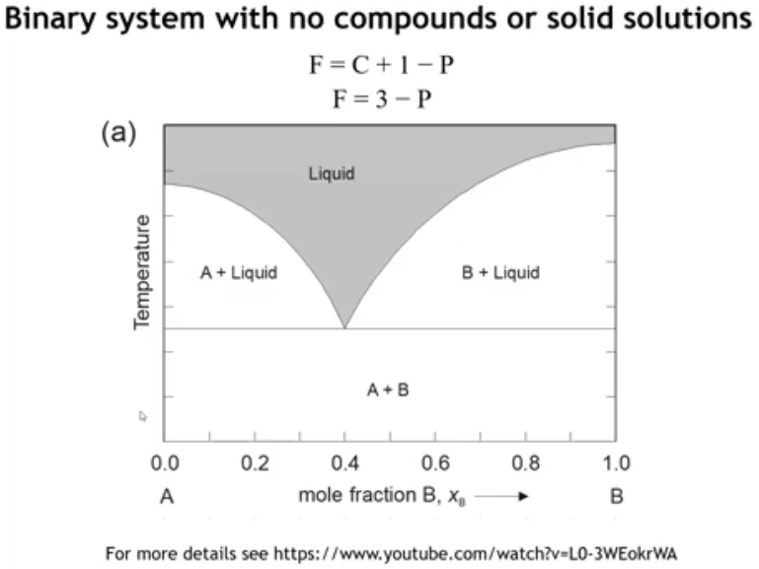
Notes:
The phase rule for two components gives degrees of freedom = 3 – P. This means in a binary phase diagram no region can contain more than two phases, and no point can have more than three phases at equilibrium. The degrees of freedom cannot be negative. With this framework, we can now examine the features of the diagram.

Slide 17
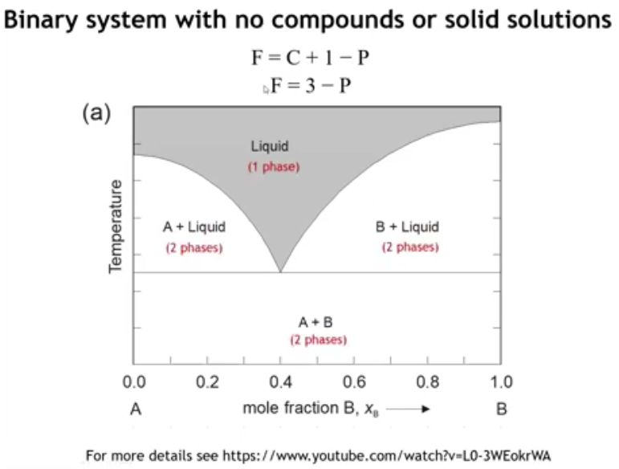

Slide 18
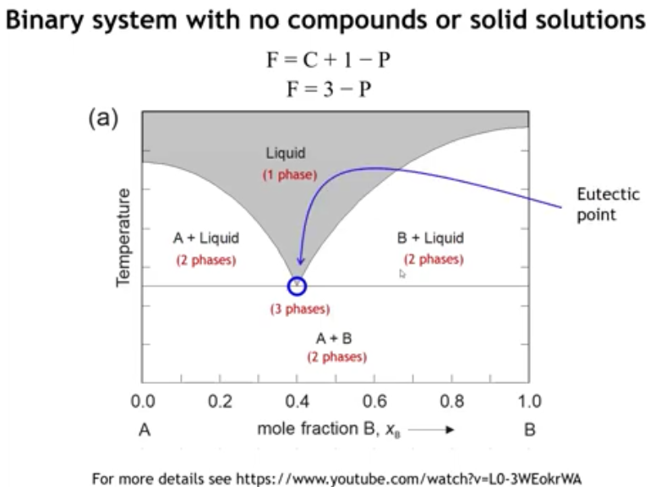
Notes:
At high temperature, the gray region represents a homogeneous liquid phase, where both composition and temperature can vary while remaining single-phase. This region has two degrees of freedom. In three other regions, two phases coexist: either solid A + solid B, or solid + liquid, depending on location relative to the solidus. At one special point, liquid, solid A, and solid B all coexist in equilibrium—the eutectic point. In a eutectic phase diagram, this point also marks the minimum melting temperature.

Slide 19
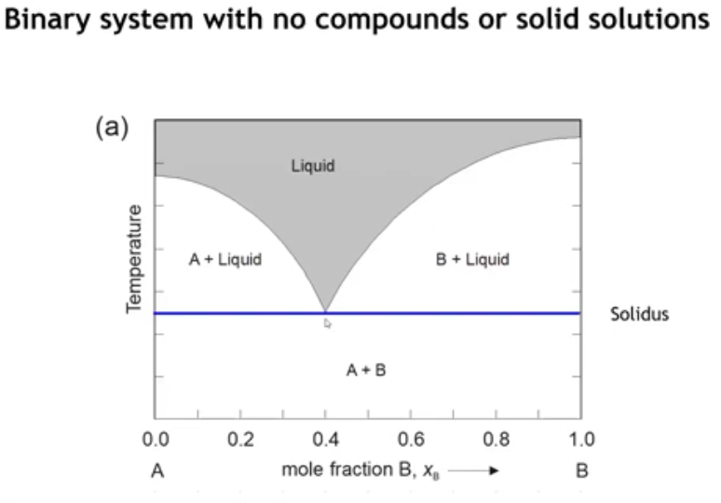
Notes:
This horizontal line that's drawn here is called the solidus, and the solidus represents the highest temperature, which no liquid phases are present. Below the solidus, we have two phase mixture of solids, and above the solidus, we have a two phase mixture of a solid in equilibrium with the liquid.

Slide 20
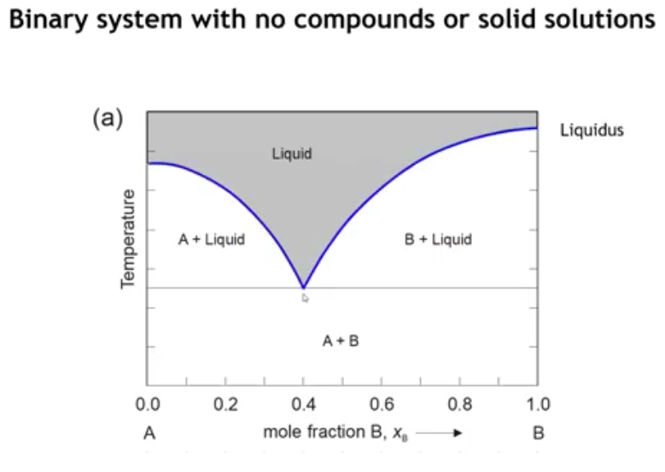
Notes:
then we have this curve line, which separates the pure liquid region from the rest of the phase diagram we call the liquidus.

Slide 21
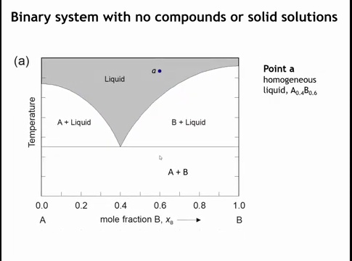
Notes:
Okay, let's take a random point on this phase diagram. Here, we pick a point A, which on the x-axis corresponds to point six. So the composition at this point is A point four, B point six. And at high enough temperature, we are going to have a homogeneous liquid. Let's examine what happens as we cool down from this temperature.

Slide 22
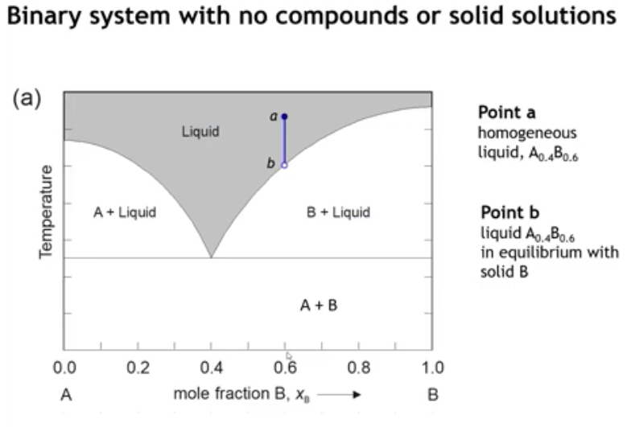
Notes:
When we reach the liquidus line, at that point, the liquid is in equilibrium with solid B. What happens if we cool a little bit further?

Slide 23
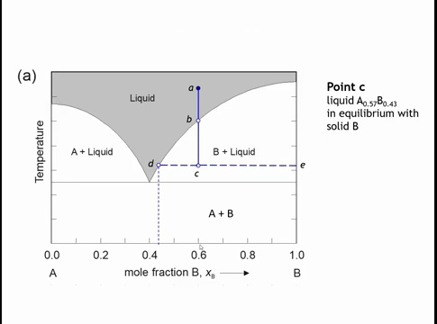
Notes:
At point C, the system enters a two-phase region: solid B + liquid. The liquid now has a different composition than at point B. To determine the compositions of coexisting phases, we draw a horizontal tie line to the single-phase regions. On the left (point D), the liquid composition is ~45% B, 55% A. On the right, the line meets pure B. Thus, at point C the sample consists of solid B in equilibrium with a liquid of composition A₀.57B₀.43, while the overall composition remains 60% B.

Slide 24
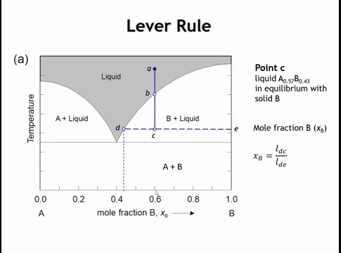
Notes:
And to do that, we're going to use something called the lever rule. We're just going to look at the lengths of the different segments on this line from D to E. So the mole fraction of the B is going to be given by the length of the line opposite to B. That is the length of the line D, C divided by the length of the entire line D, E.

Slide 25
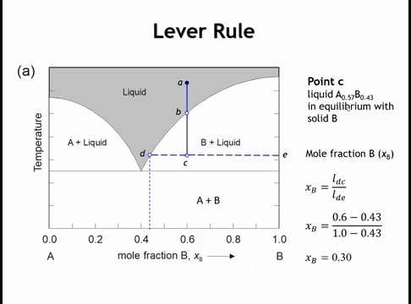
Notes:
If we read the x-axis, point C is at 0.6. The distance from C to D is 0.6 − 0.43 = 0.17, and the full distance from D to E is 1 − 0.43 = 0.57. By the lever rule, the fraction of solid B is 0.17 / 0.57 ≈ 30%. Thus, at point C the system contains 30% solid B and 70% liquid. Intuitively, as C approaches D the mixture must become mostly liquid, which is why the opposite side of the lever is used to calculate the solid fraction.
As a check, consider a sample with 30% pure B and 70% liquid of composition A₀.57B₀.43. Combining should give an overall composition of 40% A and 60% B—the same as the original, you try it yourself. The overall composition is conserved; only the distribution between phases changes.

Slide 26
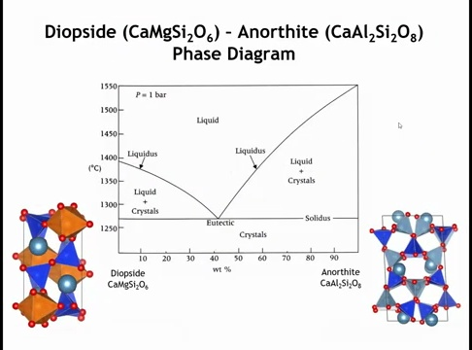
Notes:
Here's a real life example of this kind of simple eutactic phase diagram. Here we're looking at the world of silicate minerals and we have two such minerals, diopsyde and anorthite. Apparently these minerals are found in lava flows. If you were to cool on this side of the phase diagram, as soon as you cross the liquidus, you start to crystallize out diopsyde. Only when you pass the solidus do you start to crystallize an orthite. Whereas if we were to shift over to the right hand side of the phase diagram, we would see the opposite behavior. Cooling from the liquid, we would initially start to crystallize an orthite. Once we cross the liquidus and it would only be that we see crystals of diopsyde forming once we cross the solidus.

Slide 27
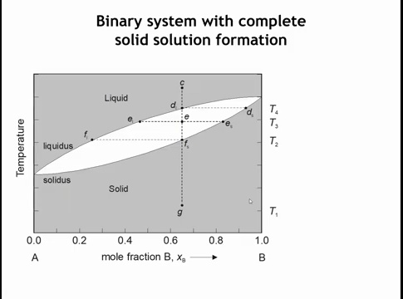
Notes:
Now let’s examine a different type of phase diagram—one where the solids form a solid solution. A solution means a homogeneous mixture: liquids often are, gases always are, and some solids can be too. For example, silver and gold both have a cubic close-packed structure, so any ratio of the two produces a homogeneous solid with silver and gold atoms randomly distributed on the lattice.
Suppose you have a sample that is 65% silver and 35% gold. You might expect it to simply melt at one temperature when heated, but the behavior is more complex than that.

Slide 28
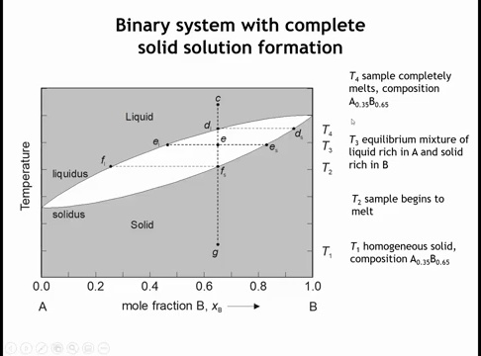
Notes:
Consider a solid solution at point G, with 65% P and 35% A. At this point the solid is homogeneous. As the sample is heated to temperature T₂ (point Fs), melting begins—but not uniformly. At T₃ (point E), the system is a two-phase equilibrium: a liquid of composition ~47% B and 53% A (from the liquidus) coexists with a solid of ~83% B and 17% A (from the solidus). As heating continues, the fraction of liquid grows while the solid becomes progressively richer in B. Once the sample reaches T₄ (point D), it melts completely, returning to a homogeneous liquid with the overall composition of 65% B and 35% A.

Slide 29
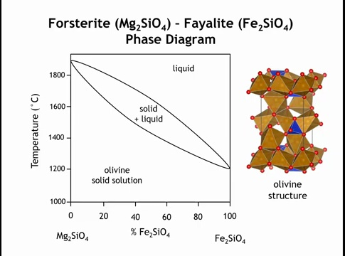
Notes:
Here’s a real-world example from silicate minerals: the phase diagram between forsterite (Mg₂SiO₄) and fayalite (Fe₂SiO₄). Both compounds have the same stoichiometry and the same structure—the olivine structure. Unlike spinel, which is based on cubic close packing of oxygen ions with cations filling tetrahedral and octahedral holes, olivine uses hexagonal close packing of the anions with the same hole-filling scheme. Because of this structural match, forsterite and fayalite form a complete solid solution, producing a simple phase diagram.

Slide 30
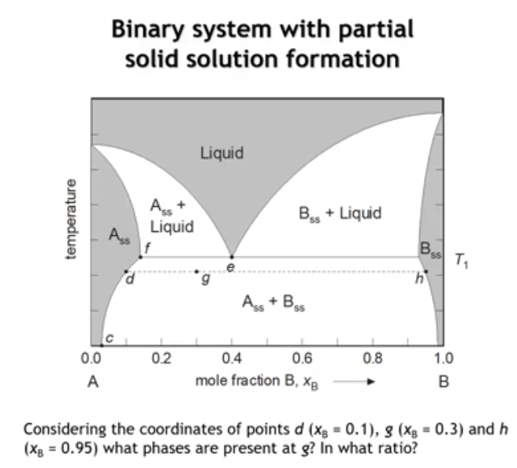
Notes:
Solid solutions can also form incompletely, producing two coexisting solids below the solidus. These are labeled A_ss and B_ss—solid solutions rather than pure A or B. Their exact compositions are read directly from the phase diagram.
For example, take point G. Suppose the coordinates are: D at 1, G at 3, and H at 9.5. At point G, we ask: which phases are present, and in what ratio? The diagram shows that two solid-solution phases coexist, and the lever rule can be applied between D and H to find their relative amounts.

Slide 31
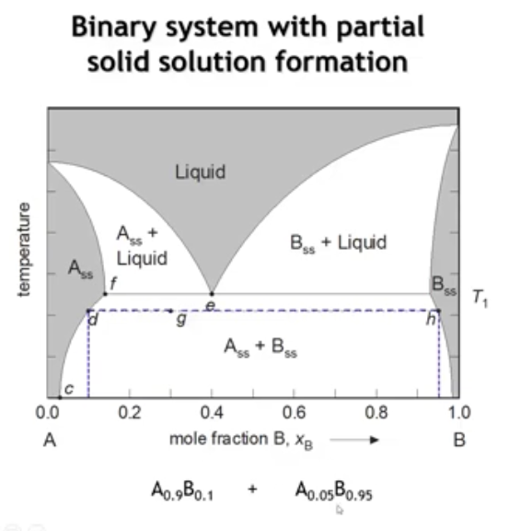
Notes:
Since point G lies in a two-phase region, we determine the coexisting phases by drawing a horizontal tie-line to the adjacent single-phase regions. To the left, the tie-line intersects a solid solution at x = 0.1, corresponding to 90% A and 10% B. To the right, the tie-line intersects a solid solution at x = 0.95, corresponding to 95% B and 5% A. Thus, at point G the sample consists of these two solid-solution phases. Their relative amounts can then be calculated using the lever rule.

Slide 32
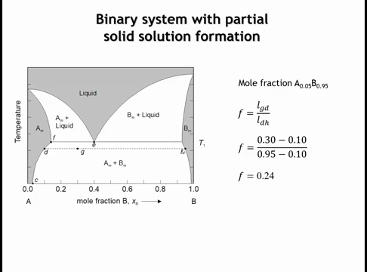
Notes:
So let's try and figure out what is the mole fraction of this phase that's very much rich in B, this phase that we encounter at point H. So the fraction of that phase is going to be the length of the segment GD divided by the length of the entire segment DH. Plugging in the numbers, we come up with a phase fraction of 24%. So that sample is going to be 24% of the phase that's rich in B, 95% B, 5% A, and it's going to be 76% the phase that's rich in A.

Slide 33
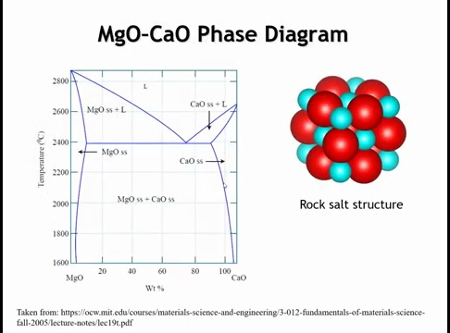
Notes:
As another real-life example, consider the phase diagram of magnesium oxide (MgO) and calcium oxide (CaO). Both adopt the rock salt structure, so you might expect a complete solid solution. In reality, a 50–50 mixture produces two crystalline phases: one rich in MgO with some Ca dissolved, and one rich in CaO with some Mg dissolved. This two-phase region separating limited solid-solution fields is called a miscibility gap. Just as oil and water are immiscible liquids, MgO and CaO mix only slightly in the solid state, resulting in partial miscibility rather than a full solid solution.

Slide 34
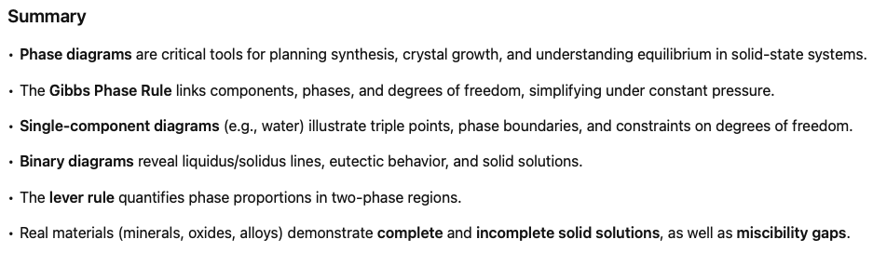

Slide 35
Homework

