Slide 1
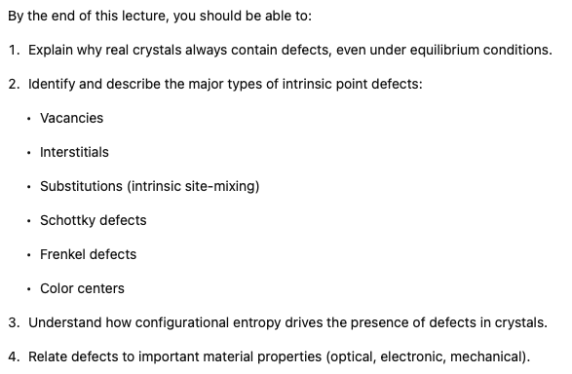
Intrinsic Defects
Notes:
We've just spent several weeks talking about the structures of crystals. In the treatment so far, we've assumed that the crystals are perfect. That is to say we have a unit cell and we repeat that unit cell exactly the same unit cell, infinitely in all directions, and we come up with a crystal. So in those kinds of crystals, there are no defects. And a perfect crystal doesn't have surfaces either. But in real life, crystals do have surfaces and they do have defects. And in the next few lectures, we're going to talk about the defects that we encounter in crystalline solids.

Slide 2
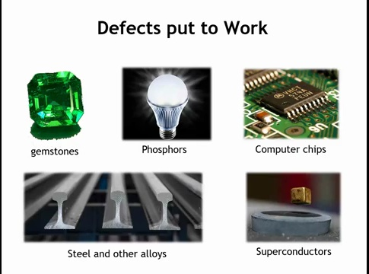
Notes:
“Defect” sounds negative, but many properties depend on them.
Optical: Gemstone colors (rubies, emeralds, garnets) from substitutional defects; phosphors in fluorescent lights/LEDs rely on intentional substitutions.
Electronic: Pure Si/Ge = dull; doping (defects) creates semiconductors → microelectronics possible.
Mechanical: Pure Fe is weak; steel’s strength comes from lattice defects.
Functional: Superconductors & colossal magnetoresistance engineered by controlling defects.
Key Idea: Defects are not flaws—they are essential design tools for tailoring material properties.

Slide 3
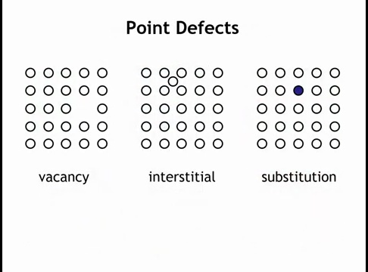
Notes:
Focus: intrinsic defects (perfect stoichiometry, no impurities).
Vacancy: missing atom from its normal Wyckoff site.
Interstitial: atom occupies normally empty site in the unit cell.
Substitution: atom occupies the wrong Wyckoff site.
Common in extrinsic (e.g., doped Si).
Also occurs intrinsically if atoms swap sites (e.g., spinel CoAl₂O₄ → Co on octahedral, Al on tetrahedral sites).
Key Idea: Even “pure” crystals exhibit defects via vacancies, interstitials, and site substitutions.

Slide 4
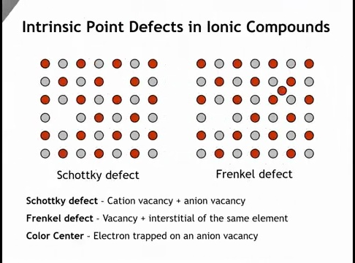
Notes:
Ionic crystals: ions have fixed charges → must maintain charge balance.
Schottky defect: paired vacancies (cation + anion).
Frenkel defect: ion leaves normal site → occupies an interstitial.
Both preserve overall stoichiometry and charge neutrality.
Key Idea: Ionic compounds accommodate defects by coupling vacancies or displacing ions to interstitials, never by unbalanced charges.

Slide 5
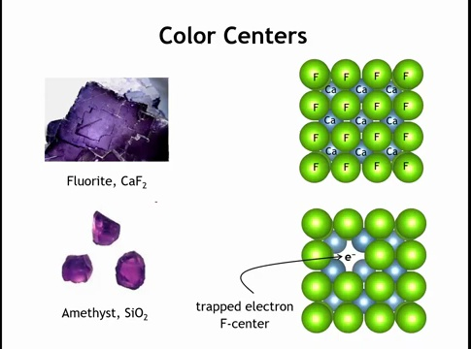
Notes:
Definition: Electron trapped at an anion site vacancy.
Examples: Purple color in fluorite & amethyst.
Formation: High-energy radiation → creates anion vacancies → electron occupies the site instead of the anion.
Environment: Site surrounded by cations → favorable for electron localization.
Quantum behavior: Acts like a “particle in a box” / hydrogen-like atom; optical absorption arises from electron excitation.
Stoichiometry: Deviates from perfect ratio (e.g., Ca:F not 1:2), but no foreign impurities introduced.
Key Idea: Color centers = intrinsic electronic point defects that create striking optical properties.

Slide 6
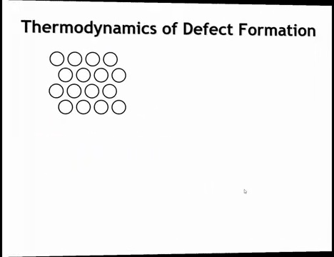
Notes:
Even in equilibrium growth (slow cooling, pure melt/solution, no impurities), defects remain.
Reason: configurational entropy → disorder is thermodynamically favored.
Key Idea: Defects are inevitable, even in “perfect” growth conditions.

Slide 7
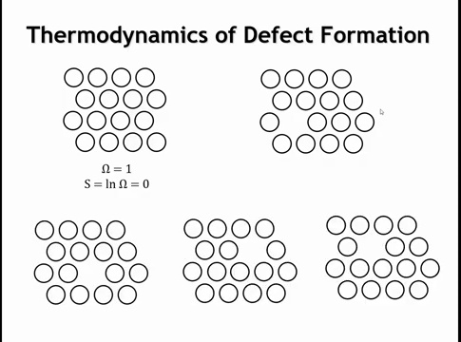
Notes:
If we think about a perfect crystal and where the atoms go in a perfect crystal, there's only one way to arrange them in a perfect crystal. Here I've drawn just a small segment of a perfect crystal. And so we have 16 atoms in this crystal. And to keep the perfect crystal, we have to arrange it in this way. Think about the red and black squares on a checkerboard. We put the red checkers on the red squares and the black ones on the black squares. There's only one way to do that. But once we introduce a defect, in this case, what we're going to do is to take an atom from the bulk and move it out to the surface. And once it gets out here on the surface, we still have the same collection of atoms. But now we've introduced more than one way that we can arrange the crystal. We could move that vacancy around.

Slide 8
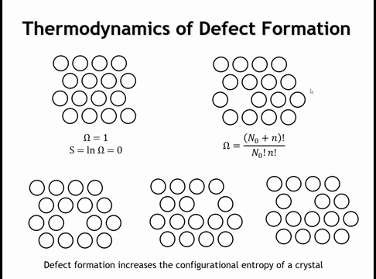
Notes:
And the formula for what the number of configurations is going to be given here. It's the number of lattice sites in the perfect crystal, plus the number of, let's say, vacancies that are created by moving an atom to the surface, factorial, divided by, and not factorial times small and factorial. So if we have 16 atoms in this crystal, then the number of configurations, once we have one vacancy, is going to be 17 factorial divided by 16 factorial times one factorial. And that's going to be 17. There are 17 different places that I could put that vacancy. Remember what Boltzmann taught us, that configurational entropy is simply going to be the natural log of the number of configurations times the Boltzmann constant. And so as we put these vacancies in, we're going to increase the configurational entropy of the crystal.

Slide 9
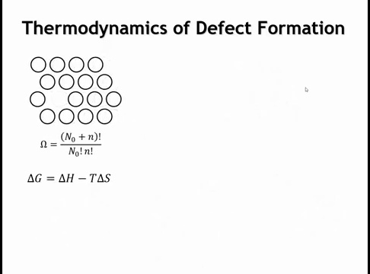
Notes:
How will that affect the free energy of the crystal? Well, the change in the free energy of the crystal, that happens when we move that atom from the Boltzmann to the surface, is the change in enthalpy minus the temperature times the change in entropy.

Slide 10
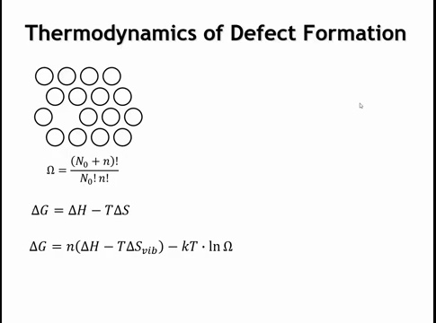
Notes:
Now the entropy term has two components. There's a certain amount of the entropy that comes from the vibrations of the atoms. And that will be slightly different if the atom is at the surface than it would be if it were in the Boltzmann. And then we have this KT times the natural log of omega. This is our configurational entropy term.

Slide 11
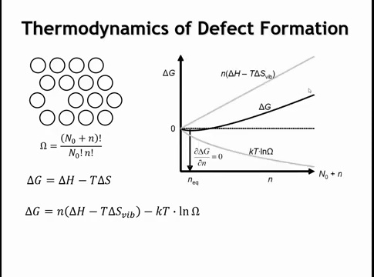
Notes:
So if we were to plot these terms as a function of the number of defects, the number of atoms that have moved from the Boltzmann to the surface, their concentration, we would get something like this. Delta H minus T delta S vibration goes up, it's positive. It is endalgically unfavorable to take an atom from the Boltzmann and move it to the surface of the crystal. And the reason why is because we're losing bonding. We do not recover all of the bonding that we get in the bulk of the crystal when we put the atom at the surface. So that is going to make delta G positive, which is thermodynamically unfavorable. At the same time, the configurational entropy is going to become more favorably negative as the number of defects increases. And so the overall delta G of this process is a balance between these two competing things.

Slide 12
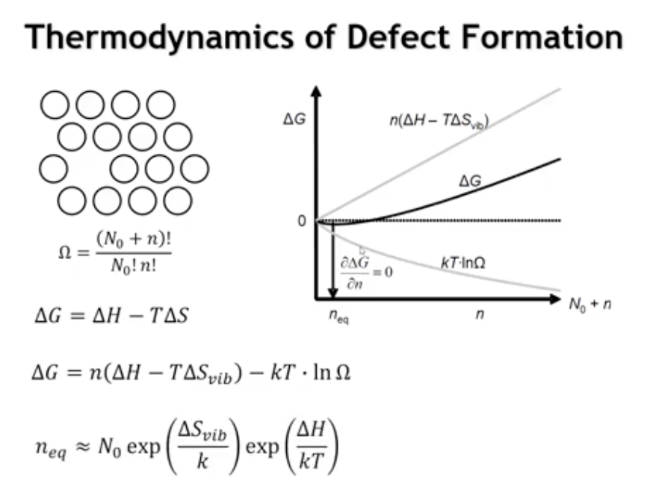

Notes:
By taking the first derivative of ΔG with respect to defect concentration, we obtain the equilibrium vacancy concentration. The minimum in ΔG arises because configurational entropy decreases rapidly at first and then more slowly as defect number increases. Intrinsic defect concentrations are favored when (1) ΔH is small—meaning little bonding energy is lost by moving an atom from the bulk to the surface—and (2) temperature is high, since entropy effects dominate at high T. Thus, it is always thermodynamically favorable for crystals to contain some defects. If bonding is very strong, the equilibrium defect concentration may still be extremely small. Finally, as a crystal cools from high temperature, diffusion slows, so actual defect concentrations often reflect the higher-temperature equilibrium rather than true room-temperature equilibrium.

Slide 13
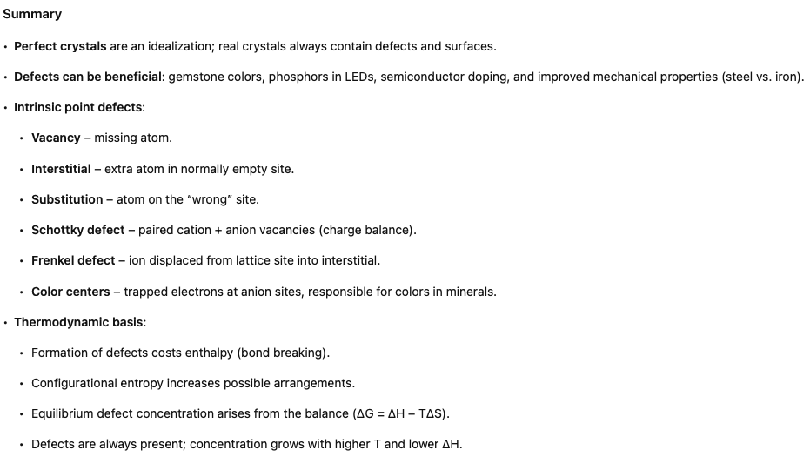

Slide 14

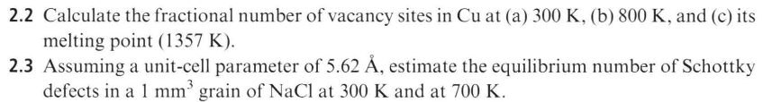
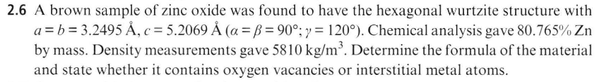
Homework

Slide 15

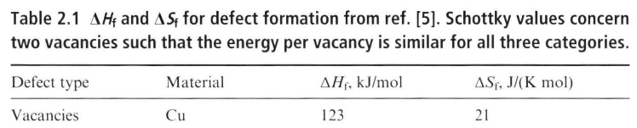
Homework

Slide 16
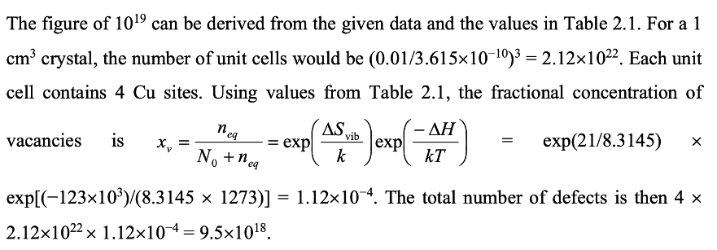

Slide 17
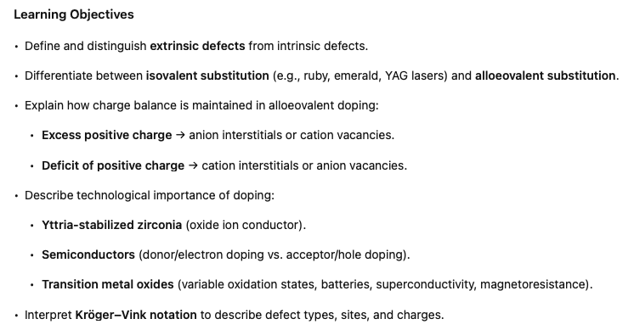
Extrinsic Defects
Notes:
In the last lecture, we considered intrinsic defects. These are defects that occur in crystals that maintain the ideal stoichiometry. In this lecture, we're going to look at extrinsic defects. An extrinsic defect is one where we introduce an atom or atoms that are not normally present in a perfect crystal.

Slide 18
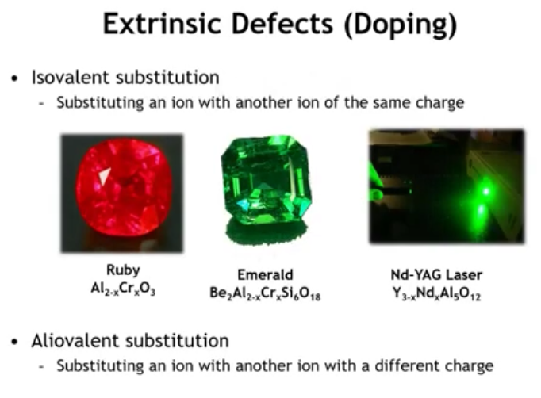
Notes:
There are two types of extrinsic defects in ionic or polar covalent compounds.
Isovalent substitution occurs when the substituting ion has the same charge as the ion it replaces. Examples include Cr³⁺ replacing Al³⁺ in ruby and emerald, and Nd³⁺ replacing Y³⁺ in YAG lasers.
Alloeovalent substitution occurs when the substituting ion has a different charge than the ion it replaces. Because overall charge neutrality must be maintained, alloeovalent substitution always triggers a compensating change elsewhere in the crystal.

Slide 19
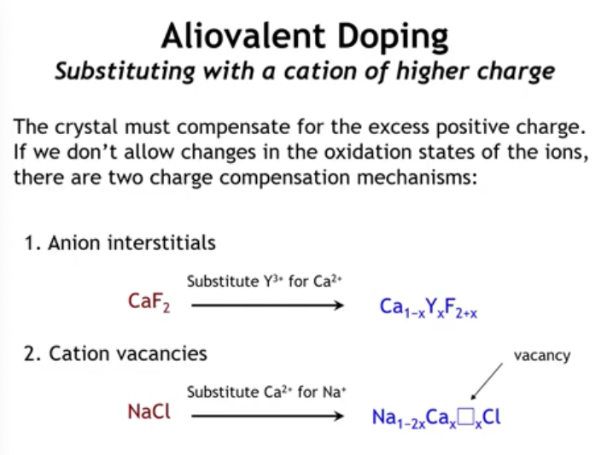
Notes:
Let’s consider the effect of alloeovalent doping in ionic compounds where ion oxidation states are fixed. When a higher-charge cation substitutes for a lower-charge one, the lattice gains excess positive charge. To restore charge balance, the crystal can:
create anion interstitials (e.g., Y³⁺ replacing Ca²⁺ in a fluoride lattice), or
create cation vacancies (e.g., Ca²⁺ substituting for Na⁺ in NaCl).

Slide 20
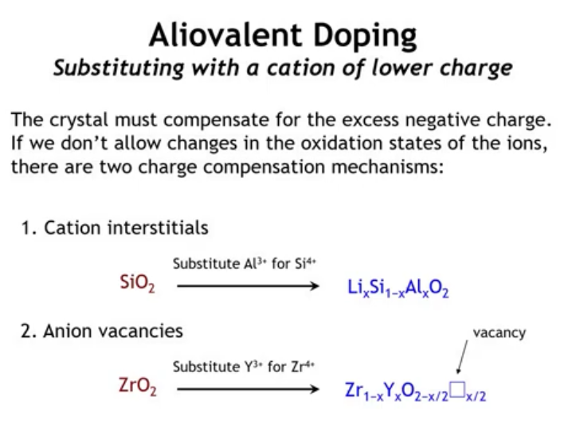
Notes:
The opposite case is alloeovalent doping that reduces positive charge. For example, substituting Al³⁺ for Si⁴⁺ in SiO₂ leaves a charge deficit. This can be compensated by cation interstitials, such as Li⁺ ions; when many accumulate, as in zeolites, they can alter the network topology and create pores, though sometimes interstitials fit without structural change. Another way to compensate is through anion vacancies. For instance, substituting Y³⁺ for Zr⁴⁺ in zirconia introduces oxygen vacancies, producing yttria-stabilized zirconia, one of the best high-temperature oxygen ion conductors with wide technological use.

Slide 21
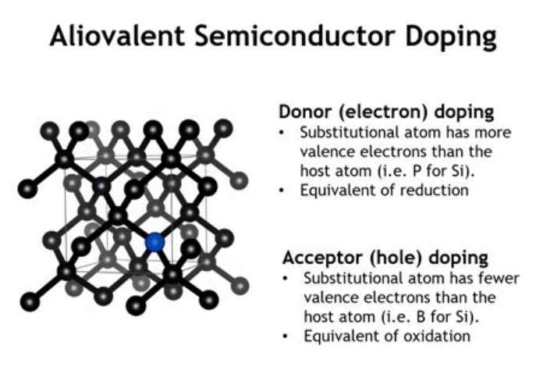
Notes:
Another key case of alloeovalent substitution is in semiconductors, where it is critical to device performance. In elemental semiconductors like silicon, substituting atoms with more valence electrons (e.g., P for Si) introduces extra electrons that move freely, boosting conductivity—this is donor or electron doping, equivalent to reducing the lattice. Substituting atoms with fewer valence electrons (e.g., B or Al for Si) creates missing electrons or holes, which act as positive charge carriers—this is acceptor or hole doping, equivalent to oxidizing the lattice.

Slide 22
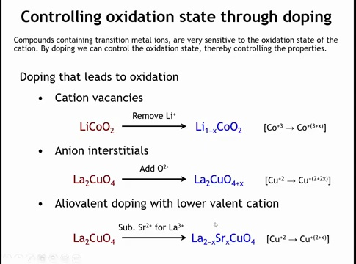
Notes:
In transition metal compounds, alloeovalent doping is often compensated by changing the oxidation state of the transition metal. For example, in LiCoO₂ (a key lithium-ion battery cathode), removing Li⁺ creates cation vacancies and charge imbalance, which is corrected by oxidizing some Co³⁺ to Co⁴⁺. A similar effect occurs with anion interstitials: in La₂CuO₄, adding oxygen interstitials raises the Cu oxidation state from +2 to ~+2.2–2.3, turning on superconductivity. The same result can be achieved by cation substitution, e.g., replacing La³⁺ with Sr²⁺, which also increases the Cu oxidation state—this was the route by which Bednorz and Müller first discovered high-Tc superconductivity in cuprates.

Slide 23
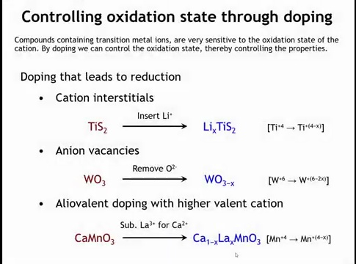
Notes:
Doping can also drive reduction of cation oxidation states. In early lithium-ion batteries using TiS₂, Li⁺ intercalation during discharge introduces positive charge, compensated by reducing Ti⁴⁺ to lower states. Reduction can also result from anion removal: in WO₃, oxygen vacancies reduce W⁶⁺ toward W⁵⁺, forming conductive, colored “bronzes” (blue/black). This ability to chane color upone reduction makes WO3 the most widely used electrochromic material. A third route is substitutional doping: in CaMnO₃ (Mn⁴⁺), replacing Ca²⁺ with La³⁺ lowers the Mn oxidation state (to ~3.5–3.3). This triggers colossal magnetoresistance, where resistivity can change by up to a million-fold under a magnetic field.

Slide 24
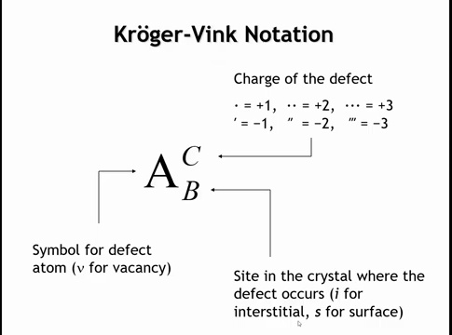
Notes:
Kröger–Vink notation is used to describe extrinsic defects.
The base symbol (capital letter) is the element of the substituting atom; for a vacancy, use a lowercase v.
The subscript indicates the lattice site being replaced: e.g., Ca on a La site → subscript La; for interstitials use i, for surface sites use s.
The superscript denotes the defect’s effective charge relative to the host lattice site: dots (•) for positive charges, primes (′) for negative charges.
This system compactly specifies the type of defect, its location, and its charge balance.

Slide 25
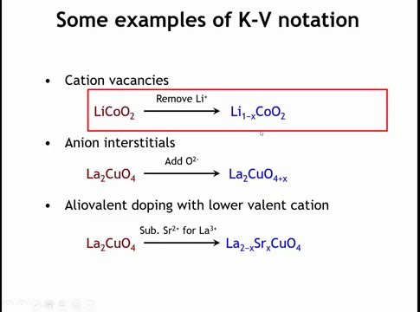

Slide 26
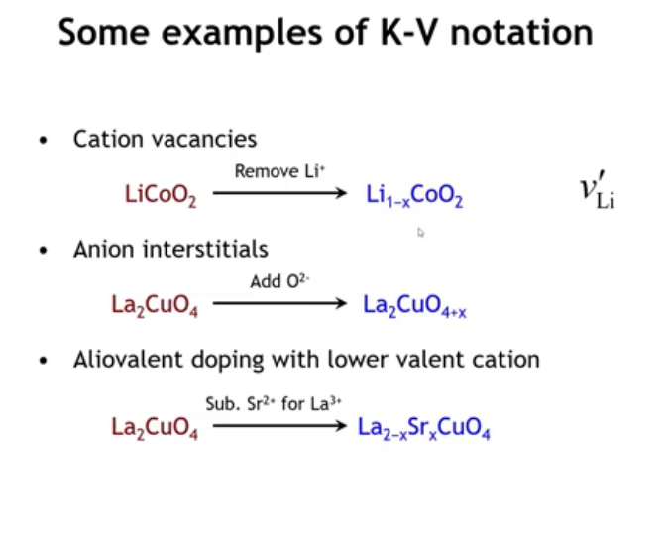
Notes:
We just go back to the examples we just talked about. Here we have lithium vacancies. And so the Kruger-Vink notation for a lithium vacancy is as follows. The thing we're introducing to the lattice is a vacancy. So we use the lowercase v. The thing that was at the vacancy site before the defect was introduced is a lithium. So the subscript is a lithium. And because that lattice site used to have a positive one charge, and now it has no charge at all, it is with respect to the host lattice negatively charged by one charge unit. And so we put a one prime there.

Slide 27
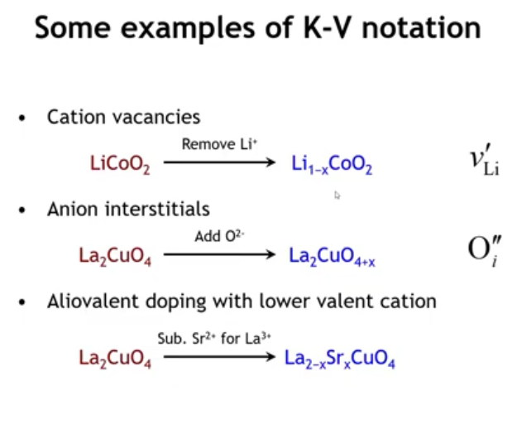
Notes:
If we were to have anion interstitials, like in lanthenum copper oxide, then the Kruger-Vink notation would be as follows. The foreign thing that's in the lattice is an oxygen ion. It is sitting at the interstitial site. So that means the subscript is this lowercase i. And because an oxide ion has a negative two charge, and it's sitting on a site that would normally be uncharged, the vacancy has a negative two charge.

Slide 28
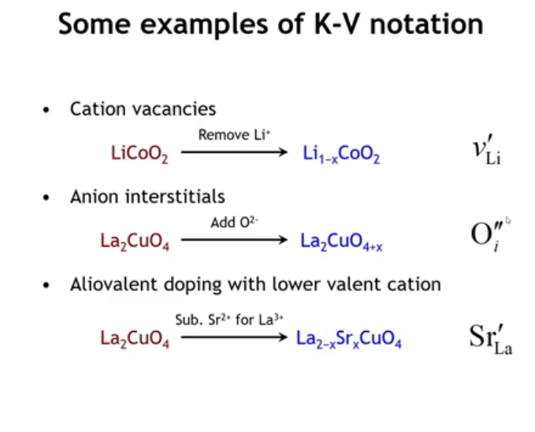
Notes:
In La₂CuO₄ doped with Sr, the Kröger–Vink notation is Sr on a La site with a –1 charge. Although Sr²⁺ is positively charged, the defect’s charge is defined relative to the replaced site: La³⁺ normally occupies it, so substituting Sr²⁺ lowers the charge by one, giving –1. The key point is that Kröger–Vink charge refers to the difference from the host site, not the absolute ionic charge.
Because these defects are negatively charged, they drive oxidation of the transition metal ions to restore charge balance, raising their oxidation state.

Slide 29
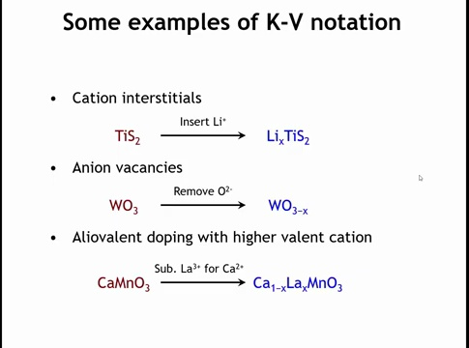
Notes:
Here are the other three defects we looked at a couple slides back. Why don't you pause the video and write out the Kruger-Vink notation for each of these defects, then come back and we'll go over them.

Slide 30
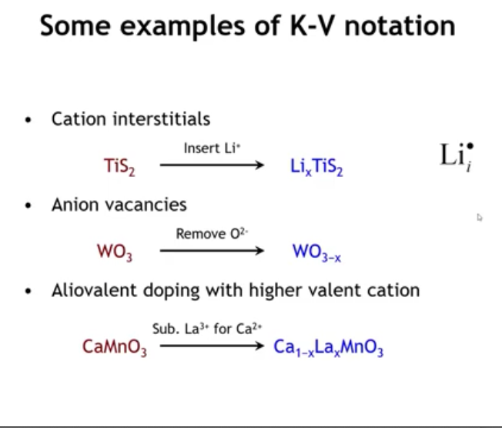
Notes:
Well, let's start with the first one. What is the defect? The defect is a lithium cation. Where is that lithium cation going? It's going to an interstitial site. And because the lithium cation has a plus one charge and the interstitial site normally has no charge, this is going to be a defect with a plus one charge. So lithium subscript i and then a dot is the superscript.

Slide 31
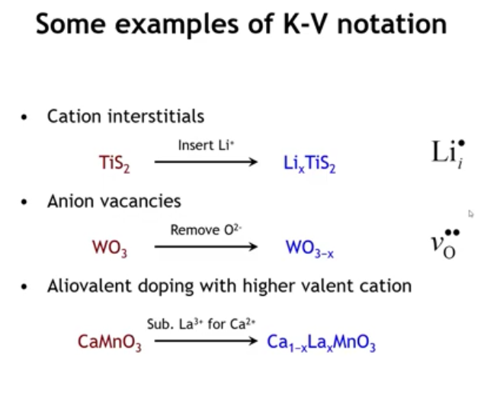
Notes:
If we introduce anion vacancies onto the tungsten trioxide lattice, that's going to be a vacancy. That's the thing that's introduced. Oxygen is the site where that extrinsic defect is going. And then the charge of this one is positive two. Because the oxygen site normally carries a negative two charge and now there's nothing there. So with respect to the host lattice, this is a plus two defect.

Slide 32
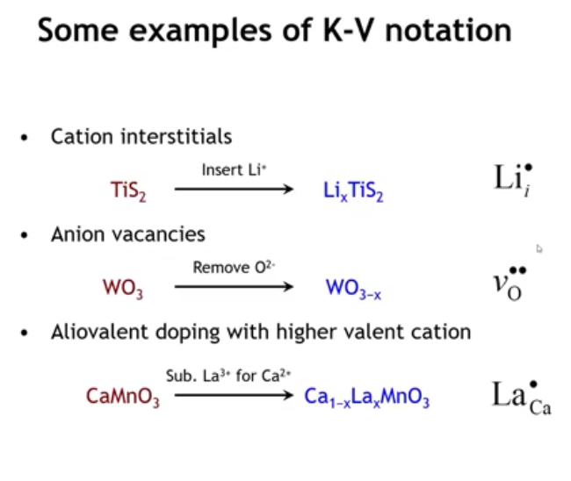
Notes:
nd then in the last case, it's lanthanum going on to a calcium site. And because lanthanum has a higher positive charge by one, plus three versus plus two, means this is a defect with a plus one charge.

Slide 33
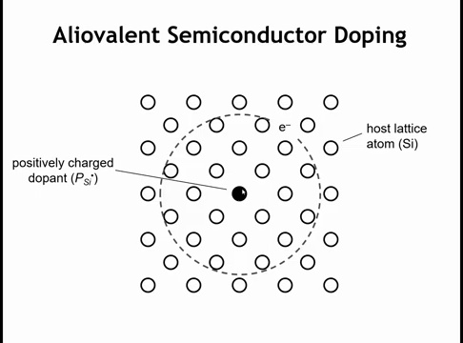
Notes:
As a preview for semiconductors, consider donor (electron) doping in Si by substituting P. Phosphorus has one extra valence electron. If that electron is donated to the lattice, the P atom is left with the same bonding as Si but with a nucleus carrying one more positive charge than Si. Relative to the Si site, this creates a +1 charged defect. At low temperature, the donated electron remains weakly bound to this positive defect in a hydrogen-like orbital. This illustrates how the charge of defects has important physical consequences.

Slide 34
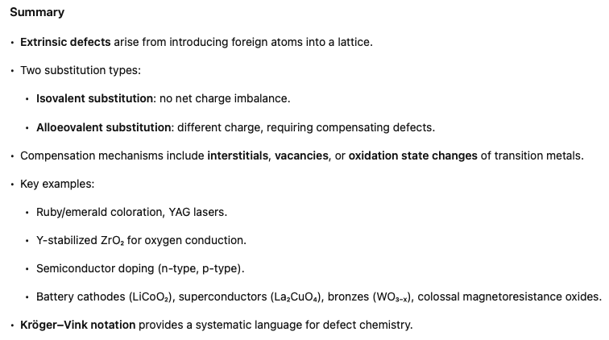

Slide 35
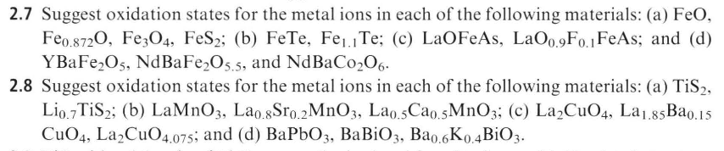

Homework

