Slide 1
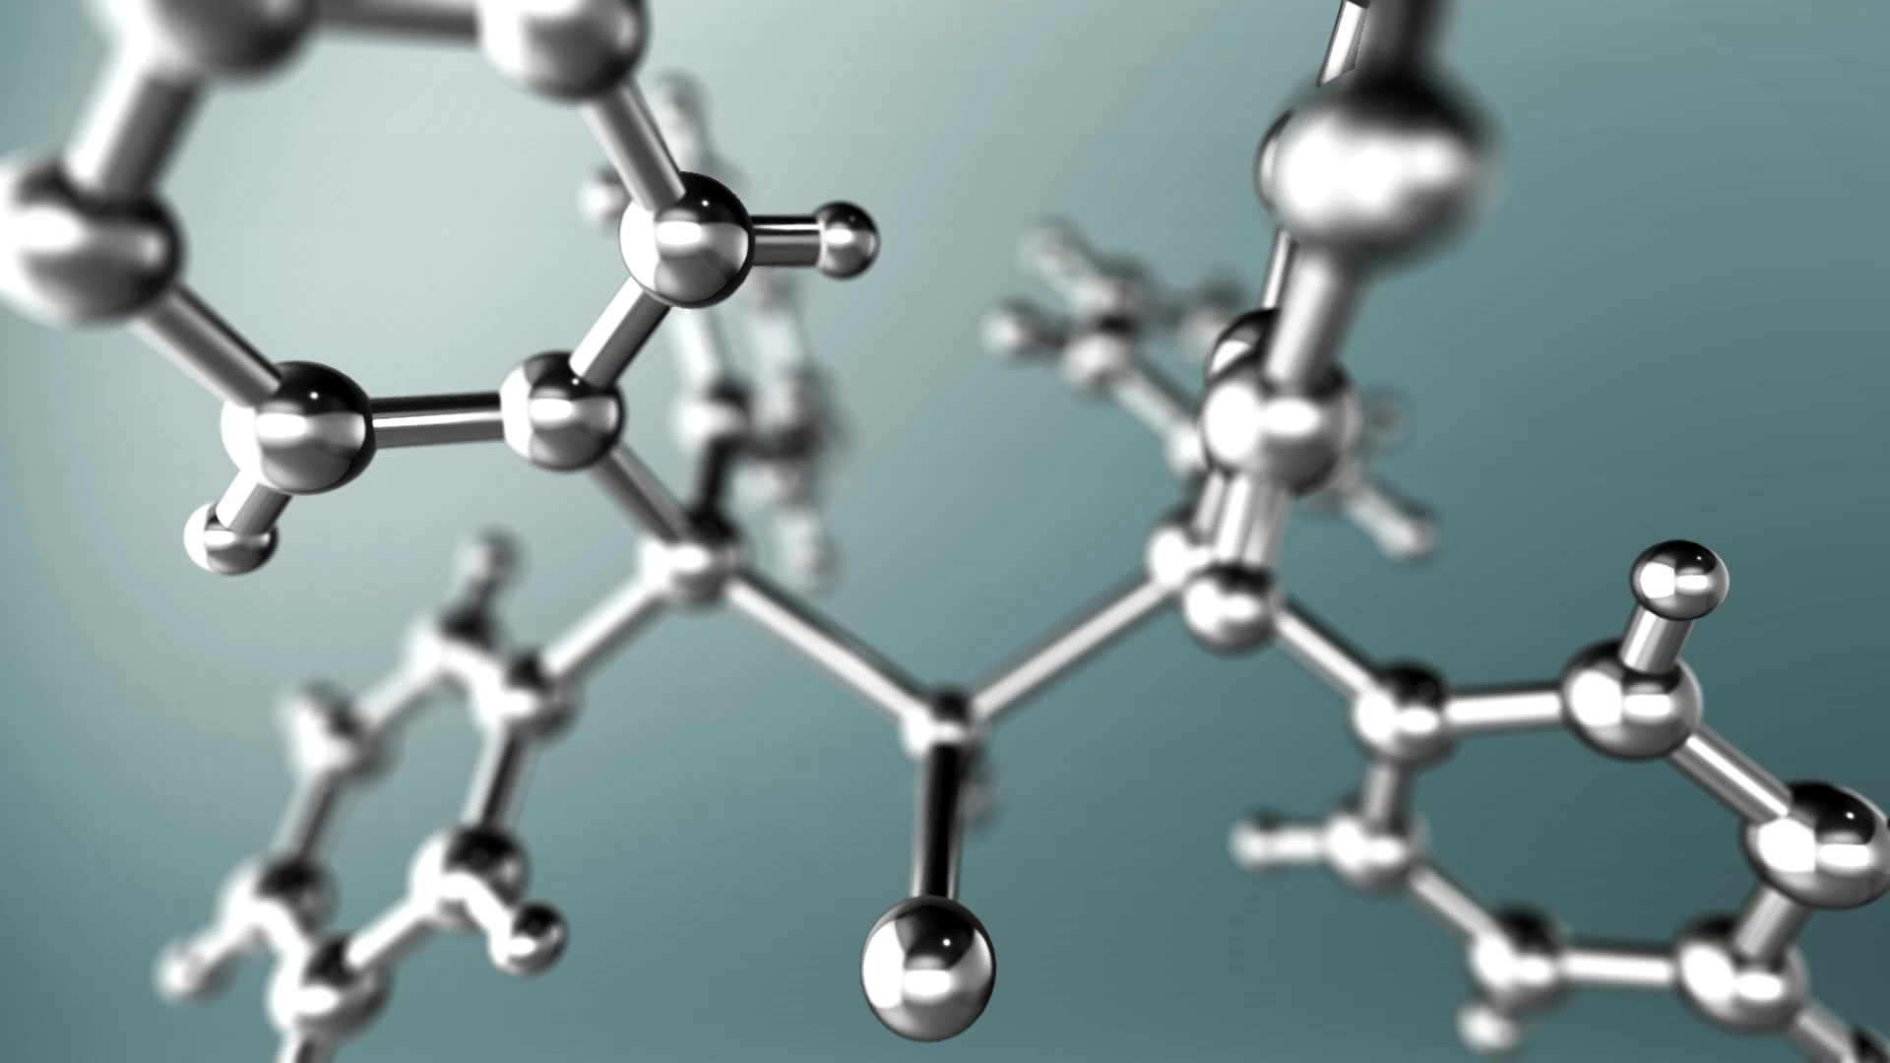
Some Important Ternary and Quaternary Structures
Notes:
To finish our survey of the structures of extended solids, we're going to look at three more structures. Two of them are ternary structures seen mostly for oxides and one a quaternary structure. And these structures house families of compounds which have many important functional properties.

Slide 2
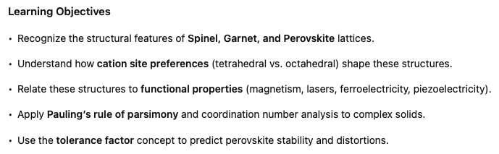

Slide 3
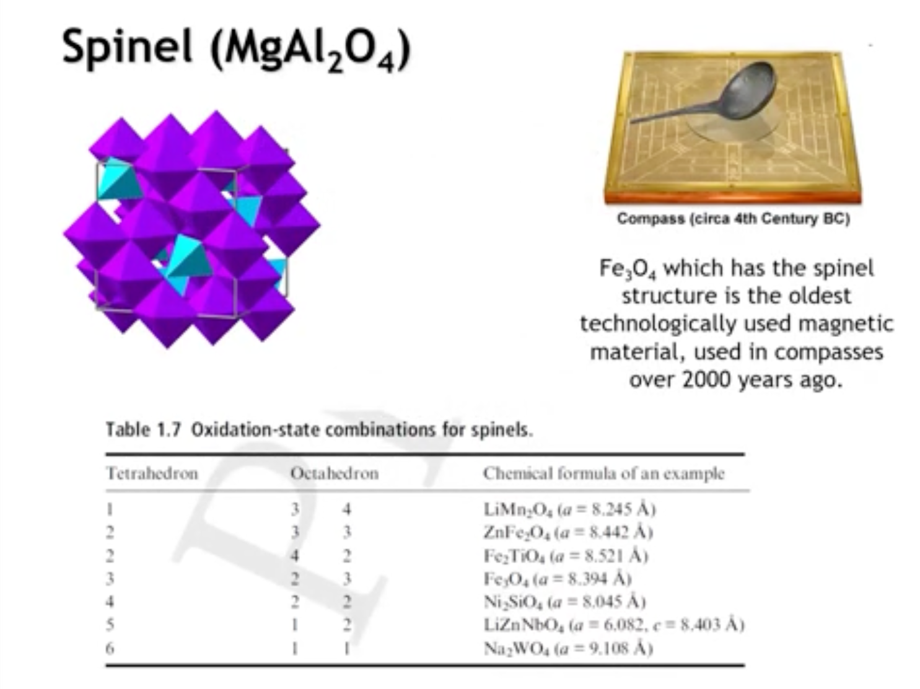
Notes:
The spinel structure, named after the mineral spinel (MgAl₂O₄), is a cubic oxide framework found in many important compounds. One well-known example is magnetite (Fe₃O₄), the earliest known magnetic material, used in Chinese compasses more than 2,000 years ago. Spinels remain widely used for their magnetic properties.
In this structure, magnesium occupies the tetrahedral sites while aluminum occupies the octahedral sites. Across the broader spinel family (AB₂O₄), the tetrahedral sites can accommodate cations with charges ranging from +1, such as lithium, up to +6, such as tungsten. The charge on the octahedral sites adjusts accordingly to maintain overall charge balance. This flexibility in site occupancy is central to the chemical and physical diversity observed in spinel compounds.

Slide 4
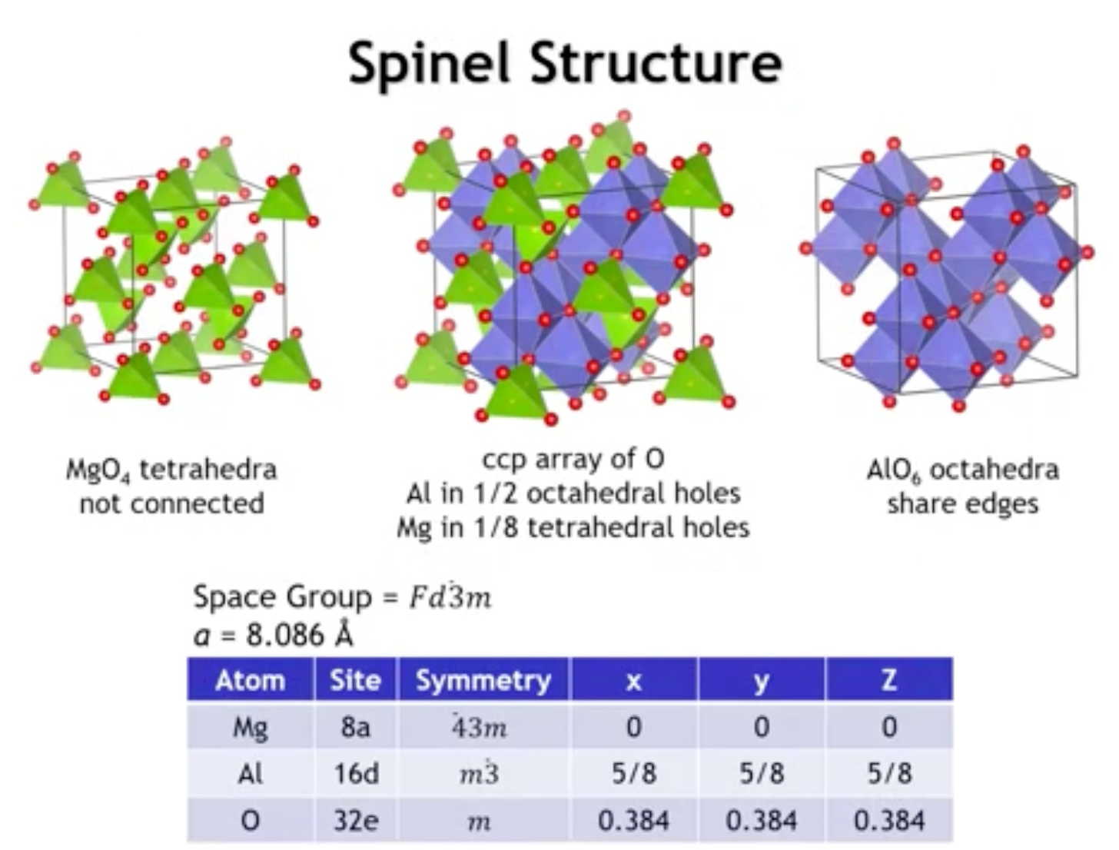
Notes:
The spinel unit cell contains 56 atoms, as seen from its Wyckoff positions. The structure is most often described as a cubic close-packed array of oxygens, with aluminum filling one half of the octahedral holes and magnesium occupying one eighth of the tetrahedral holes.
If we examine only the tetrahedral framework by removing the aluminum, the Mg-centered tetrahedra are isolated from one another and sit in the same positions as carbon atoms in diamond; both structures share the same space group, Fd3̅m. Looking instead at the octahedral framework by removing the magnesium, the AlO₆ octahedra share edges to form chains in multiple directions. This is consistent with the fact that fully occupying all octahedral sites would yield the rock salt structure, where every octahedron shares all of its edges. In spinel, not all edges are shared, but the structure still produces a network of edge-sharing octahedra.
Finally, site symmetry confirms that magnesium occupies a site of 4̅3m symmetry, corresponding to an ideal tetrahedron.

Slide 5
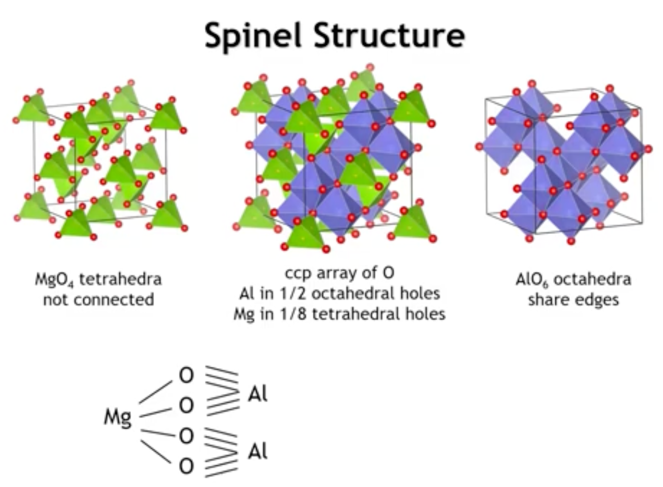
Notes:
We could draw a bond graph for the Spinell structure, which I've done here. And so in this bond graph, you can see that we do obey Pauling's rule of persimmony. Of course, we knew that must be the case from the Y-coff sites on the previous slide, because all of the oxygens are on a single Y-coff site. So therefore, they're all crystallographically and chemically equivalent, and we can say the same for magnesium and aluminum. You can see here that the oxygen makes one bond to magnesium, and then three bonds to aluminum.

Slide 6
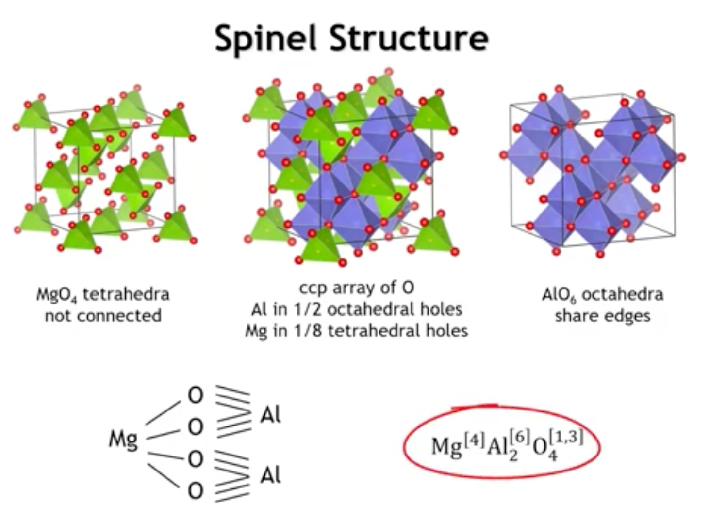
Notes:
So we could write the crystal chemical formula in this way. Magnesium's coordination number is four, aluminum's coordination number is six, and then the oxygen has four neighbors, one magnesium and three aluminum.

Slide 7
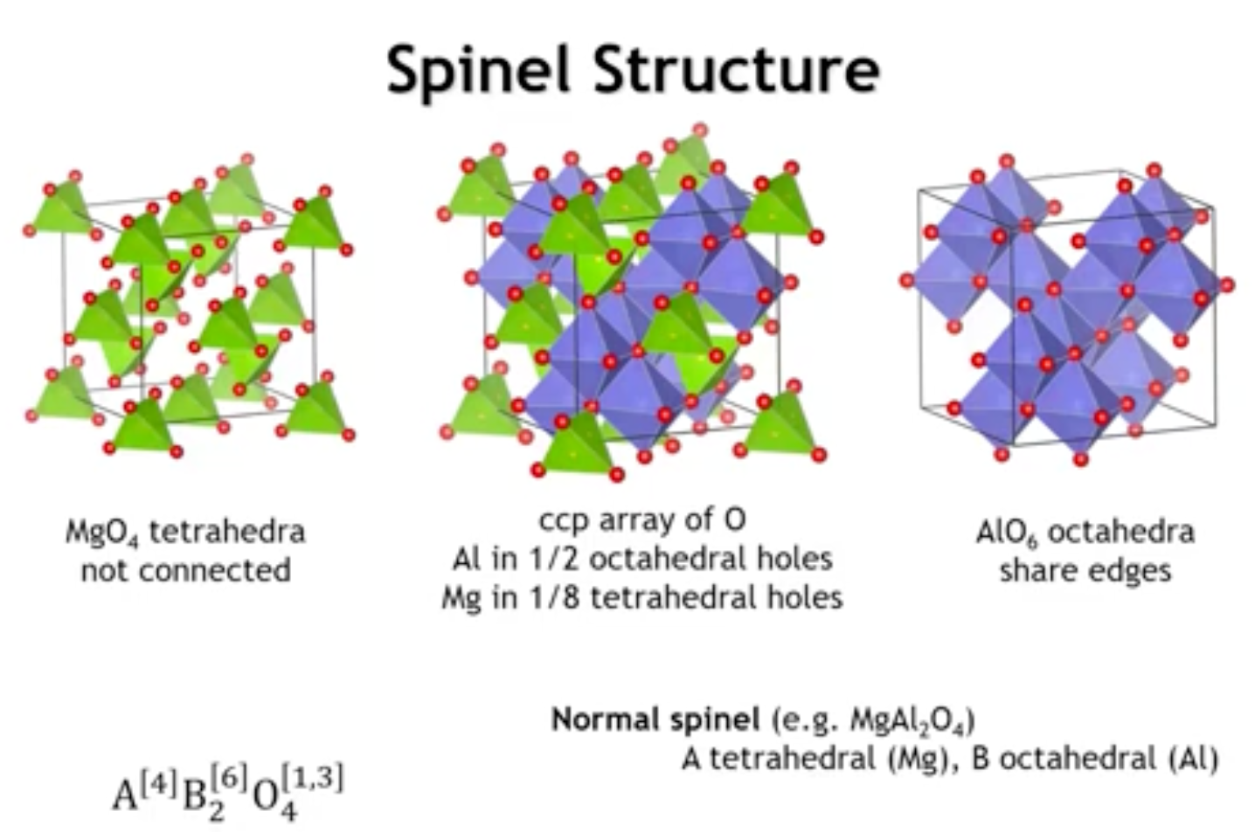
Notes:
The mineral Spinell, like many other Spinells, is what we call a normal Spinell structure. And what we mean by that is we have one magnesium and two aluminum's. So the element that's present in the smaller amount, only one of them, magnesium, goes onto the tetrahedral site, and then the other cation, of which there are two performular unit, occupies the octahedral sites.

Slide 8
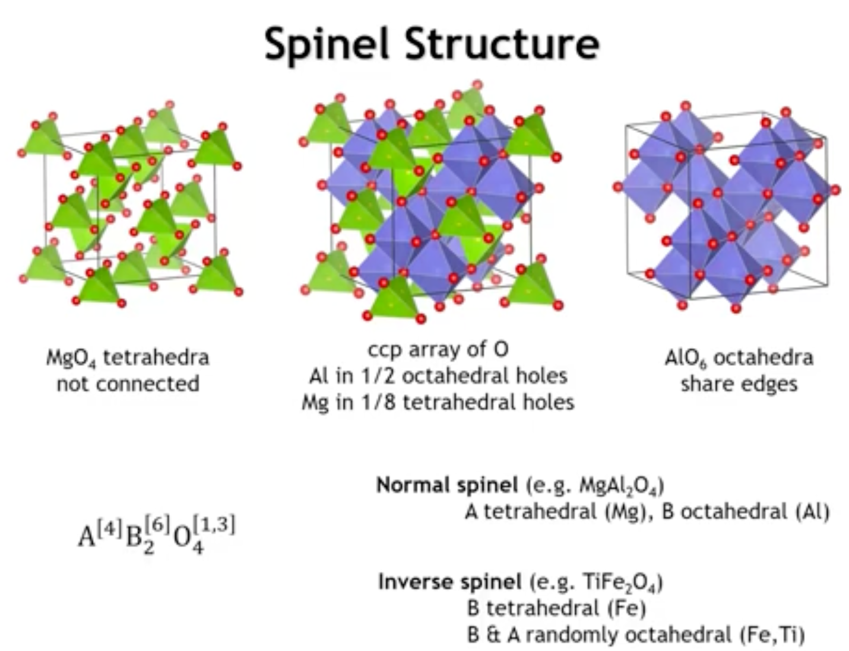
Notes:
But oftentimes we'll find what are called inverse Spinells. And in an inverse Spinell, like TIFE204, the cation that's in the minority, here the titanium, has a preference to go onto the octahedral site. And so that means the other cation, which is present in the majority, are split between the octahedral and tetrahedral sites. So in an inverse Spinell, we have a disordered or random distribution of two different cations on the octahedral sites.

Slide 9
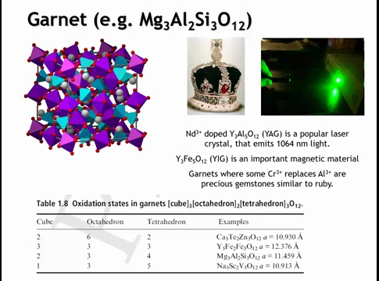
Notes:
The garnet structure (X₃Y₂Si₃O₁₂) is even more complex than spinel. In this framework, larger cations such as magnesium occupy distorted cubic sites, aluminum occupies octahedral sites, and the smallest cations, such as silicon, fill tetrahedral sites.
Garnets have many technological applications. In yttrium aluminum garnet (Y₃Al₅O₁₂, YAG), aluminum occupies both tetrahedral and octahedral positions. When yttrium is partially substituted with neodymium, the material becomes the most widely used laser crystal, producing infrared light at 1064 nm that can be frequency-doubled to visible green at 532 nm. Substituting aluminum with iron yields yttrium iron garnet (YIG), an important magnetic material. Garnets are also valued as gemstones: chromium substitution for aluminum produces red garnets often mistaken for rubies, including the historical “Black Prince’s Ruby,” which is actually a garnet.
The garnet family encompasses many variants, with properties determined by the cations placed on the cubic, octahedral, and tetrahedral sites.

Slide 10
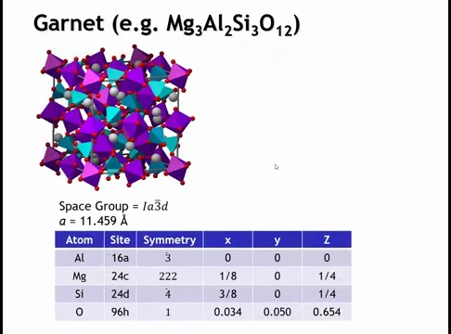
Notes:
If we were to look just a little bit more carefully at the structure, here's the details for magnesium aluminum silicate. The space group is IA3BrD, that is space group number 230, so that is the very last space group, and you might argue the most symmetric space group in the international tables. There are now 160 atoms in the unit cell, but amazingly each atom goes onto a single Y-coff site. And the reason is that all of the silicons are crystallographically and chemically equivalent, and we can say the same for aluminum, for magnesium, and for oxygen. So once again, here we obey Pauling's rule of parsimony.

Slide 11
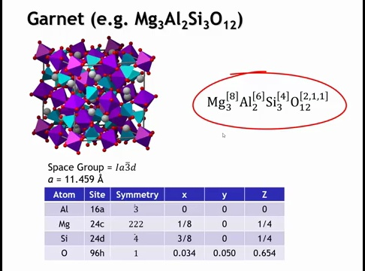
Notes:
The bond graph is a bit complicated to drag because there's so many different atoms, but we can just write the crystal chemical formula, which is shown here. So the magnesium is 8-coordinate, the aluminum 6-coordinate, the silicon 4-coordinate, and then the oxygen, we see once again, has 4 bonds to the cations, 2 bonds to magnesium, 1 to silicon, and 1 to aluminum.

Slide 12
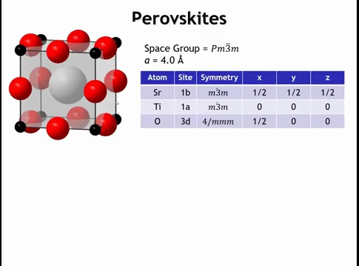
Notes:
The perovskite structure (ABO₃) is simpler than spinel or garnet, with only five atoms per unit cell. The small B-site cation (e.g., Ti⁴⁺) sits at the cube corners, oxygen occupies the midpoints of the edges, and the larger A-site cation (e.g., Sr²⁺) sits at the body center.
Removing the A cation reveals a framework of TiO₆ octahedra connected at the corners, forming an infinite 3D network equivalent to the ReO₃ structure. Inserting the A cation “stuffs” this framework, as it fits into the cavity formed by the corner-sharing octahedra. The A cation is 12-coordinate in a cubic environment, corresponding to the number of cube edges.

Slide 13
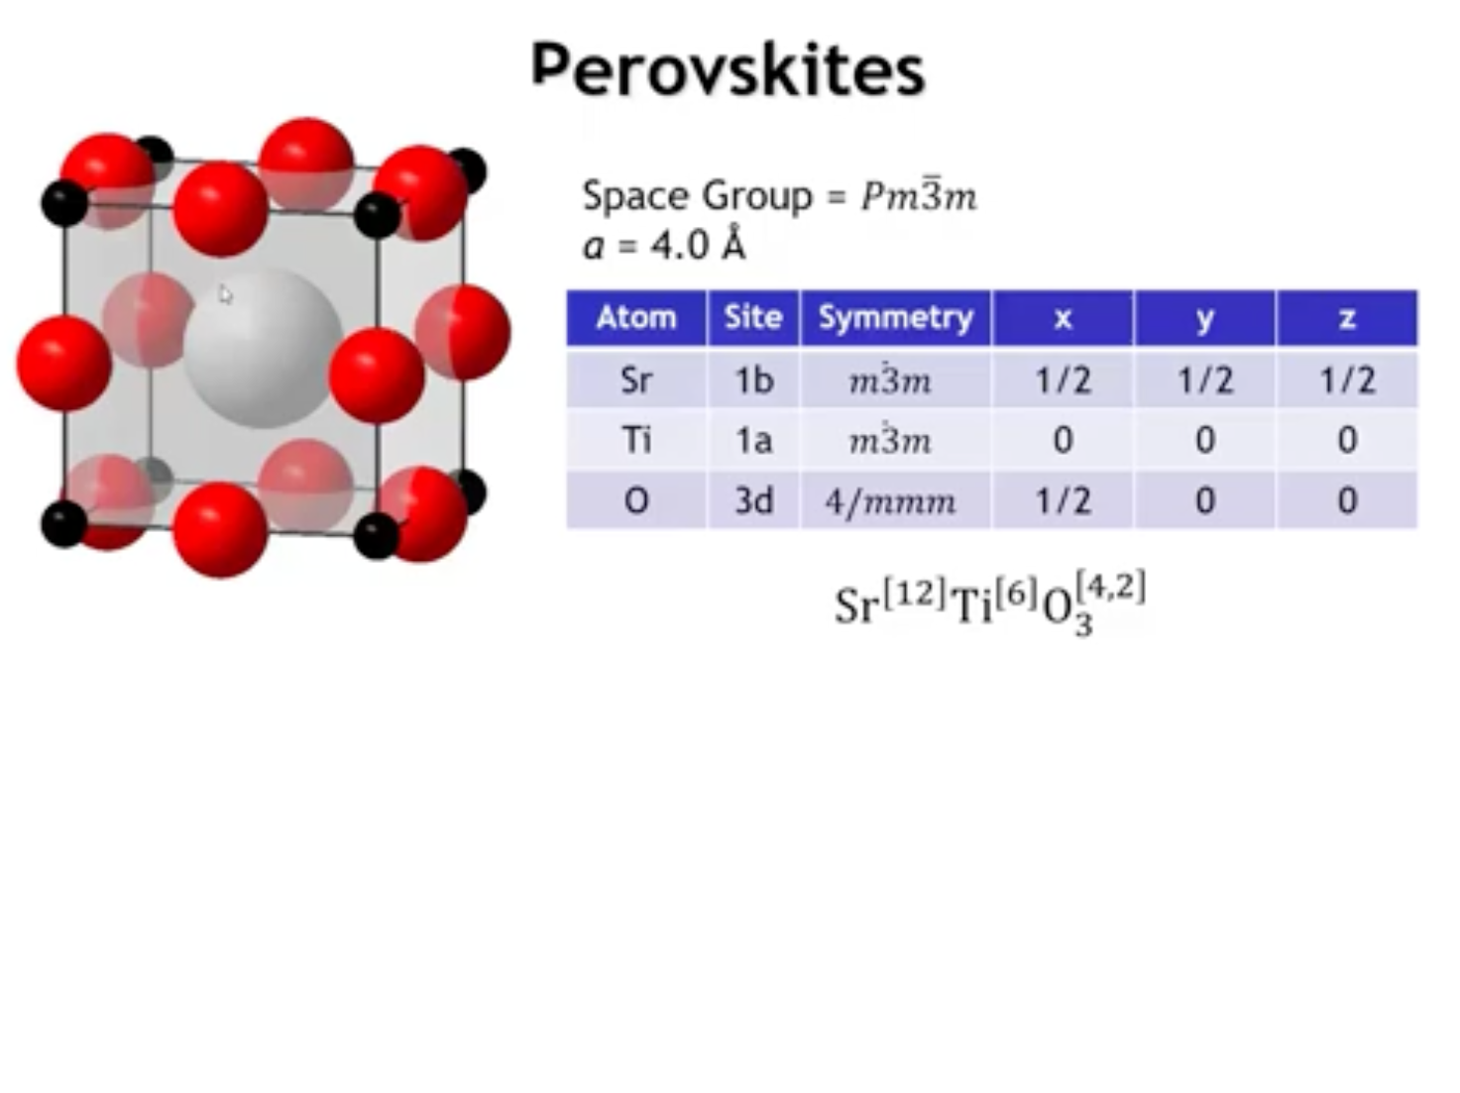
Notes:
So the crystal chemical formula is strontium-12-coronate, titanium-6-coronate, and then the oxygen has four strontiums around it and two titanium.

Slide 14
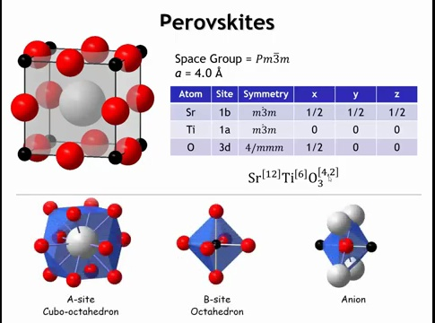
Notes:
Here would be another view of the coordination environments of the three ions in the perovskite structure.

Slide 15
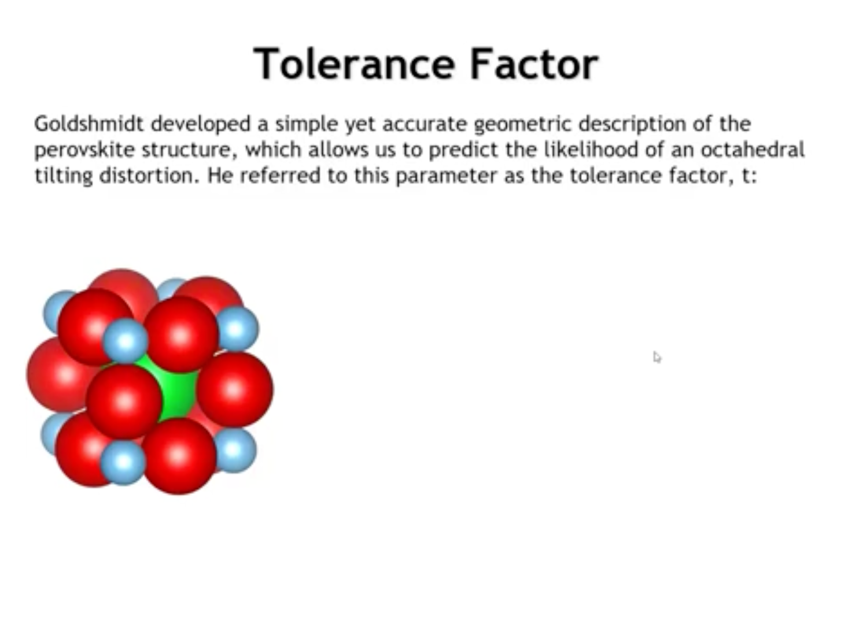

Slide 16
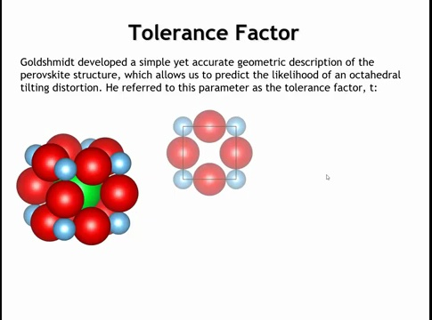
Notes:
An important factor in perovskite stability is the relative size of the ions. The structure is defined by a single parameter—the cubic cell edge—but this must satisfy two constraints: the optimal B–O distance (e.g., Ti–O) and the optimal A–O distance (e.g., Sr–O). The degree to which both requirements are met is expressed by the tolerance factor, introduced by Victor Goldschmidt about a century ago, who also synthesized some of the first perovskites. The mineral perovskite itself is calcium titanate (CaTiO₃).

Slide 17
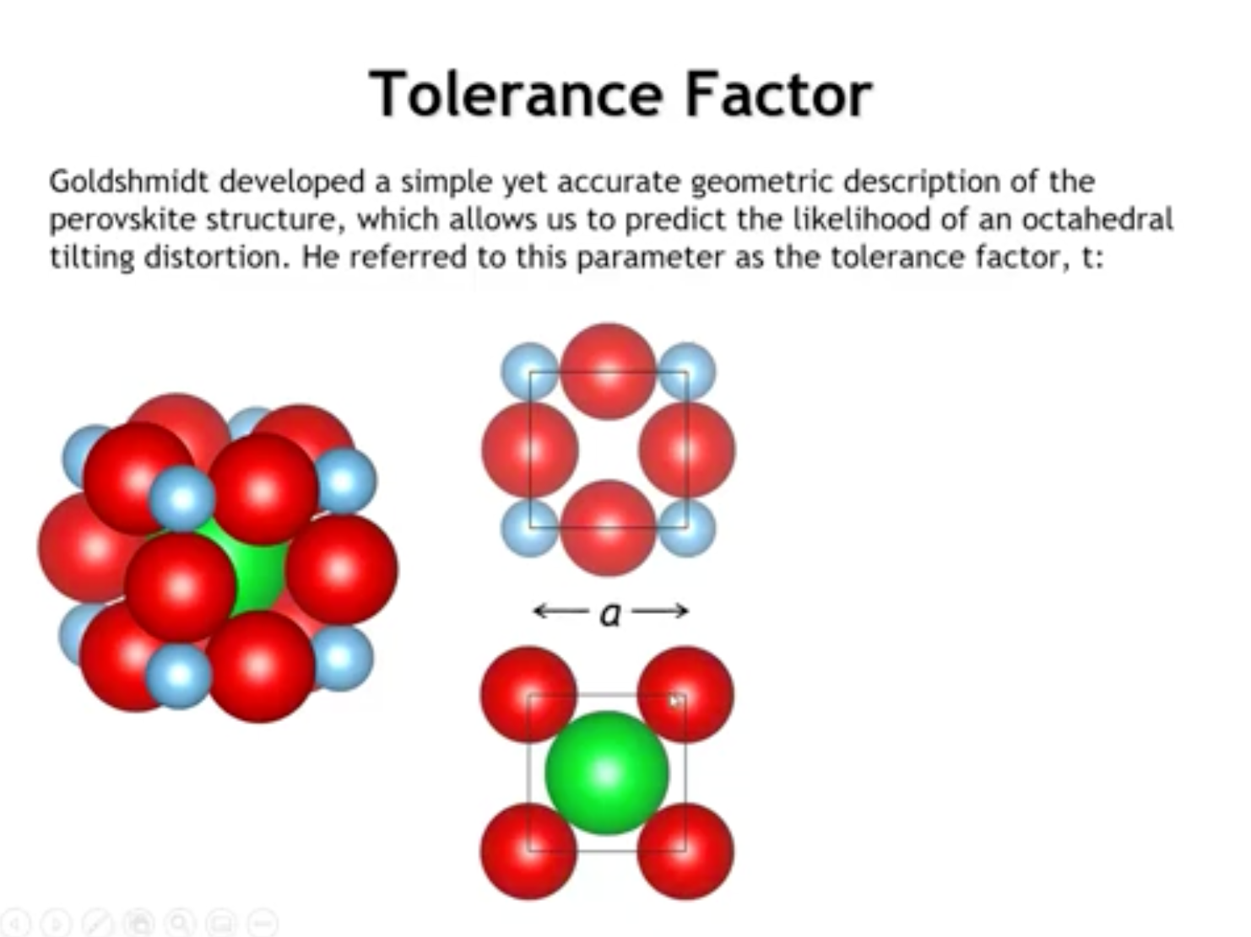
Notes:
If we were to take a cut right out of the middle of the unit cell, in that one, the strontium and the oxygen touch along this face diagonal. Okay, now if we look at the length of the edge of the cubic unit cell, we could define it either in terms of the titanium and oxygen radius or in terms of the strontium and the oxygen radius.

Slide 18
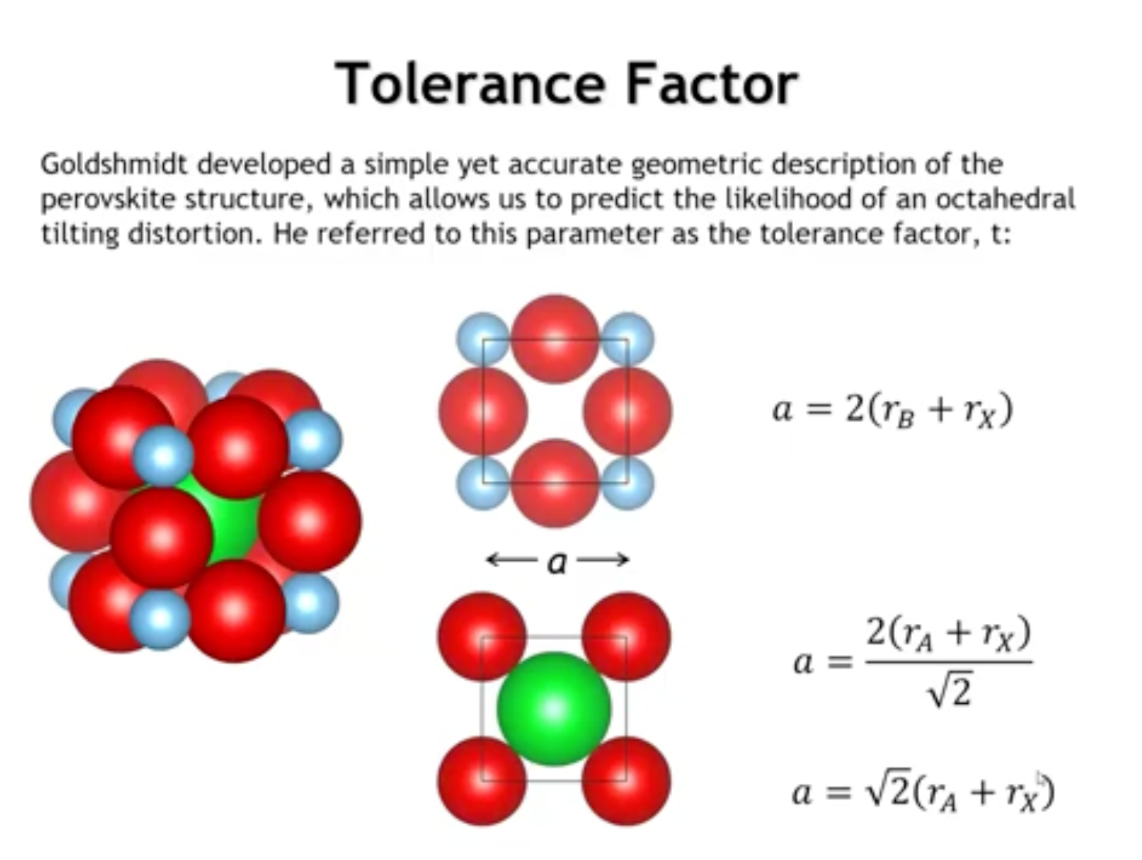
Notes:
If we were to define it in terms of the smaller octetural cation, you see we have one radius of the small cation, one, two radii of the anion, and then one more radius of the small cation. So we call that small cation B, that's often done. We can say that unit cell edge length is twice the radius of B plus the radius of the anion X. Now, if we go to the lower drawing, there the ions are touching along the face diagonal. So the distance along the face diagonal is going to be twice the radius of A plus the radius of the anion X. This is a 45 degree right triangle. So if the hypotenuse is two times the radius of A plus the radius of X, then the edge is going to be that value divided by square root of two. Now, we can simplify that to get this. So now we have two expressions for what the unit cell edge should be, and we can use those to calculate the tolerance factor.

Slide 19
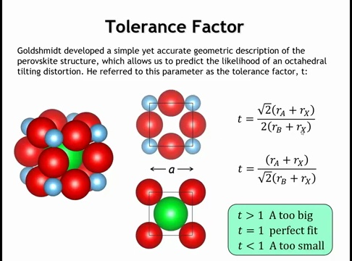
Notes:
Goldschmidt described the tolerance factor as a way to compare how well the lattice accommodates both the large A-site cation and the smaller B-site cation. It is expressed as the ratio between the unit cell size that best fits the A cation and the size that best fits the B cation. When the two values match, the tolerance factor equals one and the structure is a perfect fit. If the tolerance factor is greater than one, the A cation is too large and stretches the framework of corner-sharing octahedra. If it is less than one, the A cation is too small and sits loosely in the cavity, leaving extra space inside the structure.

Slide 20
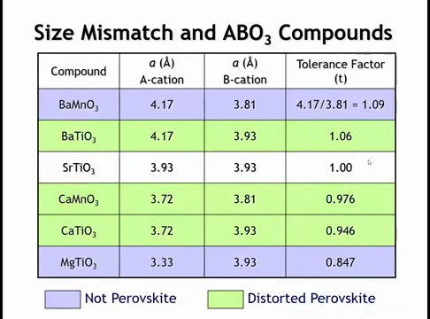
Notes:
Let’s look at some examples of tolerance factors. Strontium titanate is essentially a perfect fit, with a tolerance factor equal to one. Replacing strontium with the larger barium increases the tolerance factor above one, and substituting titanium with the smaller manganese(IV) increases it further. Going the other direction, replacing strontium with calcium lowers the factor below one, and substituting calcium with magnesium reduces it to about 0.85. At these extremes—magnesium titanate and barium manganate—the structure is no longer a true perovskite and cannot maintain the corner-connected octahedral network. Compounds with intermediate values preserve the perovskite framework but show distortions that we will examine next.

Slide 21
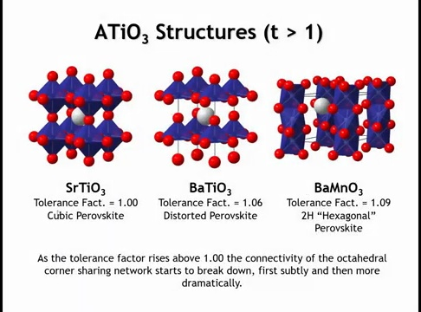
Notes:
When the tolerance factor is slightly greater than one, as in barium titanate, the octahedra are stretched and the titanium atom shifts off-center. This displacement creates a local dipole moment, making barium titanate the classic example of a ferroelectric material. Similar distortions are also important for piezoelectric and dielectric applications, many of which rely on perovskites with tolerance factors just above one. If the factor is larger still, as in barium manganate, the A-site cation is too big to maintain the corner-sharing octahedral network, and the structure instead transforms into a hexagonal perovskite with a different connectivity.

Slide 22
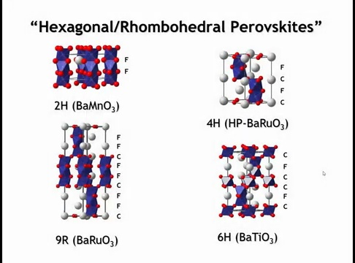
Notes:
Hexagonal and rhombohedral perovskites form when cubic close-packed AO₃ layers are partially replaced by hexagonal close packing. With full hexagonal packing, the result is the 2H structure, where octahedra share faces to create infinite chains that are not interconnected, leaving space for large cations such as barium. When cubic and hexagonal stacking are mixed, the connectivity becomes more complex. In the 4H structure, four layers repeat, producing dimers of face-sharing octahedra linked by corners. In the 9R structure, nine layers repeat, giving trimers of face-sharing octahedra connected by corners to other trimers. The 6H structure, seen in barium titanate under high pressure, combines corner-sharing octahedra with dimers of face-sharing ones. These hexagonal perovskites appear when the tolerance factor is greater than one.

Slide 23
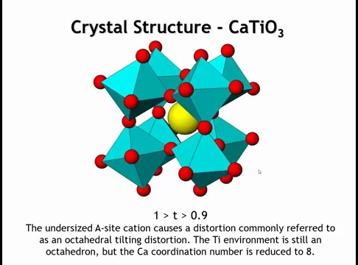
Notes:
When the tolerance factor drops below one, the A-site cation becomes too small and does not contact all of its neighbors. The structure responds with an octahedral tilting distortion: the BO₆ octahedra remain nearly ideal around the smaller cation, such as titanium, but the environment around the larger A-site cation is significantly altered. Some oxygen atoms move closer, others farther away, reducing the A-site coordination number from twelve to about eight.

Slide 24
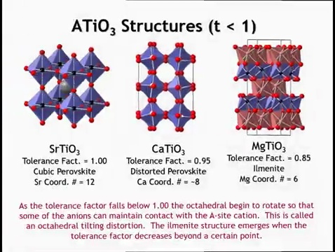
Notes:
If the tolerance factor decreases far enough, even distorted perovskites become unstable. In that case the structure often transforms into ilmenite, as seen in magnesium titanate (MgTiO₃). Ilmenite is closely related to corundum (Al₂O₃), which contains pairs of face-sharing octahedra. In ilmenite these octahedra are ordered, with titanium in one and magnesium in the other, producing alternating magnesium and titanium layers. The coordination number of the alkaline earth cation is reduced to six, which is more appropriate for a small ion such as magnesium. Overall, while some perovskites remain cubic, a much larger fraction are distorted in ways similar to calcium titanate or barium titanate. The family is vast, with thousands of members, and will appear repeatedly in discussions of functional properties.

Slide 25
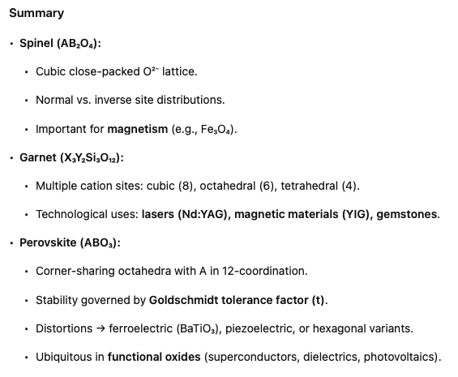

Slide 26
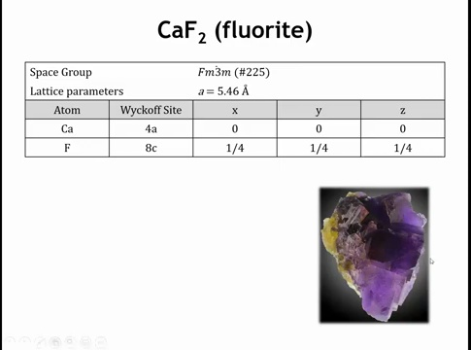
Notes:
Practice with vesta starts here

Slide 27
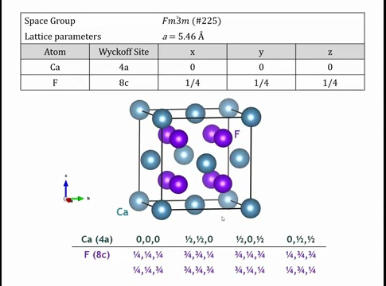
1/2,0,1/2
0,1/2,1/2
0,0,0
1/2,1/2,0
Notes:
If we draw the unit cell with all atoms fully or partially inside it, it looks like this: a calcium atom sits at the origin, and the generators place others at (½,½,0), (½,0,½), and (0,½,½). The remaining calcium atoms in the picture come from applying translational symmetry—adding integer multiples of the unit cell vectors to those four positions. we can always add or subtract integers to bring atoms back inside (or partly inside) the unit cell.

Slide 28
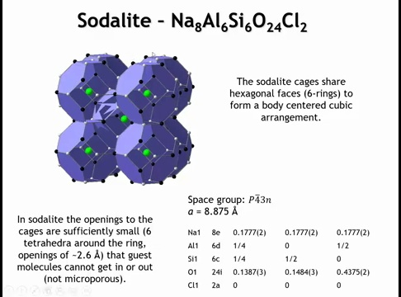
Notes:
The sodalite network takes its name from the mineral sodalite (Na–Al–Si–O–Cl). Its framework contains cages shaped like truncated octahedra, resembling blue soccer balls. These cages have hexagonal faces (six-rings) and square/diamond faces (four-rings). This geometry matches the sodalite net topology discussed earlier. In sodalite itself, Cl⁻ ions occupy the cage centers; Na and O are not shown here. While this cage is the fundamental building unit of many zeolites, in sodalite the cages are fused in a way that makes the structure non-porous, preventing molecular access.

Slide 29
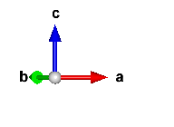
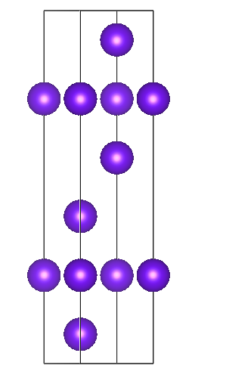
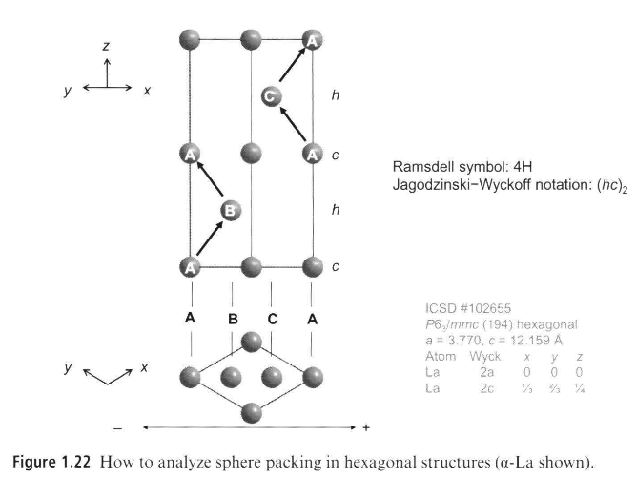
Tb
C
c
c
A
C
h
c
B
c
A
B
h
(hcc)₂
Notes:
Problem 1.18

Slide 30
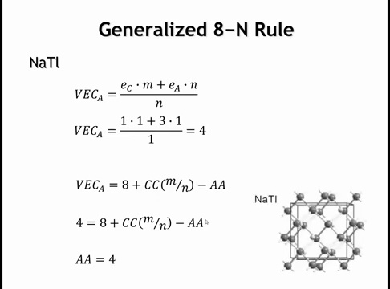
Notes:
We calculated the valence electron count (VEC) per Tl as 4. Using the generalized 8–N rule, since 8 > 4, the system must form anion–anion (AA) bonds. Cation–cation bonds or cation lone pairs don’t help here, so those terms drop out. The rule then gives 4 AA bonds per Tl.
In sodium thallide, the Tl atoms indeed bond in a diamond-like network, with Na⁺ cations filling the interstices. This is expected because once Tl gains an electron from Na, it has the same valence count as Si or C, and thus forms structures similar to diamond or silicon.

