Slide 1
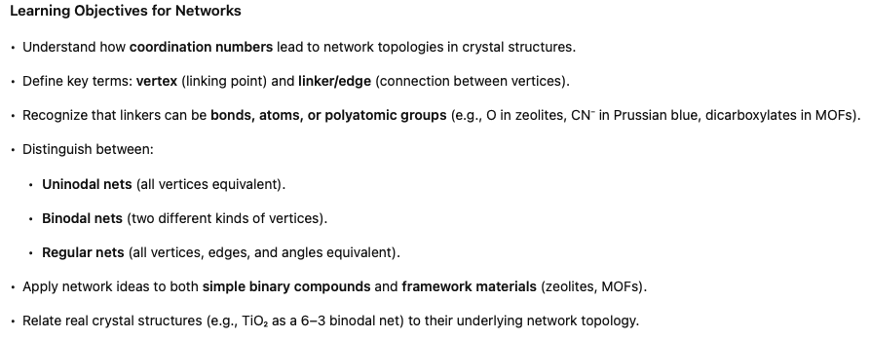
Notes:
In the last lecture, we linked empirical formulas to coordination numbers. The next step is to see how those coordination numbers define the topology of crystal structures—how atoms connect in networks. This framework is useful for simple binary compounds and especially for extended frameworks like zeolites and MOFs.

Slide 2
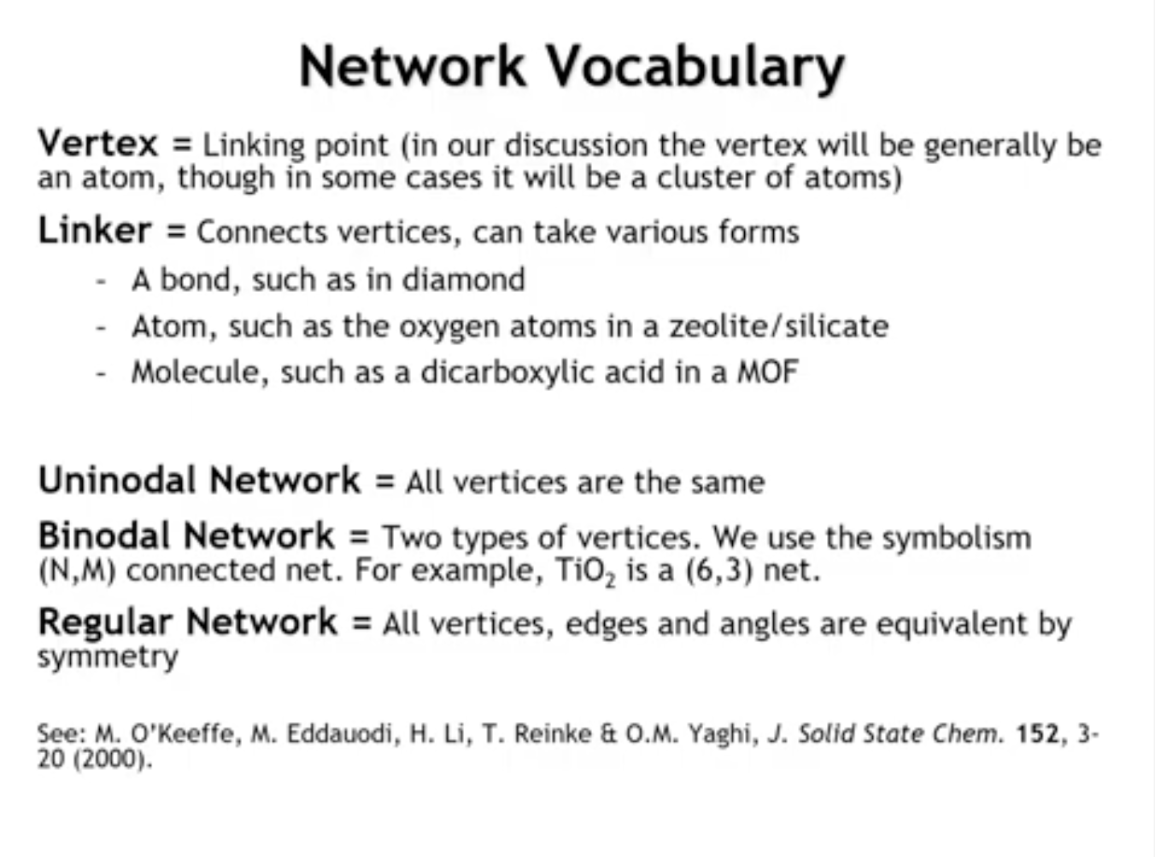
Notes:
A few key terms:
Vertex = linking point (usually an atom, but in complex structures can be a cluster).
Edge/Linker = connection between vertices. In simple compounds this is a bond, but it may also be an atom (e.g., oxygen in zeolites), a polyatomic anion (e.g., CN⁻ in Prussian blue), or a larger molecule (e.g., dicarboxylic acid in MOFs).
We describe structures as networks of vertices and linkers.
Networks with identical vertices = uninodal.
Networks with two kinds of vertices = binodal.
Example: TiO₂ has Ti (6-coordinate) and O (3-coordinate), forming a 6–3 binodal net.
Some networks are highly symmetric, with all vertices, edges, and angles equivalent. These are regular networks.
While infinitely many topologies exist, crystal chemistry relies on a finite, well-studied set. The foundational reference is by Michael O’Keeffe and Omar Yaghi (2001), with many follow-ups.
A deep understanding of this field is especially valuable for work on MOFs and zeolites, though here we focus on the basics.

Slide 3
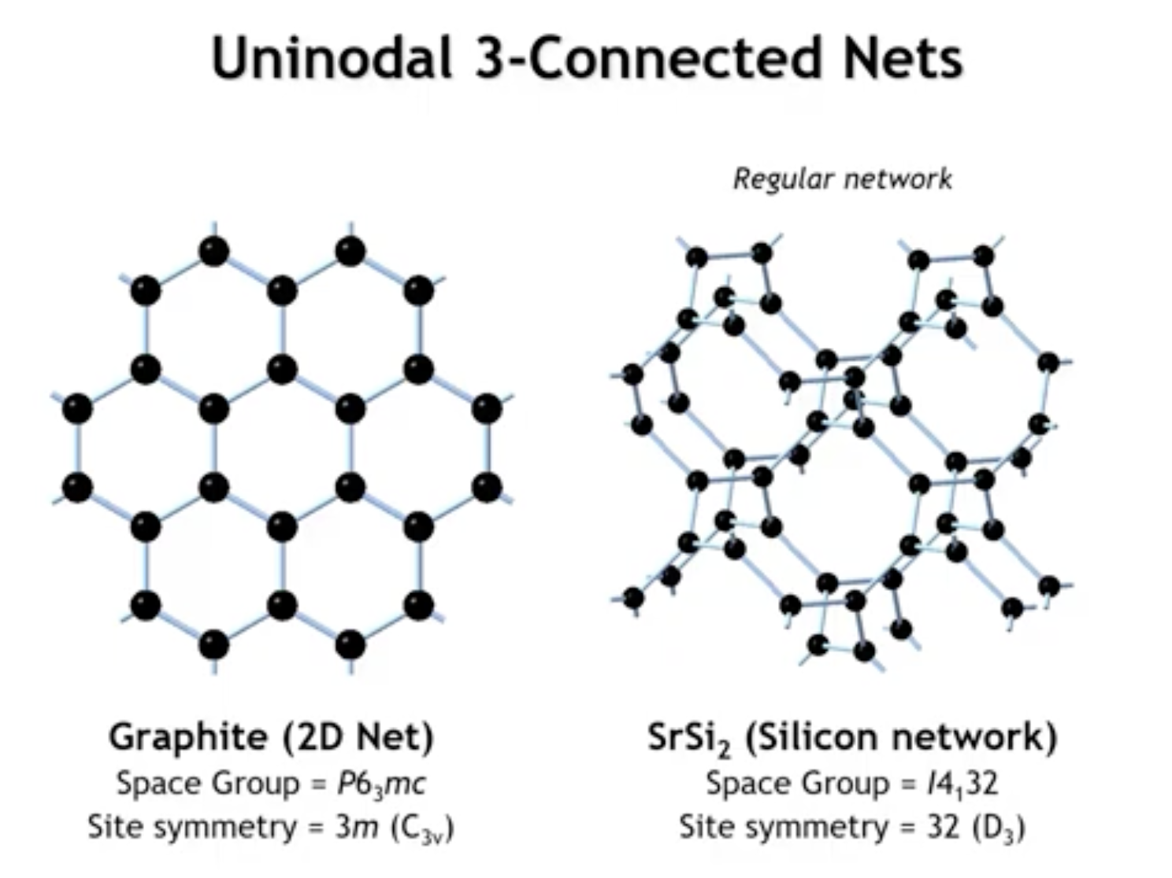
Notes:
Let’s begin with some uninodal networks, where every vertex is the same. Here are two examples of 3-connected networks, meaning each vertex links to three others.
Graphite net (left): a familiar, highly symmetric 2D three-connected network.
SrSi₂ (a Zintl phase) (right): strontium donates two electrons to the silicon network. Each silicon has 5 valence electrons, forming three Si–Si bonds plus one lone pair. This produces an idealized 3D triangular network, the most symmetric way to connect triangles in space—a regular network.

Slide 4
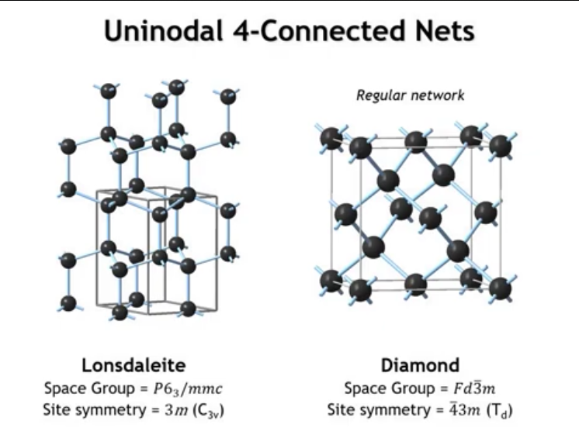
Notes:
Now let’s look at some 4-connected nets.
Diamond network: Each carbon sits in a perfect tetrahedral site symmetry; the structure is fully regular.
Lonsdaleite network: Also made of tetrahedral vertices, but with different symmetry. Its space group is P6₃/mmc (hexagonal), and each site has C3v (3m) symmetry rather than perfect tetrahedral symmetry.
Thus, Lonsdaleite is a valid 4-connected tetrahedral net, but not a regular one. The difference is in the stacking:
Diamond: tetrahedra follow an ABCABC repeating sequence.
Lonsdaleite: tetrahedra follow an ABAB sequence.
This shows that the same local geometry (tetrahedral vertices) can generate distinct networks with different overall topologies.

Slide 5
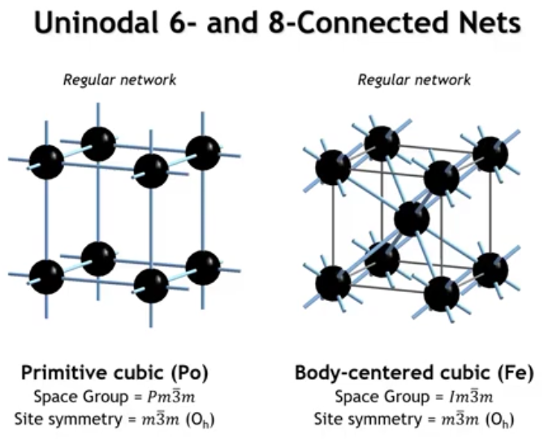
Notes:
We are going to skip over five connected nets and we will go to the six connected net. And there is one regular six connected net and that is the primitive cubic structure of Pallonium. And there is one regular body centered cubic net. And that would be the body centered cubic structure. Okay, so we could continue going on to larger nets, but really by stopping here we have covered a lot of the important nets for many common crystal structures. Of course here we are just talking about unionodal nets. So in some ways these networks are strictly speaking only valid for elements. What if we want to talk about compounds?

Slide 6
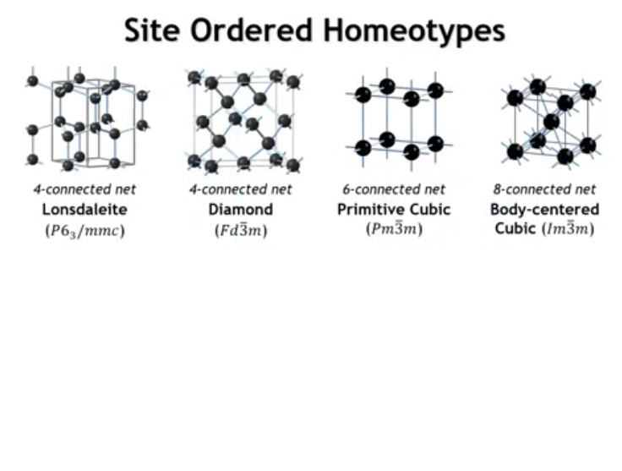
Notes:
Starting from these important unionodal nets we can develop compounds in a couple of different ways. One would be by a site ordering of the vertices. And what I mean by that let me illustrate.

Slide 7
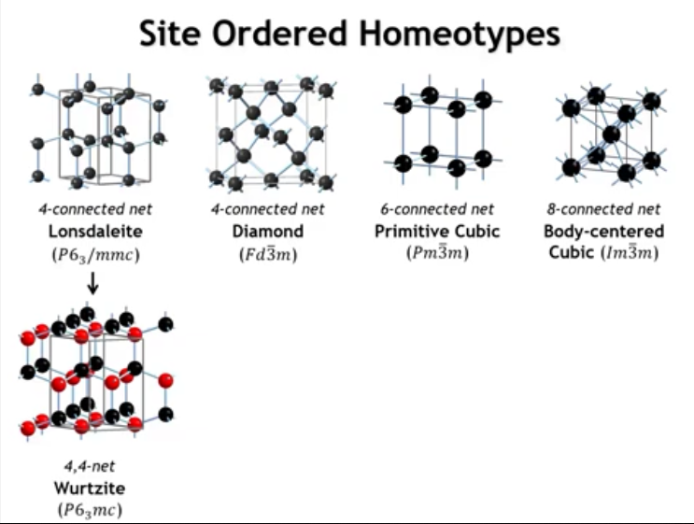
Notes:
So if we were to take the structure of Lonstelite and we were to replace all of the silicon atoms with alternating zinc and sulfur, so we would get this site ordered homeo type, that is the structure of a bird site. And so we could call this a four or four net because the two vertices now are different atoms, but they are both still tetrahedra at each vertex.

Slide 8
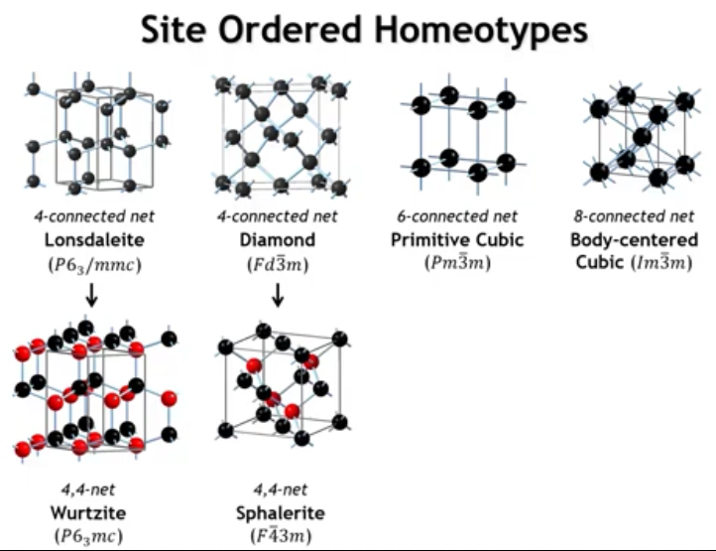
Notes:
If we were to do the same kind of site ordering to the diamond structure, we would get the structure of zinc blend or svalorite. That is another four or four net.

Slide 9
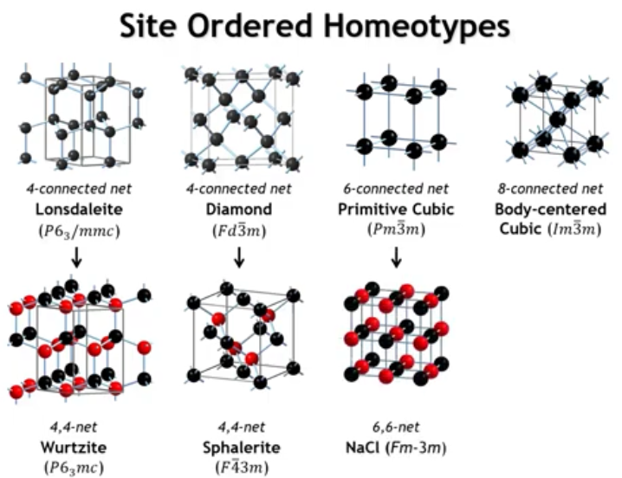
Notes:
If we were to take the primitive cubic net and do a site ordering, we could get the rock salt structure, sodium chloride structure. That is a six net.

Slide 10
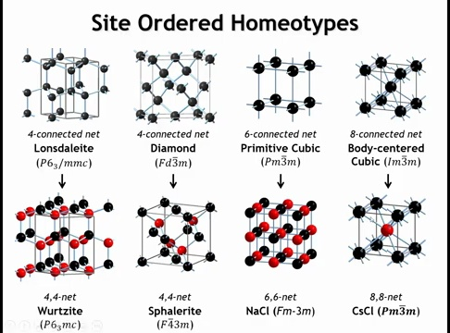
Notes:
If we take the bcc net and introduce site ordering, we obtain the CsCl structure. Similarly, many familiar compound structures—wurtzite, sphalerite, NaCl, CsCl—can be seen as ordered versions of high-symmetry uninodal nets.
Recall:
Sphalerite (ZnS) = ccp array of anions with half of the tetrahedral holes filled.
NaCl = ccp anions with all octahedral holes filled.
Thus, these compound structures can be derived either from close-packing arguments or by ordering symmetric uninodal nets.
A key point is symmetry reduction during ordering:
Diamond → Sphalerite: same cell size, but symmetry drops from m3̅m to 4̅3m.
Lonsdaleite → Wurtzite: same cell size, but symmetry drops from 6/mmm to 6mm.
This happens because in the element nets, all sites are equivalent, but ordering creates inequivalent sites and eliminates some symmetry operations.
For primitive cubic → NaCl and bcc → CsCl:
The point symmetry remains m3̅m, but translational symmetry changes.
pc → NaCl: unit cell doubles in all three directions, moving from primitive cubic to fcc Bravais lattice.
bcc → CsCl: unit cell size unchanged, but the body-centered lattice becomes primitive cubic.

Slide 11
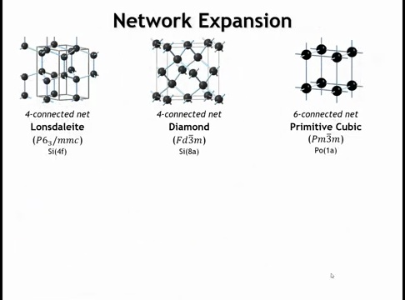
Notes:
Another way we can go from an element in a unilateral net to a compound is that we could do something called network expansion. And by that, I mean we're going to keep the same vertices but we're going to change the linker.

Slide 12
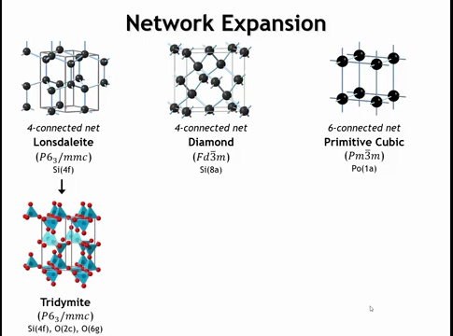
Notes:
So if we take the lawn-stallite structure and we were to put an oxygen atom as the linker between the two silicon say, then we would get one of the polymorphs of SiO2. This is called the tritomide structure and it's hexagon.

Slide 13
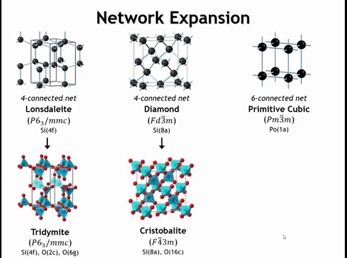
Notes:
If we take the diamond structure and put an oxygen atom between each silicon right at the midpoint of the bond, we would get what's called the idealized crystal-belite structure. And that's another polymorph of SiO2.

Slide 14
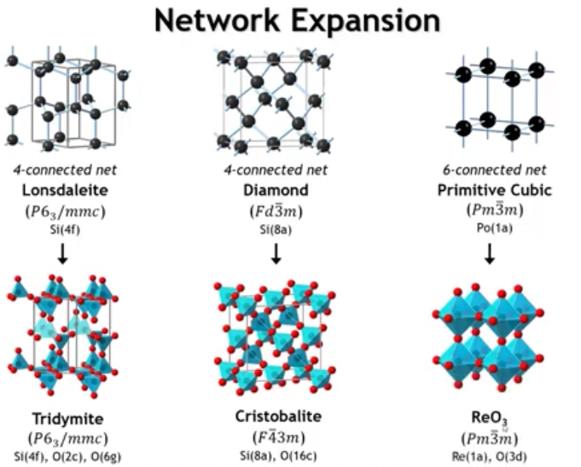
Notes:
If we take the primitive cubic net and place oxygen atoms between the vertices, we obtain the ReO₃ structure.
Adding a large cation at the cube center converts this into the perovskite structure, one of the most important ternary structure types (we’ll return to this later).
As another example, Na₃N (though unstable) was eventually synthesized and found to adopt the ReO₃-type structure, with nitrogen at cube corners, each surrounded by six sodium atoms. This highlights the 2-coordinate nature of sodium in this arrangement. Na would be the red atoms and N would be the blue. 1 atoms from all the corners, 3 atoms from all the edges.

Slide 15
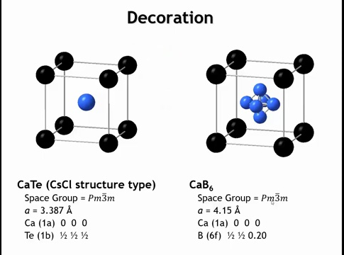
Notes:
Another modification we can make to a network is decoration—replacing some or all vertices with more complex groups of atoms.
Example:
The CsCl structure (also seen in CaTe).
If the Te²⁻ ion is replaced with a B₆ cluster, the result is CaB₆.
This transformation is an example of decorating a network by substituting simple vertices with polyatomic groups.

Slide 16
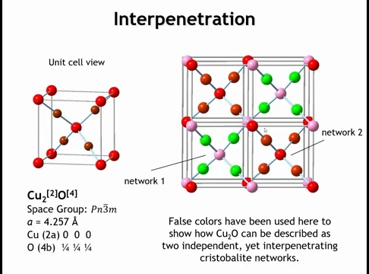
Notes:
Example: Cu₂O
Oxygen is 4-coordinate (tetrahedral).
Cu⁺ is 2-coordinate (linear).
This resembles the β-cristobalite (SiO₂) network but with cations and anions switched.
However, Cu₂O differs because its structure consists of two interpenetrating cristobalite-like nets:
One network contains the pink O and green Cu atoms.
The other contains the red O and copper-colored Cu atoms.
These two frameworks do not connect to each other.
Interpenetration is especially important in framework structures with large pores, since multiple networks can weave through the same volume, reducing available pore space.

Slide 17
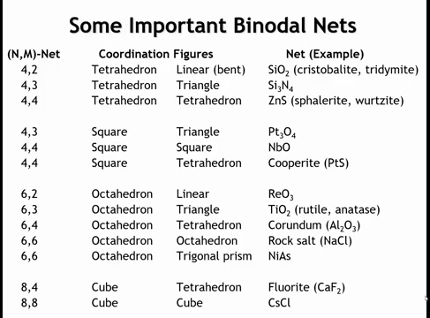
Notes:
This table shows several key binodal networks. Earlier we saw how elemental uninodal nets can be converted to compounds through site ordering or network expansion. But those same structures can also be described directly as binodal nets.
Examples:
Sphalerite and Wurtzite: derived from diamond and lonsdaleite nets, but ordered into binary compounds → 4–4 binodal nets.
SiO₂ polymorphs: connectivity balance gives Si (4-coordinate, tetrahedral) and O (2-coordinate, linear), producing cristobalite, tridymite, etc.
Si₃N₄: Si is tetrahedral (CN=4), N must be 3-coordinate, giving triangular vertices → the silicon nitride net.
Important point: coordination number does not uniquely define geometry.
CN=4 usually → tetrahedron, but sometimes square planar.
Squares + triangles → Pt₃O₄ structure.
Squares + squares → Nb₂O structure.
Squares + tetrahedra → Cu₂O or PtS.
Other examples from octahedral cations:
Octahedron + linear → ReO₃.
Octahedron + triangle → rutile/anatase (TiO₂).
Octahedron + tetrahedron → corundum.
Octahedron + octahedron → rock salt.
Octahedron + trigonal prism → NiAs.
Finally, some cations act as cubic vertices. As n and m increase (higher coordination numbers), the number of possible nets decreases.
Thus, binodal nets provide a systematic way to connect empirical formulas, coordination numbers, and real crystal structures.

Slide 18
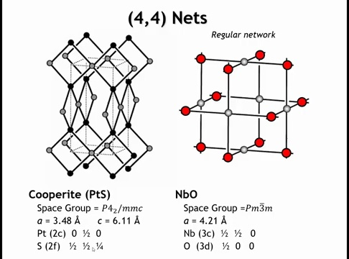
Notes:
Looking at some 4–4 nets with square-planar cations:
Cuprite (Cu₂O): square-planar Pt²⁺ (in PtS) with tetrahedral S²⁻.
Nb₂O: unusual case with both Nb and O in square-planar coordination.
If we treat all vertices as equivalent, the Nb₂O net becomes a regular network: all vertices, edges, and angles are the same. This makes it the fifth and final example of a regular 3D network.

Slide 19
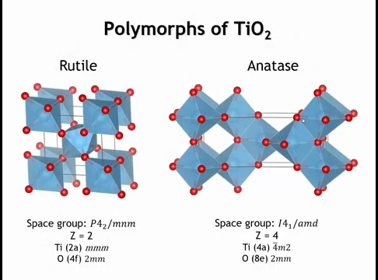
Notes:
For 6–3 nets that describe TiO₂ structures, the two most common are:
Rutile (left): Ti is octahedral; O is nearly trigonal planar but slightly distorted. Site symmetry of O is C₂v (2mm).
Anatase (right): Ti is octahedral; O is clearly 3-coordinate but geometry is closer to T-shaped than trigonal planar.
Brookite: a high-pressure TiO₂ polymorph, also based on the 6–3 net.

Slide 20
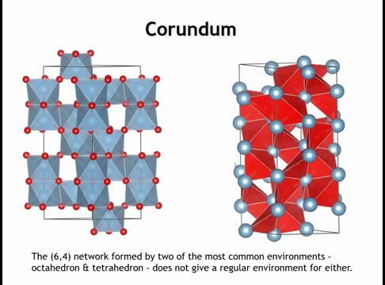
Notes:
Finally, let’s take a closer look at corundum (Al₂O₃).
Structure: hexagonal close-packed array of O²⁻ with Al³⁺ filling two-thirds of the octahedral sites. The vacancies are ordered so the Al cations shift apart from each other.
Coordination:
Al is octahedral,
O is tetrahedral.
These are among the two most common coordination environments in inorganic chemistry.
However, the network is not perfectly symmetric:
Corundum is rhombohedral, not cubic, so neither the octahedra nor tetrahedra are ideal.
Al octahedra are noticeably distorted, and the O tetrahedra are highly distorted as well.
This distortion reflects the lower symmetry of the rhombohedral space group compared to cubic structures, where perfect octahedral or tetrahedral coordination would occur.

Slide 21
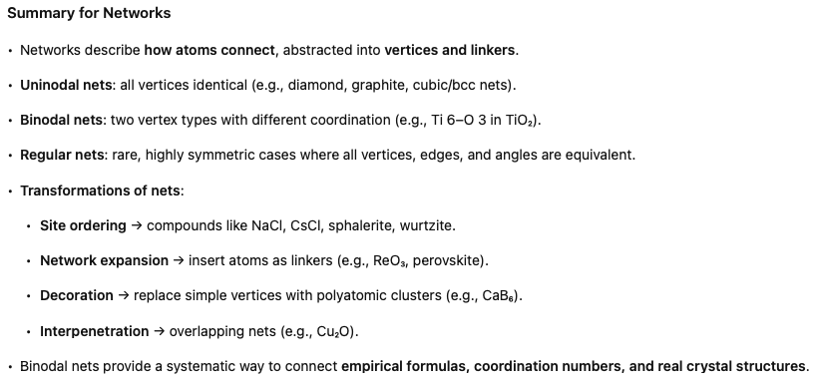

Slide 22
You try it now:

Slide 23

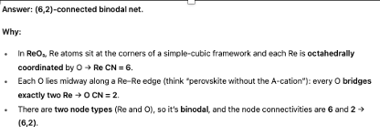

Slide 24
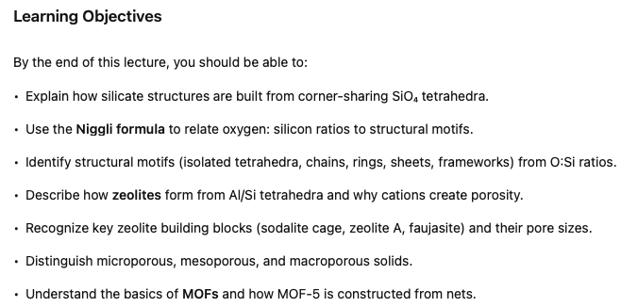
Silicates and Microporous Solids

Slide 25
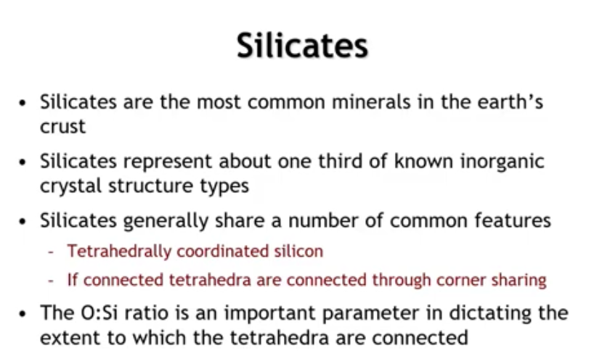
Notes:
Next, we build on networks to study silicates and microporous solids like zeolites and MOFs.
Silicates: most abundant minerals in Earth’s crust, representing a huge fraction of known inorganic structures.
about 30–35% of all known inorganic crystal structures are silicates.
Common features:
Almost all contain Si⁴⁺ tetrahedrally coordinated by O²⁻.
Tetrahedra connect only by corner-sharing (not edge- or face-sharing).
Implication: Because tetrahedra are the building blocks and corner-sharing is the rule, the O:Si ratio directly reflects how tetrahedra are connected, and becomes a useful tool for analyzing silicate formulas.

Slide 26
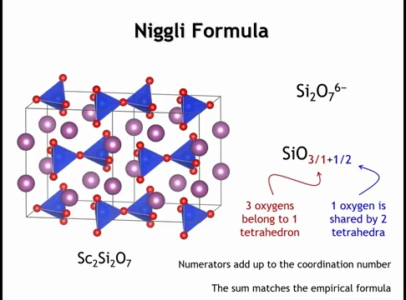
Notes:
Now let’s look at the Nikle formula using one silicate example: Sc₂Si₂O₇. We can think of this as Sc³⁺ cations and polyatomic Si₂O₇⁶⁻ anions. In the crystal, each Si₂O₇ group consists of two SiO₄ tetrahedra sharing a vertex—called a pyrosilicate ion.
The Nikle formula expresses this as
{SiO}_3/1 + O/2
Here’s what it means:
The first atom is the cation at the polyhedron center (silicon in the tetrahedron).
The fractions describe anions:
3/1 = three “terminal” oxygens bonded only to one silicon (not shared).
1/2 = one “bridging” oxygen shared between two tetrahedra.
Adding the numerators (3 + 1 = 4) gives the coordination number of Si (tetrahedral). Adding the full values (3 + ½ = 3.5) gives the effective Si:O ratio, matching the 3.5 oxygens per silicon in Sc₂Si₂O₇.

Slide 27
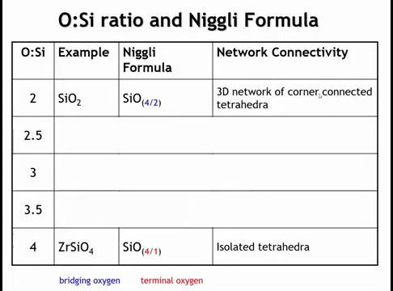
Notes:
Knowing the Nikle formula, we can examine oxygen-to-silicon ratios in silicates. When every corner of each SiO₄ tetrahedron is shared, as in SiO₂ polymorphs, the Nikle formula is SiO₄/2, giving an O:Si ratio of 2:1. This indicates a 3D network of corner-connected tetrahedra. At the other extreme, an O:Si ratio of 4:1 means no oxygens are shared, producing isolated tetrahedra, as in zircon (ZrSiO₄).

Slide 28
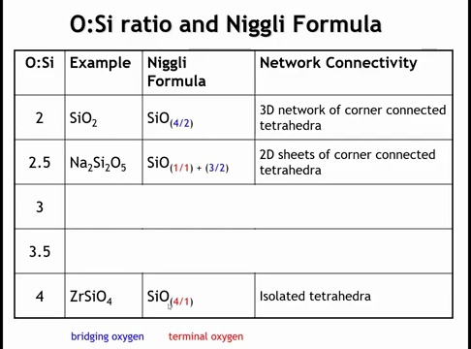
Notes:
What can we learn from intermediate oxygen to silicon ratios? Well, if it's 2.5, that would correspond to 1 terminal oxygen and 3 bridging or shared oxygens. When you have that combination, the most common structural motif is going to be a 2-dimensional sheet of corner connected tetrahedra.

Slide 29
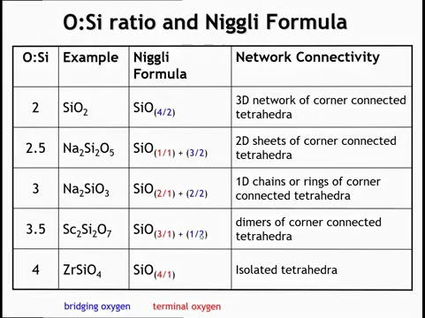
Notes:
When you have an oxygen to silicon ratio of 3, that is 2 terminal oxygens and 2 bridging oxygens, there's a variety of structural motifs that can give you that, most notably an infinite one-d chain. And when you have 3.5 oxygens for every silicon, that would be 3 terminal oxygens and 1 bridging oxygen. You have this dimers of corner connected tetrahedra that we saw on the last slide.

Slide 30
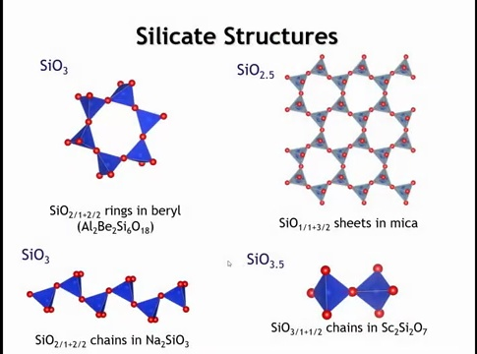
Notes:
Visually, the O:Si ratio of 1:3 does not uniquely define the structure. On the left, we see a six-membered ring of tetrahedra in beryl; with Cr doping, this becomes emerald. Below, sodium silicate shows the same ratio but forms an infinite 1D chain of corner-connected tetrahedra. In the upper right, mica illustrates an infinite 2D sheet of tetrahedra. In the lower right, scandium silicate shows a pyrosilicate group—a dimer of corner-connected tetrahedra.

Slide 31
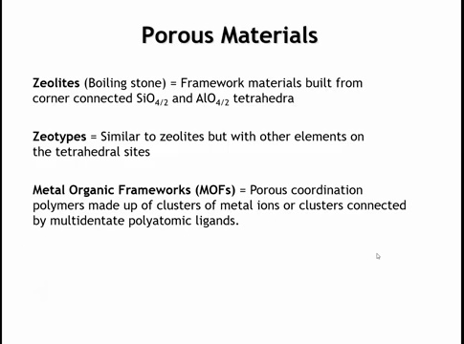
Notes:
Focusing on 3D networks of corner-connected tetrahedra, a key class is zeolites. These frameworks consist of Si and Al tetrahedra. The name “zeolite” (“boiling stone”) comes from their early discovery, when heating released trapped solvents like water, causing them to fizz. The term zeolite was coined in 1756 by Swedish mineralogist Axel Fredrik Cronstedt, when he heated stilbite and observed it “boiling” due to release of water.
Synthetic zeolites started being produced in the mid-20th century (e.g. Barrer’s work in the 1940s) for industrial uses.
Zeolites are crucial in many applications: ion exchange, catalysis (e.g., petroleum cracking to gasoline), detergents, molecular sieves, and gas separation.
A related class, zeotypes, share the same framework structures but substitute other elements for Si and Al. Finally, metal–organic frameworks (MOFs) are coordination polymers with open pores, built from metal ions or clusters linked by multidentate organic ligands.

Slide 32
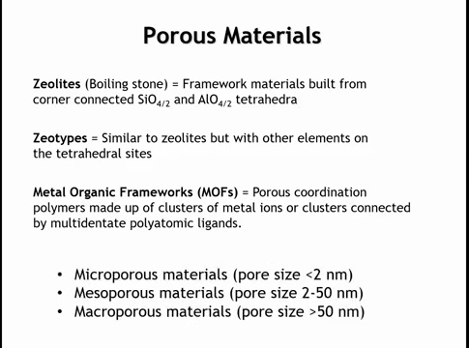
Notes:
Now, we can classify porous materials as microporous, mesoporous, or macroporous depending on the size of the pores by which molecules can come in or out of the material. By and large, when we talk about zeolites and metal organic frameworks, we're talking about microporous materials.

Slide 33
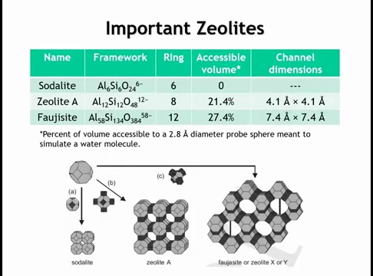
Notes:
A few important zeolites illustrate the key concepts. Sodalite, zeolite A, and faujasite all share the same basic building block—the sodalite cage. Though sodalite itself is not porous, the others are. In sodalite and zeolite A, the Si:Al ratio is 1:1, with alternating Si and Al tetrahedra. Replacing Si⁴⁺ with Al³⁺ introduces negative charges in the framework, which are balanced by cations (often Na⁺) and their waters of solvation inside the pores. These counterbalancing ions are crucial—without them, the framework would likely collapse into a dense silicate rather than a porous one.
Key structural features include the ring sizes, the fraction of accessible pore volume (about 25% in zeolite A and faujasite for a 2.8 Å probe sphere), and the dimensions of pore openings that control molecular access. Next, we focus more closely on the sodalite cage as the fundamental building block of these frameworks.

Slide 34
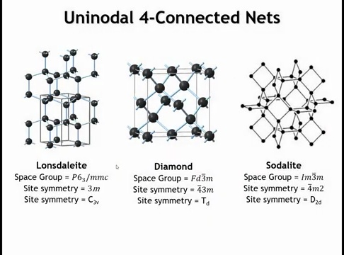
Notes:
To connect with our lecture on nets: recall uninodal four-connected nets. The most symmetric is the diamond net, where every vertex has perfect tetrahedral symmetry. Another is lonsdaleite, also four-connected but with hexagonal rather than cubic symmetry. Other important four-connected nets include quartz, and in the context of zeolites, the highly symmetric sodalite net.
In the sodalite net, each vertex is four-connected in a geometry close to a tetrahedron. The exact site symmetry is \bar{4}m2 (D₂d)—not perfectly tetrahedral, but still high, and higher than lonsdaleite. This network underlies the sodalite cage found in zeolites.

Slide 35
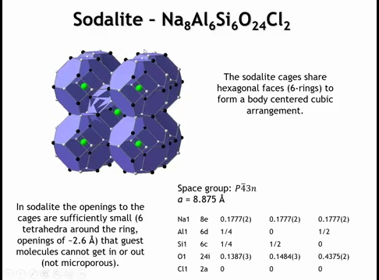
Notes:
The sodalite network takes its name from the mineral sodalite (Na–Al–Si–O–Cl). Its framework contains cages shaped like truncated octahedra, resembling blue soccer balls. These cages have hexagonal faces (six-rings) and square/diamond faces (four-rings). This geometry matches the sodalite net topology discussed earlier. In sodalite itself, Cl⁻ ions occupy the cage centers; Na and O are not shown here. While this cage is the fundamental building unit of many zeolites, in sodalite the cages are fused in a way that makes the structure non-porous, preventing molecular access.

Slide 36
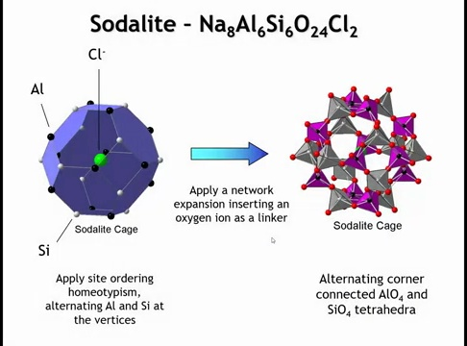
Notes:
Looking at a single sodalite cage, we can apply site ordering to form a homeotype: alternating Al–Si–Al–Si around the vertices. Next, the framework incorporates oxygen bridges—Al and Si do not bond directly but connect through O atoms at the tetrahedral vertices. Importantly, the O does not sit on the edge midpoint (which would give a linear 180° Al–O–Si bond). Instead, the bond angle is ~145°, maintaining a continuous tetrahedral network of Al and Si atoms.

Slide 37
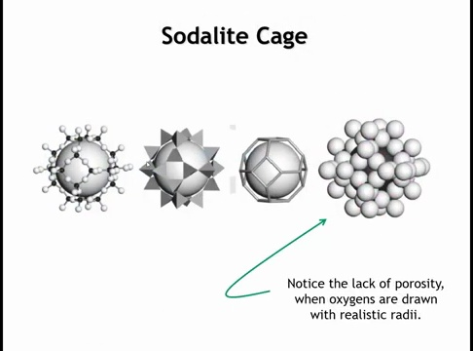
Notes:
We could look at the soda light cage in a variety of ways. Here is another view from chapter 14 of the textbook. And in this image, we're not distinguishing between aluminum and silicon, but you can see the corner connected tetrahedron. You can see that there is open space within that cage. Here's a polyhedrial view. Here's another view where we just connect the vertices by a line. That's kind of like the network view. And then the view on the far right is where we are drawing the oxygens at their proper radius. And when you look at it that way, you can see that in fact, this is not really porous. There's no real space big enough for molecules to get in and out. I think this space right here is about two and a half angstroms by maybe one and a half angstroms. And that's just not big enough for any molecules to go in and out.

Slide 38
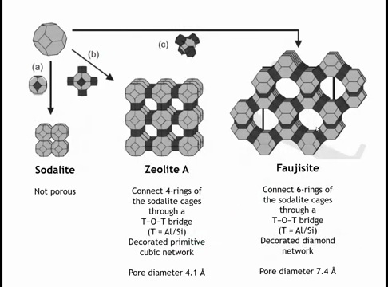
Notes:
To make the sodalite cage porous, we avoid fusing cages directly and instead link them through oxygen bridges (Si–O–Si). When cages connect via the square four-rings, the result is zeolite A, a primitive cubic network of sodalite cages with ~4 Å pores—large enough for small molecules, ions, and solvents to pass.
If the cages link through the hexagonal faces, the structure is faujasite, which has larger ~7.4 Å pores that can admit moderately large molecules. Structurally, this can be viewed as a diamond-type network, where each vertex is a sodalite cage linked by oxygen atoms—essentially a supramolecular diamond lattice.

Slide 39
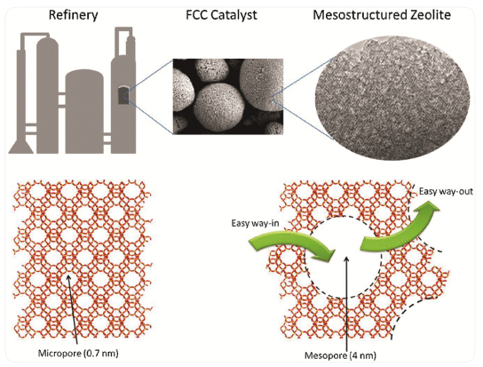
Hierarchical faujasite (zeolite Y) catalyst used in petroleum cracking. Micropores in the zeolite framework (~0.7 nm) provide the active catalytic sites, while additional mesopores (~4 nm), introduced by dealumination and leaching during catalyst preparation, act as diffusion channels. These mesopores allow larger hydrocarbon molecules to enter and exit, improving efficiency of the cracking process.
fluid catalytic cracking (FCC) in petroleum
Notes:
Fluid catalytic cracking (FCC) started in the 1940s with simple silica–alumina catalysts, but their activity was limited. In 1962, Union Carbide introduced Zeolite Y, a synthetic aluminosilicate with strong acid sites and large pores that allowed bulky oil molecules to enter and react. This doubled gasoline yields, boosted octane numbers, and gave longer catalyst life. Later improvements, like ultrastable Y (USY), rare-earth exchange, and ZSM-5 additives, made FCC the backbone of refining.
Zeolite Y has a crystalline framework (faujasite) built from AlO₄ and SiO₄ tetrahedra that form spacious cages (~12 Å) connected by 12-membered oxygen rings. Negative charges from Al atoms are balanced by cations (like Na⁺), which can be exchanged for protons (H⁺) to create Brønsted acid sites. These sites drive hydrocarbon cracking by protonating molecules to form carbocations. At ~500 °C in the FCC riser, these carbocations undergo bond scission (β-scission), isomerization, hydride transfer, and aromatization, producing gasoline-range alkanes and alkenes along with lighter gases. Coke also forms on the catalyst, blocking sites, but is burned off in the regenerator so the catalyst can be reused.
Zeolite Y is especially effective because its pores are just wide enough (~7.4 Å) for heavy hydrocarbons, it offers an enormous surface area (~900 m²/g), and its shape selectivity limits over-cracking while steering reactions toward high-octane products. The result was a jump in gasoline yield from ~45% to ~70%, higher octane from more branched alkanes and olefins, and tunable outputs of gasoline, propylene, or diesel. Today, FCC with zeolite Y processes about 40% of global crude oil.

Slide 40
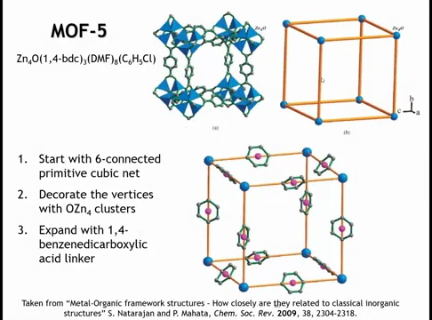
Notes:
MOFs (metal–organic frameworks) are a whole field, alongside COFs (covalent organic frameworks). To illustrate, consider MOF-5, one of the most important examples. Omar yagi introduced this structure in a Nature paper in 1999. it demonstrated exceptionally high permanent porosity (free volume, very large internal cavity), very high surface area, and established many of the design principles for what later became the large field of MOFs. It helped move the field from proof of concept to practical relevance (especially for gas storage).
Its structure can be built from a simple cubic net. At each vertex sits an OZn₄ cluster: an oxygen atom surrounded by four Zn²⁺ cations. These clusters are then connected by benzene dicarboxylate linkers—benzene rings with deprotonated carboxylate groups at both ends, which coordinate to Zn. The Zn atoms end up tetrahedrally coordinated.
Decorating the cubic vertices this way and linking them with extended organic ligands yields MOF-5. A whole series of MOFs can be made by enlarging the linker, which increases pore size. However, when the void space grows too large, interpenetration can occur—multiple frameworks weaving through each other. Avoiding this is a central design challenge in MOF chemistry. A reference at the bottom of the slide discusses the relationships between MOF frameworks and inorganic crystal structures.

Slide 41
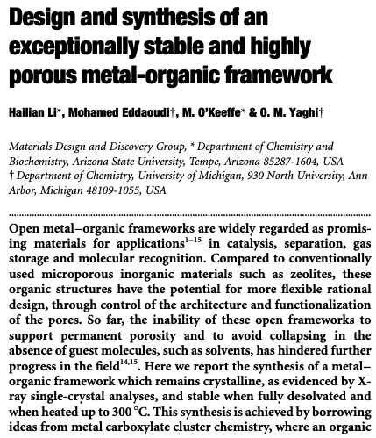
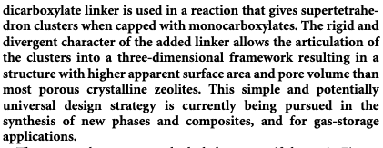
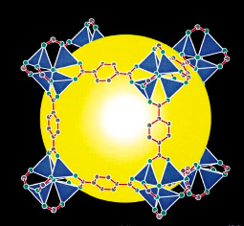
Notes:
The Mof field really go going when Omar Yagi published this paper in 1999. The 1999 Nature paper on MOF-5 was pivotal because it showed, for the first time, that you could deliberately build a crystalline solid with permanent porosity, very high surface area (~2900 m²/g), and modular designability. Unlike earlier coordination polymers that collapsed on solvent removal, MOF-5 remained stable, proving that metal clusters and organic linkers could be stitched into robust, tunable frameworks. This launched the concept of reticular chemistry—designing solids from molecular building blocks—and made clear that MOFs could rival zeolites and carbons but with vastly greater flexibility. That single result transformed MOFs from a curiosity into a general design platform for gas storage, separations, and catalysis, igniting the field that’s now central to porous materials research.

Slide 42

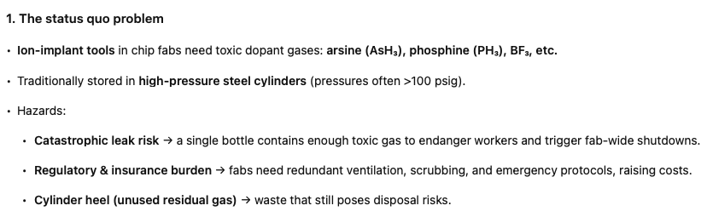
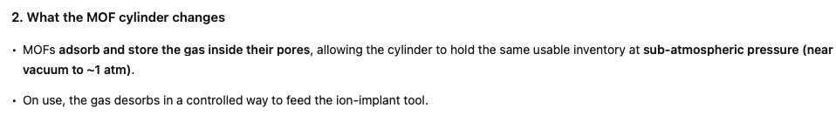
Notes:
Is there any application? Currently there is one
Sub-atmospheric dopant-gas delivery (semiconductor ion-implant).
NuMat’s ION-X® cylinders use MOFs to adsorb arsine, phosphine, BF₃, etc., enabling sub-atmospheric storage and delivery that replaces high-pressure bottles in fabs. This product is sold into mainstream ion-implant tools and has been evaluated against incumbents at Axcelis; NuMat positions ION-X as the first commercial MOF product in semiconductors.

Slide 43
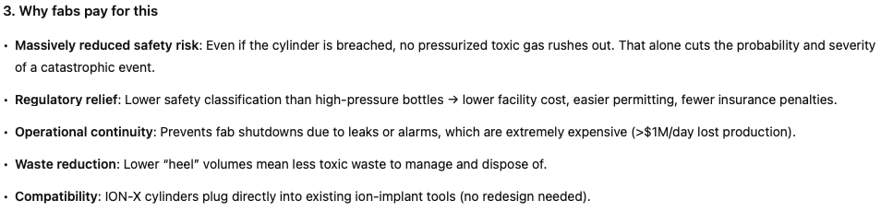


Slide 44
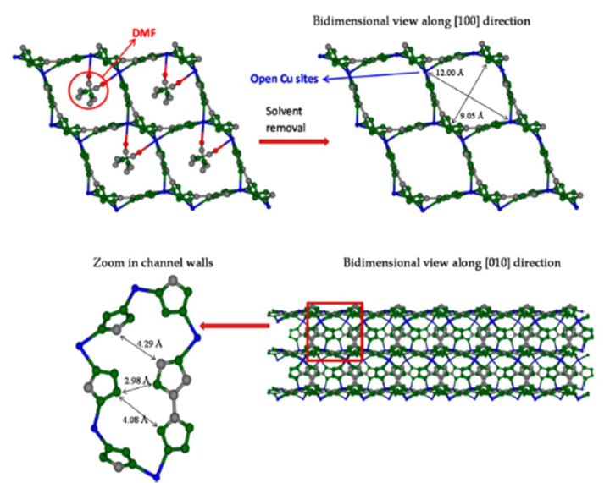

Slide 45
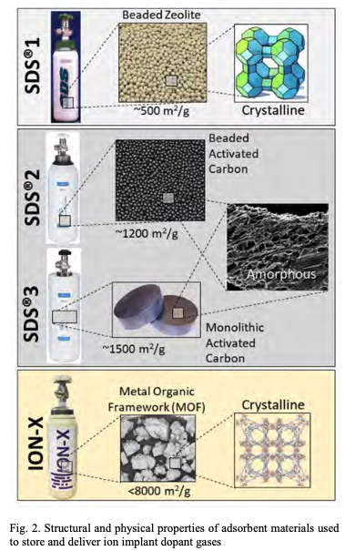
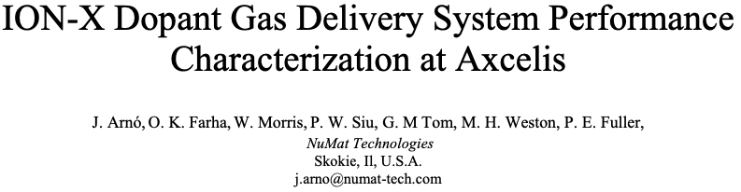
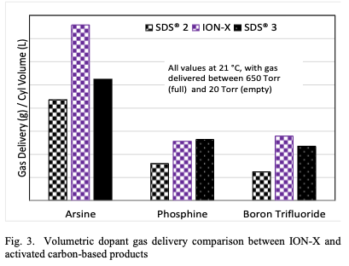
Notes:
Actuallyt the result is not that great, so the greater value is in purification of the gas.

Slide 46
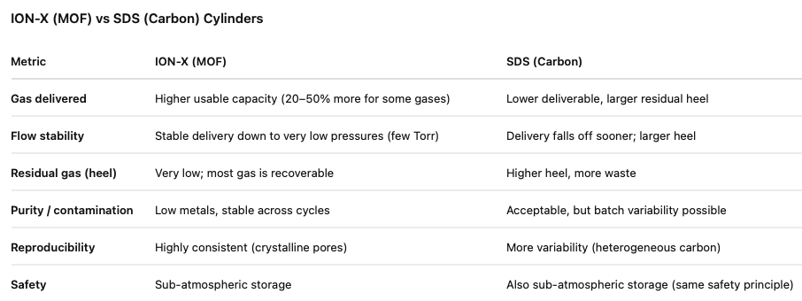

Slide 47


Slide 48

Homework
Notes:
Try problem 1.22.

Slide 49



1.22
Corner sharing tetrahedra in 1-D chains -> CrO₄ tetrahedra
What the Niggli formula describes
It’s a connectivity-based formula for one polyhedron (e.g., a tetrahedron or octahedron around a cation).
It tells you how many anion vertices there are, and how many other polyhedra each vertex connects to.
You always write it per one cation-centered polyhedron.
C A(numerator/denominator + numerator/denominator …)
Notes:
Note that 2/2 is 1 and 2/1 is 2, so we recover CrO3

Slide 50


Slide 51


