Slide 1
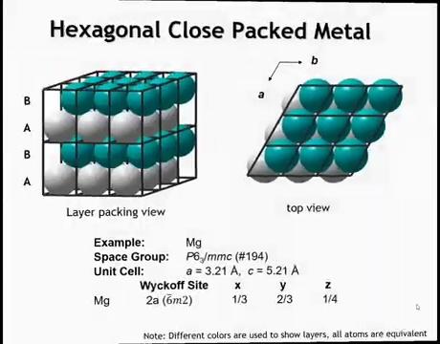
Notes:
This is the structure of a hexagonal close-packed (HCP) metal. The unit cell contains two atoms—one in layer A and one in layer B. A six-three screw axis is evident: rotating the gray layer by 60° and translating upward by half the unit cell transforms it into the green layer. All atoms are crystallographically equivalent, occupying a single Wyckoff site.

Slide 2
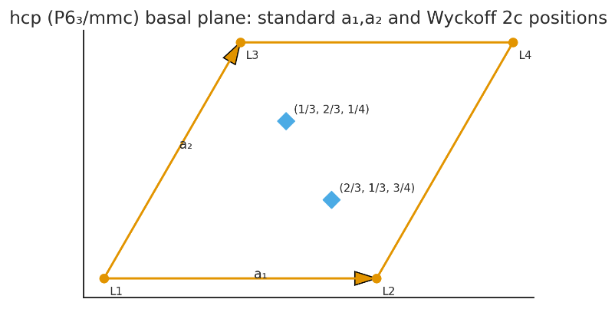
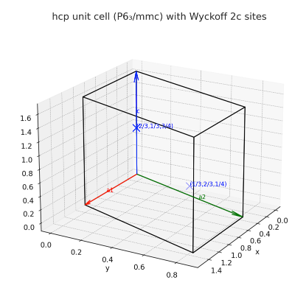

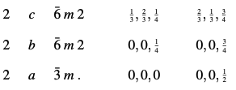
Notes:
Previous slide is not drawn correctly, the correct wycof site for Mg is site 2c, and this slide depicts the correct lattic positions. The 6/3 screw means a 60 rotation and a c/2 translation (since 3/6 = ½)

Slide 3
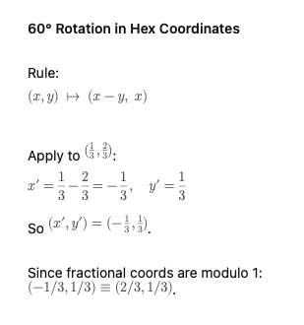
How does the screw move point
To point:
And ½ translation along c

Slide 4
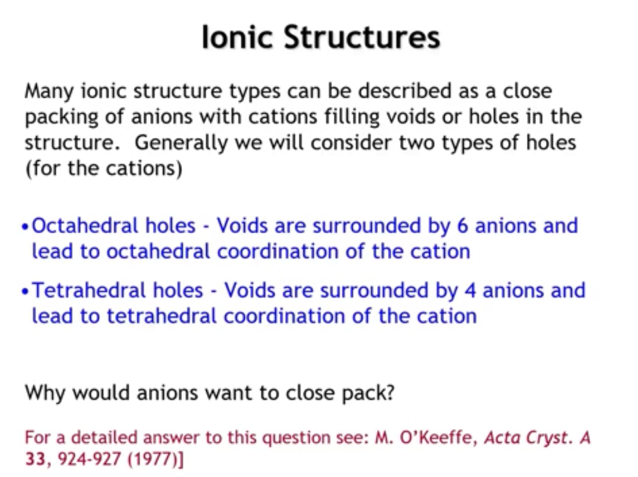
Notes:
Next, let’s look at ionic solid structures, which share surprising similarities with metallic solids from a symmetry standpoint. A useful way to describe them is to treat the anions as forming a close-packed lattice—either cubic close-packed (FCC) or hexagonal close-packed (HCP). In such lattices, ~26% of the space is voids, which cations occupy. These voids come in two types: octahedral holes (six anion neighbors, octahedral coordination) and tetrahedral holes (four anion neighbors, tetrahedral coordination).
At first, it may seem odd that anions would close-pack, since like charges should repel. The resolution lies in symmetry: arranging spheres as close together as possible produces the same geometric pattern as arranging them as far apart as possible, provided the box volume is fixed. The result is a uniform, symmetric distribution that is equivalent to close packing. Importantly, in real ionic solids, anions do not touch; instead, they remain well-separated while leaving symmetric voids for cations. The cations and anions, however, generally do touch.

Slide 5
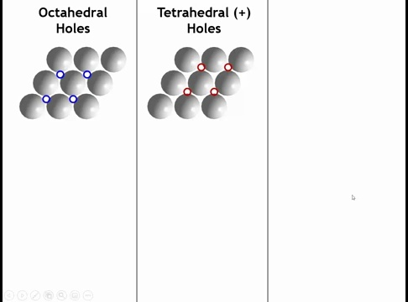
Notes:
All right, let's take a closer look at what I mean by these holes. So here I've got a very small snippet of a close-packed layer. Let's say it's anions. In many ways, we could describe these structures as a close-packed array of cations with anions in the holes. But conventionally, that's not what we do. So we've got this anion close-packed layer. And now let's put some cations on top of the layer. So we can put the cations in a couple of places. The blue circles over here on the left represent one set of voids where we could put a cation. The red circles over here are a different set of voids. Let's look at the blue voids first.

Slide 6
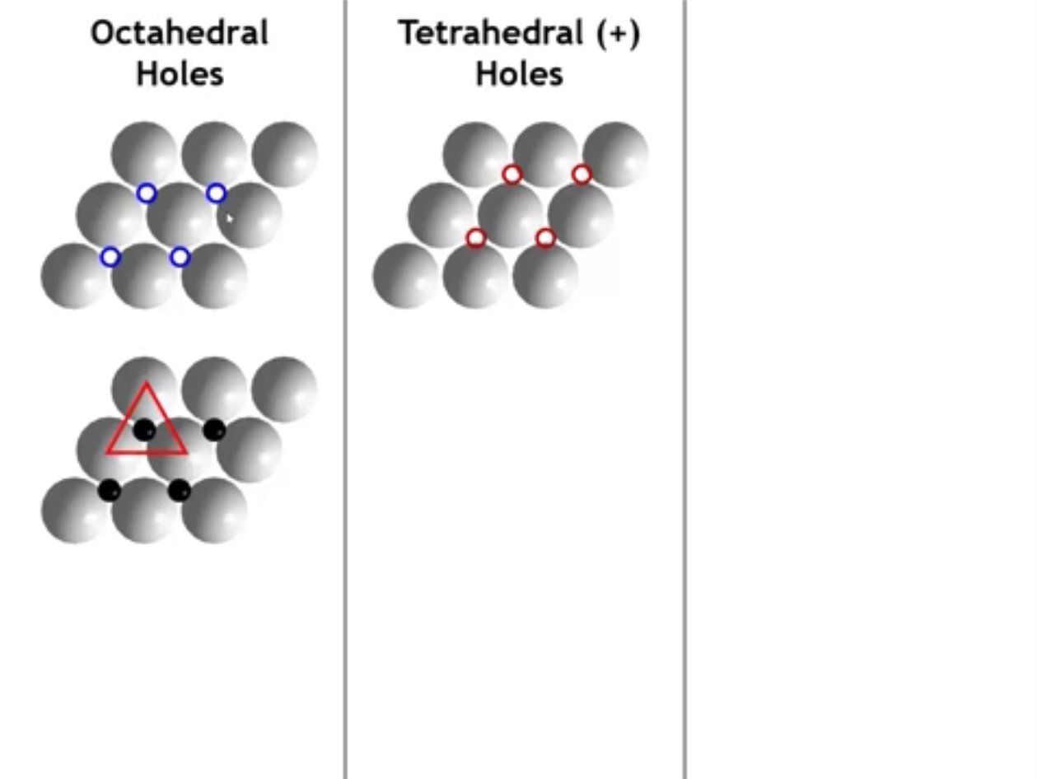
Notes:
So if we put a cation everywhere, there's a blue circle. Okay. Notice that now it's nestled up against three anions, which are on the layer below it. And they make a triangle.

Slide 7
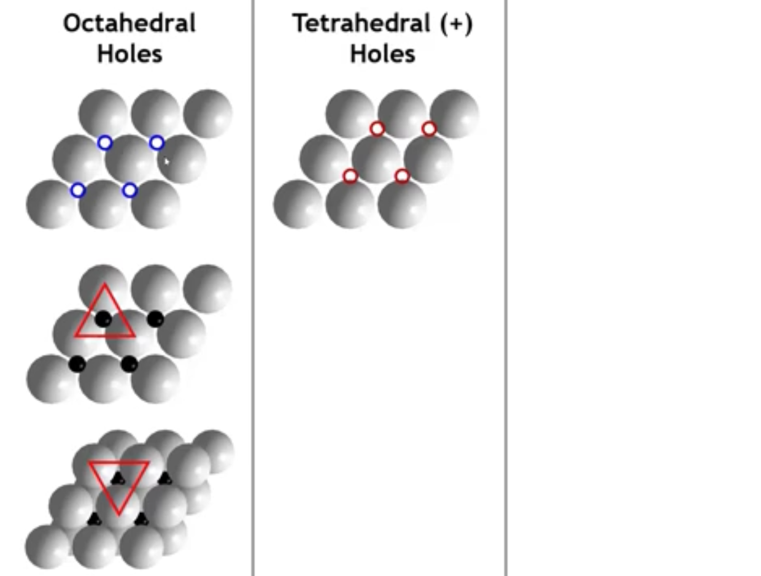
Notes:
When the next layer is added, three more anions surround the cation in the opposite orientation, forming a trigonal antiprism, which in this case is an octahedron. These are the octahedral holes. In a close-packed array of anions, the number of octahedral holes is equal to the number of anions.

Slide 8
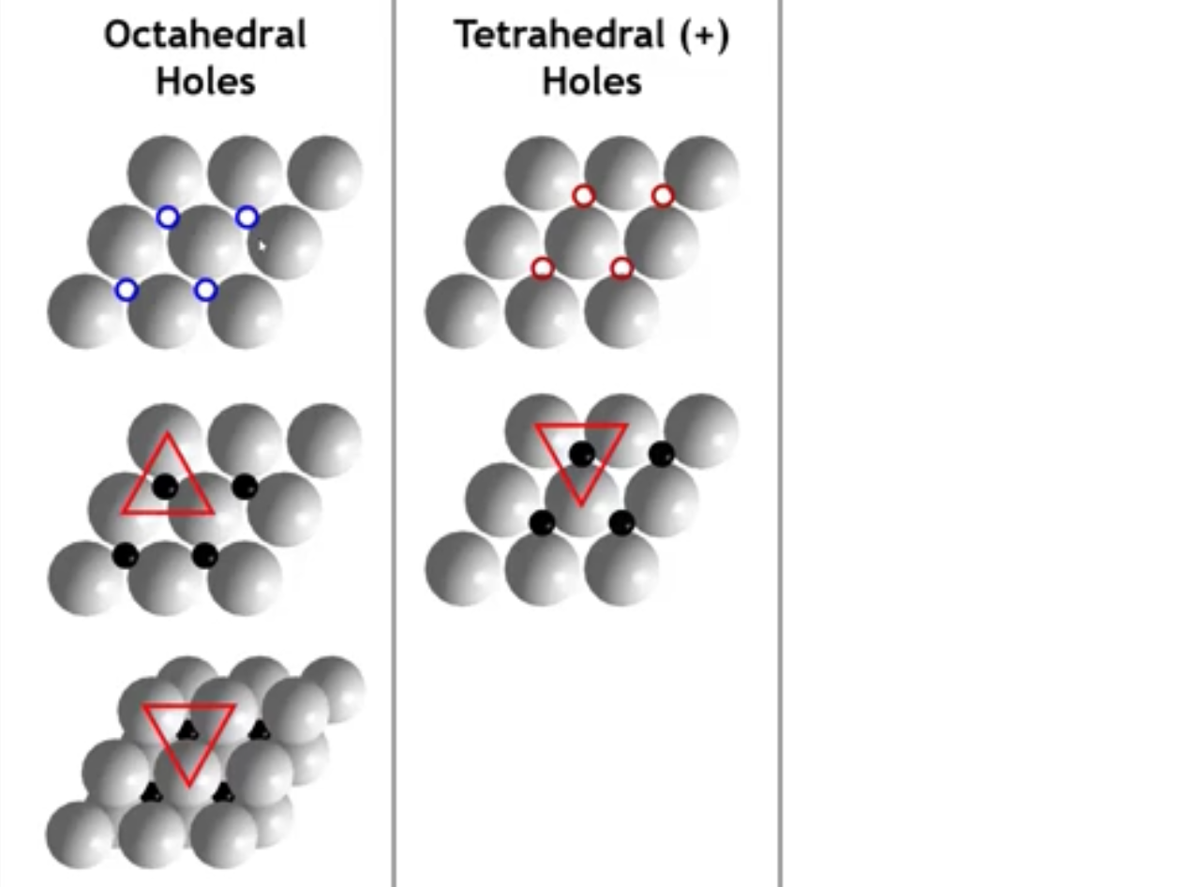
Notes:
Okay. Now let's look at the tetrahedral holes. So we've put the cations now into a different set of depressions on that close-packed layer. We still have three neighbors below, a triangle of anions that are nestled up against that cation.

Slide 9
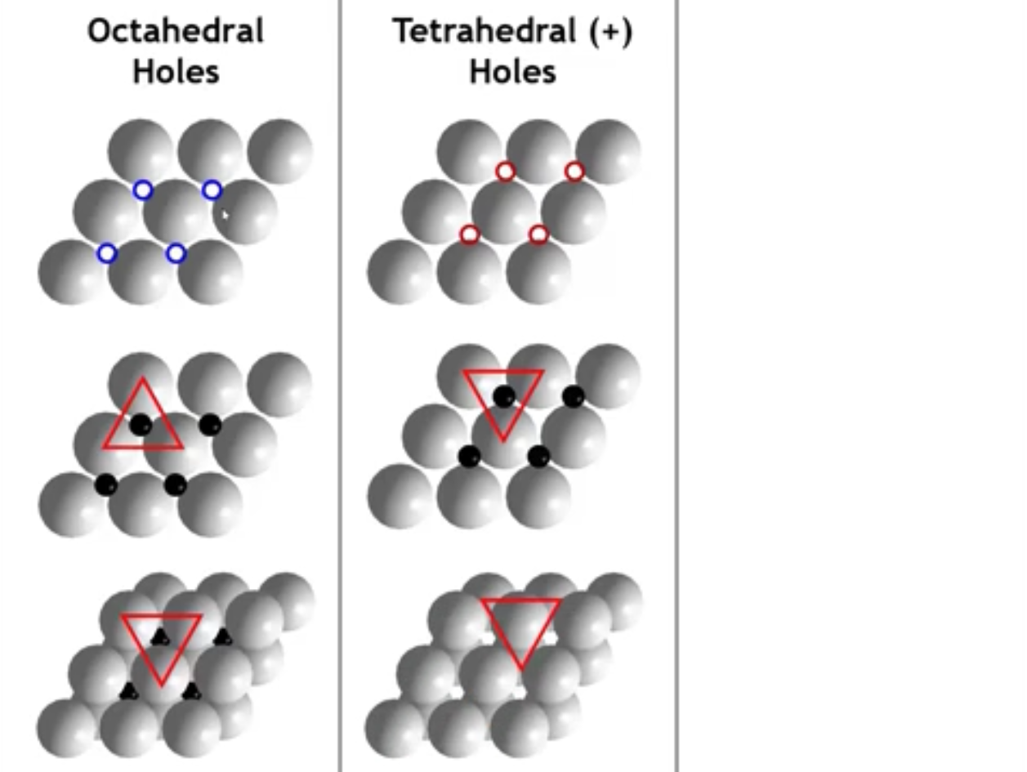
Notes:
But the difference is now when we put the layer on top, it's going to go directly over the cation. So we have a triangular base, and then we have one neighbor on the layer above. That is a triangular-based pyramid, which is basically a tetrahedron. Now the cation, in this case, is going to be sitting closer to the bottom layer than it is to the top layer so that we can make all four distances equal.

Slide 10
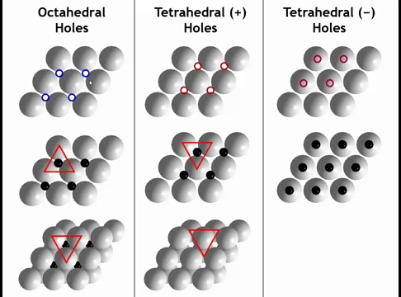
Notes:
We could also start with that same bottom layer of anions. Put cations right on top of the anions, which at first might seem counterintuitive. Why would you want to put them on top? But you could. And then when we put the next layer of anions above it, a triangle would be on top of it.

Slide 11
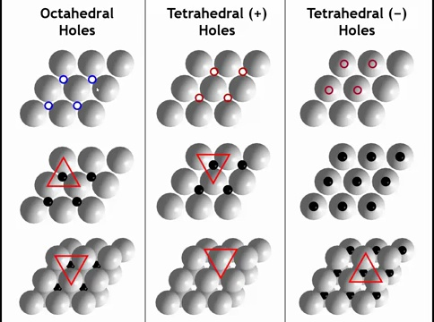
Notes:
So now we have a triangular base of neighbors above it, and one neighbor below it. Well, that's just a tetrahedron, too, but the tetrahedron is now pointing down. So we call these the tetrahedral plus holes and the tetrahedral minus holes. And the most important thing to get from this is that there are twice as many tetrahedral holes in one of these structures as there are octahedral holes.

Slide 12
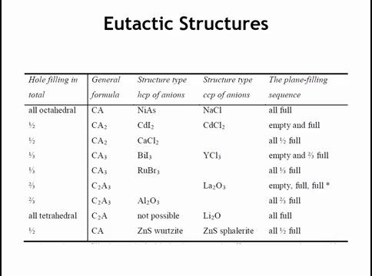
Notes:
We can describe many ionic structures by asking: do the cations fill octahedral holes or tetrahedral holes, and is the anion lattice HCP or CCP (FCC)?
Fill all octahedral holes
HCP anions → nickel arsenide structure
CCP anions → sodium chloride (NaCl) structure
In both, stoichiometry = 1:1, since the number of octahedral holes equals the number of anions.
Fill all tetrahedral holes
CCP anions → lithium oxide (Li₂O), “anti-fluorite”
Called anti-fluorite because swapping anions/cations gives fluorite (CaF₂).
HCP anions → no known stable structure.
And to see why next slide:

Slide 13
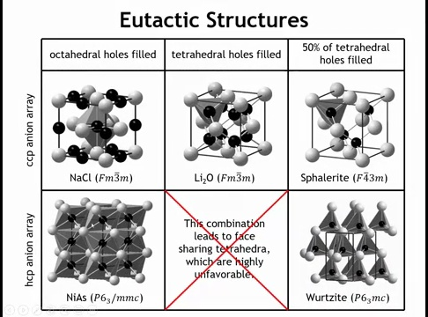
Notes:
cubic close-packed (CCP) array of anions corresponds to the FCC unit cell, with anions on the corners and faces. Filling all octahedral holes gives the NaCl structure, where octahedra share only edges. This structure is common for both highly ionic salts (NaCl, NaF) and less ionic compounds.
If instead we fill the octahedral holes in an HCP array, we obtain the NiAs structure. Here, octahedra share edges in-plane and faces between layers. Face-sharing brings cations very close together, which is unfavorable for highly ionic compounds, so NiAs is observed mainly in systems with significant covalency.
Filling all tetrahedral holes in a CCP array yields Li₂O (anti-fluorite), with oxide ions at FCC sites and lithium ions in tetrahedral sites. The related fluorite (CaF₂) structure is obtained by swapping cations and anions. In contrast, filling all tetrahedral holes in an HCP array would produce face-sharing tetrahedra, leading to cation–cation distances shorter than cation–anion distances, which is unstable; no such structure exists.
When only half the tetrahedral holes are filled, two important structures arise:
CCP anions → sphalerite (zinc blende), key for many semiconductors.
HCP anions → wurtzite, another major semiconductor structure.

Slide 14
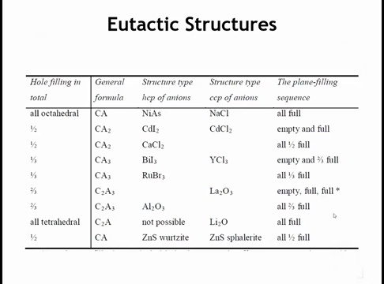
Notes:
ow let’s consider structures formed by partially filling octahedral holes.
Half-filled, symmetric arrangement → CaCl₂ structure
Filling half the octahedral sites in an ordered, uniform way produces the calcium chloride structure.
Layered, asymmetric filling → CdI₂ / CdCl₂ structures
Alternatively, filling all octahedral sites in some layers and leaving others empty creates layered structures such as cadmium iodide and cadmium chloride.

Slide 15
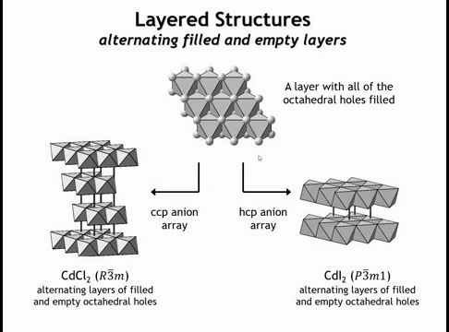
Notes:
In these structures, the filled layers consist of infinite sheets of edge-sharing octahedra, separated by empty layers of voids. This leads to compounds such as CdCl₂ (CCP anions) and CdI₂ (HCP anions), both of which are inherently layered structures.
Because of their layering, they exhibit two-dimensional electronic properties, making them relevant to modern 2D materials research. But why do cations concentrate in some layers and leave others empty, rather than maximizing separation? The answer is that these are not purely ionic structures.
They typically involve large, polarizable anions (I⁻, Br⁻, Cl⁻, Se²⁻) and cations that form partly covalent bonds. The layers themselves are held together mainly by dispersion forces, reflecting reduced ionic character.

Slide 16
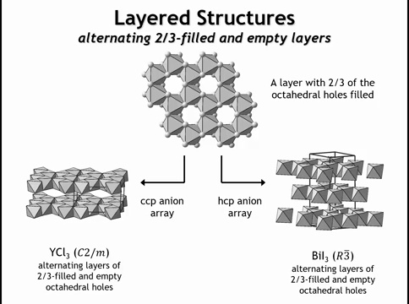
Notes:
If we fill only two-thirds of the octahedral holes in a close-packed layer, the result is a honeycomb-like pattern. Viewed as polyhedra, the octahedra form the same arrangement as atoms in graphene.
If the next layer above is left empty, the stacking alternates two-thirds filled / empty, which averages to one-third of the octahedral holes filled overall. This gives structures with 1:3 stoichiometry (cation:anion).
HCP anions → BiI₃ structure
CCP anions → YCl₃ structure

Slide 17
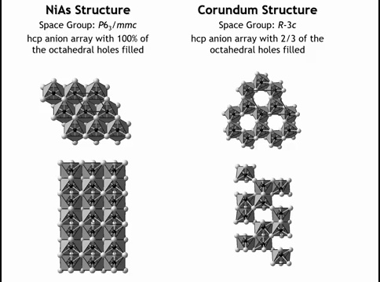
Notes:
The NiAs structure (all octahedral holes filled in an HCP array of anions) is not favored when bonding is highly ionic, because it creates infinite chains of face-sharing octahedra, bringing cations too close together.
If instead one-third of the octahedral holes are left vacant, the result is a layered, graphene-like arrangement with filled–filled–empty sequences. Stacking these with HCP anions gives the corundum structure (Al₂O₃, hematite Fe₂O₃).
This structure is stable for more ionic compounds because the vacancies break up the infinite face-sharing columns, reducing cation–cation repulsion.

Slide 18
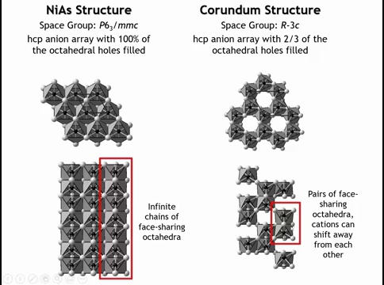
Notes:
The NiAs structure (all octahedral holes filled in an HCP array of anions) is not favored when bonding is highly ionic, because it creates infinite chains of face-sharing octahedra, bringing cations too close together.
If instead one-third of the octahedral holes are left vacant, the result is a layered, graphene-like arrangement with filled–filled–empty sequences. Stacking these with HCP anions gives the corundum structure (Al₂O₃, hematite Fe₂O₃).
This structure is stable for more ionic compounds because the vacancies break up the infinite face-sharing columns, reducing cation–cation repulsion.

Slide 19
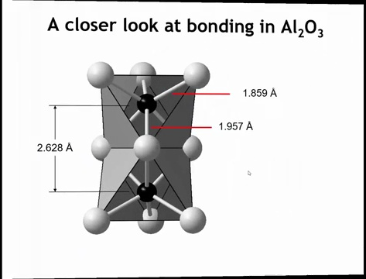
Notes:
And because there are these empty octahedral holes, the cations in the filled octahedral holes can move away from each other toward the empty space. And we can see that if we were to look at the mineral correndum and at the bond distances here. So you can see at the shared phase, the aluminum oxide distances is 1.96 angstroms, whereas the aluminum oxide distance to the bonds above it would be 1.86. So we can see that the aluminum ions are moving away from each other toward the vacancy that's above and below this dimer. And that alleviates the unfavorable ionic interactions of the shared phase.

Slide 20
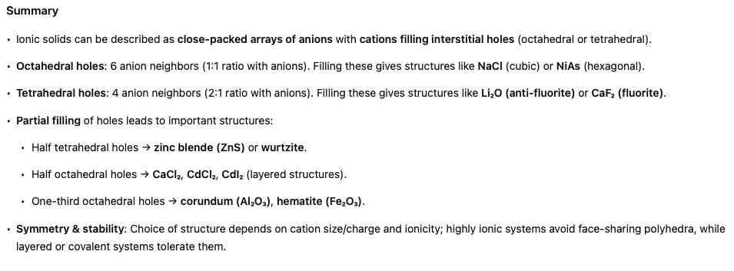

Slide 21
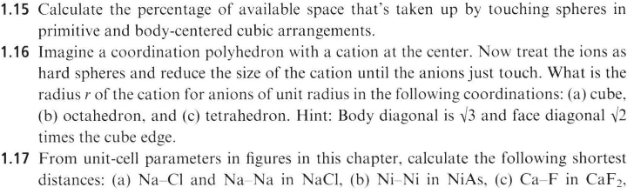
Homework:

Slide 22
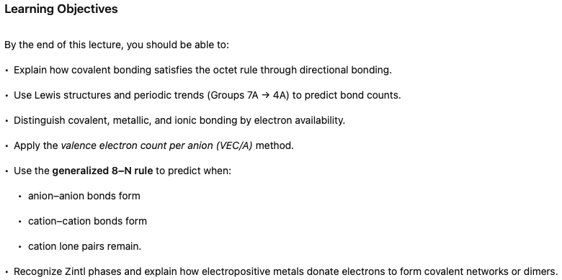

Slide 23
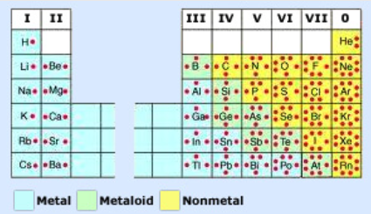
Octet Rule: Main-group atoms form bonds until they have 8 valence electrons, like a noble gas.

Slide 24
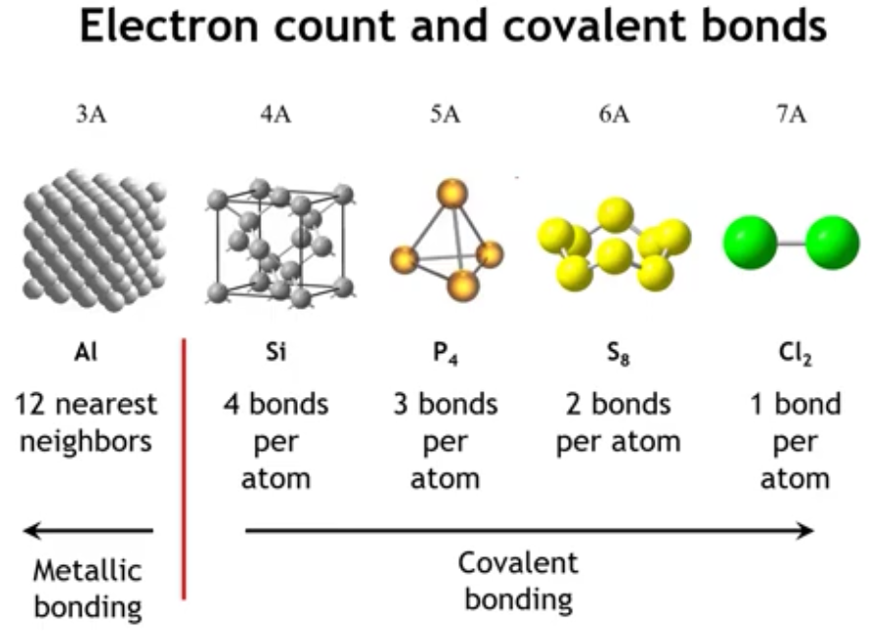
Notes:
Now let’s turn to covalent bonding and the structures that arise from it. We’ll begin with an electron-counting scheme. Moving across the third period of the periodic table illustrates where covalent bonding gives way to metallic bonding.
Halogens (Group 7A): 7 valence electrons, one short of an octet → each atom makes 1 bond (e.g., Cl₂).
Group 6A (e.g., S): 6 valence electrons, two short → each atom makes 2 bonds.
Group 5A (e.g., P): 5 valence electrons, three short → each atom makes 3 bonds (e.g., white phosphorus).
Group 4A (C, Si, Ge): 4 valence electrons, four short → each atom makes 4 bonds, forming extended covalent networks like diamond, silicon, and germanium (important semiconductors).
Group 3A (Al): 3 valence electrons, far from an octet → octet completion by covalent bonds is not feasible. Instead, atoms pack closely and delocalize electrons, leading to metallic bonding.
This progression shows how electron count determines whether atoms form directional covalent structures or metallic lattices.

Slide 25
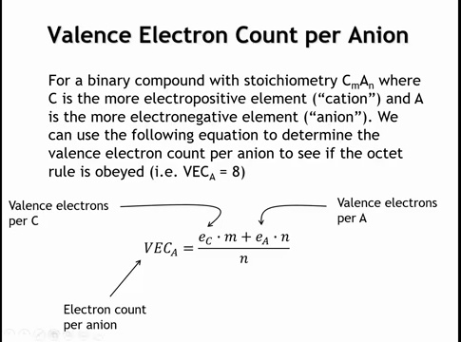
Notes:
We can use an electron-counting argument for binary compounds. Label the more electropositive element as C (“cation”) and the more electronegative as A (“anion”). The key is the valence electron count per anion.
Take sodium chloride as an example: Na has 1 valence electron, Cl has 7. Sodium transfers its electron to chlorine, giving Cl a full octet. In this scheme:
E_C = 1 (valence electrons from Na), M = 1 (one Na atom per formula unit), E_A = 7 (valence electrons from Cl), N_A = 1 (one Cl per formula unit)
So the total per anion is (E_C \times M + E_A \times N_A)/N_A = (1 + 7)/1 = 8.
That gives chlorine its octet, consistent with the textbook ionic picture.

Slide 26
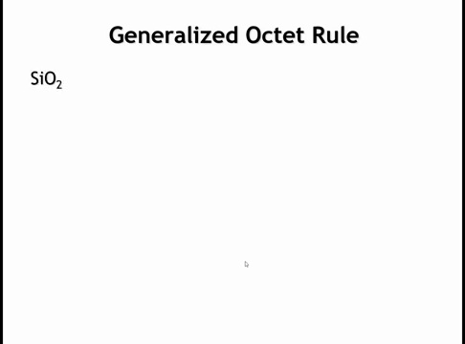

Slide 27
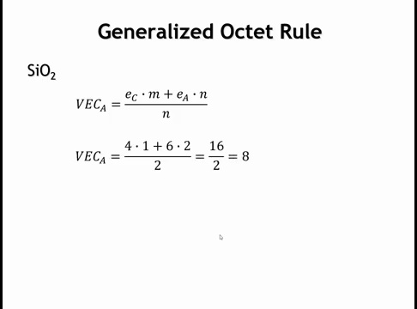
Notes:
Silicon dioxide (SiO₂) and the octet rule:
Bonding is highly covalent, not ionic. Each Si contributes 4 valence electrons (1 atom) and each O contributes 6 (2 atoms). Total = 4 + (2×6) = 16. Divide by 2 (two oxygens) = 8 → octet rule satisfied. This method just keeps track of electrons, even in covalent systems.

Slide 28
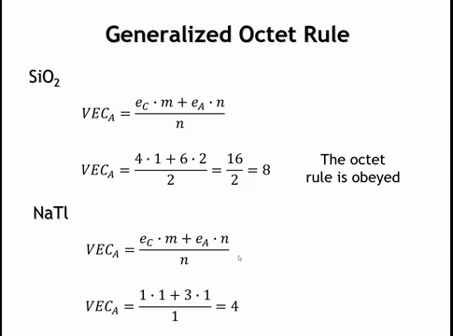
Notes:
Octet rule beyond ionic compounds:
Doesn’t matter if bonding is ionic or covalent—just identify the more electropositive and electronegative elements. Example: NaTl. Na has 1 valence e⁻, Tl has 3 → total = 4 e⁻ per Tl after transfer. That’s not 8, so the octet rule is not satisfied. This highlights cases where the rule breaks down.

Slide 29
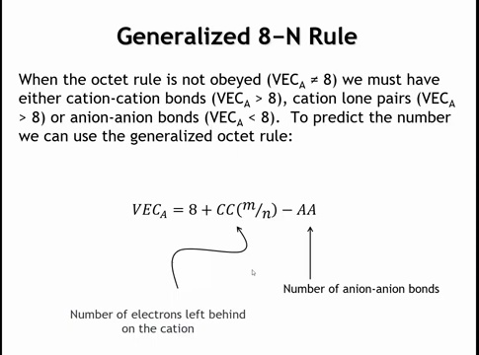
Notes:
To answer this, we use the generalized 8–N rule (generalized octet rule). In sodium thallium, the valence electron count per anion is only 4. Since this is less than 8, the anion has too few electrons, so thallium must form bonds with other thallium atoms—just as P, S, or Si form bonds with themselves in elemental structures. These are anion–anion (Tl–Tl) bonds.
If instead the valence electron count per anion exceeds 8, the anion cannot accept all the cation’s electrons. The excess electrons are left on the cation, called cc. In that case, either cation–cation bonds form or the cations retain nonbonding electron pairs.
Applied to sodium thallium: thallium’s electron count of 4 (too few) drives Tl–Tl bonding.

Slide 30
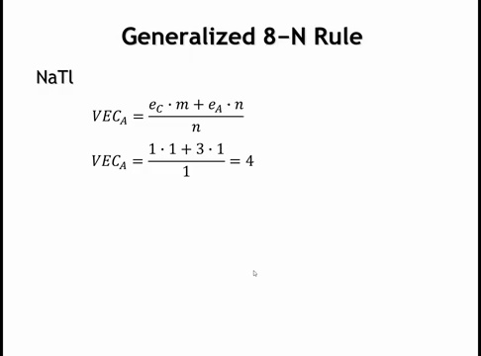
Notes:
We calculated the valence electron count (VEC) per Tl as 4. Using the generalized 8–N rule, since 8 > 4, the system must form anion–anion (AA) bonds. Cation–cation bonds or cation lone pairs don’t help here, so those terms drop out. The rule then gives 4 AA bonds per Tl.
In sodium thallide, the Tl atoms indeed bond in a diamond-like network, with Na⁺ cations filling the interstices. This is expected because once Tl gains an electron from Na, it has the same valence count as Si or C, and thus forms structures similar to diamond or silicon.

Slide 31
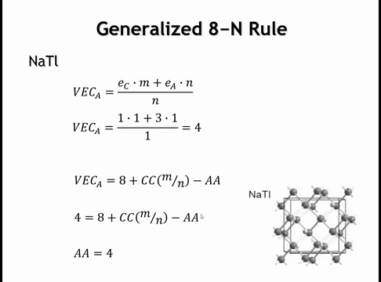
Notes:
We calculated the valence electron count (VEC) per Tl as 4. Using the generalized 8–N rule, since 8 > 4, the system must form anion–anion (AA) bonds. Cation–cation bonds or cation lone pairs don’t help here, so those terms drop out. The rule then gives 4 AA bonds per Tl.
In sodium thallide, the Tl atoms indeed bond in a diamond-like network, with Na⁺ cations filling the interstices. This is expected because once Tl gains an electron from Na, it has the same valence count as Si or C, and thus forms structures similar to diamond or silicon.

Slide 32
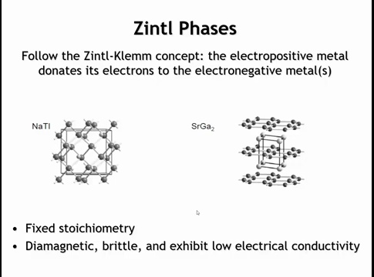
Notes:
For Tl, the valence electron count (VEC) is 4. Applying the generalized 8–N rule: since 8 > 4, the structure requires anion–anion (AA) bonds, while cation–cation bonds or cation lone pairs drop out. The rule gives 4 AA bonds per Tl.
In NaTl, the Tl atoms form a diamond-like network, with Na⁺ cations in the interstices. This makes sense because once Tl gains an electron from Na, it has 4 valence electrons—just like Si or C—so it adopts similar diamond/silicon-type structures.

Slide 33
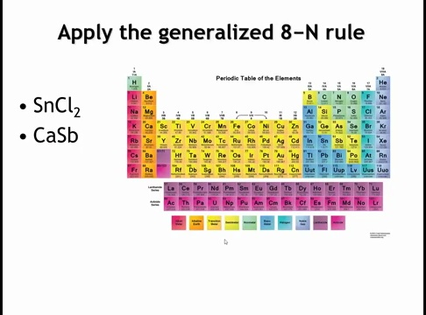
Notes:
Let’s finish with two examples: SnCl₂ and Ca₂Ti. Apply the generalized 8–N rule—do you get cation–cation bonds, anion–anion bonds, or cation lone pairs?

Slide 34
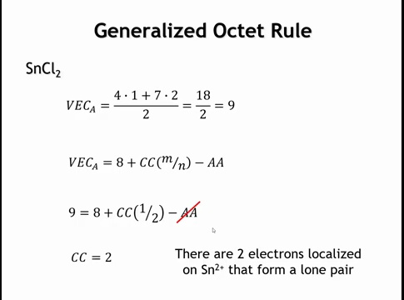
Notes:
For SnCl₂, Sn has 4 valence electrons and Cl has 7, giving a valence electron count per Cl of 9. Since 9 > 8, the chlorides cannot accept all of Sn’s electrons. Applying the generalized 8–N rule, anion–anion bonds aren’t needed; instead, cc = 2, meaning two electrons remain on Sn. These occupy the Sn 5s orbital as a lone pair, which is typical for Sn²⁺.

Slide 35
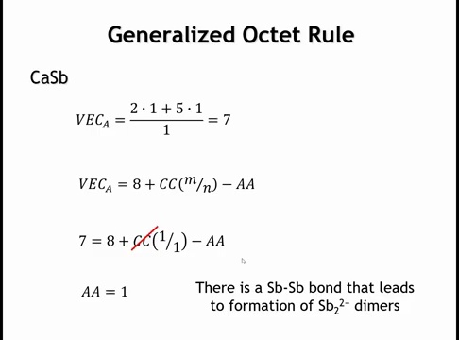
Notes:
For Ca₂Sb, each Ca gives 2 electrons to Sb, which starts with 5, so the valence electron count per Sb is 7. Since 7 < 8, the octet rule isn’t satisfied. The cc term (electrons left on cations) drops out, and the generalized 8–N rule requires one anion–anion (AA) bond per Sb. This means Sb atoms dimerize.
With 7 valence electrons, Sb behaves like a halogen—forming one bond to make a diatomic species. Here, the [Sb₂]²⁻ dimer is the covalently bonded polyatomic anion, charge-balanced by Ca²⁺ cations.

Slide 36
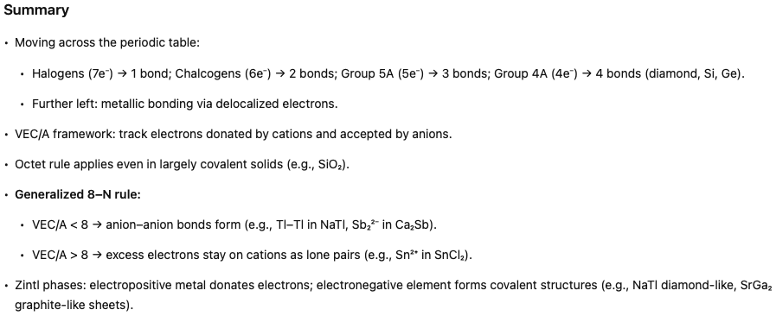

Slide 37
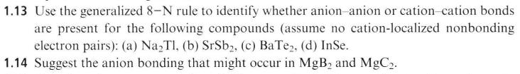
Homework

Slide 38
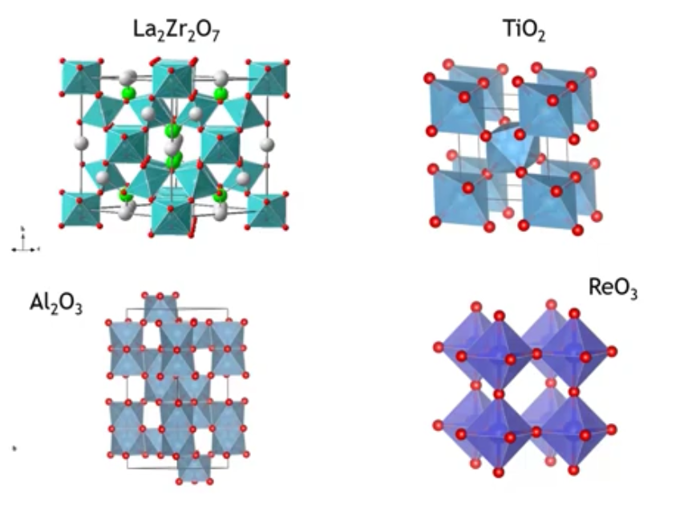
Notes:
Over the last lectures, we’ve explored several inorganic crystal structures—just a small sample of the huge variety that exist (as of august 2025 there are 318,000 well-defined and characterized structures out of an estimate 10 million (100B if you include stoichiometry). These structures are not random; their form is strongly influenced by stoichiometry. For example, four different metal oxides built from metal–oxygen units can have four distinct structures because each has a different empirical formula.
In this lecture, we’ll examine the relationship between empirical formula and crystal structure.

Slide 39
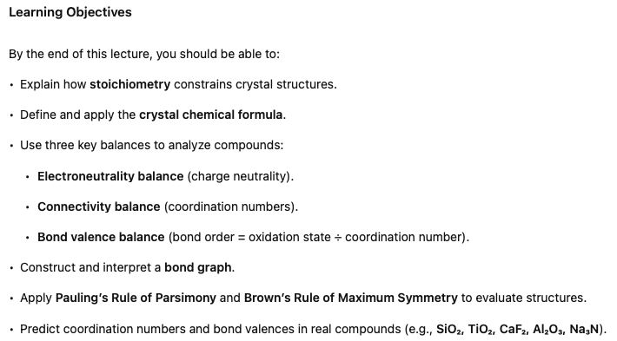

Slide 40
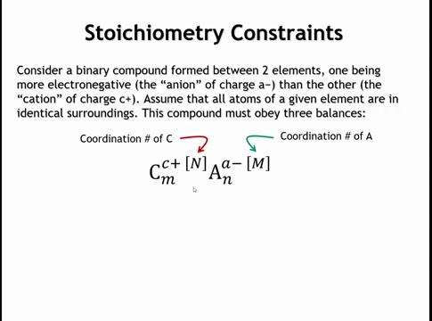
Notes:
For a polar covalent compound, label the more electropositive atom as the “cation” (C) and the more electronegative atom as the “anion” (A). The method applies regardless of electronegativity difference—working for both highly ionic and strongly covalent compounds.

Slide 41
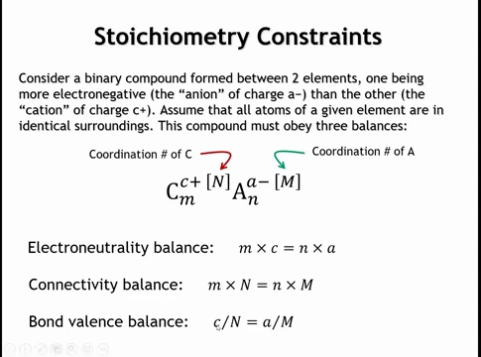
Notes:
Charge balance: (# cations × cation charge) = (# anions × anion charge). Oxidation numbers can be used in place of true charges.
Connectivity balance: In crystal chemical formulas, use superscripted N (coordination number of C) and M (coordination number of A). Then (# cations × N) = (# anions × M).
Bond valence ≈ bond order = (oxidation number ÷ coordination number).
Bonds to the cation = bonds from the anion, so both calculations must match.
Equivalently: bond order can be calculated from either cation or anion oxidation number ÷ coordination number.
the bond valence has to be the same for C going to A and A going to C, the number of electrons associated with the bond is equal

Slide 42
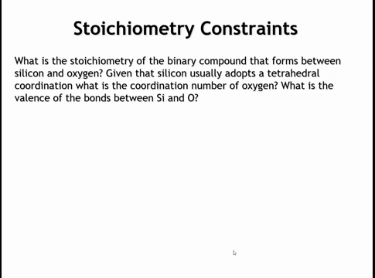
Notes:
Let’s do a simple example: the binary compound between silicon and oxygen. Silicon strongly prefers tetrahedral coordination, which it nearly always adopts with oxygen. Using this, can we determine the compound’s empirical formula, the coordination number of oxygen, and the bond order (valence) of the Si–O bonds?

Slide 43
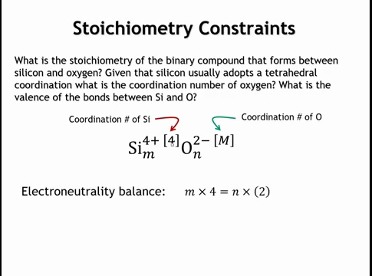

Slide 44
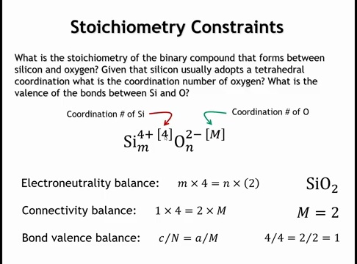
Notes:
Here’s the crystal chemical formula. Silicon is in the +4 oxidation state, oxygen is –2, and silicon’s coordination number is 4.
Electroneutrality balance: To balance charges, the Si:O ratio must be 1:2 → empirical formula is SiO₂.
Connectivity balance: One Si makes 4 bonds; with 2 O atoms, each O must coordinate to 2 → oxygen CN = 2 (linear or bent possible).
Bond valence balance: Si⁴⁺ over 4 bonds = 1 per bond; O²⁻ over 2 bonds = 1 per bond. Thus, each Si–O bond has valence 1.

Slide 45
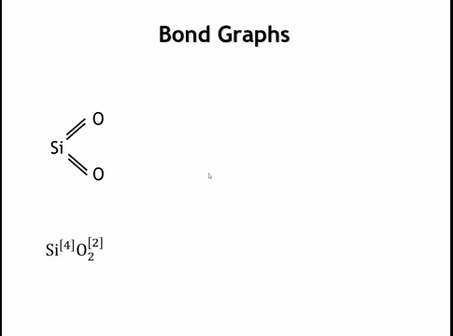
Notes:
It’s often easier to visualize this with a bond graph. For SiO₂, each atom in the empirical formula (1 Si, 2 O) is placed in the graph. Si has a coordination number of 4, so we draw four bonds from Si, distributing them evenly: two bonds to each O. This shows Si is 4-coordinate and O is 2-coordinate. From the oxidation states (Si⁴⁺, O²⁻), the bond valence is 1 per bond.

Slide 46
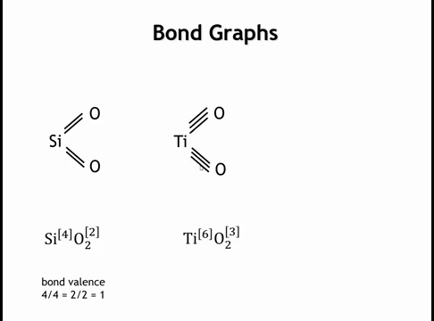
Notes:
Let's Now consider TiO₂. Titanium is larger than silicon and typically adopts octahedral (6-fold) coordination. In a bond graph, Ti has 6 bonds—three to each O—so Ti is 6-coordinate and O is 3-coordinate. Remember: multiple lines here do not mean double or triple bonds; they are simply a notation for coordination. Calculating bond valence: Ti⁴⁺ spread over 6 bonds = ⅔ per bond; O²⁻ spread over 3 bonds = ⅔ per bond. Thus, each Ti–O bond has valence ⅔. In inorganic compounds, bond valence need not be an integer, unlike in organic molecules where valences are fixed.

Slide 47
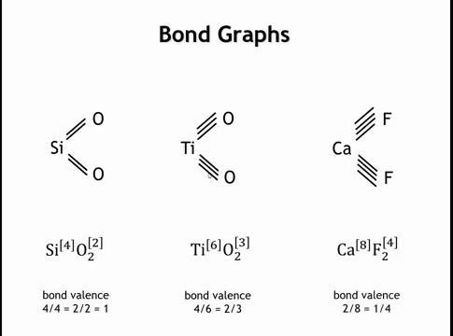
Notes:
What about calcium fluoride, CAF2? Well, calcium is bigger still and a common coordination number we might find for calcium would be eight. And so if the calcium is eight coordinate, it tells us that the fluorine must be four coordinate. And in the last lecture I believe we talked about the structure of calcium fluoride where we have tetrahedral fluoride and eight fluorides around each calcium in a cube.

Slide 48
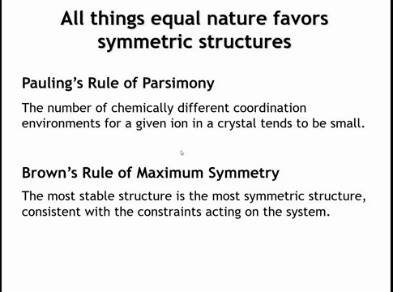
Notes:
Another key factor is symmetry. By this I don’t mean all the group theory we’ve discussed, but rather two guiding principles:
Pauling’s Rule of Parsimony (1930): Each ion in a crystal should have as few distinct coordination environments as possible—ideally all ions of the same type share the same environment.
Brown’s Rule of Maximum Symmetry (modern): The most stable structure is the one with the greatest symmetry allowed by system constraints, especially stoichiometry.
We aim to follow these rules when possible, though real crystals often show violations.

Slide 49

Notes:
All right, so now I'd like you to think about something. There are two compounds, aluminum oxide and sodium nitrite. What can you tell me about their crystal structures from these balances we've been talking about? And let's assume that in both crystal structures the rule of parsimony is obeyed.

Slide 50

Notes:
Take Al₂O₃. Al³⁺ and O²⁻ require 2 Al and 3 O to satisfy charge balance. The bond graph will have 2 Al and 3 O atoms. Next, assume a coordination for Al—commonly tetrahedral or octahedral in oxides. If we try tetrahedral: each Al makes 4 bonds to O. That gives two O atoms with 3 bonds and one O with only 2. This violates Pauling’s rule of parsimony, since we now have two chemically distinct oxygens. Because we want to avoid multiple coordination environments, this suggests the tetrahedral assignment is probably not correct.

Slide 51


Slide 52


Slide 53

Notes:
Now assume Al³⁺ is octahedral in Al₂O₃. Each Al makes 6 bonds to O → bond graph shows both Al as 6-coordinate, each of the 3 O atoms as 4-coordinate. This satisfies Pauling’s parsimony (all O equivalent). The crystal chemical formula can be written accordingly. If we calculate bond valence: Al³⁺/6 = ½ per bond, O²⁻/4 = ½ per bond, so each Al–O bond has valence 0.5.

Slide 54


Slide 55

Notes:
Now consider sodium nitride (Na₃N). N³⁻ and Na⁺ give a bond graph with 1 N and 3 Na. Nitrogen typically has CN 4–6; sodium, being large, usually has CN 6–12. If we assume N is 6-coordinate (the upper limit), then each Na must be 2-coordinate. Thus, in the crystal chemical formula, N = 6-coordinate and Na = 2-coordinate. Bond valence: N³⁻/6 = ½, Na⁺/2 = ½, so each bond has valence 0.5.
Remarkably, Na₃N was only discovered in 2002. Normally Na + N yields sodium azide (NaN₃). The difficulty arises because Na rarely adopts such a low coordination—2-coordinate is an extreme outlier compared to its usual 6–12. This explains why Na₃N is so hard to make. Even when synthesized, it decomposes near 360 K.

Slide 56


Slide 57

Homework

