Slide 1
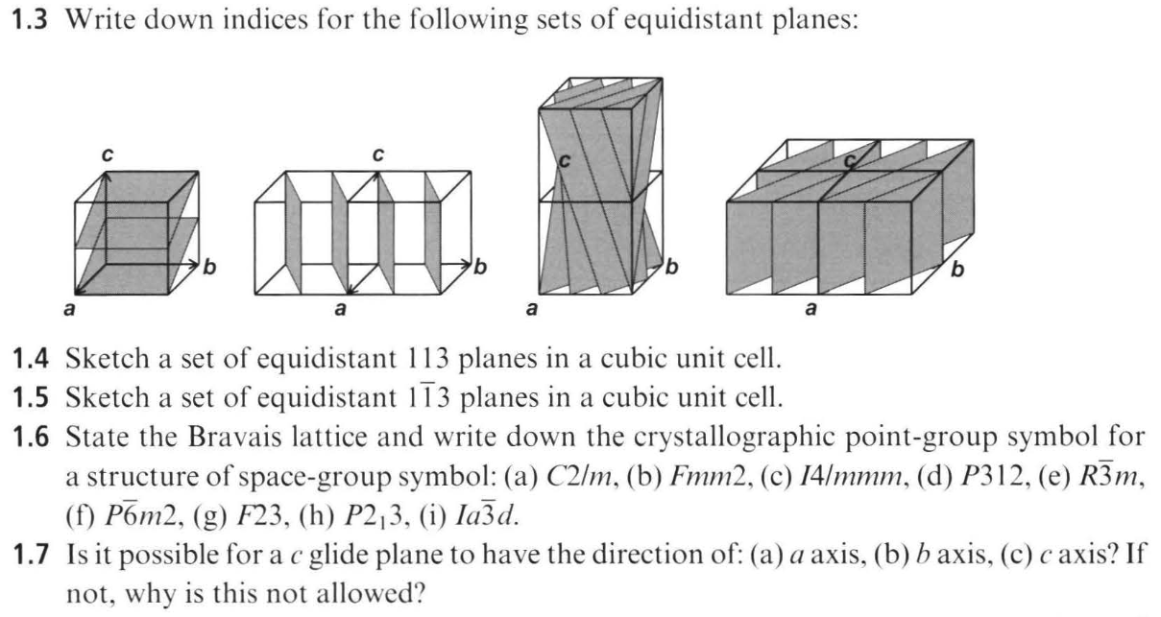
Work through these problems for next time:
Notes:
Do these problems.

Slide 2
For problem 1.6:
Parse the symbol.
Split it into lattice centering (first capital letter: P, A, B, C, I, F, R) and the symmetry part (numbers, bars, m’s, glides/screws). E.g., C2/m → lattice C; symmetry 2/m.
Identify the crystal family/system from the symmetry part.
Highest fold tells you the family: triclinic (1, -1), monoclinic (2 or m or 2/m), orthorhombic (222, mm2, mmm), tetragonal (4, -4, 4/m, 422, 4mm, -42m, 4/mmm), trigonal (3, -3, 32, 3m, -3m), hexagonal (6, -6, 6/m, 622, 6mm, -6m2, 6/mmm), cubic (23, m‑3, 432, -43m, m‑3m).
Read off the Bravais lattice.
Combine the family with the centering letter to name the Bravais lattice (one of the 14).
Examples: F+orthorhombic → face‑centered orthorhombic; I+tetragonal → body‑centered tetragonal; R → rhombohedral (trigonal); trigonal symbols starting with P use the hexagonal primitive Bravais lattice. (The hexagonal family contains both trigonal and hexagonal crystal systems.)
Derive the point group from the space group by removing translations.
  Replace screw axes by pure rotations (e.g., 2₁ → 2, 3₁/3₂ → 3, 4₁/4₂/4₃ → 4, 6₁…6₅ → 6).
  Replace glide planes by mirrors (a, b, c, n, d, e → m).
  The result is the point‑group HM symbol (possibly with orientation details like 312 vs 321, both belonging to point group 32). CCP4Wikipedia

Slide 3
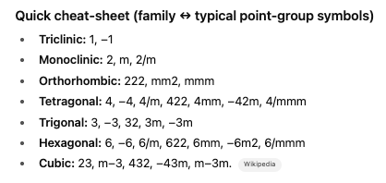

Slide 4
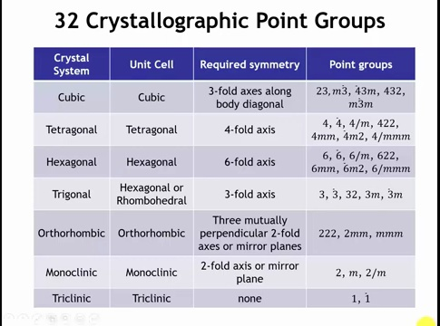
Notes:
What does 6/mmm mean from Emily’s question?

Slide 5

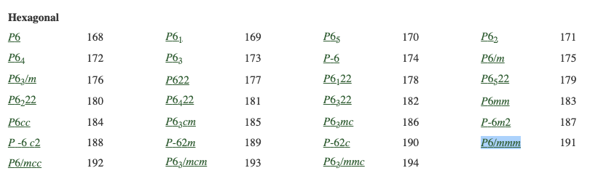
https://onlinelibrary.wiley.com/iucr/itc/doi/10.1107/97809553602060000928
Notes:
Last time Emily asked me about

Slide 6
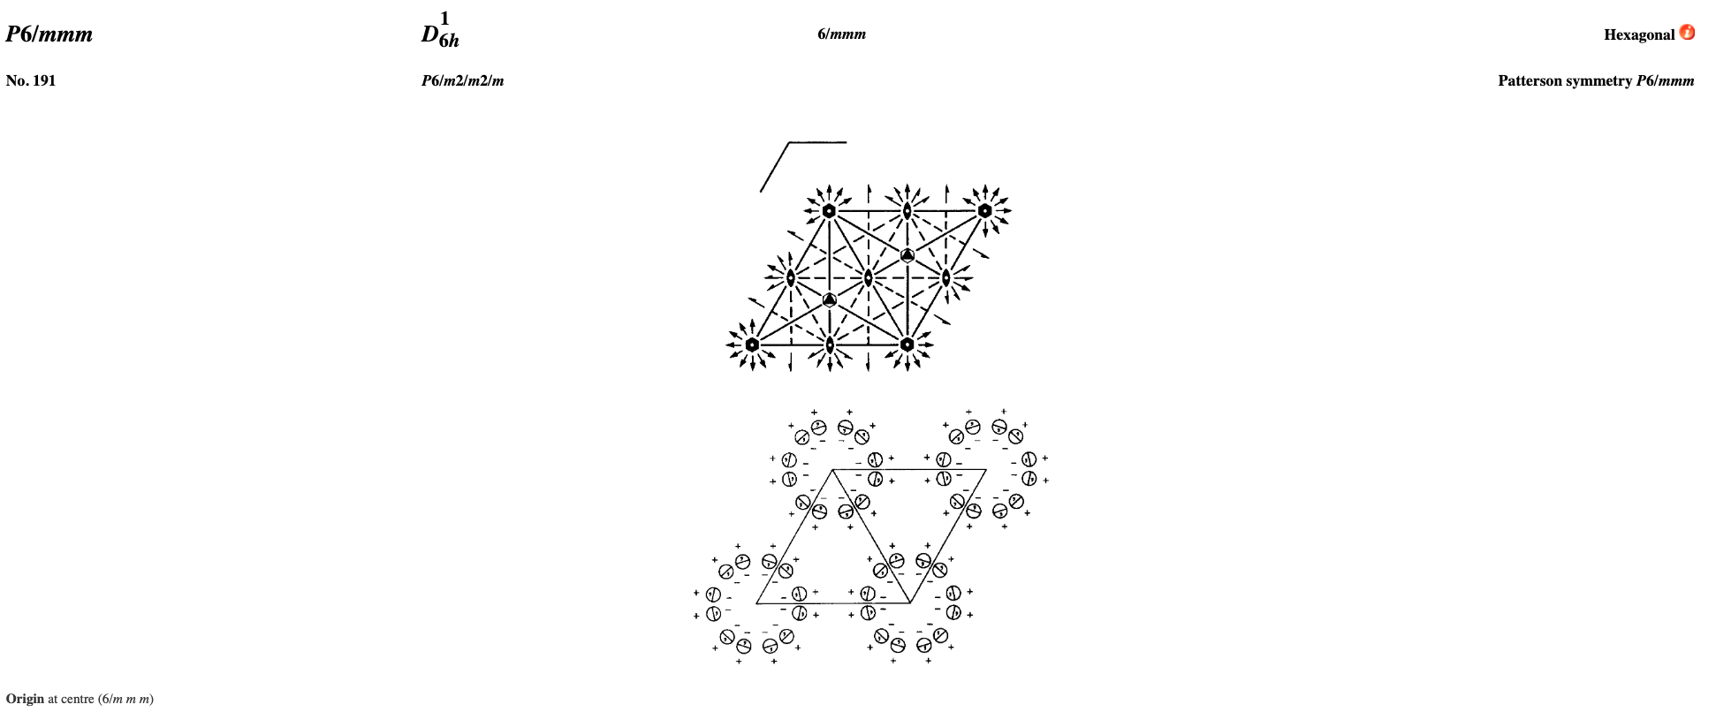
One 6-fold rotation axis along c
Six 2-fold axes perpendicular to c (in the basal plane)
Horizontal mirror plane perpendicular to c
Six vertical mirror planes containing c
Inversion center at the origin
“6” = sixfold rotation axis along the c-axis (the hexagonal axis).
“/m” = a mirror plane perpendicular to the sixfold axis (i.e., a horizontal mirror plane at c = 0).
“mm” = mirror planes parallel to the c-axis:
Notes:
Last time Emily asked about the 6/mmm notation for the hexagonal crystal system.

Slide 7
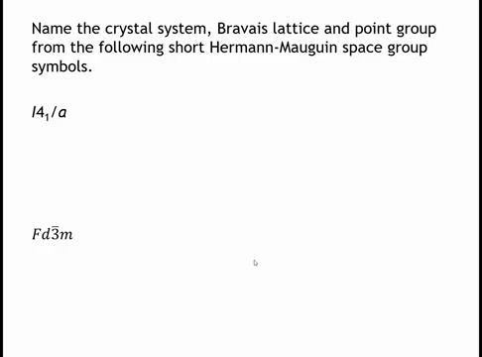
Notes:
The top example belongs to the tetragonal crystal system. What gives it away? The 4 The subscripted 4₁ indicates a fourfold screw axis along c. The I denotes a body-centered tetragonal Bravais lattice. The point group reduces to 4/m (C₄h), where the screw converts to a pure fourfold rotation and the glide converts to a mirror. Because both a screw axis and a glide plane are present, this is a nonsymmorphic space group.
The bottom example, Fd-3m. The F indicates a face-centered cubic Bravais lattice. The presence of “3” in the second position confirms the cubic system, while d represents a diamond glide. Like the tetragonal case, the presence of glide operations makes this a nonsymmorphic space group.

Slide 8
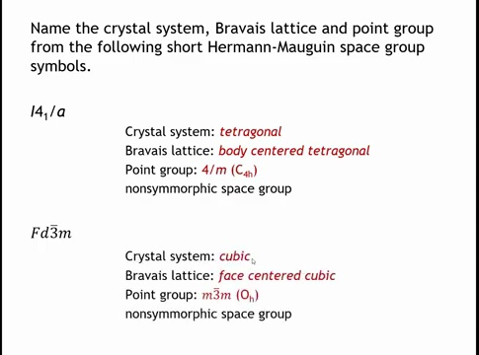
Notes:
The top example belongs to the tetragonal crystal system. What gives it The subscripted 4₁ indicates a fourfold screw axis along c. The I denotes a body-centered tetragonal Bravais lattice. The point group reduces to 4/m (C₄h), where the screw converts to a pure fourfold rotation and the glide converts to a mirror. Because both a screw axis and a glide plane are present, this is a nonsymmorphic space group.
The bottom example, Fd-3m. The F indicates a face-centered cubic Bravais lattice. The presence of “3” in the second position confirms the cubic system, while d represents a diamond glide. Like the tetragonal case, the presence of glide operations makes this a nonsymmorphic space group.

Slide 9
How do we represent Crystal Structures?
Sometimes there are hundreds of atoms per unit cell
We don’t want to draw them all out
How do we represent the crystal structures more compactly?
How can we use software to better visualize crystal structures?

Slide 10
Learning objectives:
Represent Crystal Structures: Understand the compact formalism used to describe complex crystal structures, including the space group, unit cell dimensions, and Wyckoff sites.
Interpret Wyckoff Sites: Learn how to use Wyckoff site information from the International Tables for Crystallography to determine atom positions, multiplicity, and site symmetry within a unit cell.
Handle Centered Lattices: Understand how centering operations (like face-centering) generate additional atomic positions from a single set of fractional coordinates.
Calculate Crystal Density: Be able to calculate the theoretical density of a crystal using its unit cell dimensions, atomic contents (derived from Wyckoff multiplicities), and atomic masses.

Slide 11
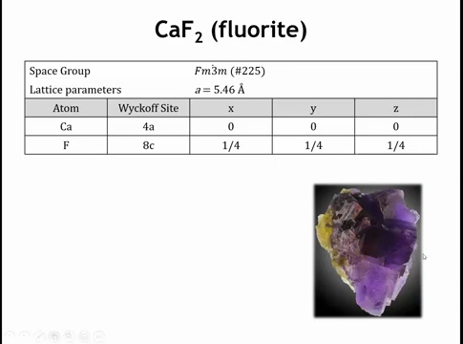
Notes:
CaF should be colorless, the color is from missing fluoride atoms, called color centers. Everything we neeed to know about fluorite is in this table. Space grouop symmetry, dimensions of the unit cell, we need the Wyckoff sites of the atoms, and the coordinates of those Wyckoff sites. Cubic cell so only one dimension. Ca is on wyckofff site 4a, one of the four atoms is at the origin, fluoride atoms are on site 8c, one of those atoms is ¼,1/4,1/4,

Slide 12

How to read the notation (Hermann–Mauguin)
For cubic point groups the three symbol positions map to fixed direction families. The full symbol for m-3m is 4/m −3 2/m, interpreted as:
First position (〈100〉): 4/m → three 4-fold axes along x, y, z, each with a mirror plane ⟂ to the axis (i.e., {100} mirrors).
Second position (〈111〉): −3 → four body-diagonal 3-fold rotoinversion axes (each axis runs through opposite cube corners).
Third position (〈110〉): 2/m → six 2-fold axes along face diagonals, each with a mirror plane ⟂ to the axis (i.e., {110} mirrors).
The condensed m-3m omits the explicit “4/” and “2/” because those rotations are implied by the mirrors and −3.

Slide 13
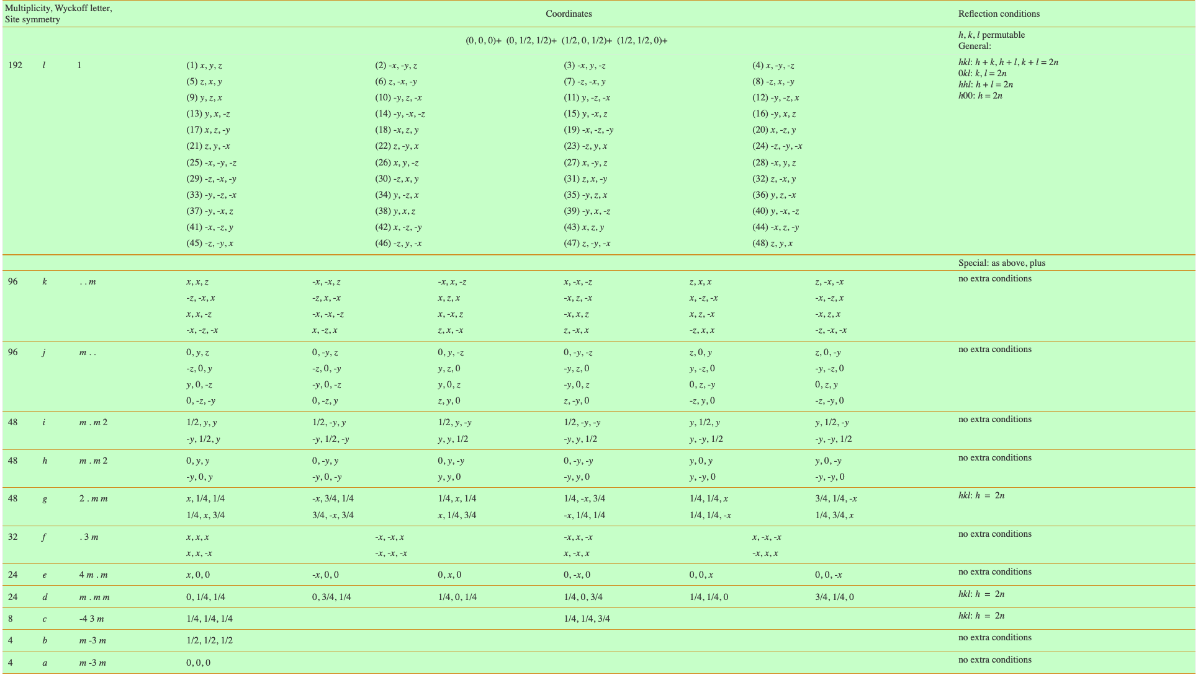
Notes:
Here are all the Wyckoff sites, 11 different special positions associated with a symmetry element. the general position has a multiplicity of 192. of course for this size of box you can’t have an atom on the general position.

Slide 14
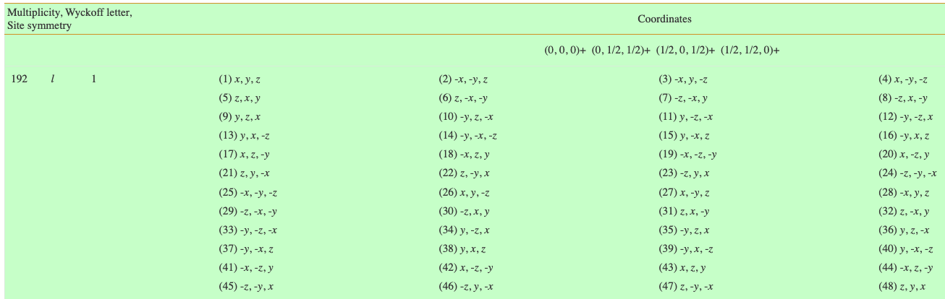
Notes:
So for our fluorize we have 4a and 8c. Note the 4a has only one site shown, the 4 comes from the cooridinates givien at the top, which translates the origin to each face center, because this is a face centered cell. If we just had a face ceneter cubic metal we would only have the 4a sites, therefore the origin and 4 faces. Here we don’t just have the origin we also have the 8c site.

Slide 15
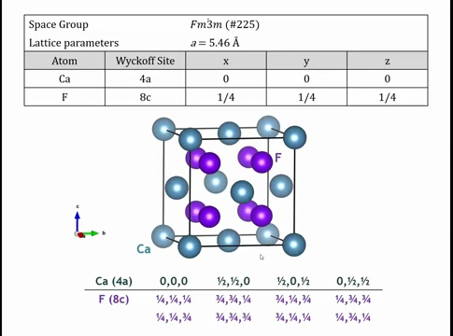
1/2,0,1/2
0,1/2,1/2
0,0,0
1/2,1/2,0
Notes:
If we draw the unit cell with all atoms fully or partially inside it, it looks like this: a calcium atom sits at the origin, and the generators place others at (½,½,0), (½,0,½), and (0,½,½). The remaining calcium atoms in the picture come from applying translational symmetry—adding integer multiples of the unit cell vectors to those four positions. we can always add or subtract integers to bring atoms back inside (or partly inside) the unit cell.

Slide 16
1/4,1/4,3/4
1/4,1/4,1/4
Notes:
For fluorine, there are eight atoms in the unit cell. One sits at (¼,¼,¼) and another at (¼,¼,¾). Applying the centering vectors—for example, adding (½,½,0)—generates equivalent positions such as (¾,¼,¼). In general, starting from (¼,¼,¼) or (¼,¼,¾), the symmetry operations produce all permutations of ¼ and ¾ in the three coordinates. Because fractional coordinates are defined modulo 1, values like 1¼ are reduced to ¼, ensuring all eight fluorine positions lie fully or partially within the unit cell.

Slide 17
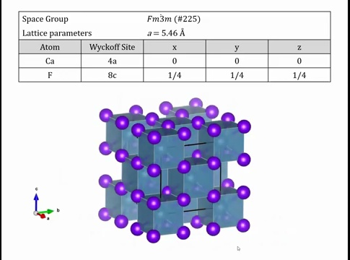
Notes:
We can also represent the structure with polyhedra. Around each calcium atom, the fluorides form a cubic environment with \bar{3}m octahedral symmetry—the same symmetry as a cube. Each fluoride, in turn, is coordinated by a tetrahedron of calcium atoms. This unit cell contains 12 atoms in total, but we only need to specify the symmetrically distinct positions—the asymmetric unit, or motif from lecture one—since symmetry generates the rest.

Slide 18
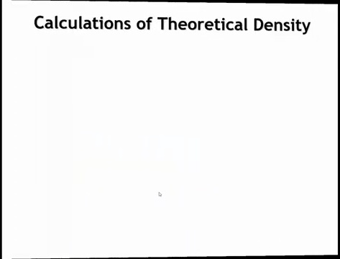

Slide 19
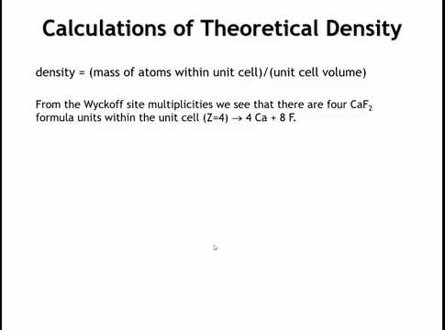

Slide 20
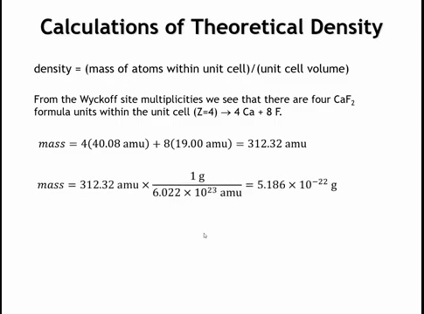
Notes:
Density of a unit cell is same same as the density of a crystal, so you can use the knowledge of the mass of the atoms and unit cell dimensions to calculate a theoretical density for a crystal.

Slide 21
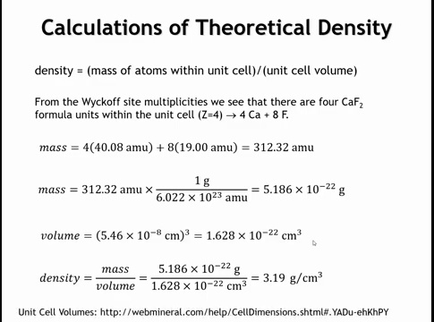

Slide 22
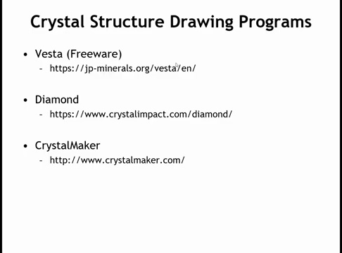
Notes:
There’s various crystal structure programs, we’ll use vesta.

Slide 23
Summary - Representing Crystal Structures (Example: CaF₂)
Why compact representations?
Unit cells can contain many atoms → instead of listing all positions, we use:
Space group symmetry
Unit cell dimensions
Wyckoff positions + fractional coordinates of unique atoms
Case study: Calcium Fluoride (CaF₂)
Space group: Fm-3m (#225), cubic, a = 5.46 Å
Atoms: Ca at Wyckoff 4a (0,0,0), F at 8c (¼,¼,¼)
Multiplicities & centering operations generate all atoms in unit cell
Coordination: Ca in cubic (octahedral) environment; F in tetrahedral environment
Density calculation
4 CaF₂ units per cell → 4 Ca + 8 F = 312.32 amu
Converted mass: 5.19 × 10⁻²² g
Cell volume: (5.46 × 10⁻⁸ cm)³ = 1.63 × 10⁻²² cm³
Density = 3.19 g/cm³ (reasonable for a mineral solid)
Tools
Visualization/drawing: VESTA (free), CrystalMaker, Diamond
Useful for measuring distances/angles & building polyhedral views

Slide 24
Learning Objectives
By the end of this lecture, you should be able to:
Classify extended solids into metallic, ionic, and covalent types, based on bonding and structural features.
Explain packing in metallic solids, including two-dimensional hexagonal packing and its extension into three dimensions.
Differentiate close-packed structures: hexagonal close-packed (HCP) vs cubic close-packed (FCC), including stacking sequences (ABAB vs ABCABC).
Describe metallic unit cells (FCC, BCC, primitive cubic) and compare their coordination numbers and packing efficiencies.
Recognize periodic trends in metallic crystal structures and their relation to bonding and band filling.
Identify variations and intermetallic structures, such as alternative stacking sequences (e.g., ABAC), ordered compounds (CsCl, Cu₃Au), and high-coordination examples (e.g., SmCo₅).

Slide 25
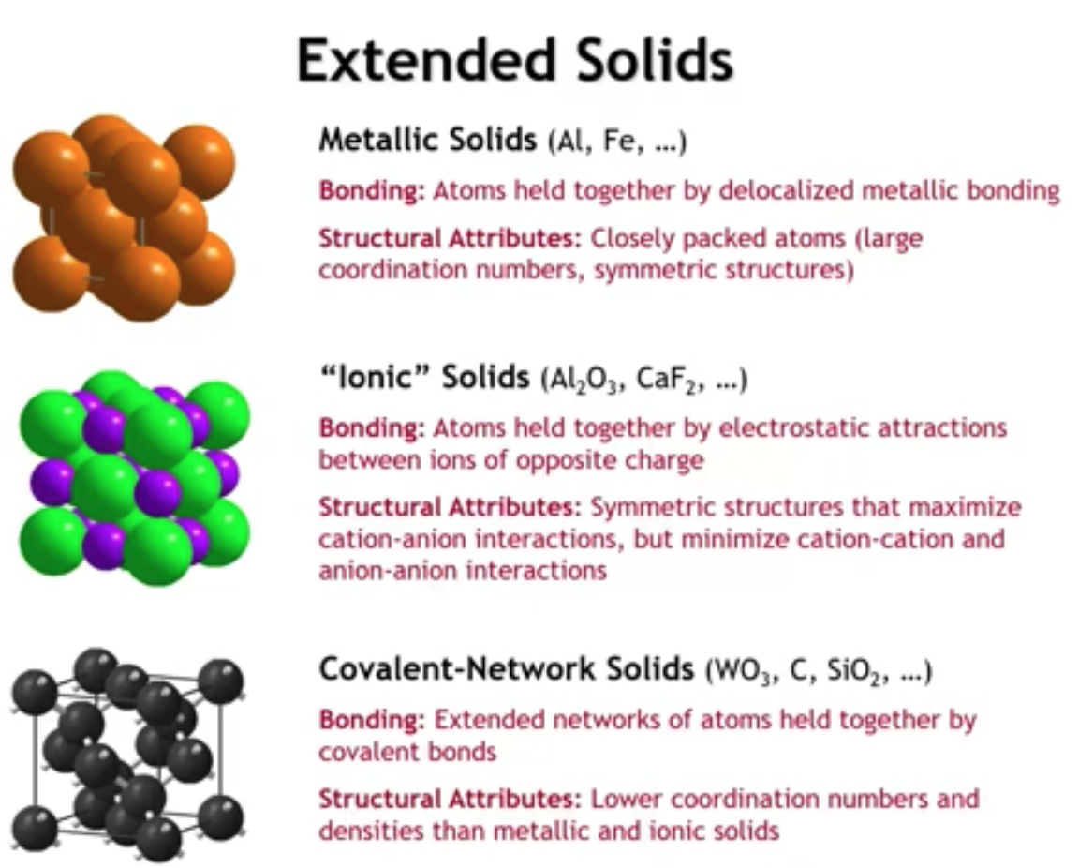
Notes:
Now that we’ve covered crystallographic symmetry, we can begin discussing the structures of extended (non-molecular) solids. These can be broadly divided into three categories:
Metallic solids: Atoms are held together by delocalized electrons, leading to closely packed structures with high coordination numbers.
Ionic solids: Atoms are bound by electrostatic attraction between cations and anions. These structures favor maximizing cation–anion contacts while minimizing like-charge interactions, often producing high symmetry and large (though smaller than metals) coordination numbers.
Covalent network solids: Examples include diamond, SiO₂, and WO₃. Strong, localized covalent bonds lead to smaller coordination numbers, with structures that may be either high or low symmetry depending on element bonding preferences and stoichiometric constraints.
In this lecture, we’ll focus on metallic solids, but this overview sets the stage for understanding the broader diversity of extended solid structures.

Slide 26
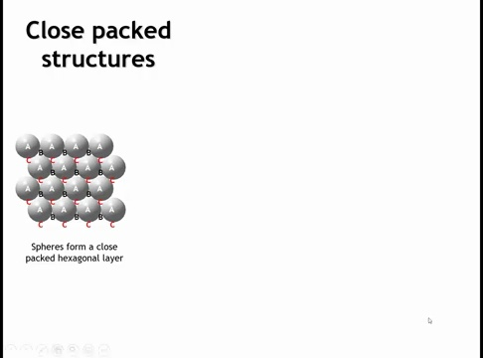

Slide 27
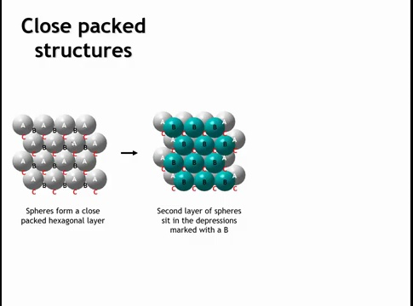
Notes:
Now let’s look more closely at metallic solids. In two dimensions, the densest packing of spheres forms a hexagonal close-packed (hcp) layer, represented by a hexagonal unit cell with atoms at each corner. Each atom touches six neighbors—the most efficient 2D packing.
In three dimensions, we extend this idea. Each sphere in the first layer is marked A at the top, while the triangular depressions between spheres are labeled B and C. A new layer of spheres must sit in these depressions, but because the B and C sites are too close to be filled simultaneously, only one set can be occupied

Slide 28
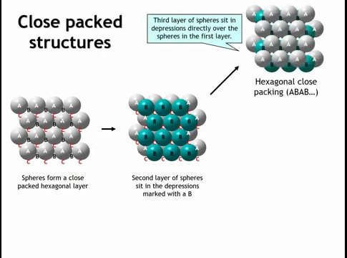
Notes:
Let's say that we put the second layer of spheres over the depressions marked with the letter B. We could say we have an A, B stacking. If you only had two layers, this is the only possible way to stack them as densely as possible. But now, as we go to a third layer, we have two options for where the third layer can go. It could go back over the spheres marked with an A, or it could choose to go onto the depressions of the spheres marked with C.
If we put the third layer immediately over the first layer, that has a kind of symmetry where every second layer we repeat. So the repeat pattern is layer A, layer B, layer A, layer B, layer A, layer B, A, B, A, B, A, B, A, B. And we call this hexagonal close packing.

Slide 29
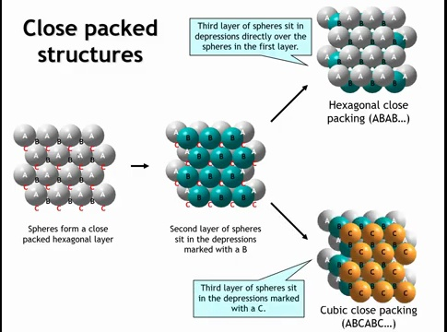
Notes:
If we place the next layer over the depressions marked C, the stacking sequence becomes A–B–C–A–B–C, which is called cubic close packing. Looking back at the first layer, we see that the C and B depressions each sit on a three-fold rotation axis, while each sphere position (A) lies on a six-fold rotation axis. This gives the layer hexagonal symmetry. Stacking these layers directly produces a hexagonal close-packed structure. It is less obvious, however, how this same packing of hexagonal layers yields a cubic unit cell.

Slide 30
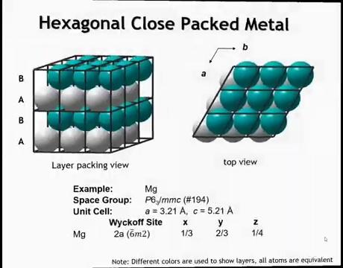
Notes:
This is the structure of a hexagonal close-packed (HCP) metal. The unit cell contains two atoms—one in layer A and one in layer B. A six-three screw axis is evident: rotating the gray layer by 60° and translating upward by half the unit cell transforms it into the green layer. All atoms are crystallographically equivalent, occupying a single Wyckoff site.

Slide 31
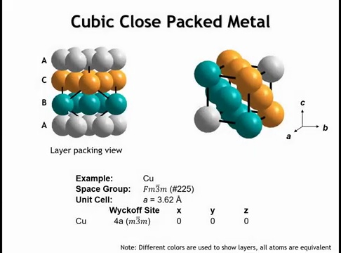
Notes:
How do we get a cubic unit cell from hexagonal layers? The key is that a cube has a three-fold rotation axis along its body diagonal. If we look along the stacking direction of the A–B–C sequence, that axis corresponds to the cubic three-fold. Trimming the structure to atoms that lie within the unit cell, we see that moving along the body diagonal takes us from A to B to C and back to A. The resulting unit cell has atoms at each corner and each face—this is the face-centered cubic unit cell. Its space group is Fm-3̅m, and all atoms are crystallographically equivalent, occupying the same Wyckoff site.

Slide 32
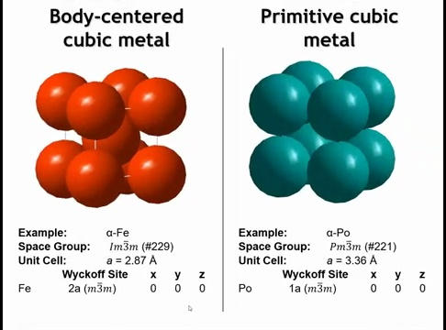
Notes:
We also encounter body-centered cubic (BCC) metals such as α-iron, and the rare primitive cubic (PC) metal polonium, which has atoms only at the cube corners. In both cubic close-packed (CCP) and hexagonal close-packed (HCP) metals, each atom has 12 nearest neighbors—6 in its own plane, 3 above, and 3 below—with a packing efficiency of 74%. In BCC metals, the coordination number decreases to 8, with each atom surrounded by a cube of neighbors. In PC metals, the coordination number falls further to 6, arranged octahedrally. Thus, packing efficiency and density decrease from CCP/HCP → BCC → PC.
Interestingly, all three structures—CCP, BCC, and PC—have the same site symmetry, m\bar{3}m (or O_h). This arises because the local environments (12-fold polyhedron in CCP/HCP, cube in BCC, and octahedron in PC) all share that symmetry.

Slide 33
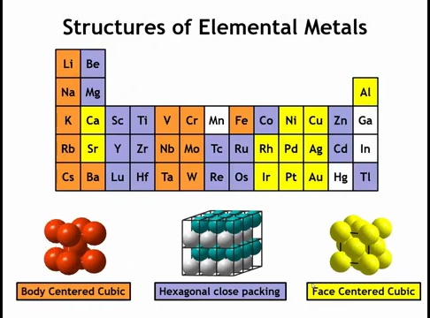
Notes:
You might expect metals to strongly favor close-packed structures—face-centered cubic (FCC) and hexagonal close-packed (HCP)—since both achieve maximum packing density. However, a look at the periodic table shows that body-centered cubic (BCC), a less dense structure, is nearly as common. There is also a periodic variation in which structure is most stable. This preference depends not just on packing efficiency, but on the details of metallic bonding and band filling, which are complex and not easily reduced to a simple rule.

Slide 34
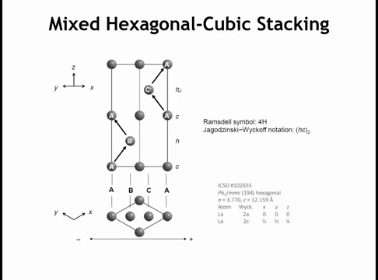
Notes:
Some metals adopt close-packed structures that don’t fit the simple ABAB (HCP) or ABCABC (FCC) stacking. For example, lanthanum shows an ABAC sequence—still close-packed, but with a different repeat pattern. This type of stacking occurs in rare earths and other metals.
There are two notations for describing such sequences. In Ramsdell notation, the ABAC sequence has four layers per unit cell and corresponds to the hexagonal space group P6_3/mmc. In Jagodinsky–Yoffe notation, the same sequence is written as HC^2: hexagonal–cubic–hexagonal–cubic.
The distinction between “hexagonal” and “cubic” layers depends on the neighbors above and below. If a layer is sandwiched by identical layers (e.g., A-B-A), it is called hexagonal, just as in ABAB stacking. If the layers above and below differ (e.g., B-A-C), the middle one is labeled cubic. Applying this rule to ABAC gives the sequence H-C-H-C.

Slide 35
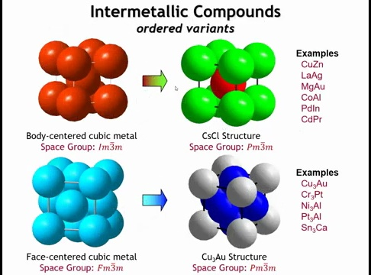
Notes:
Some metals form ordered intermetallic structures by occupying the same lattice sites as simple metallic structures but with different atoms. For example, starting from a BCC lattice: if the body-center atom differs from the corner atoms, we obtain the cesium chloride structure. While CsCl is ionic, metals like PdIn and MgAu also adopt this structure. Because the center and corner atoms are no longer equivalent, the symmetry reduces from body-centered cubic to primitive cubic.
A similar situation arises in FCC metals. Pure Au and Cu are FCC, but when combined in a 3:1 ratio, they form the Cu₃Au structure, with Au atoms on the cube corners and Cu atoms on the faces. Other compounds share this ordered intermetallic arrangement.
The key point is that these ordered intermetallic compounds have fixed stoichiometry and long-range order, distinguishing them from random alloys.

Slide 36
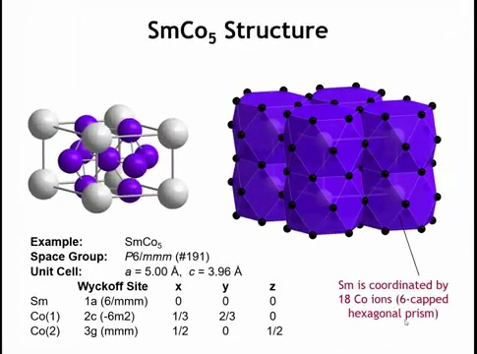
Notes:
One last notable structure is samarium cobalt-5 (SmCo₅), an important permanent magnet. It has a hexagonal unit cell with one samarium atom at the origin and five cobalt atoms per cell. Extending the lattice shows that each Sm is surrounded by 18 Co atoms: a hexagonal prism of Co above and below, with each hexagonal face capped by additional Co atoms. This creates a capped hexagonal prism coordination polyhedron, giving samarium an unusually high coordination number of 18.

Slide 37
Summary:
Extended (non-molecular) solids can be classified as metallic, ionic, or covalent based on bonding and structural features.
Metallic solids favor close packing due to delocalized electrons, leading to dense structures like HCP (ABAB) and FCC/CCP (ABCABC).
Unit cells:
HCP: 2 atoms, 12 neighbors, 74% packing.
FCC: atoms on corners + faces, 12 neighbors, 74% packing.
BCC: body atom + corners, 8 neighbors, lower packing.
Primitive cubic: corners only, 6 neighbors, lowest packing.
Stacking variations (e.g., ABAC) exist in rare-earth and other metals; described with Ramstell or Jagodinsky–Y-Coff notation.
Ordered intermetallics (e.g., CsCl, Cu₃Au) arise when different atoms occupy lattice sites, reducing symmetry.
Some complex structures, such as SmCo₅, exhibit unusually high coordination (CN = 18).
Choice of metallic structure is influenced by band structure and bonding, not just packing efficiency.

Slide 38
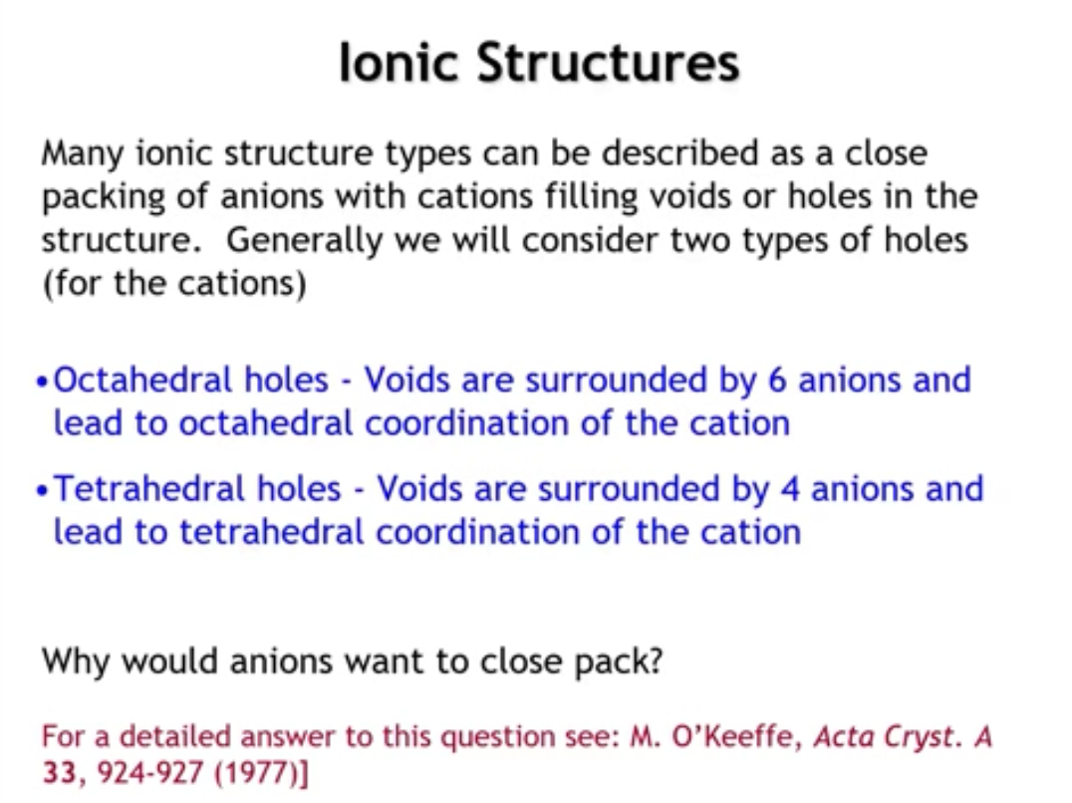
Notes:
Next, let’s look at ionic solid structures, which share surprising similarities with metallic solids from a symmetry standpoint. A useful way to describe them is to treat the anions as forming a close-packed lattice—either cubic close-packed (FCC) or hexagonal close-packed (HCP). In such lattices, ~26% of the space is voids, which cations occupy. These voids come in two types: octahedral holes (six anion neighbors, octahedral coordination) and tetrahedral holes (four anion neighbors, tetrahedral coordination).
At first, it may seem odd that anions would close-pack, since like charges should repel. The resolution lies in symmetry: arranging spheres as close together as possible produces the same geometric pattern as arranging them as far apart as possible, provided the box volume is fixed. The result is a uniform, symmetric distribution that is equivalent to close packing. Importantly, in real ionic solids, anions do not touch; instead, they remain well-separated while leaving symmetric voids for cations. The cations and anions, however, generally do touch.

Slide 39
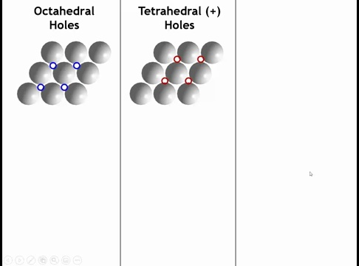
Notes:
All right, let's take a closer look at what I mean by these holes. So here I've got a very small snippet of a close-packed layer. Let's say it's anions. In many ways, we could describe these structures as a close-packed array of cations with anions in the holes. But conventionally, that's not what we do. So we've got this anion close-packed layer. And now let's put some cations on top of the layer. So we can put the cations in a couple of places. The blue circles over here on the left represent one set of voids where we could put a cation. The red circles over here are a different set of voids. Let's look at the blue voids first.

Slide 40
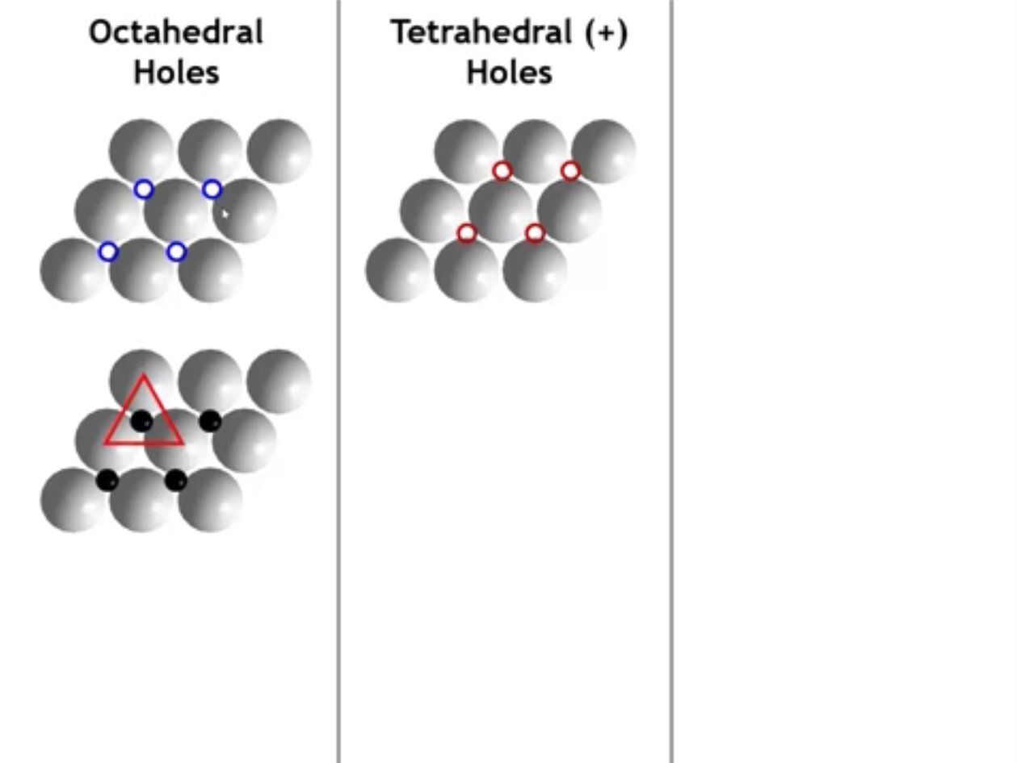
Notes:
So if we put a cation everywhere, there's a blue circle. Okay. Notice that now it's nestled up against three anions, which are on the layer below it. And they make a triangle.

Slide 41
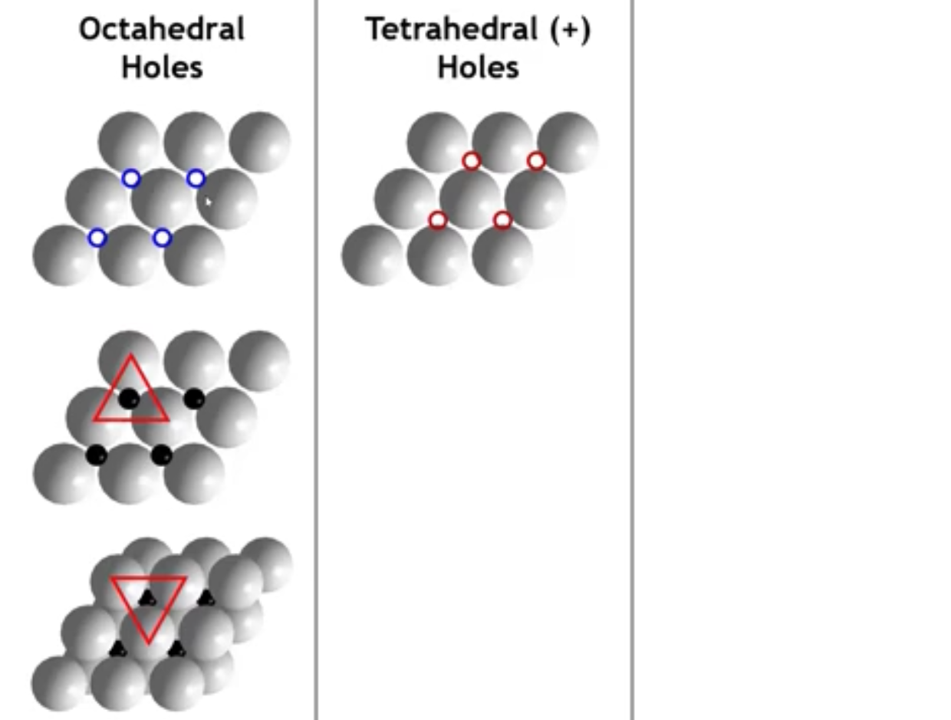
Notes:
When the next layer is added, three more anions surround the cation in the opposite orientation, forming a trigonal antiprism, which in this case is an octahedron. These are the octahedral holes. In a close-packed array of anions, the number of octahedral holes is equal to the number of anions.

Slide 42
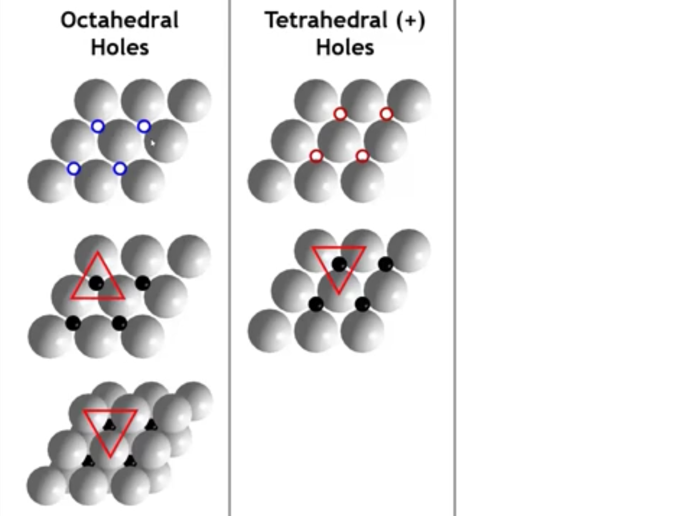
Notes:
Okay. Now let's look at the tetrahedral holes. So we've put the cations now into a different set of depressions on that close-packed layer. We still have three neighbors below, a triangle of anions that are nestled up against that cation.

Slide 43
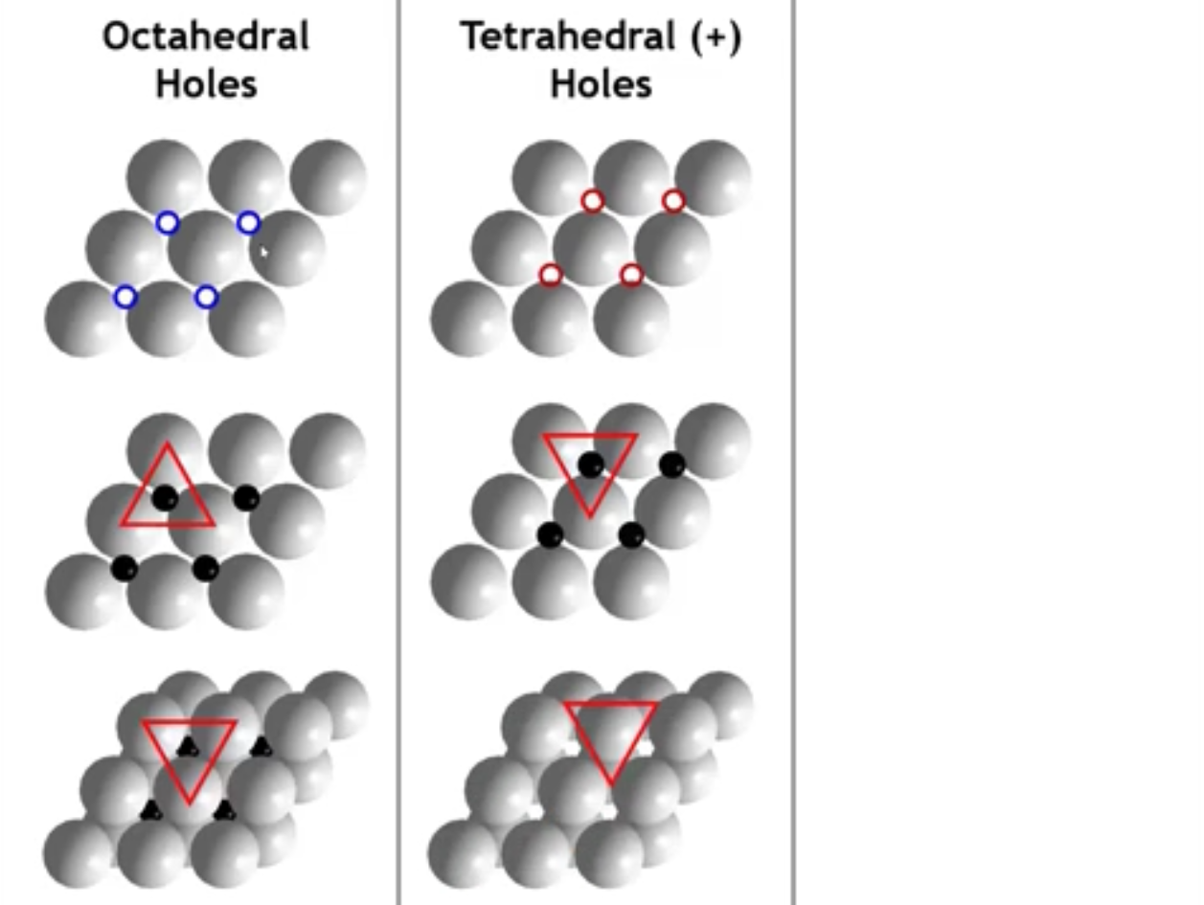
Notes:
But the difference is now when we put the layer on top, it's going to go directly over the cation. So we have a triangular base, and then we have one neighbor on the layer above. That is a triangular-based pyramid, which is basically a tetrahedron. Now the cation, in this case, is going to be sitting closer to the bottom layer than it is to the top layer so that we can make all four distances equal.

Slide 44
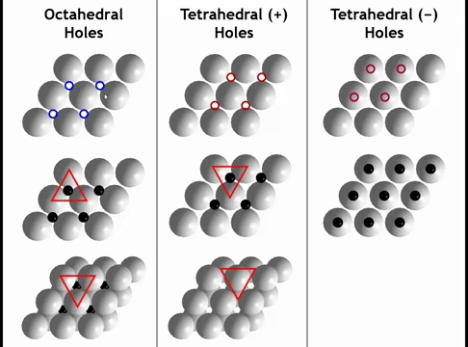
Notes:
We could also start with that same bottom layer of anions. Put cations right on top of the anions, which at first might seem counterintuitive. Why would you want to put them on top? But you could. And then when we put the next layer of anions above it, a triangle would be on top of it.

Slide 45
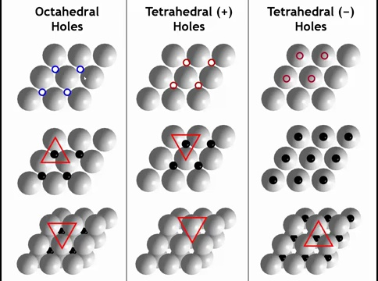
Notes:
So now we have a triangular base of neighbors above it, and one neighbor below it. Well, that's just a tetrahedron, too, but the tetrahedron is now pointing down. So we call these the tetrahedral plus holes and the tetrahedral minus holes. And the most important thing to get from this is that there are twice as many tetrahedral holes in one of these structures as there are octahedral holes.

Slide 46
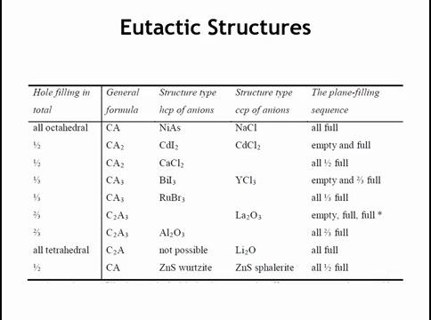
Notes:
We can describe many ionic structures by asking: do the cations fill octahedral holes or tetrahedral holes, and is the anion lattice HCP or CCP (FCC)?
Fill all octahedral holes
HCP anions → nickel arsenide structure
CCP anions → sodium chloride (NaCl) structure
In both, stoichiometry = 1:1, since the number of octahedral holes equals the number of anions.
Fill all tetrahedral holes
CCP anions → lithium oxide (Li₂O), “anti-fluorite”
Called anti-fluorite because swapping anions/cations gives fluorite (CaF₂).
HCP anions → no known stable structure.
And to see why next slide:

Slide 47
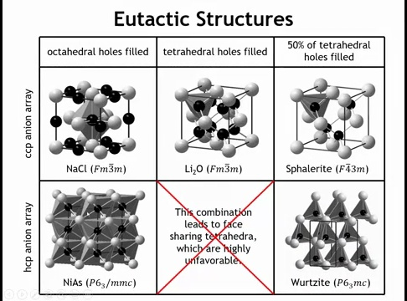
Notes:
cubic close-packed (CCP) array of anions corresponds to the FCC unit cell, with anions on the corners and faces. Filling all octahedral holes gives the NaCl structure, where octahedra share only edges. This structure is common for both highly ionic salts (NaCl, NaF) and less ionic compounds.
If instead we fill the octahedral holes in an HCP array, we obtain the NiAs structure. Here, octahedra share edges in-plane and faces between layers. Face-sharing brings cations very close together, which is unfavorable for highly ionic compounds, so NiAs is observed mainly in systems with significant covalency.
Filling all tetrahedral holes in a CCP array yields Li₂O (anti-fluorite), with oxide ions at FCC sites and lithium ions in tetrahedral sites. The related fluorite (CaF₂) structure is obtained by swapping cations and anions. In contrast, filling all tetrahedral holes in an HCP array would produce face-sharing tetrahedra, leading to cation–cation distances shorter than cation–anion distances, which is unstable; no such structure exists.
When only half the tetrahedral holes are filled, two important structures arise:
CCP anions → sphalerite (zinc blende), key for many semiconductors.
HCP anions → wurtzite, another major semiconductor structure.

Slide 48
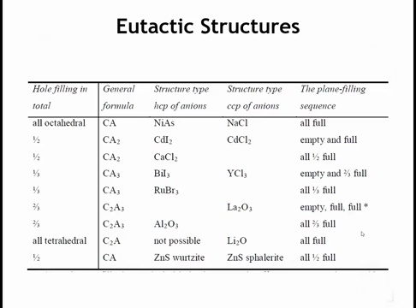
Notes:
ow let’s consider structures formed by partially filling octahedral holes.
Half-filled, symmetric arrangement → CaCl₂ structure
Filling half the octahedral sites in an ordered, uniform way produces the calcium chloride structure.
Layered, asymmetric filling → CdI₂ / CdCl₂ structures
Alternatively, filling all octahedral sites in some layers and leaving others empty creates layered structures such as cadmium iodide and cadmium chloride.

Slide 49
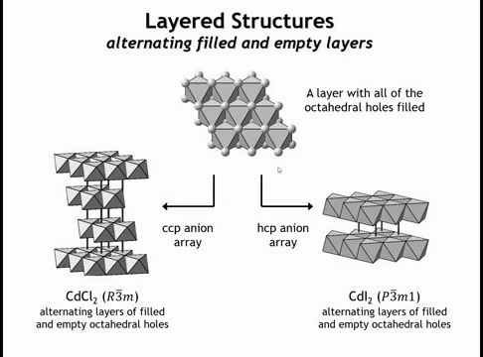
Notes:
In these structures, the filled layers consist of infinite sheets of edge-sharing octahedra, separated by empty layers of voids. This leads to compounds such as CdCl₂ (CCP anions) and CdI₂ (HCP anions), both of which are inherently layered structures.
Because of their layering, they exhibit two-dimensional electronic properties, making them relevant to modern 2D materials research. But why do cations concentrate in some layers and leave others empty, rather than maximizing separation? The answer is that these are not purely ionic structures.
They typically involve large, polarizable anions (I⁻, Br⁻, Cl⁻, Se²⁻) and cations that form partly covalent bonds. The layers themselves are held together mainly by dispersion forces, reflecting reduced ionic character.

Slide 50
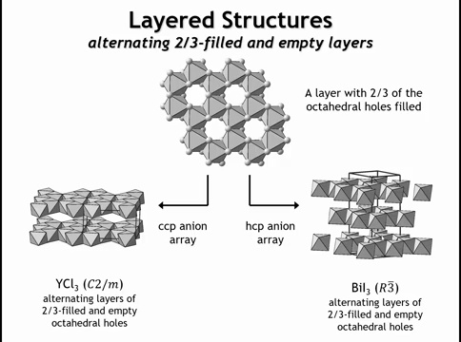
Notes:
If we fill only two-thirds of the octahedral holes in a close-packed layer, the result is a honeycomb-like pattern. Viewed as polyhedra, the octahedra form the same arrangement as atoms in graphene.
If the next layer above is left empty, the stacking alternates two-thirds filled / empty, which averages to one-third of the octahedral holes filled overall. This gives structures with 1:3 stoichiometry (cation:anion).
HCP anions → BiI₃ structure
CCP anions → YCl₃ structure

Slide 51
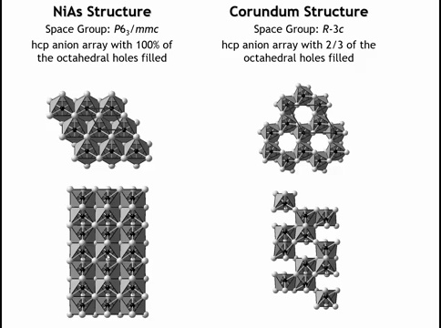
Notes:
The NiAs structure (all octahedral holes filled in an HCP array of anions) is not favored when bonding is highly ionic, because it creates infinite chains of face-sharing octahedra, bringing cations too close together.
If instead one-third of the octahedral holes are left vacant, the result is a layered, graphene-like arrangement with filled–filled–empty sequences. Stacking these with HCP anions gives the corundum structure (Al₂O₃, hematite Fe₂O₃).
This structure is stable for more ionic compounds because the vacancies break up the infinite face-sharing columns, reducing cation–cation repulsion.

Slide 52
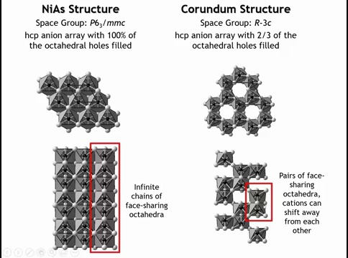
Notes:
The NiAs structure (all octahedral holes filled in an HCP array of anions) is not favored when bonding is highly ionic, because it creates infinite chains of face-sharing octahedra, bringing cations too close together.
If instead one-third of the octahedral holes are left vacant, the result is a layered, graphene-like arrangement with filled–filled–empty sequences. Stacking these with HCP anions gives the corundum structure (Al₂O₃, hematite Fe₂O₃).
This structure is stable for more ionic compounds because the vacancies break up the infinite face-sharing columns, reducing cation–cation repulsion.

Slide 53
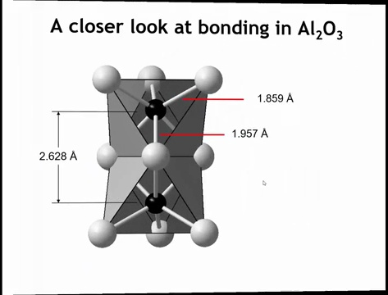
Notes:
And because there are these empty octahedral holes, the cations in the filled octahedral holes can move away from each other toward the empty space. And we can see that if we were to look at the mineral correndum and at the bond distances here. So you can see at the shared phase, the aluminum oxide distances is 1.96 angstroms, whereas the aluminum oxide distance to the bonds above it would be 1.86. So we can see that the aluminum ions are moving away from each other toward the vacancy that's above and below this dimer. And that alleviates the unfavorable ionic interactions of the shared phase.

Slide 54
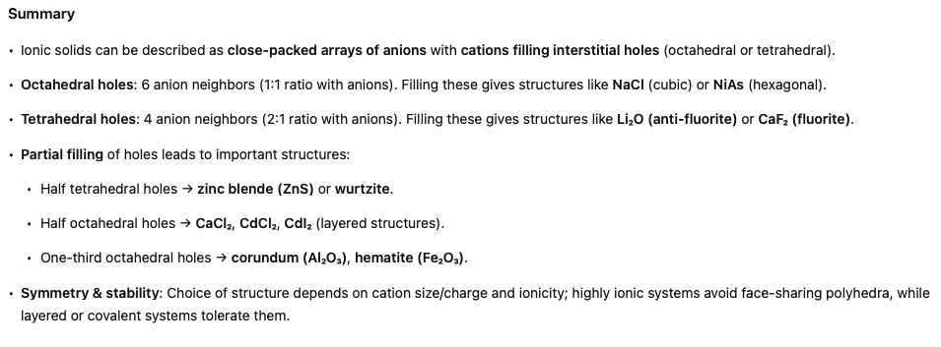

Slide 55
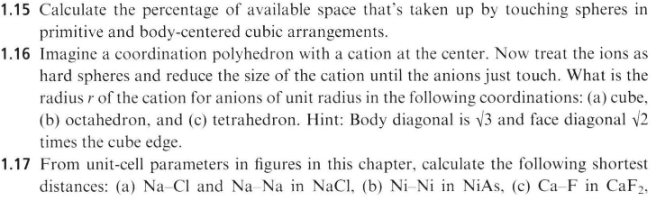
Homework:

