Slide 1
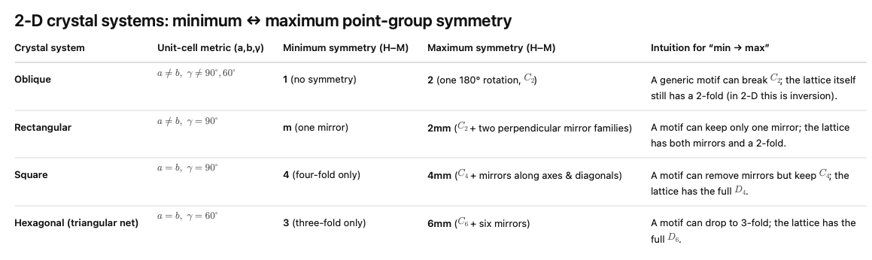
From last time, I want to clarify what 4mm and 6 mm mean.
Notes:
In both symbols the “mm” means mirror planes that contain the rotation axis. 4mm (C4v) = one 4-fold rotation axis with four vertical mirror planes in two perpendicular families (along axes and along diagonals). 6mm (C6v) = one 6-fold rotation axis with six vertical mirror planes in two alternating families (through hexagon axes and bisectors). Both are non-centrosymmetric and polar along the principal axis. “mm” literally means “two mutually perpendicular mirror planes that both contain the principal axis.”

Slide 2
Note to self: If you teach this lecture again you should make it easier for yourself to know which symmetry operations go with what parts of the figure for every figure that you show.

Slide 3
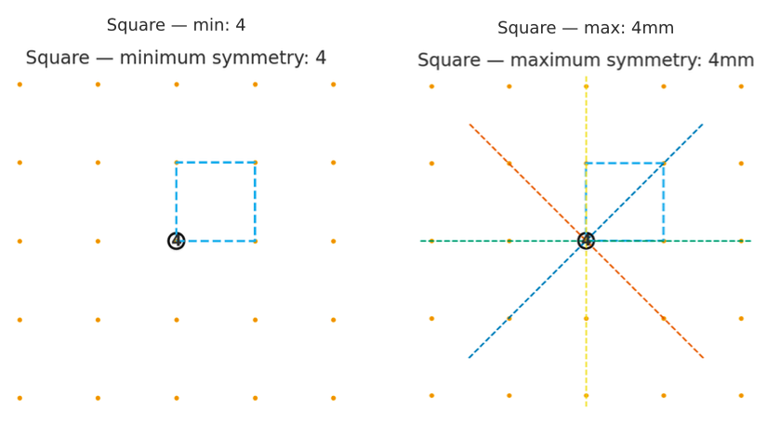
Notes:
4mm (C4v) = one 4-fold rotation axis with four vertical mirror planes in two perpendicular families (along axes and along diagonals).

Slide 4
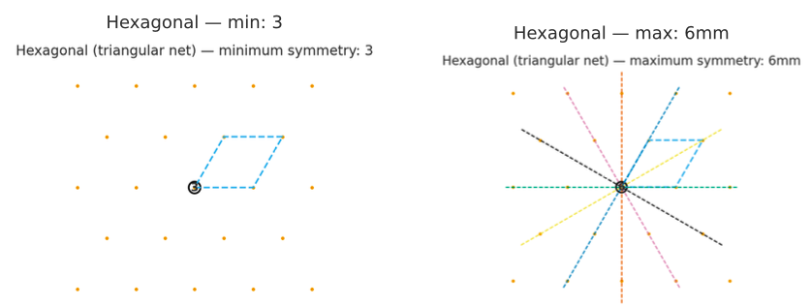
Notes:
6mm (C6v) = one 6-fold rotation axis with six vertical mirror planes in two alternating families (through hexagon axes and bisectors)

Slide 5
Homework
List the five fundamental point-symmetry elements and briefly describe what each does.
Why are only 2-, 3-, 4-, and 6-fold rotations allowed in crystals?
Notes:
1. Identity (E): Does nothing; every object has it.
Inversion (i): Maps (x, y, z) to (−x, −y, −z) through a center.
Mirror plane (m): Reflects across a plane.
Proper rotation axis (N): Rotation by 360°/N about an axis; repeat N times to return to start.
Rotoinversion axis (N̅): Rotate by 360°/N, then invert through a point.
2. Because only these rotational symmetries are compatible with translational periodicity. Rotations like 5-fold or 8-fold cannot fill three-dimensional space without leaving gaps or overlaps, so they are forbidden in periodic lattices.

Slide 6
Homework Question
Notes:
The symbol direction refers to the corner of a cube, hence [111] [−111] [1−11] [11−1] [−1−11] [−11−1] [1−1−1] [−1−1−1] or likewise with overbars replacing minuses.

Slide 7
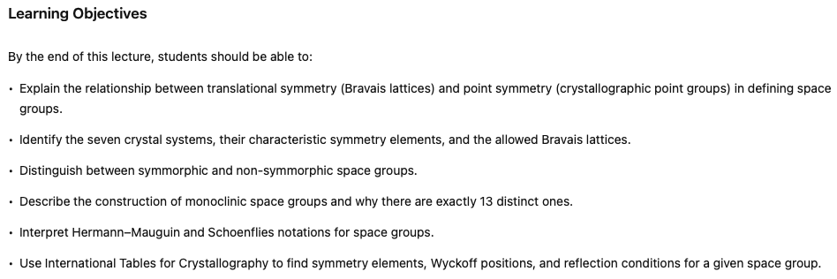

Slide 8
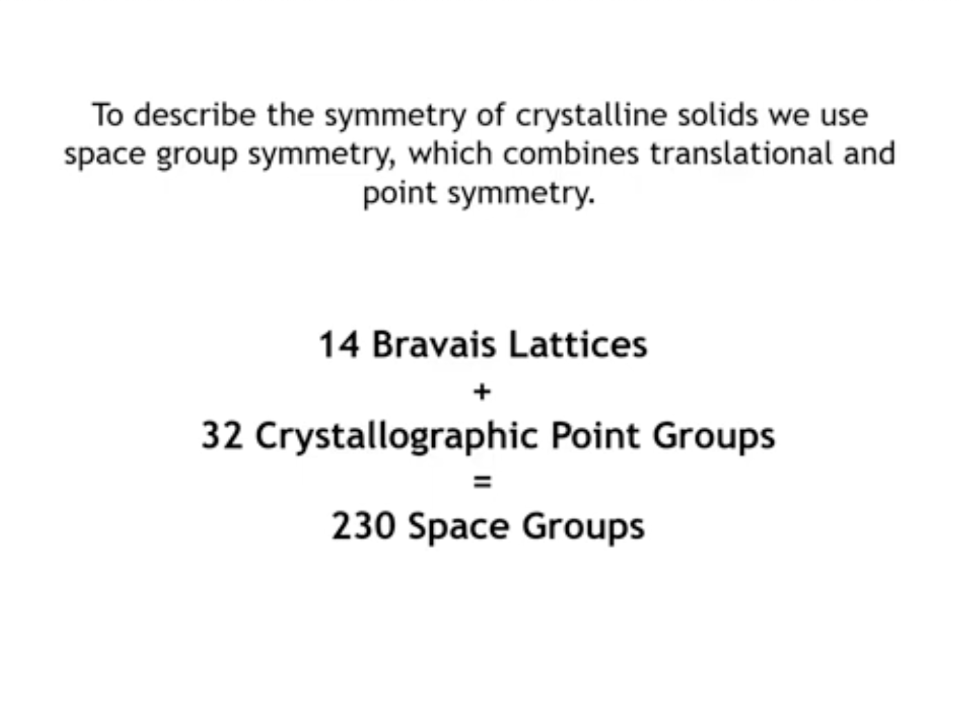

Slide 9
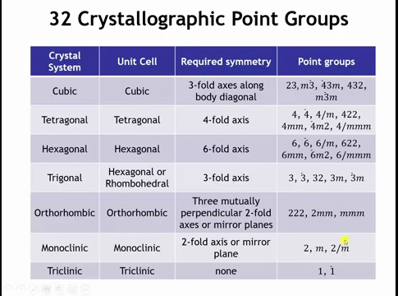

Slide 10
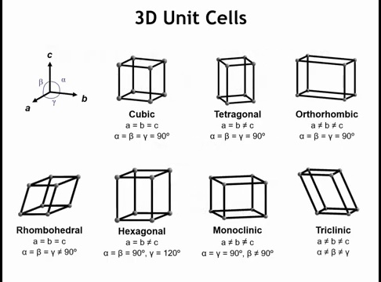

Slide 11
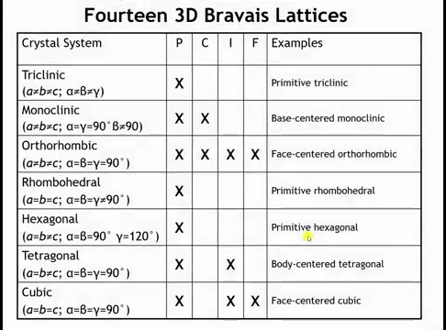

Slide 12
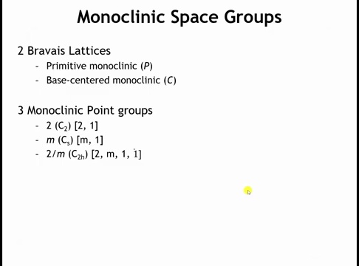

Slide 13
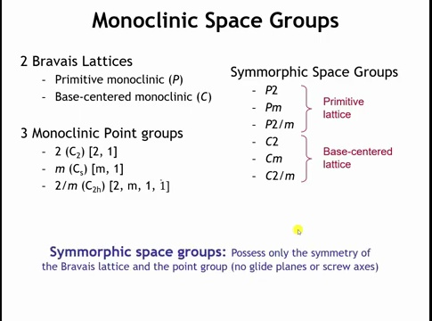

Slide 14
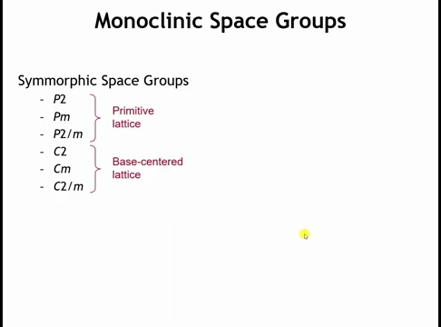

Slide 15
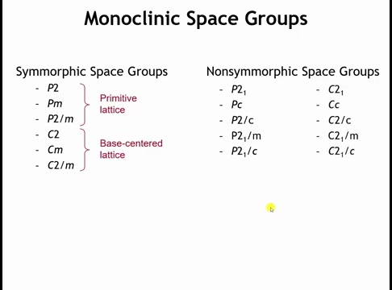

Slide 16
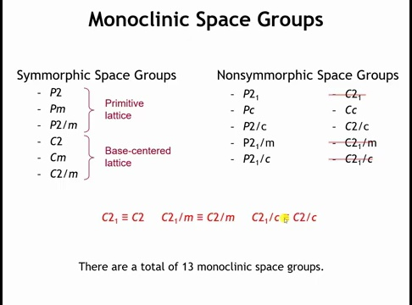
Notes:
C2 is a base-centered monoclinic lattice with a twofold rotation axis (180°) along the b-direction.
C21 looks different at first: it’s supposed to have a 21 screw axis along b (a 180° rotation plus a translation of ½b).
The key is the C-centering translation:
In a C-centered monoclinic cell, every motif is duplicated by the centering translation (½a + ½b).
If you apply the twofold rotation of C2, you get a rotated motif.
If you then apply the centering translation, you generate a partner motif shifted by ½b, which is exactly the screw component of a 21 axis.

Slide 17
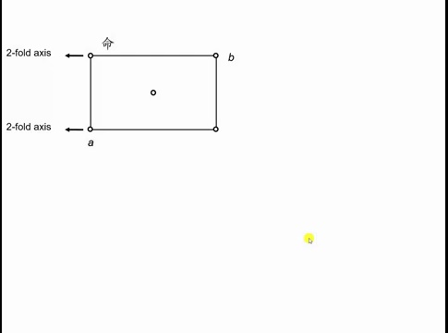

Slide 18
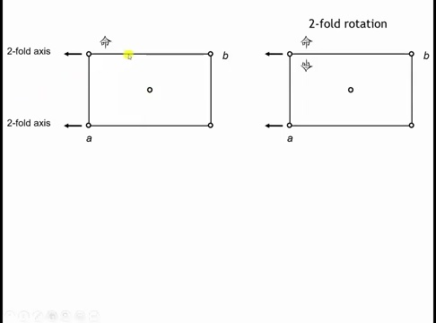

Slide 19
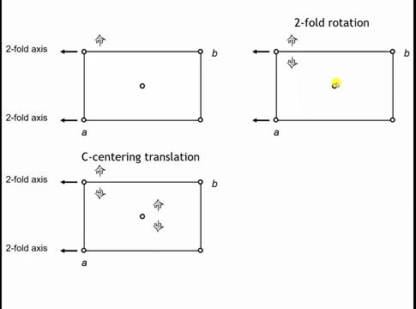

Slide 20
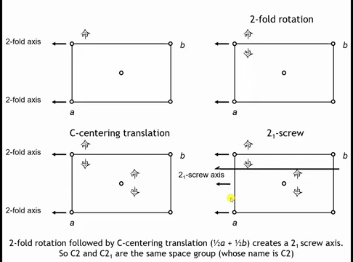

Slide 21
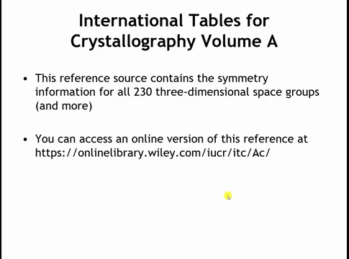

Slide 22
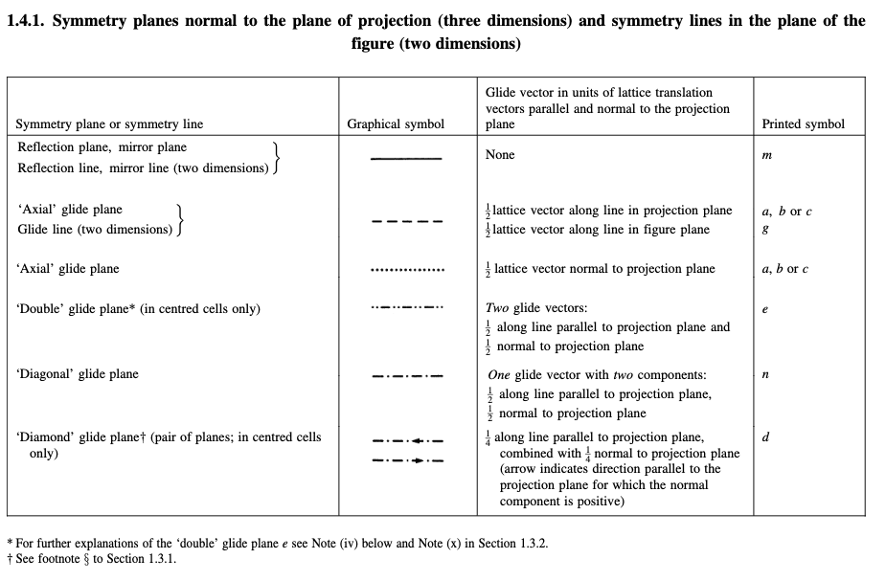

Slide 23
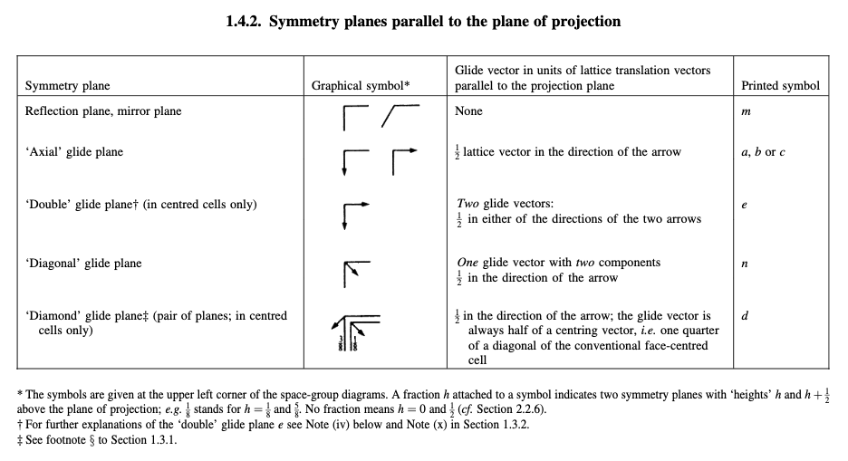

Slide 24
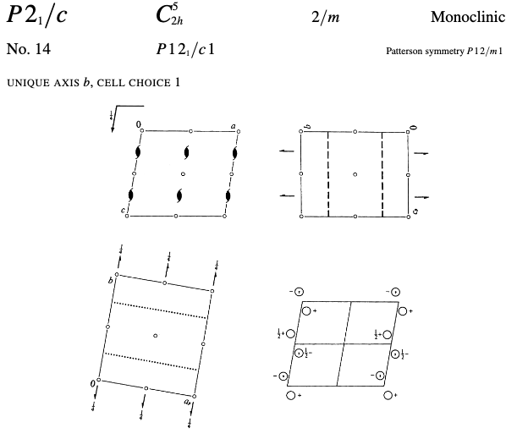

b
a
c
c
b
a

Slide 25
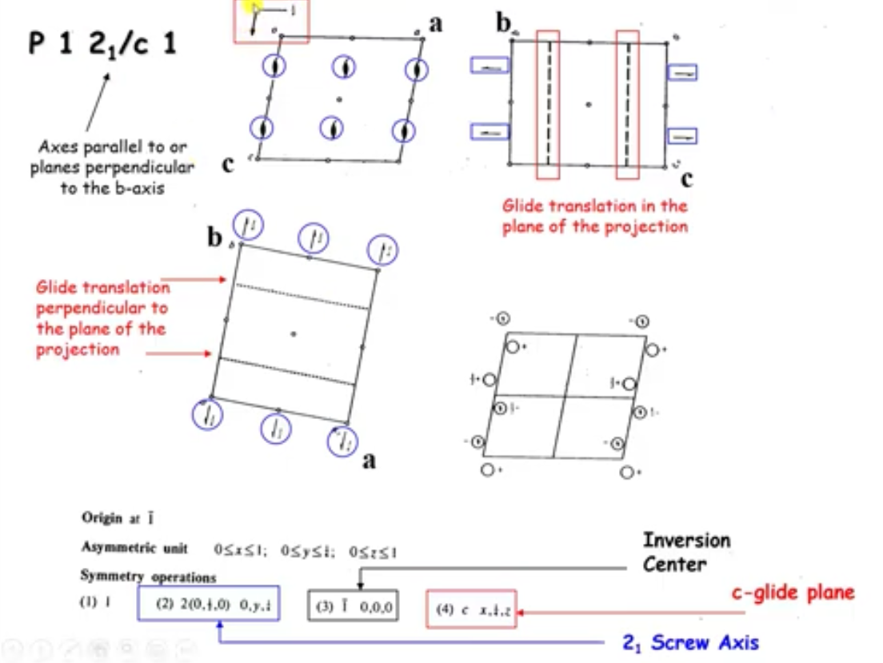

Slide 26
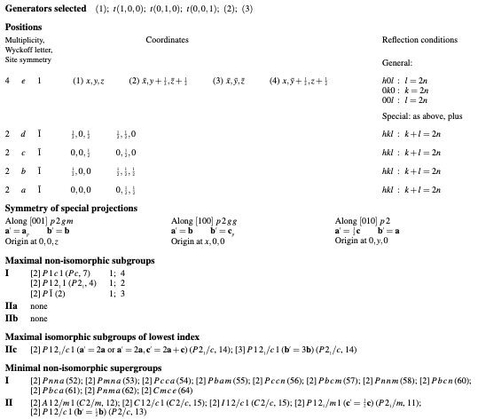
Page 2

Slide 27
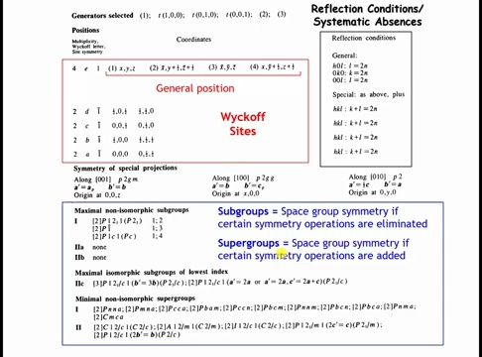

Slide 28
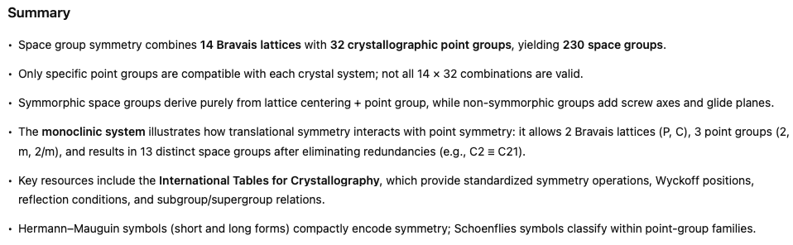

Slide 29
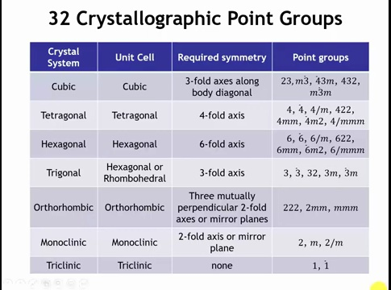

Slide 31
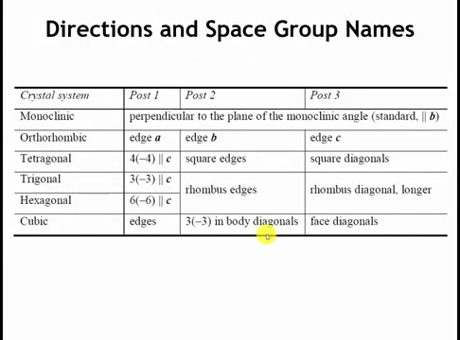
Post = the conventional direction in a crystal along which the principal symmetry element (rotation axis, mirror, or inversion axis) of the crystal system is oriented.
So when the table lists “Post 1, Post 2, Post 3,” it is giving the standard orientation of symmetry axes for that crystal system.

Slide 32
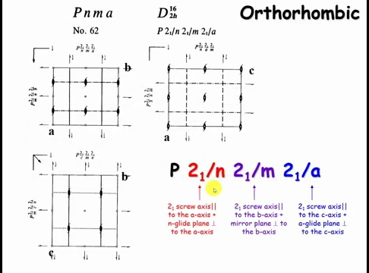

Slide 33
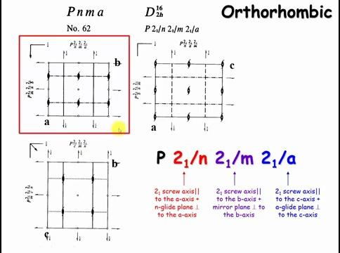

Slide 34
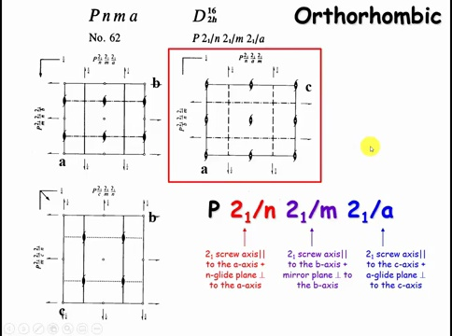

Slide 35
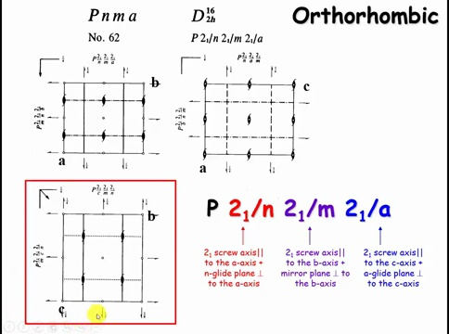

Slide 36
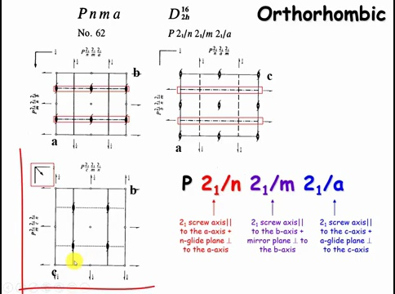

Slide 37
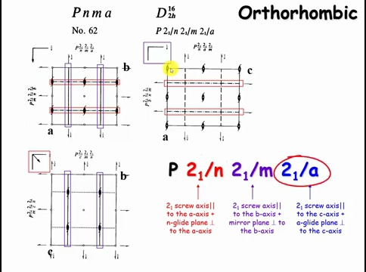

Slide 38
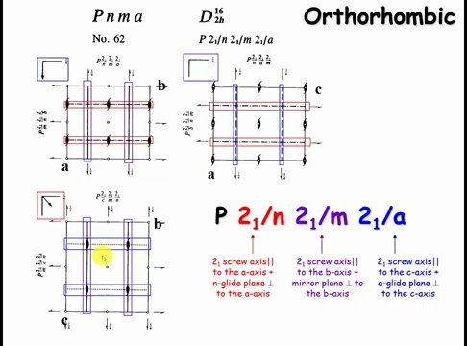

Slide 39
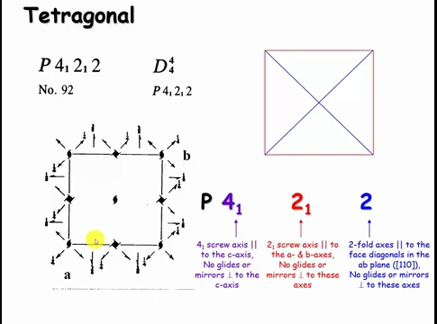

Slide 40
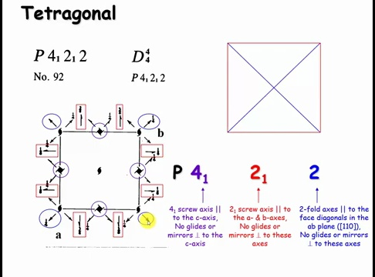

Slide 41
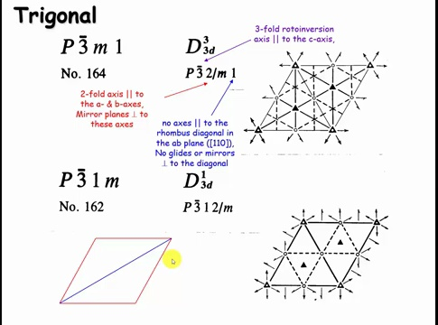

Slide 42
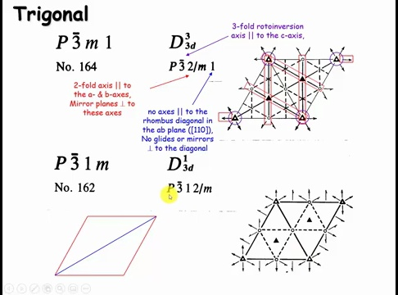

Slide 43
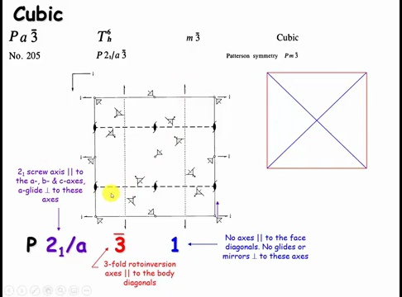

Slide 44
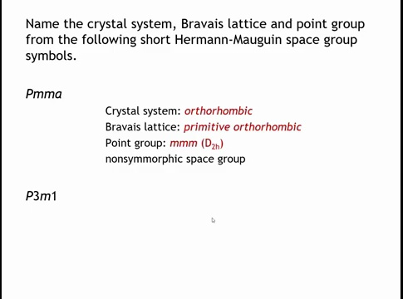

Slide 46
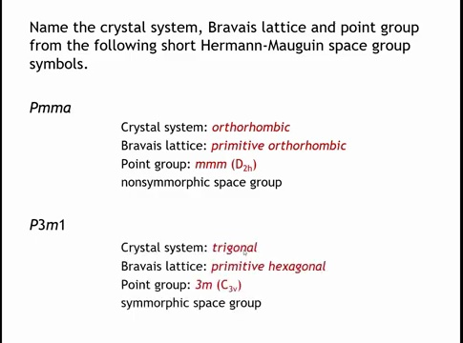

Slide 47
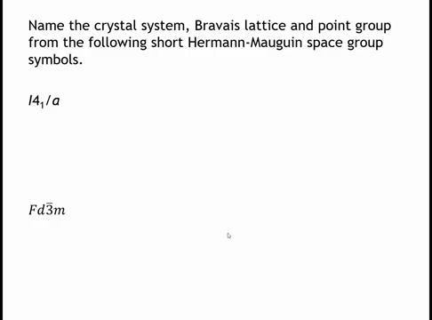
Notes:
For I41/a: tetragonal crystal system; body‑centered tetragonal Bravais lattice; point group 4/m (C4h); nonsymmorphic space group.
For Fd3̅m: cubic crystal system; face‑centered cubic Bravais lattice; point group m3m (Oh); nonsymmorphic space group; method recap—identify centering, read the principal axis and screws, note perpendicular mirrors/glides, and remove translations to recover the underlying point group.

