Slide 1
Homework:
Consider the cubic crystal system. Why is there no distinct “base-centered cubic” lattice?
Notes:
There is no distinct “base-centered cubic” Bravais lattice because a base-centered cubic unit cell is not the smallest possible primitive description of the lattice.
In the cubic system, all three lattice vectors must be equal in length and mutually perpendicular.
If you try to add lattice points only to two opposite faces of a cube (making it “base-centered”), those extra points are not symmetry-equivalent to the cube corners under cubic symmetry.
Instead, the array of points you generate can be described more simply as a primitive tetragonal lattice with a smaller unit cell. In other words, the base-centered cubic is just a redundant choice of cell vectors.

Slide 2

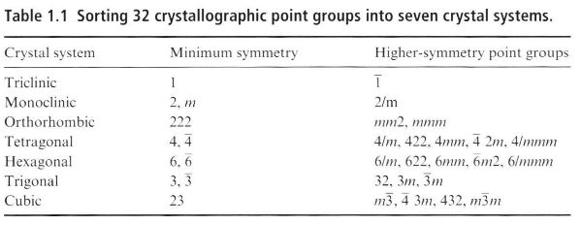
Homework
Notes:
Four crystal systems; square with minimum symmetry 4 (or maximum 4mm), hexagonal with minimum symmetry 3 (maximum 6mm), rectangular with minimum symmetry m (or maximum 2mm) and oblique (tilted parallelograms) with axis 1 as minimum or 2 as maximum. Five Bravais lattices; primitive of the above systems plus a centered rectangular lattice. The other symmetry-maintaining centerings are equivalent to the primitive lattices.

Slide 3
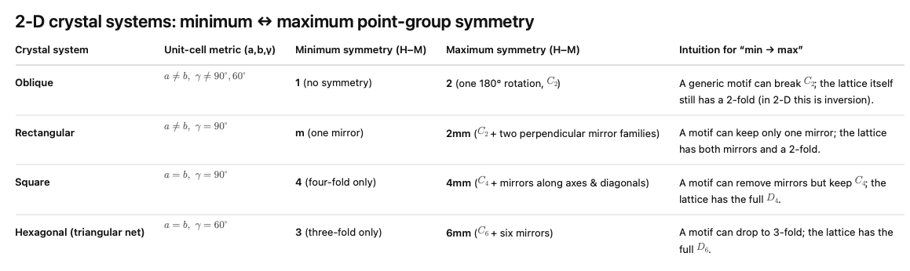

Slide 4
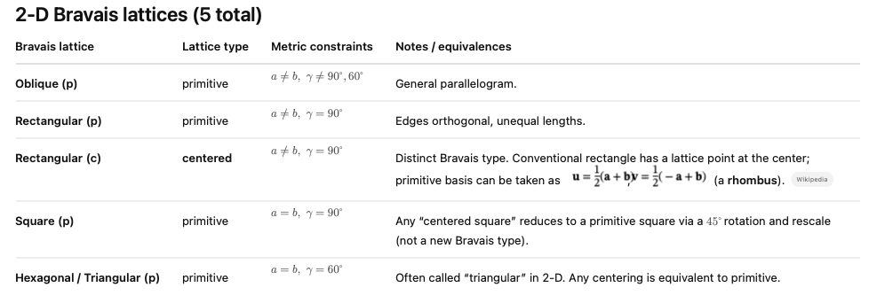

Slide 5
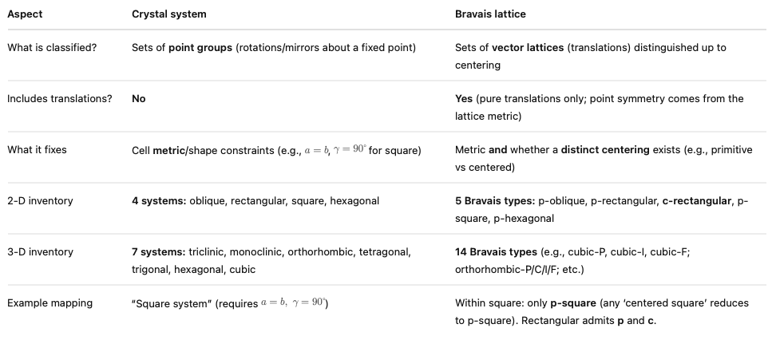

Slide 6
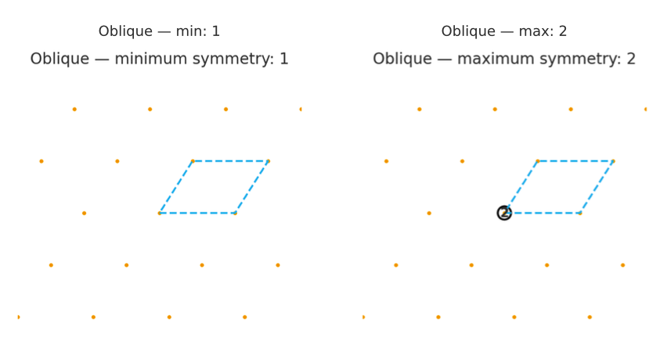
Notes:
The lattice by itself always has the maximum point symmetry allowed by its metric (e.g., the triangular lattice has 6mm).
But when you attach a motif, you can reduce the symmetry—never increase it—because the motif may not respect all the lattice operations.

Slide 7
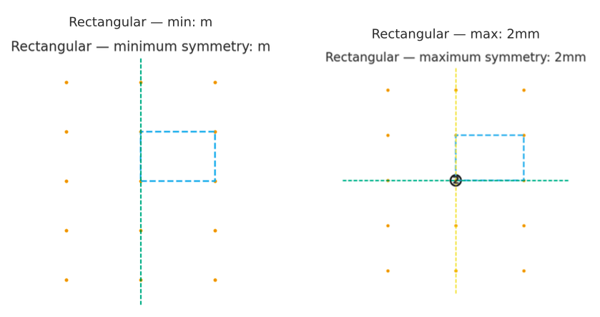

Slide 8
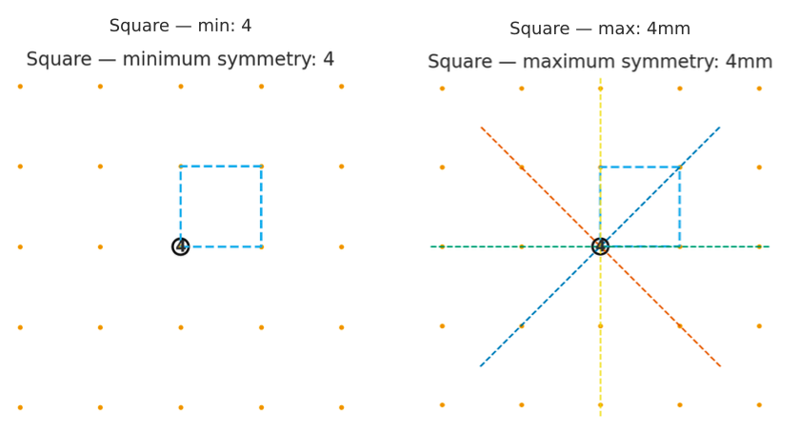

Slide 9
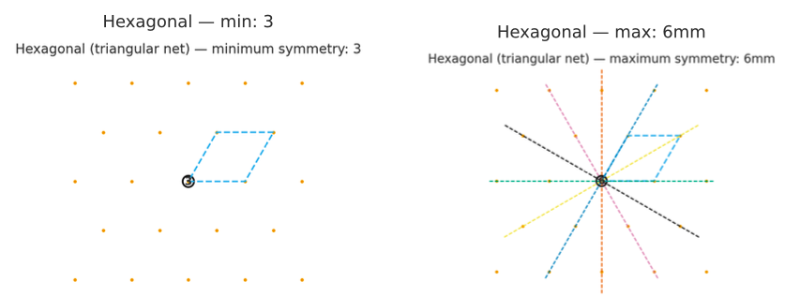

Slide 10
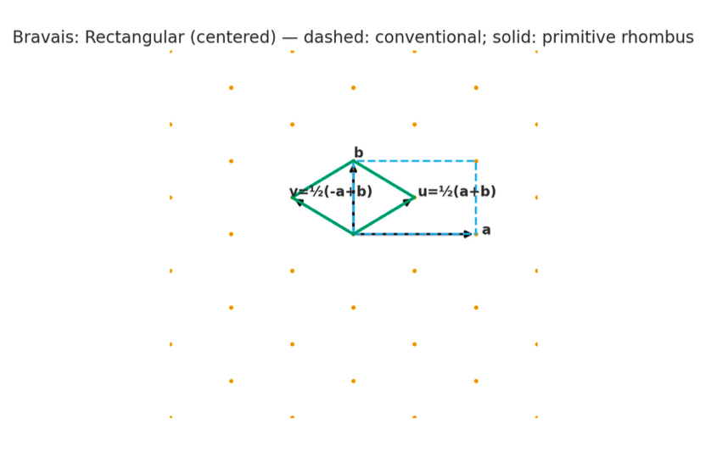

Slide 11
Learning Objectives
Define and describe the basic crystallographic point-symmetry elements (identity, inversion, mirror, rotation, rotoinversion).
Distinguish between point groups (fixed point symmetry only) and space groups (point symmetry plus translation).
Recognize and interpret non-symmorphic symmetry elements (glide planes and screw axes).
Understand why only 2-, 3-, 4-, and 6-fold rotations are compatible with a lattice.
Relate sets of symmetry elements to crystal systems, with the idea that these are organized into the 32 crystallographic point groups.

Slide 12
What is a Symmetry Operation?
A symmetry operation is any transformation (rotation, reflection, inversion, translation, etc.) that maps a structure onto itself — i.e. after applying it, the object is indistinguishable from where it started.
Symmetry is a way crystallographers classify different types of crystals.
Notes:
We have already met the concept symmetry in relation to crystal structures: the lattice generates the translational symmetry—the motif is repeated on every lattice point.

Slide 13
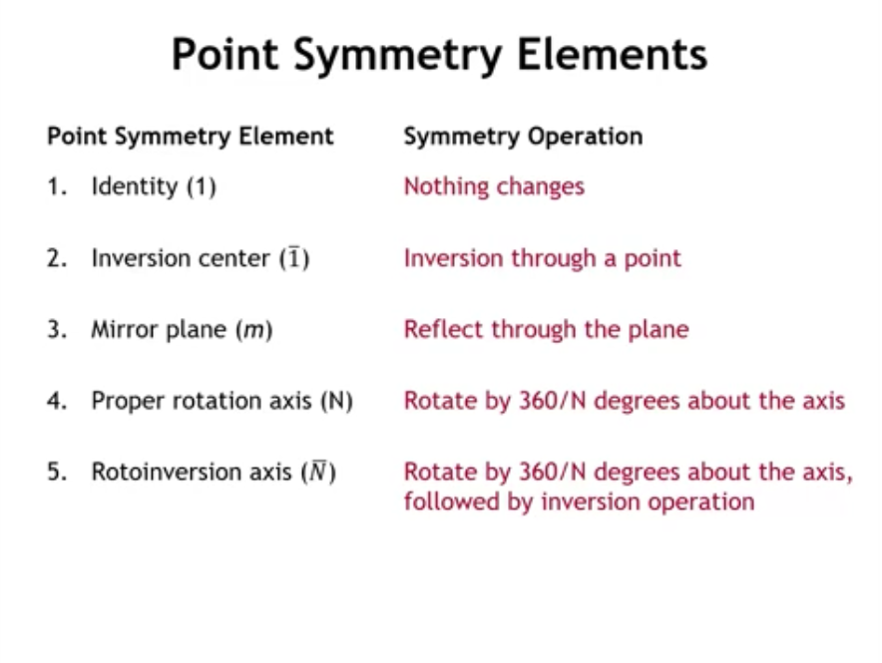
Notes:
Point Symmetry Elements. these are the fundamental operations that leave an object centered at a point unchanged. They’re the building blocks of crystallographic symmetry.
Idenity – doing nothing. Inversion center -

Slide 14
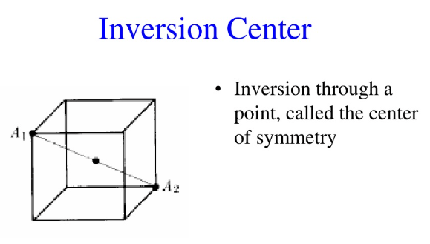

Slide 15
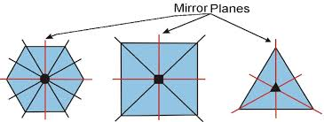

Slide 16
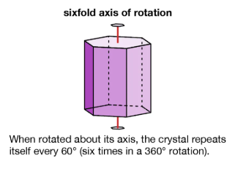

Slide 17
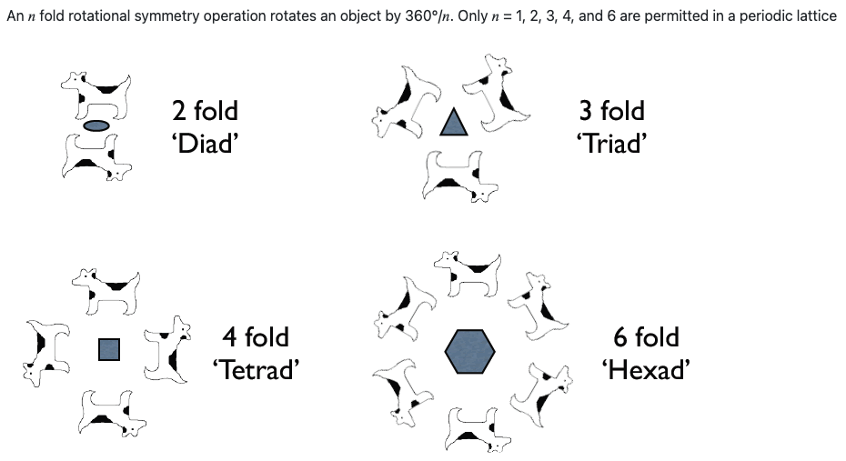

Slide 18
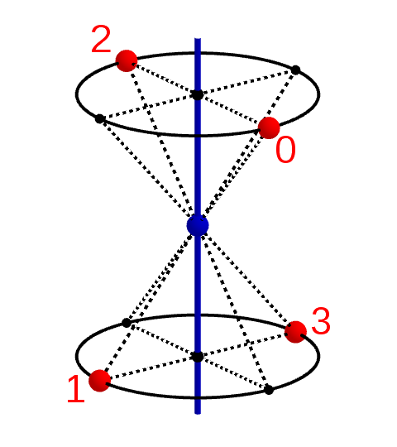
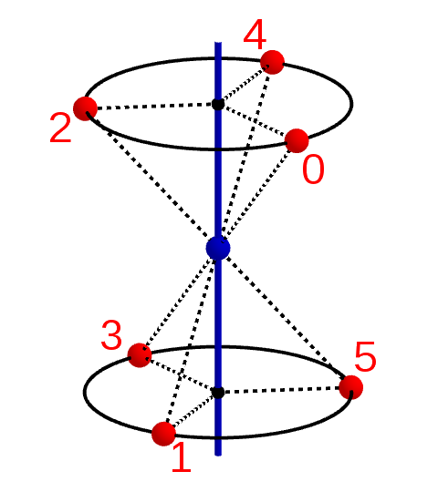
RotoInversion

Slide 19
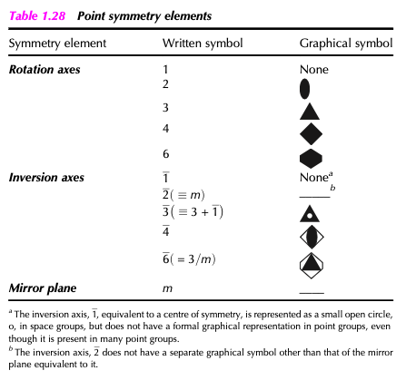
From West, Solid State Chemistry and its Applications

Slide 20
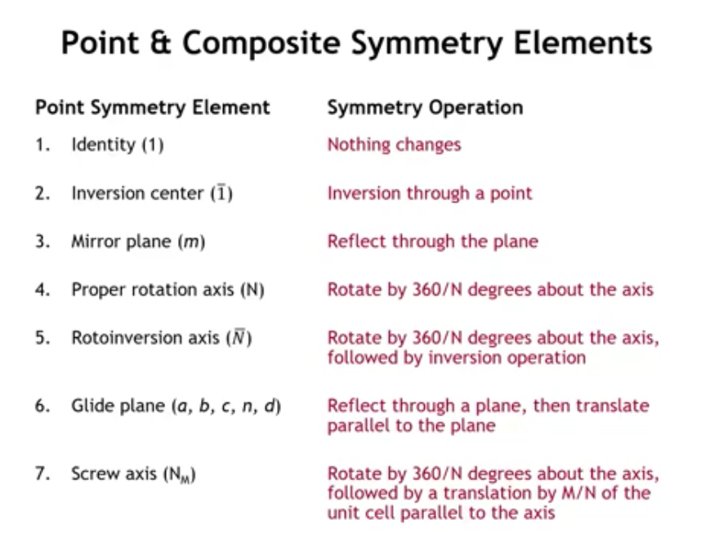

Slide 21
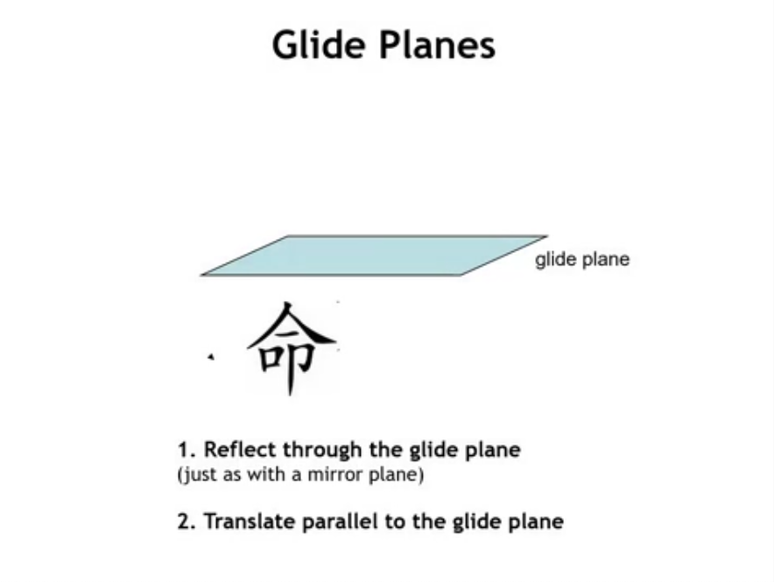

Slide 22
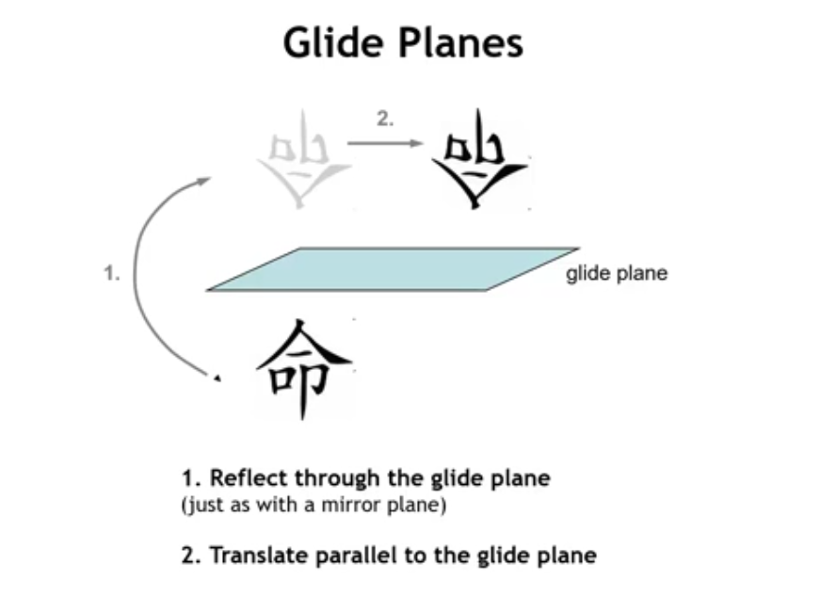

Slide 23
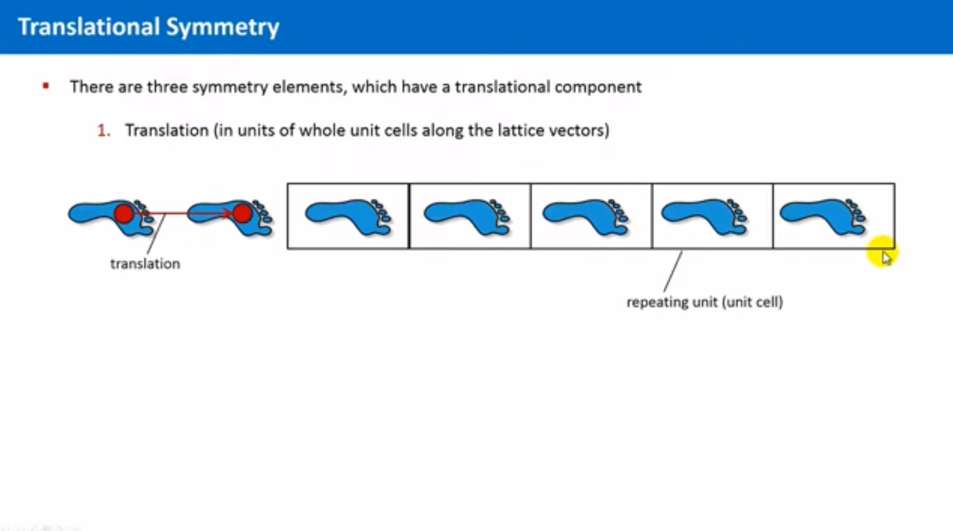

Slide 24
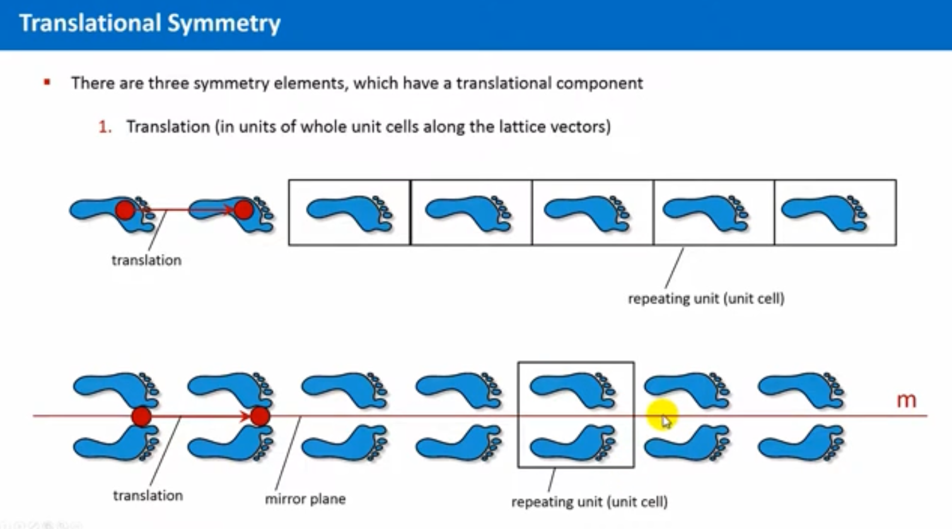

Slide 25
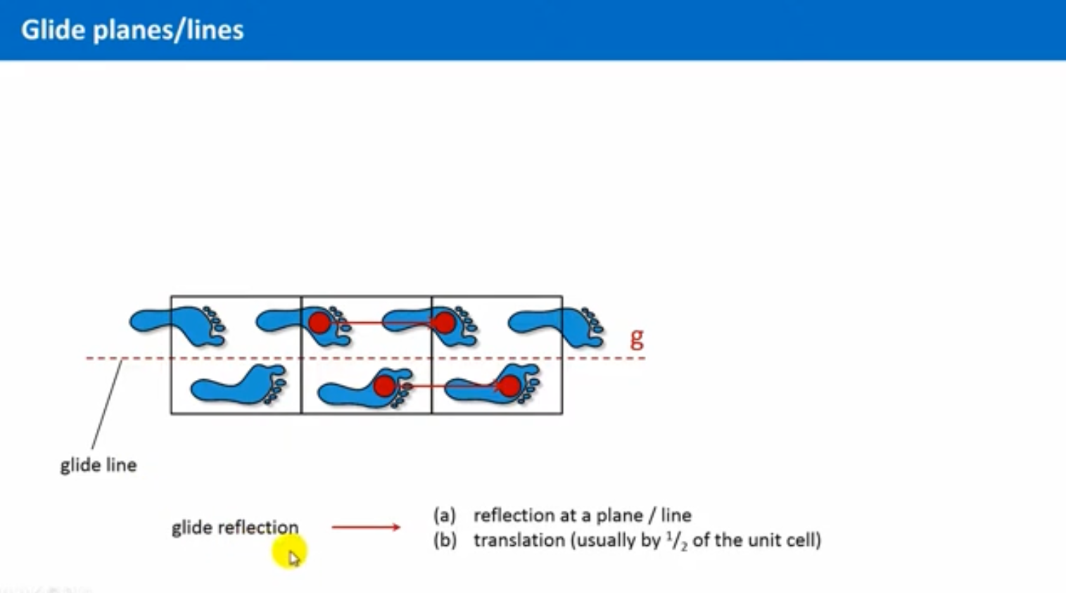

Slide 26
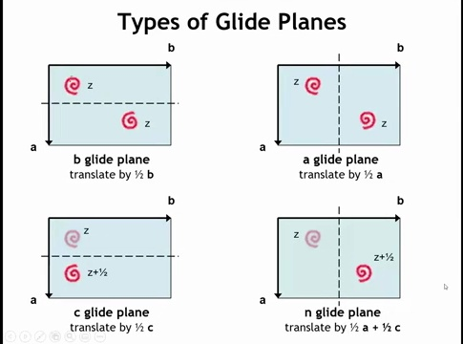

Slide 27
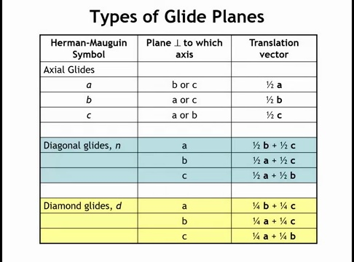

Slide 28
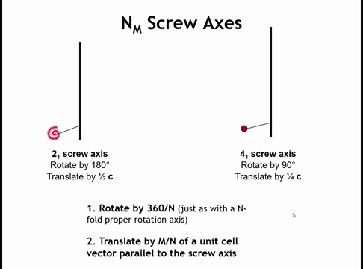

Slide 29
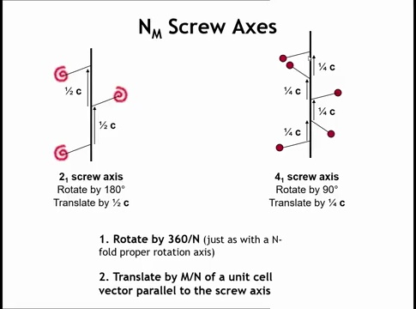

Slide 30
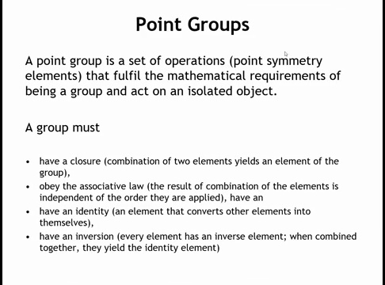
Notes:
Let's take a twofold rotation axis. And let's have a mirror plane perpendicular to it. And I want you to tell me, is that a valid point group, just those two symmetry operations. And if not, what other symmetry operations do we need to add to those two operations or elements to get a valid point group?

Slide 31
Question
Let's take a twofold rotation axis. And let's have a mirror plane perpendicular to it.
Is that a valid point group, just those two symmetry operations?
If not, what other symmetry operations do we need to add to those two operations or elements to get a valid point group?

Slide 32
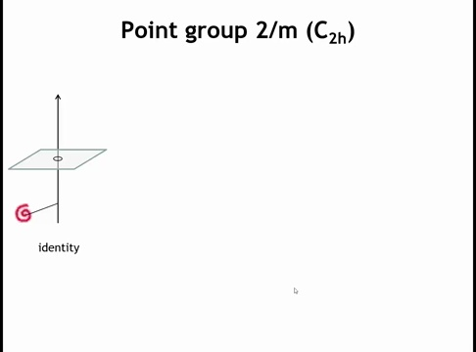

Slide 33
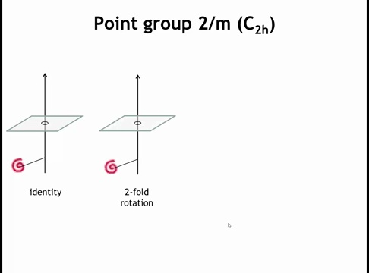

Slide 34
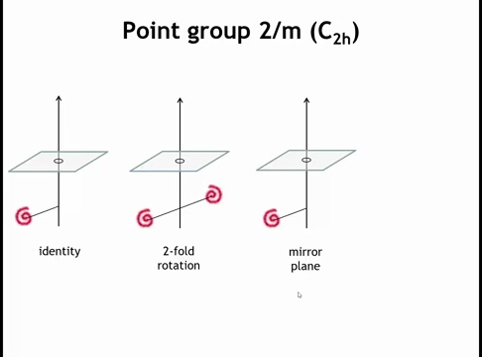

Slide 35
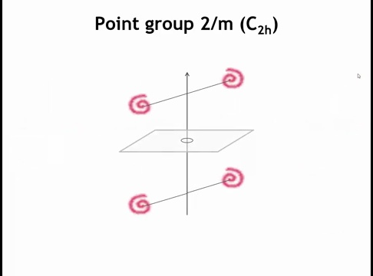

Slide 36
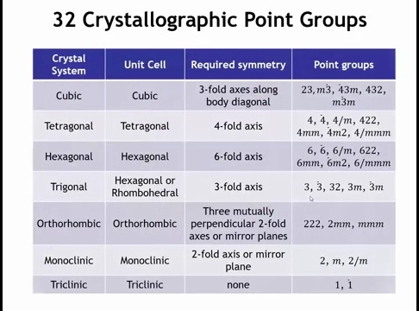

Slide 37
Who Cares about Point Groups?
This classification gives a “shorthand” for the full set of symmetries — instead of listing all operations one by one, you just say “C₂v” or “m3̅m” and an expert immediately knows the symmetries present.
Many physical properties (optical, electrical, mechanical) depend directly on the symmetry of the crystal:
Piezoelectricity only occurs in non-centrosymmetric point groups.
Ferroelectricity only occurs in certain polar point groups.
Optical anisotropy (birefringence) depends on whether the point group has rotational symmetry axes that constrain refractive indices.
By knowing the point group, you can immediately rule in or rule out whole classes of properties.

Slide 38
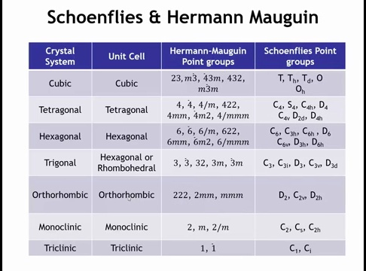

Slide 39
Homework
List the five fundamental point-symmetry elements and briefly describe what each does.
Why are only 2-, 3-, 4-, and 6-fold rotations allowed in crystals?
Notes:
1. Identity (E): Does nothing; every object has it.
Inversion (i): Maps (x, y, z) to (−x, −y, −z) through a center.
Mirror plane (m): Reflects across a plane.
Proper rotation axis (N): Rotation by 360°/N about an axis; repeat N times to return to start.
Rotoinversion axis (N̅): Rotate by 360°/N, then invert through a point.
2. Because only these rotational symmetries are compatible with translational periodicity. Rotations like 5-fold or 8-fold cannot fill three-dimensional space without leaving gaps or overlaps, so they are forbidden in periodic lattices.

Slide 40
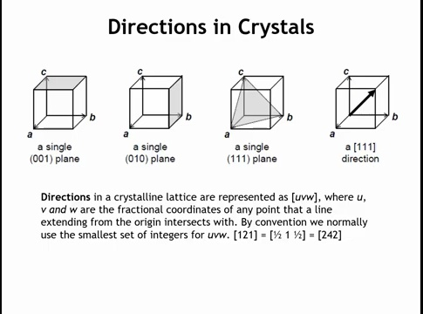

Slide 41
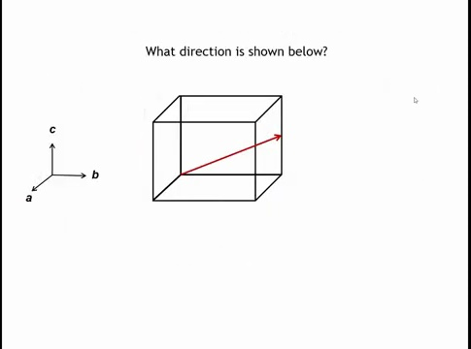

Slide 42
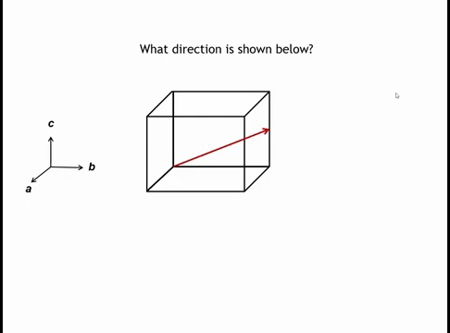

Slide 43
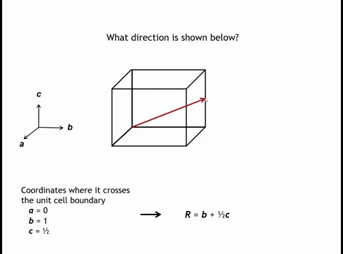

Slide 44
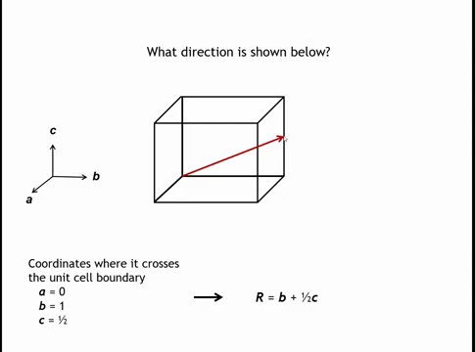

Slide 45
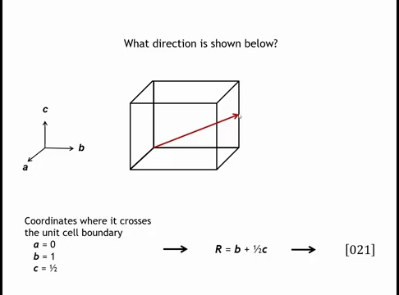

Slide 46
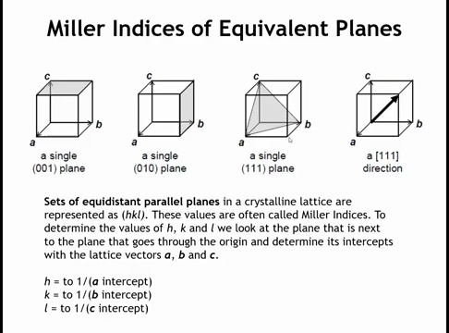

Slide 47
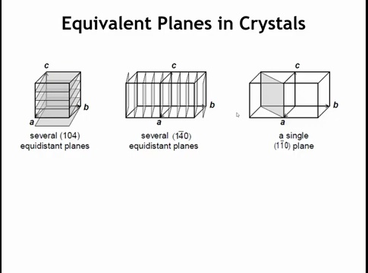

Slide 48
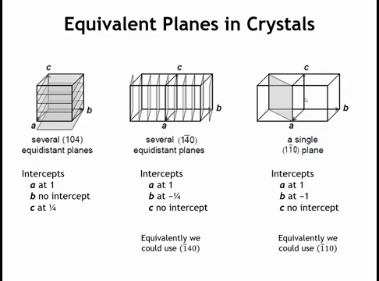

Slide 49
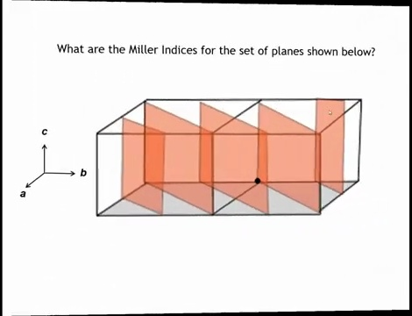

Slide 50
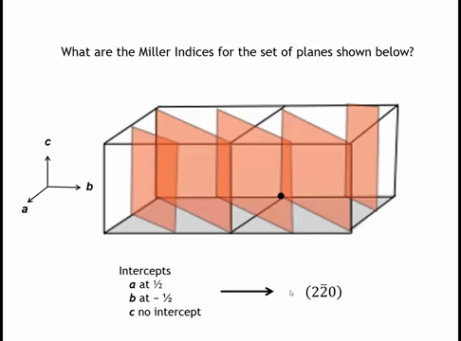

Slide 51
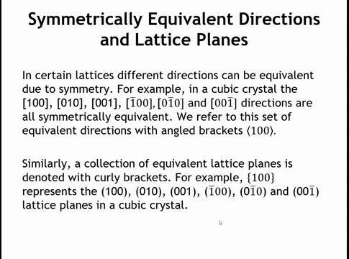

Slide 52
Homework Question
Notes:
The symbol direction refers to the corner of a cube, hence [111] [−111] [1−11] [11−1] [−1−11] [−11−1] [1−1−1] [−1−1−1] or likewise with overbars replacing minuses.

