Slide 1
Review the survey

Slide 2
We Start From the Beginning
Warning: section 1.1 of the book is very DENSE and difficult to UNDERSTAND
It is an attempt to condense several chapters of crystallography into a few pages.
We will EXPAND upon this material in the next few lectures
Other helpful ONLINE resources:
  West, Solid State Chemistry and its Applications
  Hammond, The Basics of Crystallography and Diffraction

Slide 3
A Comprehensive Mathematical Framework for Describing Crystals
One way to describe crystals is to look at the packing of the atoms using spheres as spherical representations. This is good for building some intuition.
However, it is not good for understanding ALL POSSIBLE CRYSTALS, you would be overwhelmed with trivia.
What if you could come up with the minimum mathematical framework to describe all crystals?

Slide 4
Translational Symmetry in 2D
Goal
Build intuition for lattices & unit cells in 2D
See why only certain symmetries work in crystals
Learning Objectives
Differentiate crystalline vs amorphous solids
Define lattice, vectors, unit cell
Identify shapes that tile space
Recognize allowed rotation axes (2, 3, 4, 6-fold)
See how lattice + motif → crystal (e.g. graphene)
Relationship to Text
Structures of Crystalline Materials, Ch. 1 (pp. 1–12)
1.1.1 Translational Symmetry (pp. 2–3)
1.1.2 Rotational Symmetry (pp. 3–5)
1.1.3 Crystal Systems (pp. 5–6)
1.1.4 Bravais Lattices (pp. 6–8)

Slide 5
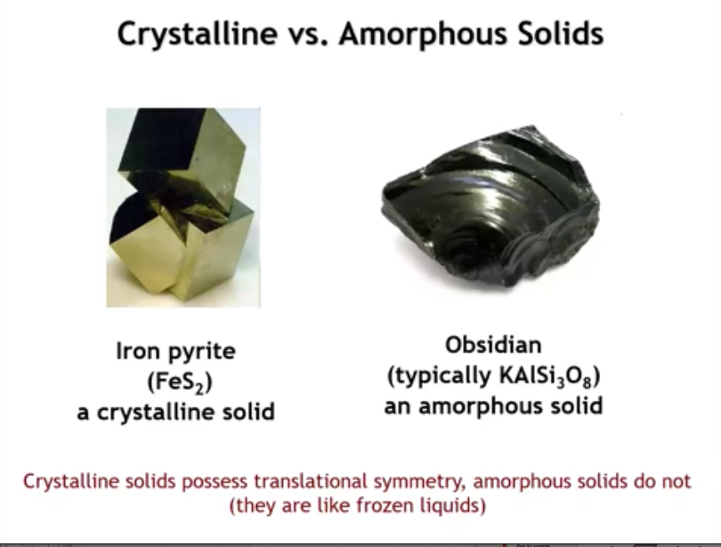

Slide 6
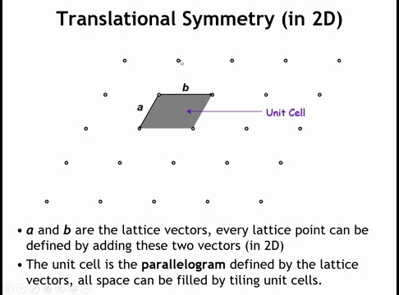

Slide 7
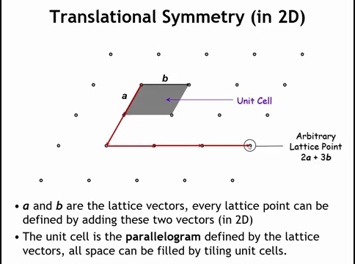

Slide 8
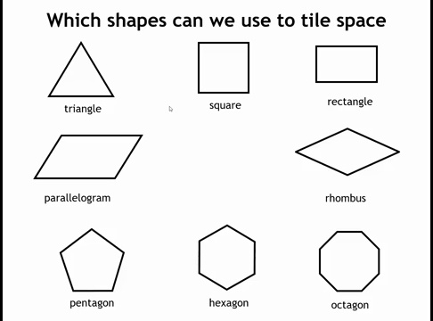

Slide 9
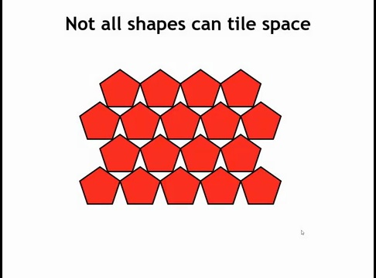

Slide 10
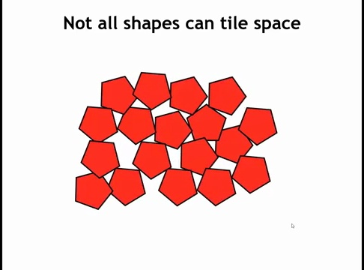

Slide 11
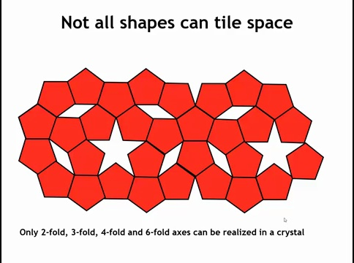

Slide 12
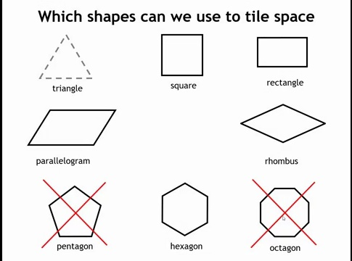

Slide 13
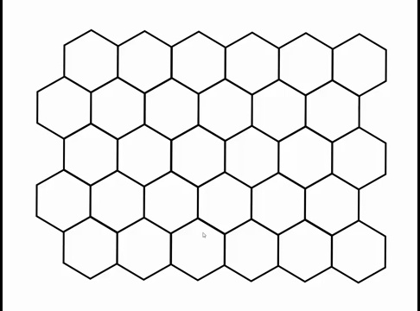

Slide 14
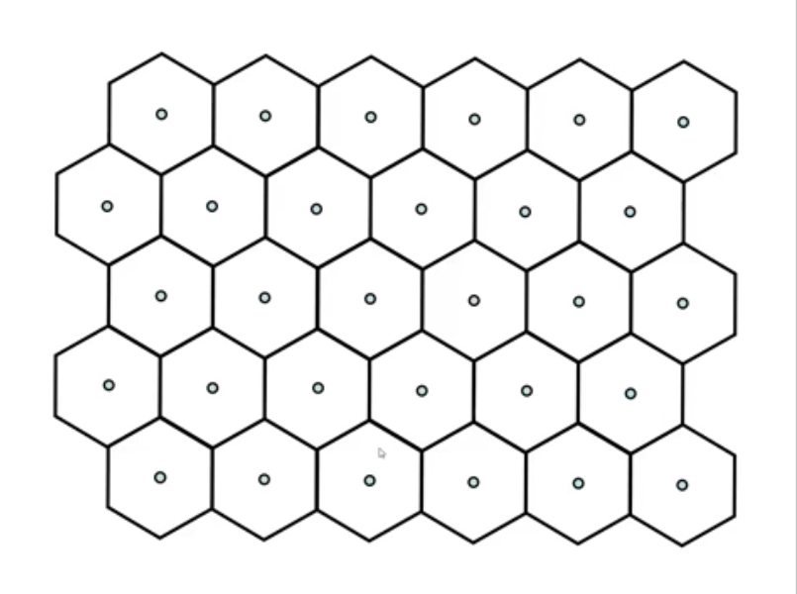

Slide 15
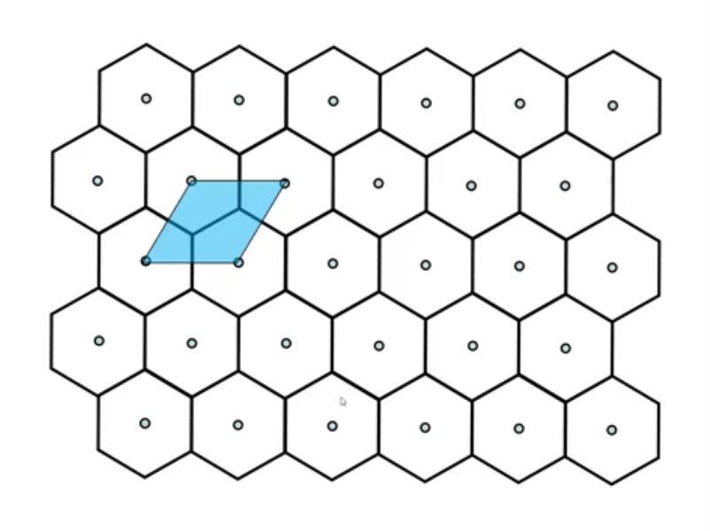

Slide 16
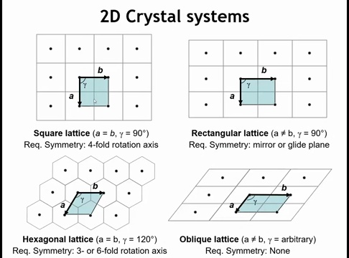

Slide 17
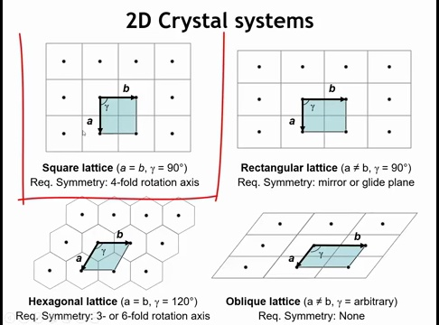

Slide 18
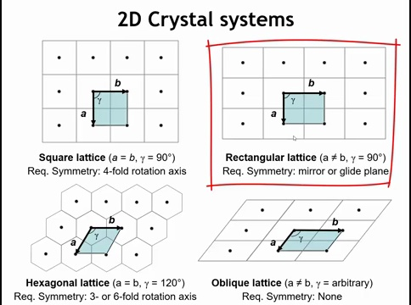

Slide 19
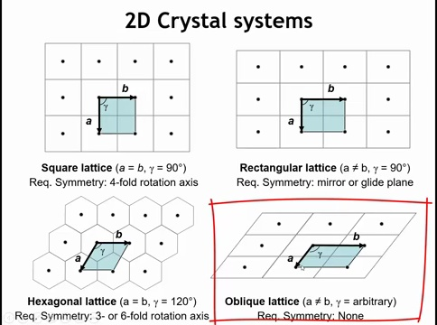

Slide 20
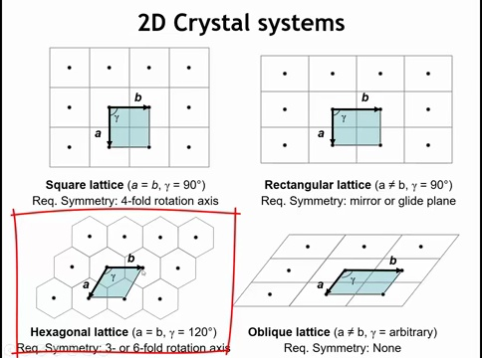

Slide 21
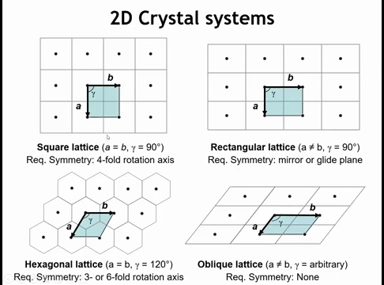

Slide 22
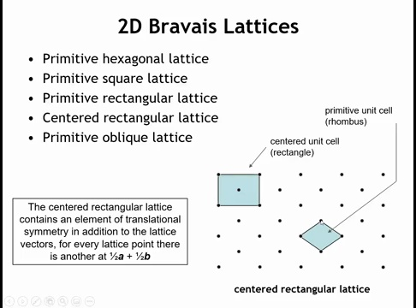

Slide 23
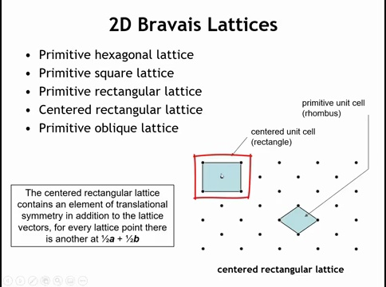

Slide 24
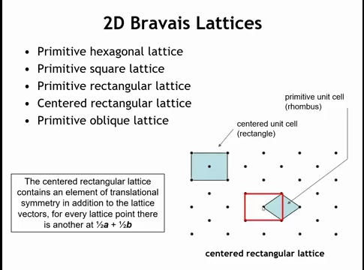

Slide 25


Slide 26
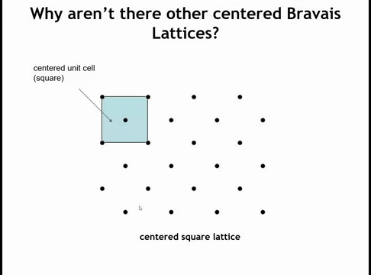

Slide 27
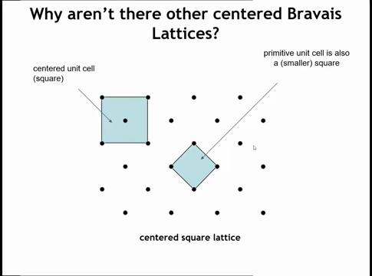

Slide 28
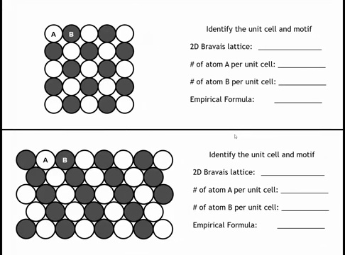

Slide 29
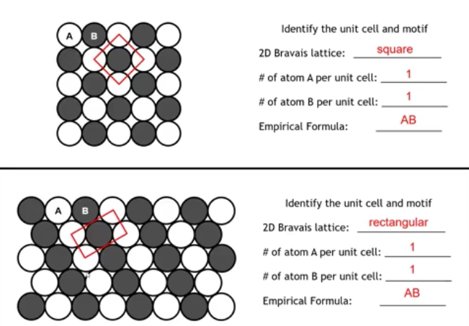

Slide 30
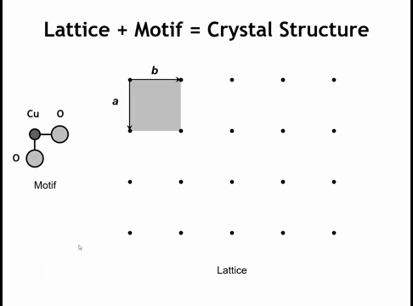

Slide 31
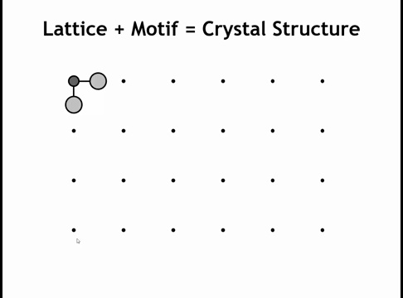

Slide 32
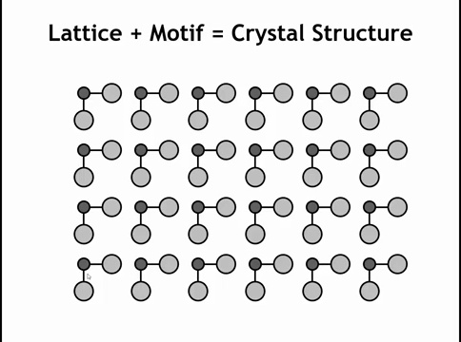

Slide 33
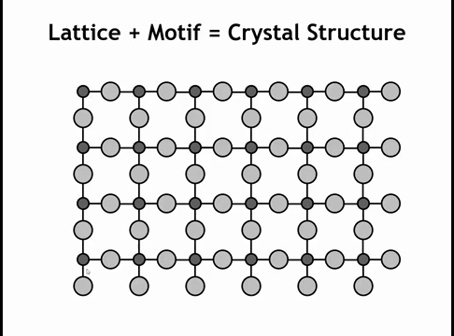

Slide 34
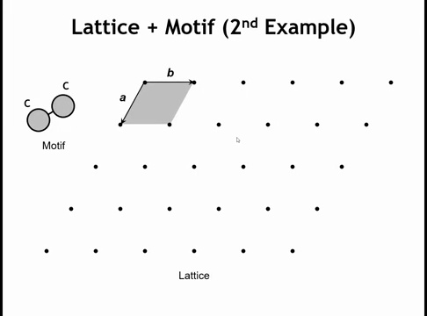

Slide 35
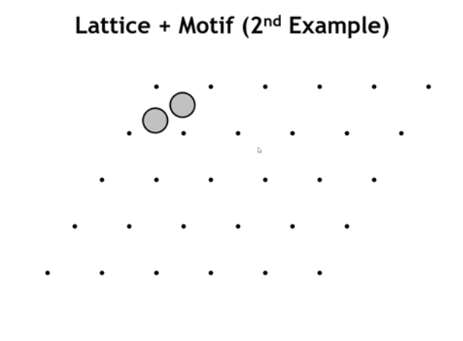

Slide 36
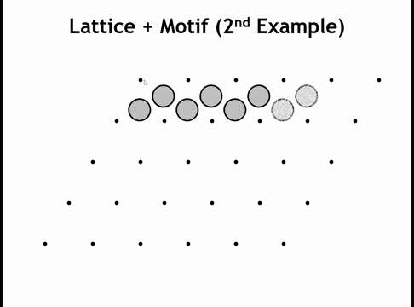

Slide 37
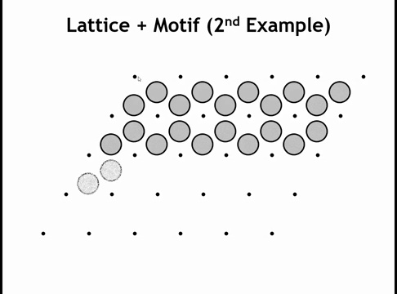

Slide 38
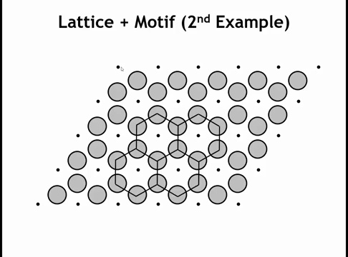

Slide 39
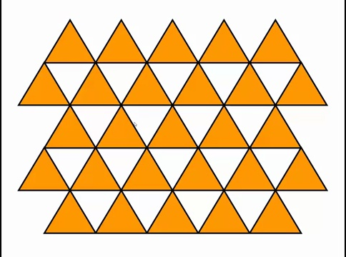

Slide 40
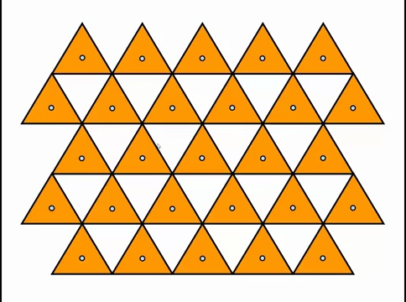

Slide 41
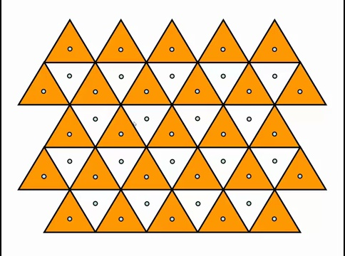

Slide 42
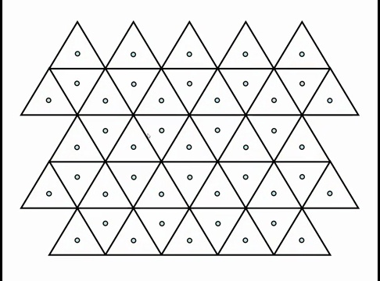

Slide 43
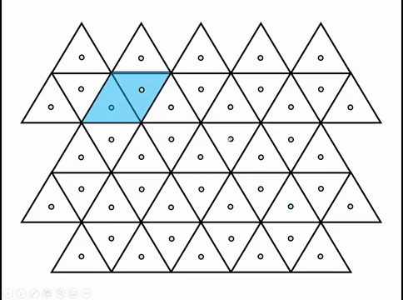

Slide 44
Summary — Lecture 1: Translational Symmetry in 2D
Two types of solids:
Crystalline = periodic atomic pattern
Amorphous = no long-range order
Lattice + Unit Cell:
Lattice = infinite grid of equivalent points
Unit cell (parallelogram in 2D) repeats to tile space
Which shapes/lattices tile 2D space?
Square, rectangle, oblique (parallelogram), hexagonal, centered rectangular
Symmetry Constraints:
Only 2-, 3-, 4-, 6-fold rotational symmetry compatible with periodic lattices
Motif (Basis):
Atoms/group of atoms attached to each lattice point
Lattice + Motif = Crystal structure
Examples:
CuO₂ motif → layered cuprates
2C motif in hexagonal lattice → graphene

Slide 45

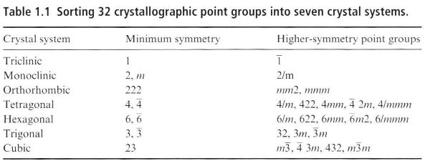
Homework

Slide 46
Translational Symmetry in 3D
Goal:
Introduce the 3D unit cell and the classification of Bravais lattices as the foundation for describing all crystal structures.
Learning Objectives:
Recognize the 7 crystal systems and their defining features
Distinguish primitive, body-, face-, and base-centered lattices
Understand how 14 Bravais lattices arise from translational symmetry
Relationship to Text:
Based on Structures of Crystalline Materials, Chapter 1, Section 1.1 (pp. 1–12)

Slide 47
A unit cell is the smallest repeating volume that can be translated through space (by lattice vectors) to build the entire crystal lattice.
In 2D, the unit cell is an area (a parallelogram).
In 3D, it’s a volume (a parallelepiped — six faces, opposite faces parallel, each face a parallelogram).

Slide 48
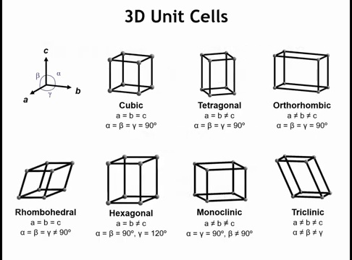

Slide 49

Lattice centering tells us how many lattice points are inside a chosen unit cell (beyond just the corners).
A primitive (P) unit cell has only corner lattice points, which add up to exactly 1 lattice point per cell.
A centered unit cell has additional lattice points located inside the cell (body center or face centers).
These are not “extra atoms” — they’re just extra repeat positions that fall inside the boundaries of that particular choice of unit cell.
A lattice point is an abstract point in space that marks the repeating positions of the crystal pattern.
Mathematically, every lattice point is generated by:
Physically, you don’t put a single atom at a lattice point necessarily. Instead, you attach a motif (an atom, group of atoms, or molecule) to every lattice point. The whole crystal is then the lattice + motif.

Slide 50
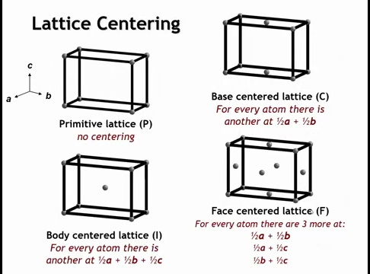

Slide 51

Bravais lattice = infinite set of equivalent points
A Bravais lattice is the set of all points generated by integer linear combinations of a primitive set of lattice vectors:

Slide 52
The 14 Bravais lattices are the irreproducible building blocks of all 3D crystals.
Rules for a Bravais lattice
Translational Equivalence
Every lattice point must be identical (equivalent environment) when shifted by an integer combination of lattice vectors.
Minimal Cell (Primitive Cell Exists)
You cannot define a larger “centered” cell if a smaller primitive cell generates the same lattice more simply.
→ Redundant centerings are thrown out.
Consistency with Crystal System Symmetry
The Bravais lattice must obey the symmetry constraints of its crystal system (e.g., cubic requires all edges equal, all angles 90°).
→ Some centering choices break the system’s symmetry and therefore aren’t distinct.

Slide 53
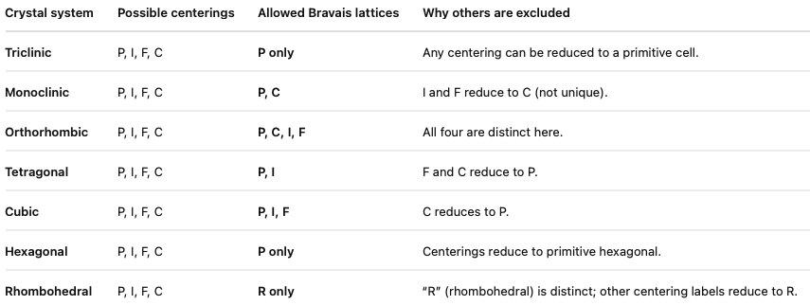
There are 7 crystal systems × 4 possible centering types (primitive P, body I, face F, base C) = 28 candidates.
But many are duplicates or impossible under the rules above:

Slide 54
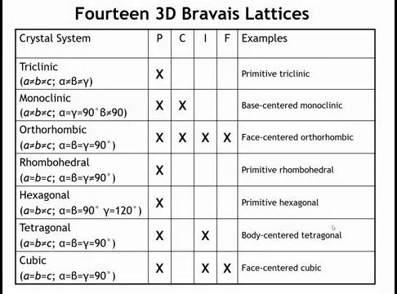

Slide 55
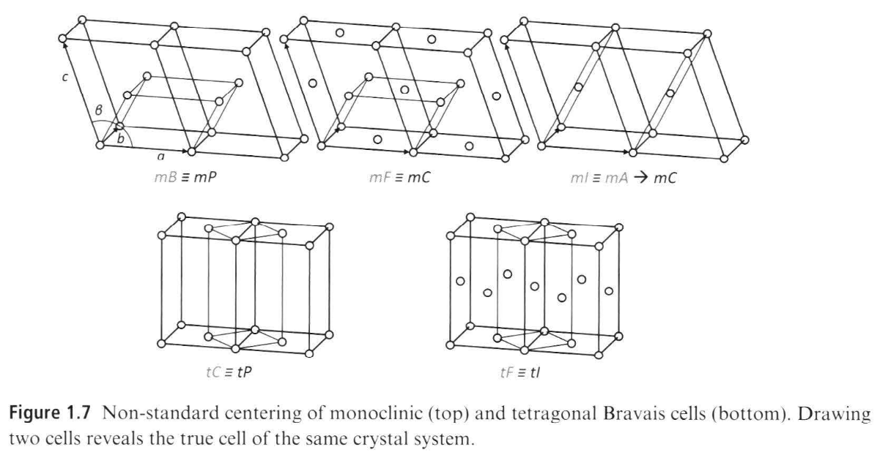
Notes:
Figure 1.7 gives an idea why only certain types of centering are possible ror certain crystal systems. For example, (bottom) a C-centered tetragonalcell could always be described with a smaller primitive cell, an F-centered tetragonal with a smaller /-centered cell. Similarly, a monoclinic B cell becomes a smaller P cell, monoclinic F cell becomes a smaller C cell, and a monoclinic / cell is equivalent to a C cell via an A cell rotated around b. However, there are cases where it is useful to choose a non-standard Bravais cell; for example in order to illustrate similarity between two structures.

Slide 56
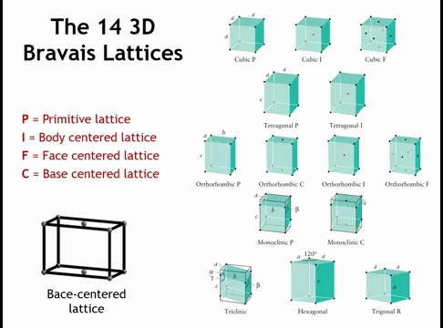

Slide 57
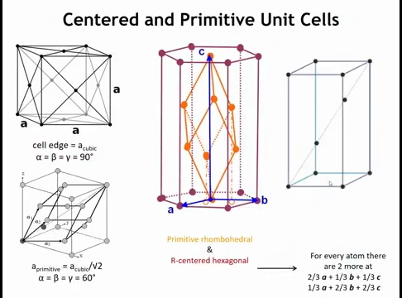

Slide 58
Slide Title: Summary – Translational Symmetry in 3D
Key Points:
A 3D crystal is built by repeating a unit cell (a parallelepiped) through translational symmetry.
Seven crystal systems: cubic, tetragonal, orthorhombic, rhombohedral, hexagonal, monoclinic, triclinic.
Centered lattices: primitive (P), body-centered (I), face-centered (F), base-centered (A, B, C).
Combining systems + centering gives the 14 Bravais lattices, the complete set of 3D lattice types.
This framework underpins all crystallography: every crystal structure belongs to one of these lattices.

Slide 59
Homework:
Consider the cubic crystal system. Why is there no distinct “base-centered cubic” lattice?
Notes:
There is no distinct “base-centered cubic” Bravais lattice because a base-centered cubic unit cell is not the smallest possible primitive description of the lattice.
In the cubic system, all three lattice vectors must be equal in length and mutually perpendicular.
If you try to add lattice points only to two opposite faces of a cube (making it “base-centered”), those extra points are not symmetry-equivalent to the cube corners under cubic symmetry.
Instead, the array of points you generate can be described more simply as a primitive tetragonal lattice with a smaller unit cell. In other words, the base-centered cubic is just a redundant choice of cell vectors.

